Slide 1
Some Applications of Remote Sensing and GIS
1,2
Xue WANG
PhD Candidate, Department of Geography and Resource Management, The Chinese University of Hong Kong, Email: wsnow@link.cuhk.edu.hk
Visiting Fellow (Mar 1, 2018 – Aug 31, 2018), Center for Geographic Analysis (CGA), Harvard University
Notes:
I spent my undergraduate and master period in Peking University and majors during my study were GIS and remote sensing, respectively

Slide 2
4 projects
1. Extraction of Urban Building Damage
2. Building Extraction
3. Estimating the Fraction of Built-up Area (BUA)
4. Making Map Series of Nike Factories

Slide 3
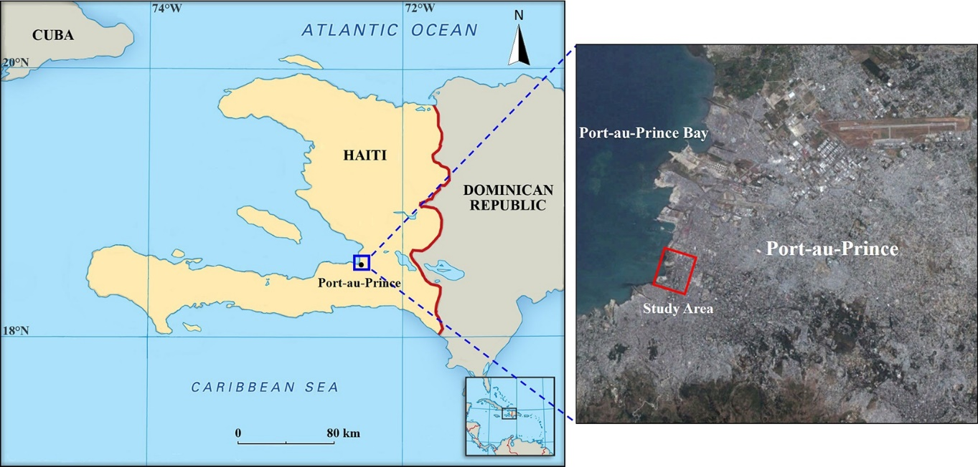
1. Extraction of Urban Building Damage
Reason: 1. Port au Prince of Haiti (heavily hit by an earthquake On 12 January 2010)
2. Building Damage Information: of great importance to disaster assessment
3. automatic extraction method
Notes:
My undergraduate thesis and master thesis, at the second year of my undergraduate study, Haiti earthquake happened. I start to think my major is remote sensing. Then How remote sensing can do for disaster relief

Slide 4
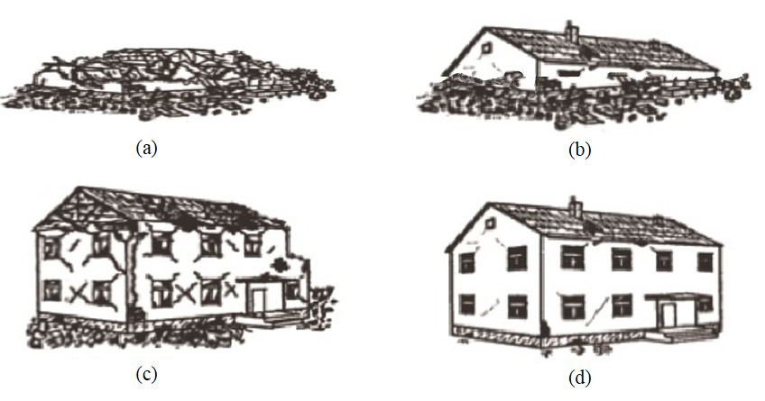
1. Extraction of Urban Building Damage
Types of building damage
Automatic detection: (a) (b) (c), dramatic changes in height or surface structure
2 Characteristics
(1) significant change in height; (2) significant change in surface structure (roof)

Slide 5
2. Building Extraction
Satellite image (QuickBird)
Height Data (LiDAR)
Building Distribution
General method: height data (no ground)->NDVI (no tree) -> building
Problem: Buildings with green roofs
One solution: building -> texture of satellite image or height data is smooth
Notes:
Satellite take a picture of the earth from sky
Height data bright object is high and dark areas are low.
NDVI an vegetation index used to distinguish vegetation and non vegetation

Slide 6
3. Estimating the Fraction of Built-up Area (BUA)
PhD thesis: Monitoring Urban Expansion Using Time Series Multi-sensor Data
Fraction of Built-up Area (BUA): percentage of BUA in one pixel
Study Area: Whole China
Data: Night time light (NTL), NDVI (vegetation index), Land Surface Temperature (LST)
Spatial resolution: low-> 1 km (each pixel covers 1km×1km area, each pixel includes different land covers)
Method: BUA feature->high NTL, low NDVI, high LST ->Spectral Mixture Analysis (SMA)
Notes:
The reason to calculate BUA fraction but not extracting BUA area is because the study area is the whole China, therefore I used low spatial resolution datasets for this study, which were NTL NDVI and LST. The spatial resolution of those datasets is 1km, which means
Almost no pixel can be identified as one pure land cover class. Therefore estimating the percentage of each land cover types in pixels are more reasonable.
Method for estimating BUA fraction is by combining BUA feature and Spectral Mixture Analysis. SMA related to many mathematical functions, not say in detail here
the BUA feature means normally, BUA have high value in…

Slide 7
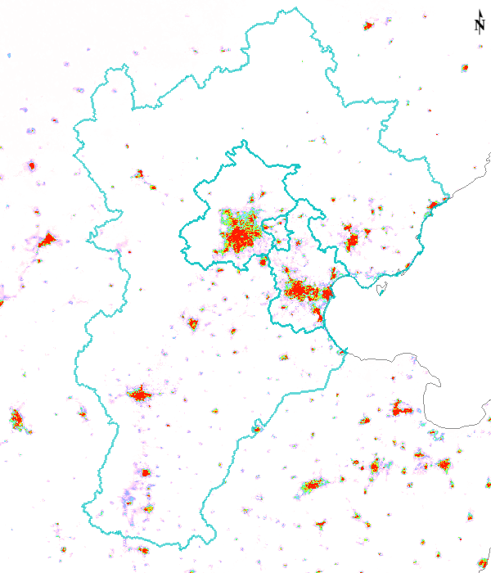
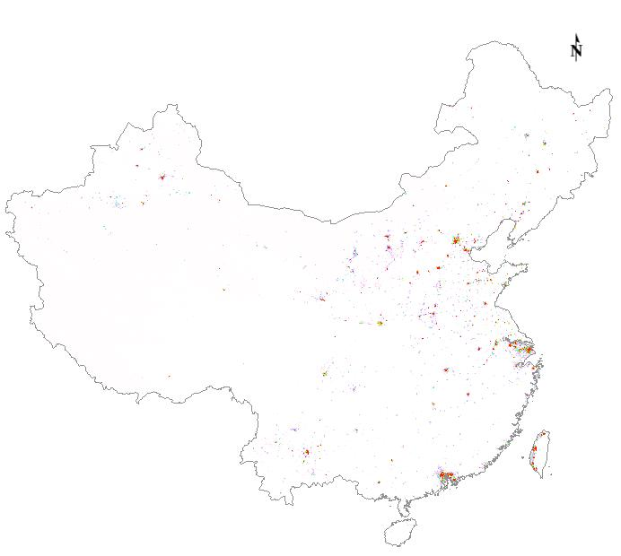
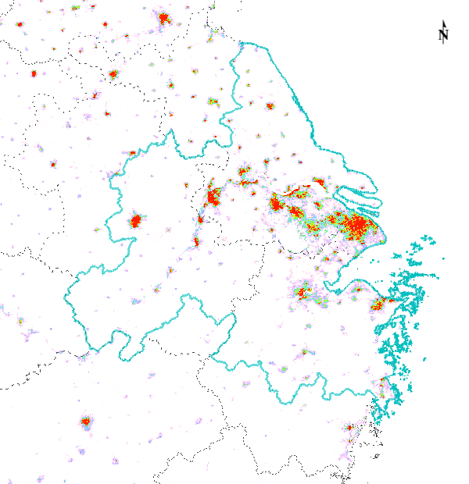
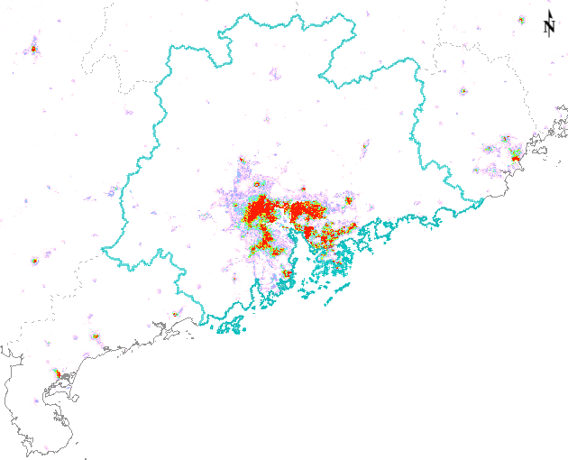
3. Estimating the Fraction of Built-up Area (BUA)
BUA Fraction Result (2010):
Yangtze River Delta
Jing-Jin-Ji
0
1
Greater Pearl River Delta

Slide 8
4. Making Map Series of Nike Factories
Objective: Making Nike maps showing information of product type and supplier
Data: excel with information of location, supplier and product type
Software: ArcGIS
Notes:
A small project I did during my visit in CGA.
Import data from excel to ArcGIS

Slide 9
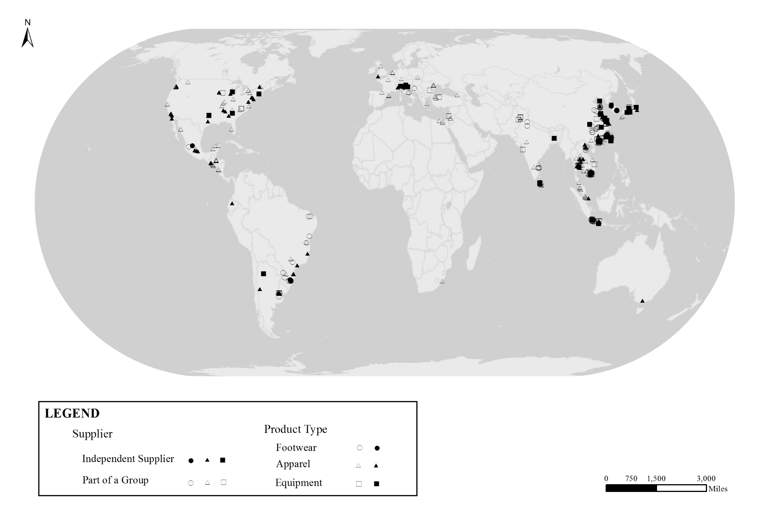
4. Making Map Series of Nike Factories

Slide 10
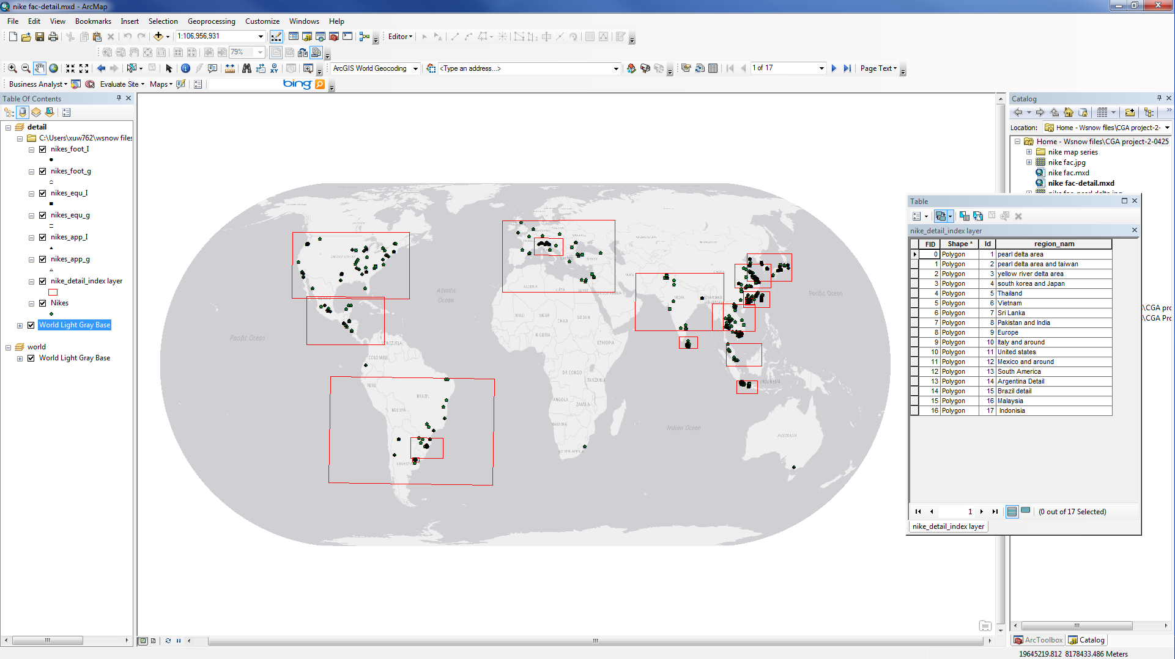
4. Making Map Series of Nike Factories
Index Map

Slide 11
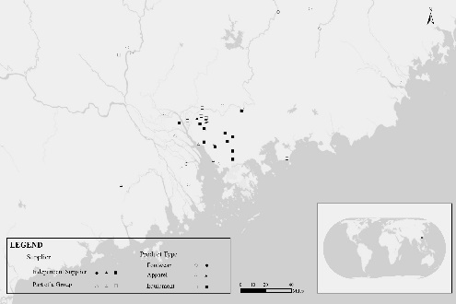
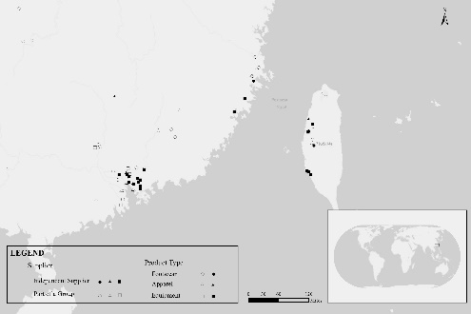
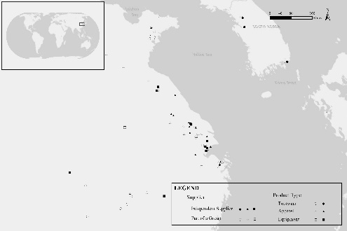
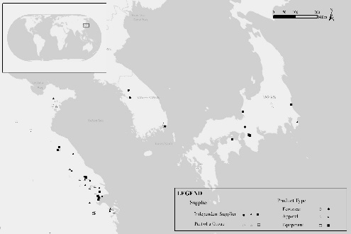
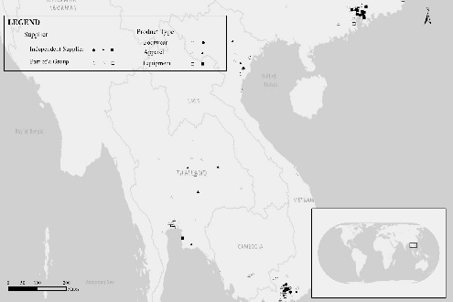
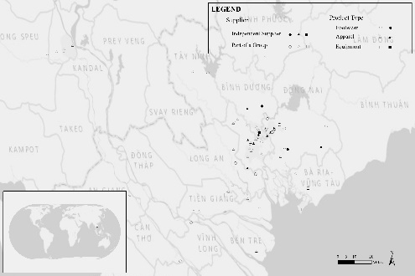
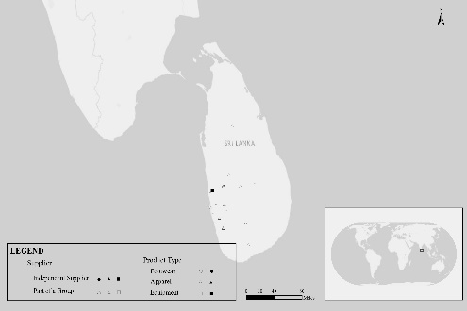
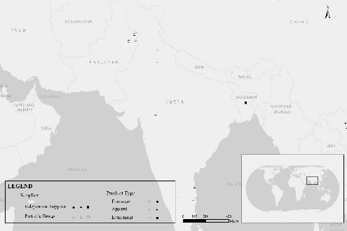
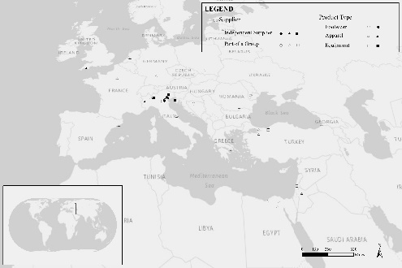
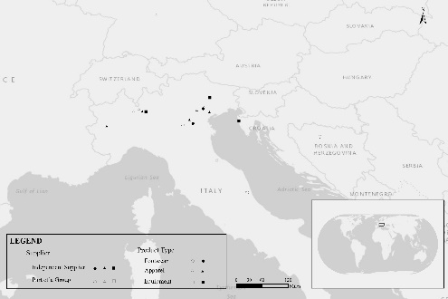
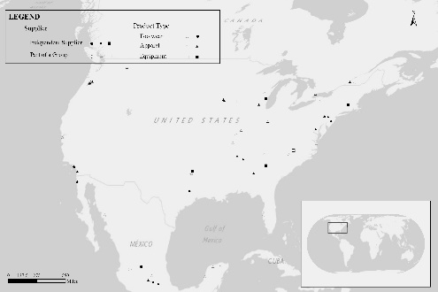
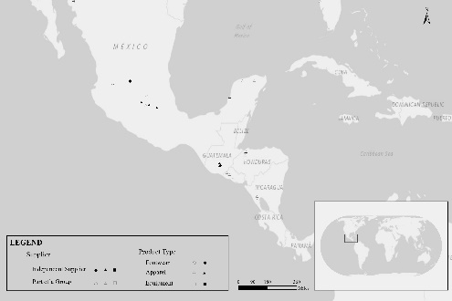
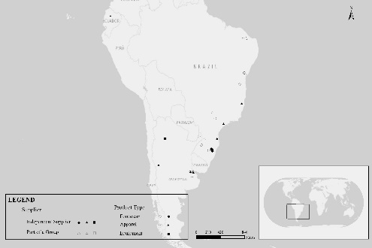
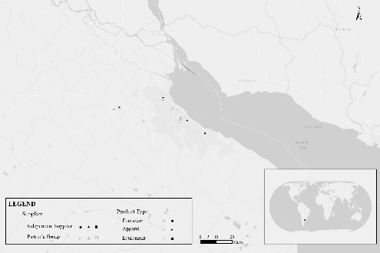
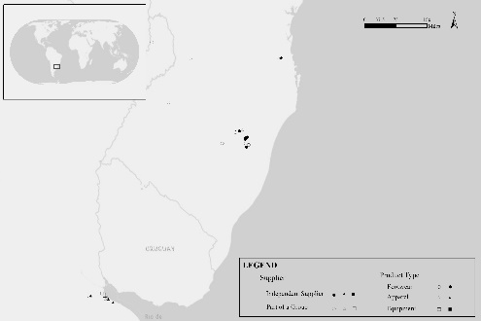
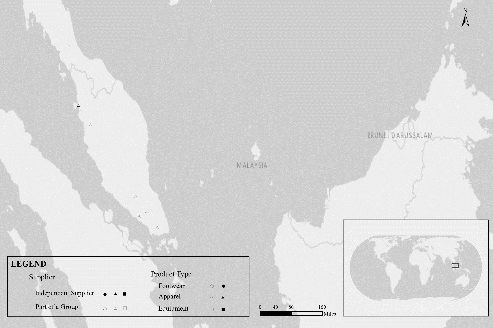
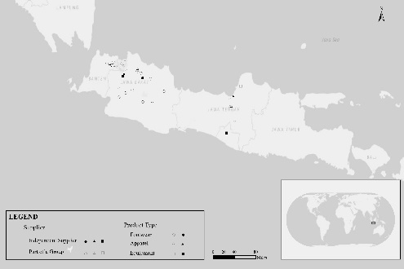
4. Making Map Series of Nike Factories
Notes:
Get corresponding maps automatically

Slide 12
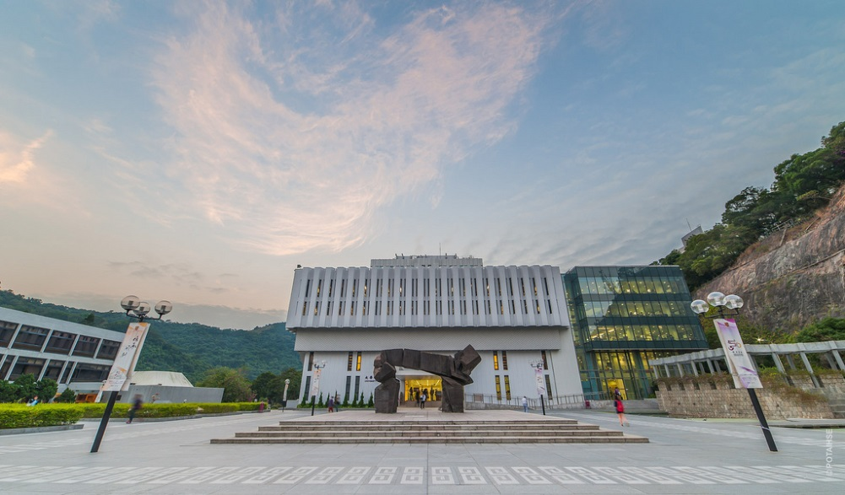
Thank You !

