Slide 1
Applying GIS to Cancer Epidemiology
A brief overview
Hari Iyer
July 26, 2018
BLISS/SHARP Luncheon at Harvard Center for Geographic Analysis

Slide 2
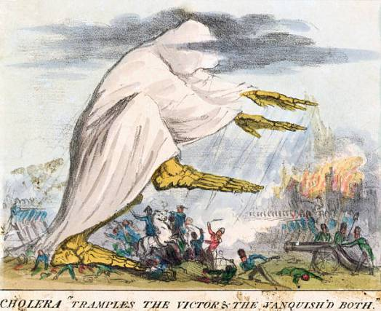
Geographic Information Systems and Public Health
Humans have long known that different places confer different risk of disease
In the industrial age, European and American social scientists described links between place, social class, and health
Answers the question of “where” – important for planning public health budgets and targeting services

Slide 3
What is Cancer Epidemiology?
Science of designing studies and implementing programs to control cancer burden at population level
Disease progression
Primary exposure
Disease irreversible
Diagnosis
Clinical outcome
Public Health
Medicine

Slide 4
Uses of GIS in cancer epidemiology
Population Surveillance
  Describing/comparing trends in cancer in different places
  Identifying where disparities occur
Program Management
  Determining where to implement screening programs
  Identifying location-based barriers to accessing care/treatment
Etiologic Research (Risk Factors)
  Conducting studies to see if cases exhibit spatial patterning to generate hypotheses about environmental exposures (cluster analysis)
  Using remote sensing and GIS to develop measures to capture contextual environmental characteristics
Notes:
Maybe put in pictures

Slide 5
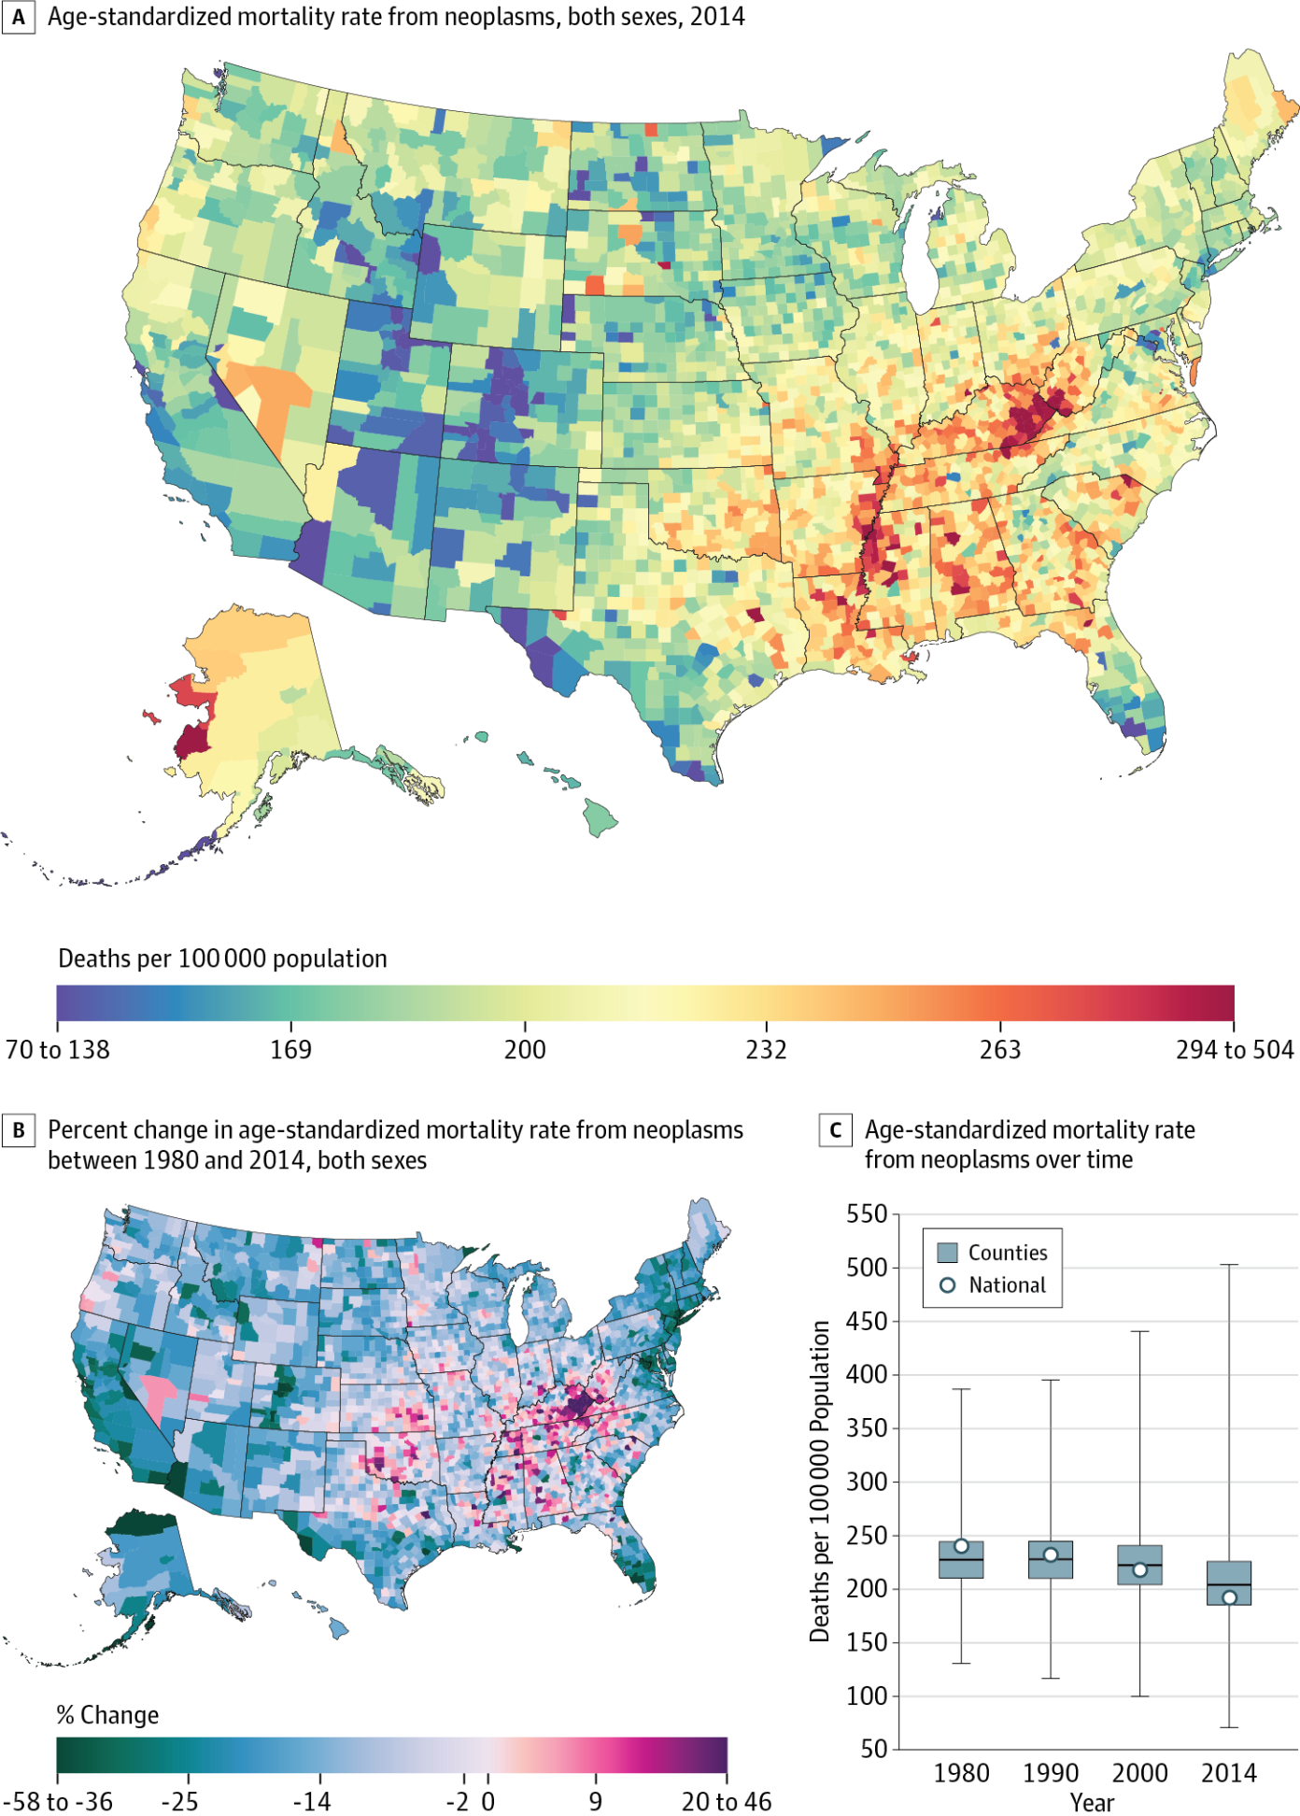
Cancer Mortality Surveillance in the United States
From: Trends and Patterns of Disparities in Cancer Mortality Among US Counties, 1980-2014
Mokdad. JAMA. 2017;317(4):388-406. doi:10.1001/jama.2016.20324

Slide 6
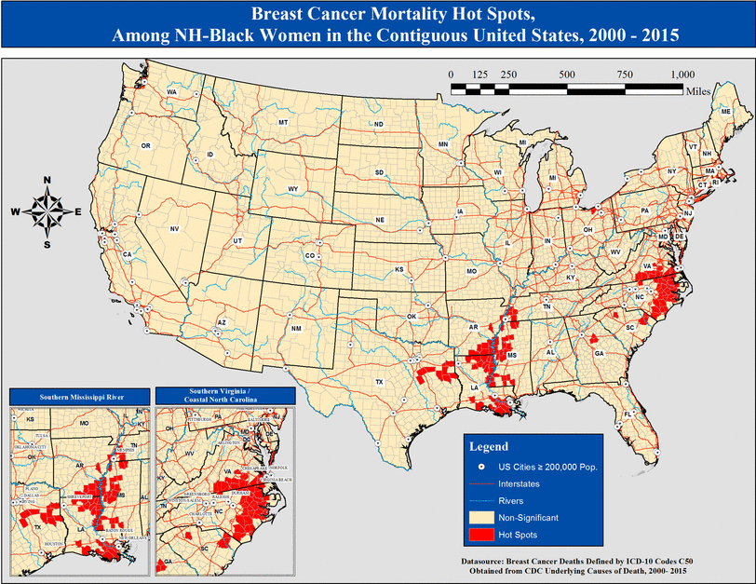
Identify “hot spot” clusters and geographic factors (SES, health care access) associated with higher county rates of African American breast cancer mortality
From: Mapping hot spots of breast cancer mortality in the United States: place matters for Blacks and Hispanics. Moore. Cancer Causes & Control (2018) 29;737-750

Slide 7
Uses of GIS in cancer epidemiology
Population Surveillance
  Describing/comparing trends in cancer in different places
  Identifying where disparities occur
Program Management
  Determining where to implement screening programs
  Identifying location-based barriers to accessing care/treatment
Etiologic Research (Risk Factors)
  Conducting studies to see if cases exhibit spatial patterning to generate hypotheses about environmental exposures (cluster analysis)
  Using remote sensing and GIS to develop measures to capture contextual environmental characteristics
Notes:
Maybe put in pictures

Slide 8
Where to implement breast cancer screening in Perth, Australia
Proposed New facility
Least advantaged
Most advantaged
Relocating 7 existing mammography clinics would reduce travel distance of target population by 14%
Hyndman 2000

Slide 9
Uses of GIS in cancer epidemiology
Population Surveillance
  Describing/comparing trends in cancer in different places
  Identifying where disparities occur
Program Management
  Determining where to implement screening programs
  Identifying location-based barriers to accessing care/treatment
Etiologic Research (Risk Factors)
  Conducting studies to see if cases exhibit spatial patterning to generate hypotheses about environmental exposures (cluster analysis)
  Using remote sensing and GIS to develop measures to capture contextual environmental characteristics
Notes:
Maybe put in pictures

Slide 10
Identifying significant clusters of breast cancer mortality in the Northeast US
Age-adjusted
Significant Clusters
Kulldorff, 1997

Slide 11
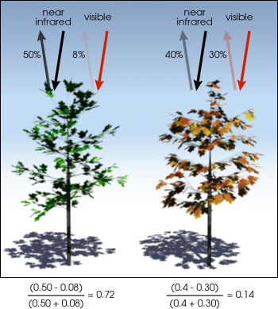
Remote sensing: Measuring natural vegetation
Normalized Difference Vegetation Index (NDVI)
James 2016

Slide 12
Does living in a neighborhood with more natural vegetation reduce your risk of prostate cancer?
Design: Cohort of 50,000 middle-aged male health professionals enrolled across the US in 1986 and followed until 2014
Exposure: NDVI at baseline (averaged over four seasons)
Outcome: Lethal prostate cancer (evidence of metastasis, cause of death)
Statistical analysis: Cox proportional hazards models adjusting for clinical, sociodemographic, and diet/lifestyle factors

Slide 13
Summary
GIS helps answer the question of “where” cancer and risk factors occur
GIS can help cancer epidemiologists in several ways:
  Surveillance
  Program management
  Etiologic research
For etiologic research, remote sensing allows epidemiologists to measure environmental exposures that previously could not be easily studied

Slide 14
Questions?
Email: hai161@mail.harvard.edu

Slide 15
Reference
Mokdad, A., Dwyer-Lindgren, L., Fitzmaurice, C., Stubbs, R., Bertozzi-Villa, A., Morozoff, C., . . . Murray, C. (2017). Trends and Patterns of Disparities in Cancer Mortality Among US Counties, 1980-2014. JAMA, 317(4), 388-406.
Moore, J., Royston, X., Langston, K., Griffin, J., Hidalgo, M., Wang, E., . . . Akinyemiju, B. (2018). Mapping hot spots of breast cancer mortality in the United States: Place matters for Blacks and Hispanics. Cancer Causes & Control, 29(8), 737-750.
Hyndman, J., & Holman, C. (2000). Differential effects on socioeconomic groups of modelling the location of mammography screening clinics using Geographic Information Systems. Australian and New Zealand Journal of Public Health, 24(3), 281-286.
Kulldorff, M., Feuer, E., Miller, B., & Freedman, L. (1997). Breast cancer clusters in the northeast United States: A geographic analysis. American Journal of Epidemiology, 146(2), 161-70.
James, P., Hart, J., Banay, R., & Laden, F. (2016). Exposure to Greenness and Mortality in a Nationwide Prospective Cohort Study of Women. Environmental Health Perspectives, 124(9), 1344-52.
James, P., Bertrand, K., Hart, J., Schernhammer, E., Tamimi, R., & Laden, F. (2017). Outdoor Light at Night and Breast Cancer Incidence in the Nurses’ Health Study II. Environmental Health Perspectives, 125(8), 087010.

