Slide 1
GIS Visualizations Presented at the “Circulating across Europe? Transgressive Narratives about the Past” seminar. August 29, 2018 Jeff Blossom GIS Service Manager jblossom@cga.harvard.edu http://gis.harvard.edu

Slide 2
What is GIS?
Geographic Information System (GIS) defined:
A collection of computer hardware and software designed for capturing, storing, updating,, manipulating, analyzing, displaying, and publishing all forms of geographically referenced information.
People performing different roles are required.
Common methodologies are applied within a GIS.
Notes:
GIS was started in the late 1960’s, and today is really an industry unto itself that is used by numerous disciplines in private, government, and academic work.

Slide 3
Center for Geographic Analysis (CGA)
Founded in 2006
A member organization of the Institute for Quantitative Social Science (IQSS)
Serves the entire University – anyone with a HUID

Slide 4
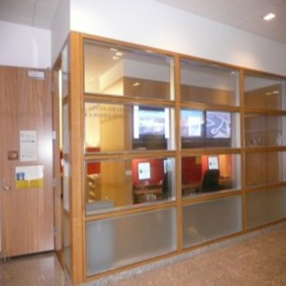
Our mission
To support research and education that relies on geographic information.
CGA’s location at
1737 Cambridge St., Cambridge
Our offices: Concourse level, CGIS Knafel building

Slide 5
What we do:
Research support – Geocoding, map creation, geographic analysis, and more.
Software development – an open source, free web GIS. http://worldmap.Harvard.edu
Teaching – 2 hour to 2 week workshops, course curriculum development, custom training.

Slide 6
Geospatial Research Consultation http://gis.harvard.edu/contactus
Data issues, e.g.
Public and commercial data sources
Data collection and management techniques
Data conversion, scanning, digitizing, etc.
Hardware/software issues, e.g.
What GPS to buy – accuracy, compatibility, etc.
Which software to use for various tasks
Methodology issues, e.g.
How to select parameters in spatial interpolation
How to build location-allocation models
Visualization issues, e.g.
How to do 3-D maps or time-series animation
How to allow users make interactive maps from a web browser

Slide 7
GIS visualization: Static maps for a book
This volume provides a comprehensive account of how the Nazis conducted the Holocaust throughout the scattered towns and villages of Poland and the Soviet Union. It covers more than 1,150 sites, including both open and closed ghettos. Regional essays outline the patterns of ghettoization in 19 German administrative regions. Each entry discusses key events in the history of the ghetto; living and working conditions; activities of the Jewish Councils; Jewish responses to persecution; demographic changes; and details of the ghetto's liquidation. Personal testimonies help convey the character of each ghetto, while source citations provide a guide to additional information. Documentation of hundreds of smaller sites—previously unknown or overlooked in the historiography of the Holocaust—make this an indispensable reference work on the destroyed Jewish communities of Eastern Europe.

Slide 8
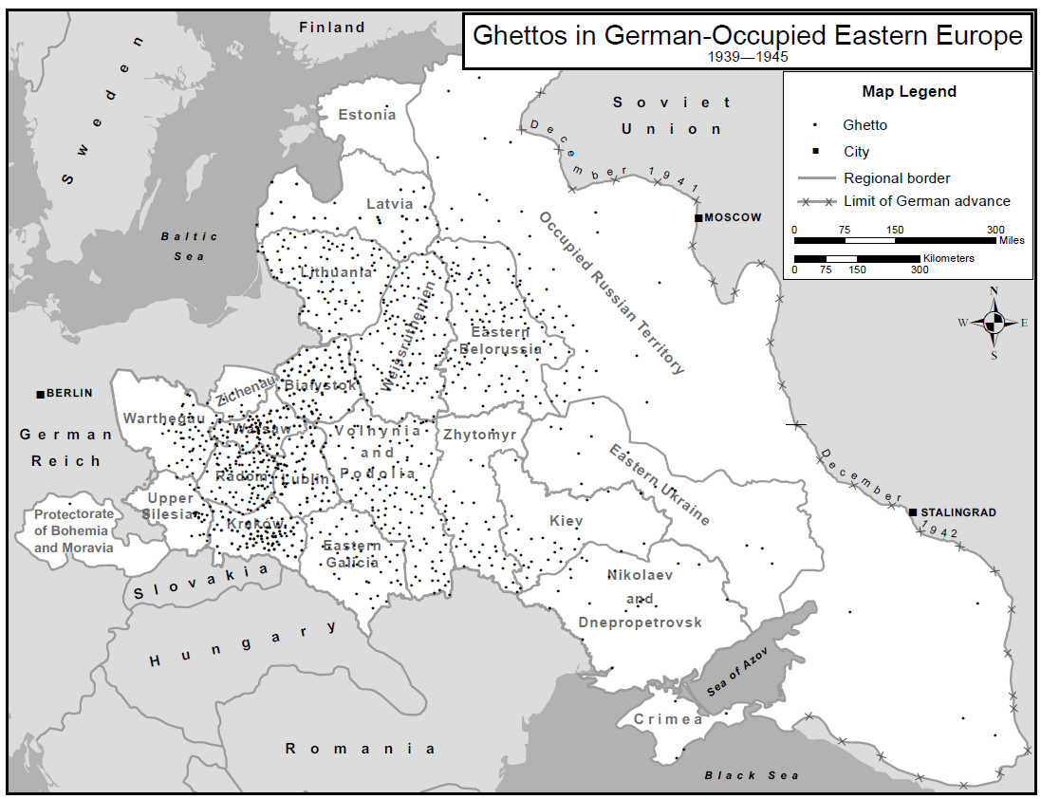

Slide 9
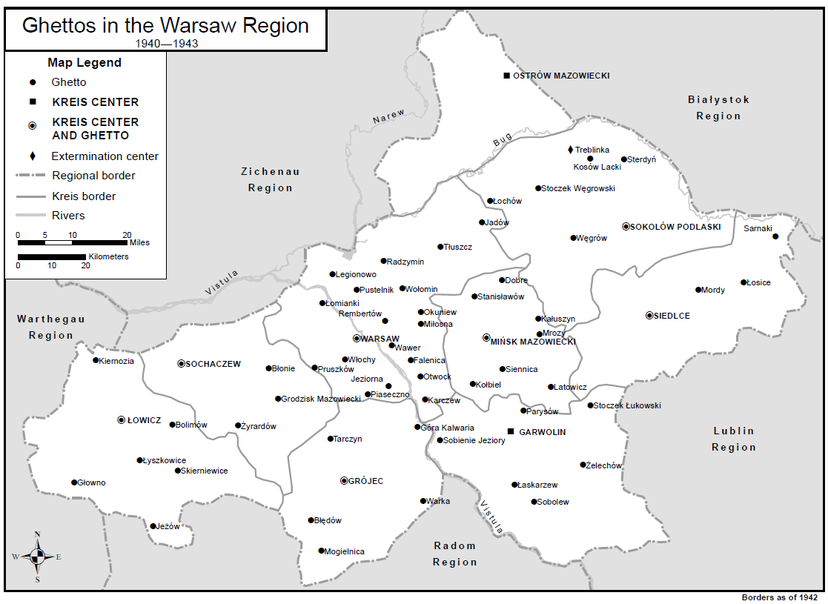

Slide 10
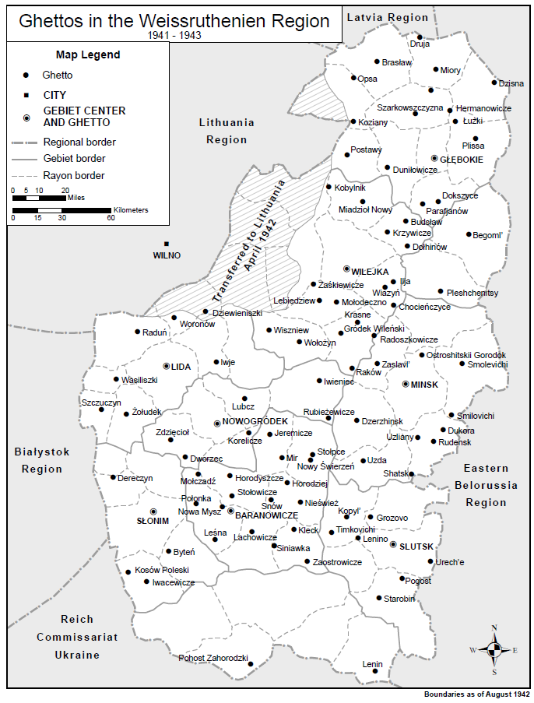

Slide 11
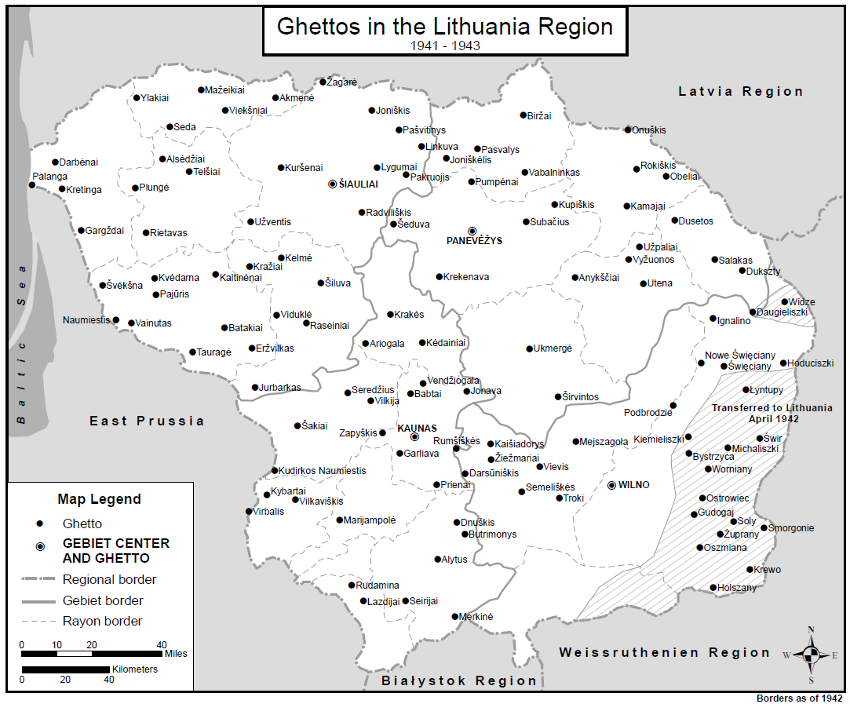

Slide 12
Moderated by Franziska Seraphim, Boston College History Professor, fellow at Harvard.
The Allied War Crimes Trials following the Second World War constituted a wide-ranging intervention by the victors in the making of the postwar world whose geographical scale is not yet fully understood. To the extent that the trials can be understood as the world's first "global justice network," we interrogate the transnational and comparative characteristics of the program writ global from the perspective of its geographical spread. This workshop focuses on discovering new methodologies that integrates quantitative information with qualitative analysis, and aims at representing transnational and comparative historical insights visually.

Slide 13
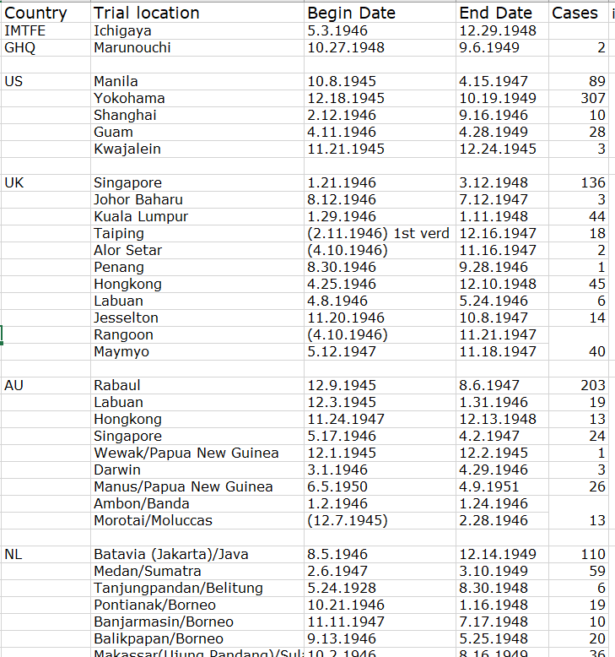
War crime trial data to be visualized:

Slide 14
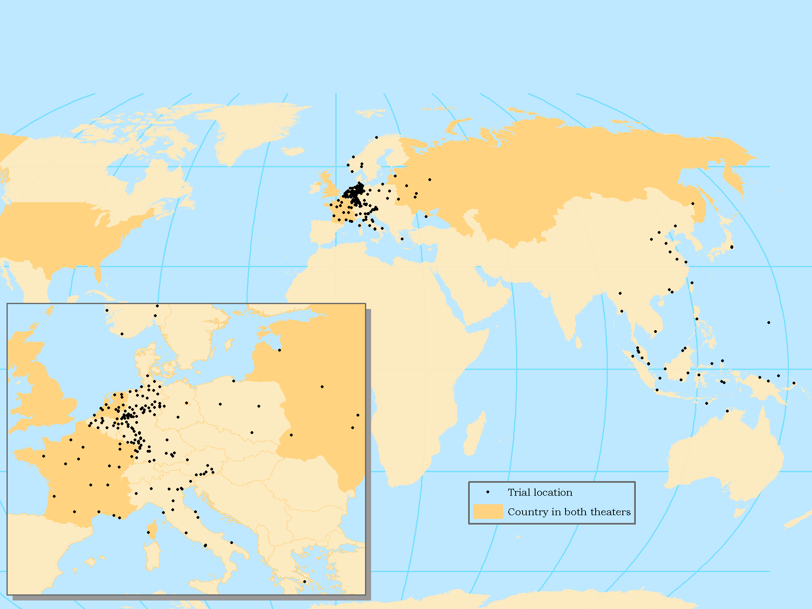
War crime trial visualization: Static map

Slide 15
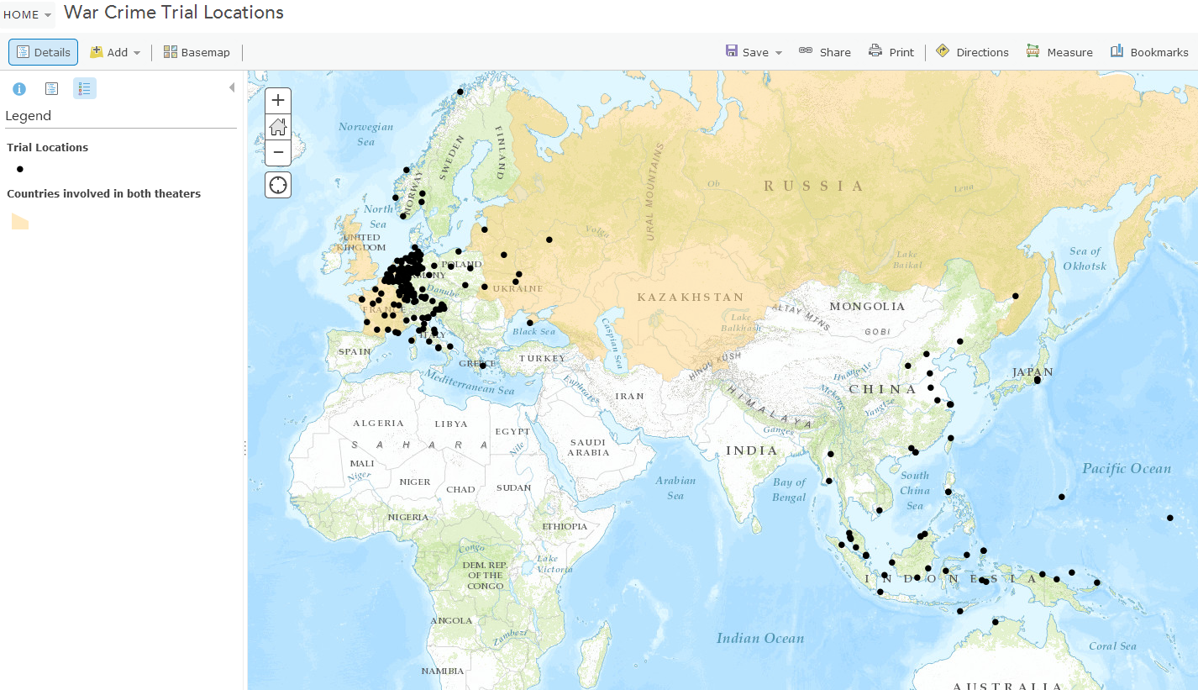
War crime trial visualization: Interactive map
Notes:
http://bit.ly/1mqiYrB

Slide 16
War crime trial visualization:
historic map overlay
Notes:
Bartholomew 1955, David Rumsey map collection

Slide 17
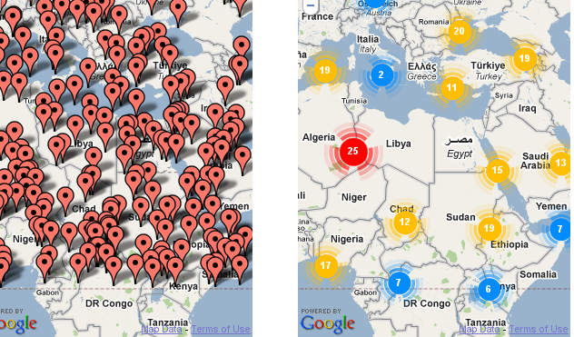
Visualizing coincident features

Slide 18
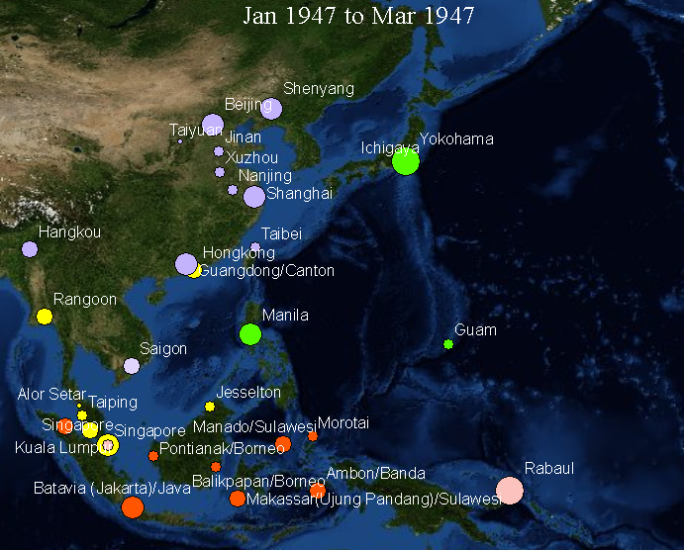
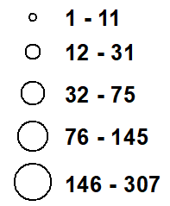
AU China/KMT China/PRC FR GHQ IMTFE NL PH Soviet Union UK US
War crime trial visualization: Country, number of trials, trial locations, time
Number of trials
Country conducting
trial
http://www.screencast.com/t/EoiiBLcs

Slide 19
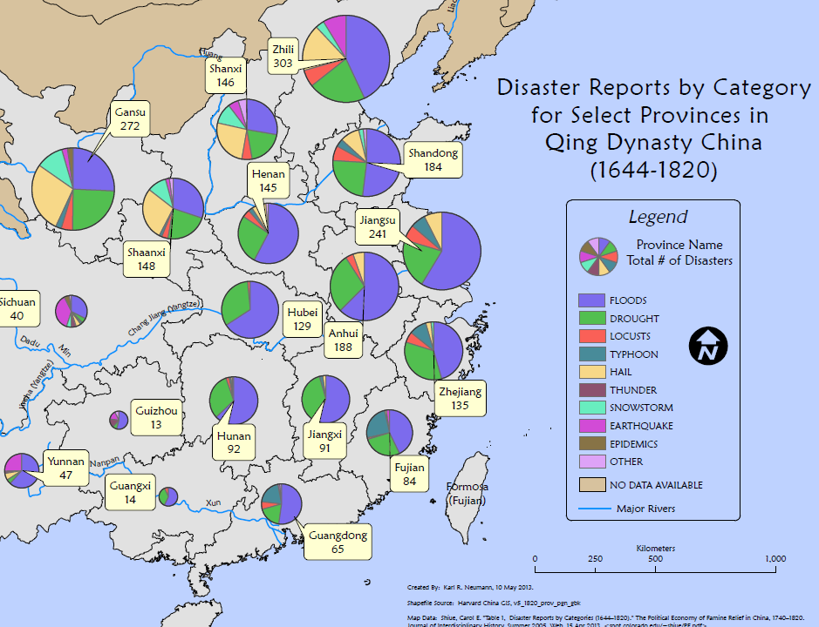
Visualizing multiple attributes
Notes:
Karl Neuman, Geographic Communication Today, 2014

Slide 20
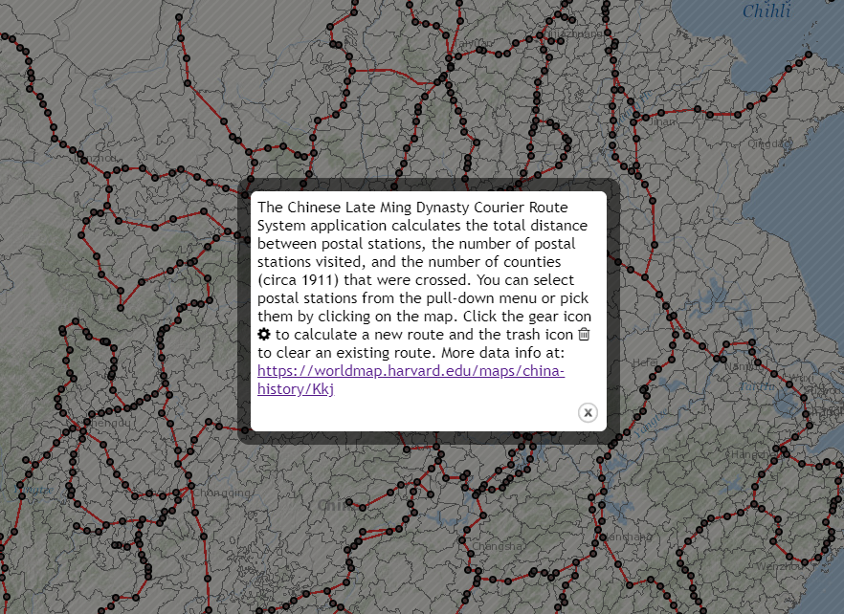
Historic GIS Analysis (on the web!)
http://maps.cga.harvard.edu/chinapostoffice/

Slide 21
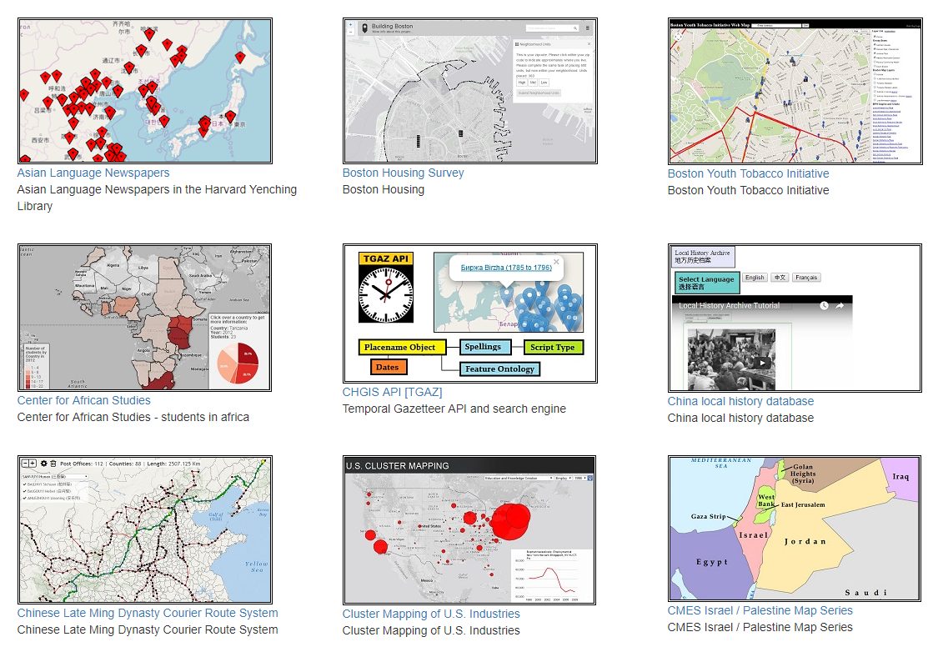
More cool web maps http://maps.cga.harvard.edu

Slide 22
Visualizing the 1932 journey of Lotte Jacobi, photographer
Maps created for Maria Gough, Harvard Professor of Modern Art

Slide 23
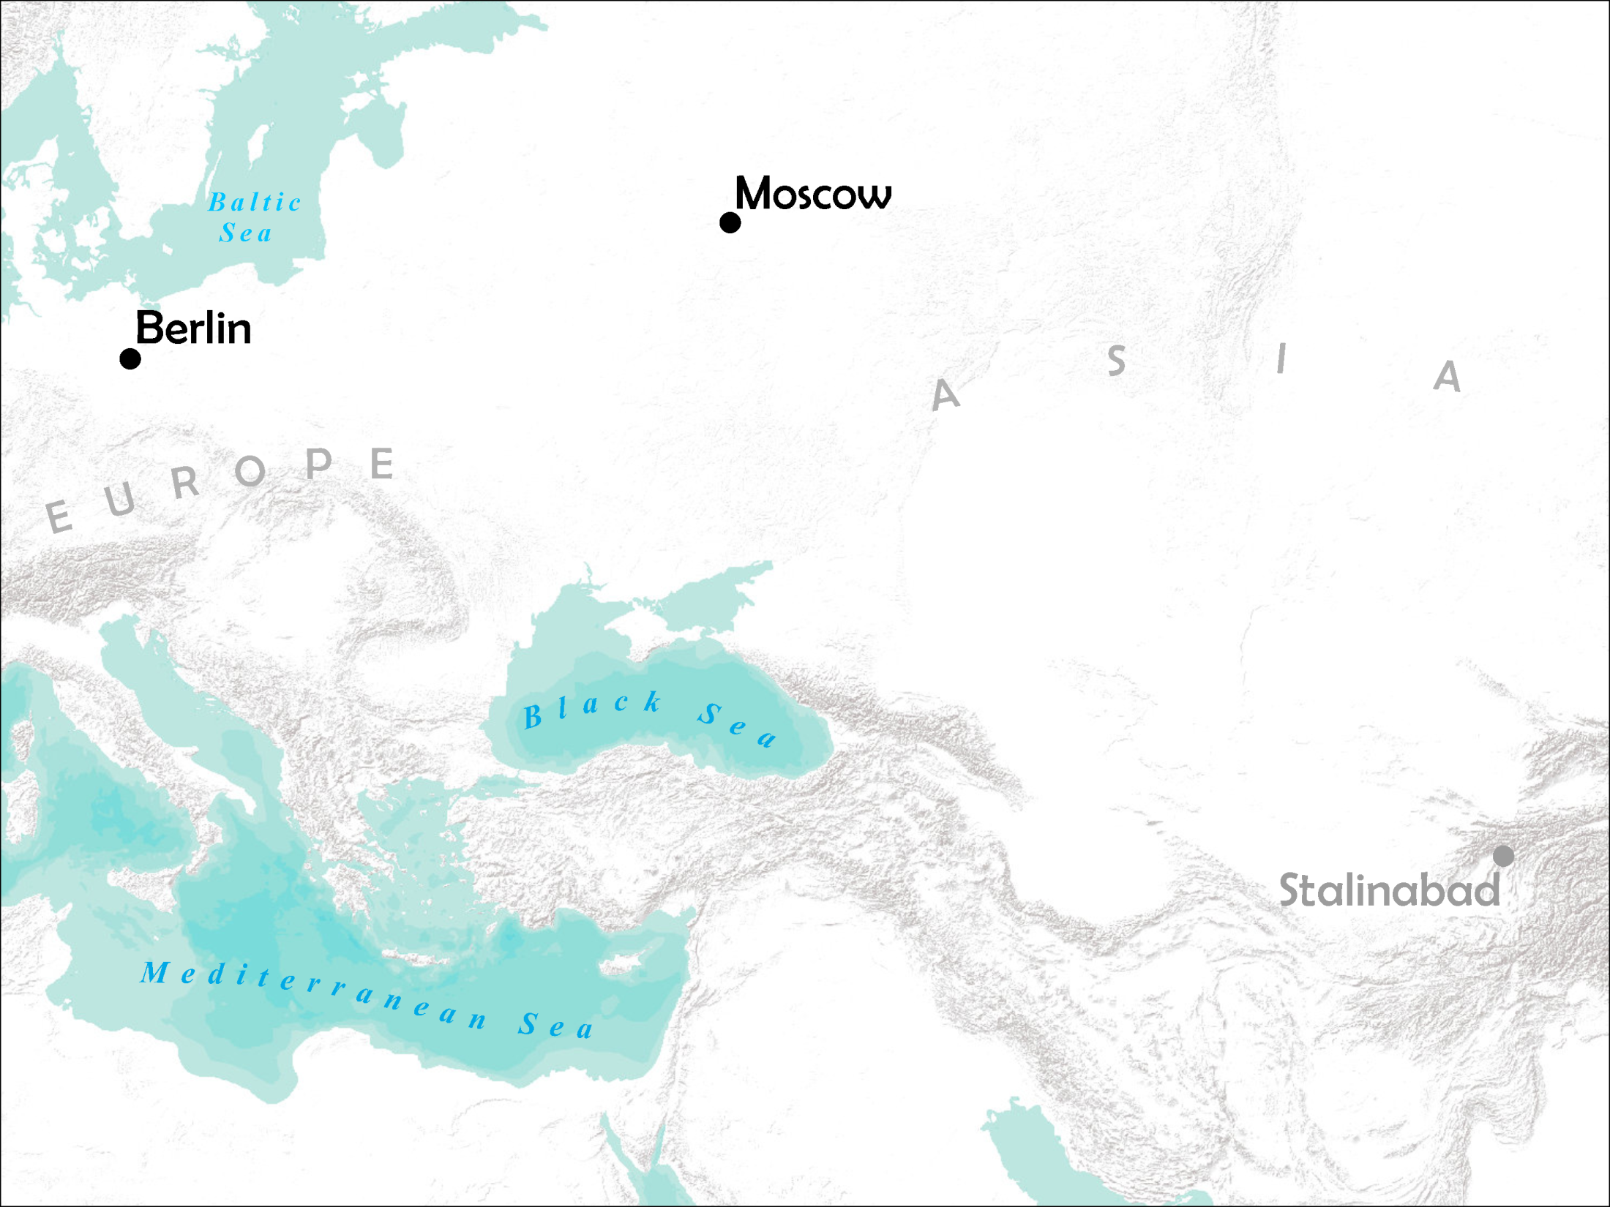
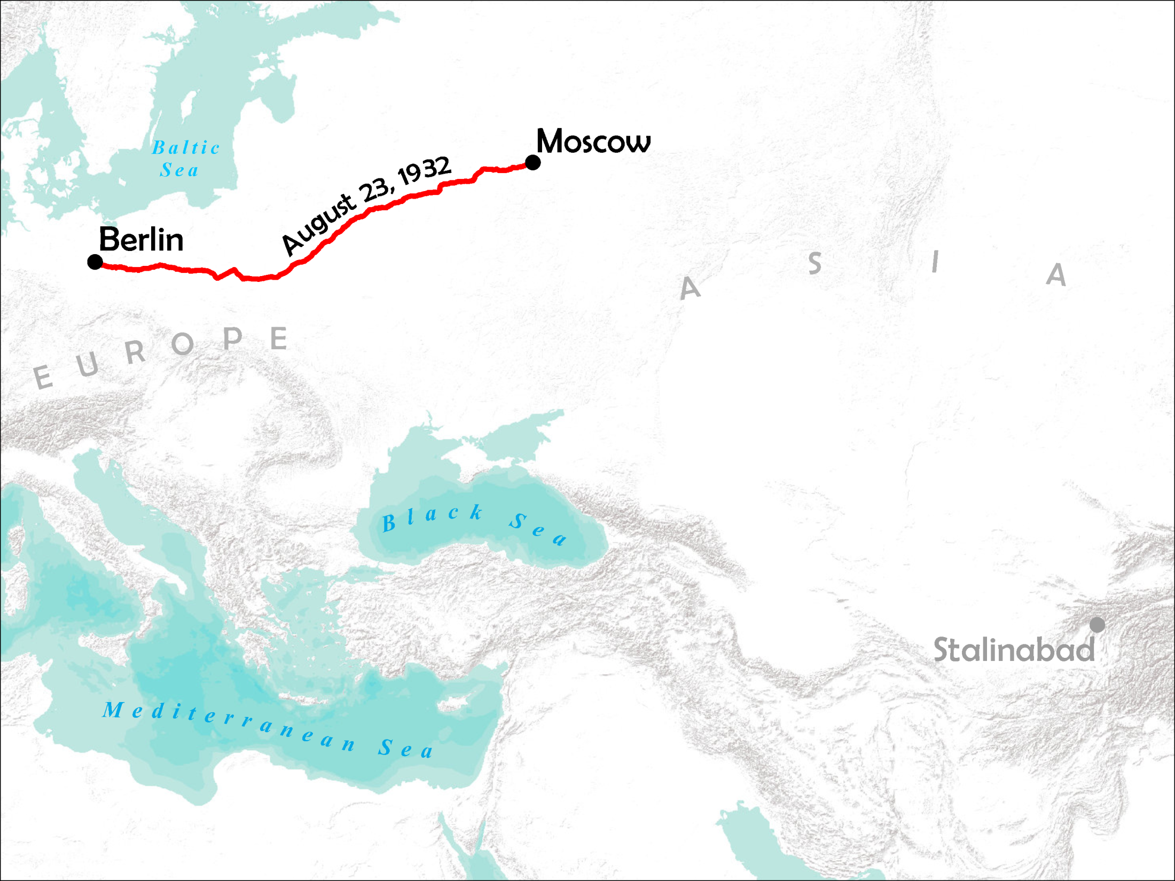
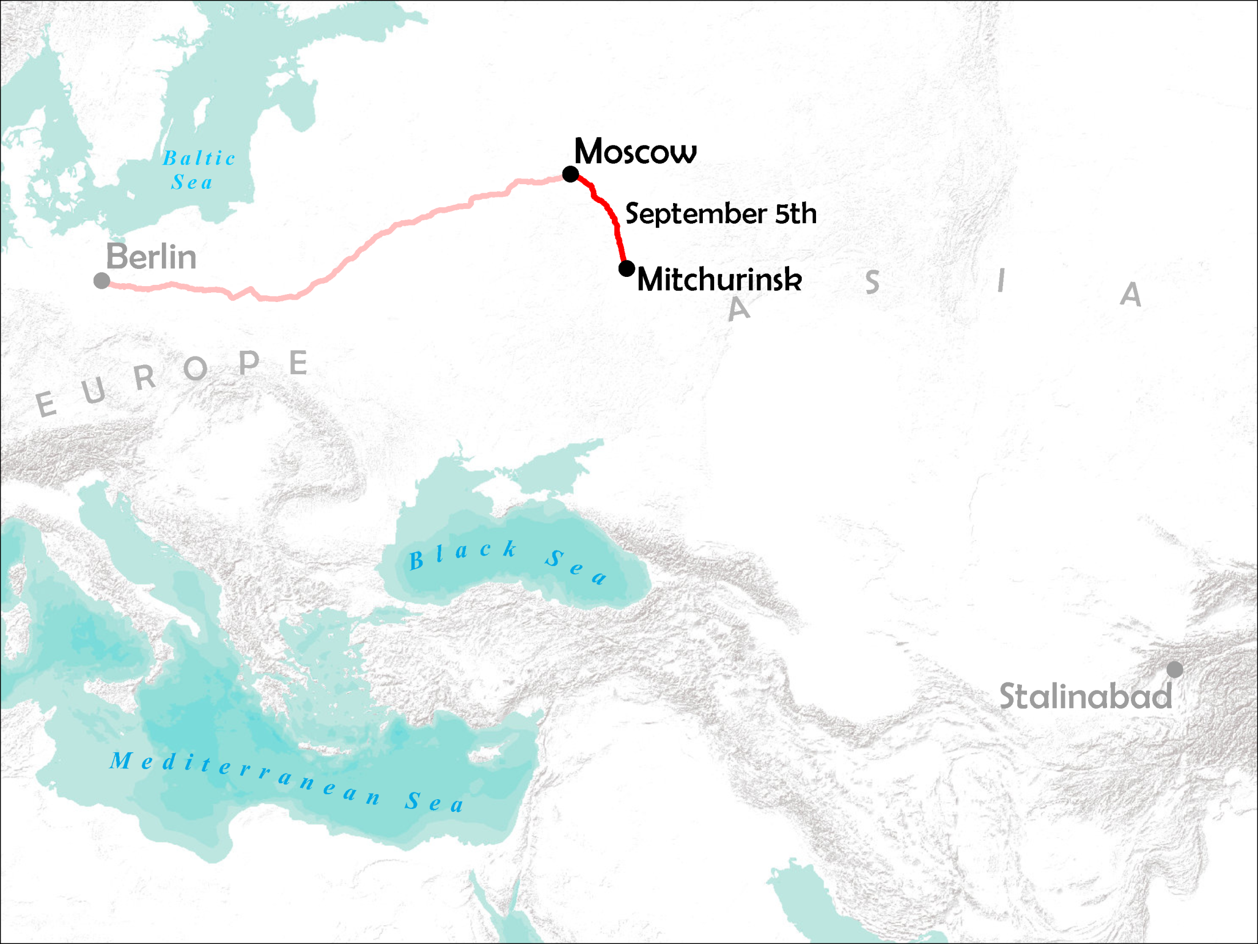
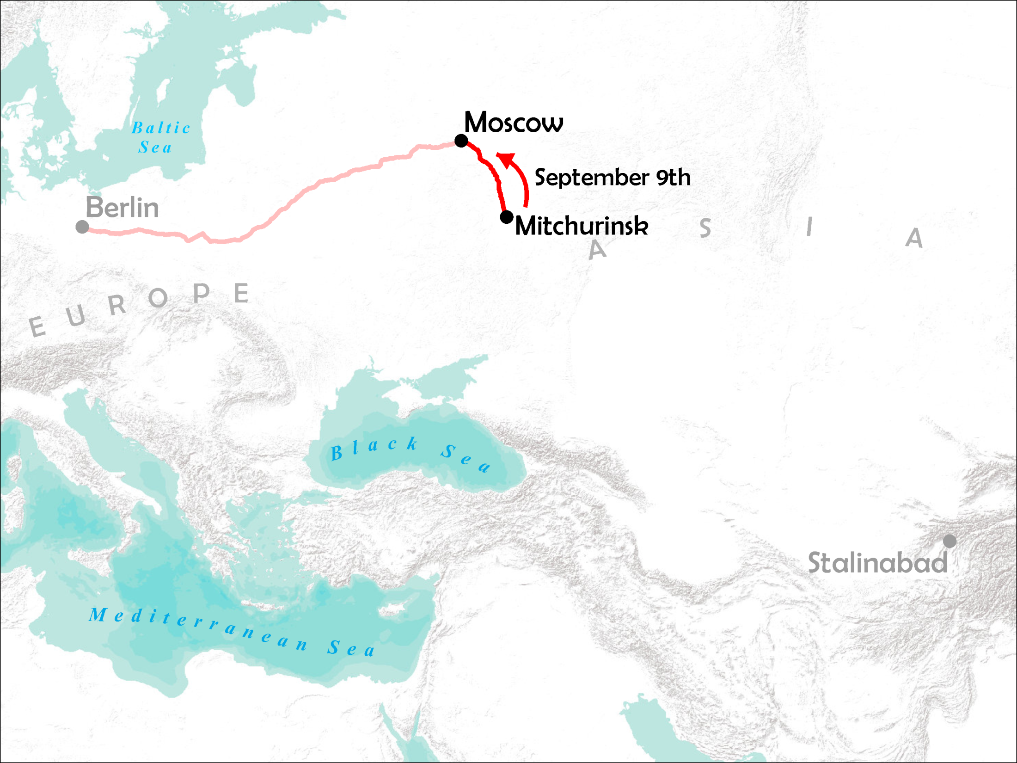
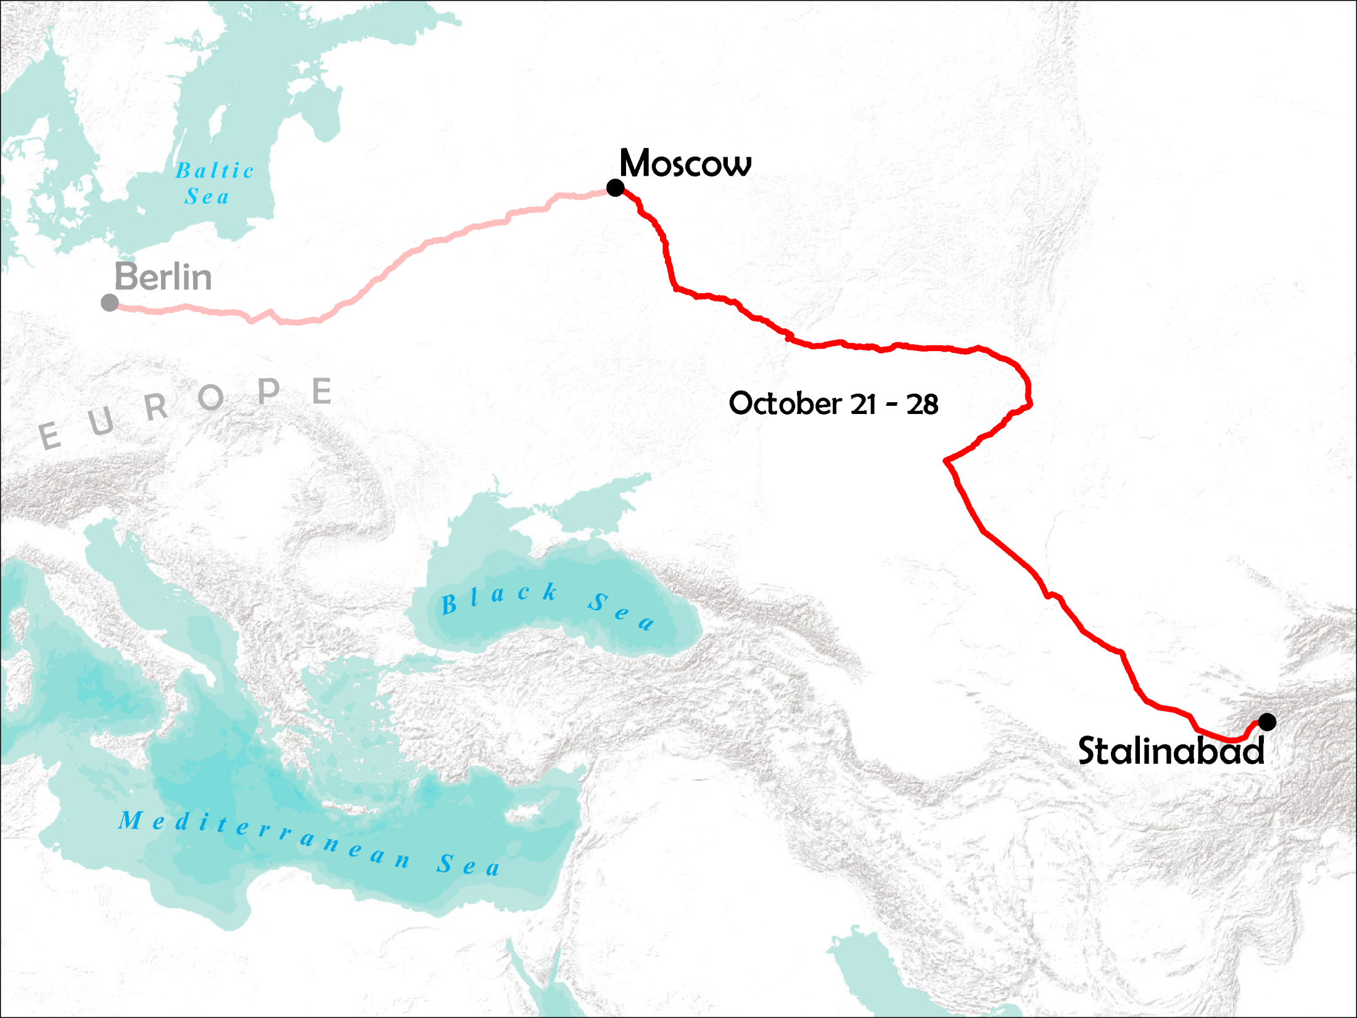

Slide 24
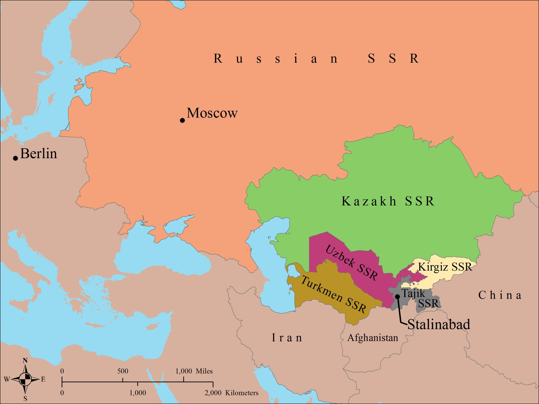
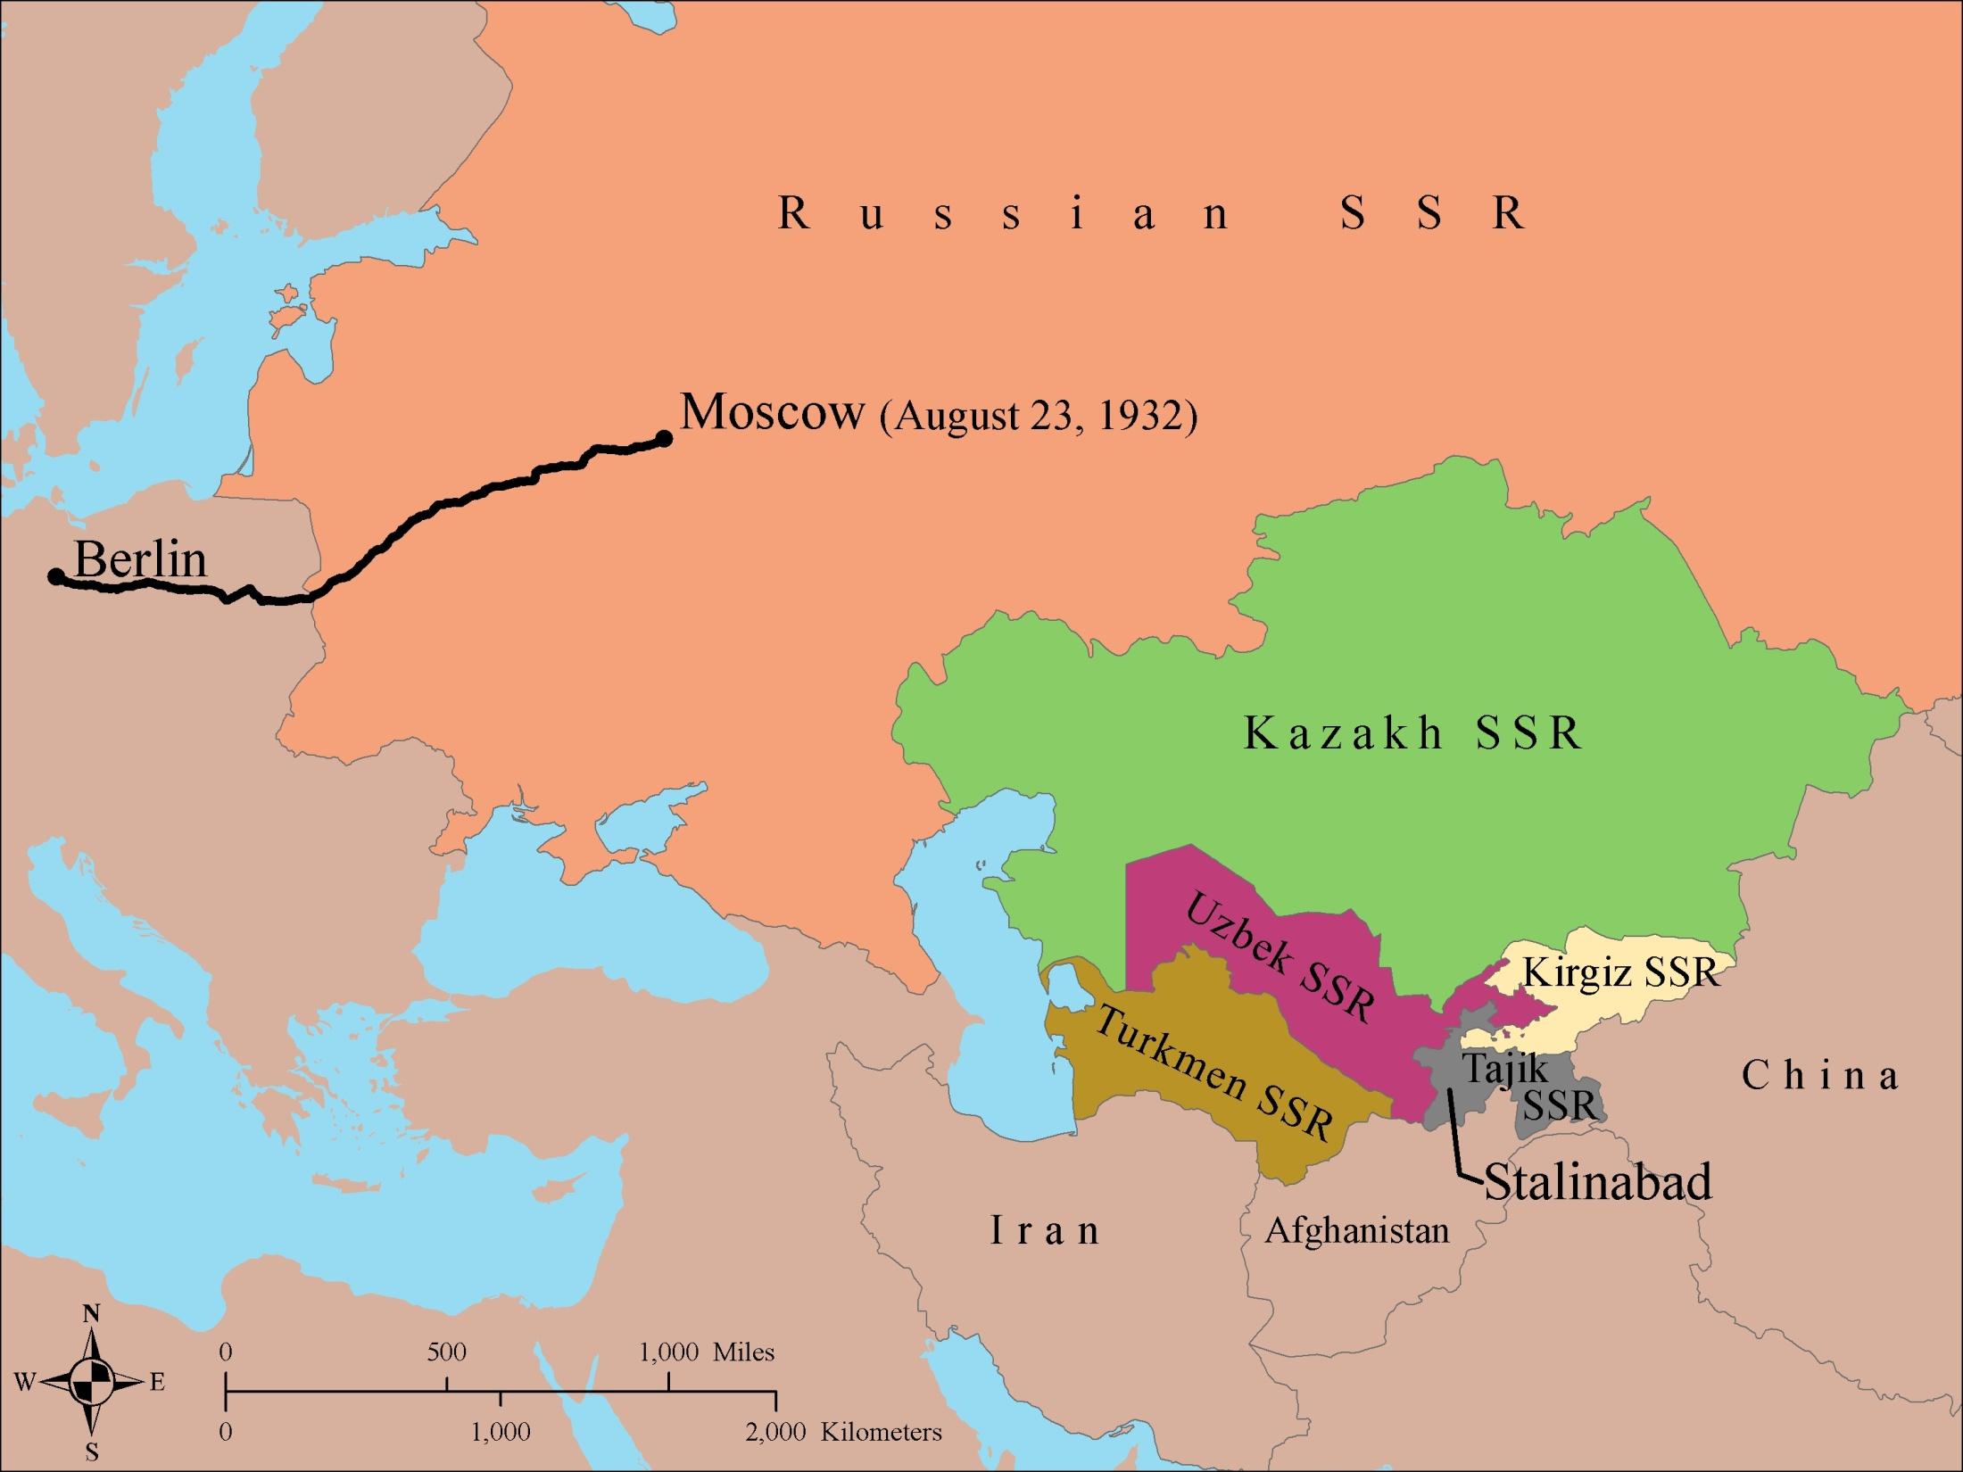
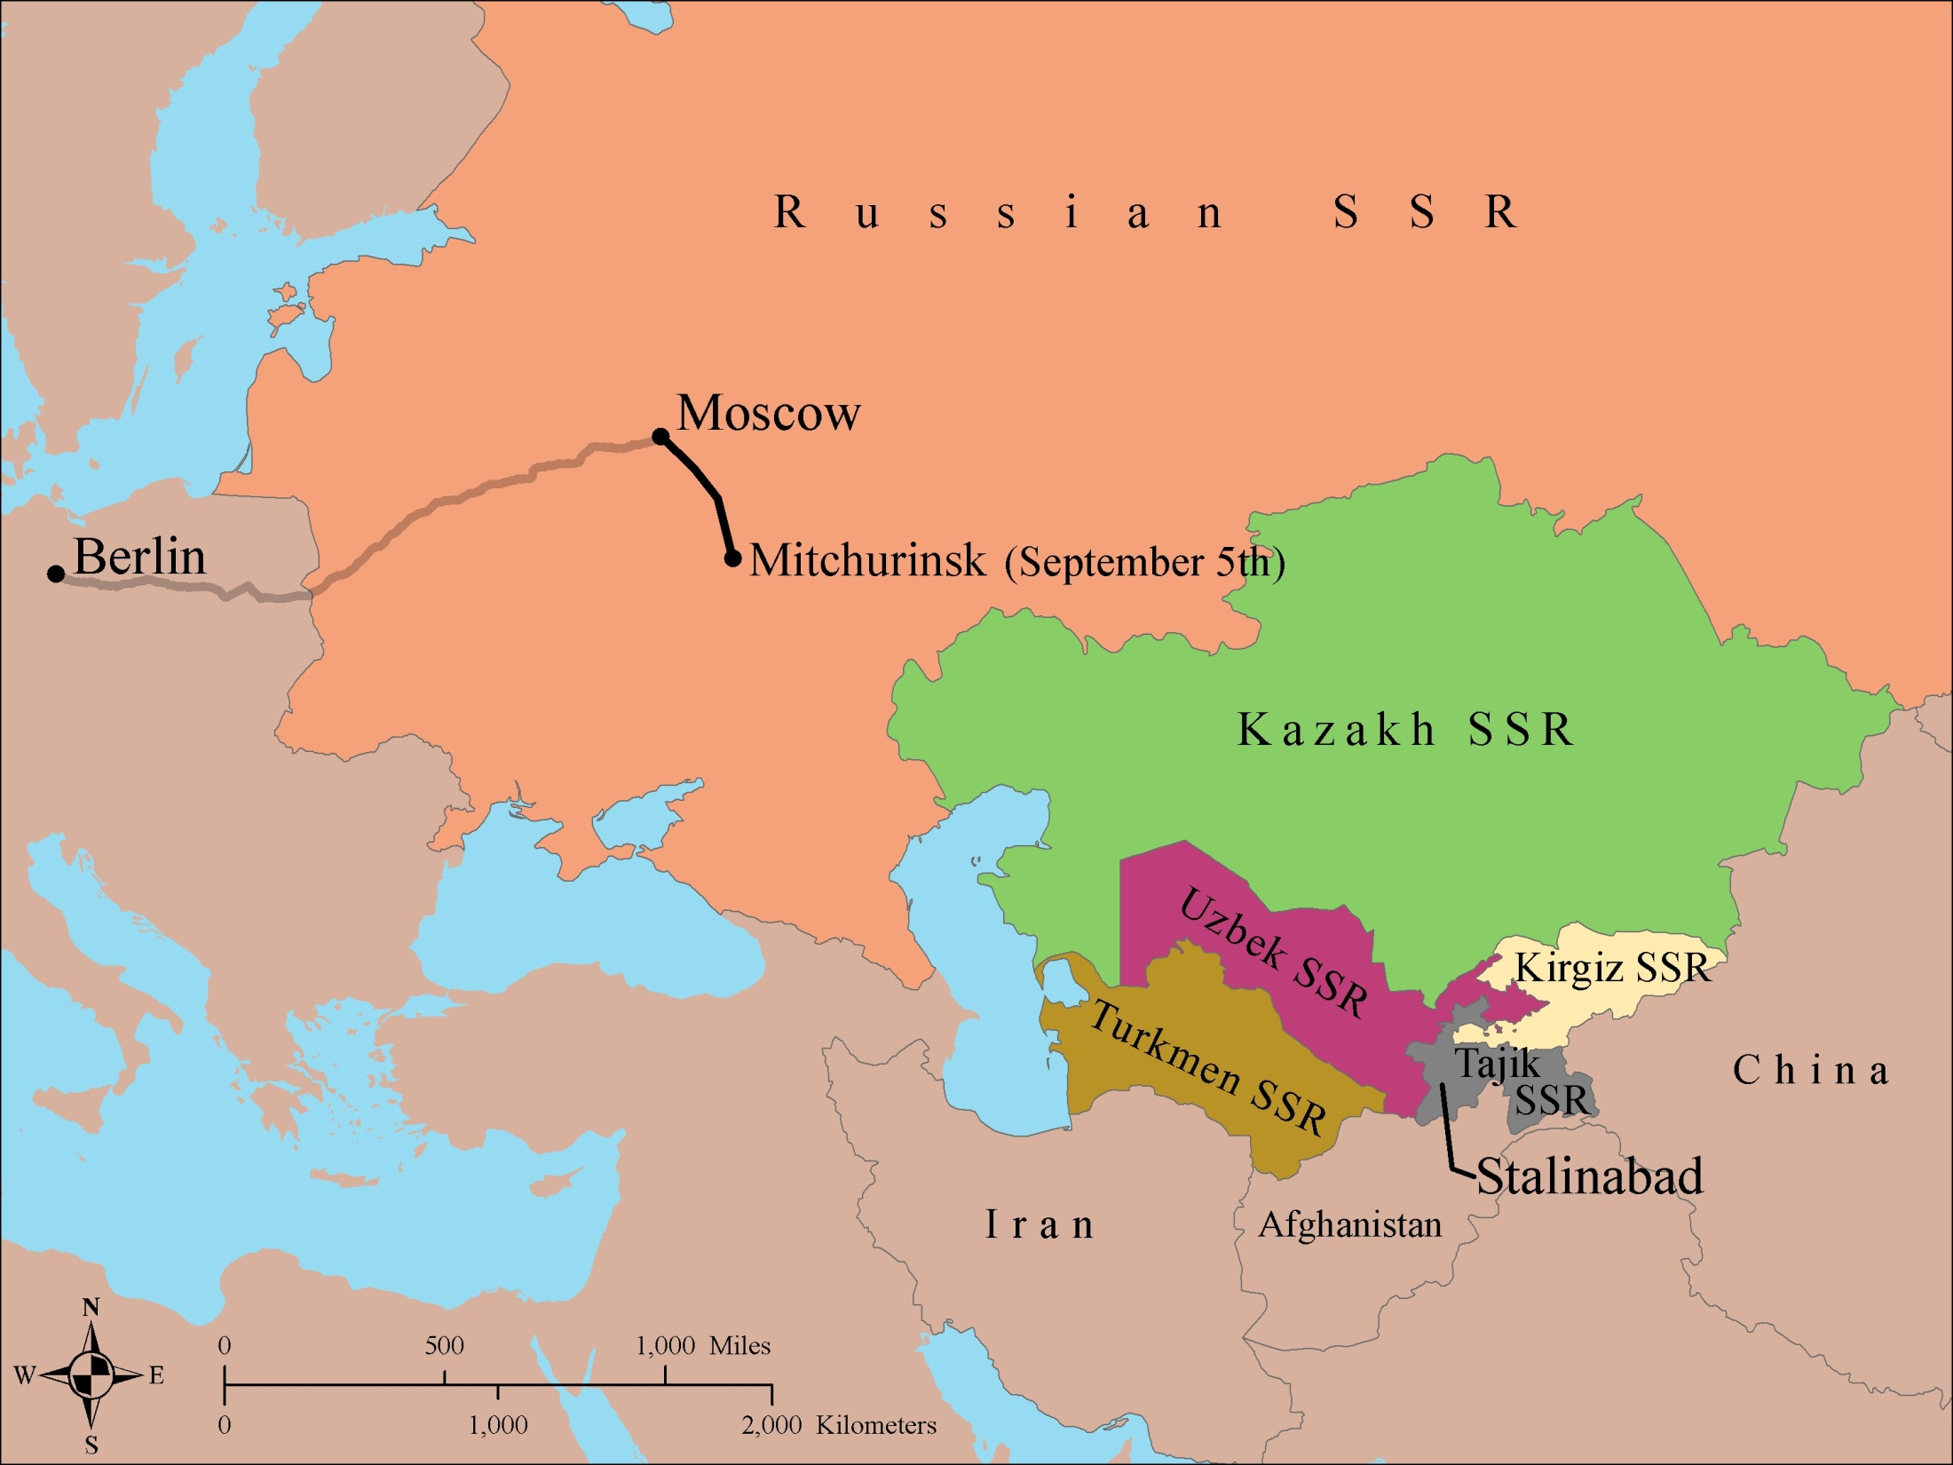
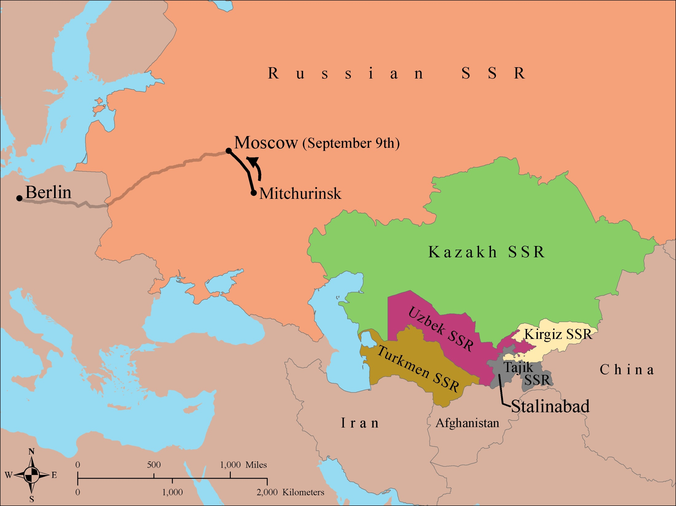
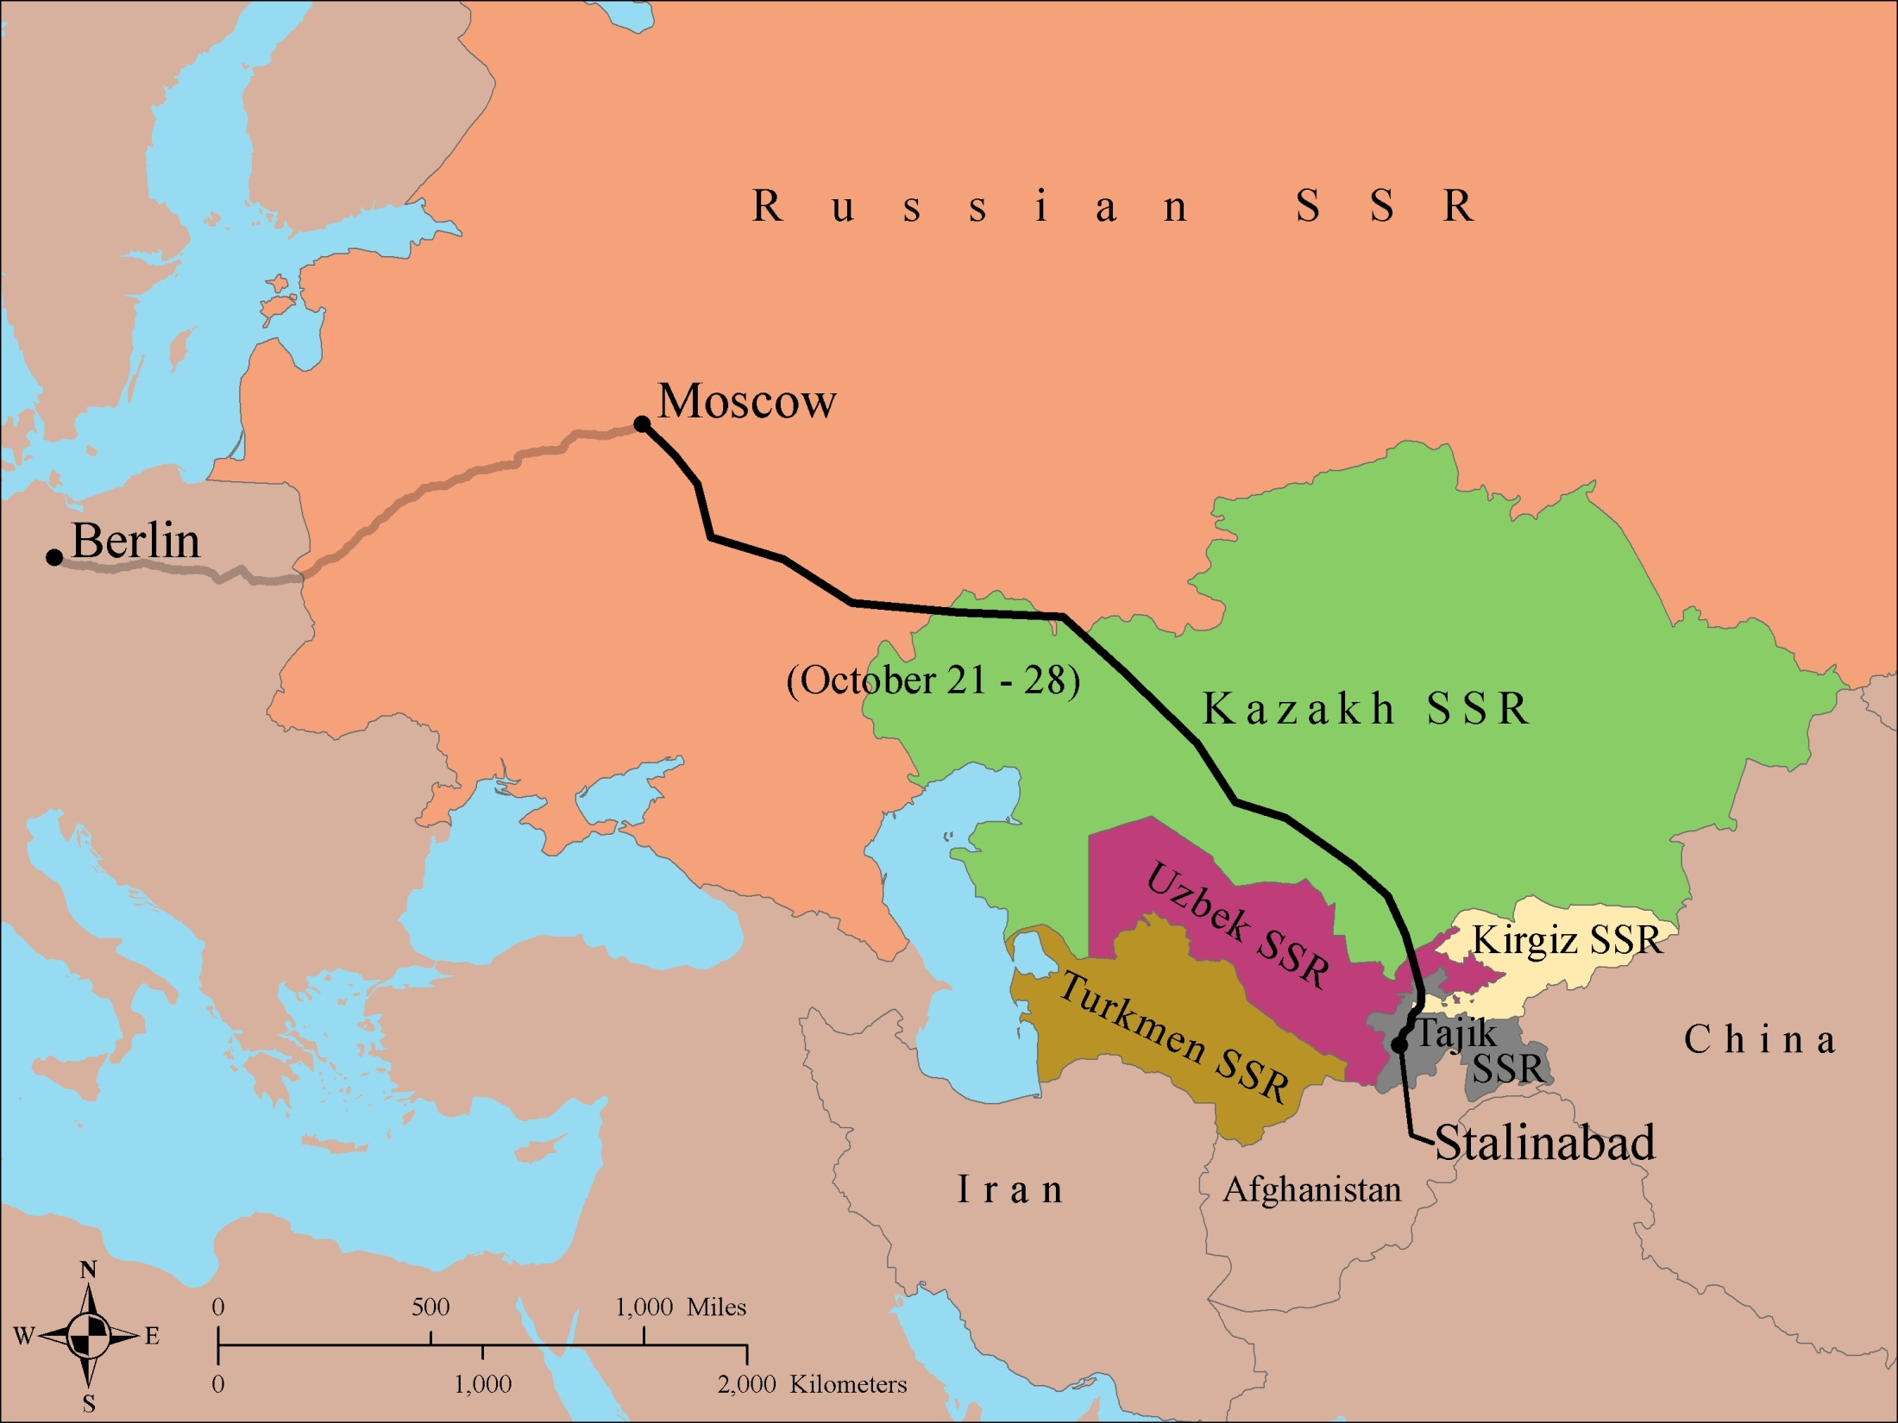
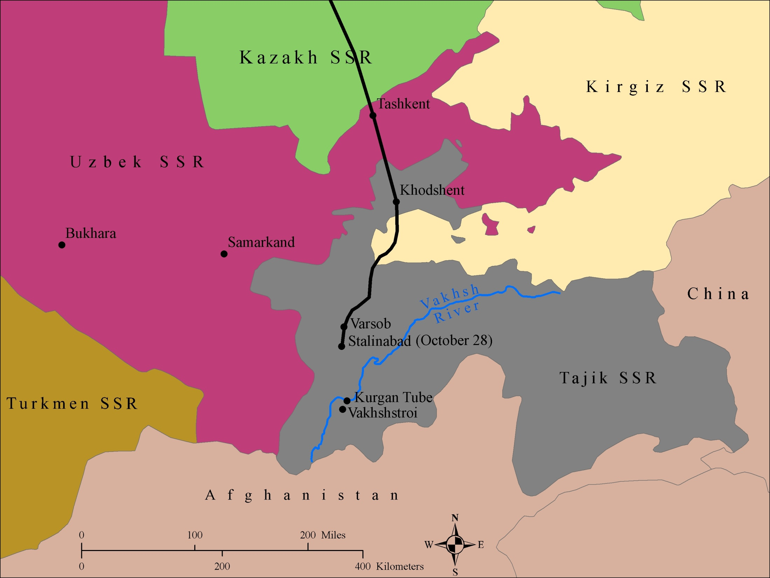
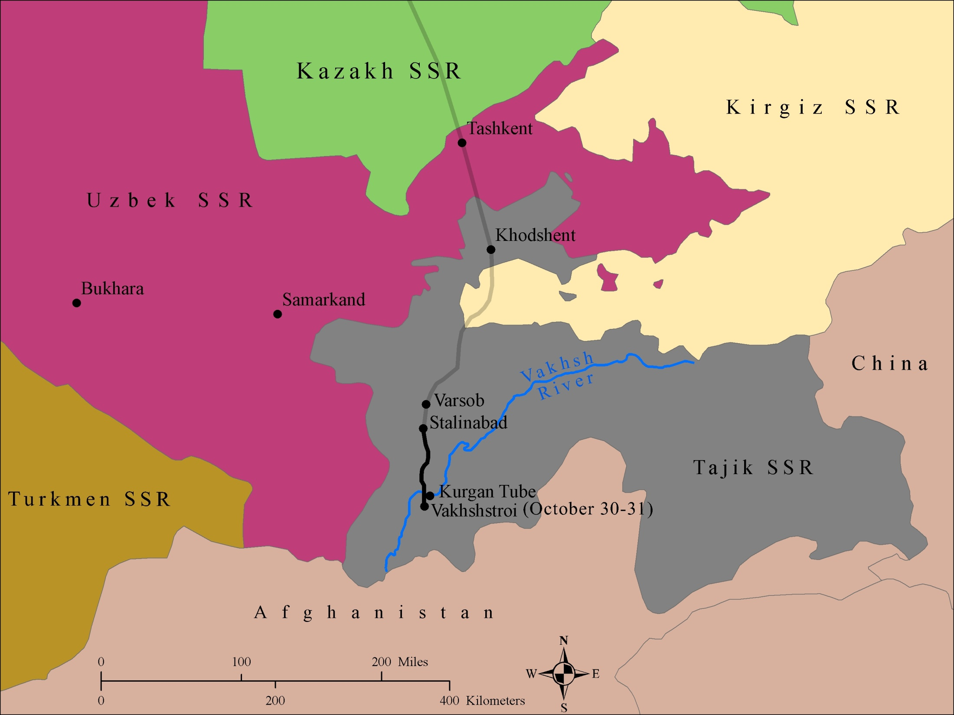
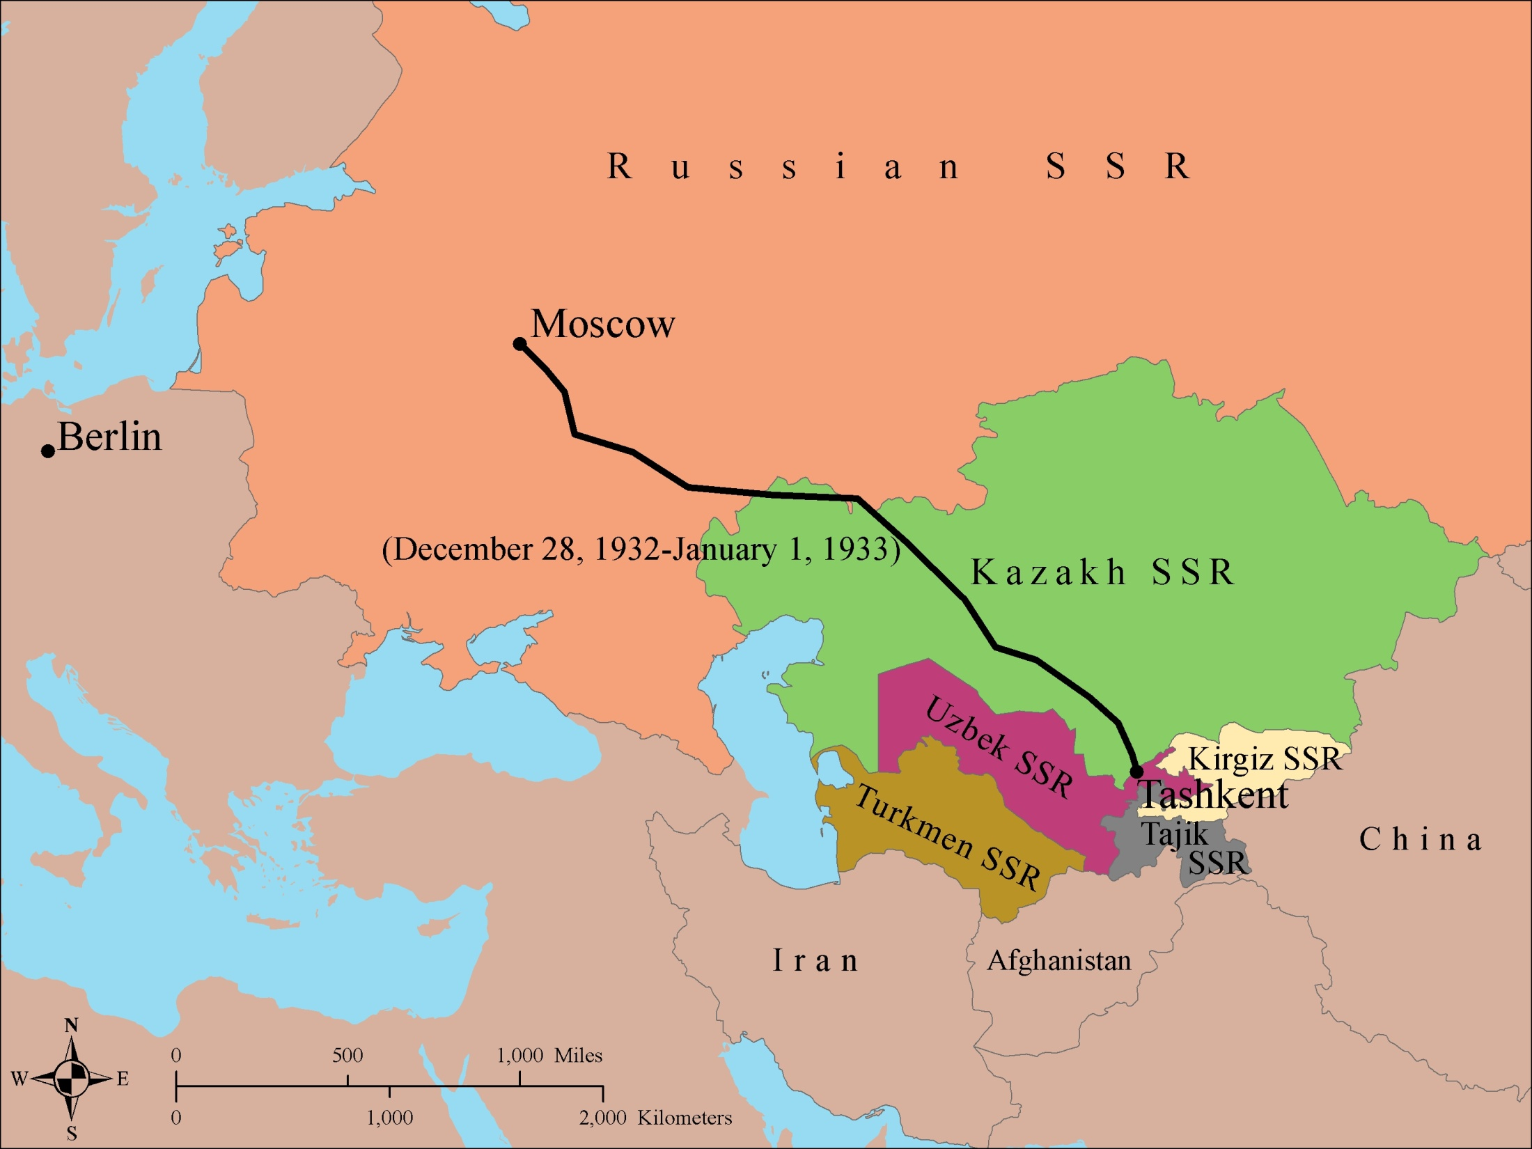
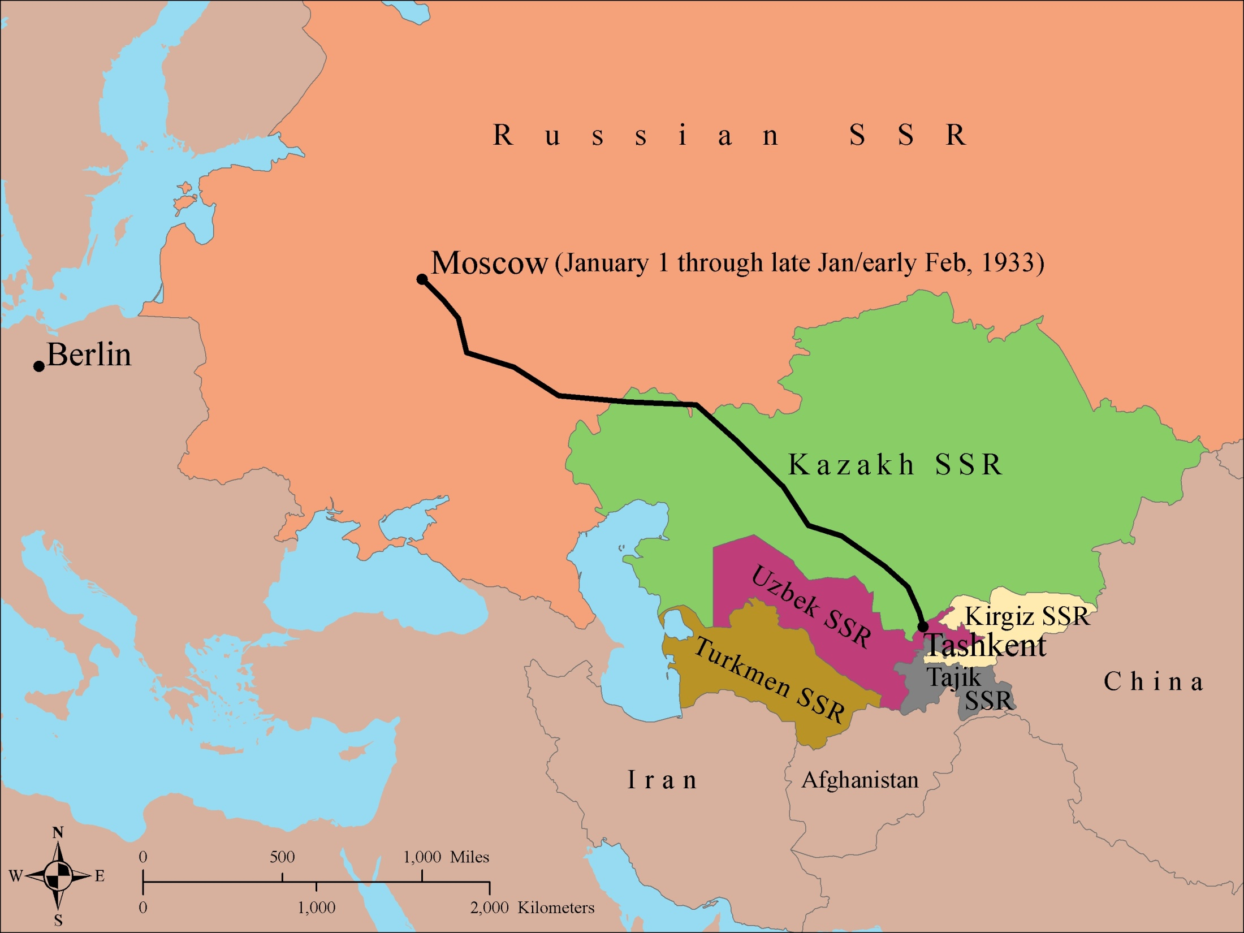
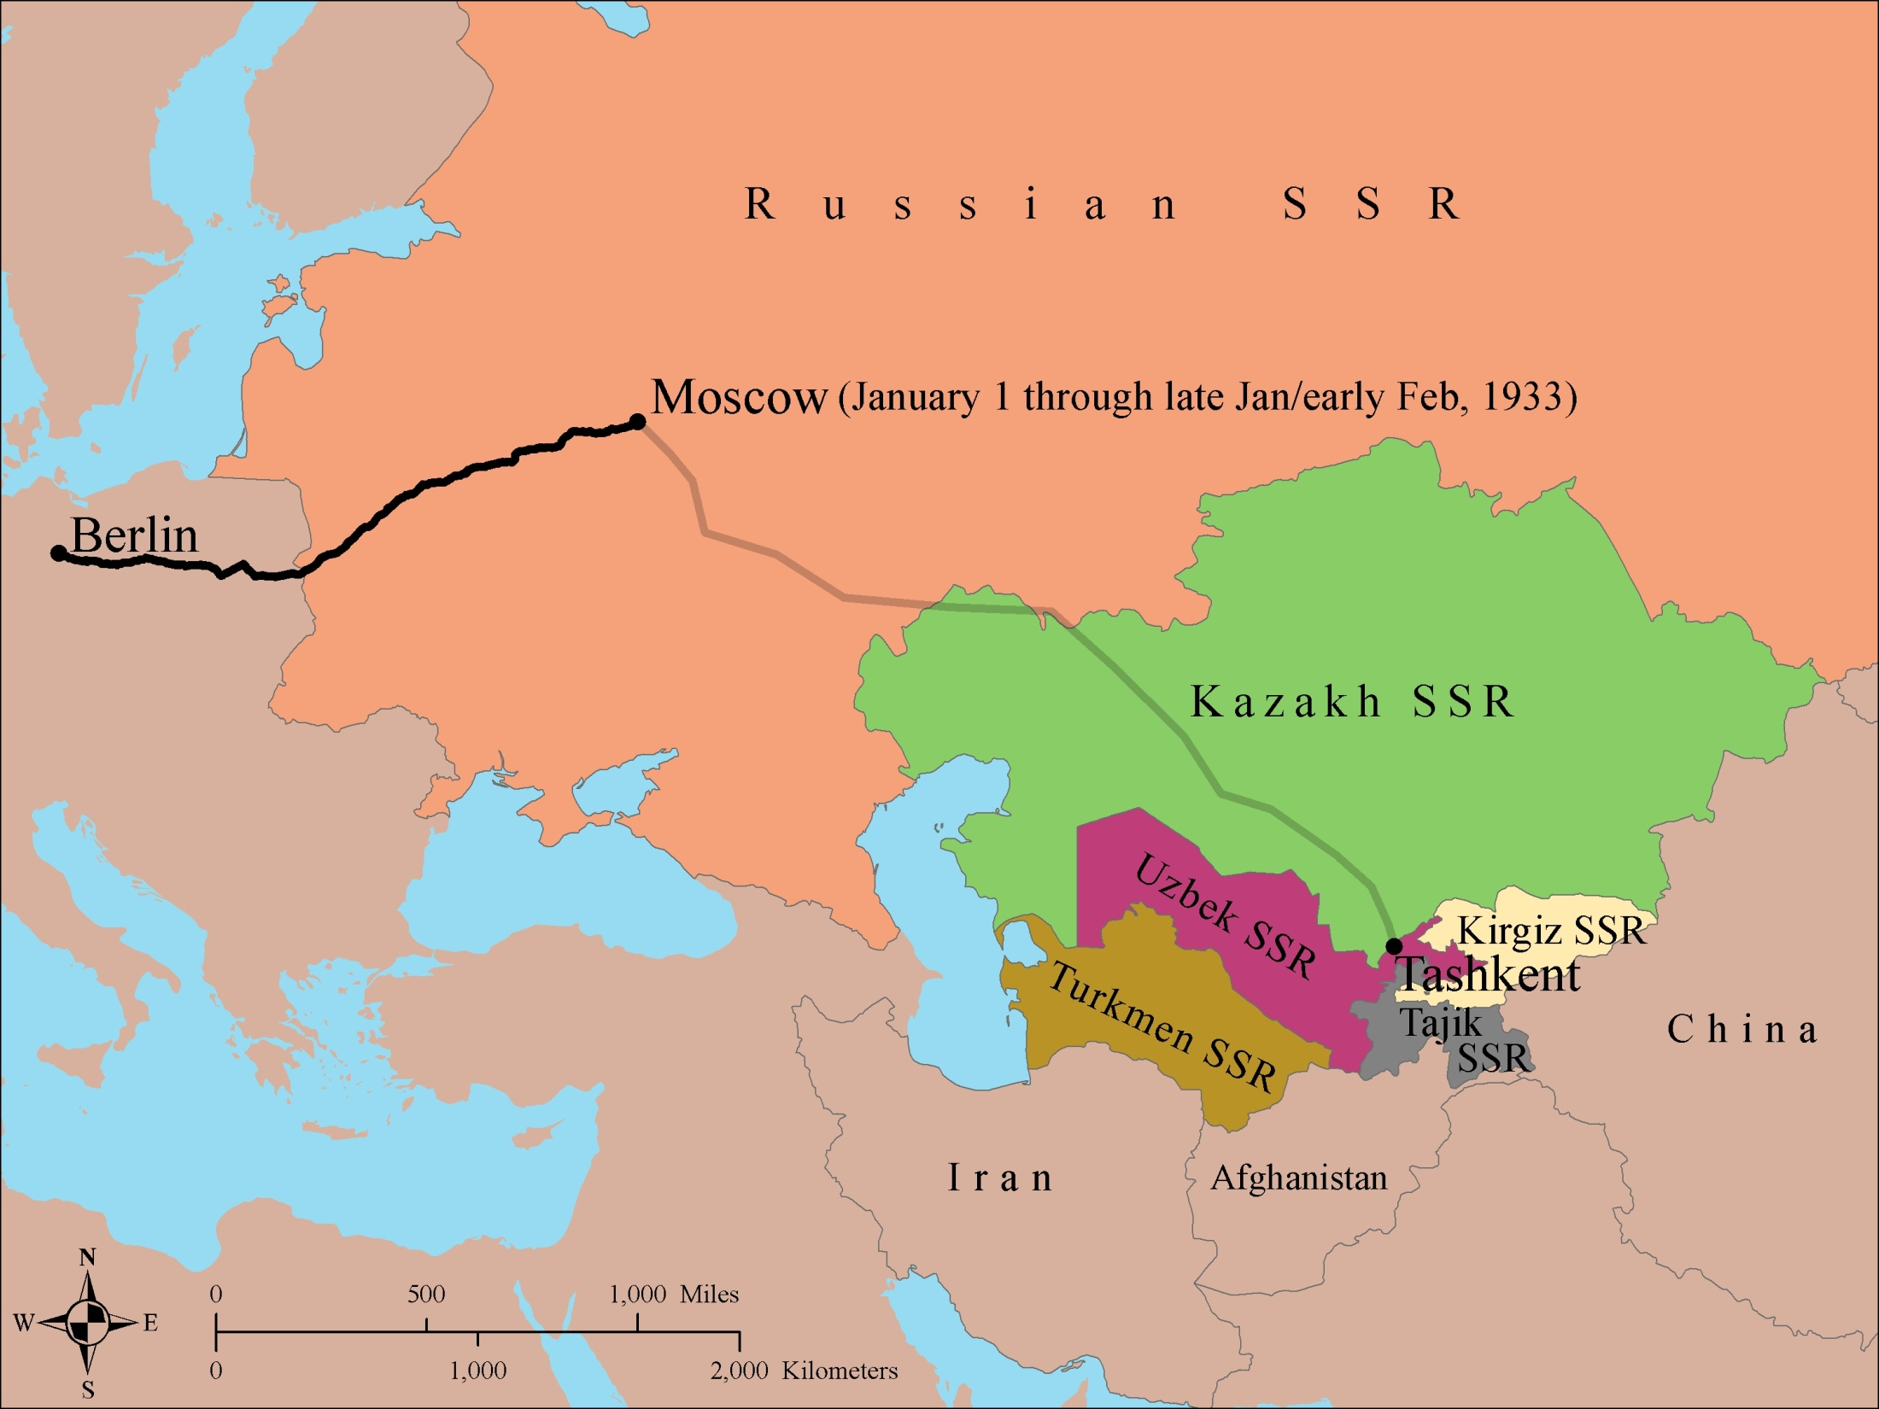

Slide 25
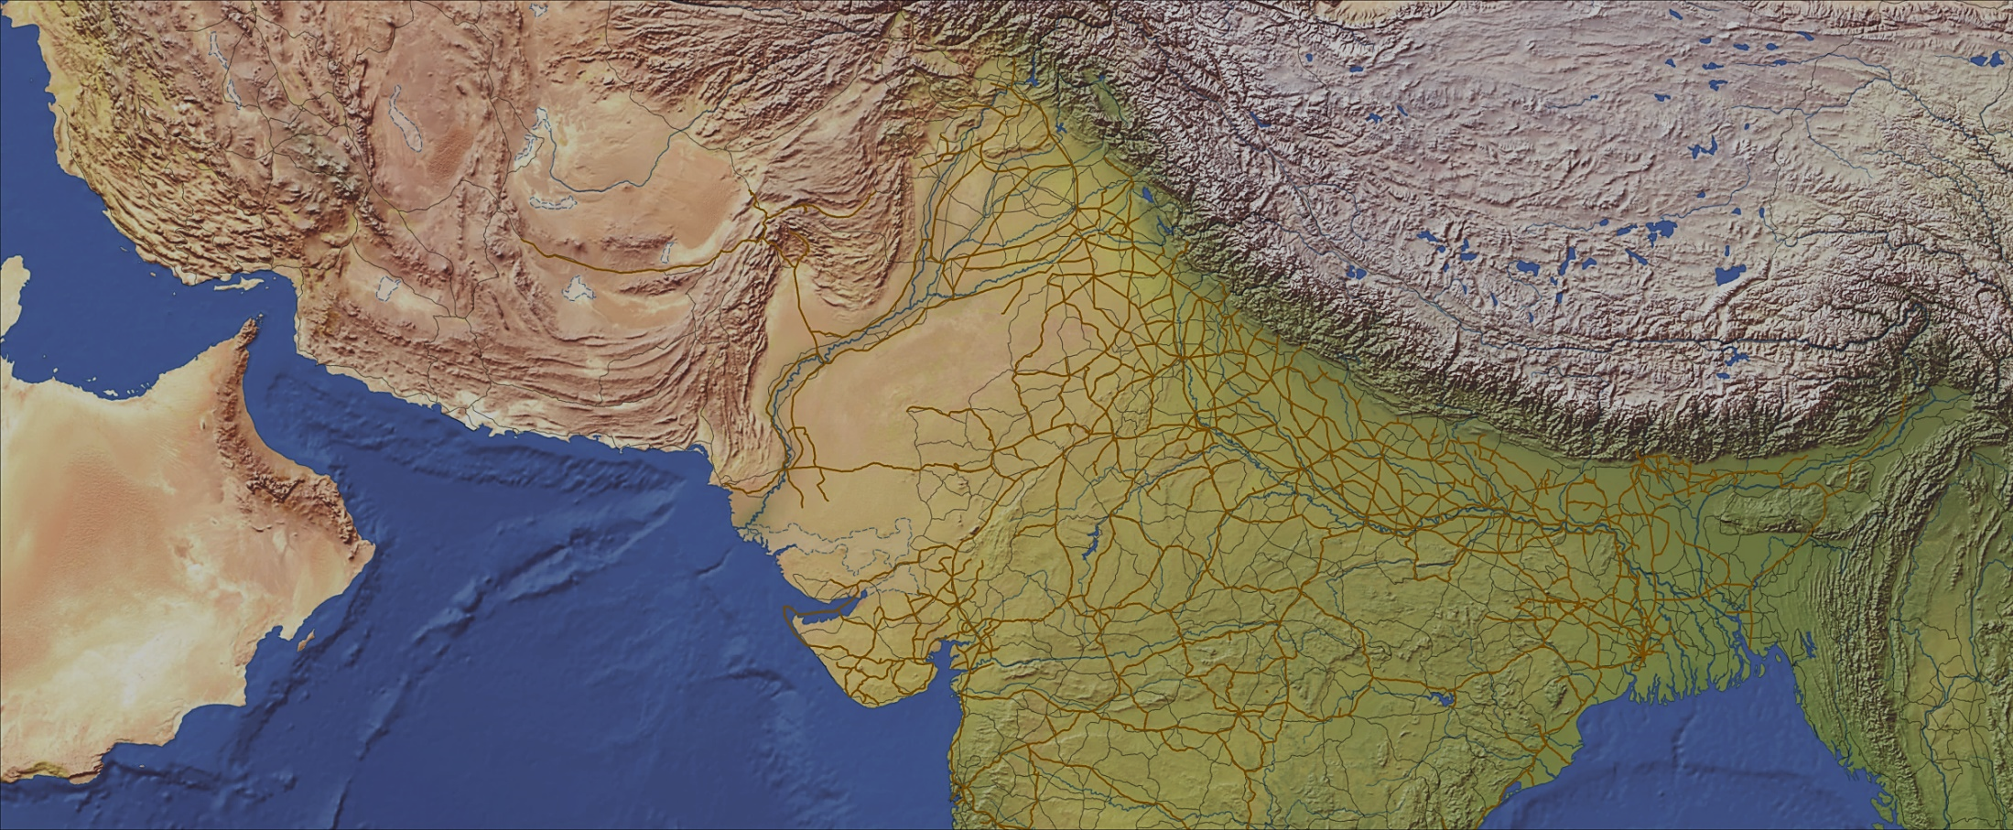
Visualizing migrations resulting from the 1947 India/Pakistan partition, for Professor Tarun Khanna
Lahore
P A K I S T A N
Delhi
Karachi
Migration Routes
Official
I N D I A
Crowdsourced
Foot
Rail
Plane
Sea
Foot
Rail
Road
Plane
Sea
Multi-stop
BANGLADESH
Bombay
0 500 1,000 Kilometers
Map by Jeff Blossom, Center for Geographic Analysis, Harvard University
Data Sources: Natural Earth Data; DIVA-GIS
Notes:
Routes and forms of migrations identified through archival resources versus new routes and forms of migration identified through oral stories.

Slide 26
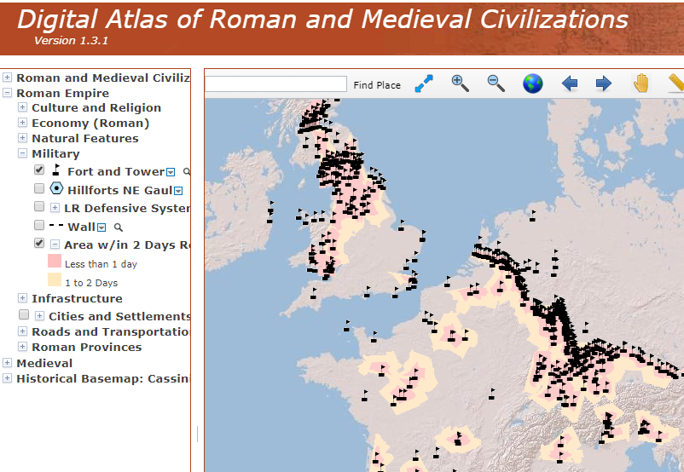
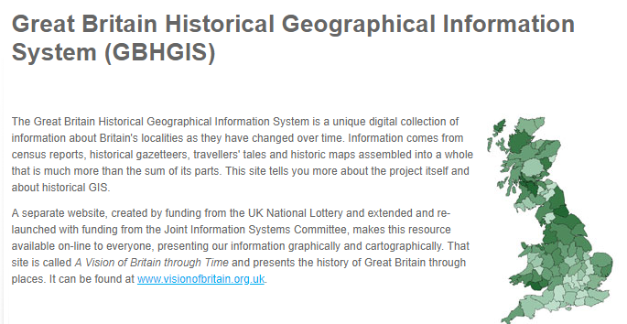
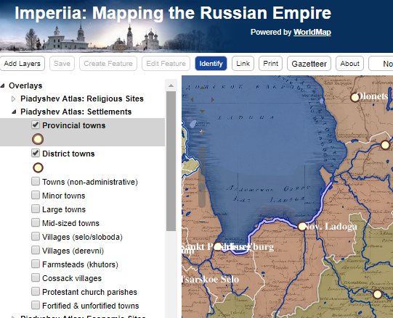
Additional historic GIS projects:
Notes:
http://maps.cga.harvard.edu/darmc/
http://www2.port.ac.uk/research/gbhgis/
http://worldmap.harvard.edu/maps/russianempire
http://gis.huri.harvard.edu/

Slide 27
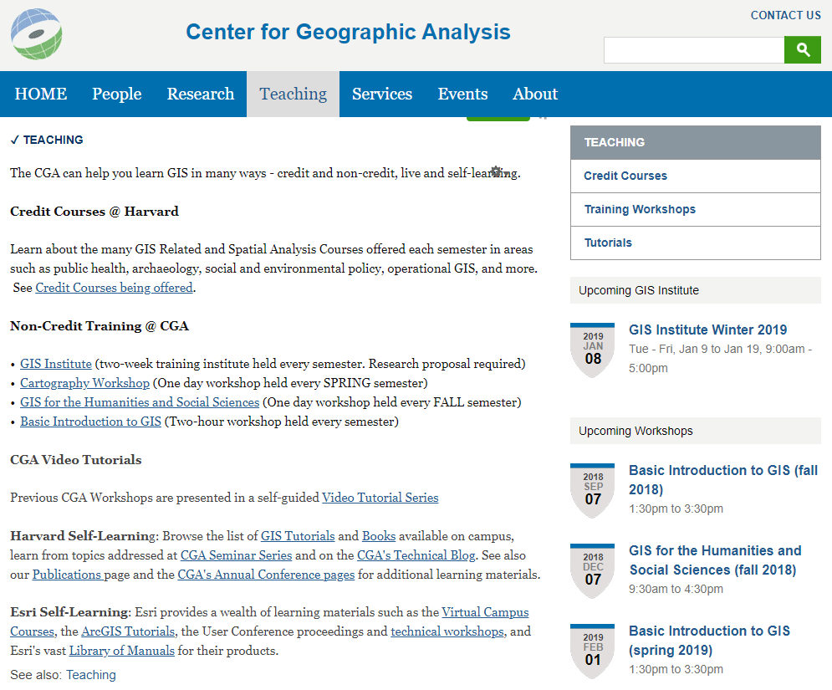
Where to learn GIS and mapping https://gis.harvard.edu/teaching

Slide 28
Thank You!
Jeff Blossom
jblossom@cga.harvard.edu
CGA website: http://gis.harvard.edu/
CGA general contact: http://gis.harvard.edu/contactus
Notes:
28

