Slide 1
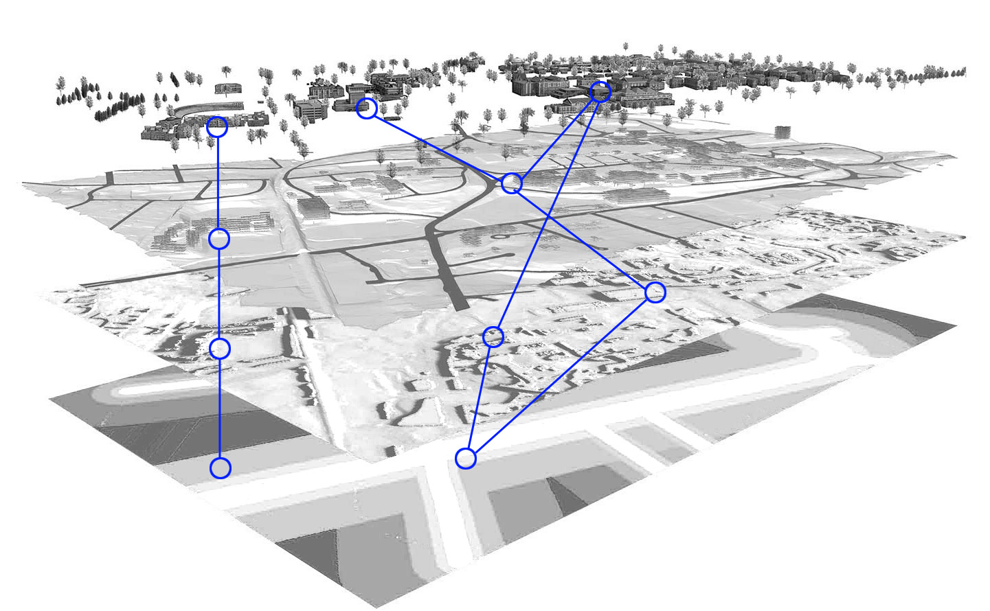
CONNECTING THE DOTS
How geospatial technology is changing the design profession
Guoping Huang, D.Des.
School of Architecture
University of Virginia

Slide 2
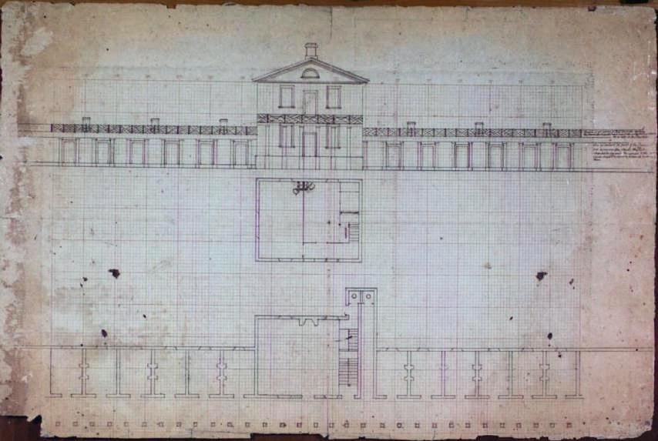

Slide 3
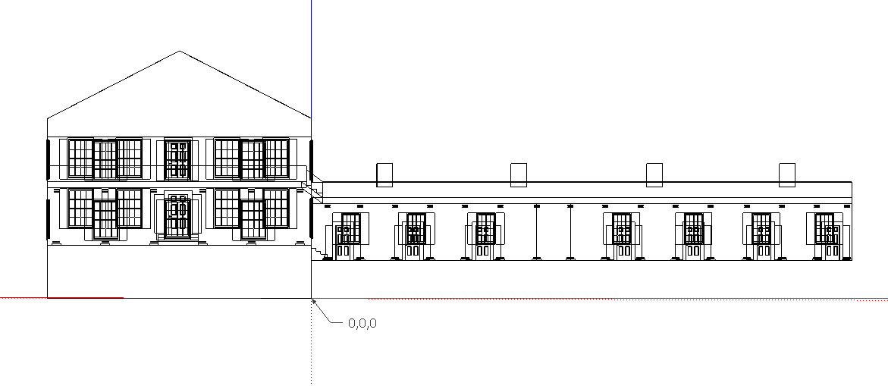

Slide 4
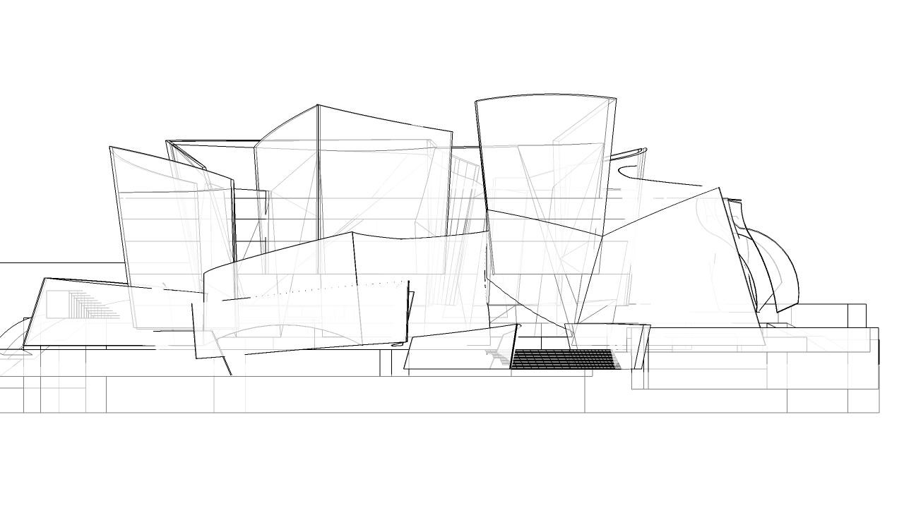

Slide 5


Slide 6
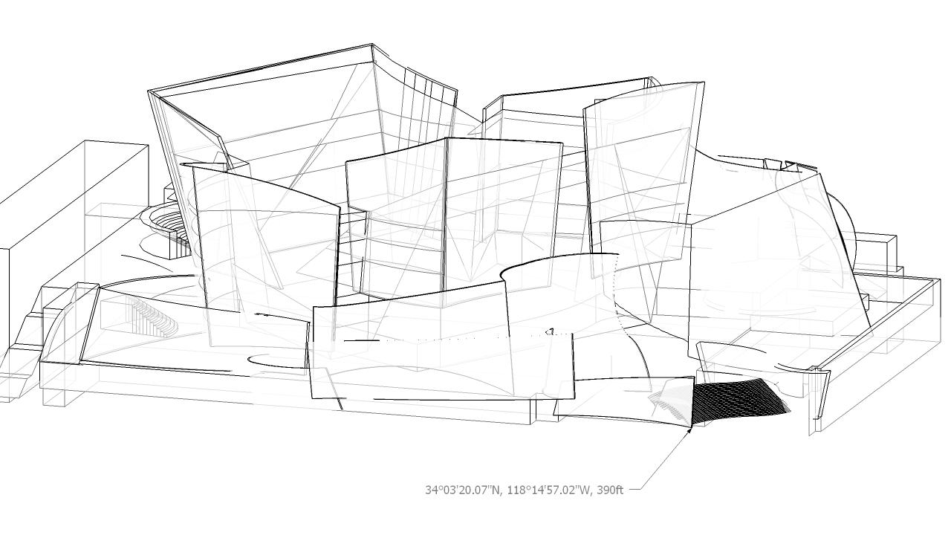

Slide 7
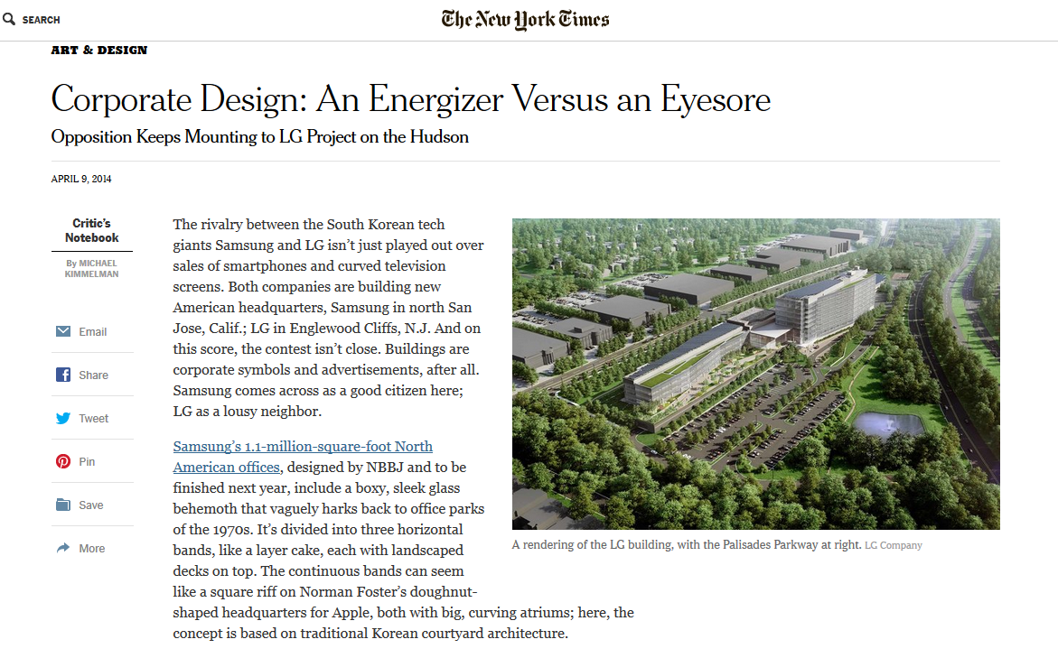

Slide 8
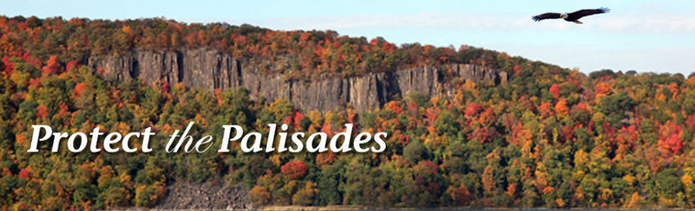
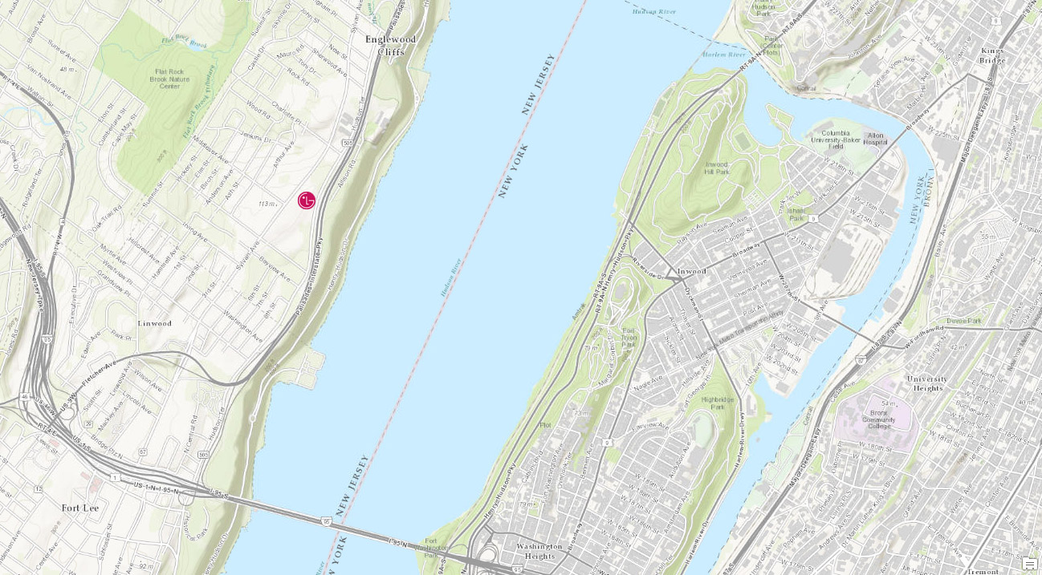

Slide 9
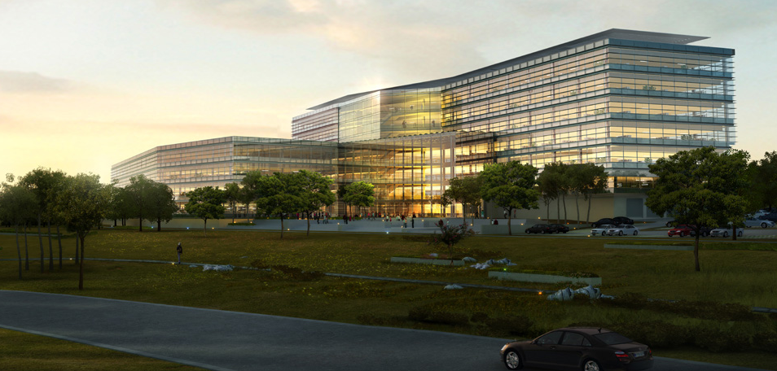
2010
LG Purchased the 27-acre property in Englewood Cliffs
2011
Englewood Cliffs zoning board approved LG headquarters
2012
LEED Gold Certified
LG hoped to break ground in late 2012
5,000 construction jobs.
1,200 full time employees
$1.3 million additional revenue in taxes.
- Mayor Joseph Parisi
Notes:
The Zoning Board of Adjustment voted 6-to-1 late Wednesday night to grant the company several variances, including one that would allow for a 143-foot tall building in an area zoned for buildings no taller than 35 feet. Board alternate Edward Halas voted against it saying he was concerned about the height.

Slide 10
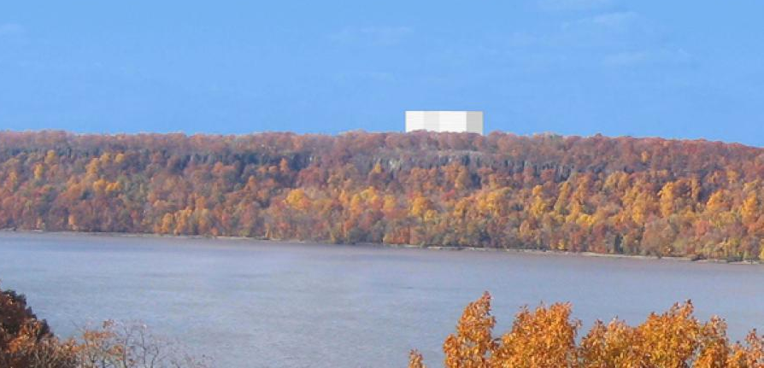
2012
Englewood Cliffs residents filed separate lawsuits
2013
Nearly a dozen conservation groups have filed briefs with the court
2014
Senator Charles E. Schumer joined the protest against this project
Attorney General Eric T. Schneiderman of New York asked an appeals court in New Jersey to stop the construction.

Slide 11


Slide 12
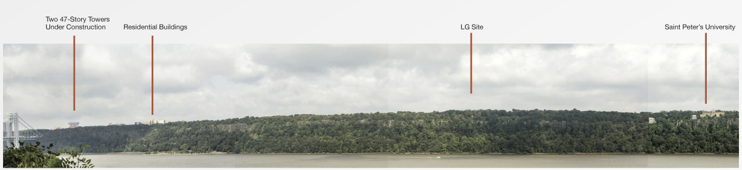
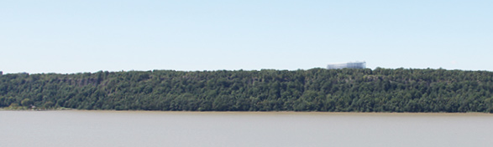
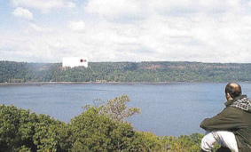
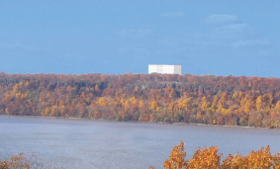
VS

Slide 13


Slide 14
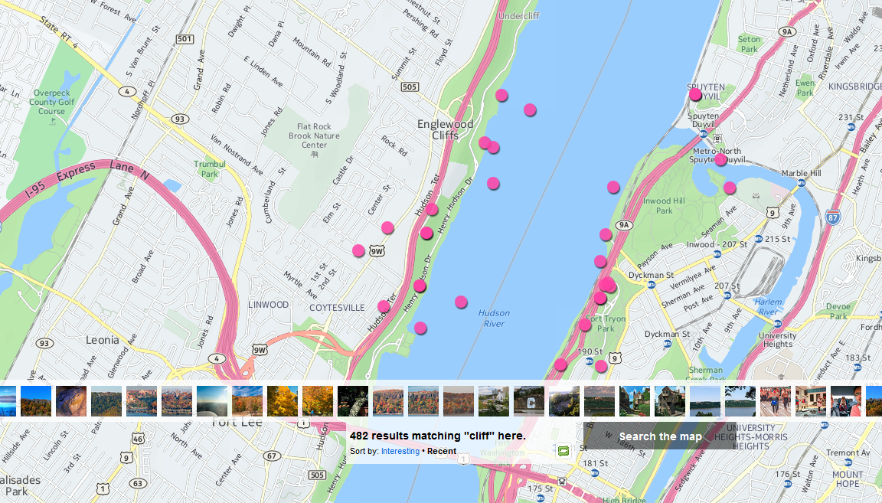

Slide 15
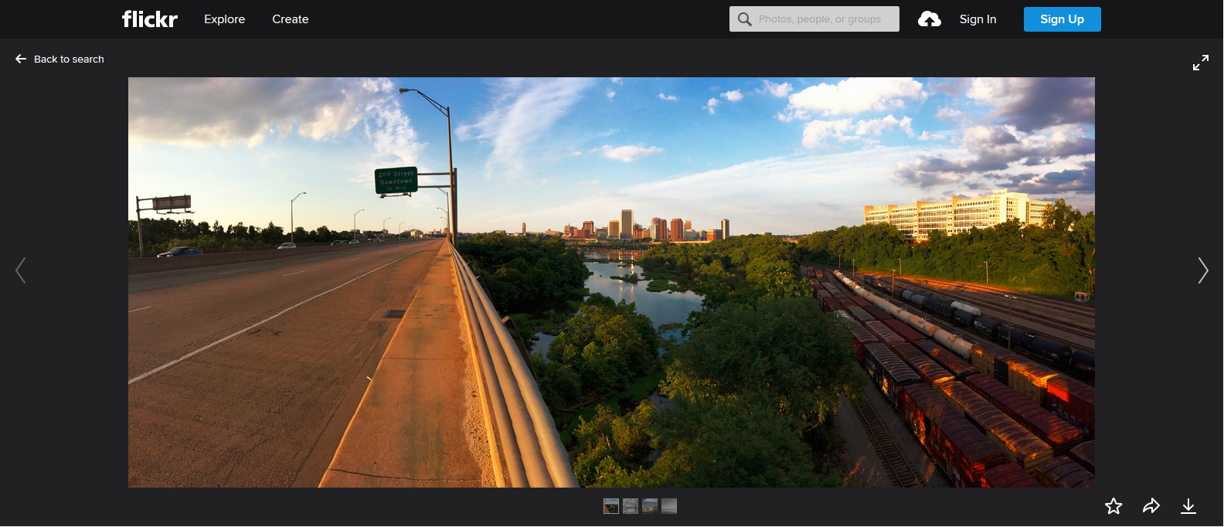
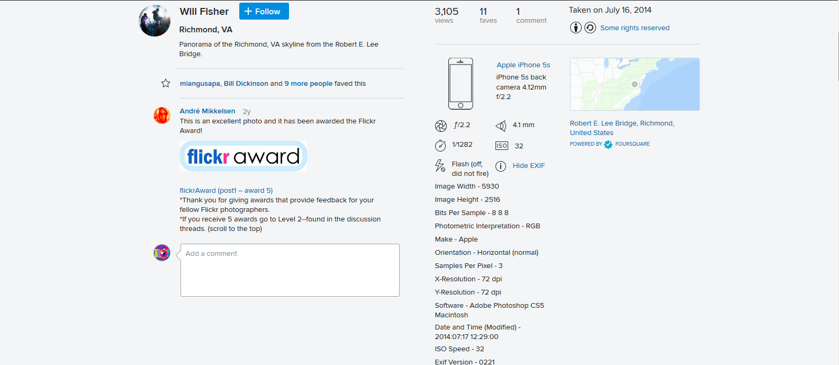
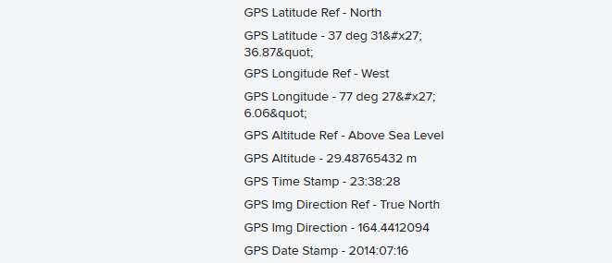

Slide 16
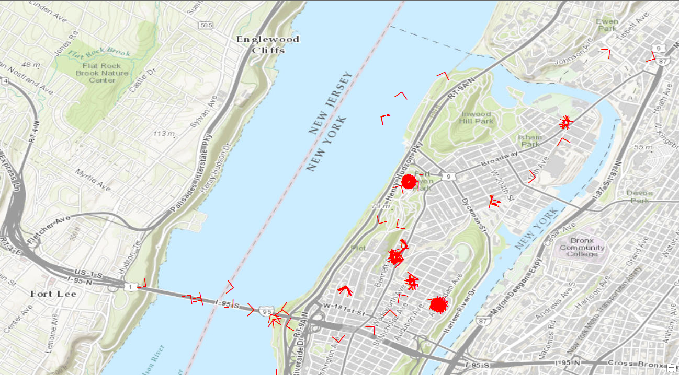

Slide 17


Slide 18

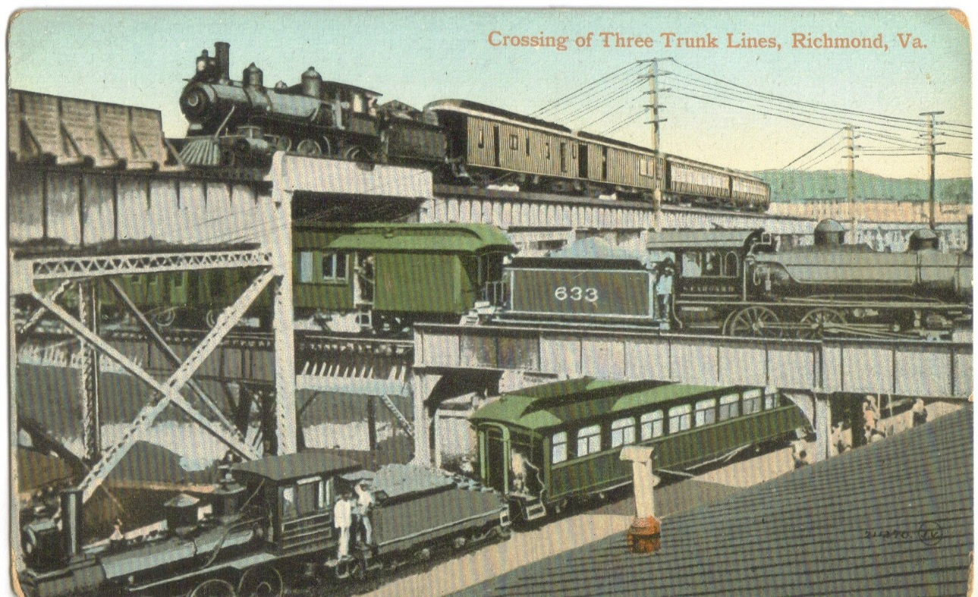

Slide 19
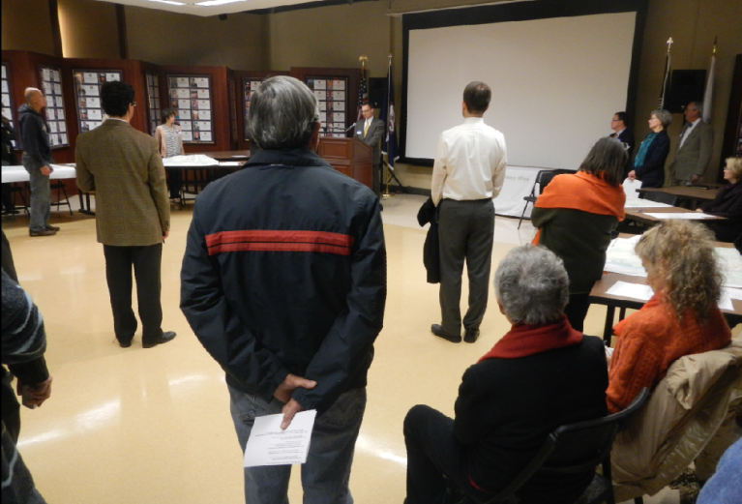
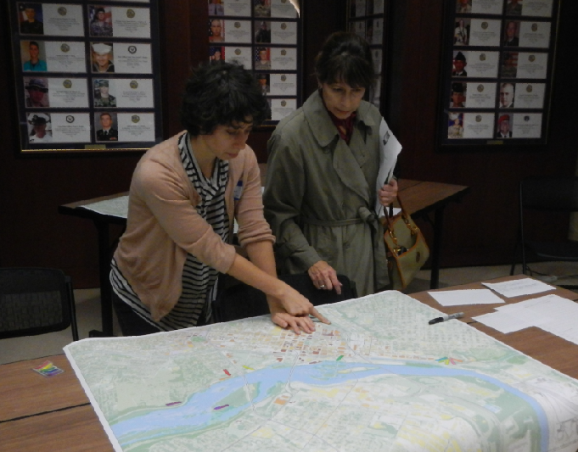
Public input meeting on November 20, 2013

Slide 20
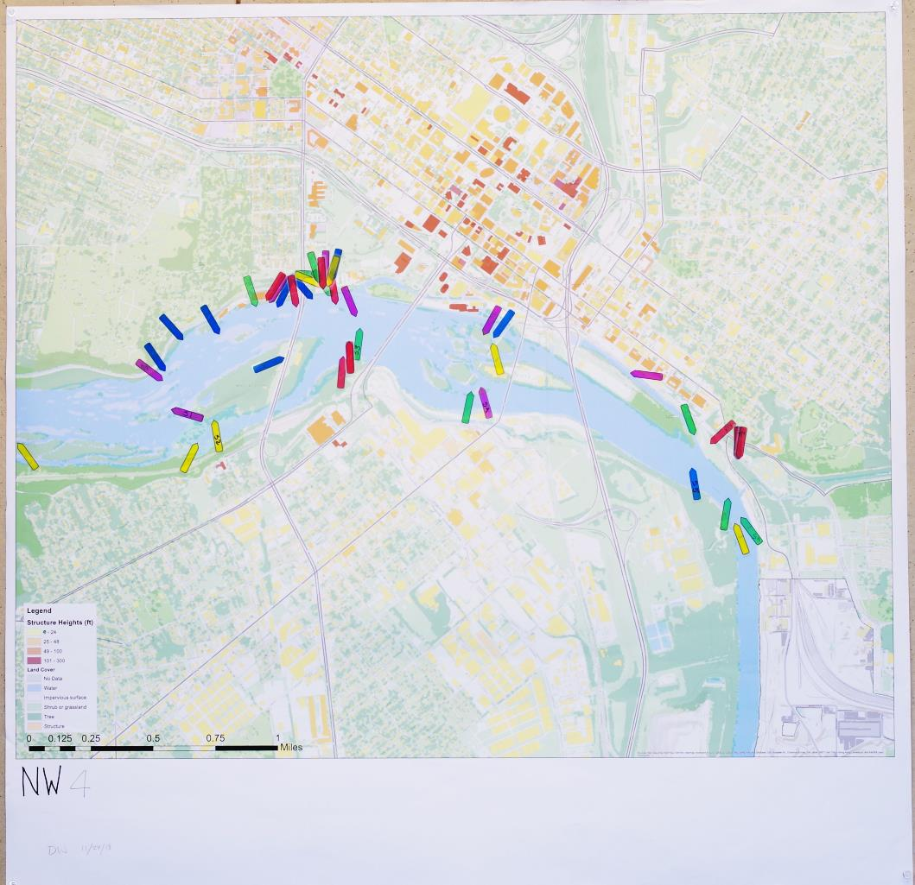

Slide 21
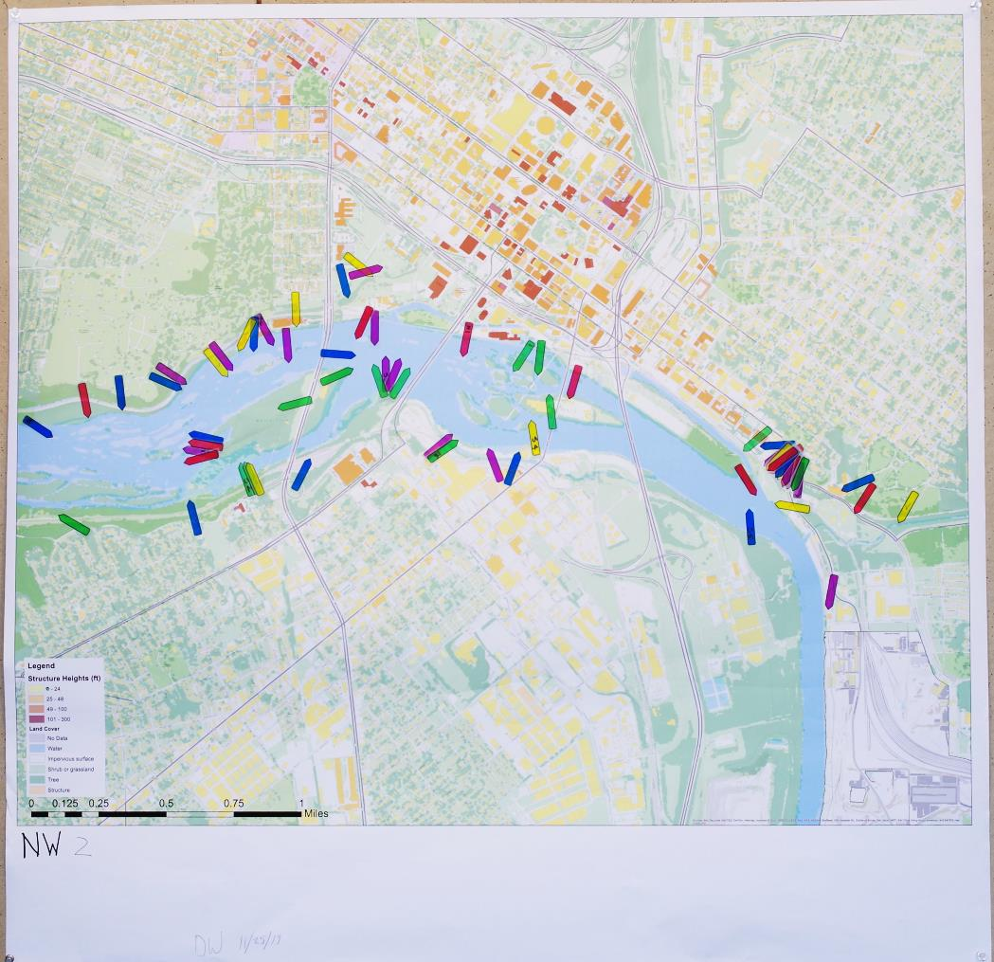

Slide 22
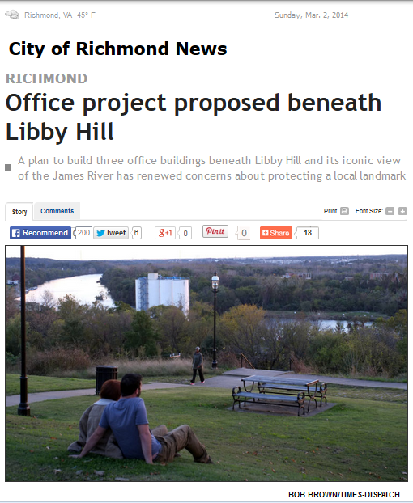
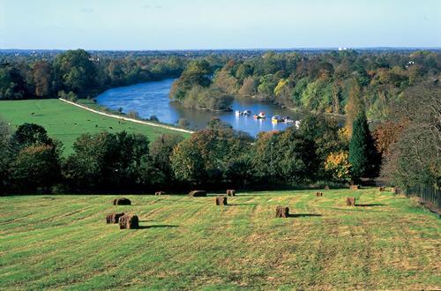

Slide 25
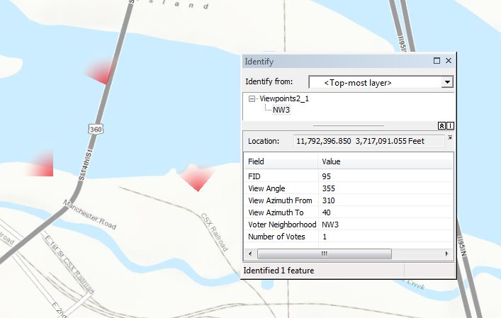
Digitization of votes

Slide 26
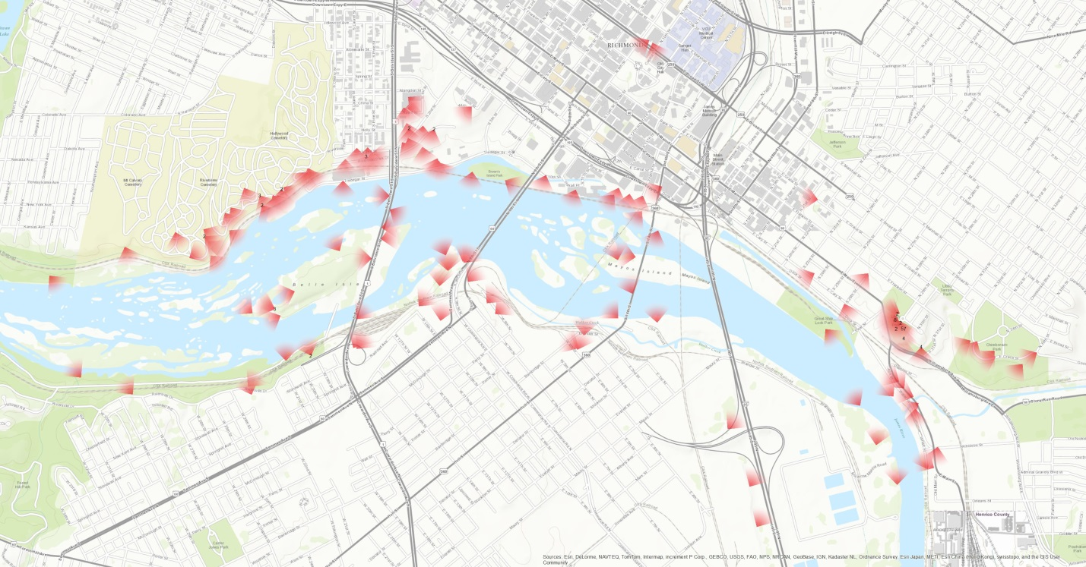
Distribution of all the votes collected at the public input meeting

Slide 27
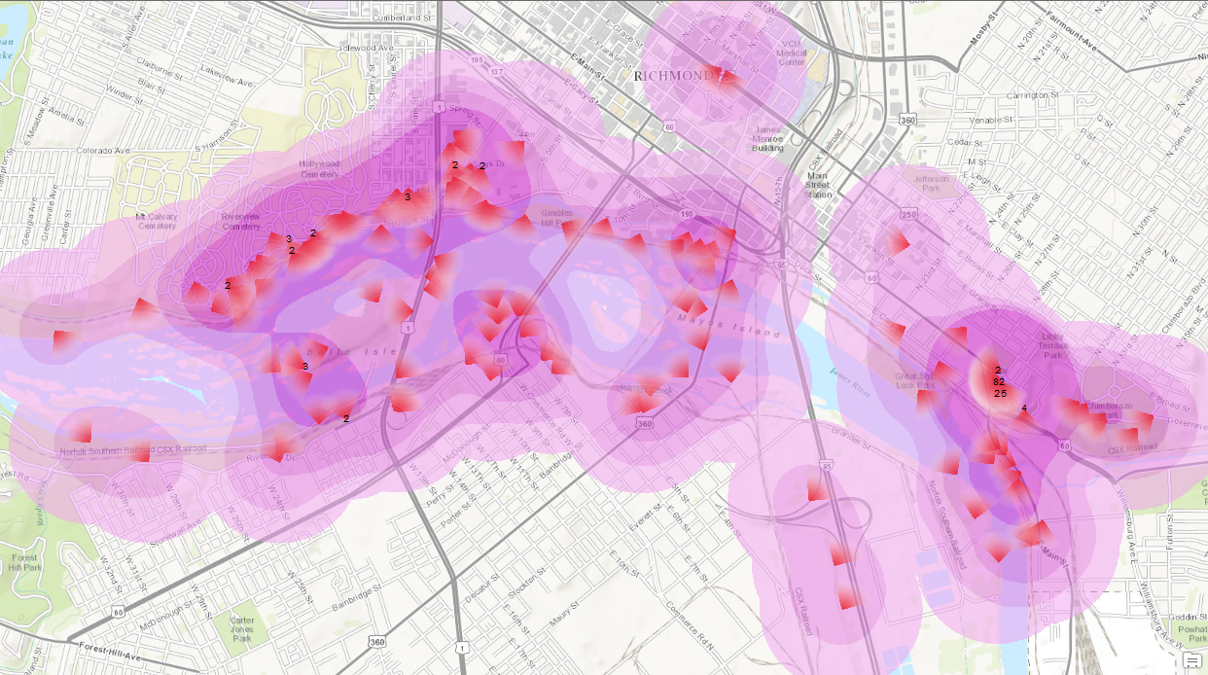
Kernel density of nominated viewpoints

Slide 28
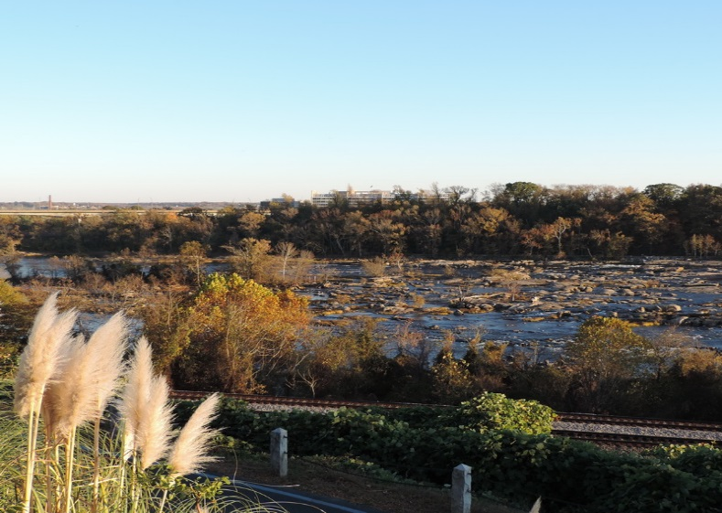
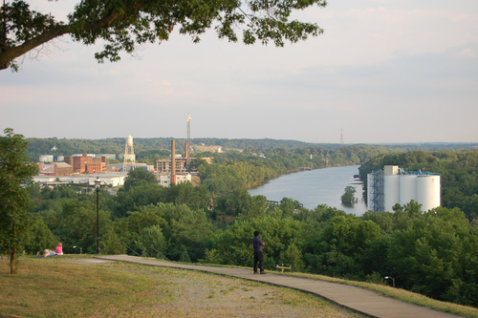
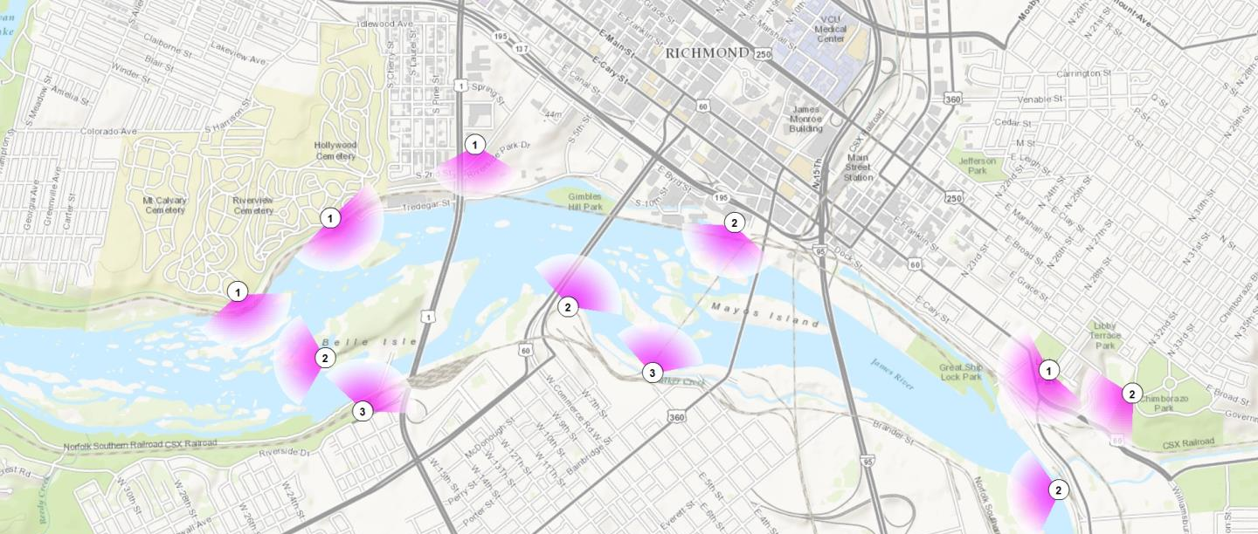
Best river views

Slide 29
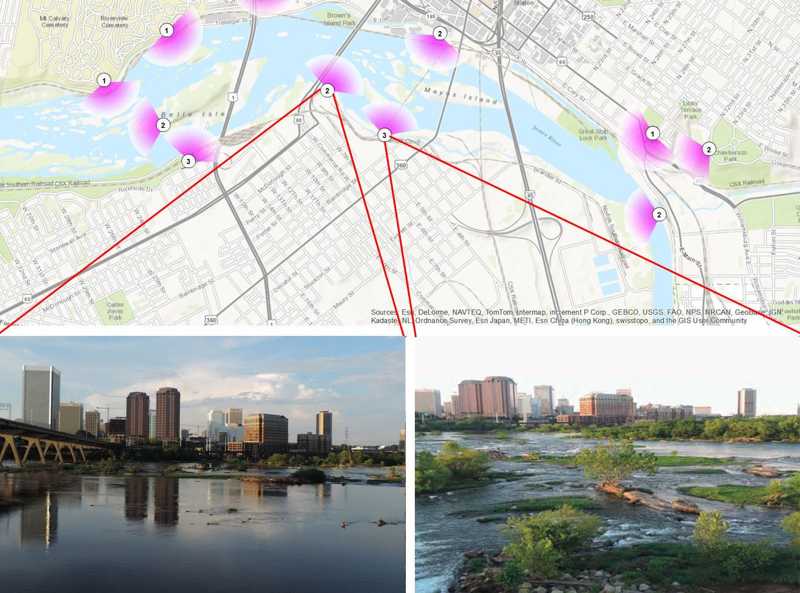


Slide 30
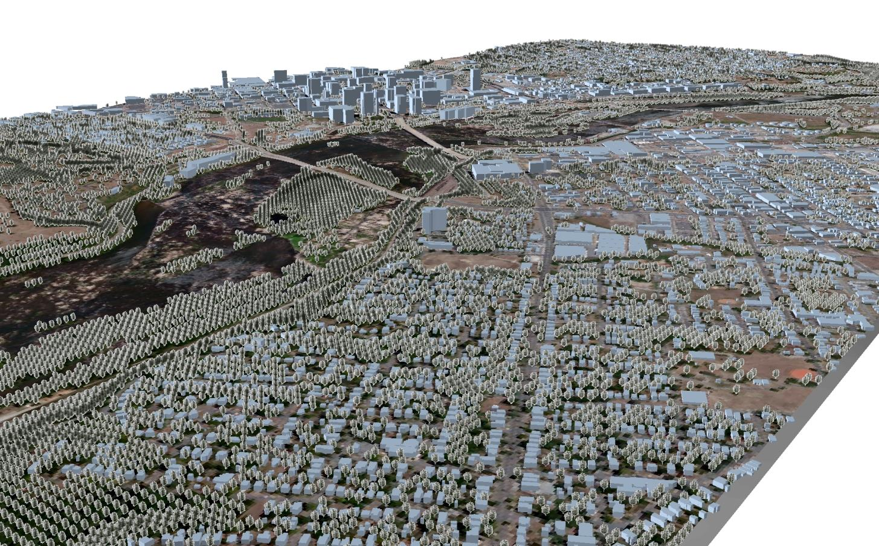
Ground elevation with vegetation heights and building heights

Slide 31
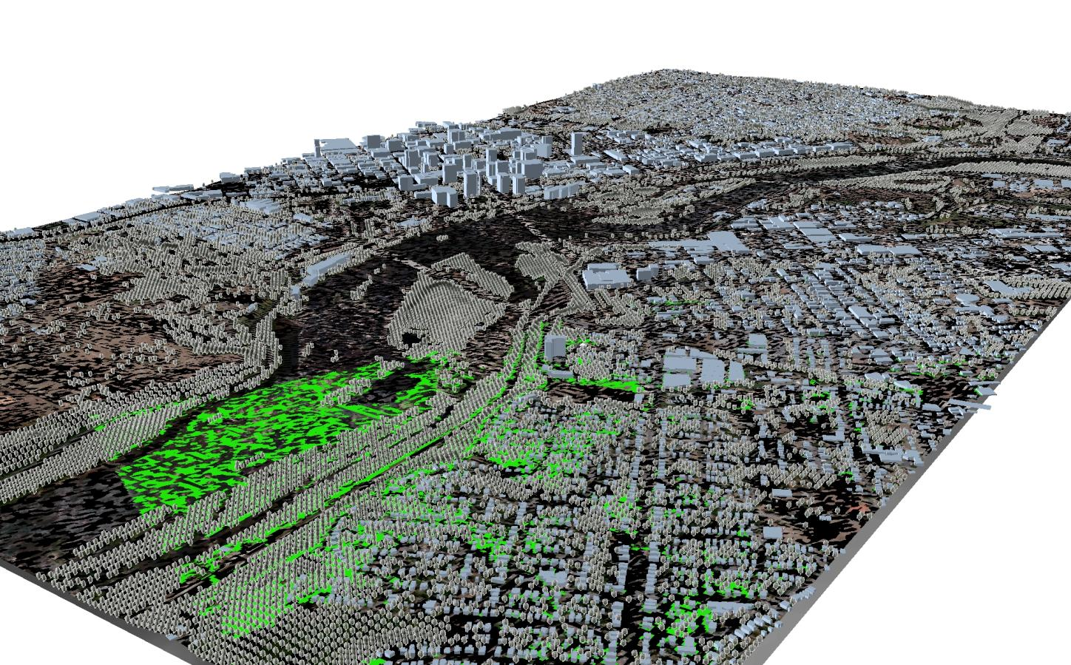
Viewshed mapping

Slide 32
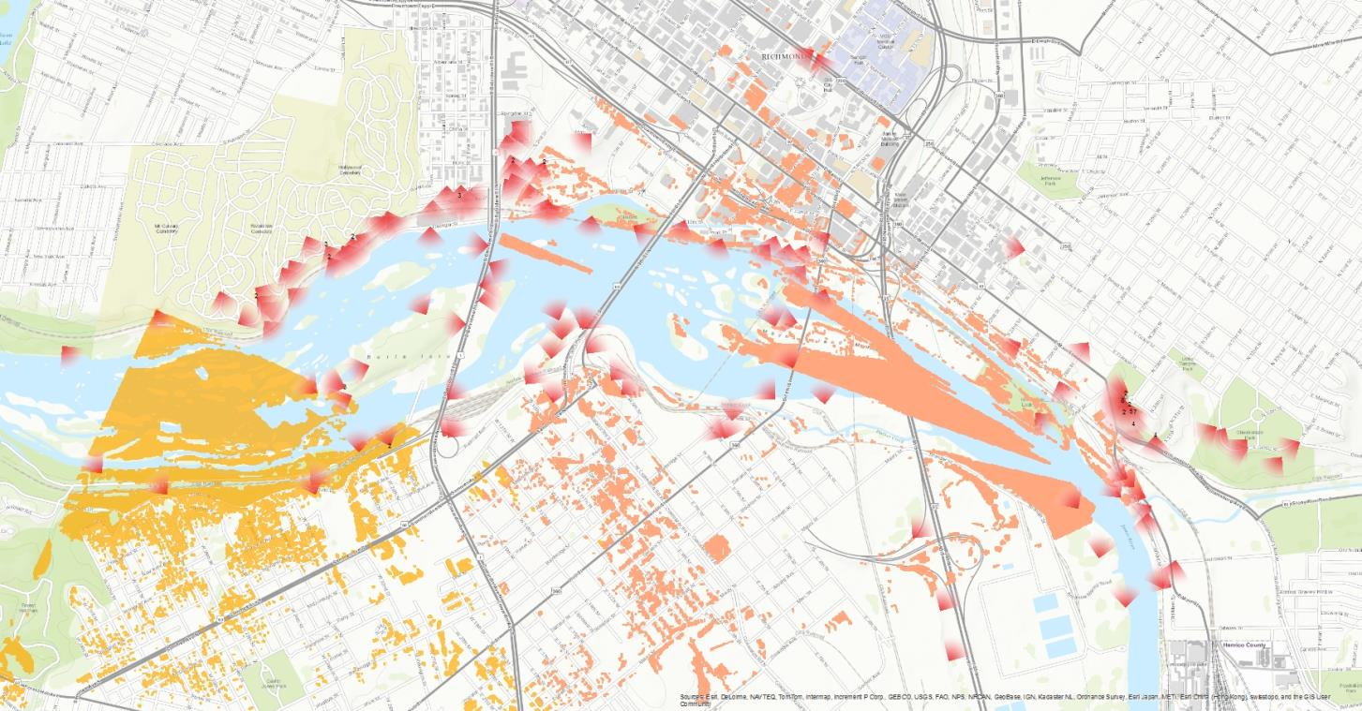
Viewshed mapping

Slide 33
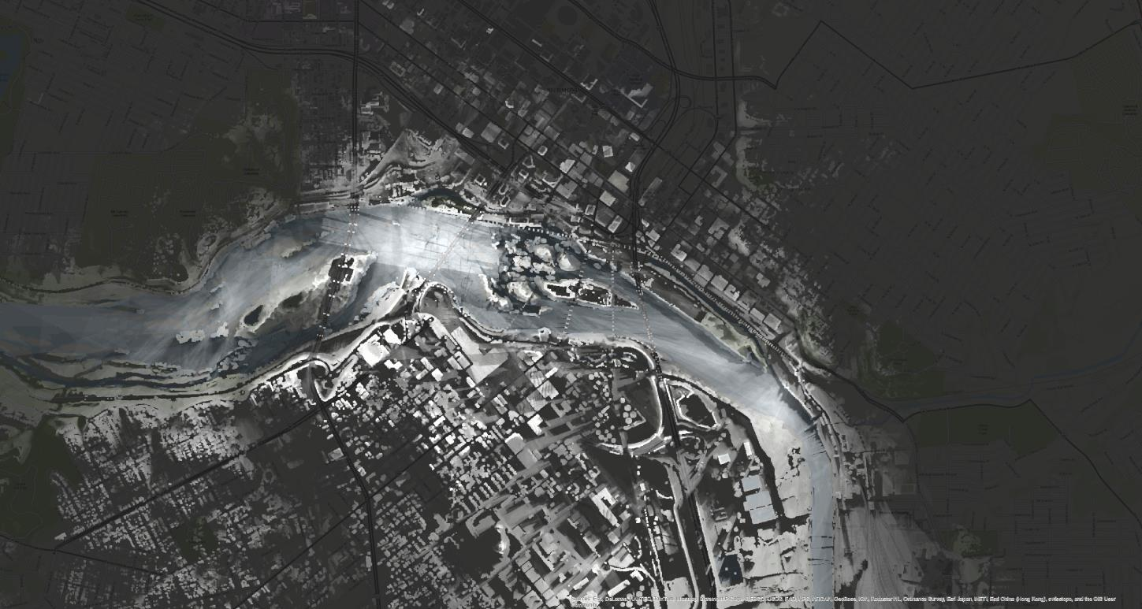
Overlaps of viewsheds of all the nominated viewpoints

Slide 34
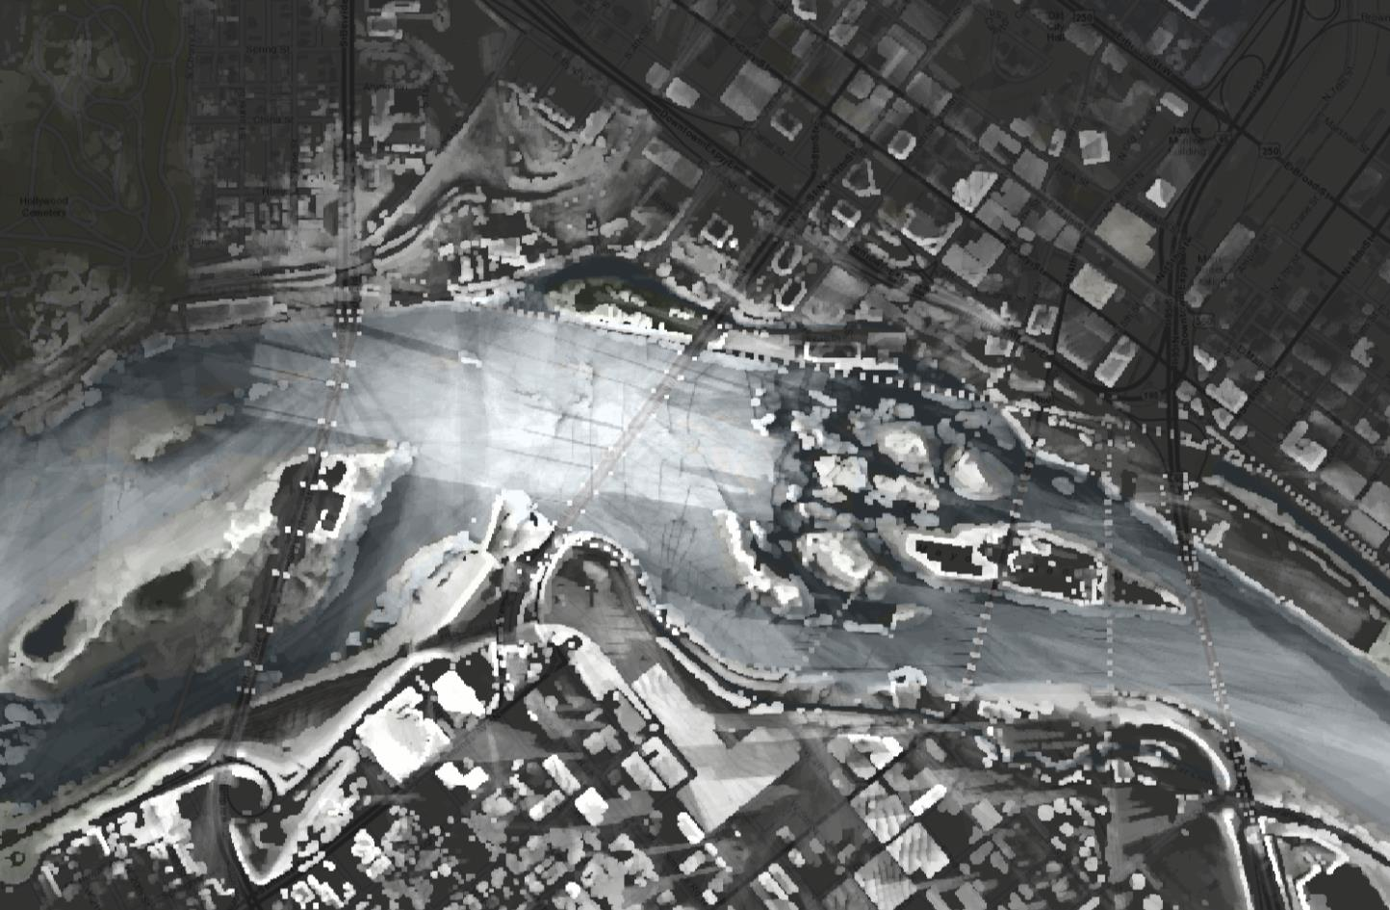

Slide 35
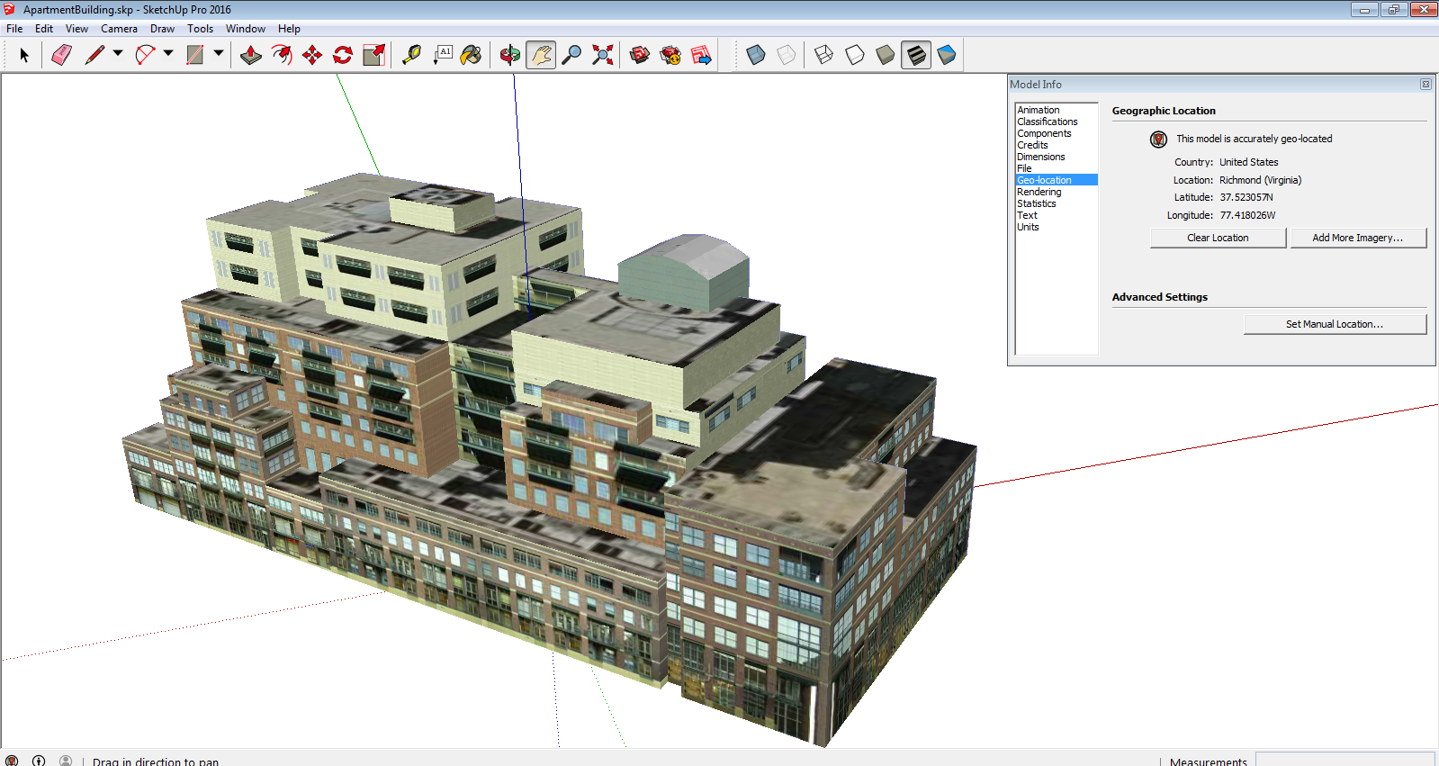

Slide 36
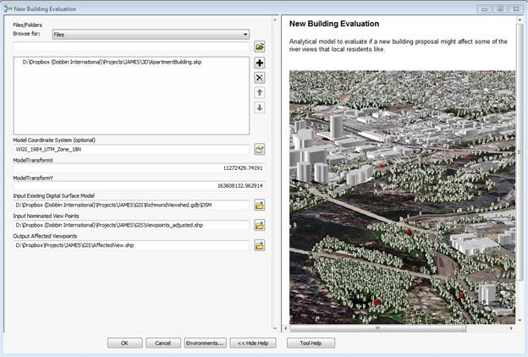

Slide 37
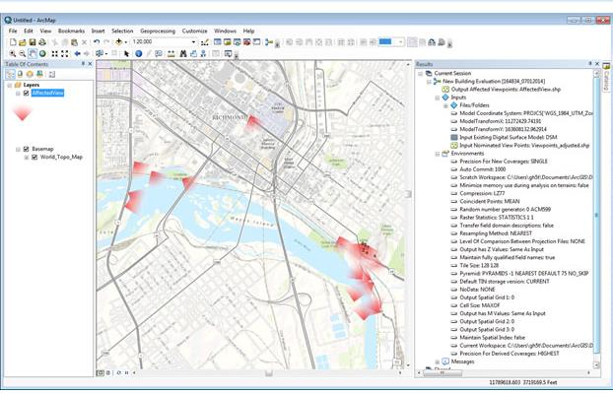

Slide 38
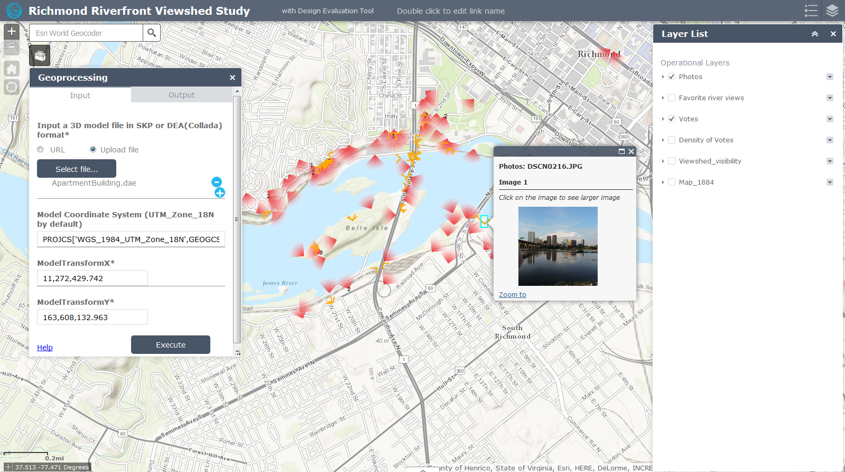
http://uvalibrary.maps.arcgis.com/apps/webappviewer/index.html?id=8c459a14d11b4a76a0c84c7e449d8b31

Slide 39



Slide 40
However, bicycle planning has long suffered from the lack of “systematically documented bicycle traffic data” (Lindsey, 2014).

Slide 41
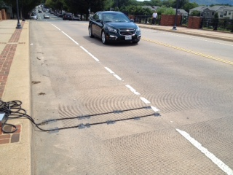

Current Data Collection Method
Counting

Slide 42
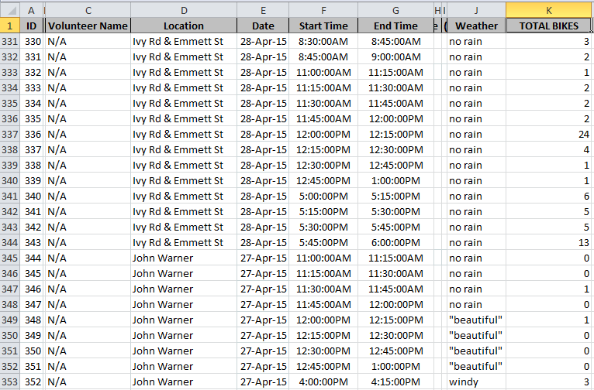

Slide 43
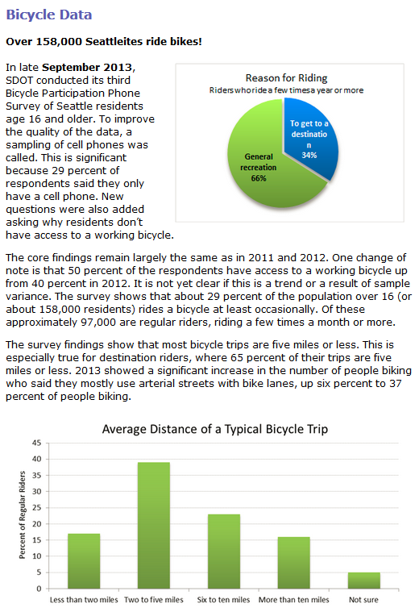
Survey
Seattle, an annual Bicycle Participation Phone Survey is conducted to provide supplementary data.

Slide 44
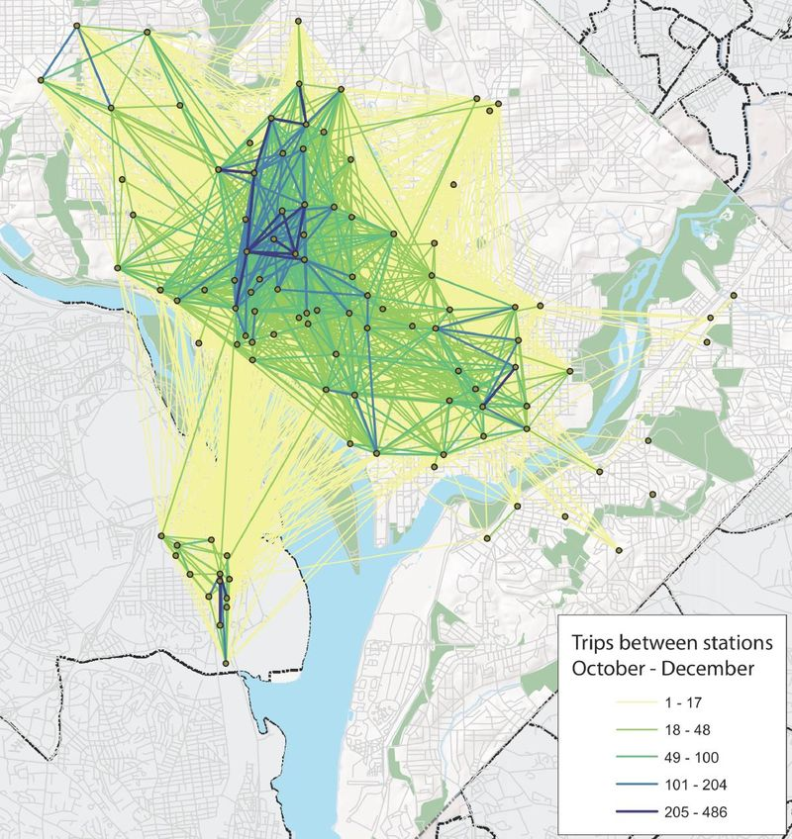
Tracking

Slide 45
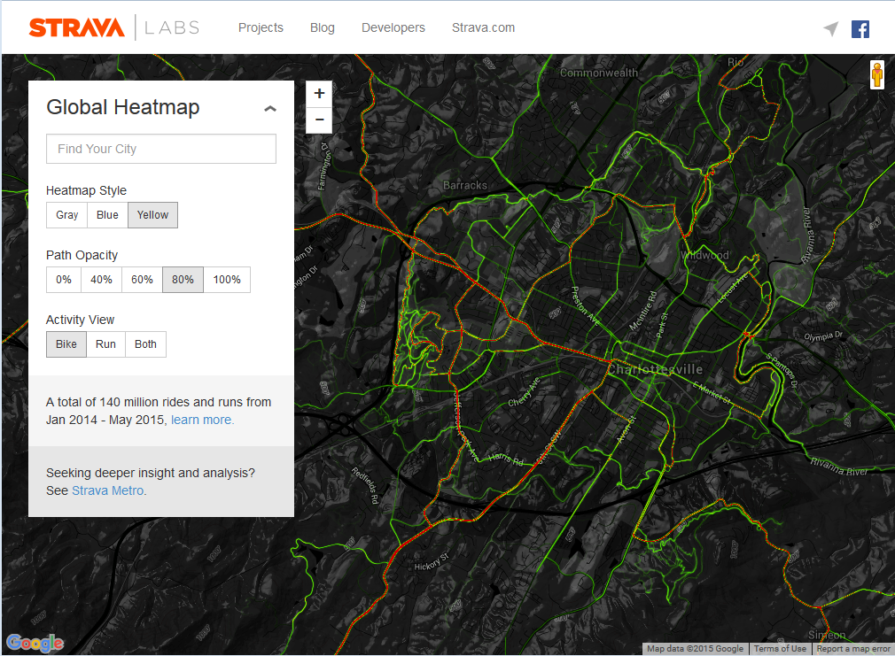

Slide 46
Current Data Collection Method
Problems:
  Labor intensive to collect and organize data
  High cost, and difficult to maintain
  Incomplete coverage
  Heavily relies on volunteers, thus
  Questionable and/or biased data

Slide 47
Census Transportation Planning Product (CTPP)
Is based on systematically documented American Community Survey (ACS), 3 million households every year.
Documents home and work locations, modes of transportation & departure time
Is released every five years at County – Census tract – TAZ (Transportation Analysis Zone) level by American Association of State Highway and Transportation Officials (AASHTO)
Recent release : 2014 (2006-2010 5-year estimates data)

Slide 48
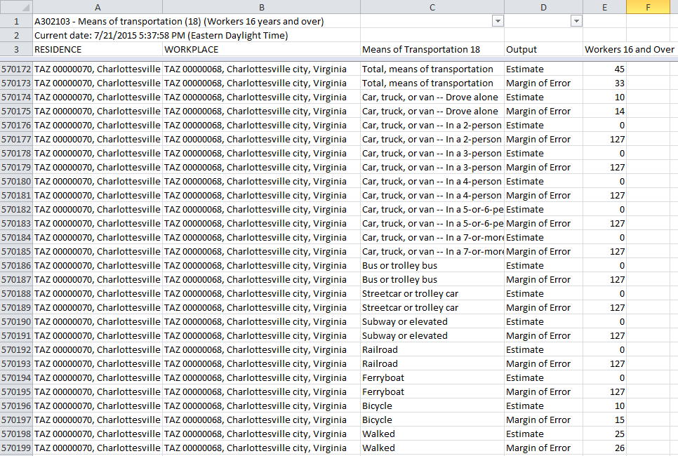

Slide 49
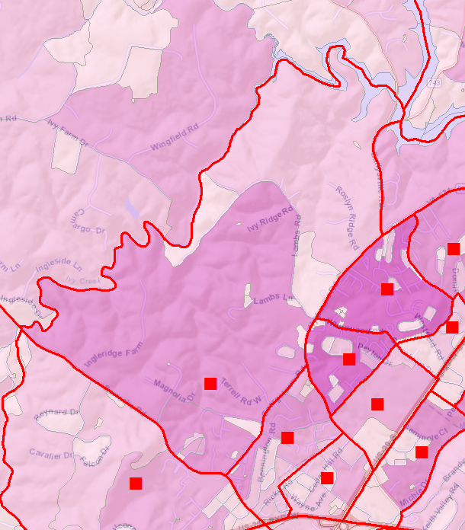
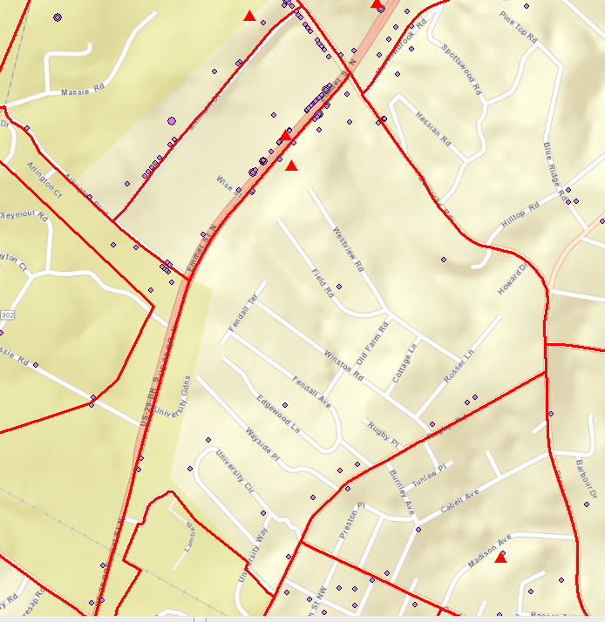
Assignment of Origin and Destination Points

Slide 50

CTPP:
TAZ 5154000000055
10 origins
45 destinations
O: Population (age 15>65) weighted random points
D: Employment weighted random points

Slide 51
Model Commuting Routes with GIS
Code the roads by distance and travel time, plus
Energy Consumption
  Etotal = Eh + Ev
    BICYCLING SCIENCE, by Frank Rowland Whitt et al, The MIT Press Cambridge, 1985
Safety Concern
  Type of bike lane
  Speed
  Intersection
  Bikeability
  Includes all above

Slide 52

Safety: 20’ x 1.2
Energy: 20’ x 0 Calories/ft
Time: 20’ / 18mph
Bikeability: 20’ x (1.2 x 1x 1)
Safety: 20’ x 1.3
Energy: 20’ x 0.00436 Calories/ft
Time: 20’ / 15mph
Bikeability: 20’ x (1.3 x 1.05 x 1.05)
Safety: 20’ x 1
Energy: 20’ x 0.00436 Calories/ft + 1’ x 0.3048 Calories/ft
Time: 20’ / 10mph
Bikeability: 20’ x (1.1 x 1.2 x 1.1)
Safety: 20’ x 1.1
Energy: 20’ x 0.00436 Calories/ft
Time: 20’ x /15mph
Bikeability: 20’ x (1.1 x 1.05 x 1.05)

Slide 53



Energy
Safety
Bikeability

Slide 54

Routing by Time
Routing by Time or Energy

Slide 55

Routing by Safety or Bikeability

Slide 56


Slide 57


Slide 58


Slide 59
201504

Slide 60
201510

Slide 61

Mozambique Systematic Country Diagnostic (Draft), World Bank

Slide 62

Dasymetric model of poverty headcount

Slide 63


Deforestation of the Lichinga Plateau (1990-2010)
In general, forest lands closer to the City of Lichinga were more likely to be converted.
Forest lands around Muembe also experienced significant pressure. Forest Change Detection Composite (1990-2010)

Slide 64

Agriculture Suitability Analysis
Agriculture Spatial Analysis:
Statistics
    Net Potential Agriculture Land in Hectares (by Suitability Ranking)
      Low: 884
      Med: 89,209
      High: 597,268
    Net Existing Agriculture Land in Hectares (by Suitability Ranking):
      Low: 8
      Med: 17,636
      High: 175,552
Preliminary Scenario
  A mixture of commercial agriculture production in areas of low population density with subsistence agriculture closer to villages and the city center
  Conversion of natural vegetation/landscapes to agriculture should be avoided

Slide 65

District Growth Poles, Nodes, Corridors
Notes:
GROWTH NODE MAP #1

Slide 67


Slide 69


Slide 70

Adapted from 2009 ASLA Professional Analyis & Planning Honor Award. Urban Corridor Planning, City of Houston / The Planning Partnership

Slide 71

Adapted from 2009 ASLA Professional Analysis & Planning Honor Award. Urban Corridor Planning, City of Houston / The Planning Partnership

