Slide 1
Big Data, Geospatial Computing, and My 2 Cents in an Open Data Economy
Presented at
IACS Seminar Series and Geography Colloquium
Budhendra Bhaduri
Corporate Research Fellow
Director, Oak Ridge Urban Dynamics Institute
April 10, 2015
Cambridge, MA

Slide 2
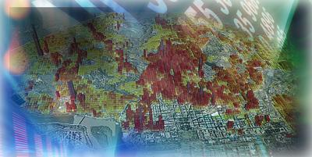
How I plan to waste your next hour
Background
  About us
  Geography and the “Big” issue
Recent progress in data analysis
  Few examples
Data democratization
  Crowdsourcing and citizen science
  Me and my data
Challenges and future possibilities
Disclaimer
  Many pictures are shamelessly borrowed from the Internet

Slide 3
Geographic Information Science & Technology
High Resolution Population and Social Dynamics
Geographic Pattern Recognition
Population-Infrastructure Dependency
Demographic Analysis
Geographic Data Sciences
Spatiotemporal data mining and uncertainty analysis
Machine learning and pattern recognition
Participatory sensing and volunteered geographic information
Geocomputation and Visualization
High performance geocomputation
Scalable visualization
Emerging architectures
Disciplines
Geography, Anthropology
Computer Science and Computer Engineering
Electrical Engineering
Geosciences
Civil and Environmental Engineering
Industrial and Information Engineering
Applied mathematics, Chemistry, Statistics
An interdisciplinary group of 65+ researchers
Fostering advances in the nexus of GIScience and computing
One of the oldest GIScience R&D groups and uniquely focused within DOE

Slide 4
Geographic data has driven innovation
1790
First US Census. 3.9 million people counted.
1810
1850
Census collects data on manufacturing, quantity, and value of products.
Census collects data on taxation, churches, pauperism, and crime.
1890
1896
Punched-card tabulating machines are used to count 63 million people.
Tabulating Machine Company (TMC) formed.
1911
1924
TMC becomes C-T-R (Computing-Tabulating-Recording) Company.
C-T-R becomes International Business Machines (IBM) Corporation.
1963
1969
First use of the phrase “geographic information system”.
First commercial GIS software companies formed.
1972
1985
NASA launches first earth observation satellite (Landsat 1).
First GPS satellite launched.
2001
2004
Keyhole Corp. creates dynamic 3D mapping of geographic information.
Google Earth initiates the “Web Wide World” and visual discovery.
20??
Intelligent Locational Awareness: Real time access to multidimensional
information of locations, states, and environments of entities.

Slide 5
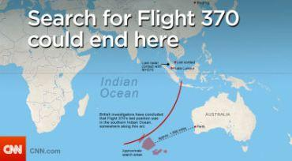
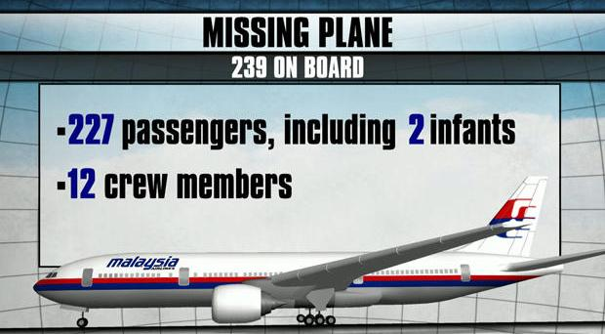

Slide 6

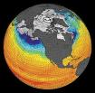

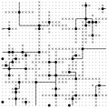

Evolving diverse, dynamic world of data
  Experiments
  Simulations
  Archives
  Sensors
  Social Media
Government
NASA
NOAA
Private
Industry
NGO
Citizens
Citizen scientists
Crowdsourcing
USGS
…
Foundations
…
...
Academia
University
Colleges
K-12
Multimodal, Multiresolution, and Multisource
Social Media
LiDAR
Text
Images
Sensors
Video
Moving towards a community data ecosystem

Slide 7
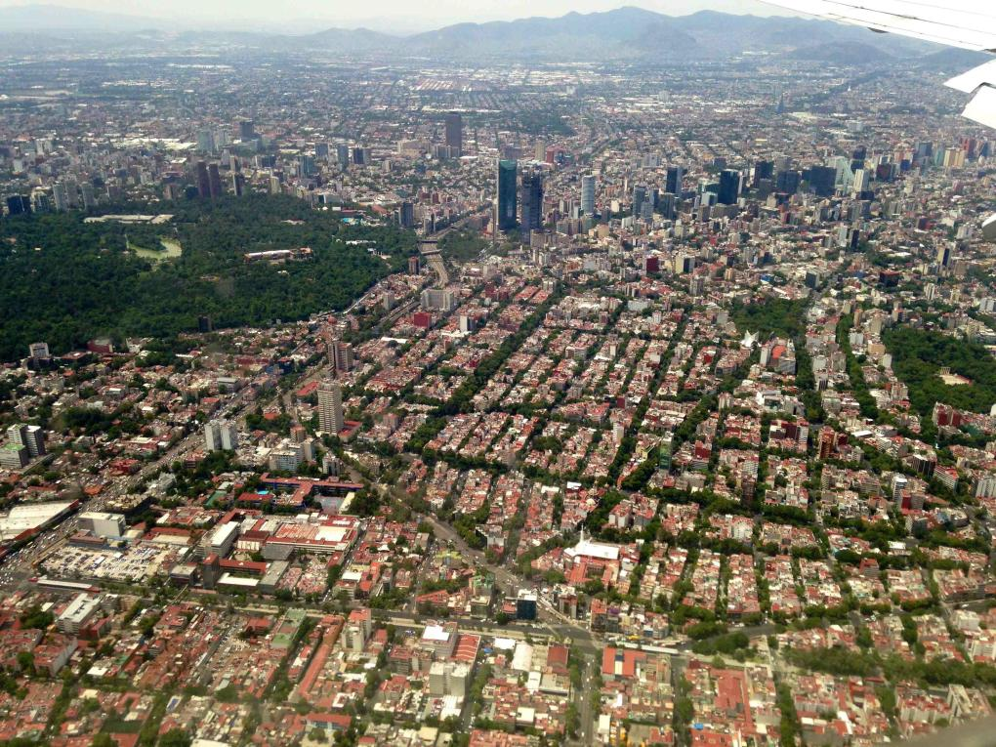

In the Garden of Big and Evil
Our interests focus on two questions:
  Why that happens (descriptive)?
  What might happen (predictive)?
Big Data analytics must provide a clear ROI or value proposition
  A better answer (new knowledge)
  A quicker answer or savings in time/energy/money
  Enable individuals through organizations
More data doesn’t always provide a better answer
  Applications are often time sensitive
  Applications tuned with small data
Big Urban Data
  Data of urban environments that are generated because of our increasing ability to observe, sense, and measure
Urban Big Data
  Data generated by urban modeling and simulation with increasing computational capacity
  ITC based access to transactional “small” data
  New form of data from social media generated by urban crowd

Slide 8
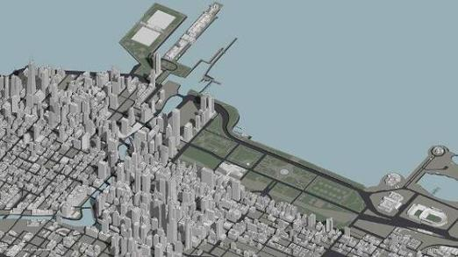
Our energy challenges and solutions are often local to regional
Energy savings potential is a macro-level (regional to national) phenomenon driven by individual socioeconomic behavior at the micro-level (local)
Useful insights will come
from characterizing interactions among
human, energy, and transportation networks
Success of future strategies depends on understanding complexity and consequences of proposed systems in which energy, environment and mobility interests are simultaneously optimized
Homes
Gas stations
(regional)
Work
Shop
Banks
(state)
Gas stations
(regional)
Cleaners
Homes
Schools

Slide 9
Disparate data integration improving knowledge of population distribution and dynamics
LandScan Global
Ambient population (average of 24 hours)
Remote sensing based global data modeling and mapping
LandScan USA
Nighttime and daytime population
Spatial resolution of 30 arc seconds (~1km)
Spatial resolution of 3 arc seconds (~90m) coverage for the United States
Integration of infrastructure and activity databases
LandScan HD (ongoing development)
Spatial resolution of 3 arc seconds (~90m) global coverage
Ambient population (average of 24 hours); Nighttime and daytime population where adequate land use data is available
Settlement mapping from very high resolution imagery (1m or less)
Integration of population density and activity databases

Slide 10
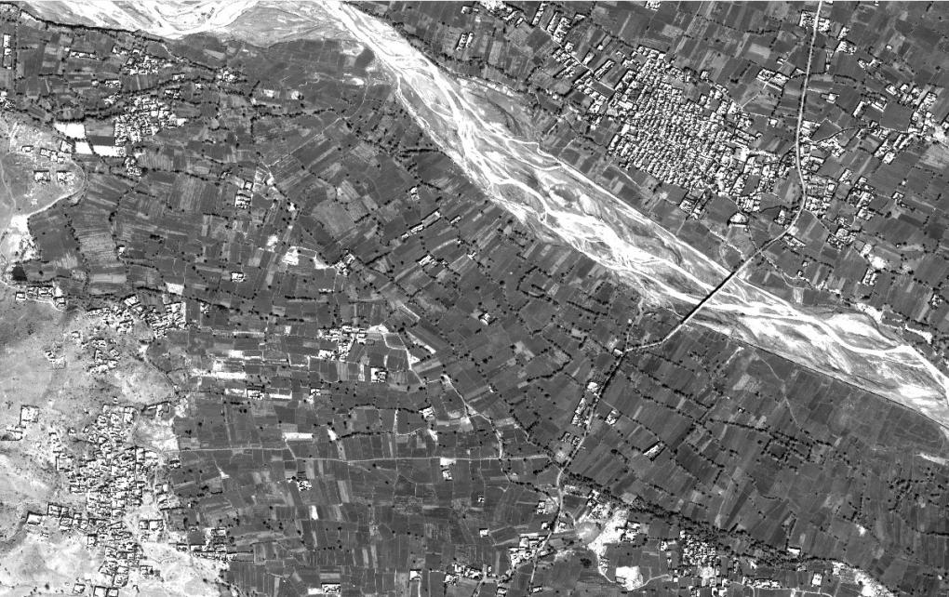
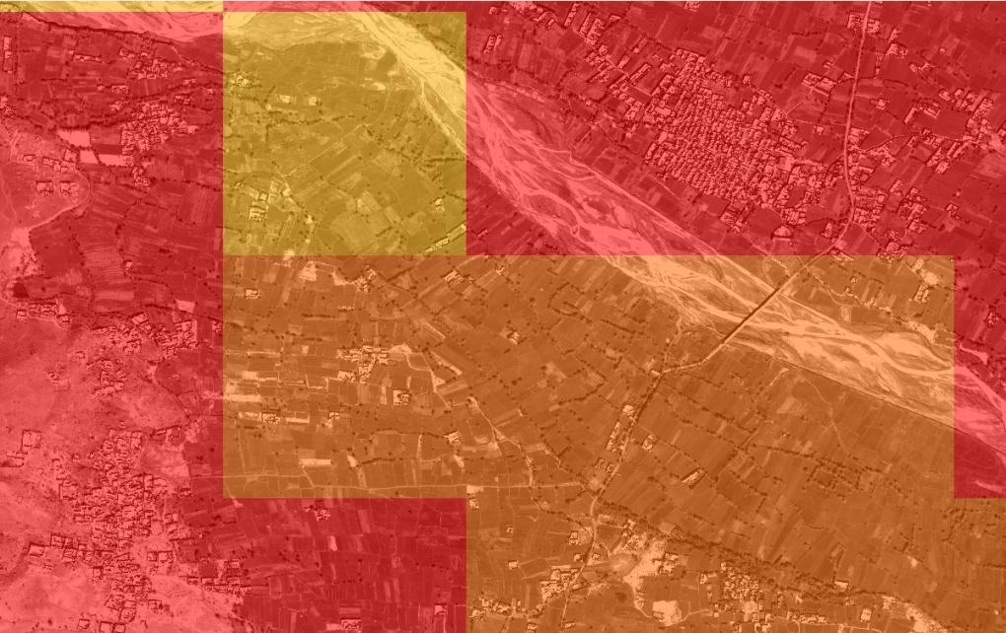
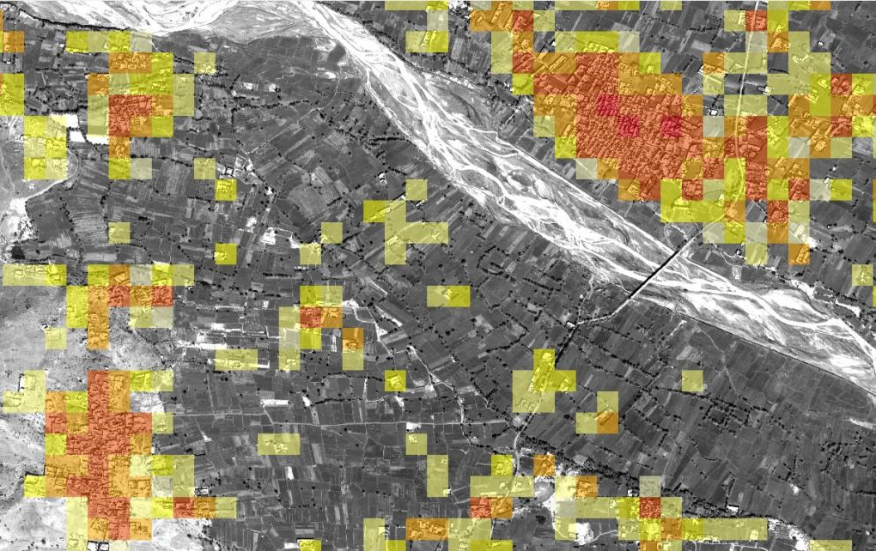
Spatial refinement of LandScan Global

Slide 11
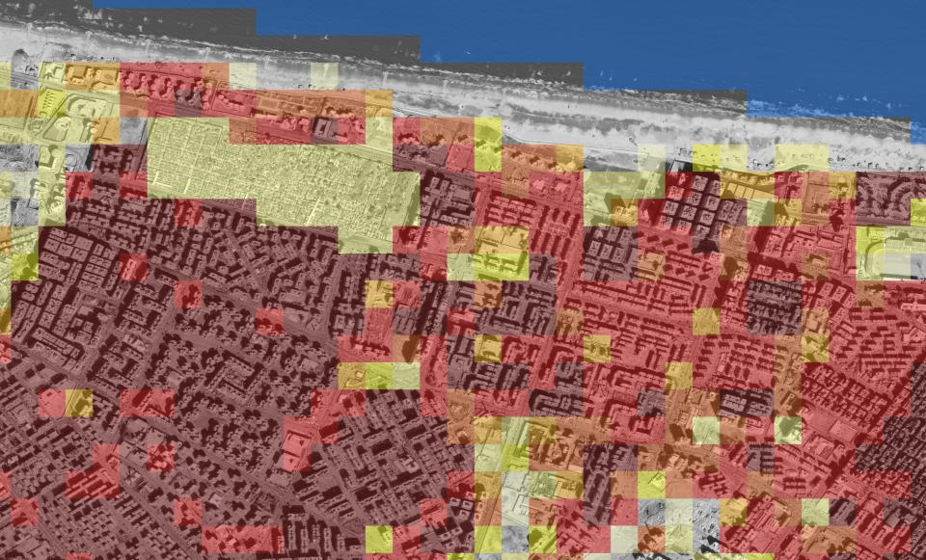
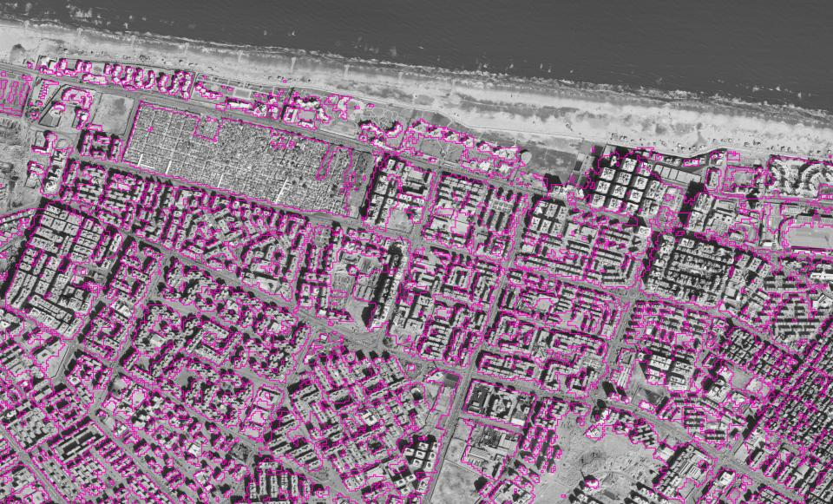
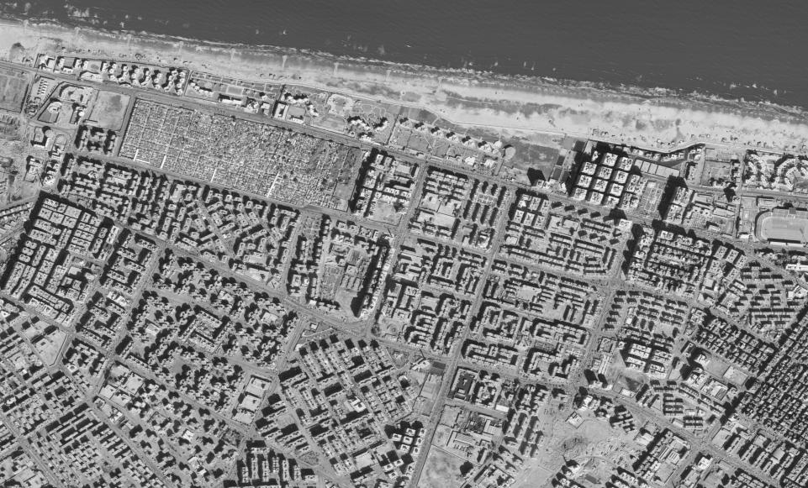
Port Said

Slide 12
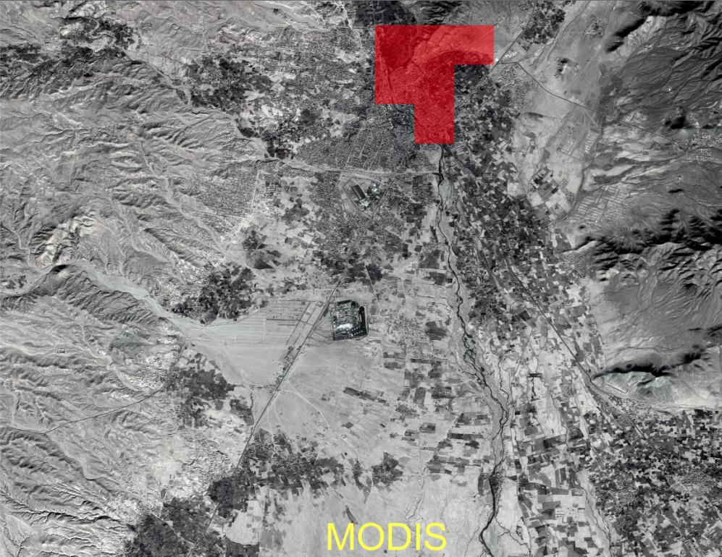
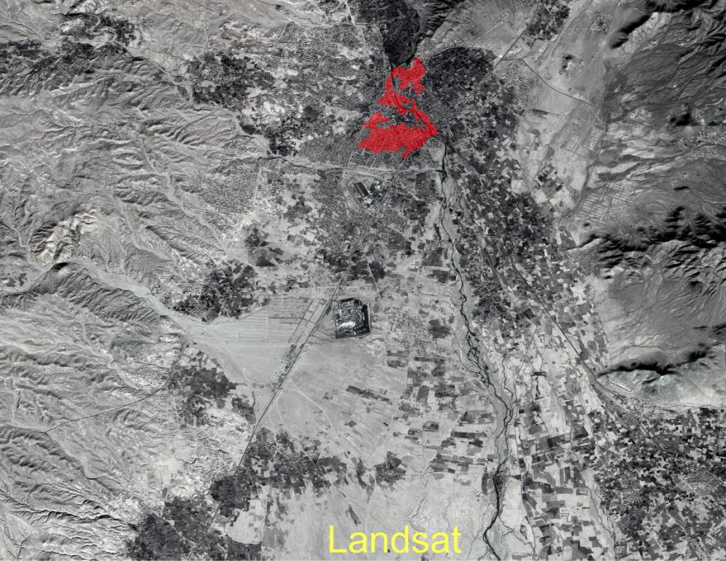
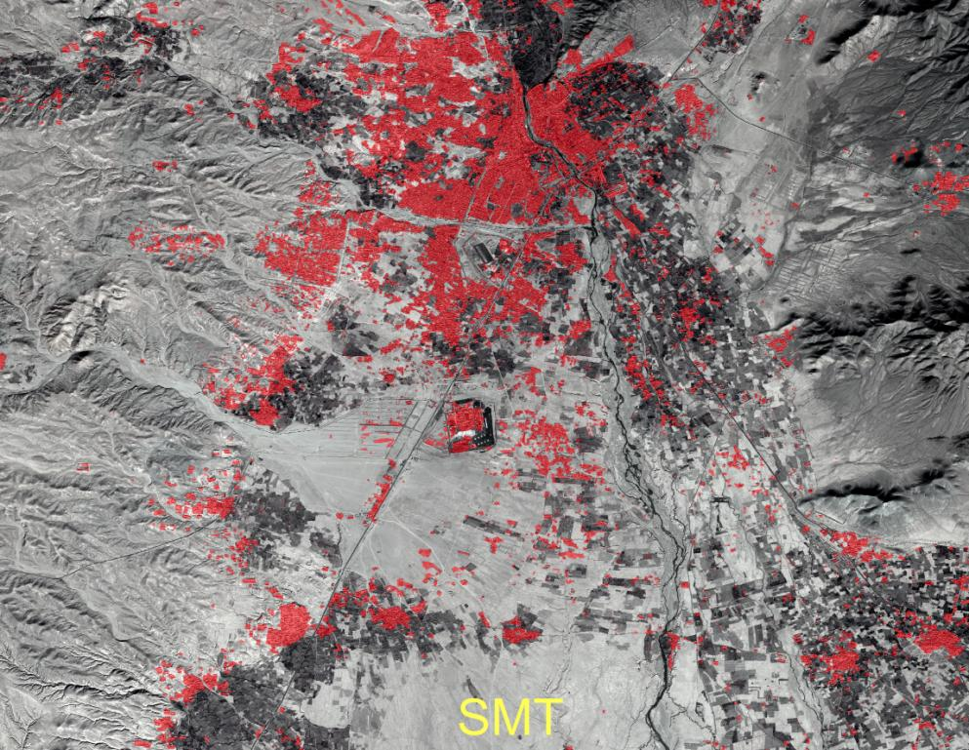
“Developed Land Cover” Examples
Notes:
MODIS 1 KM
Landsat 30m
SMT-16 meters

Slide 13
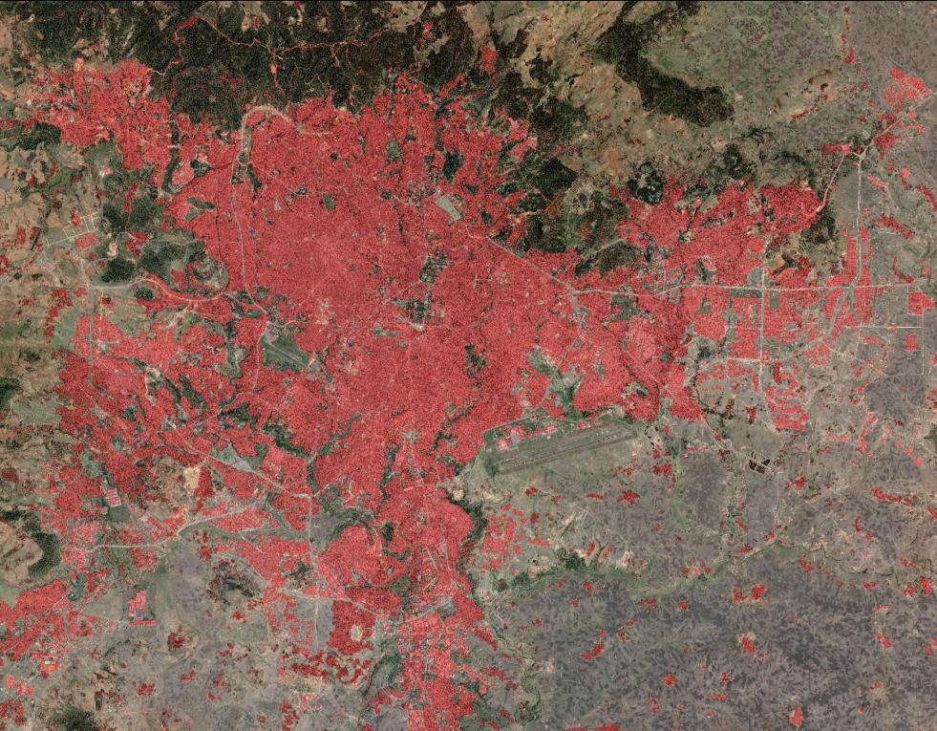
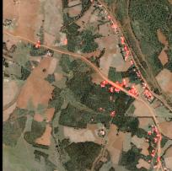
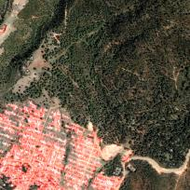
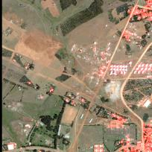
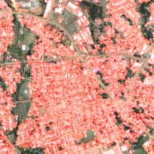
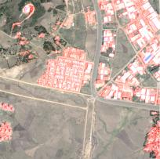
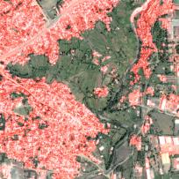
Addis Ababa, Ethiopia
Image analyzed (0.6m)
  40,000x40,000 pixels (800 sq. km)
  RGB bands
Overall accuracy 93%
  Settlement class 89%
  Non-settlement class 94%
Total processing time
  15 seconds

Slide 14
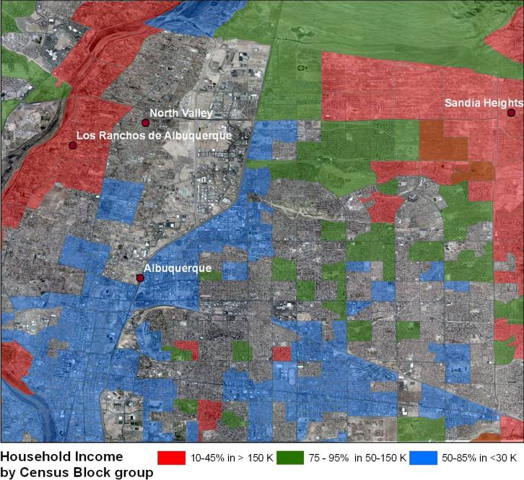
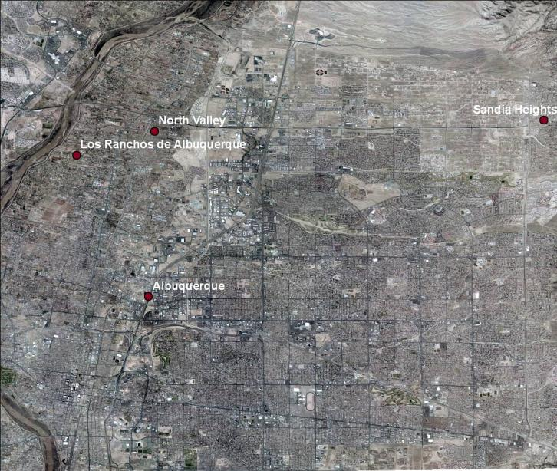
Settlements are economic indicators
Notes:
These graphics show the high resolution images and
A categorized income map based on census data.
I have used the block groups
With 25 % or greater number of households with 150K or more household income as rich neighborhood.
With 75-95 % of the households with 30-150 K household as middle income.
With 50 -60% of households with less than 30K household income as poor neighborhood.
These particular breaks were chosen form the data to show the distinct pattern in the images in one scene. Other break points had overlap and were tough to put on visualization.

Slide 15
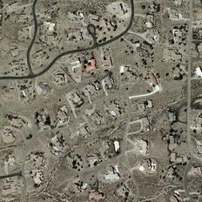
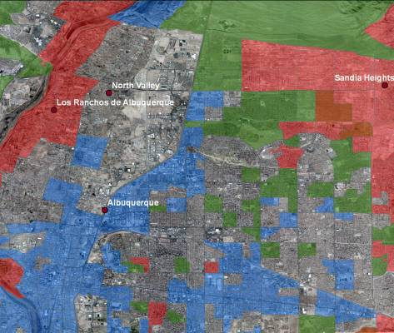
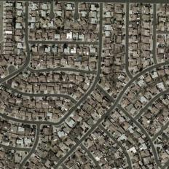
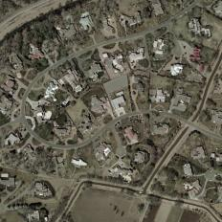
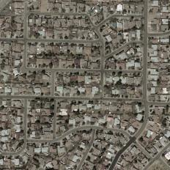
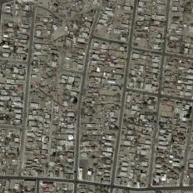
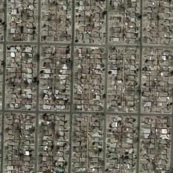
Patterns in overhead imagery
Higher Income
Middle Income
Lower Income
Notes:
These graphics show visually distinct pattem between rich and middle income neighborhood for Albuquerque area.

Slide 16
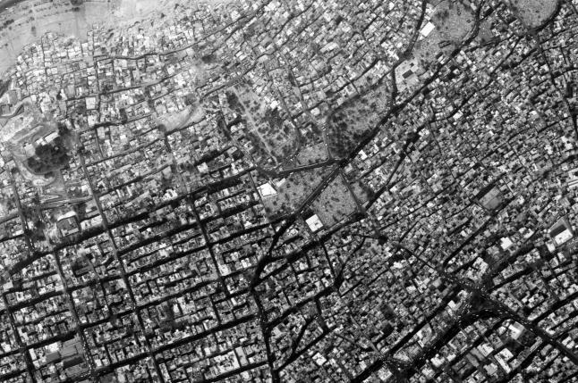
Edge Orientation Distribution
Unplanned Settlement
Probability
Edge Orientations
Planned Settlement
Probability
Peakness in the distribution around edge orientations separated by 90 degrees is a good indicator for planned settlements.
Edge Orientations

Slide 17

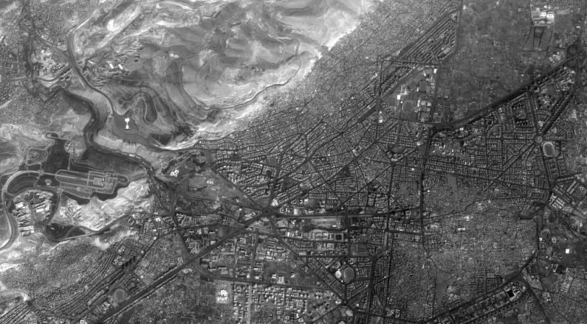
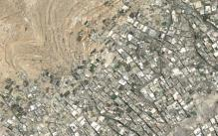
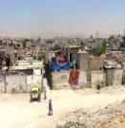
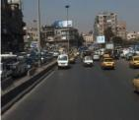
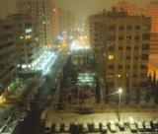


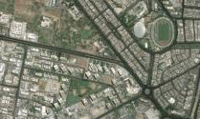
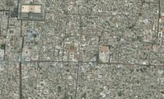
Neighborhood mapping: From local interactions to global realizations
Unstructured Settlements
Lowest to lower middle income
Rural migrants
Very loosely structured
Historical ethnic quarters/neighborhoods
Poor residents currently being displaced in some areas with urban development/tourism
Damascus, Syria
Formal Urban Planning
Typical Urban Services
Middle to Upper Income

Slide 18
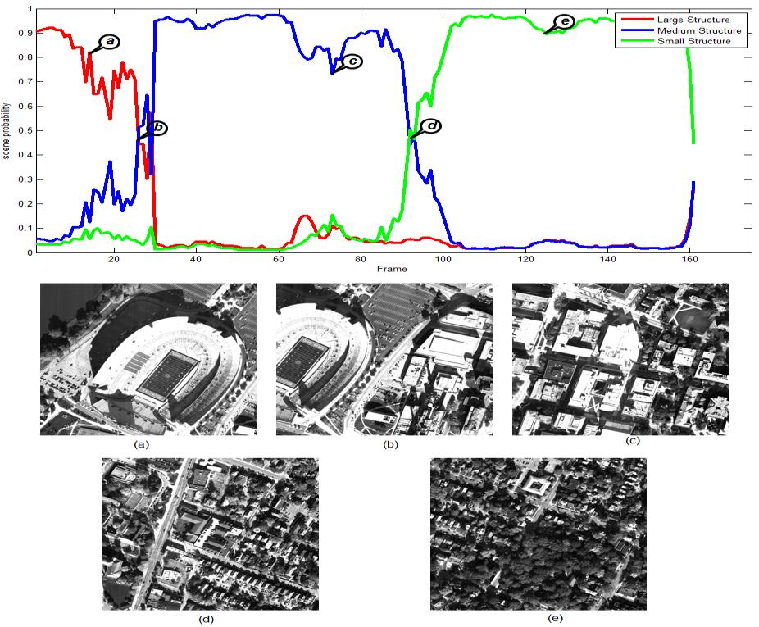
Rapid Scene Analysis
Play uavrun1output.avi

Slide 19

Population density data from open source
Population/1000 ft²
55 facility categories in 8 land use classes
Documented data sources and methodology with traceable provenance
Open source collection from reputed sources
  Academic journals, official government statistics, corporate and university webpages, tourism brochures.
  Utilizing other sources such as GeoCommunity, Wikipedia, Panoramia, and Wikimapia.
http://extranet.ornl.gov/pdt

Slide 20
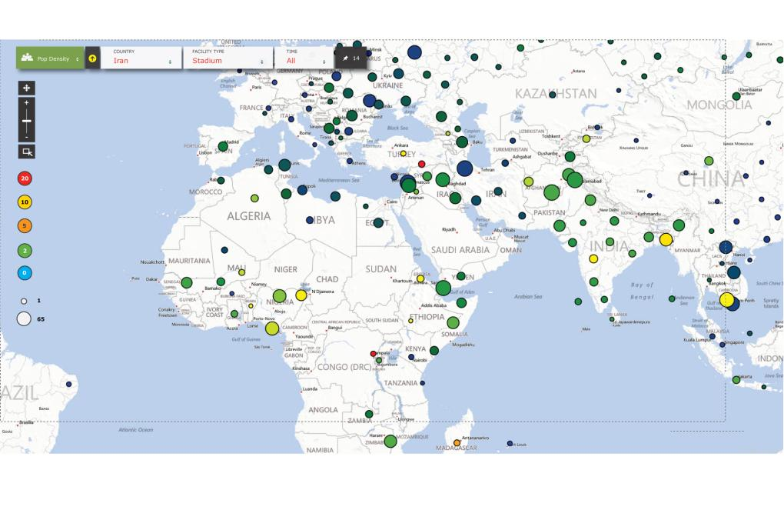
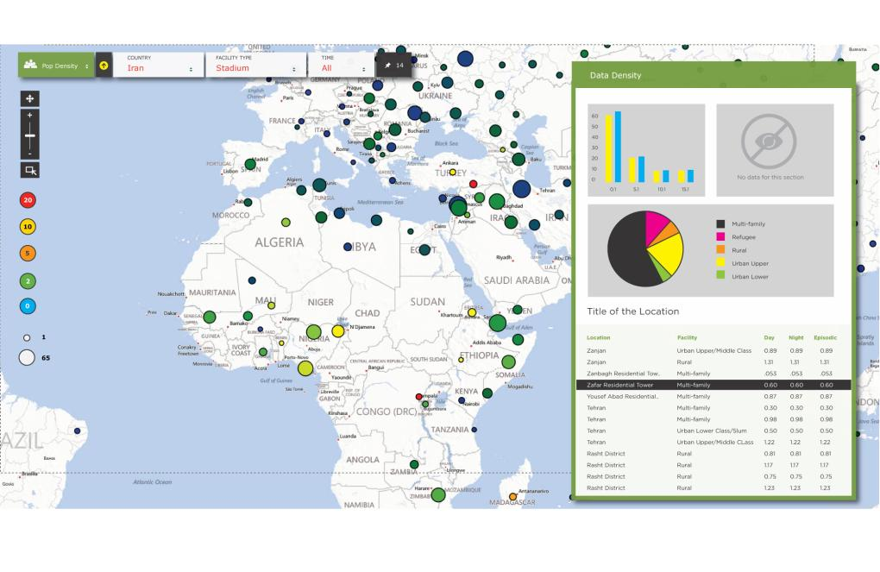
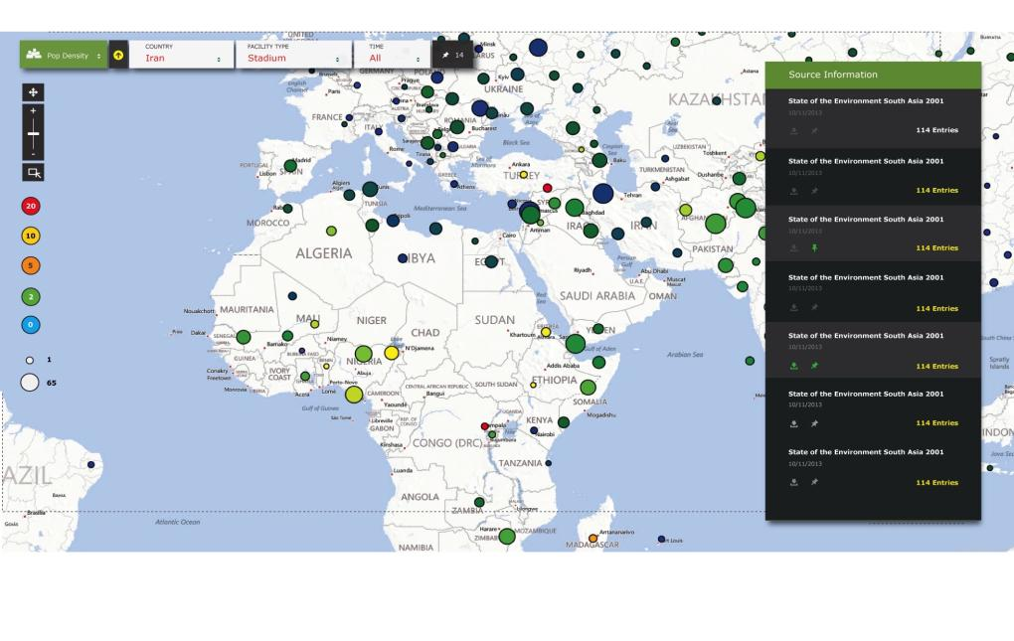
Retaining data provenance is critical

Slide 21
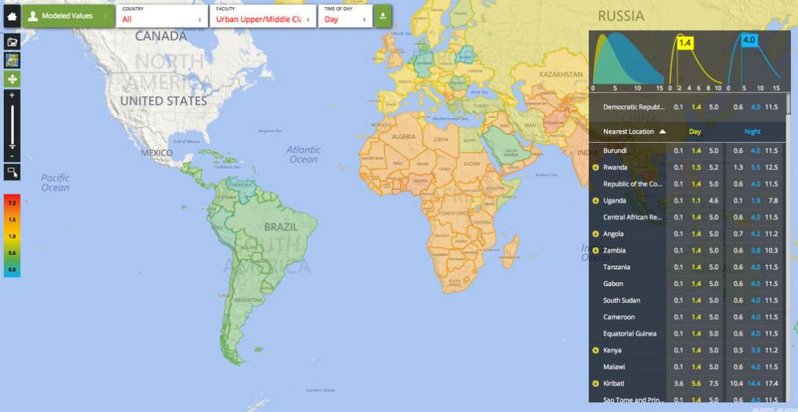
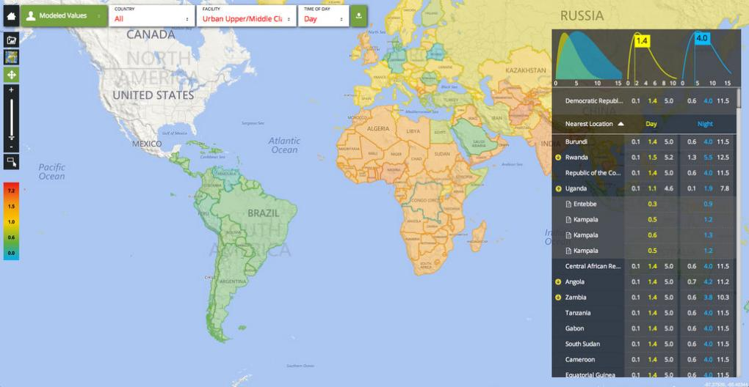
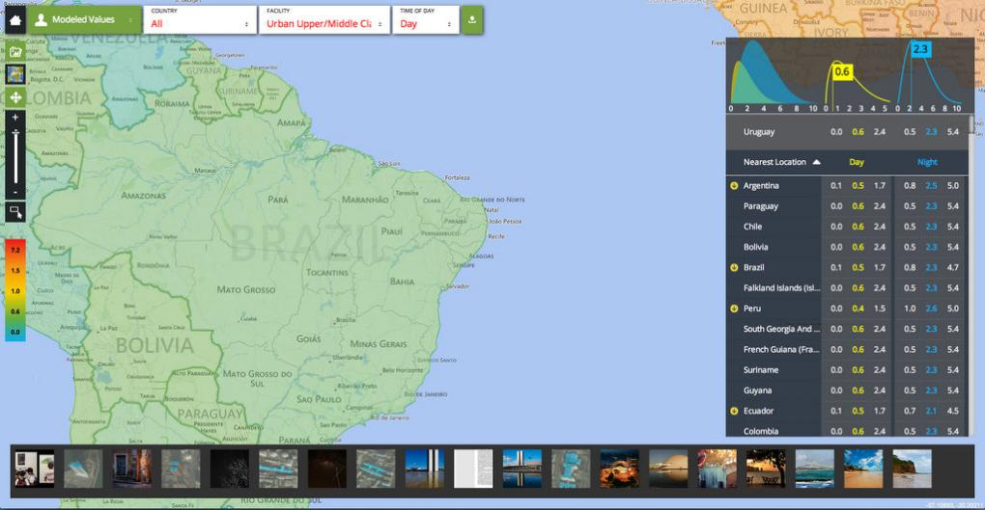
PDT includes modeled and other data
Bayesian approach provides modeled data for areas where observation based data is unavailable
Notes:
The first shows the global coverage that the Bayesian approach provides. The charts and data will update as you explore the map.
The second image shows pop density data that has supporting reports that help refine the Bayesian curve.
Finally, we have done an initial integration with Flickr. There are some issue with pulling relevant photos from their API, but we have also filled in some pictures from within PDT itself to provide better material. We are exploring other sources for these types of photos that might be relevant.
Eddie also had an interesting idea where we could explore applying the overhead statistics work to images as they come in to find buildings. This would be an interesting challenge and one we will explore as we move forward.

Slide 22
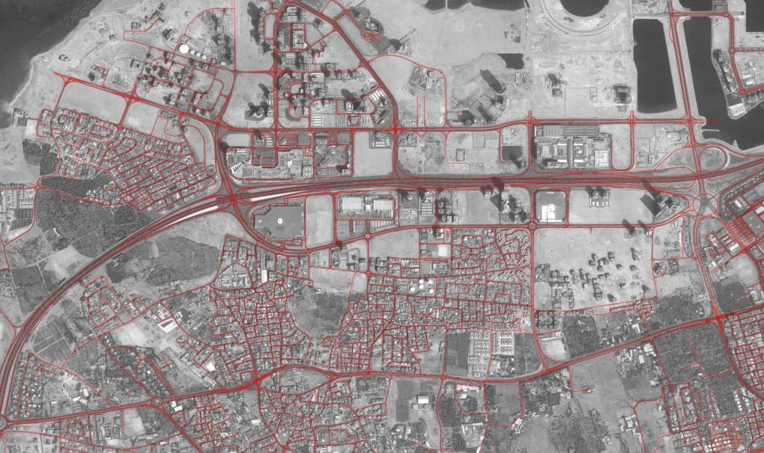
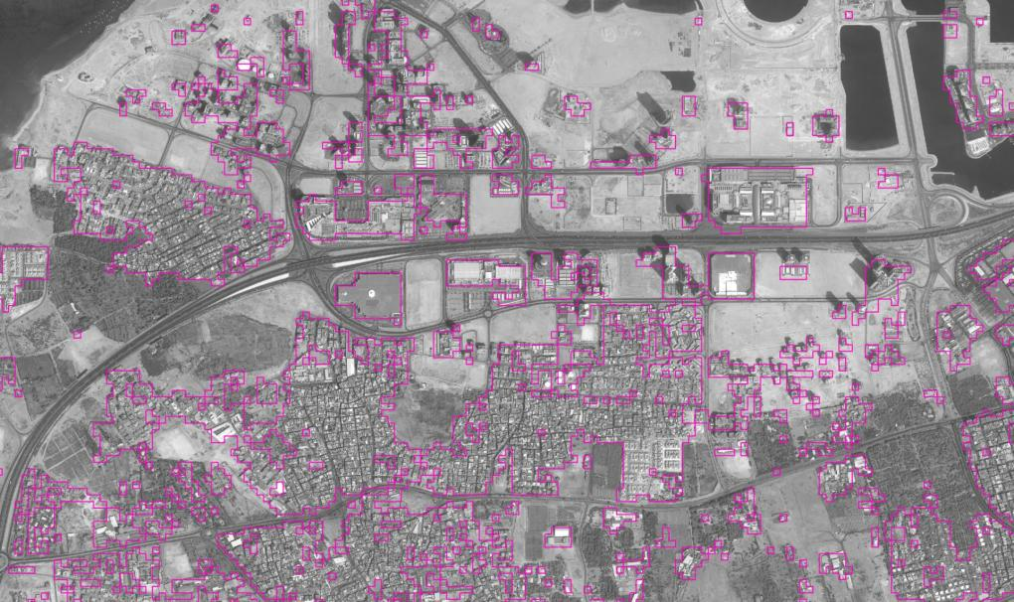
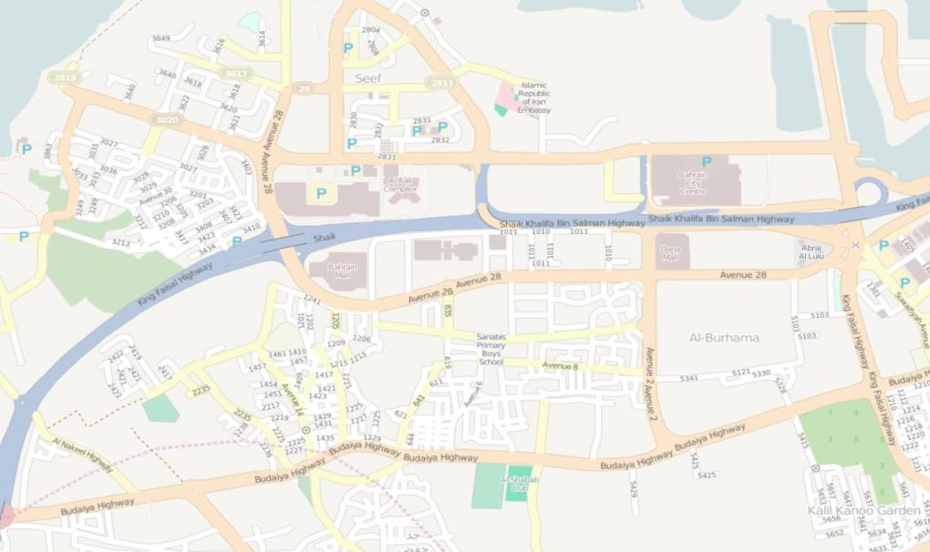






Example: LandScan HD data for Bahrain
Nighttime
Daytime
Ambient

Slide 23

Critical infrastructure data development
We develop and maintain spatially enabled, foundation level data for a number of critical infrastructures for research and operational communities.
Educational Institutes
Prisons
Day-care Centers
Rail lines/Rail points
Hospitals
Solid Waste Landfills
Mobile Home Parks
Energy Data Layers

Slide 24













U.S. mobile home parks database
High within-class variation
Nation
State
City
Need for scalable solutions
Local Area
Total Area: 9.827 million sq. km
Covered by ≈ 9.8 Trillion pixels of resolution 1m x 1m

Slide 25





Automated and scalable detection
Data: NAIP 1m imagery
8423 samples of 300m x 300m patches
State of TX
  Order of magnitude improvement compared to open source compilation
Database point
Detected point
~1500 points by manual compilation (9 man-weeks)
~15,000 points by automated detection (1 week)
Notes:
The mhp-detection system runs on a heterogeneous architecture consisting of two Intel CPUs and four Tesla GPUs. The two Intel CPUs are Xeon pro E5620 Westmere
2.4 GHz Quad Core 32nm CPU with 256 KB Cache/core and 12MB Shared L3. The system has 96 GB of DDR3 Memory.
It is equipped with four NVIDIA C2075 GPU Compute Processors. The C2075 GPU is based on the Tesla Architecture. It has 14 Streaming Processors, each having 32 CUDA cores. It provides 6 GB GDDR5 Memory thus maximizing performance and reduces data transfers by enabling the programmer to keep larger datasets on GPU memory.

Slide 26




Assessing Population Dynamics
Dynamic tracking of people and vehicle fleet movement from multisensor data
  Video
  Cell Phones
  Social media
Model based assessments
  Activity based
  Variable space and time scales

Slide 27


Slide 28

Population Dynamics Models and Data
LandCast model and datasets
  spatially explicit (90m) projections of US population for 2030 and 2050
  McKee et al. 2015 (www.pnas.org/cgi/doi/10.1073/pnas.1405713112)
Notes:
It is a 3D visualization of the projected population change between 2010 and 2050.
This represents just the change, not the overall total population.
The extruded heights are based on the projected change, relative to the total population in 2010. So, the larger spikes indicate areas of new development. Since the original purpose of this research was to identify the spatial extent and distribution of future population, this illustration sums up the entire project quite well, showing that while population in and around metropolitan areas are continuing to grow, new land is not being developed. Due to existing infrastructure and population within these metropolitan areas, growth is either occurring vertically or in some form of urban renewal or land use change. What were are really interested in is where new population growth is developing new land, as signified by the large spikes.

Slide 29

Worker Commute and Shoppers Flows
Worker commute modeled with LandScan USA
Shoppers commute using a double constraint interactive model

Slide 30


Agent Based (PHEV) Adaptation Model
Decision to buy a new car is a function of
  Household Income and Age of Car
Decision to buy a PHEV
  Dynamic variables
  Static variables
Dynamic Variables
  Quality of cars/Confidence of buyer
  Gasoline / Electric price ratio
  Conventional / PHEV price ratio
  Incentives from Tax Credit
  CO₂ Tax
  Travel Distance per charge
  Neighborhood Effect (Social diffusion of
  technology)
Static Variables
  Household Income
  Education Level
  Travel Distance
  Number of cars in household
  Family Size

Slide 31


Slide 32



Each Way to Work

Slide 33
Scenario Based Insights
On any working day:
Total work commute trips : 178,923
Average travel time : 19.02 minutes
(Census 2005-2007 travel time 21.1)
Total travel time : 3,403,545 minutes
Average travel distance : 11.43 miles
Total travel distance : 1,859,173 miles
Under a scenario of 10% workers distributed over the entire county switching to more fuel efficient vehicles
  Impacted efficiency is on 186,000 miles per trip per day
However, allocating that 10% to workers from the higher income groups impacts significantly more miles
Family income level | Difference with county average
$50,000–$60,000 | 12%
$60,000–$80,000 | 15%
$80,000–$90,000 | 24%
$90,000–$100,000 | 29%
>$100,000 | 29%

Slide 34




The Prosumer generation
Traditional surveys methods are no longer useful
  Alarmingly low response rates
  Landline phone and mail based
  Technology infusion can help
Past methods will not be economically viable
Progress and commoditization of geospatial, cyber, and communication technologies will only increase data production and use
  Internet interest groups and social networks
  Real time streaming platforms
Crowdsourcing is an effective strategy
  Hotline, Tipline, Amber Alert

Slide 35

The unknown unknowns
Volume
Sustainability
Quality
Credibility
Source
Sharing
Privacy
Ownership
But is a 50% nonrandom sample better than a 5% random sample?

Slide 36



Space-time is our new biometric

Slide 37


Spatial Distribution of U.S. Household Carbon Footprints Reveals Suburbanization Undermines Greenhouse Gas Benefits of Urban Population Density
Christopher Jones *† and Daniel M. Kammen *†‡§
†Environ. Sci. Technol., 2014, 48 (2), pp 895–902
Notes:
The UC Berkeley researchers found that the primary drivers of carbon footprints are household income, vehicle ownership and home size, all of which are considerably higher in suburbs. Other important factors include population density, the carbon intensity of electricity production, energy prices and weather.

Slide 38

Citizen science is making an impact
Level 4 Extreme Citizen Science
Collaborative science-problem definition, data collection, and analysis
Level 2 Distributed Intelligence
Citizens as basic interpreters
Level 1 Crowdsourcing
Citizens as sensors
Level 3 Participatory Science
Participation in problem definition and data collection
Courtesy: Dr. Muki Haklay, UCL

Slide 39




Noise mapping around London Heathrow

Slide 40




Slide 41




Big Data and democracy

Slide 42




Empowering the individual citizen

Slide 43




Moving away from the average

Slide 44



Distributed Energy Generation Scenario: How will individual adoption of photovoltaic impact the grid?
Utilizing detailed elevation data and simulation of exposure to the sun, it is possible to understand potential for energy generation at the individual facility level
Energy usage patterns from facilities can provide insights into possible impact on the grid

Slide 45





Disappearing public-private boundary

Slide 46







Democratizing My Data in Big Data
A new sharing paradigm
Privacy is a concern, but has resulted in overcorrected systems
It’s my privacy, so is my data
Individual motivations and incentives are a key driver
Notes:
Airbnb offers a professional photographer, deals with the money and provides a 24/7 customer support service (including $1 million insurance for the host). To date the company has had more than 10 million nights booked in more than 19,000 cities in 192 countries, mostly in Europe.
At the start of 2012, one million people had used the site. By the end of 2012, it was 4 million.
"I looked up Intercontinental recently and they do 100m nights a year." Except, when I get home, I do the sums, and 150,000 x 365 days is nearly 55m bed nights a year.

Slide 47



I want control and my 2 cents
Enabling individuals to manage their own data
Options and ease of participating in the open data economy
Self-interest can often be key
Technology can help

Slide 48


Crowdsourcing: Points to ponder
Crowdsourced information clearly augment space-based data
  Increase density and resolution of data (Gap filling) e.g. NetQuakes
  Enhance currency and quality of observation and model data (incidence report, damage qualification, and local knowledge)
  The media makes great use of it (CNN iReport, Weather Channel)
Traditional top-down spatial data quality standard doesn’t work
  When’s good is good enough (user defined and fit for purpose)
When does crowdsourcing make the system vulnerable?
  Reliability of the crowd and crowd fatigue (are there disaster magnitude and frequency thresholds similar to relief funds)
  Digital divide, victim crowd, and system overuse
  Social, legal, and ethical concerns

Slide 49

On the shores of a vanishing island
Maps and land use land cover are episodic/periodic.
Data gaps in land use history is best captured in local knowledge.
http://worldphoto.org/images/image/424312/?FromImageGalleryID=16934&FromImageGalleryGroupID=2

Slide 50





Acknowledgement
People who do the real work
  Our group members
  ….. And many collaborators
People who make it possible
  Our sponsors

Slide 51


Slide 52
Oak Ridge Urban Dynamics Institute
Delivering transformational science and technology capabilities
Science and informatics for energy and urban infrastructures
  Data from individual components (sensors) of infrastructure networks (energy, water, transportation, telecommunication,…)
  Data from users of infrastructure (human network)
Characterization of the interaction between the human dynamics and integrated infrastructures
  Discovering emerging behavior of urban systems over large spatial and temporal scales (at unprecedented resolution)
Efficient data management, analysis, creation, and visualization of meaningful information within useful timeframe
Developing interdisciplinary bridge between foundational R&D, operational communities, and industry
Data, cyber, and computing
Transportation, buildings, and electric grid
Sensors and wireless communication
Sustainability, water, renewable energy
Population
Distribution and dynamics
Mobility
Energy
Efficiency
Resiliency
Cyber security
Disaster management
Land use change
Connected vehicles
Driver-assistance systems
Communication
Pollution
Safety
Sustainability
Citizen science

Slide 53

Oak Ridge National Laboratory:
Meeting the challenges of the 21st century
www.ornl.gov

