Slide 1
Documenting State Presence along Transnational Border Crossings Beth Simmons, Shelley Liu, Angie Bautista-Chavez (with lots of help from Jeff Blossom)
Key questions:
Are borders as permeable as studies of globalization suggest?
What are the motivations for physical investments states make at their international border crossings?
Purposes of this project:
To explore the relationships between physical investments at borders and state/social anxieties and ideologies
Findings (very tentative):
state ‘presence’ at border crossings vary significantly over space and time.
Evidence of sensitivity to economic and maybe even perceived cultural threats reflected in the built environment at border crossings

Slide 2
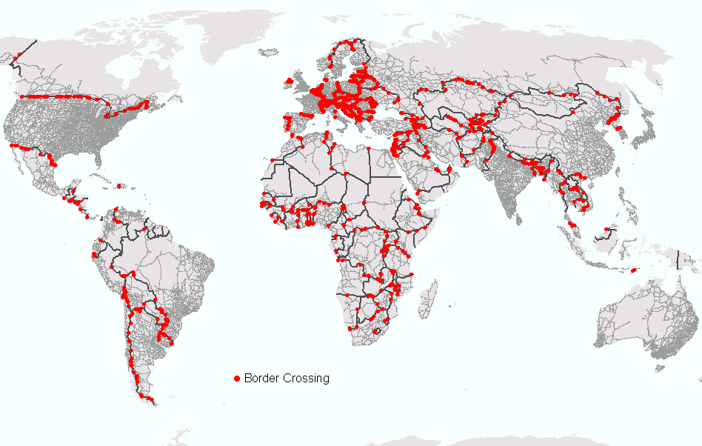
Step 1: Locate Border Crossings (major highways that intersect international political boundaries
We are constructing two databases:
A collection of dated and geo-coded satellite imagery of border crossings [picture collection]
Human coded spread sheet of what we see at the crossings (in the process of creating a time series).

Slide 3
Step 2: Evidence of “state presence” at border crossings
Are images available on google earth?
Is there really a border crossing? Confirm.
Zoom in on the road/border intersection. Code for the following:
Gates/barriers (and covered gates)
Multiple lanes
Split lanes (suggesting inspection areas)
Official buildings (and multiple buildings)
How hard is this? A closer look at “official buildings”…

Slide 4
Instructions for official buildings
Official Building?
Code 1 if there is one or more official looking buildings at or near the border. Official looking buildings tend to be:
at or near the border (proximity; nearer the border than residential or commercial structures.);
symmetrical on each side of the road;
located on road loops that swing out from and then rejoin the main road;
near to inspection areas; near to gates/barriers.
one of a kind or one of a cluster of a kind around an inspection center/vehicle holding or parking area.
Linked/near to the gates or barriers
Guideline: (override this if there are other reasons to code as official buildings): Code 1 if proximity plus at least one other characteristic hold; otherwise code 0.
Recommendation: Look at street shots if available. Consider parking lots configurations; trucks lined up near buildings (but watch but for gas stations.)
Building Confidence: 1 low, 2 med, 3 high

Slide 5
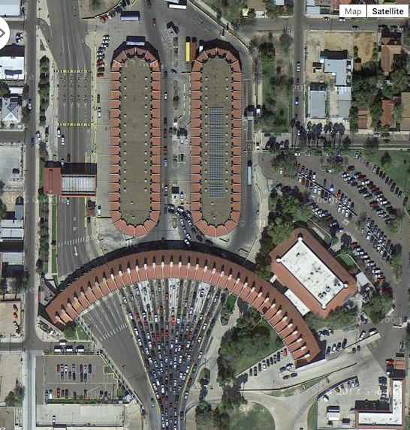
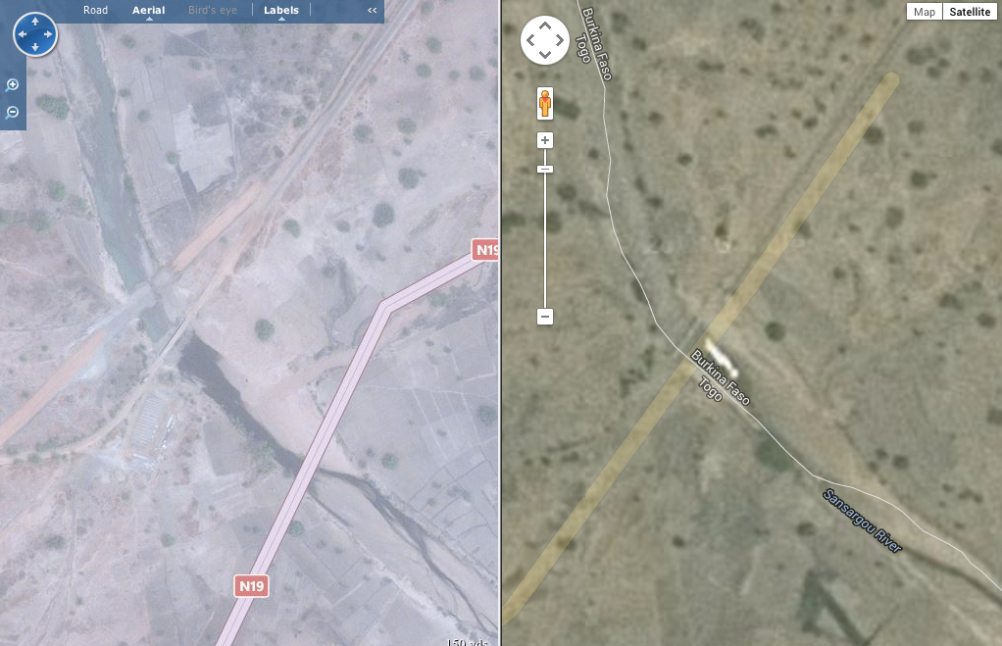
Latitude: 27.354159, Longitude:-99.45647 (US-Mexico border): Example of “thick” state presence
Latitude: 10.977346, Longitude: 0.514248 (Burkina Faso-Togo border): example of no state presence

Slide 6
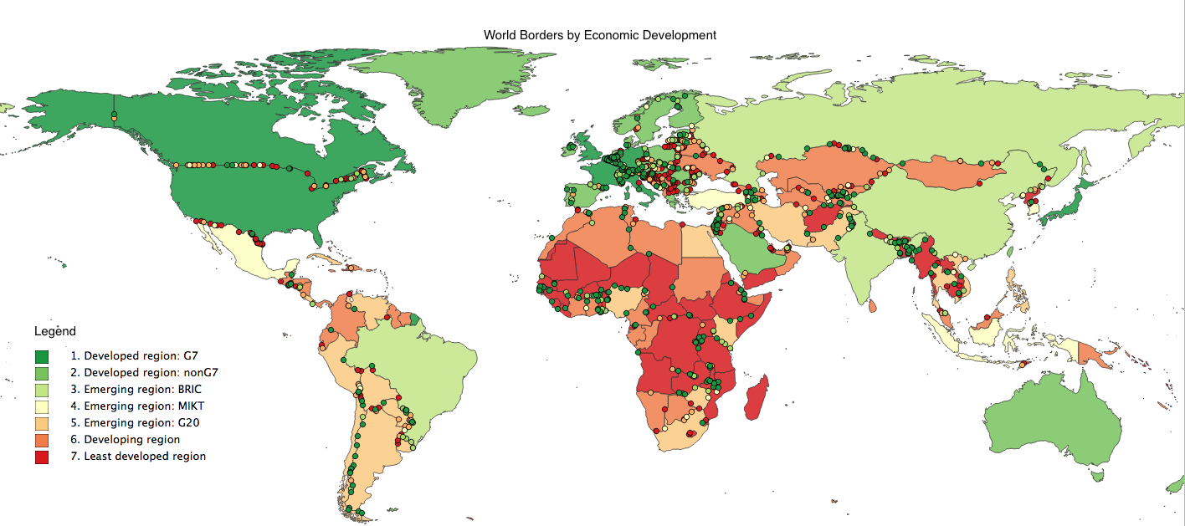
Border Crossings and State Presence
*N=0
N=12
*N = For each border crossing, N represents the accumulated value of 12 measurable binary variables (0 for Yes, 1 for No) indicating higher state presence as N increases.

Slide 7
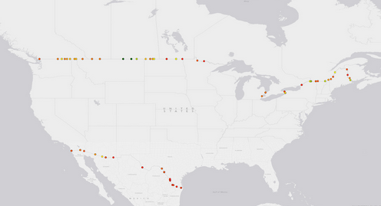
North America

Slide 8
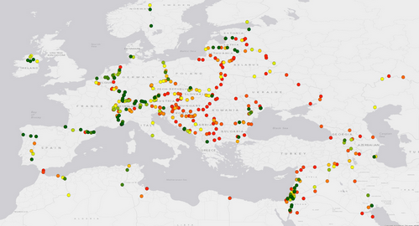
Europe

Slide 9
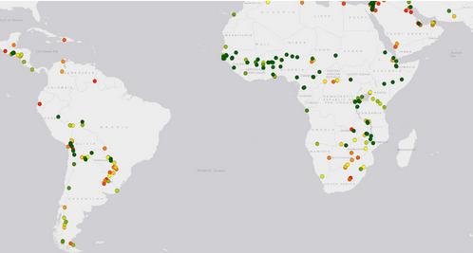
Southern Hemisphere

Slide 10
Do the data make any sense? Preliminary Analysis
States mimic one another at the borders. Gates and official buildings on one side predict gates on the other.
The rich build to block out the poor. The wealthier a state and the poorer its neighbor, the thicker its official border presence.
Homogeneous states guard their borders. Ethnically, religiously and linguistically heterogeneous states have thinner official border presence.
Democracies are less likely to block their borders. Autocracies have a much thicker official border presence.

Slide 11
Do the data make any sense?
 | (1) | (2) | (3)
VARIABLES | gates | official buildings | official presence
Bordering state has gate(s) | 0.83***
 | (0.03)
Bordering states has official building(s) |  | 0.81*** (0.03)
Bordering state’s total official presence |  |  | 0.86*** (0.03)
Logged GDP per capita, state 1 (ego) | 0.09*** (0.02) | 0.05*** (0.02) | 0.15*** (0.04)
Logged GDP per capita, state 2 (partner) | -0.07*** (0.02) | -0.04** (0.02) | -0.12*** (0.03)
Ethnic, religious and linguistic heterogeneity state 1 | -0.07* (0.04) | -0.07** (0.03) | -0.16** (0.08)
Polity score, state 1 | -0.00778** | -0.00297 | -0.0116*
 | (0.00339) | (0.00240) | (0.00597)
Civil war, state 2 | 0.0101 | 0.00130 | 0.00687
 | (0.0192) | (0.0121) | (0.0315)
Constant | 0.0939 | 0.235 | 0.348
 | (0.183) | (0.144) | (0.338)
Observations | 421 | 421 | 421
R-squared | 0.754 | 0.718 | 0.800
OLS; Robust standard errors in parentheses; *** p<0.01, ** p<0.05, * p<0.1 (unit of analysis: border pairs (average of crossings)

Slide 12
Into the Future: Time Series Project
In process: a database that documents change at the border over time.
Google Earth stores images as far back as 1980, though image quality is only adequate since about 1990.
Time series data will allow investigation of the dynamics of change at the border:
what events or conditions prompt states to heighten their border presence?
The US-Mexico border (27.596992°, -99.535692) near San Antonio, Texas illustrates border build up that show build up during a period of intense liberalization between these two states.
Does globalization stimulate thicker borders?

Slide 13
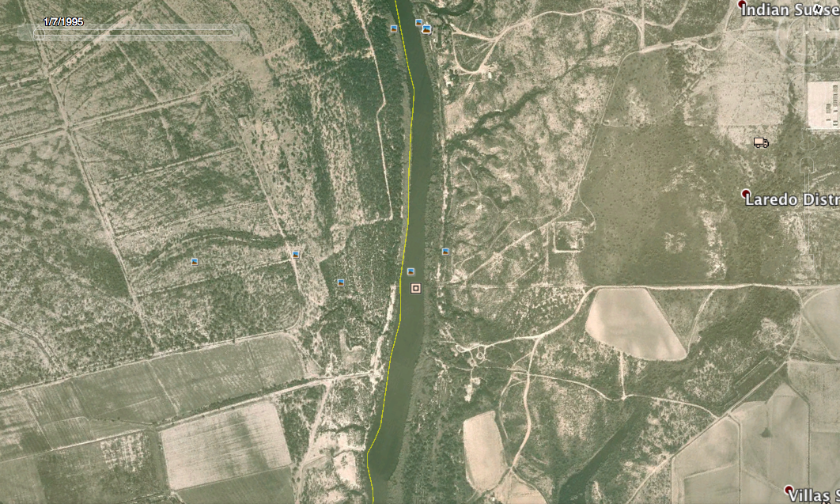
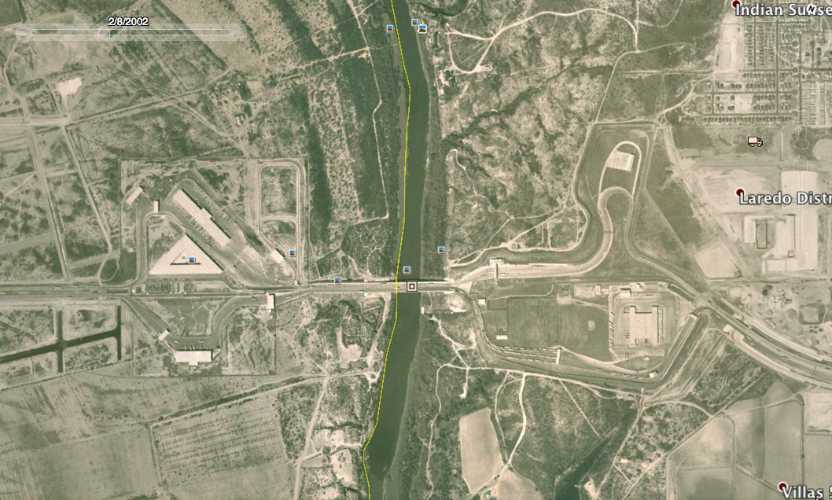
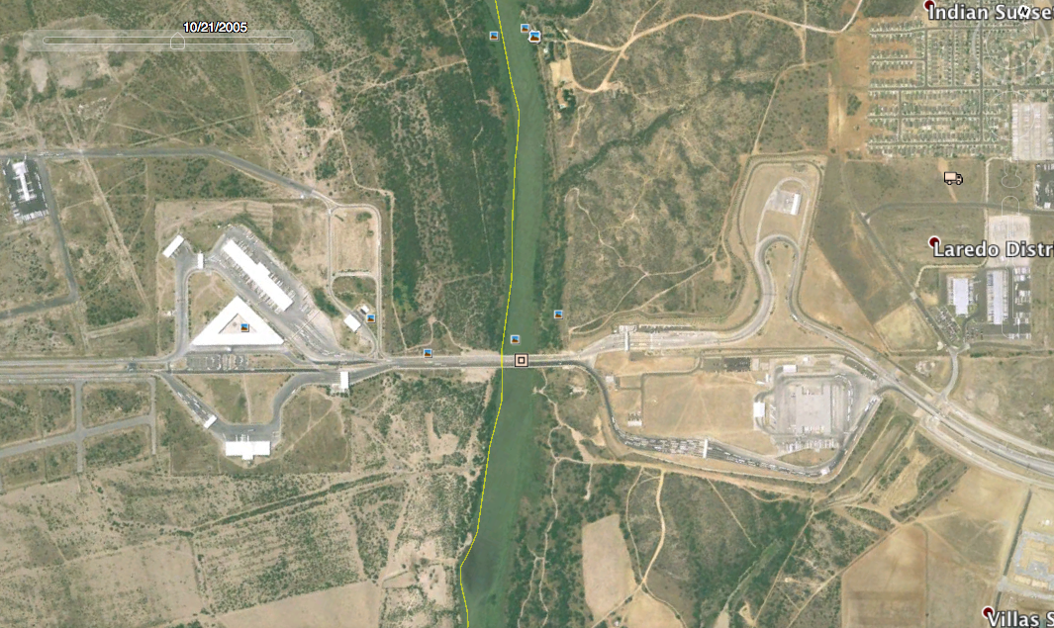
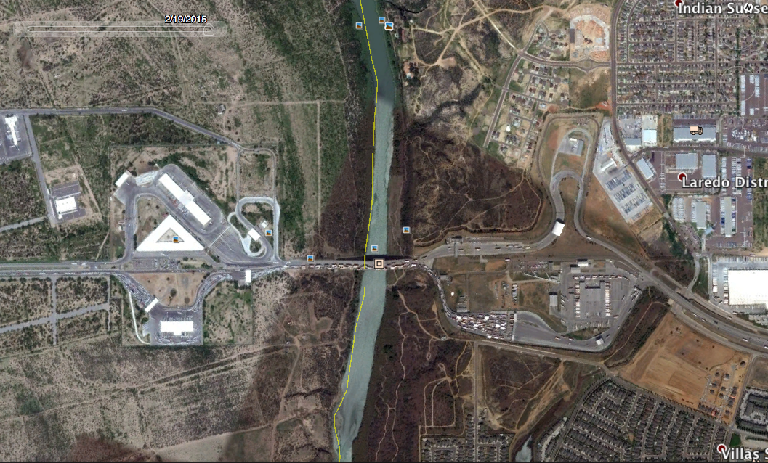
U.S –Mexico Border (27.5965, -95.53569)
1995
2002
2010
2015

Slide 14
Likelihood of observing a gate:

Slide 15
Adding geographic information
Completed:
Distance to nearest city > 500,000
Distance to nearest country capital
Elevation
In progress:
Slope within 5km
Population within 5km
Lights at night within 5km
Ruggedness

Slide 19
Possible directions
Border environments and globalization: “disappearing” or thickening?
Borders as anxiety: as response to multiple threats
Economic; traditional security; ontological security
Border crossings as cooperative environments
Borders, corruption and rents

Slide 20
end

Slide 21
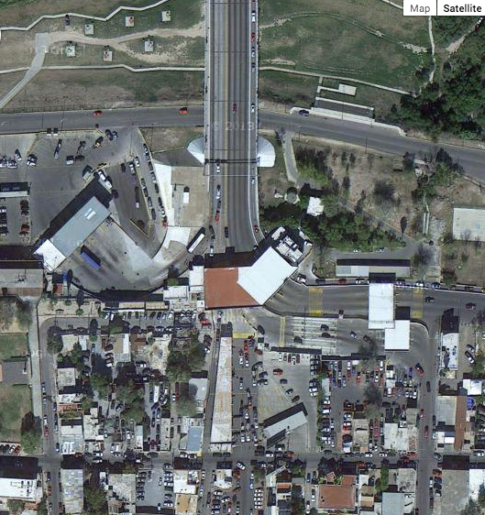
Documenting State Presence along Transnational Border Crossings
Harvard Institute of Quantitative Social Science | Undergraduate Research Scholars Program
Motivation
Are borders as permeable as studies of globalization suggest? We can learn a great deal about state motivations and identities by watching the physical investments they make at their international borders. Using global satellite imagery, our team is creating the first ever dataset documenting “state presence” along major highways that connect neighboring states. We are finding that state presence along borders vary significantly over space and time. Efforts of the state physically to regulate exit and entry within its territory expresses economic and security concerns, cultural anxieties, and political ideologies. Our database can also be used for the study of licit and illicit transnational flows, law enforcement, and border conflict.
Lead Researchers: Beth Simmons and Jeff Blossom Graduate Assistant: Shelley Liu
Assistant Researchers: Nick Rossenblum, Dina Perez, Ed Magema, Hanel Bavejal
Into the Future:
Time Series Project
To date two or more students have coded both sides of 1,066 border crossings using the most recent imagery available. Our next step is to develop a database that documents change at the border over time. Google Earth stores images as far back as 1980, though image quality is only adequate since about 1990. Time series data will allow investigation of the dynamics of change at the border: what events or conditions prompt states to heighten their border presence? The US-Mexico border (27.596992°, -99.535692) near San Antonio, Texas illustrates border build up that show build up during a period of intense liberalization between these two states. Does globalization stimulate thicker borders?
Methods
We inspected images from Google/Bing. For each border crossing, we document whether or not there is: a gate and/or a barricade on the road, a covered gate and/or a barricade on the road, multiple lanes for vehicles, and presence of single or multiple governmental buildings. We also collected screenshots of each border crossing.
*N=0
N=12
*N = For each border crossing, N represents the accumulated value of 12 measurable binary variables (0 for Yes, 1 for No) indicating higher state presence as N increases.
Explaining a state’s official border presence
Preliminary Analysis
A preliminary analysis of the data collected to date suggests we are capturing and coding important border characteristics, and not just gathering ‘noise.’ To the left are the results of regressions that test some basic relationships that should hold if the data are actually reflecting real expressions of state sovereignty at border crossings.
Findings:
States mimic one another at the borders. Gates and official buildings on one side predict gates on the other.
The rich build to block out the poor. The wealthier a state and the poorer its neighbor, the thicker its official border presence.
Homogeneous states guard their borders. Ethnically, religiously and linguistically heterogeneous states have thinner official border presence.
Democracies are less likely to block their borders. Autocracies have a much thicker official border presence.
U.S –Mexico Border
(27.5965, -95.53569)
 | (1) | (2) | (3)
VARIABLES | gates | official buildings | official presence
Bordering state has gate(s) | 0.83***
 | (0.03)
Bordering states has official building(s) |  | 0.81*** (0.03)
Bordering state’s total official presence |  |  | 0.86*** (0.03)
Logged GDP per capita, state 1 (ego) | 0.09*** (0.02) | 0.05*** (0.02) | 0.15*** (0.04)
Logged GDP per capita, state 2 (partner) | -0.07*** (0.02) | -0.04** (0.02) | -0.12*** (0.03)
Ethnic, religious and linguistic heterogeneity state 1 | -0.07* (0.04) | -0.07** (0.03) | -0.16** (0.08)
Polity score, state 1 | -0.00778** | -0.00297 | -0.0116*
 | (0.00339) | (0.00240) | (0.00597)
Civil war, state 2 | 0.0101 | 0.00130 | 0.00687
 | (0.0192) | (0.0121) | (0.0315)
Constant | 0.0939 | 0.235 | 0.348
 | (0.183) | (0.144) | (0.338)
Observations | 421 | 421 | 421
R-squared | 0.754 | 0.718 | 0.800
OLS; Robust standard errors in parentheses *** p<0.01, ** p<0.05, * p<0.1 (unit of analysis: border pairs (average of crossings)
1995
Latitude: 27.354159, Longitude:-99.45647 (US-Mexico border): Example of “thick” state presence
2002
2010
Latitude: 10.977346, Longitude: 0.514248 (Burkina Faso-Togo border): example of no state presence
2015

