Slide 1
Atmospheric Correction
Advanced Remote Sensing
Land Use / Land Cover Change Analysis
Module 3
Stacy Bogan 2/13/2018

Slide 2
Module Outline
Atmospheric Correction on Level1 Landsat Data
Collecting data needed for TerrSet AtmosC module
Running correction
https://clarklabs.org/tutorial-videos/

Slide 3
Scene in Pará, Brazil

Slide 4
Scene in Pará, Brazil
Before Correction
After Correction
Landsat 5 TM data Collected July 12, 2009 at 1:37 pm

Slide 5
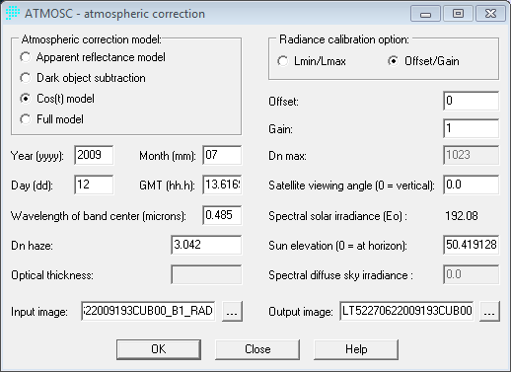
TerrSet ATMOSC Module COS(t) Model
Collect sun elevation and timestamp from metadata
Convert timestamp to decimal
Collect haze value from each band image
Band | Year | Month | Day | TimeStamp | GMT | Wavelength of Band Center | DN Haze/ RAD Haze | offset | gain | Dn max | Viewing Angle | Sun elevation
1 | 2009 | 7 | 12 | 13:37:01 | 13.61694 | 0.485 | 3.042 | 0 | 1 | 1023 | 0 | 50.41912
2 | 2009 | 7 | 12 | 13:37:01 | 13.61694 | 0.56 | 1.952 | 0 | 1 | 1023 | 0 | 50.41912
3 | 2009 | 7 | 12 | 13:37:01 | 13.61694 | 0.66 | 0.9276 | 0 | 1 | 1023 | 0 | 50.41912

Slide 6
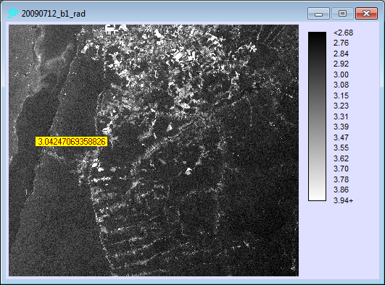
IDRISI ATMOSC Module COS(t) Model
Find the haze value over a deep, clear body of water with the Inquire tool

Slide 7
Want to learn more? Related Modules
Module 1:
Planning a Remote Sensing Project
Module 2:
Downloading Landsat Data
Module 4:
Analysis with the Land Change Modeler
https://clarklabs.org/tutorial-videos/

Slide 8
Thank you! Please submit feedback http://gis.harvard.edu/form/workshop-evaluation-form

