Slide 1
Downloading Landsat Data
Advanced Remote Sensing
Land Use / Land Cover Change Analysis
Module 2
Stacy Bogan 2/13/2018

Slide 2
Module Outline
How to download Landsat Data
Study area selection
Narrowing search results
Processing levels

Slide 3
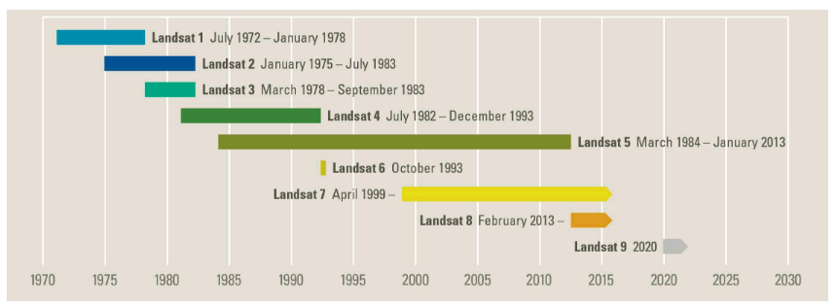
Landsat Satellite Missions
https://landsat.usgs.gov/landsat-missions-timeline

Slide 4
Downloading Landsat Data
USGS Earth Explorer
http://earthexplorer.usgs.gov/
Create a free account/sign in
Search for data by place name, coordinates, or shape
Select date range(s) and temporal restrictions
Choose datasets
Browse through tiles and download

Slide 5
Definitions
Digital Number – uncalibrated relative value recorded by the sensor 0 – 255
Radiance – calibrated brightness value in milliWatts per square centimeter per steradian per micron
Reflectance – Energy reflected by an object 0 - 1

Slide 6
Want to learn more? Related Modules
Module 1:
Planning a Remote Sensing Project
Module 3:
Processing Level1 Landsat Data
Atmospheric Correction
Module 4:
Analysis with the Land Change Modeler

Slide 7
Thank you! Please submit feedback http://gis.harvard.edu/form/workshop-evaluation-form

