Slide 1
Planning a Remote Sensing Project
Advanced Remote Sensing
Land Use / Land Cover Change Analysis
Module 1
Stacy Bogan 2/13/2018

Slide 2
Module Outline
Planning for a land use / land cover change analysis remote sensing project
Collect background information
Select a classification scheme
Select a remotely-sensed dataset
Build a scene model

Slide 3
Collect Background Information
What is the phenomenon you want to study?
What reflectance would you expect in the different areas of the electromagnetic spectrum?
What are the other land covers that you need to differentiate?
What are the physiological processes dictating the spectral reflectance patterns?
Are there different patterns during different times of the year?

Slide 4
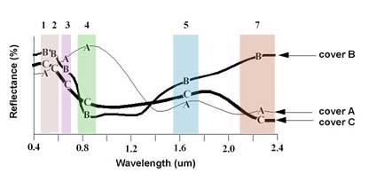
Select a classification scheme
Different schemes require different types of input information
One good web-based tool for choosing which bands to use is the USGS Spectral Characteristics viewer: http://landsat.usgs.gov/tools_spectralViewer.php

Slide 5
USGS Spectral Library
http://speclab.cr.usgs.gov/spectral.lib06/

Slide 6
ASTER Spectral library
http://speclib.jpl.nasa.gov/

Slide 7
Collect Spectra in the field

Slide 8
Develop training sites

Slide 9
Select possible datasets
Name | Launched | Pixel size | Swath | Temporal | Spectral
NOAA/AVHRR | 1978 | 1 Km | 2600 km | daily | 4 - 6 bands
Landsat | 1970 | 30 m | 183 km | 16 days | 7 bands
SPOT | 1998 | 20 m | 60 Km | 2-3 days | 4 - 6 bands
ASTER | 2000 | 15 - 30 m | 60 Km | 16 days | 14 bands
MODIS | 2001 | 250m - 1 Km | 2300 Km | 2-3 days | 36 bands

Slide 10
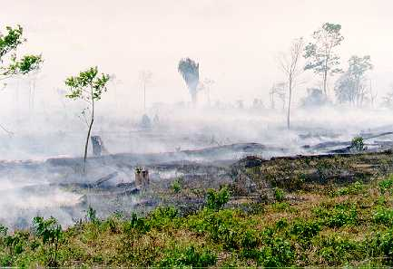
example Scene model: Burn Monitoring in San Diego County, CA
Environment Type | Forest and shrub
 | Mediterranean Type Ecosystem
Spatial Scale | grain = smallest burned vegetation 1m - 5m
 | extent = San Diego County 144 x 102 km
Temporal Scale | One image per week during May - October
Spatial dimensions | H resolution
 | grain: 1m - 5m
 | extent: 144 km x 102 km
Temporal dimensions | May - October
Spectral dimensions | blue (400-500 nm)
 | green (500-600 nm)
 | red (600-680 nm)
 | NIR (750-900 nm)
Radiometric dimensions | 11 bit
Error tolerance levels | error < smallest unit of measurement, 1-5m

Slide 11
Data Compliance Matrix
Parameter | Scene Model | Data, IKONOS | Level of Match | Data, 4 bands of LANDSAT TM | Level of Match
Spatial
pixel size | 1-5m | 4m | suitable | 30m | unsuitable
scene extent | 144 x 102 km | 11 x 11 km | suitable | 185 km x 185 km | suitable
H/L resolution | H | H | suitable | L | unsuitable
Spectral
No. of Bands | 4 | 4 | suitable | 4 | suitable
Position of Bands | blue | blue |  | blue
 | green | green |  | green
 | red | red |  | red
 | NIR | NIR |  | NIR
Radiometric
resolution | 10 bit | 11 bit | suitable | 8 bit | unsuitable
Temporal
Date | May - October | yearly | suitable | yearly | suitable
Scale | 1 per week | every 3 days | suitable | every 16 days | suitable
Time + Cost | imagery | high* | depends on | free | suitable
 | processing | high** | budget | moderate | suitable

Slide 12
Want to learn more? Related Modules
Module 2:
How to download Landsat Data
Module 3:
Processing Level1 Landsat Data
Atmospheric Correction
Module 4:
Analysis with the Land Change Modeler

Slide 13
Thank you! Please submit feedback http://gis.harvard.edu/form/workshop-evaluation-form

