Slide 1
Introduction to Mapping and Geographic Information Systems
WORKSHOP FOR THE SROH INTERNS
Jeff Blossom
jblossom@cga.harvard.edu
Harvard University
gis.harvard.edu

Slide 2
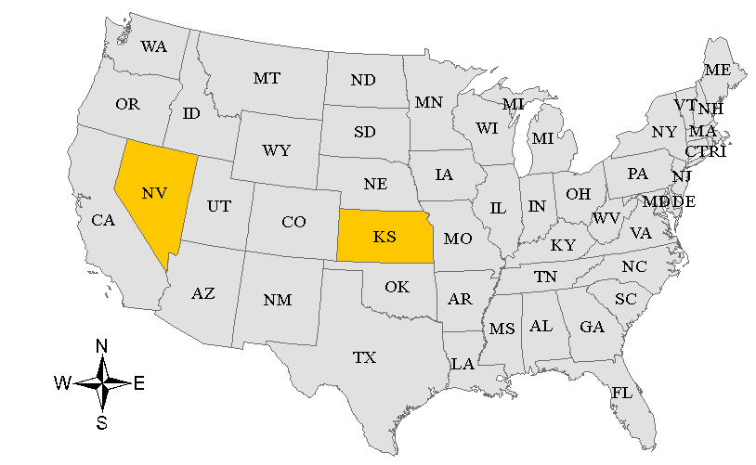
Why Maps?
Maps are a form of communication that show:
Geographic context
Nevada
Kansas

Slide 3
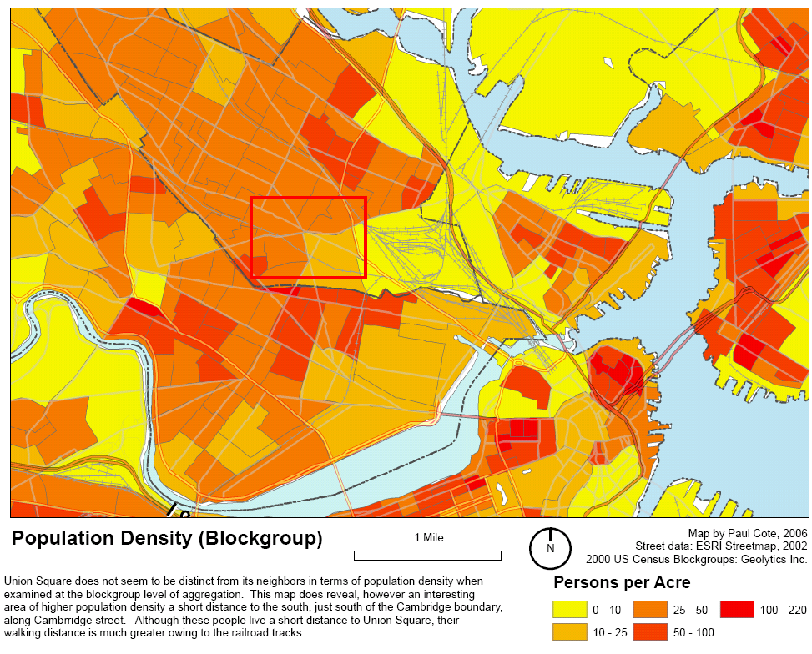
Why Maps?
Maps are a form of communication that show:
Similarities and differences between places

Slide 4
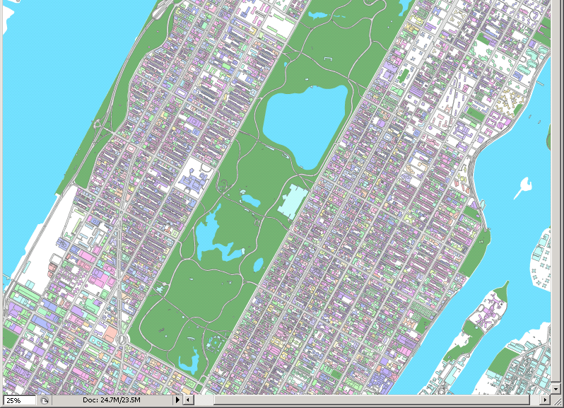
Why Maps?
Maps are a form of communication that show:
Characteristics about a place

Slide 5
Why Maps?
Maps help us reconstruct history, or plan for the future.
Notes:
Maps can show patterns over time.
http://www.schofieldbros.com/railroads.html

Slide 6
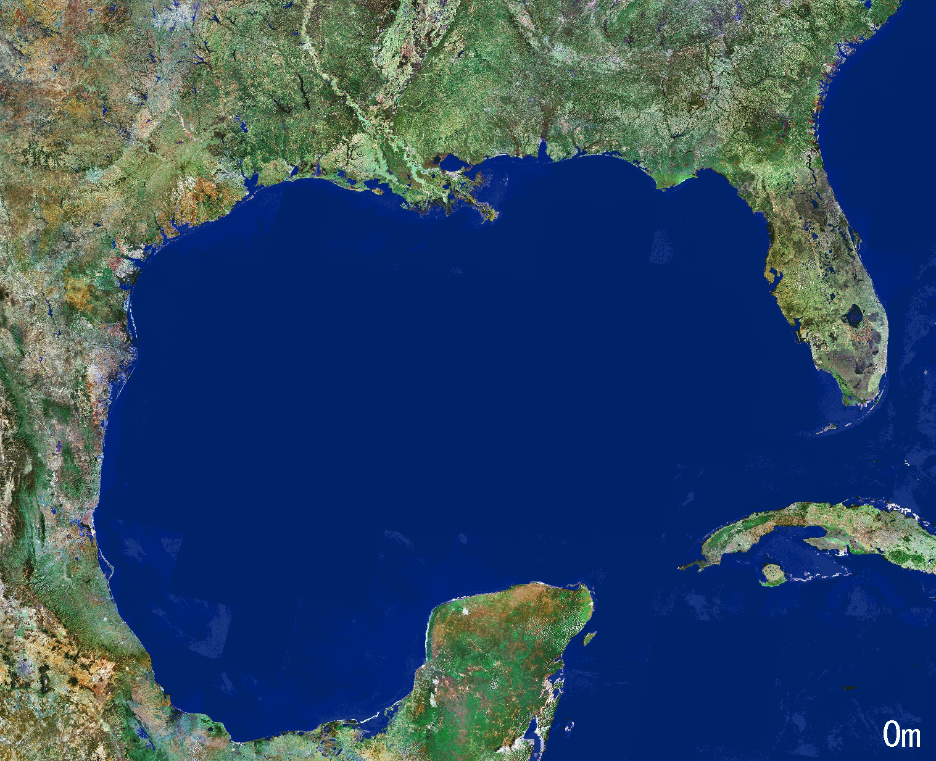
Why Maps?
Maps help us conceptualize, reconstruct history, illustrate the present, or plan for the future.

Slide 7
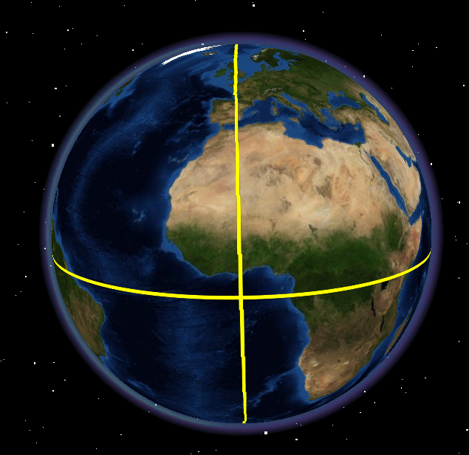
Geographic Coordinate System – a common reference used to map things on Earth.
Use lines of longitude and latitude.
Any location on Earth can be represented by the intersection of a longitude, latitude line.
42.3744,-71.1166 is the latitude, longitude location of Harvard Yard
Notes:
Now let’s look at each letter in the acronym “GIS”. The first, G stands for geographic. (read the slide)

Slide 8
Google Maps Coordinate System Notation Geographic Decimal Degrees
Values of latitude (south to north range from -90 to 90) and
longitude (west to east range from -180 to 180)
A pair of latitude, longitude values represent a discreet spot on Earth.
90.0
45.0
0.0
-180.0
-90.0
180.0
0.0
90.0
-45.0
-90.0

Slide 9
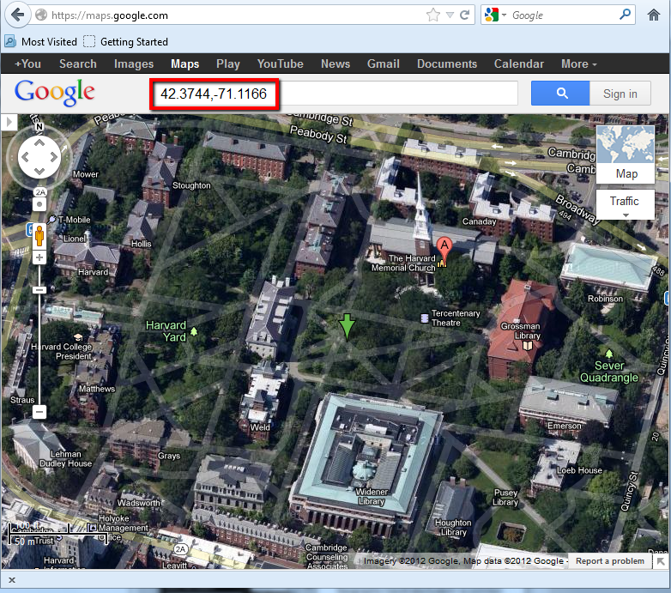
Notes:
And if we enter these coordinates into a geographic application like Google Maps, the map will zoom to this exact spot on earth, which happens to be in the center of Harvard Yard.

Slide 10
Hands on exercise: Create a list of locations in a spreadsheet,
and map the locations using BatchGeo.com
Geocoding: The process of turning information into locations on a map.

Slide 11
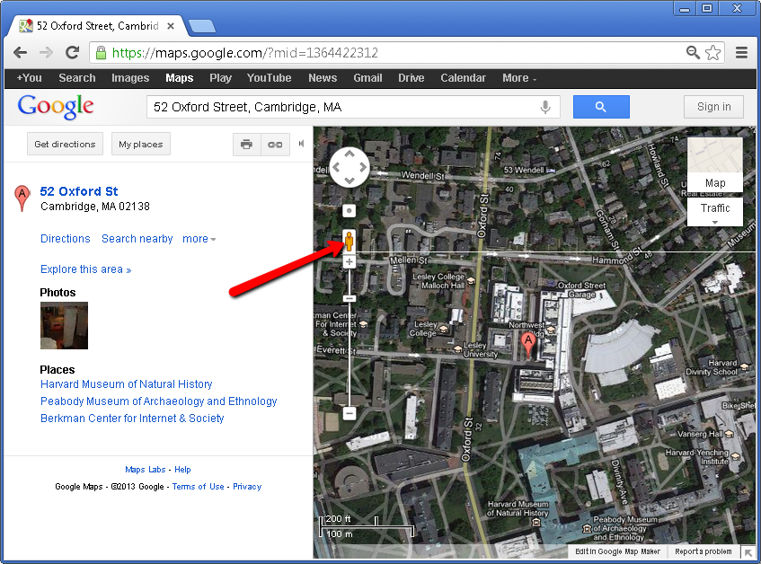
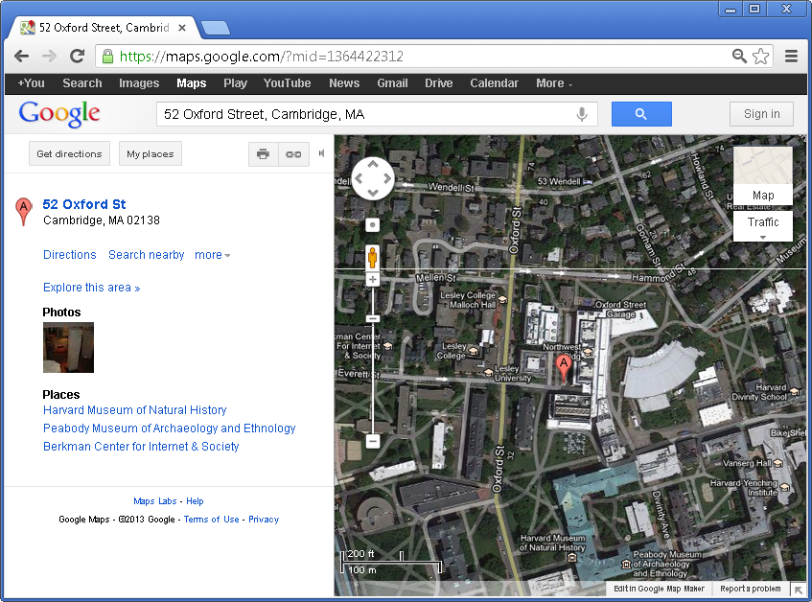
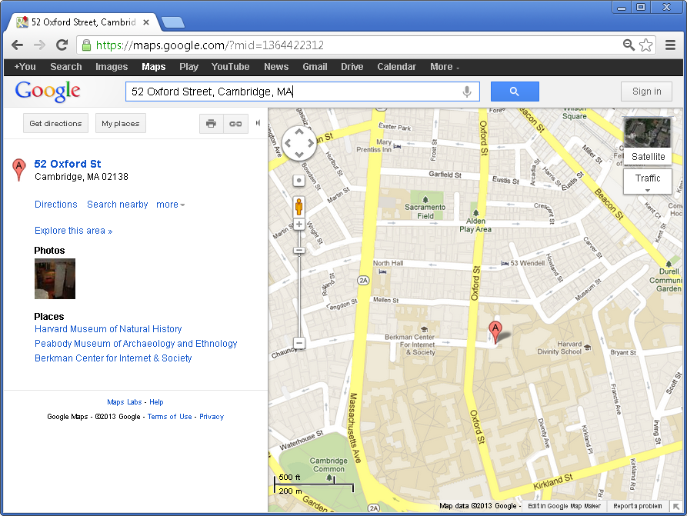
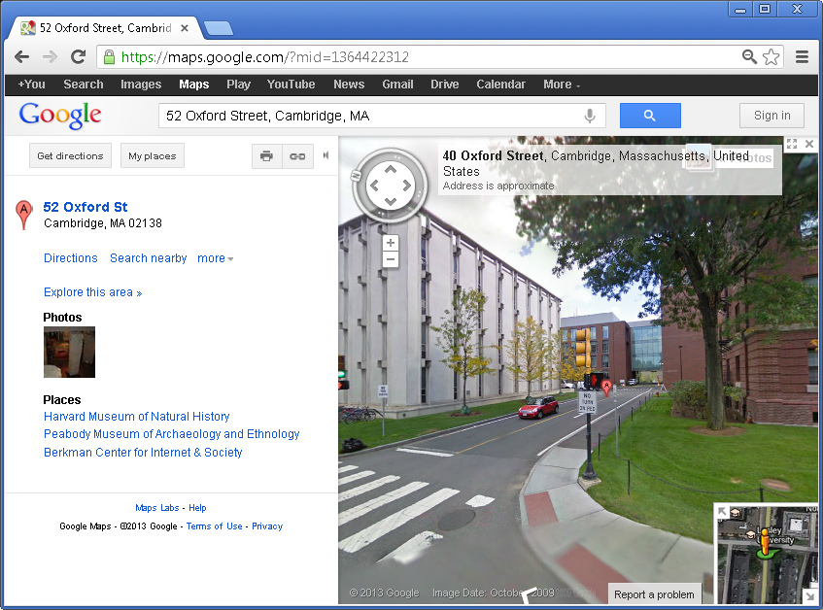
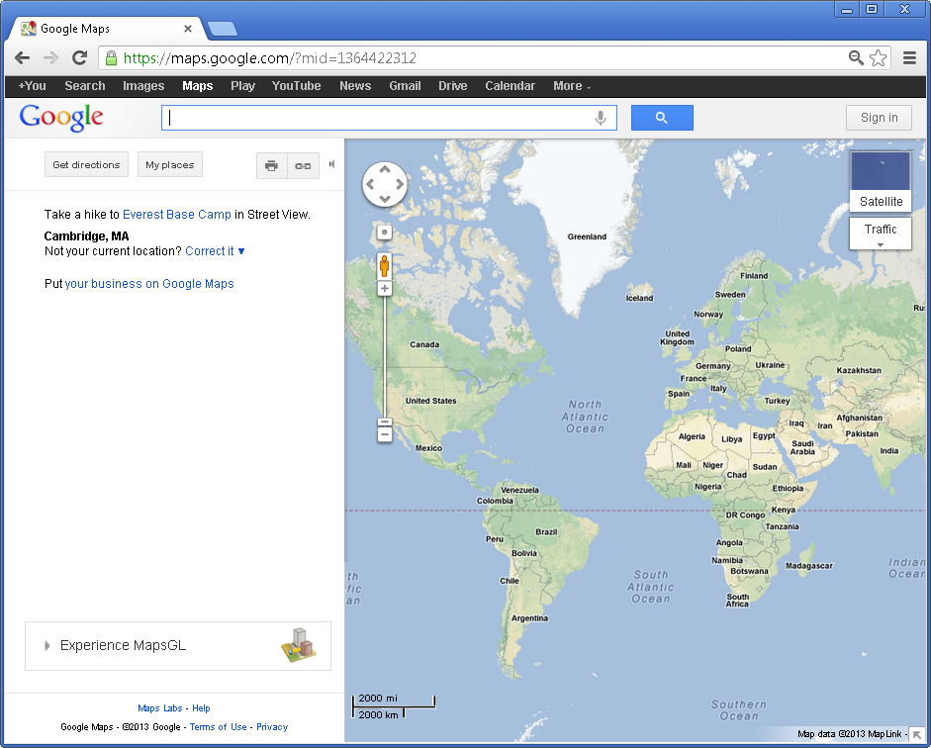
What is a Google Map? Maps.google.com - interactive street, satellite, terrain maps and more.
Notes:
What is a Google map? Go to maps.google.com: and there is an interactive map interface.
It is several maps of the whole world.
You can type in an address or location, and the map will zoom to that location.

Slide 12
Google Maps Exercise
Open Google Chrome by clicking Start > All Programs > Google Chrome > Google Chrome
2. Download the exercise by going to: http://gis.harvard.edu
3.Click the “Intro to GIS for SROH interns” link.
4. Click Download Google Maps Workshop Materials
5. Open the Google_Workshop zip file, and copy the contents to your Desktop.
6. Open the Gmaps_Exercise.pdf

Slide 13
Google Maps, Earth, Fusion Tables, and Mashups Differences and similarities
Google MyMaps
A free web application (no software installation necessary)
2 dimensional map view, with street, satellite, terrain basemaps
Allow for searching the Google gazetteer for places.
Data creation possible (points, lines, polygons), reads limited kml.
A selected set of map overlays and functions available.
Specific maps can be saved and shared easily on the web.
Google Earth
A free desktop application (downloading and installation necessary).
3 dimensional map view with satellite basemap, many map overlay layers, and a rich set of visualization tools.
Allow for searching the Google gazetteer for places.
Data creation possible (points, lines, polygons).
Complex kml creation is possible.
Google Fusion Tables
A free service allowing one to upload LOTS of tabular / spreadsheet data, and map it.
Google Maps Mashups
A free service allowing one to embed a Google Map into a web page.
2 dimensional map view, with street, satellite, terrain basemaps.
Highly customizable to include everything in MyMaps and more.
Customization requires using javascript and HTML.
Requires access to a web-server to publish to the web.

Slide 14
Google Maps, Earth, Fusion Tables, and Mashups Which one to use?
Google MyMaps
Locating, measuring, or learning about the geography of a place.
If you want to share a map.
Communicate geographic information quickly.
Google Earth
Visualizing terrain, 3d buildings, historical imagery, and access to many thematic map layers.
Virtual tour creation (movies)
Small amounts of data collection, geocoding, and image geo-referencing.
Google Fusion Tables
To map lots of tabular data, and allow others to load to the same table.
To make a quick thematic map
To link your data to other tables of information.
Google Maps Mashups
Used to embed a map into a new or existing website.
Create interactive web maps for your users.

Slide 15
What is GIS?
Geographic Information System (GIS) defined:
A collection of computer hardware and software designed for capturing, storing, updating,, manipulating, analyzing, displaying, and publishing all forms of geographically referenced information.
People performing different roles are required.
Common methodologies are applied within a GIS.
Notes:
GIS was started in the late 1960’s, and today is really an industry unto itself that is used by numerous disciplines in private, government, and academic work.

Slide 16
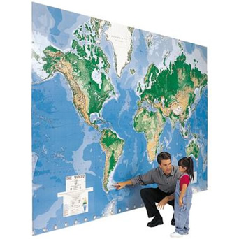
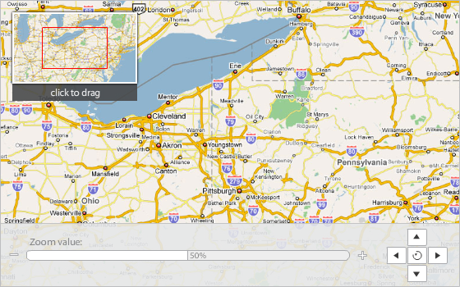
What is GIS? (Geographic Information Systems)
A pan-able and zoom-able map – so that little girl can see places above Argentina and Chile.
Notes:
GIS is not just one map – it is the entire world, mapped at multiple scales from global all the way down to neighborhood, accesses by anyone using a computer.

Slide 17
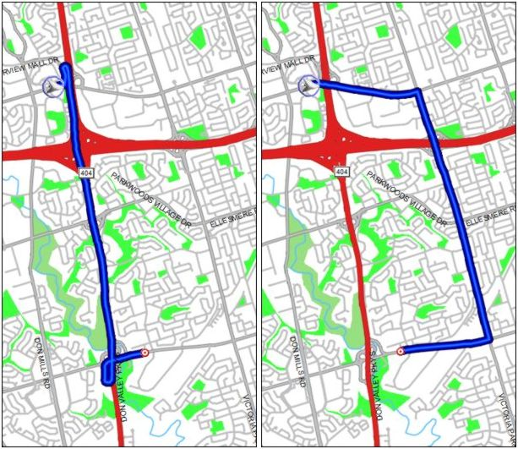
An intelligent map to answer your questions: How to get from place A to place B (network routing)?
A
A
B
B
Notes:
Features like roads shown on this map aren’t just mapped – there’s intelligence built into each road, like the speed limit of that road. This travel speed information can be used in GIS the fastest route between two locations on the map, shown here with the blue line on the left. Intelligent features in GIS can also accommodate for barriers in a network. For example if there was construction on the interstate, the routing algorithm would take this into account, and map the fastest path around the obstruction, shown in the image on the right.

Slide 18
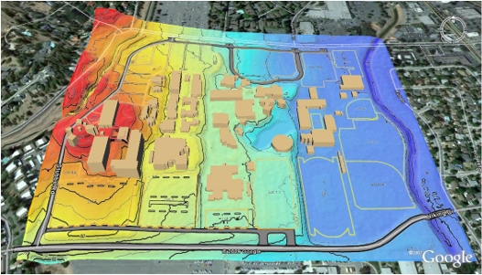
An intelligent map to answer your questions: What exist at the same location (overlay)?
Notes:
On this map the colors represent elevation, red as high, ranging to blue as low. Everything in blue is in the floodplain, here along the river. The tan shapes are buildings. GIS can be used to answer the question “which buildings lie in the floodplain?” by overlaying the buildings with the elevation, showing us that all buildings in lying on the blue area of the map are in the floodplain.

Slide 19
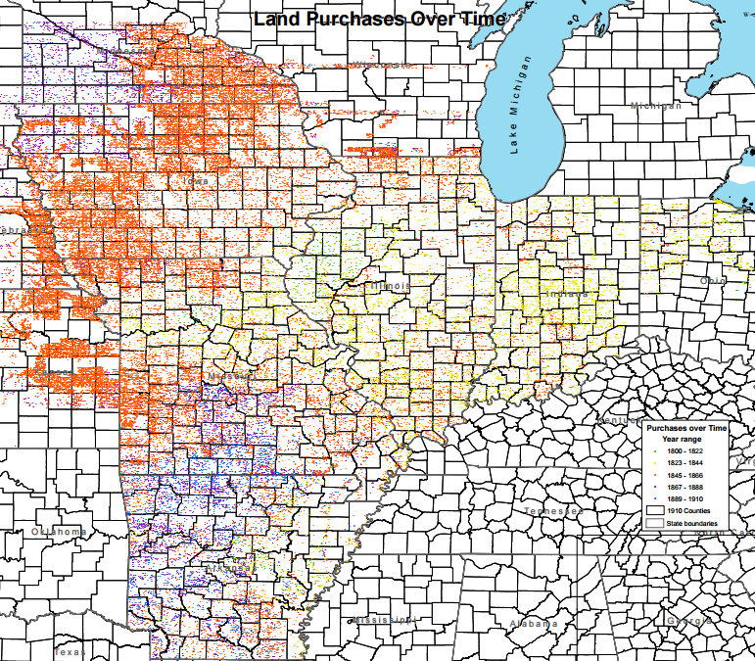
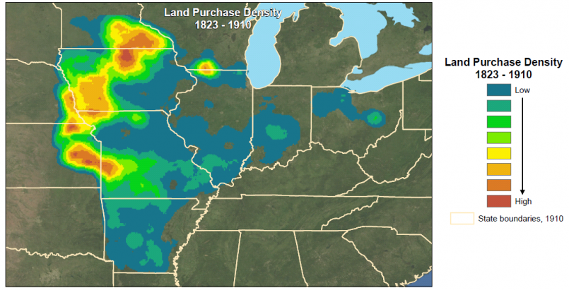
An intelligent map to answer your questions: Where are the hot spots ?
Notes:
This map of the midwestern U.S. shows county boundaries in black lines, and the colored dots are land purchases by women between 1823 and 1910. There are over a hundred thousand dots on this map, and displayed like this it is hard to get a feel for the distribution of purchases.
(next slide)
GIS can be used to produce heat maps, or “density maps” that display this phenomenon much more effectively. This map shows all points combined into one heat surface, with dense areas in red, and lower density areas in blue. Now it is easy to see where the “hot spots”, or high density areas of land purchases are.

Slide 20
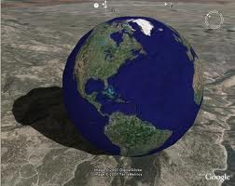
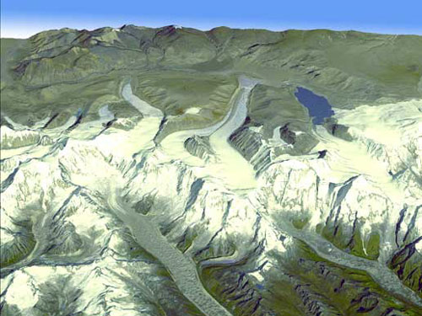
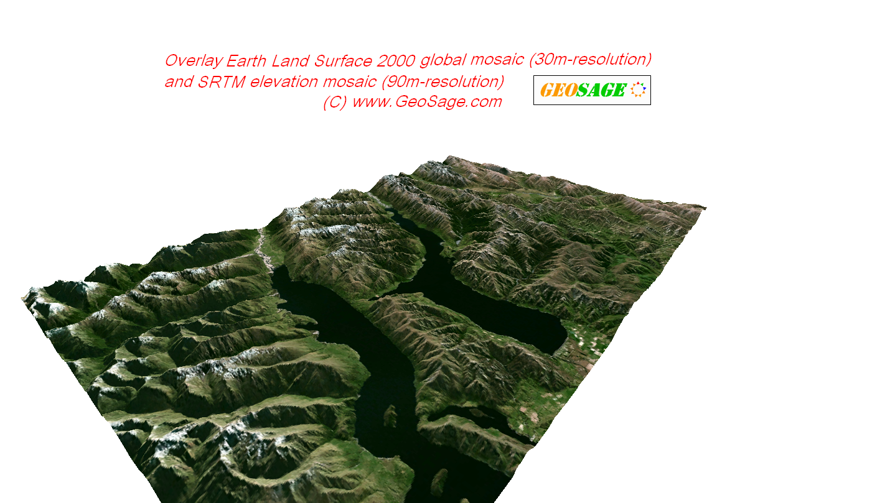
A spinning globe with elevated terrain – so to give you a realistic view of places on earth.
… and more
Notes:
The earth is a spherical shape, in three dimensions. GIS programs such as google earth show the earth this way, and are great for depicting terrain, buildings, or other features that are best represented in 3D.

Slide 21
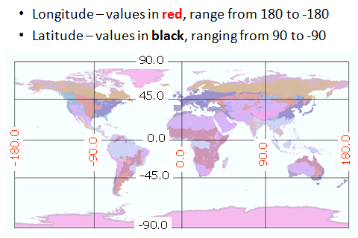
Geographic Coordinate System – a common reference used to map things on Earth.
** There are also other coordinate systems that use units of meters or feet instead of longitude and latitude **
Notes:
(read the slide, explaining how the coordinates relate to specific places on the map)
All GIS software uses this common geographic coordinate system, enabling the use of mapped data in many GIS systems.

Slide 22
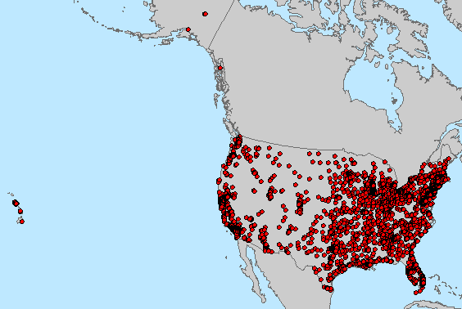
Information is linked to features (like cities) on the map.
Stored in tabular form
Geographic Information Systems
Notes:
The “I” in GIS is information, perhaps the most powerful part of a GIS, as an unlimited amount of information can be associated with each mapped feature. Here is the information table behind a GIS cities layer. Not only does this dataset contain the locations of each city, but each location is represented by a row in a table. The columns in the table describe about each feature, such as the city name, state, population, and median age, shown here.

Slide 23
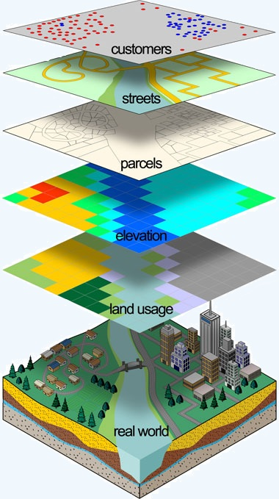
Geographic Information System
Hardware - Software - Data - Methodology - People - Management
A common set of
tools and procedures
A well managed system
of information
Database
Data Files
Notes:
Read the slide, then: The image on the right is the classic “layer cake” GIS graphic showing many different mapped features aligned properly in the same geographic space, allowing one to not only make maps of these features, but answer questions like “what is the land usage of my parcels?” What is the distance from my customers to the nearest major street?

Slide 24
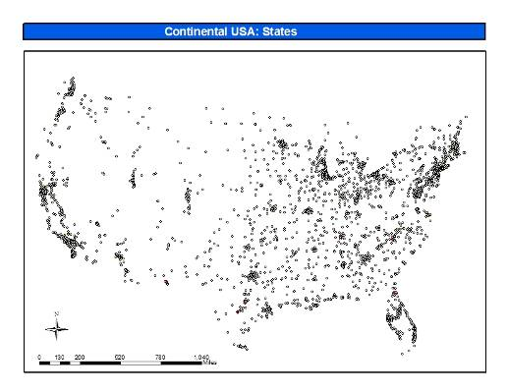
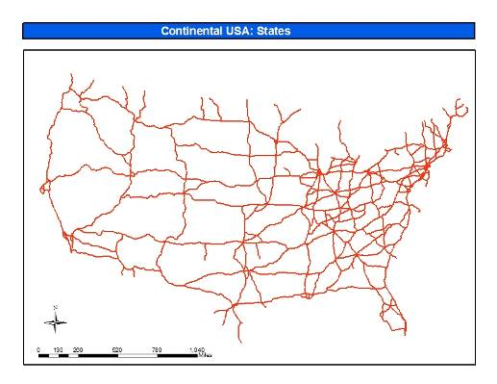
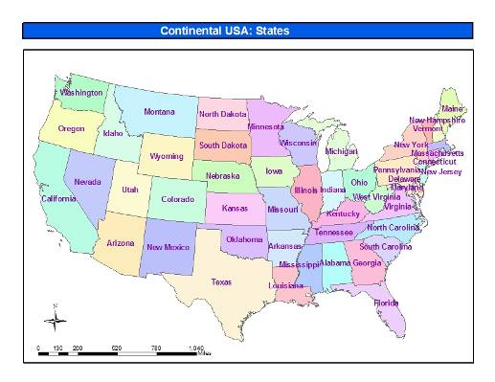
Vector Representation of Geographic Features
Point: a pair of x and y coordinates
Line: a series of points connected together
Polygon: a line enclosed from end to end
Examples:
Point: cities
Line: roads
Polygon: states
Notes:
Depending on scale and accuracy, a real world object may be represented in more than one type of features. For example, a city can be a point, or can be a polygon around the city boundary. A river can be a line, or can be a polygon mapping the full width of the river. A feature can have one part, or many parts. For example, the islands of Hawaii are mapped with many polygons, but only one row in the attribute table.

Slide 25
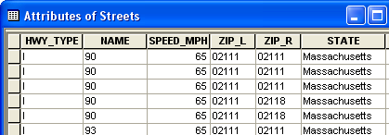
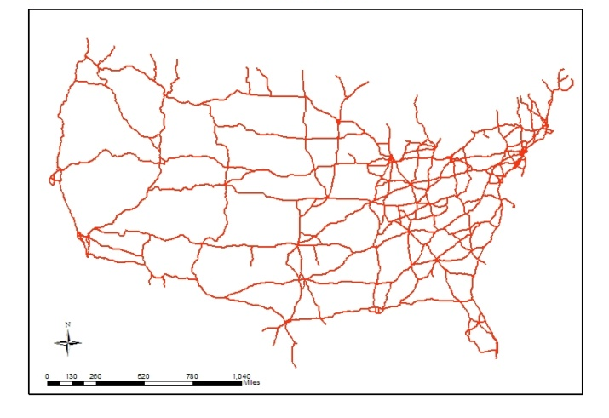
Attribute tables store information about the geographic features.
Vector GIS data
Lines – U.S. Interstates
Points – U.S. Cities
Polygons – U.S. States

Slide 26
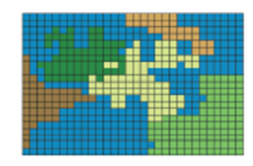
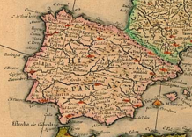
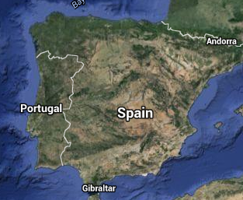
Raster Data
Each pixel has a value
If the raster on the right represents land cover, the values might be:
1 = water (colored blue)
2 = forest (dark green)
3 = desert (dark brown)
etc…
Scanned maps like the historic one on the right, and satellite image below it are raster.
Notes:
Read the slide

Slide 27
Vector and raster data
In general:
Vector is used to represent discrete features that do not completely cover the Earth’s surface like roads, trees, buildings, etc.
Raster is used to represent broad, continuous features that cover the entire Earth’s surface like elevation, precipitation, tempature, land cover, and imagery.
Notes:
Read the slide

Slide 28
Exercise 2: Using web GIS (WorldMap) and Desktop GIS (QGIS)

Slide 29
Exercise 2: Using web GIS (WorldMap) and Desktop GIS (QGIS)
Open Google Chrome by clicking Start > All Programs > Google Chrome > Google Chrome
2. Download the exercise material by going to: http://gis.harvard.edu
3.Click the “Intro to GIS for SROH interns” link.
4. Click Download GIS Workshop Materials
5. Open the GIS_Basics zip file, and copy the contents to your Desktop.
6. In the GIS_Basics_Workshop/Instruction folder, Open the GIS_Basics_Exercise.docx

Slide 30
GIS analysis, problem solving, and case studies
Data Exploration
Quantitative mapping
Location based query
Attribute query
Data Analysis
Proximity analysis
Overlay analysis
Adjacency analysis
Network analysis
Geostatistical analysis
Notes:
Quantative mapping – What is the total area of the rain forest?
Location based query – Which toxic waste sites are inside my city boundary?
Attribute query – What cities have a median age over 40?
Proximity – What is the distance from all patient addresses to the nearest doctor?
Overlay – How many factories are in each county?
Adjacency – Which land parcels border the state forest?
Network – What’s the driving distance from each Mexican city to the U.S. border?
Geostatistical – Are the oil spill locations clustered, dispersed, or randomly distributed?

Slide 31
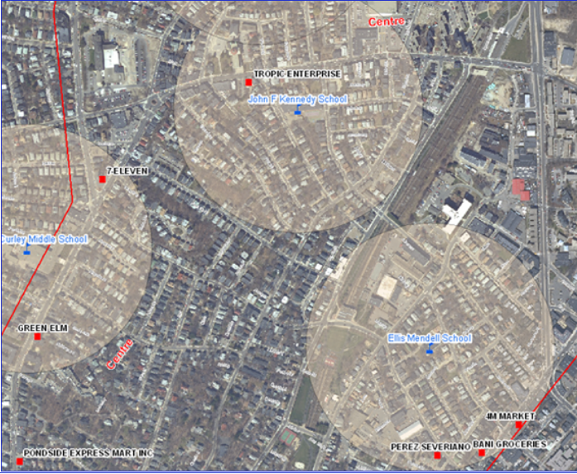
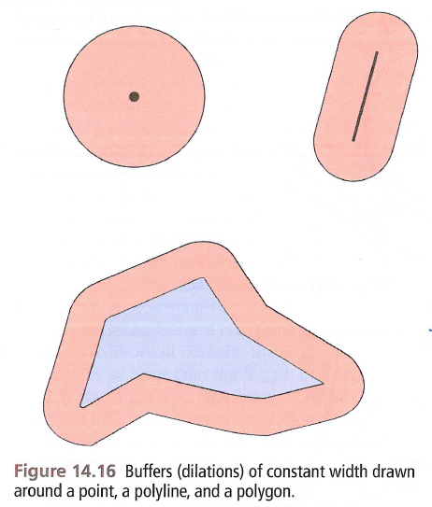
Question: How many tobacco retailers are within ¼ mile of all schools?
Answer: Use proximity analysis and the GIS buffer tool (creates a new polygon around features at a specified distance), and overlay analysis with the spatial join tool to count the number of retailers within each buffer.
¼ mile buffers around Boston schools.
Red dots are tobacco retailers
Notes:
Read slide, and explain that buffers can be created around point, line, or polygons.
Map on the right shows schools in blue with tan buffer around them, tobacco retailers in red, with a satellite image background.

Slide 32
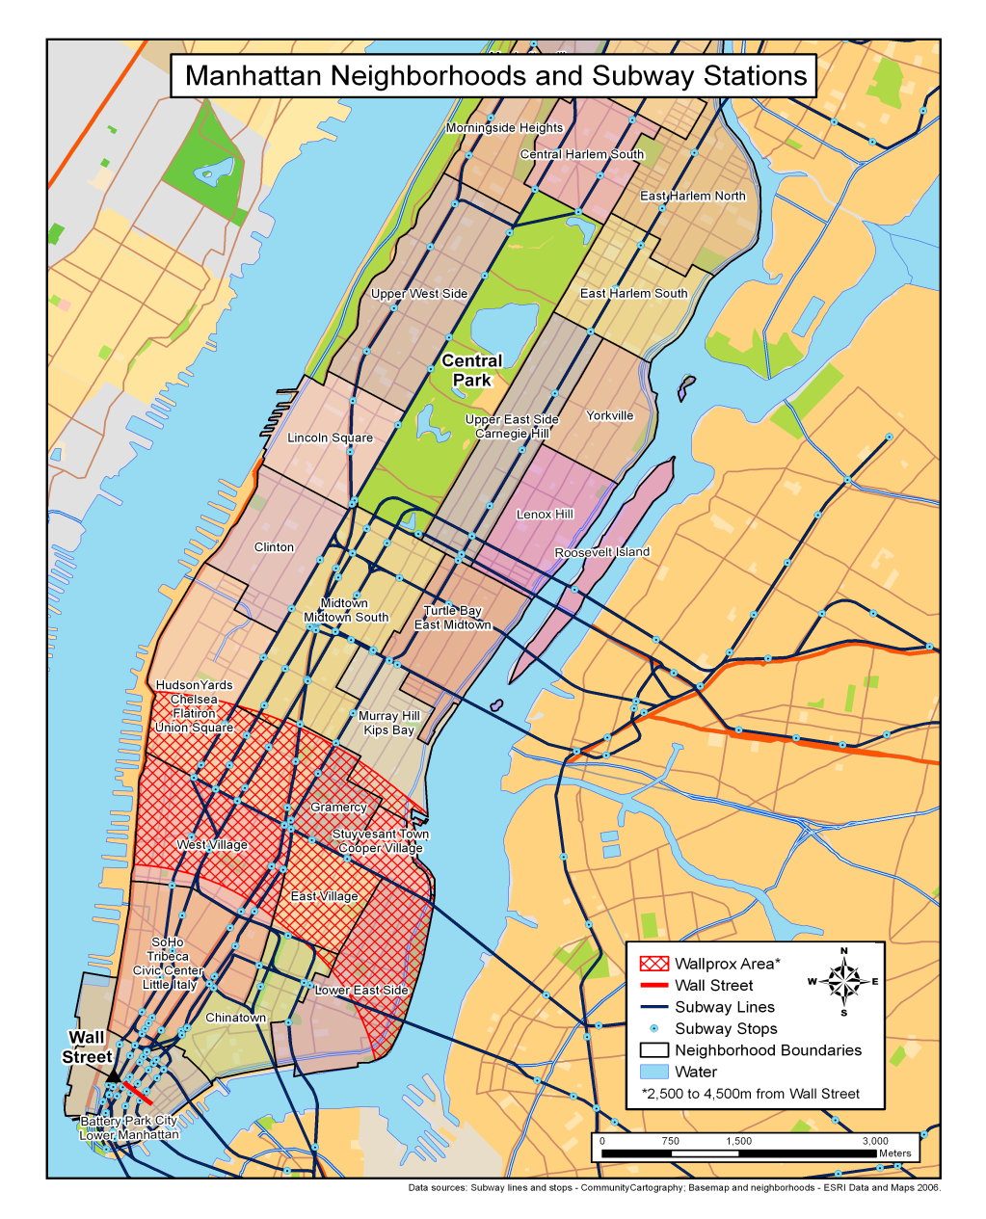
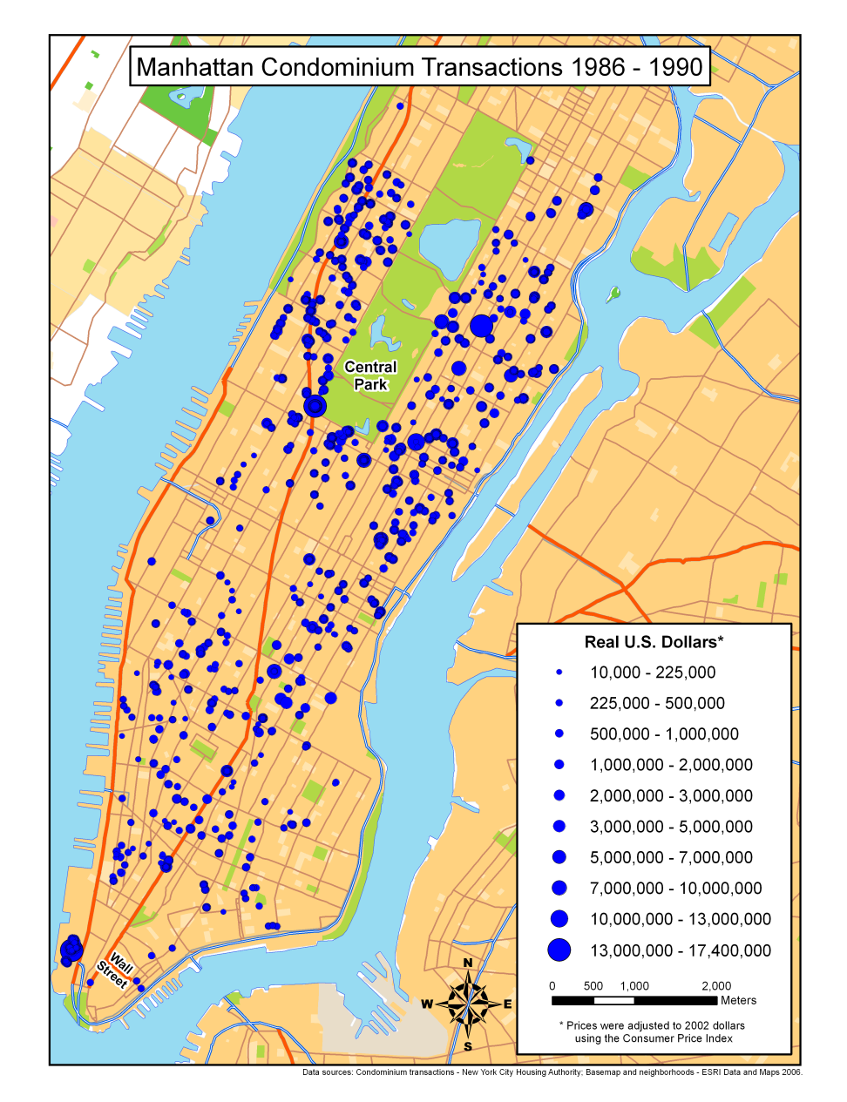
Case study: Determining where condos in NYC increase in value the most. Geographic variables for statistical regression of independent geographic variables (distance to nearest school, hospital, central park, wall street) with the dependent variable (real estate valuation rate) reveal “Wallprox” area where valuation is the greatest.
Notes:
Condominium addresses were geocoded and mapped, shown on the right, represented as blue dots. Then read the “Geographic variables….” on the slide.
The Wallprox area is both in close proximity to Wall Street where many people work, not too far from Central Park (popular place for recreation), with lots of subway stops and schools nearby. This kind of analytical conclusion would not be possible to determine without GIS.

Slide 33
Exercise 3: Query and analysis with ArcGIS Continue on with Exercise 3 in the GIS_Basics_Exercise.docx

