Slide 1
Spatial Models – Raster
Stacy Bogan
sbogan@cga.harvard.edu

Slide 2
Raster data are made of pixels
Surface of values composed of square
pixels each with a specific value
10 m
Pixels are a specific
size (ex. 10 m)
10 m
3
Pixels are arranged in rows and columns

Slide 3
Pixel Size = Spatial Resolution

Slide 4
Pixel Size Matters!

Slide 5
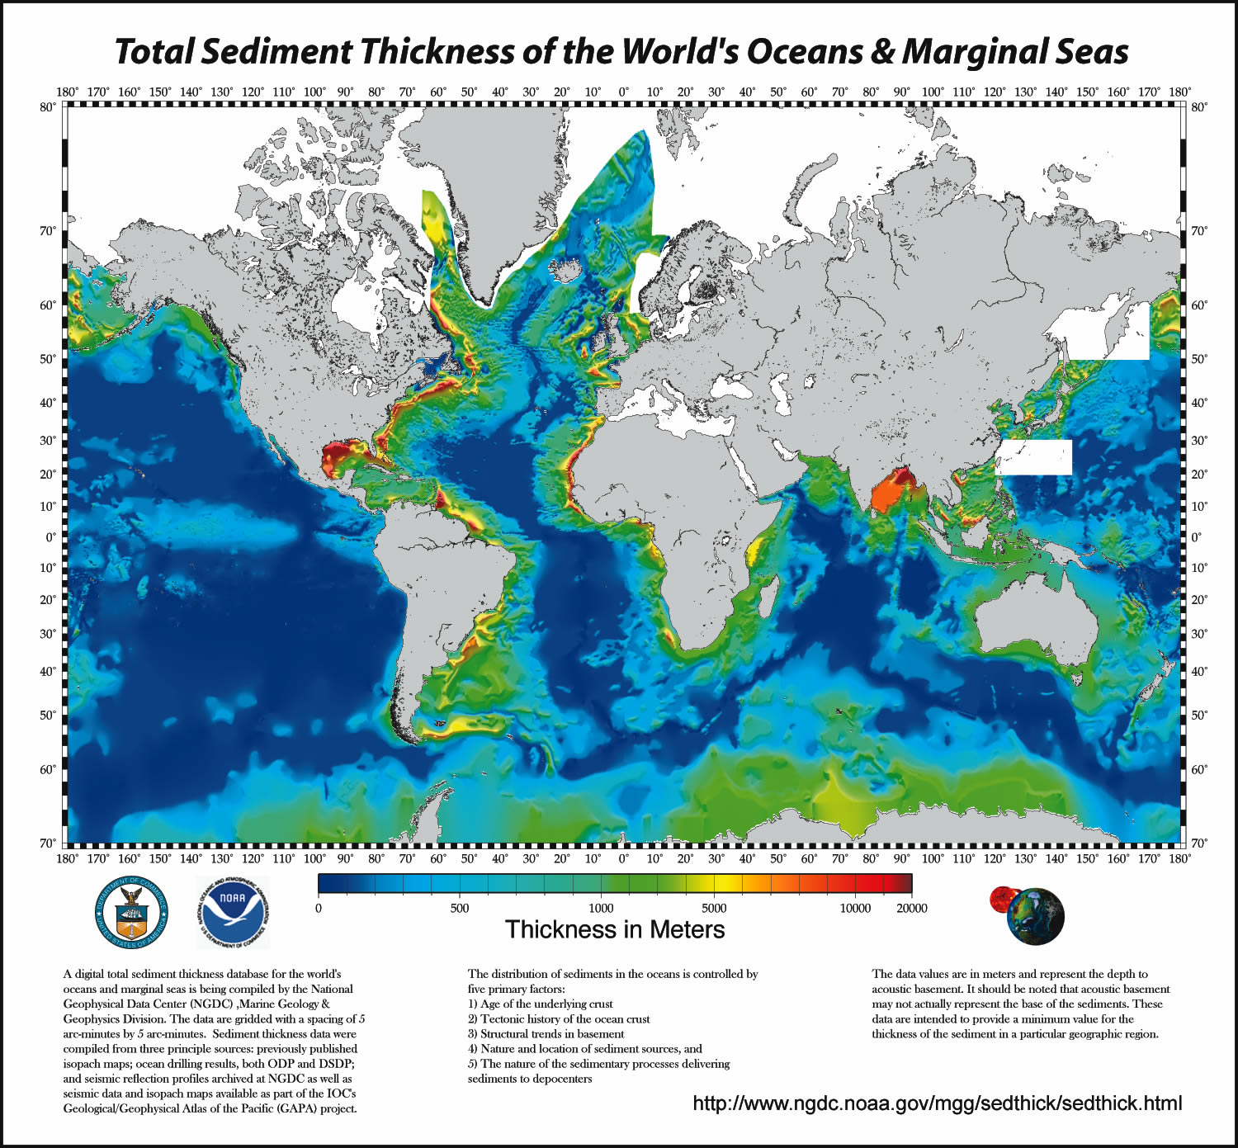
Advantages of Raster Data
Represents a data surface. Every location within the raster extents has a value
Sometimes smaller file size than shapefiles containing the same amount of data
Looks good on a map if you’re not close to the raster resolution

Slide 6
Disadvantages of Raster Data
Doesn’t look so good on a map if you try to zoom in close to the raster resolution
Coarse resolution raster data don’t translate well to finer resolutions

Slide 7
Types of Raster Data
Continuous
Floating point or Integer
Examples: Topography, satellite imagery, distance grids

Slide 8
Types of Raster Data
Discrete or Thematic
Could be binary (1,0)
Could be limited number of unique values
Examples: Land cover classification, true/false suitability

Slide 9
You can always Reclassify
Continuous to Discrete,
but never Discrete to Continuous

Slide 10
Some Popular Raster Formats
ESRI Grid
Geo TIFF
IMG
JPEG
MrSID
netCDF
HDF
USGS DEM

Slide 11
Raster Attribute Tables
Discrete raster data can have an attribute table
OID, VALUE, & COUNT fields can not be changed
You can add fields, calculate fields, & join tables just like with vector data

Slide 12
Rendering and Symbolizing
Stretched – continuous data displayed across a gradual ramp of colors
RGB Composite – multi-band data in three filters

Slide 13
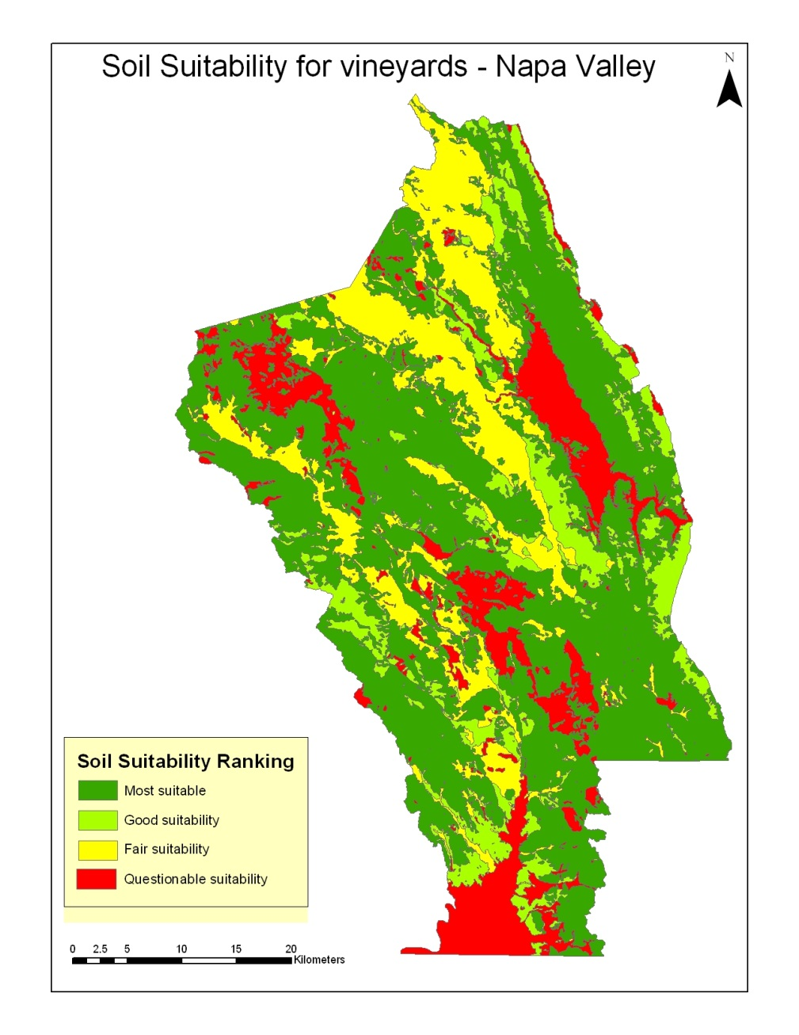
Rendering and Symbolizing
Classified – displays thematic rasters by grouping cell values into classes
For example, classifying a range of soil types into “suitable” to “not suitable” for vineyards

Slide 14
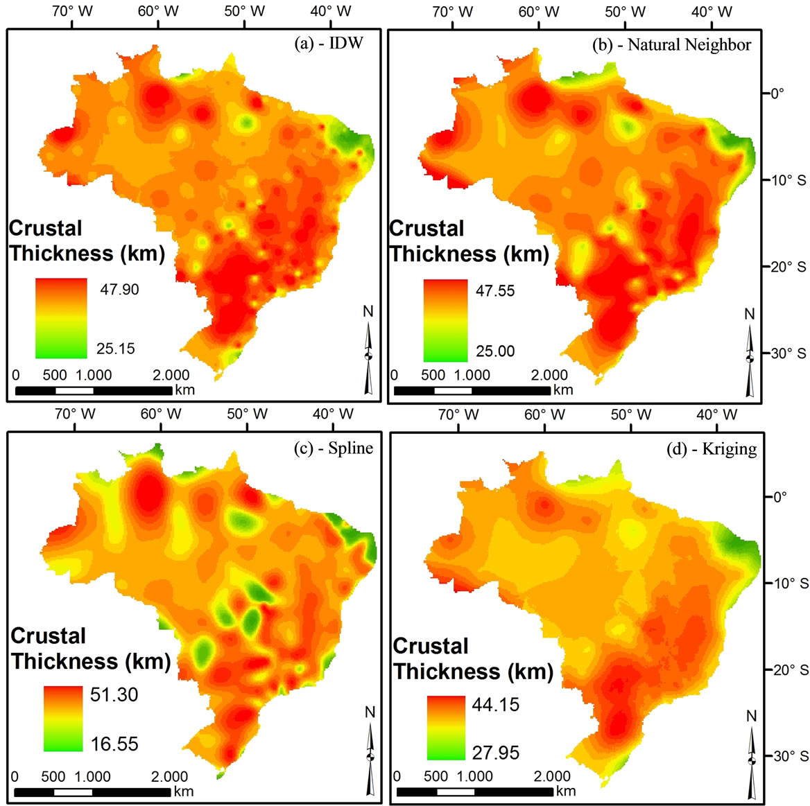
Raster Processing Tools in ArcGIS
Create rasters from vectors with Spatial Analyst Tools
Interpolation
Density
Distance
Polygon to Raster (Data Management Tools)

Slide 15
Raster Processing Tools in ArcGIS
Collect raster data with vectors
Zonal statistics
Extract values to points
Raster Calculator for Overlay
Simple Arithmetic
Algebra
Geometry

Slide 16
Raster Processing Tools in ArcGIS
For example, create a new grid of elevation greater than 600 m

Slide 17
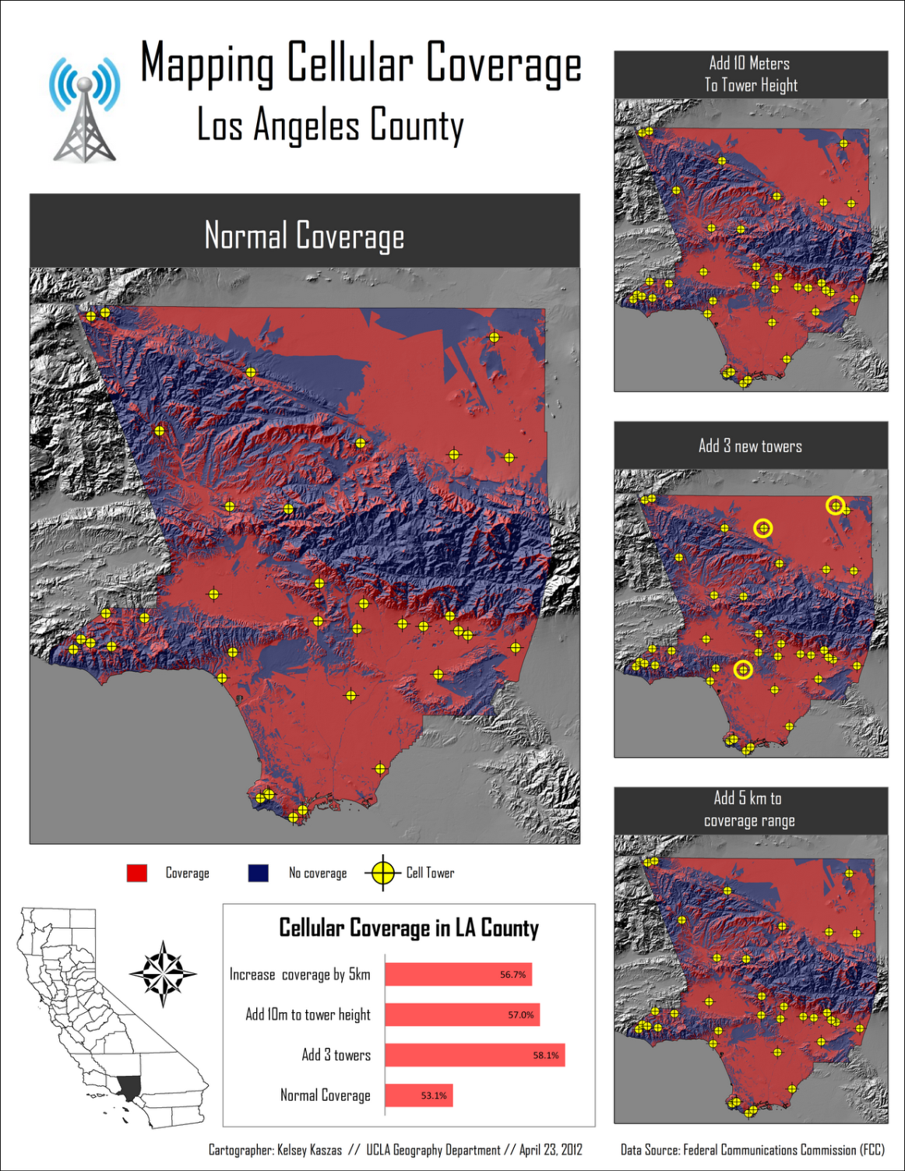
Terrain Analysis
Slope - degree or percent
Aspect - slope direction (0- 360˚)
Viewshed – which cells are visible from point locations
Catchment – e.g. watersheds
Flow path - distance of water flow to point

Slide 18
Hillshade for Texture Visualization

Slide 19
Distance Calculation

Slide 20
Gypsy Moth Risk in Michigan
Using overlays to identify stands of forest that are at high risk of gypsy moth infestation.

Slide 21
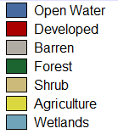
Land Use / Land Cover Change

Slide 22
Land Use / Land Cover Change
Which land covers gained and lost between the time period?
Which land covers gained or lost to which others?

Slide 23
Multi-Criterion Evaluation (MCE)
Farmland risk index for fracking development in Southwestern Pennsylvania
Combining multiple pieces of information to address a research question.
Variables are put into a similar scale, and can be weighted for importance.
Raster math is used to create the final output.

