Slide 1


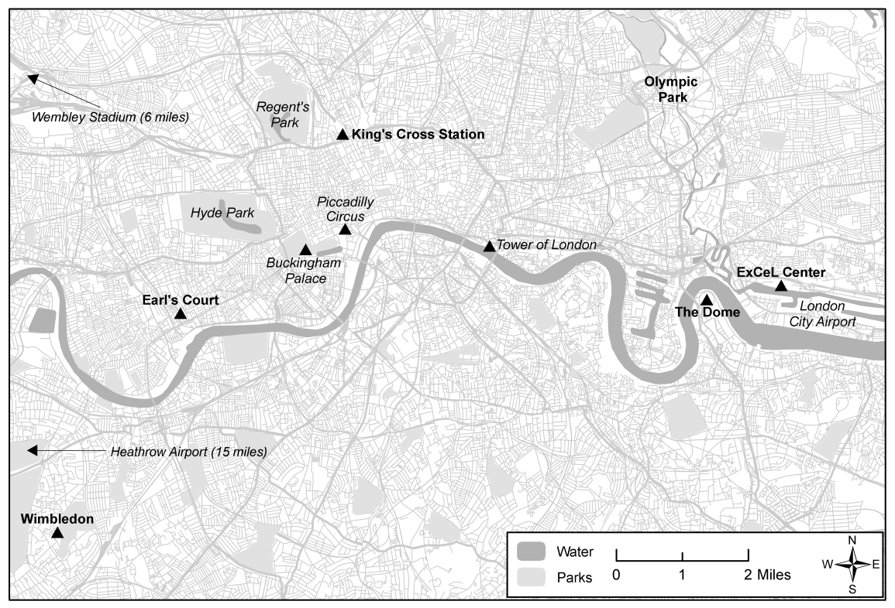
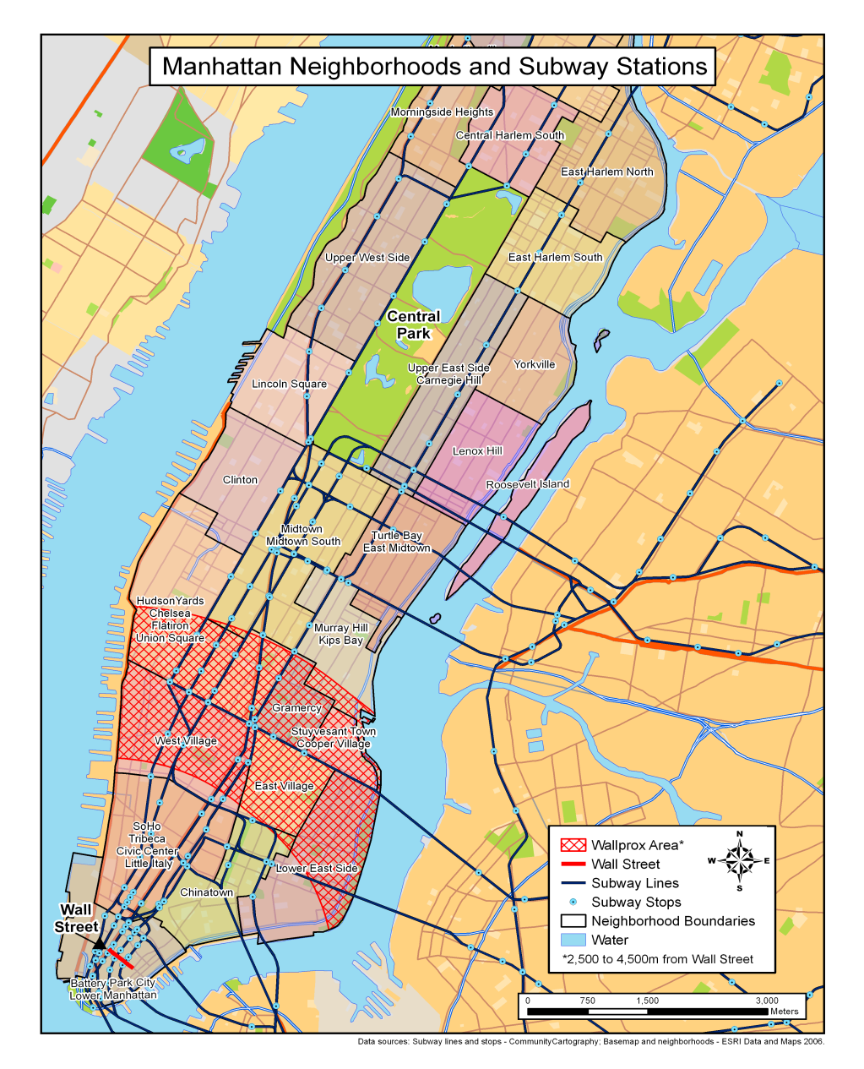

Center for Geographic Analysis services and projects
Jeff Blossom – jblossom@cga.harvard.edu
Summer GIS Institute - 2017
http://worldmap.harvard.edu

Slide 2


Center for Geographic Analysis (CGA)
Founded in 2006
A member organization of the Institute for Quantitative Social Science (IQSS)
Serves the entire University – anyone with a HUID

Slide 3

Our mission
To support research and education that relies on geographic information.

Slide 4

Service
Software Development
Teaching

Slide 5
CGA Basic Services
Maintaining help desks in both campuses;
Consulting with students, faculty, and staff on research and teaching projects;
Consulting on grant proposals;
Providing non-credit group instruction in geospatial software applications on a regular basis;
Assessing, organizing, financing for, and maintaining university site licenses for software;
Providing hardware and support for geospatial tools;
Undertaking initiatives that improve the university infrastructure in relation to geographic analysis.

Slide 6
GIS Training Workshops (2 hours ea.)
GIS Basics with ArcGIS
Wrangling Data into Maps
Making Sense out of Spatial Data
Introduction to Remote Sensing
Advanced Remote Sensing
GPS Data Collection
Database Design for GPS/GIS Applications
ModelBuilder for ArcGIS
Using Google’s Mapping Products
ArcGIS Online & Esri Maps for MS Office
Open Source Desktop GIS with Quantum
How to Use WorldMap

Slide 7


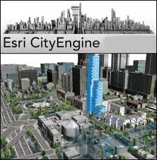






GIS Site Licenses

Slide 8
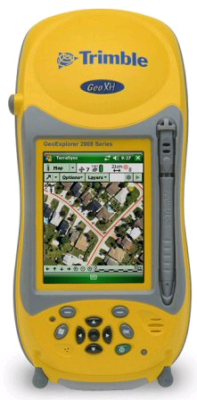
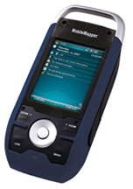

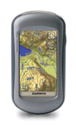

Equipment
Maintaining GPS receivers for use by Harvard affiliates.
Providing large format (42” wide) printing service.

Slide 9

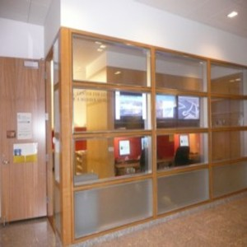
CGA Help Desk
Where:
  Cambridge Campus
  Rm K-00A, Lower Level
  Knafel Building , CGIS
  1737 Cambridge Street ,
  Cambridge, MA 02138and
  Longwood Campus
  Micro Lab, Lower Level
  Kresge Building
  677 Huntington Avenue
  Boston, MA 02115
  Harvard Business School (only on the 3rd
  Wednesday of each month)
  Baker Library, Room 130
  3 Soldiers Field Road, Boston, MA
When:
  Tuesday, 1:30pm - 4:00pm
Email:
  http://gis.harvard.edu/contactus
CGA’s location at
1737 Cambridge St.
The Cambridge Help Desk

Slide 10

Research Consultation
Data issues, e.g.
  Public and commercial data sources
  Data collection and management techniques
  Data conversion, scanning, digitizing, etc.
Hardware/software issues, e.g.
  What GPS to buy – accuracy, compatibility, etc.
  Which software to use for various tasks
Methodology issues, e.g.
  How to select parameters in spatial interpolation
  How to build location-allocation models
Visualization issues, e.g.
  How to do 3-D maps or time-series animation
  How to allow users make interactive maps from a web browser

Slide 11
Consultation and Service Projects usually fall into one of these 4 groups:
Geocoding
GIS Analysis
Maps and Visualization
Web Maps

Slide 12
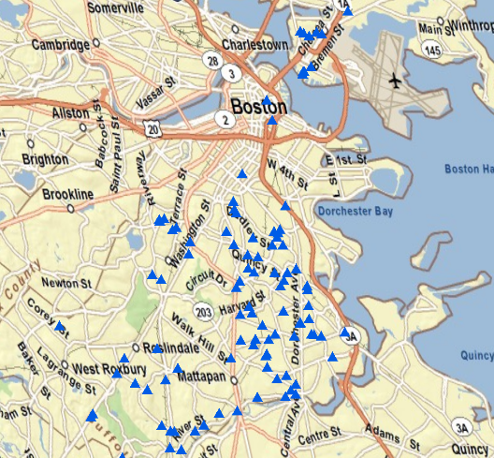
Address geocoding example: Boston foreclosures
Address | City | State
39 Brookview St. | Boston | MA
1916 Hyde Park Ave. | Boston | MA
883 Harrison Ave. | Boston | MA
etc…

Slide 13
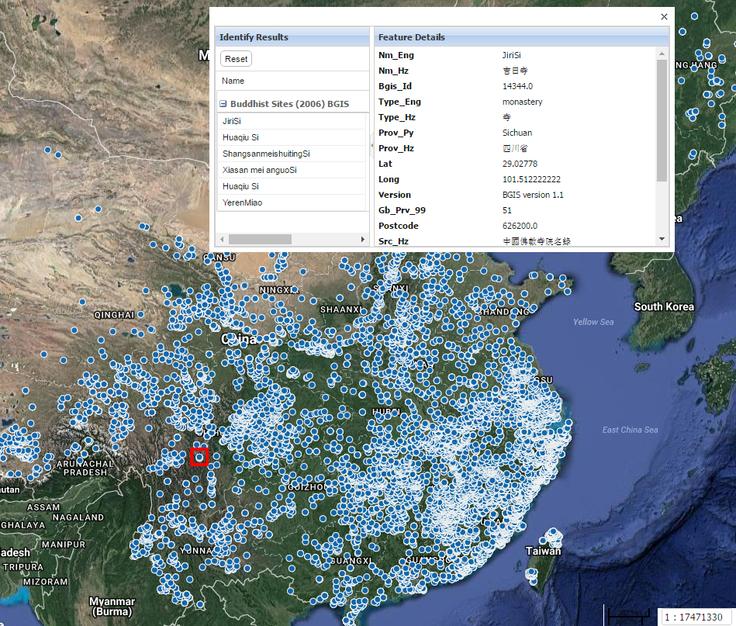
Village geocoding example: Buddhist monasteries
Notes:
http://worldmap.harvard.edu/maps/chinamap/WW5

Slide 14
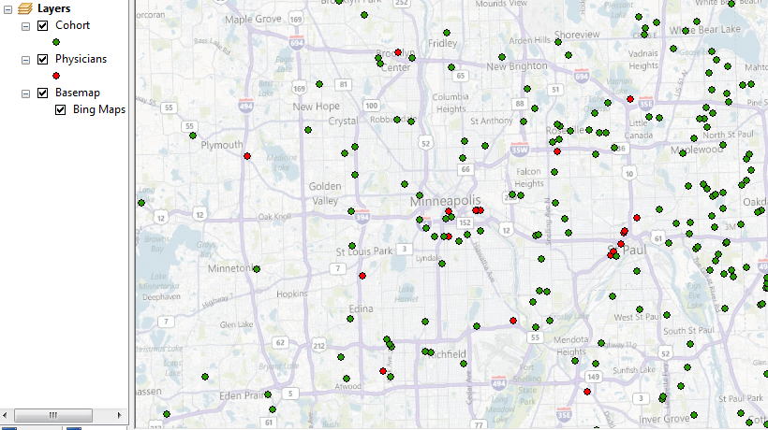
CGA Service Projects: Geocoding
Health Care Accessibility

Slide 15
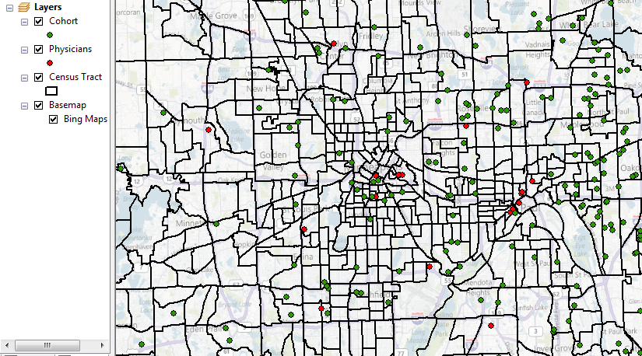
CGA Service Projects: Geocoding
Health Care Accessibility → Census tract determination

Slide 16
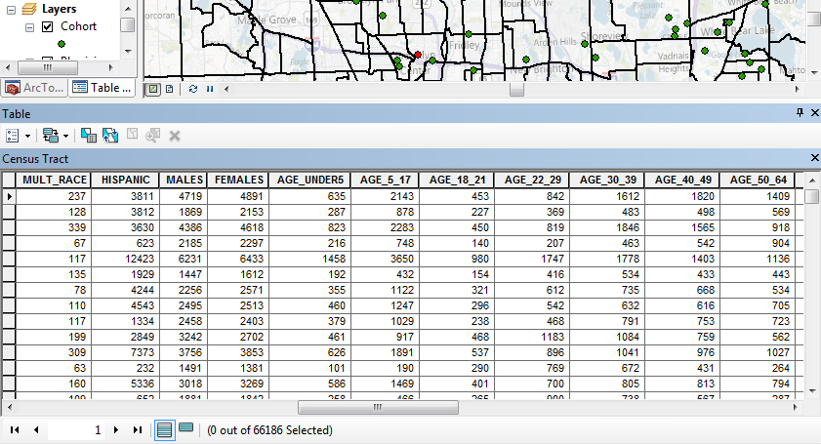
CGA Service Projects: Geocoding
Health Care Accessibility → Census tract determination → Socio-economic break down of cohort

Slide 17
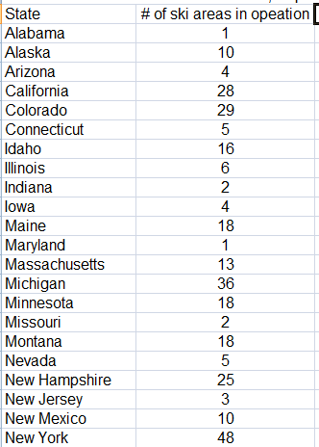
CGA Service Projects: Geocoding
Administrative area
geocoding to produce a
thematic map such as
ski areas per U.S. state

Slide 18
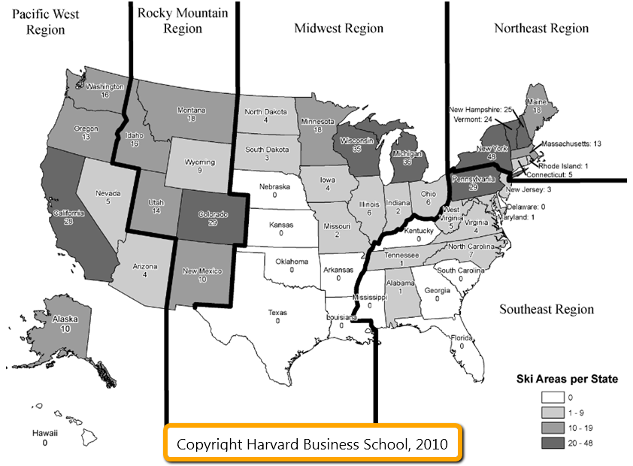
Notes:
CGA project for harvard business school

Slide 19
Consultation and Service Projects usually fall into one of these 4 groups:
Geocoding
GIS Analysis
Maps and Visualization
Web Maps

Slide 20
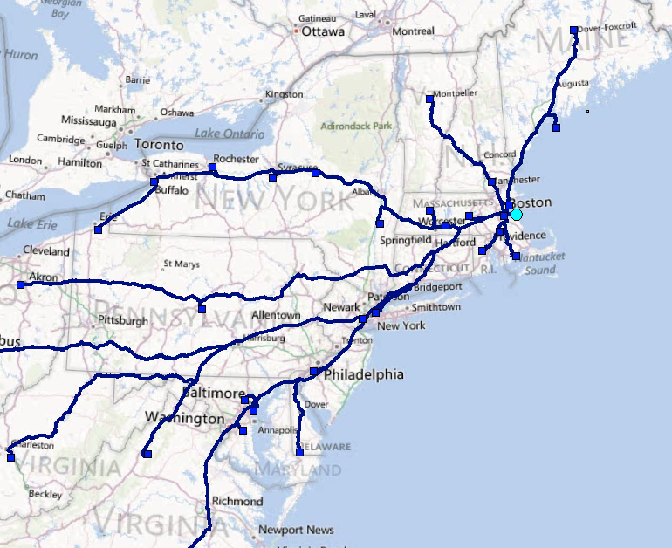


Slide 21
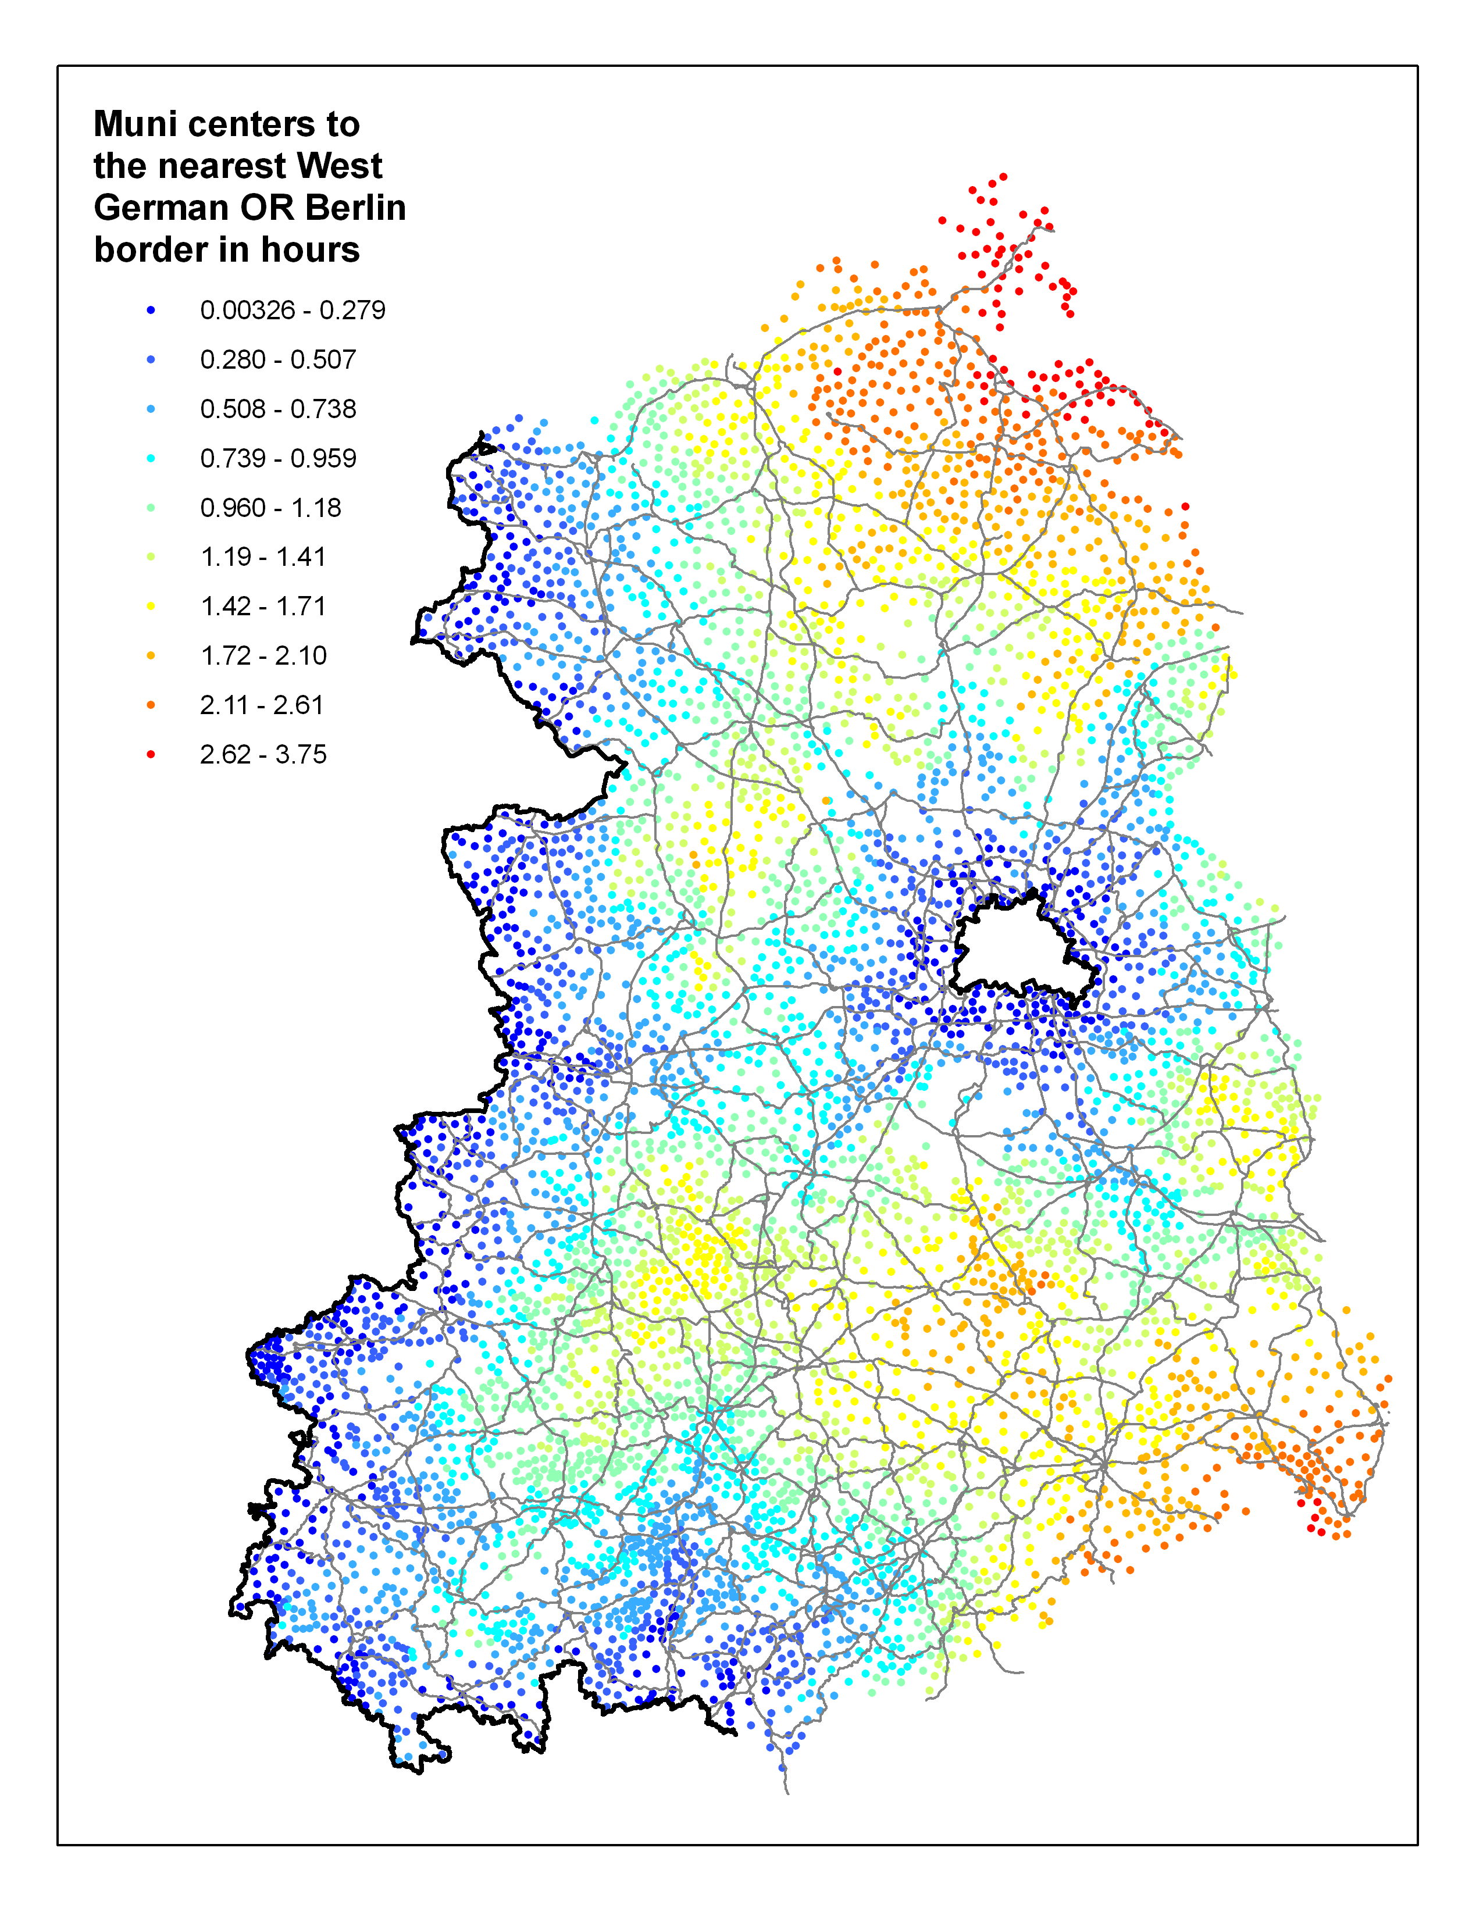

Slide 22
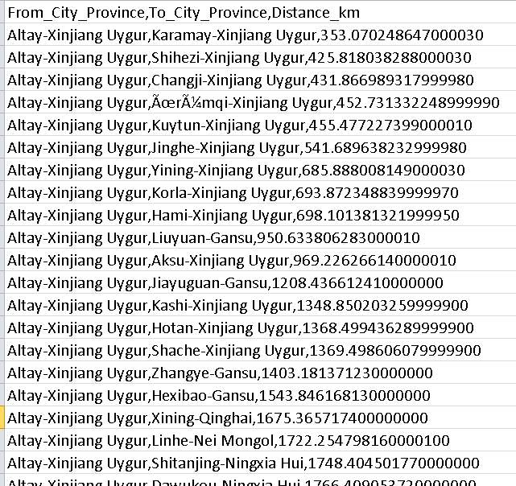
GIS Analysis: Chinese city distance calculations

Slide 23

CGA project: Building a comprehensive database of social and environmental stressors for 1,000 patient locations for an asthma study
1,000 locations for an asthma study
PESBART
Effects of Physical Environment and Stress in Blacks in relation to Asthma severity and Response to Therapy

Slide 24
GIS Variables created for Specific Research Questions
  Does weather play a role in the incidence or severity of asthma events? If so, what components of weather should we look at?
  What environmental allergens could be collected via GIS research?
  Do social events in a person’s life influence asthma severity? For example, divorce, abuse, death in family?
  Does food/nutrient intake, sun exposure (vitamin D) effect asthma outcomes? What about exercise and physical fitness?

Slide 25
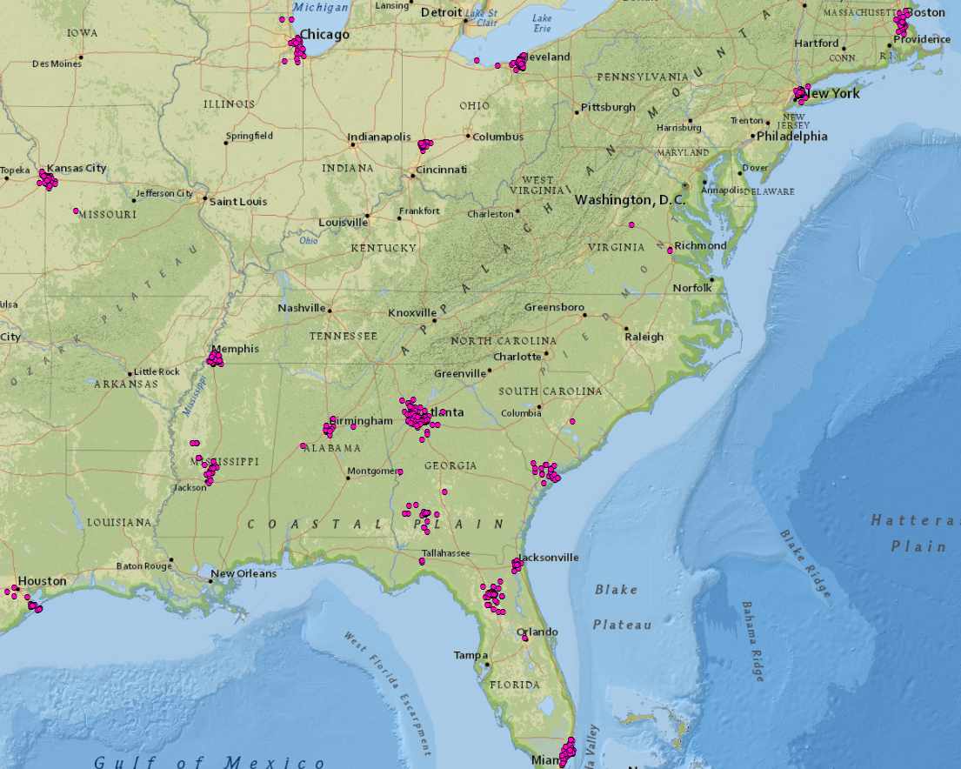
Overall Geographic Distribution of PESBART address locations (1,075)

Slide 26
Summary of Specific GIS variables Collected
Air Quality Distance to major road mileage of major roads nearby pollen severity, AQI, Ozone, SO2, CO, NO2, PM_2.5 distance to nearest factory, factories nearby | Community Amenity Access Distance to and densities of: Pharmacies, hospitals, subway stations, bike paths, libraries, supermarkets, athletic centers, day care centers.
Crime and Chronic Stress Alcohol consumption, homicides, rapes, robberies, assaults, thefts, auto thefts. | Consumer Spending Prescription drugs for asthma, Vitamin D supplements, total medical expenditures, groceries, fitness, pet products, vet visits.
Demographic Educational attainment, race, age, rural/urban, household size, tenure, multiple family and single parent households. | Economic Unemployment, poverty, income inequality, median household income, community economic growth or decline, food stamps, delayed rent or mortgage payments.
Housing conditions Peeling paint, water leaks, inadequate heating, # units occupied, age of structure, square footage, construction type, presence / lack of heating, air conditioning, gas stoves and heaters. | Weather/Environment Temperature, precipitation, humidity, wind speed, % sunshine, PBL, extreme weather events, NDVI.

Slide 27
Specific GIS variables not Collected
Air Quality Idling laws, busses with emissions controls, number of stoplights, traffic counts, advocacy to improve air quality. | Community Amenity Access Public health programs, outreach programs, subsidized public transportation, MD’s per capita, mixed use development, zoning regulations.
Crime and Chronic Stress Abandoned or foreclosed homes, domestic abuse, calls to 911, protection orders, litter, graffiti, vandalized buildings, neighborhood disorder, divorce rate, deaths, ambulance data, domestic abuse, criminal victimization | Consumer Spending Non-prescription drugs for asthma, Primateen mist, Metanephryn, taking medicine or receiving treatment for mental health or emotional problems.
Housing conditions Mold, dust mites, rodent, roach, and bed bug infestations and exposers. | Social General Social Survey, Gallup Well-Being Index, psychosocial measures, Behavioral Risk Factor Surveillance System survey.
7

Slide 28
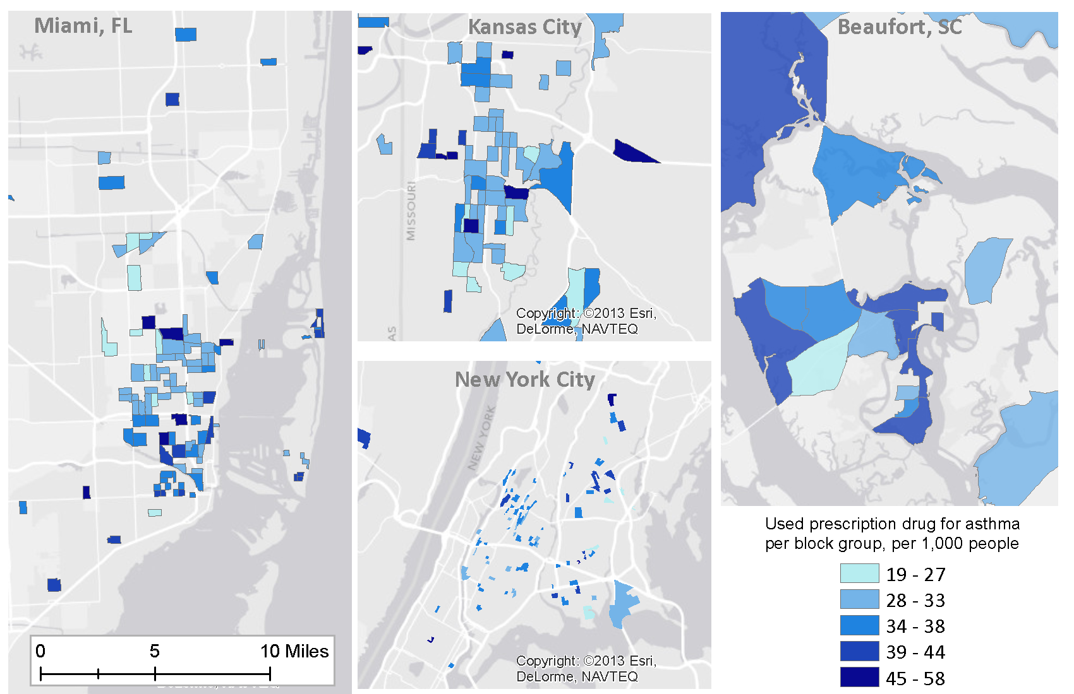
GIS Variable: Used prescription drug for asthma in 2013

Slide 29
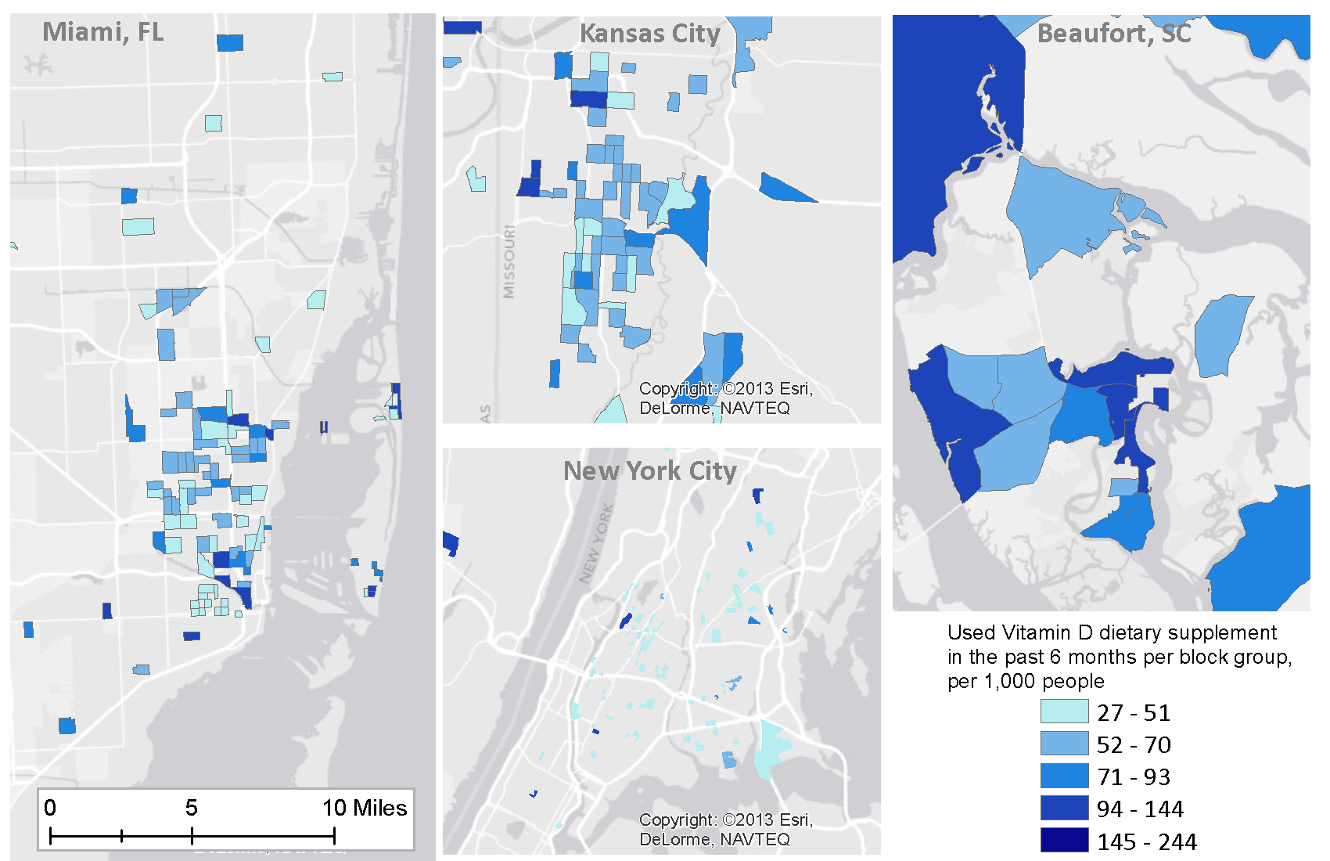
GIS Variable: Used Vitamin D supplement, past 6 months

Slide 30
GIS Variable: Distance to nearest bus or train terminal, or subway stop
Count (n=1,075)
Distance

Slide 31
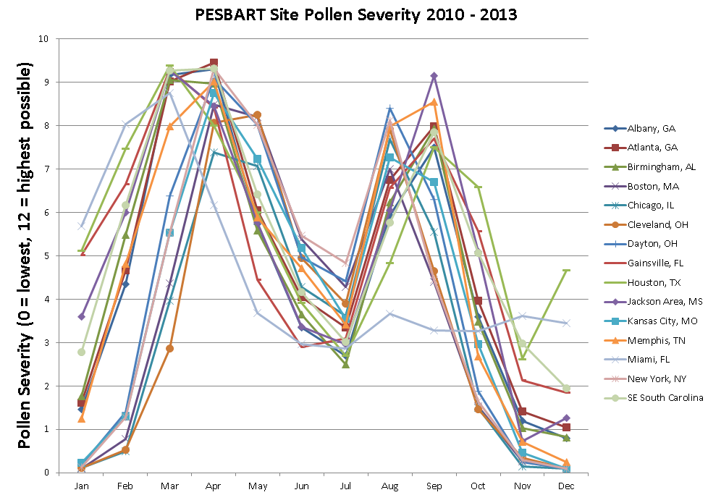

Slide 32
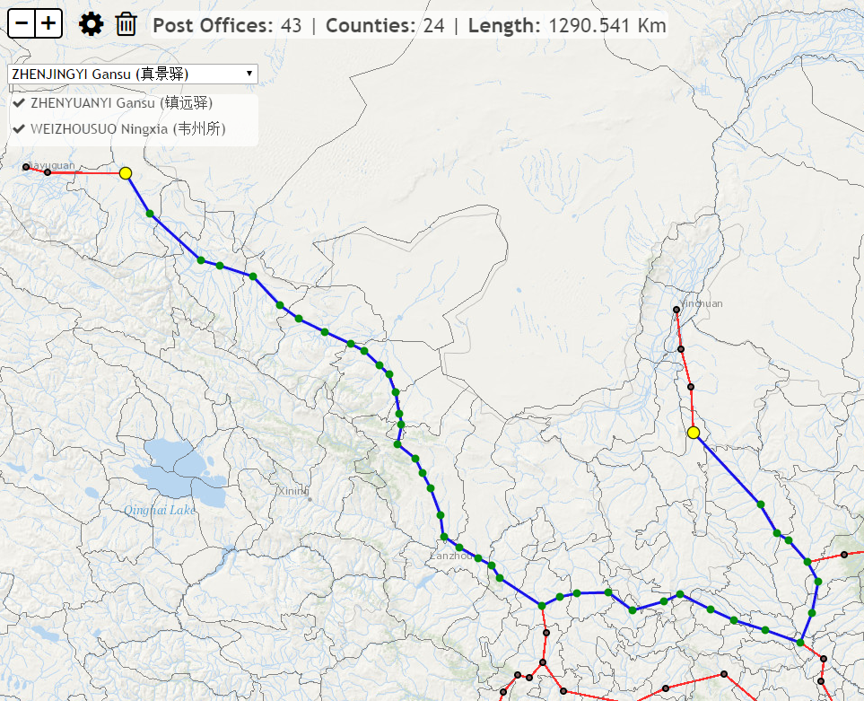
Custom analytical web map: Esri
The Chinese Late Ming Dynasty Courier Route System
Notes:
http://maps.cga.harvard.edu/chinapostoffice/

Slide 33
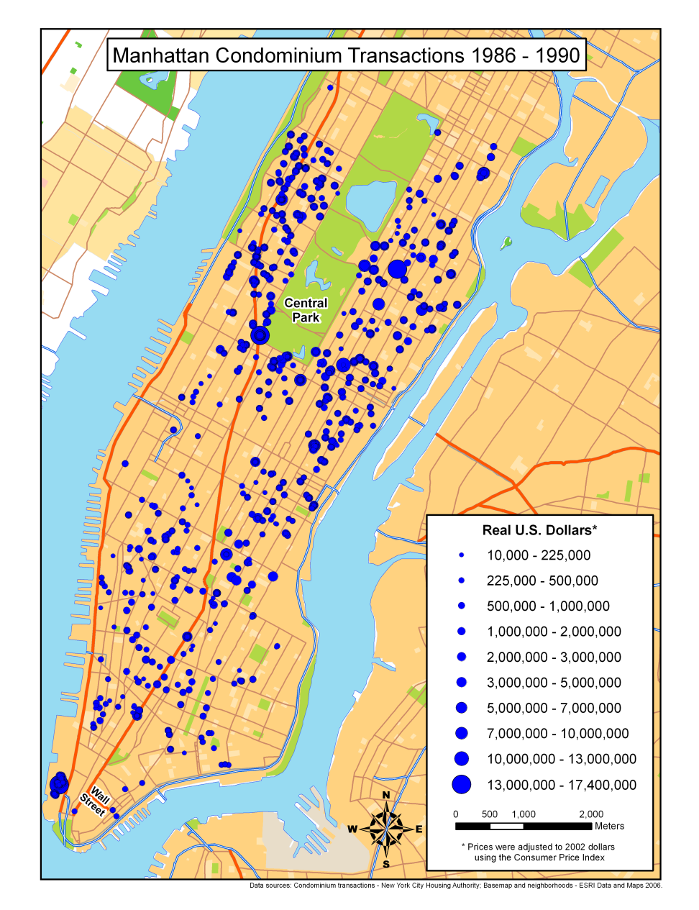
New York City Real Estate Analysis
CGA Service Projects: GIS Analysis
Notes:
Through regression analysis of many geographic variables (distance to schools, water, Wall Street, Central park, etc.)
It was determined that the area that property values appreciated the most was within 2,500 and 4,500 meters of Wall street.

Slide 34
Consultation and Service Projects usually fall into one of these 4 groups:
Geocoding
GIS Analysis
Maps and Visualization
Web Maps

Slide 35
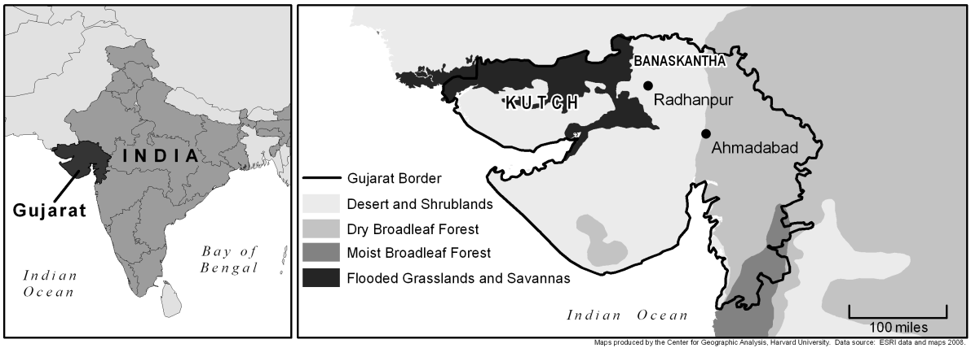
CGA Service Projects: Maps and Visualization
Venues of the 2012 London Olympics
Land cover of Gujarat province, India

Slide 36
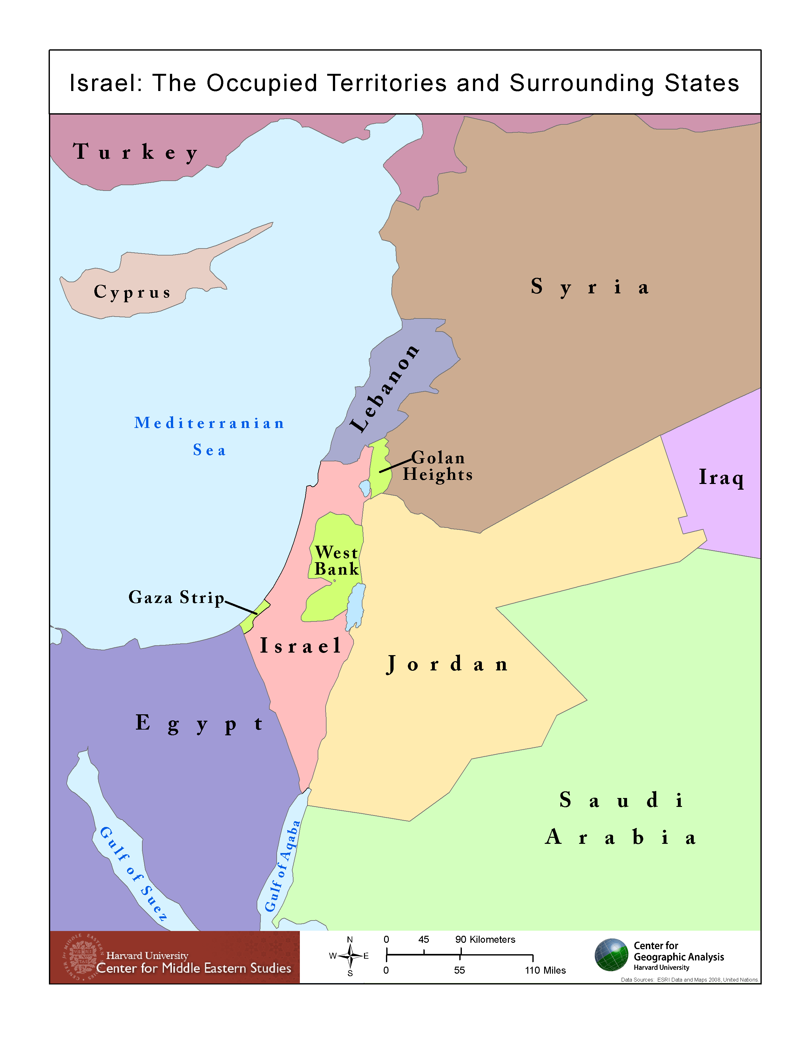
CGA Service Projects: Maps and Visualization
Center for Geographic Analysis Service Projects

Slide 37
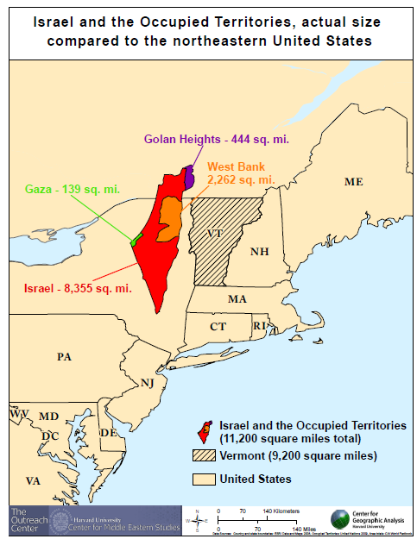
CGA Service Projects: Maps and Visualization

Slide 38
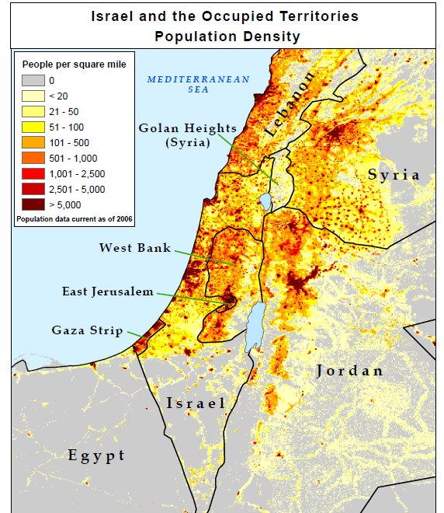
CGA Service Projects: Maps and Visualization

Slide 39
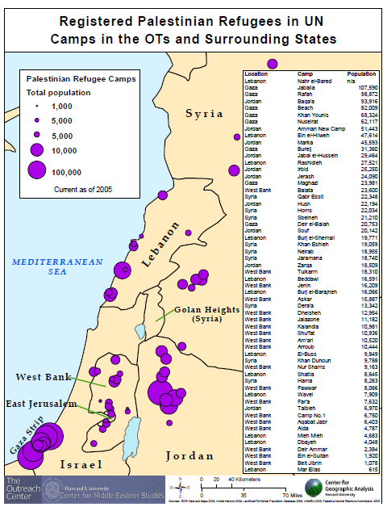
CGA Service Projects: Maps and Visualization

Slide 40
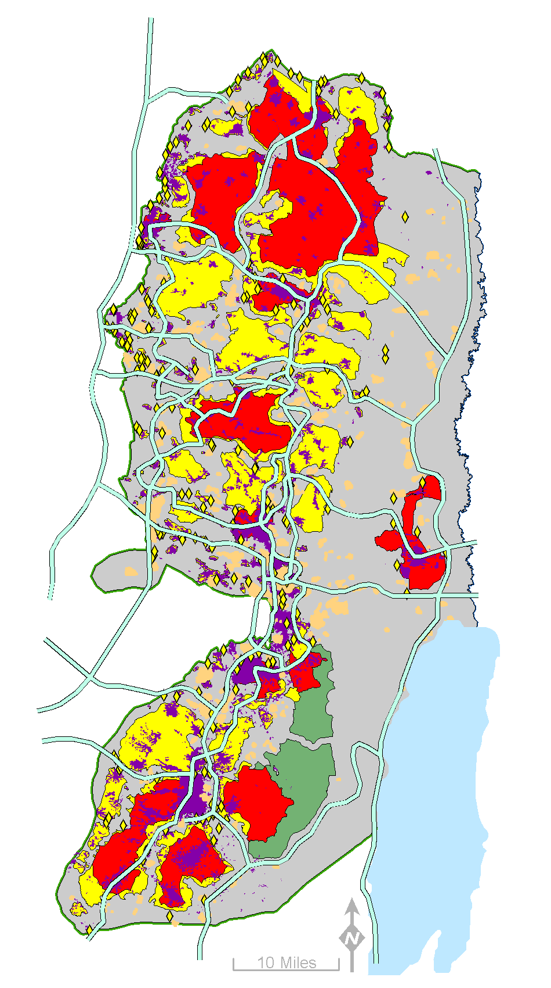
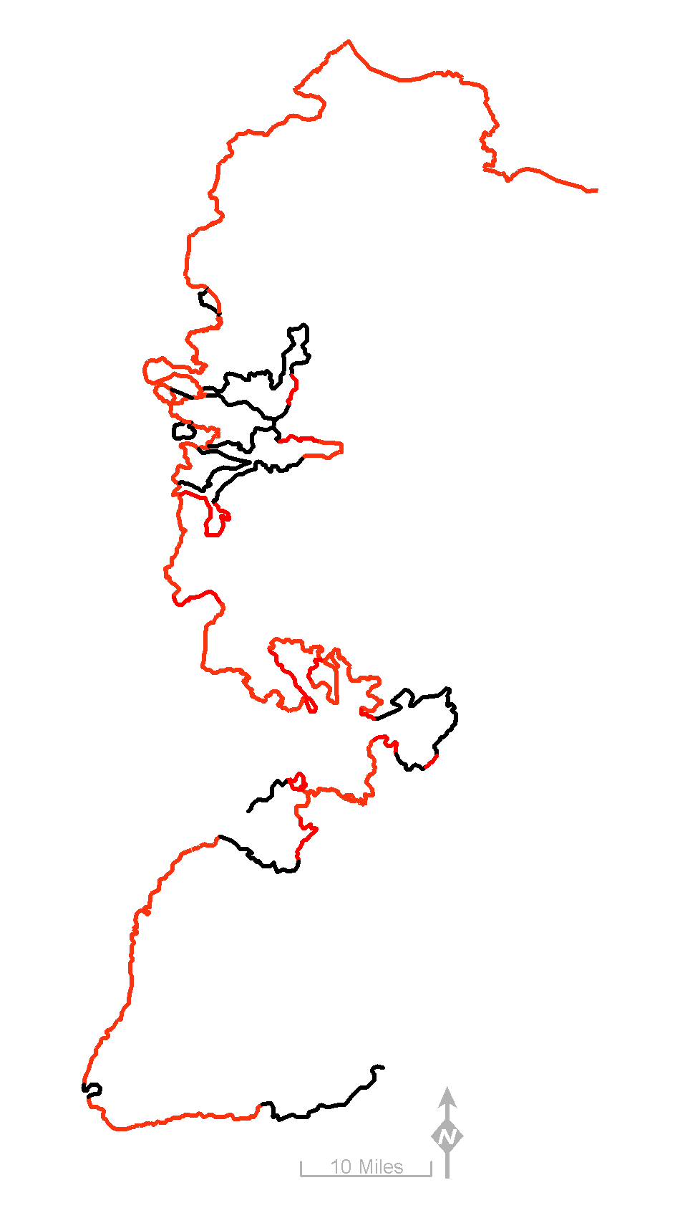
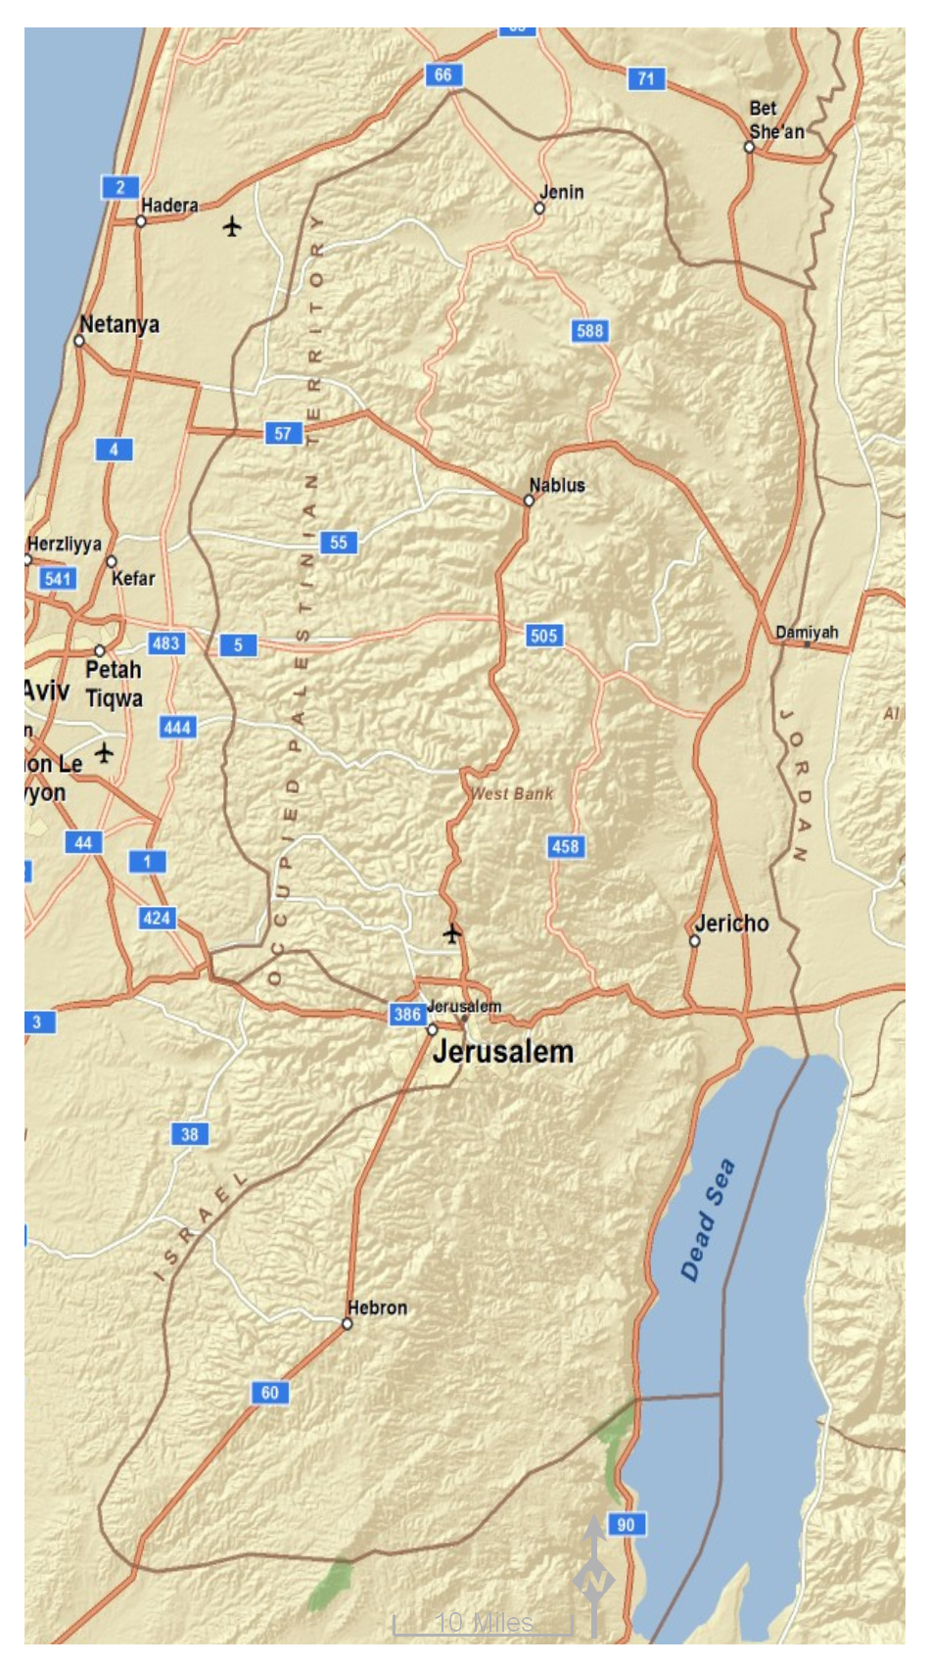
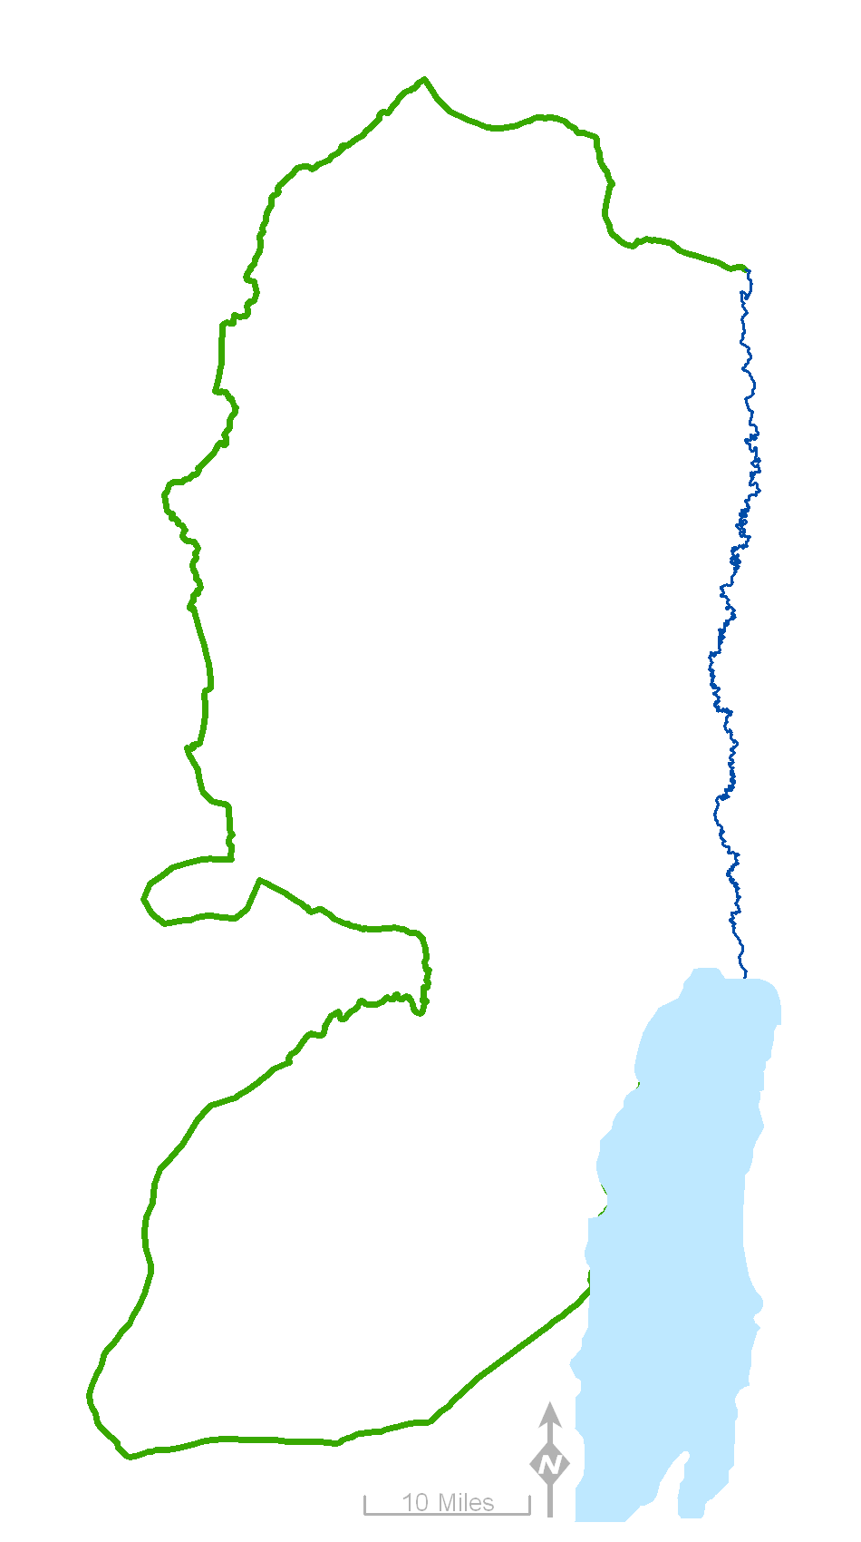
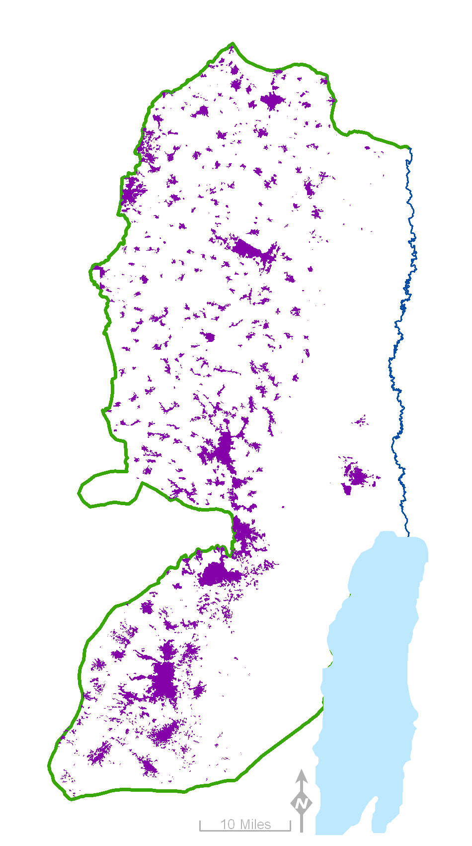
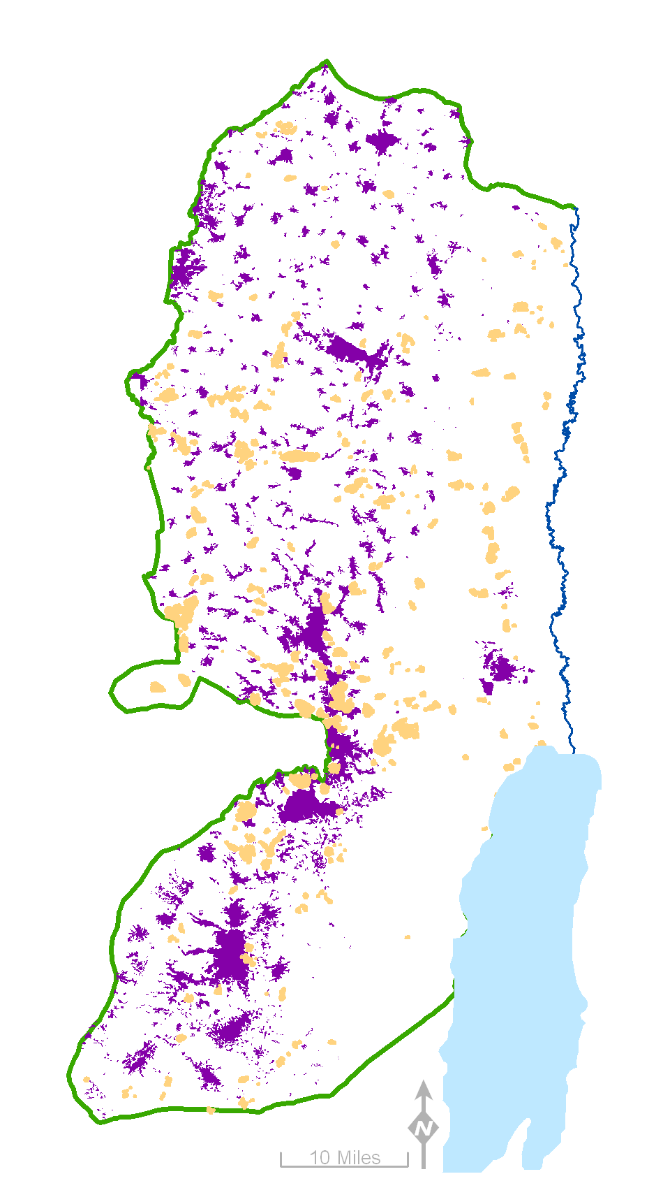
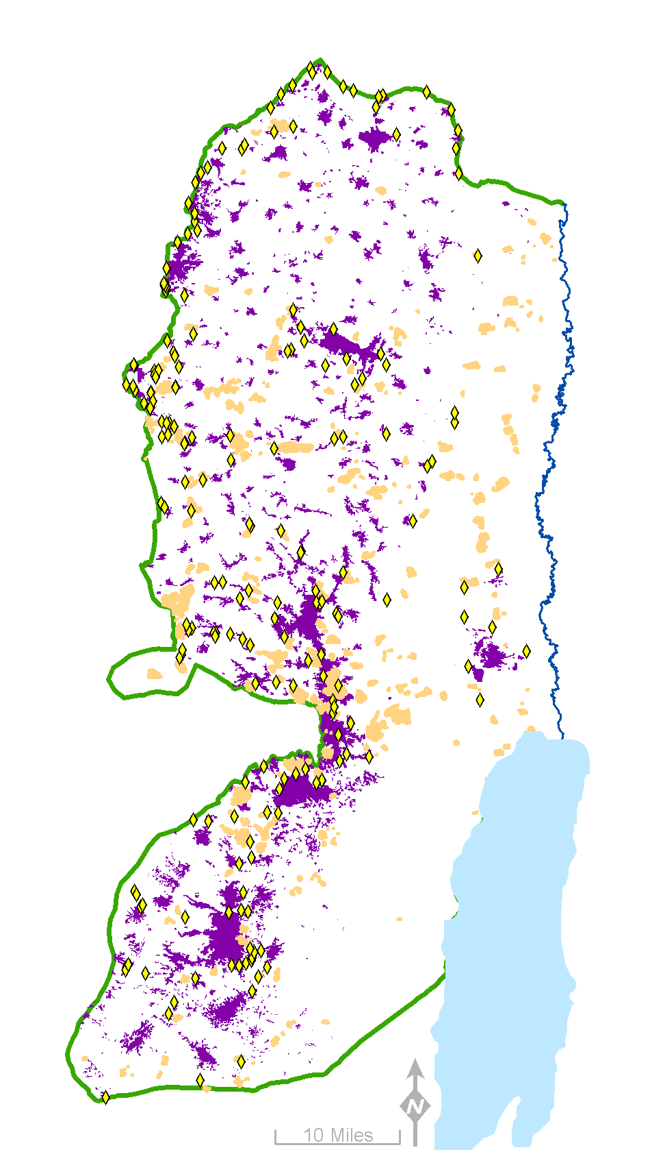
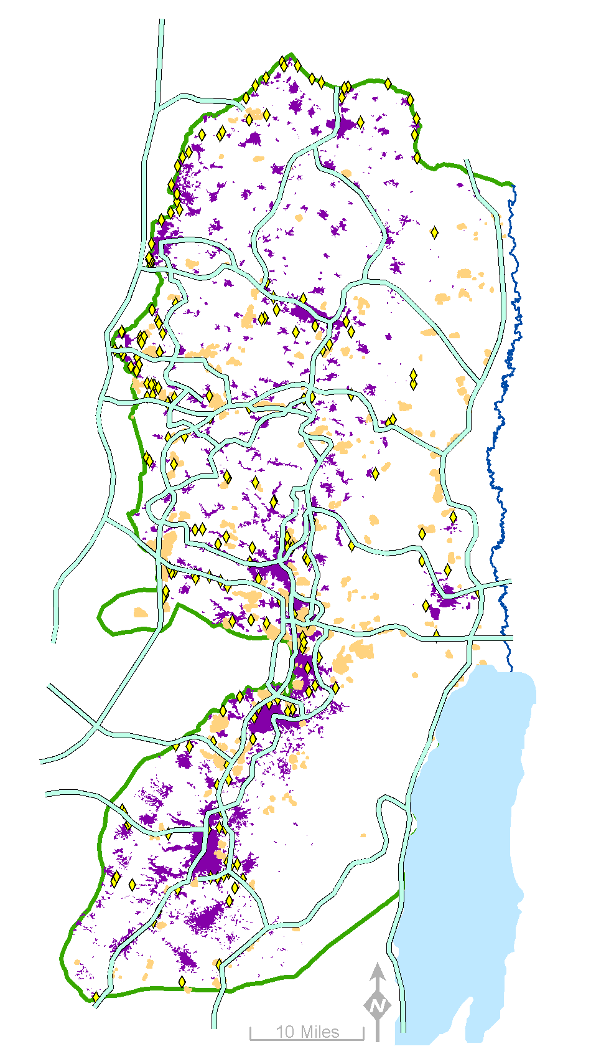
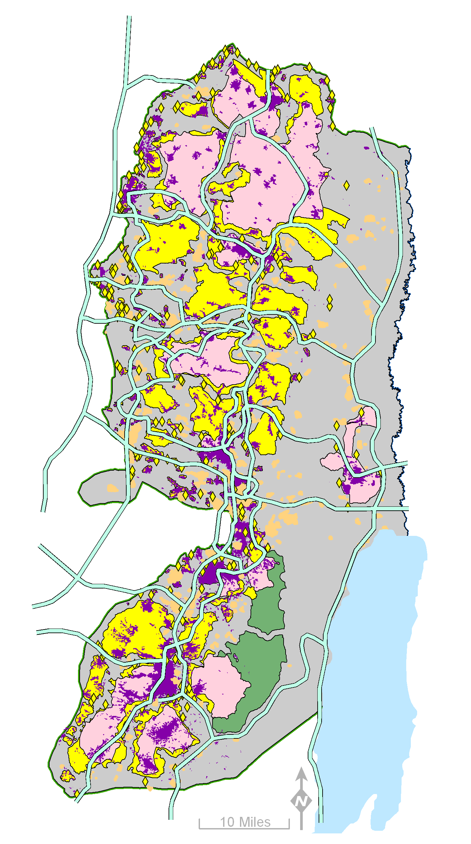
West Bank under
Military Occupation
The Green Line
Palestinian population areas
Israeli settlements and military locations
Check points, barriers, and wall gates*
Bypass roads
Areas A B C Nature Reserve
A B C
% of West Bank land: 17.6 18.3 61.0
% WB Israeli population: 0 0 100%
The wall constructed planned
* Only 249 of approximately 750 are depicted on the map

Slide 41
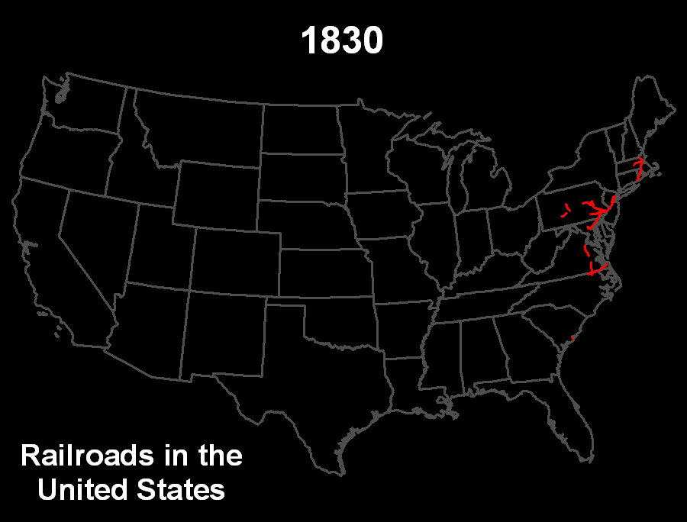
Notes:
Maps can show patterns over time.
http://www.schofieldbros.com/railroads.html

Slide 42
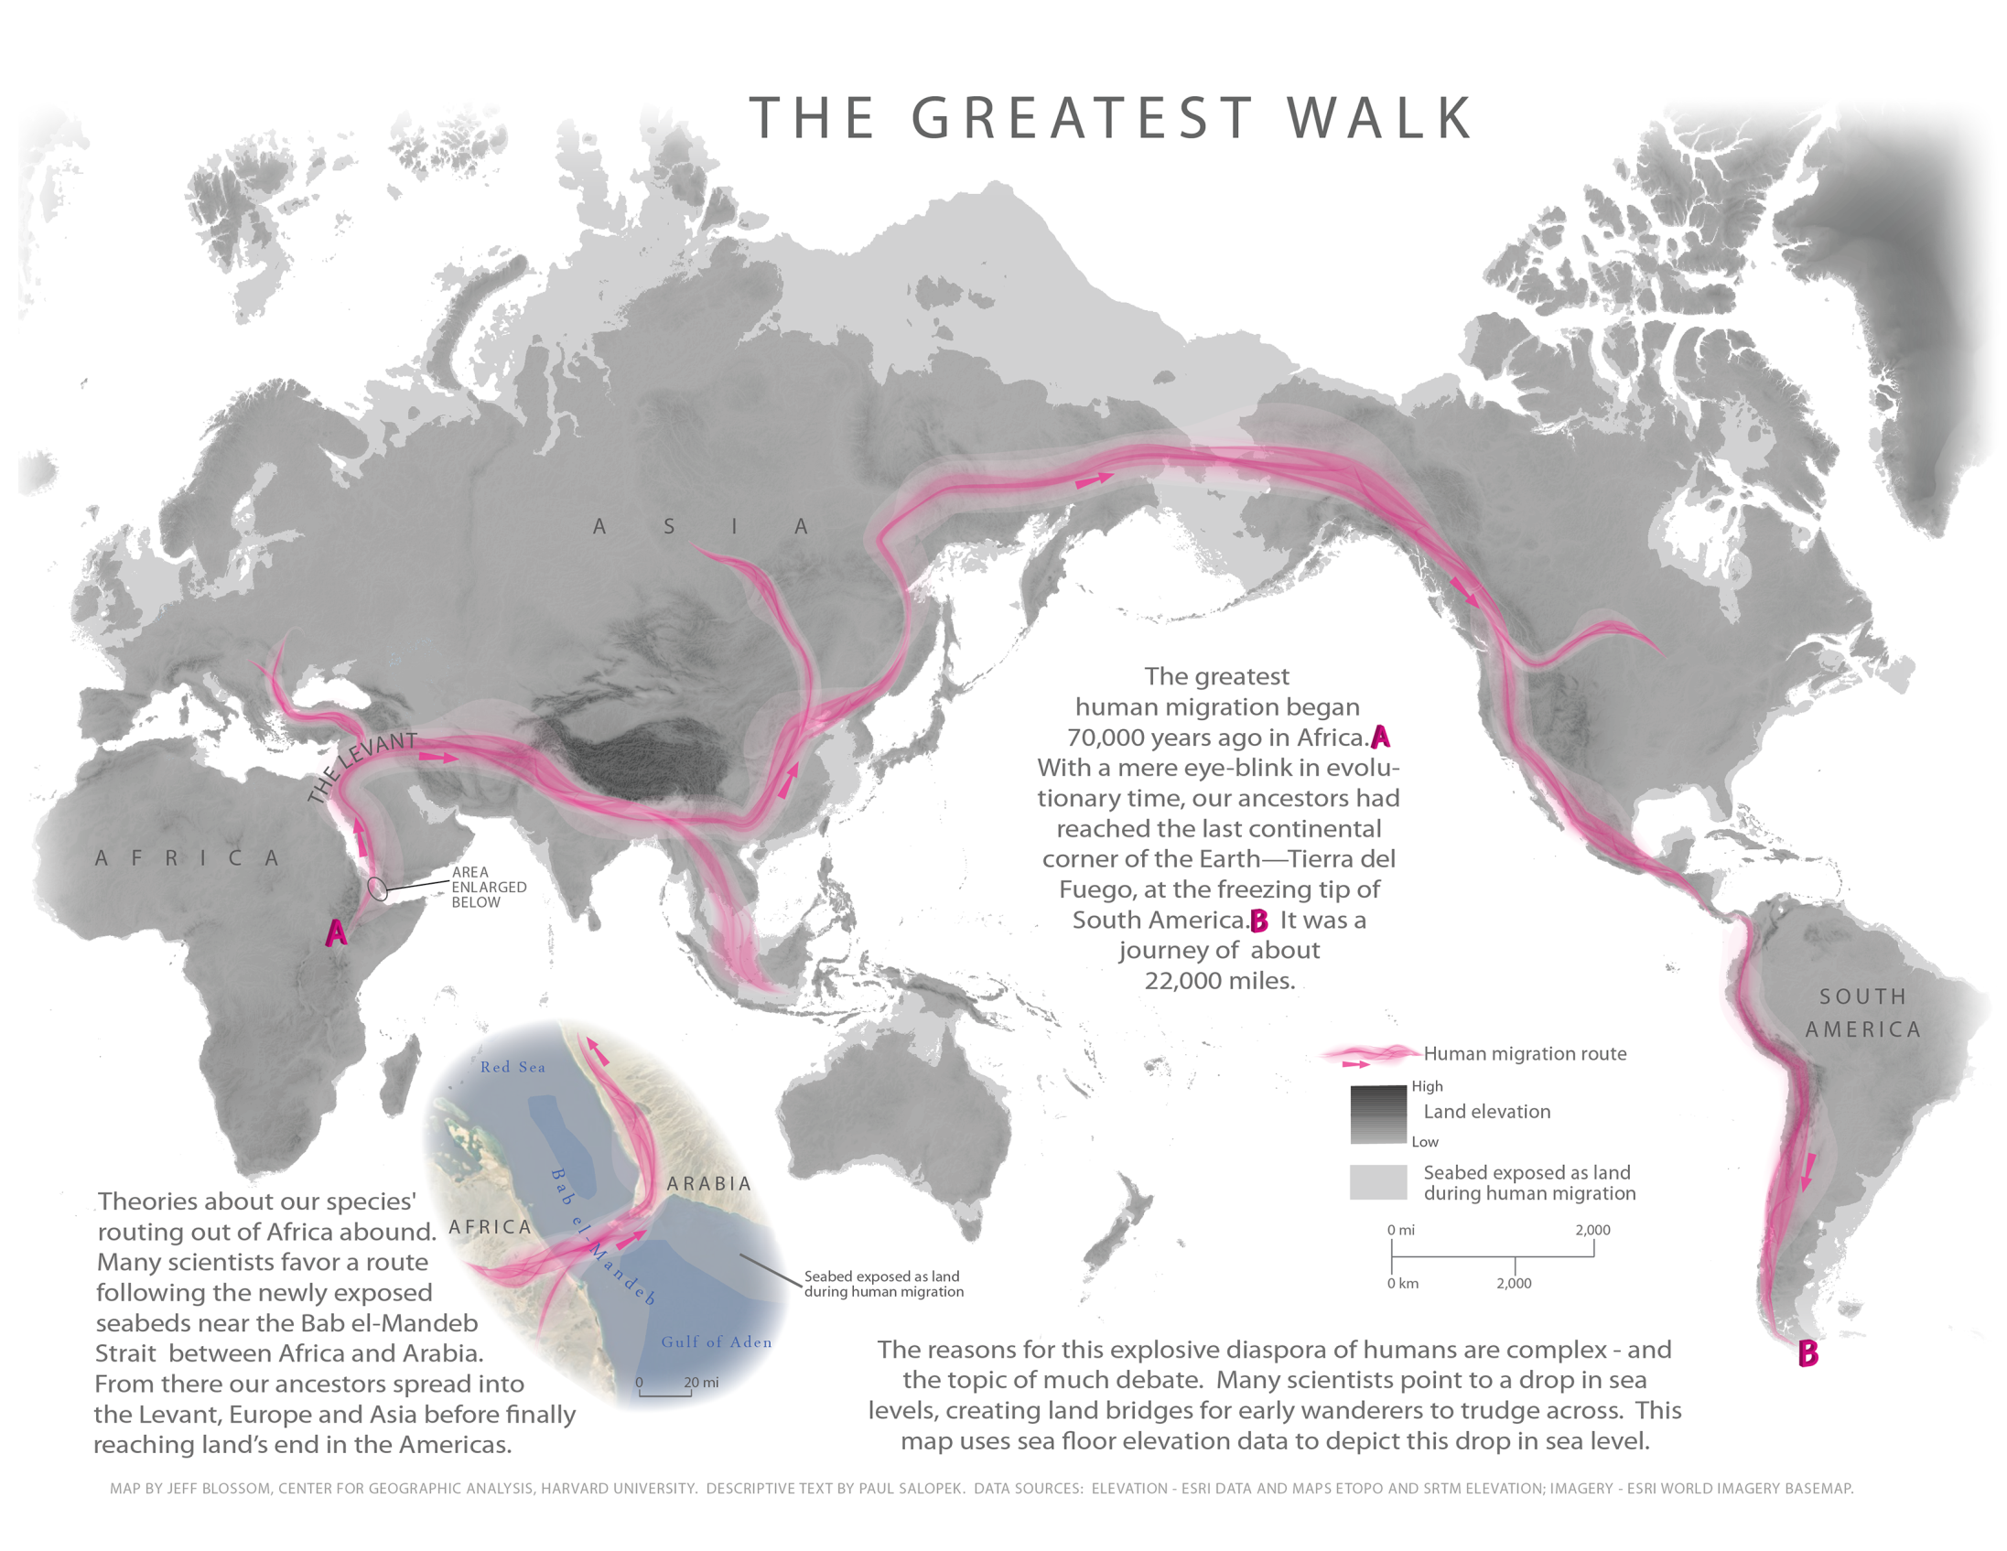


Notes:
http://www.outofedenwalk.com/
http://www.outofedenwalk.com/map-room/thematic-maps/

Slide 43
Notes:
http://www.outofedenwalk.com/
http://www.outofedenwalk.com/map-room/thematic-maps/

Slide 44
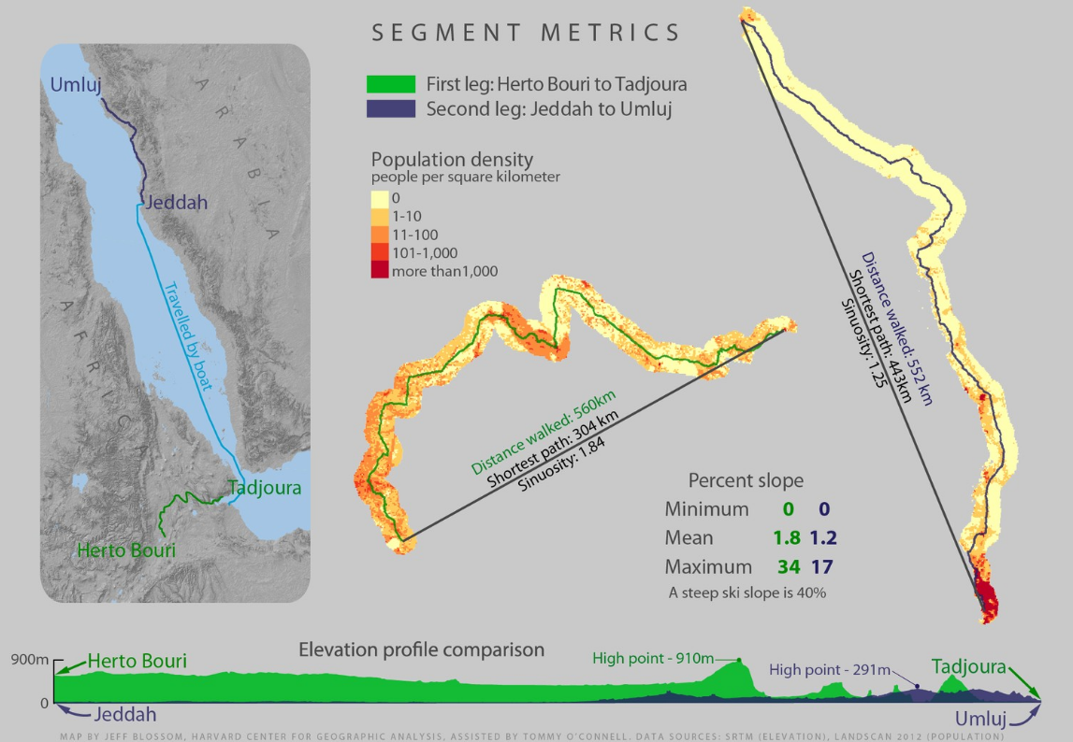
Notes:
http://www.nationalgeographic.org/projects/out-of-eden-walk/media/2013-12-1312_segment_metrics

Slide 45
Consultation and Service Projects usually fall into one of these 4 groups:
Geocoding
GIS Analysis
Maps and Visualization
Web Maps

Slide 46
What is Web Mapping?
GIS + World Wide Web
Major types of web maps:
  Visual
  Analytic
  Animated
  Collaborative (OSM)
  Realtime (Traffic, Earthquake, Weather)
Notes:
Fusion of classic GIS and the WWW trough the main web browser such as (FF, IE, Chrome, Safari,....)
Type:
Closest to the classic GIS environment because offers GIS analysis.
Visualize spatial data
show changes in the map over time by animating one of the graphical or temporal variables
show the situation of a phenomenon in close to realtime (only a few seconds or minutes delay)
46

Slide 47
Web mapping evolution:
Map Servers (MapServer, GeoServer, Esri IMS)
APIs (Google Maps, others)
Online Mapping Frameworks
1997
2005
2013
1990
2000
2010

Slide 48













Web Mapping today…
Fusion Tables
Notes:
Today we are facing an exciting time for what concern mapping on the WEB.
There are several online platforms and tools to create a web map and visualize your data.
Many of those are free.
All of them try to minimize the barrier between non specialized users and final product (map) that gets created.
Some of them have also started to leverage the analytical side of mapping.
CGA has develop is own platform called WorldMap,
Focus on a specific Google product (Fusion Tables).
Fusion Tables is an experimental data visualization web application to gather, visualize, and share larger data tables.
So, what’s very interesting about FT from a mapping prospective is the fact that contains several geographical features
or functionality.
HyperCities: Platform for organizing historical maps collaboratively
48

Slide 49
 | Analytic | Visual | Animated | Collaborative | Realtime | API | Cost
Google Maps |  |  |  |  |  |  | Pricing model based on functionality and usage
ESRI |  |  |  |  |  |  | Pricing model
CartoDB |  |  |  |  |  |  | Pricing model
MangoMap |  |  |  |  |  |  | Pricing model
MapBOX |  |  |  |  |  |  | Pricing model
GIS Cloud |  |  |  |  |  |  | Pay As You Go
MapLarge |  |  |  |  |  |  | Pay As You Go
GeoCommons |  |  |  |  |  |  | Pay As You Go
Mapzen |  |  |  |  |  |  | Free
Google Fusion Table |  |  |  |  |  |  | Free
MapStory |  |  |  |  |  |  | Free
hypercities |  |  |  |  |  |  | Free
Leaflet |  |  |  |  |  |  | Free
WorldMap |  |  |  |  |  |  | Free
Notes:
This is just a table that try to recap

Slide 50
What is WorldMap
A web-based, cloud hosted mapping platform
Made available to the world to use
Designed to lower barriers for researchers who wish to use geospatial technology
Open source software with a global developer community

Slide 51
WorldMap Allows Users to
Organize one’s own (large) mapping datasets online
Discover other people’s (public) data
Mashup / Overlay one’s data with data of others
Create maps with complex symbology
Collaborate by letting several people edit the same map, comment on maps and rank data
Publish maps and data to the world or to just a few collaborators

Slide 52
Connection to Many Data Sources
Google maps, Open Street Maps, Bing, MapQuest, ESRI
Google Street View
Google Earth
Picasa, YouTube, GeoRSS
Geonames, Google Places, Yahoo Places
Social Explorer, Yelp
WMS, WFS, ESRI REST, MapD

Slide 53
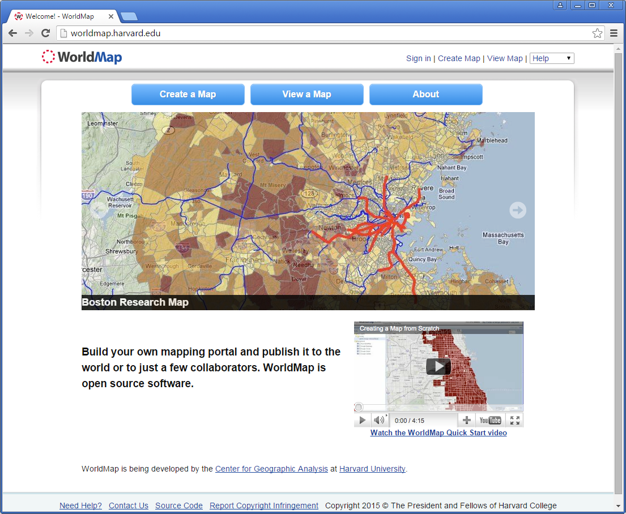
Notes:
http://worldmap.harvard.edu/

Slide 54
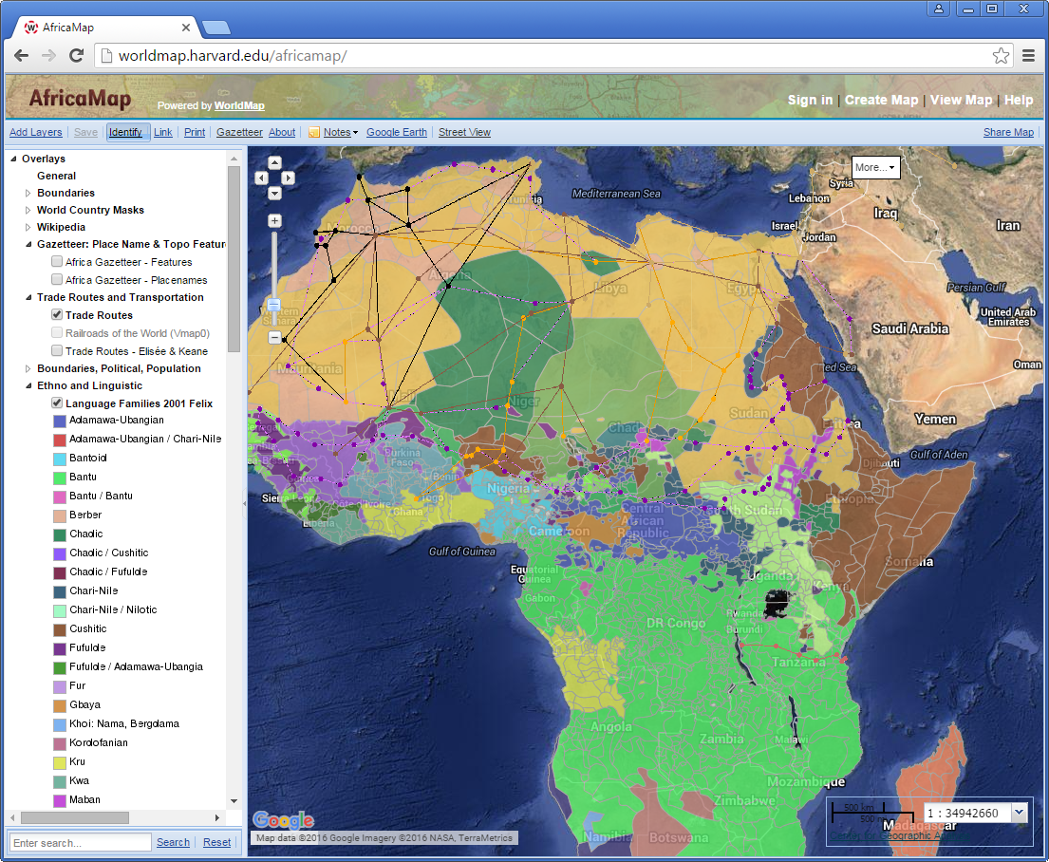
Notes:
http://worldmap.harvard.edu/africamap/

Slide 55
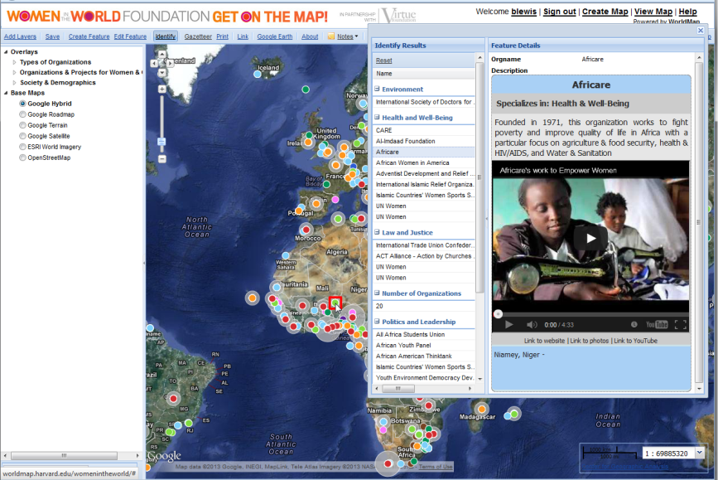
Notes:
http://worldmap.harvard.edu/womenintheworld/

Slide 56
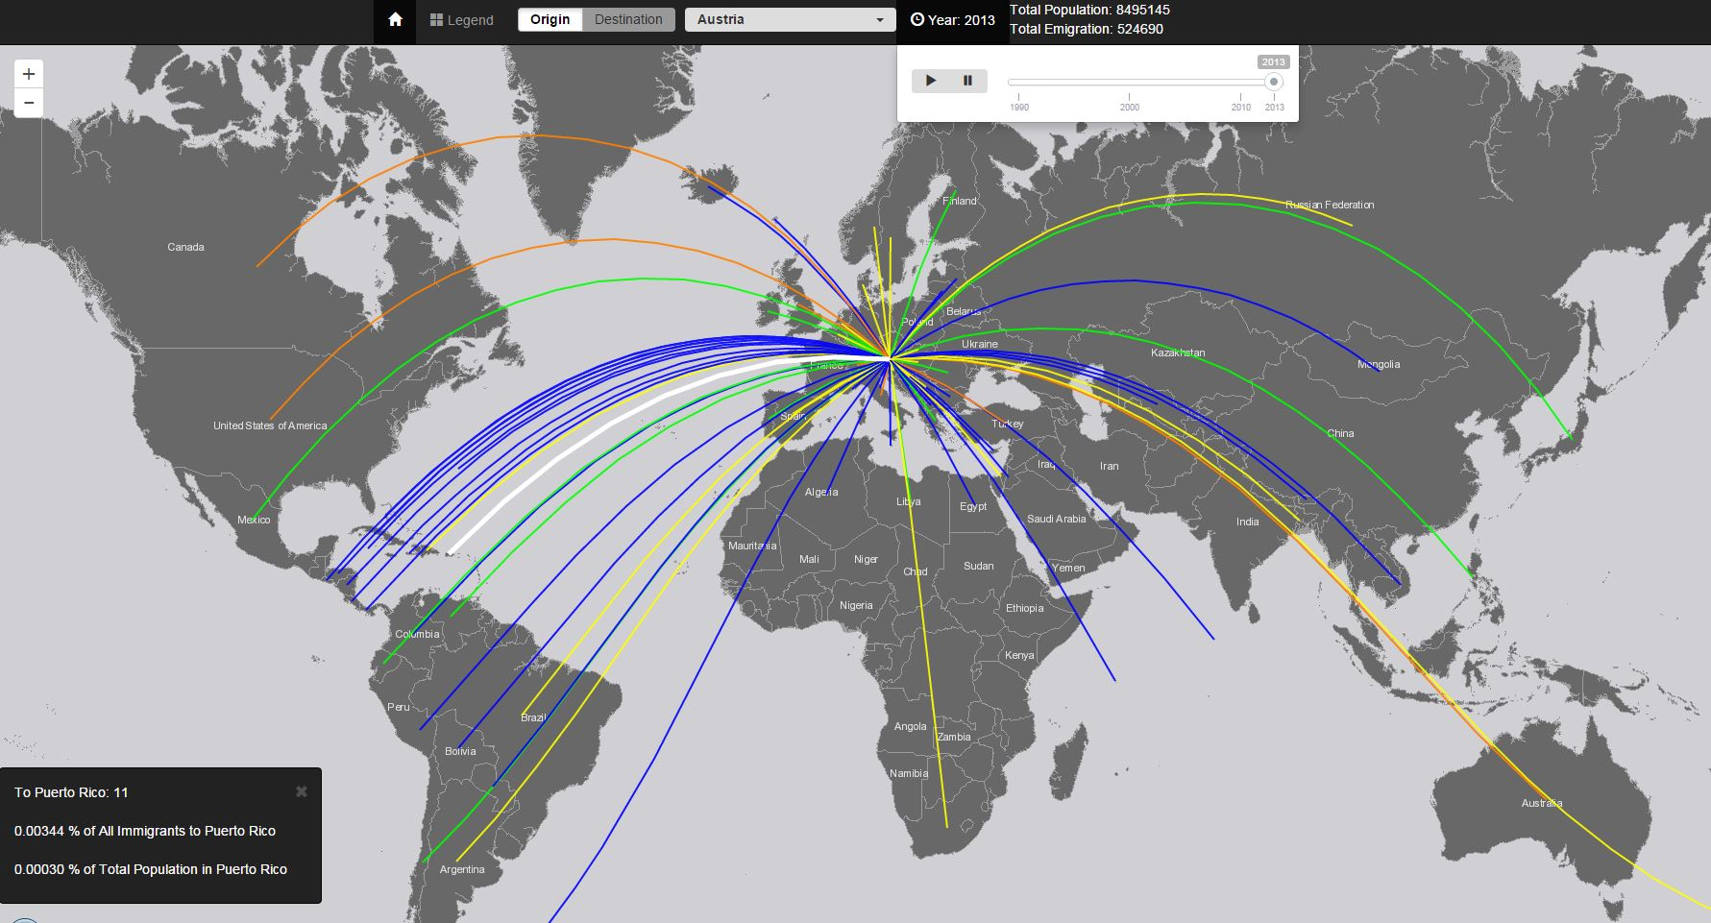
Custom web map: Esri
Visualizing global statistics: Migration
Notes:
http://crossroadsofmigration.com/

Slide 57

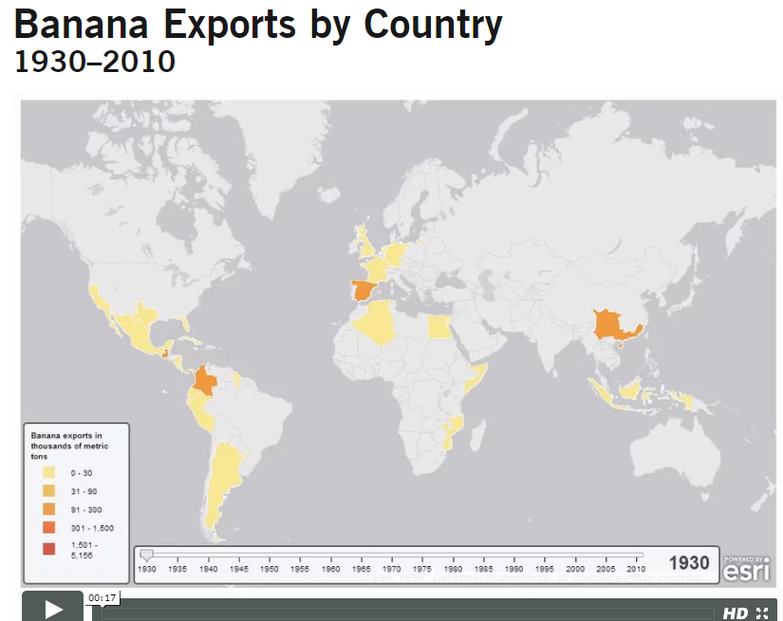
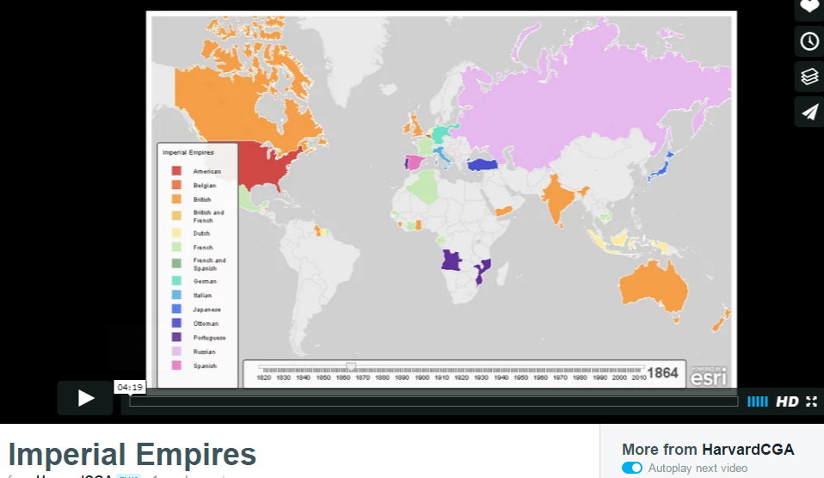
Notes:
http://www.hbs.edu/businesshistory/teaching/resources/Pages/historical-data-visualization.aspx
http://www.hbs.edu/businesshistory/teaching/resources/Pages/historical-data-visualization-details.aspx?data_id=1
https://vimeo.com/196895680

Slide 58
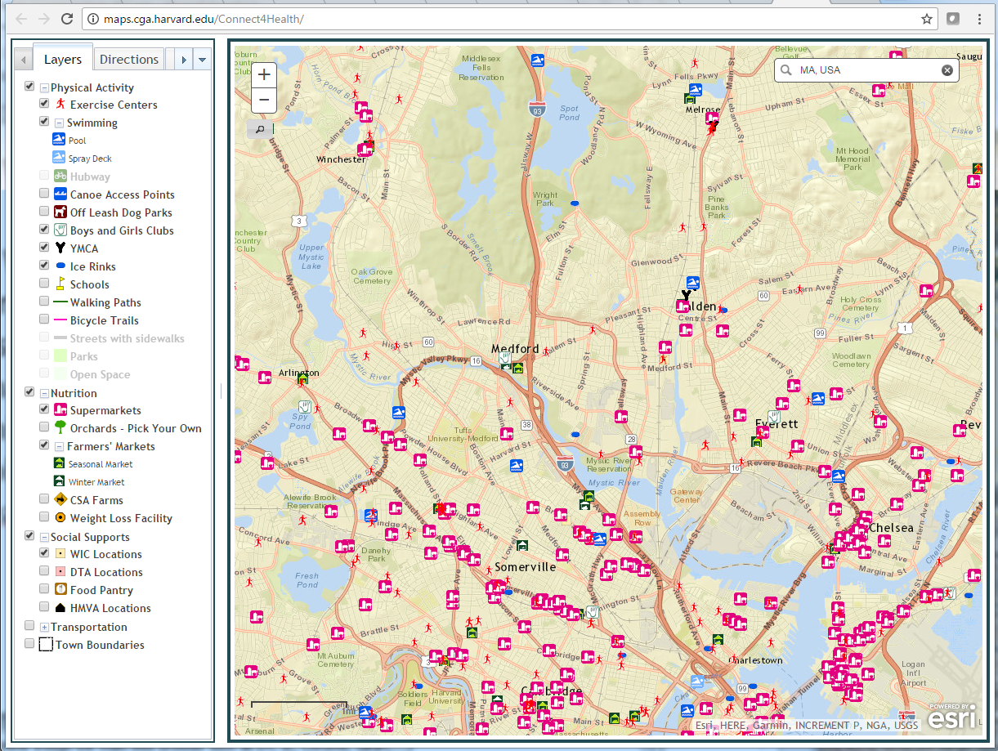
Connect4Health: Healthy eating and exercise awareness
Notes:
http://maps.cga.harvard.edu/Connect4Health/

Slide 59
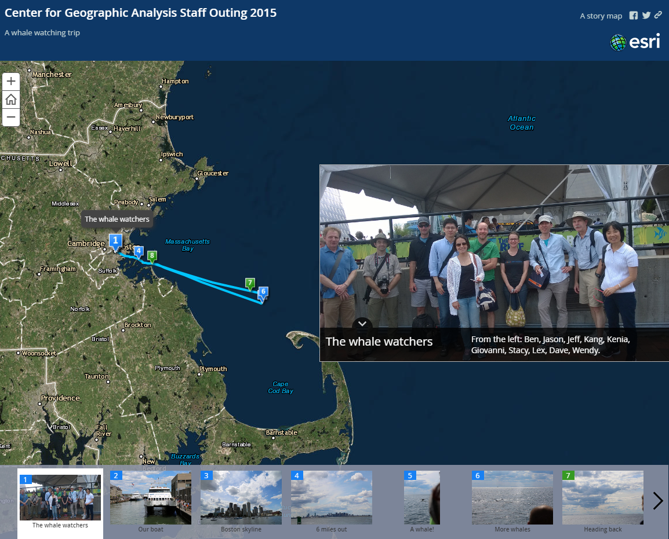
“Story map” visualizations
Notes:
http://harvard-cga.maps.arcgis.com/apps/MapTour/index.html?appid=74c1d61407f2469eb2cffa7a63b97719

Slide 60
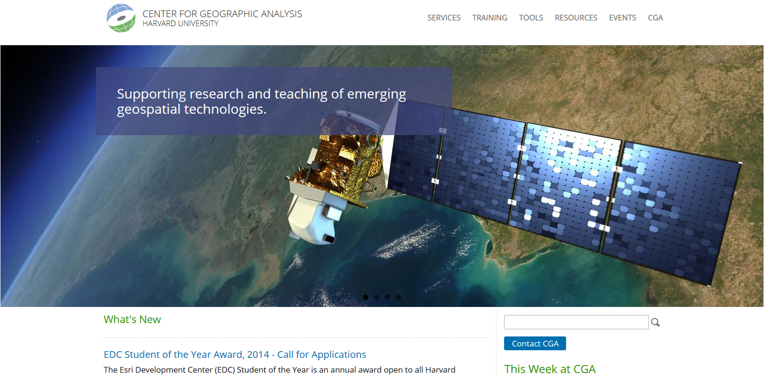
Thanks!
Jeff Blossom
jblossom@cga.harvard.edu
CGA website: http://gis.harvard.edu/
CGA staff email addresses: http://gis.harvard.edu/people/staff
WorldMap: http://worldmap.harvard.edu/
CGA general contact: http://gis.harvard.edu/contactus
Notes:
60

