Slide 1
Building Mashable Boston: a cautionary tale Lightning Talk at Harvard Center for Geographic Analysis 6 May 2011
Raj Singh, PhD
Director, Interoperability Programs
Open Geospatial Consortium

Slide 2
the experiment:
mashup events with photographs to get a look at how the character of a neighborhood changes before, during and after a concert

Slide 3
Notes:
so I found that both Yelp and eventful have event listings and APIs to get at them. Eventful turns out to have a MUCH richer set of events

Slide 4
Notes:
I wanted to try out Yahoo Pipes as a way to build this mashup without doing too much programming. Here’s the beginning of a “Pipe” that allows a user to input a date, which the Pipe then uses to query Eventful for their concert information. For some reason the system wasn’t working reliably, and I couldn’t see clearly how Pipes would let me have another user feedback step, where the user selected a concert that occurred on their chosen date, and then have the program go query another service for pictures taken at the location of that concert.
So I decided to fall back on the tried and true method of PHP and Javascript hacking.

Slide 5
Notes:
eventful has a nice library of pre-built interfaces for different programming environments, so getting going was easy. I chose to use Javascript

Slide 6
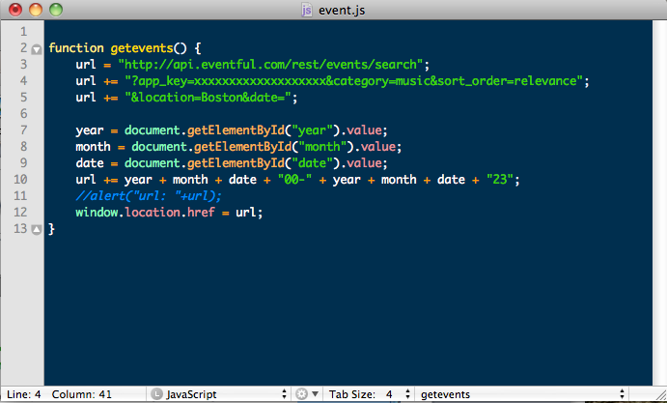
Notes:
So I built myself a quick web interface for user date input, and wrote a very quick and dirty Javascript call…

Slide 7
Notes:
…and was able to get back events for a certain date. The API supposedly allows you to specify the query down to the hour, but it didn’t seem that people are very good about putting the correct hours on their events, so I wouldn’t trust that.
Anyway, so far so good.

Slide 8
Notes:
now I need to find pictures, so I naturally looked to the Flickr API.
There I found a very promising method called flickr.photos.geo.photosForLocation

Slide 9
Notes:
the documentation looked good, so I started working with it. The problem was that I missed a key term there – a user.
After figuring out how to make an authenticated API call, I realized this was only giving me back pictures for my user account. If I wanted pictures from all users, I needed to look elsewhere in the API

Slide 10
Notes:
It turns out that the basic flickr.photos.search method is all I needed

Slide 11
Notes:
This seems to be the workhorse API of the large Flickr developer library.
It has a huge, rich specification,

Slide 12
Notes:
allowing one to do a geographic search based on a bounding box,

Slide 13
Notes:
a place_id

Slide 14
Notes:
or lat, lon and radius, which is exactly what I wanted

Slide 15
Notes:
so I wrote some PHP to query Flickr for photos in a particular location – at this point on any date.

Slide 16
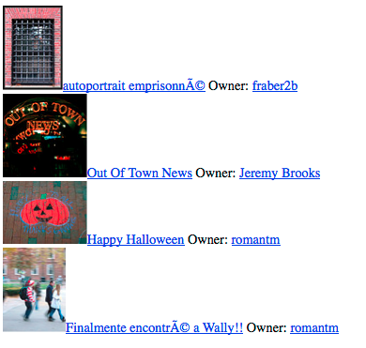
only 5% of Flickr photos are geocoded!
Flickr photos on 31 October 2010
total: 480,471 100%
has_geo: 23,836 5%
tagged "boston": 121 0.025%
place ID is Boston: 52 0.011%
½ mile from my point: 4
Notes:
and…succcess! I was able to get back pictures!
This is a cautionary tale, because after all this work, I only got back 6 pictures in a half-mile radius of a point in Cambridge. And this is without constraining the date.
I thought maybe the service was artificially limiting me, even though the default should be to return at least 100 pictures, so I tried with a date of last Halloween, and only got 4 pictures, which should have been a busy picture taking time.

Slide 17
Notes:
now I feel old because I thought Flickr would have a rich set of photos to browse. What I really need is to do the same thing with Facebook, because that’s where everyone is posting their photos nowadays. However, there is no API call to get all user photos is an area. You have to go user by user. So, back to the drawing board…

Slide 18
the APIs provide interesting data
but it takes blood, sweat and tears to do something interesting with more than one service
I encourage everyone to contribute to mashableboston.net to ease the pain for those who come after…

