Slide 1
May 6, 2011
CGA Conference
Harvard University, Cambridge, MA
Collection Researcher:
A GIS Web Application for Living Plant Collection Research
Brian Morgan
Putnam Research Fellow
Arnold Arboretum of Harvard University

Slide 3
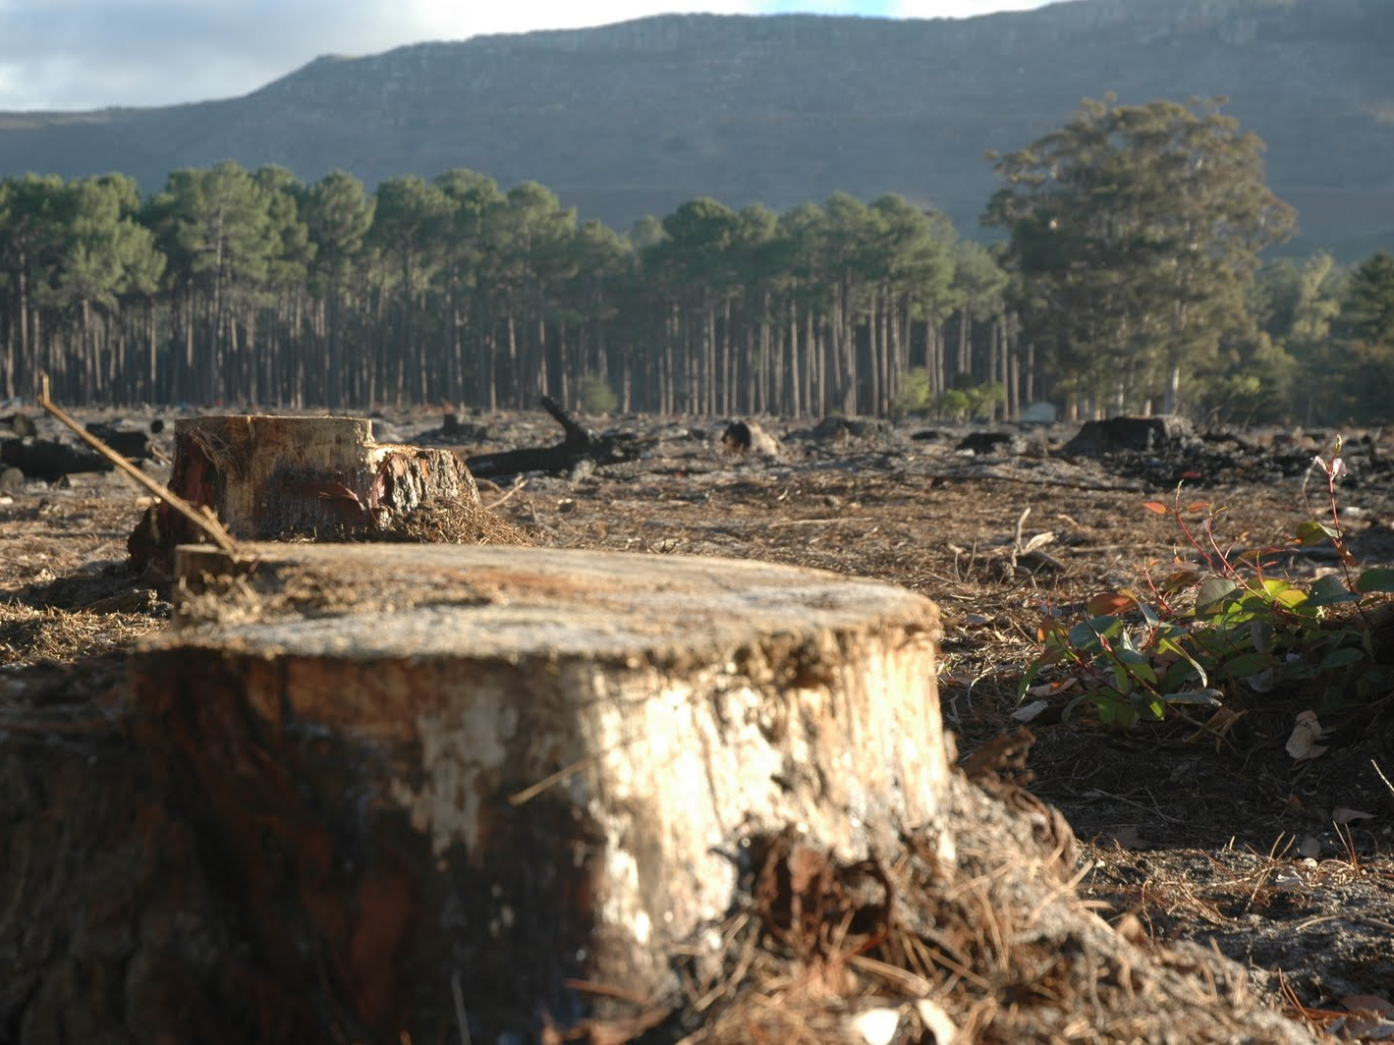

Slide 5
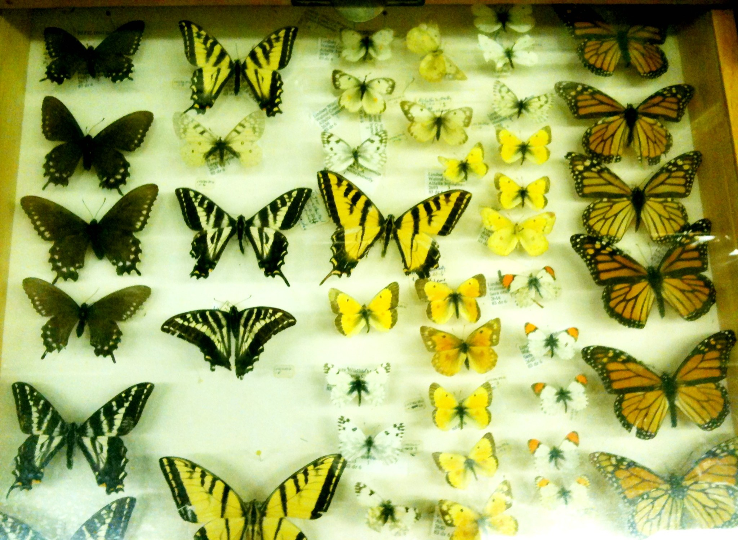

Slide 6
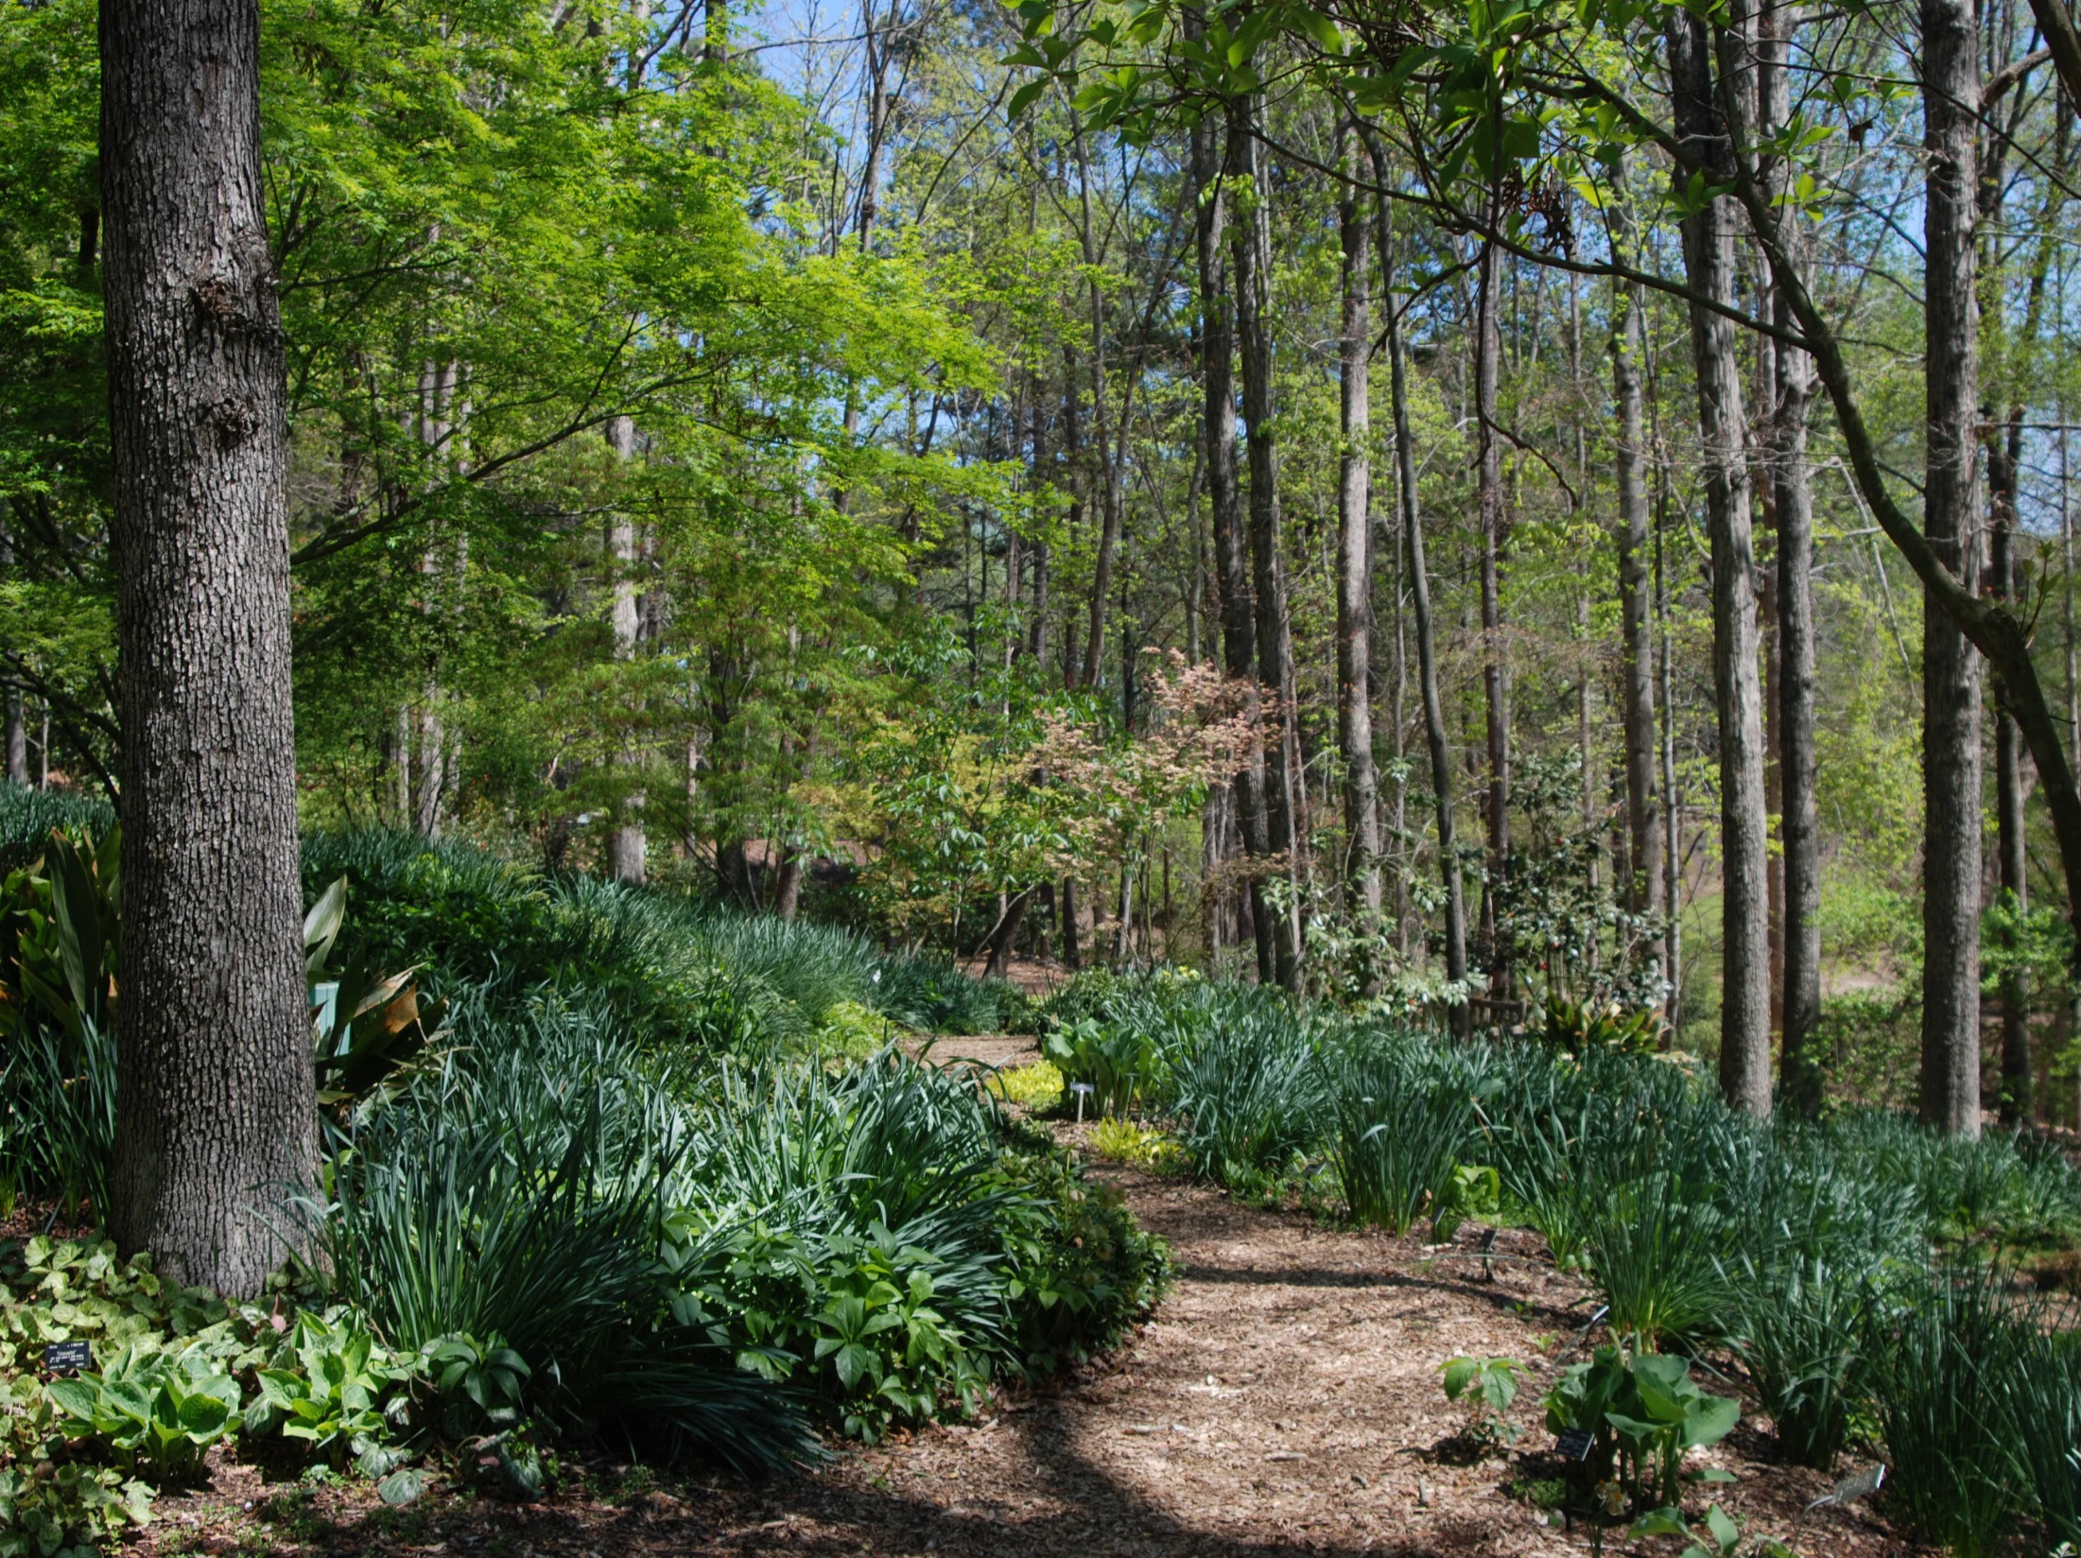

Slide 7
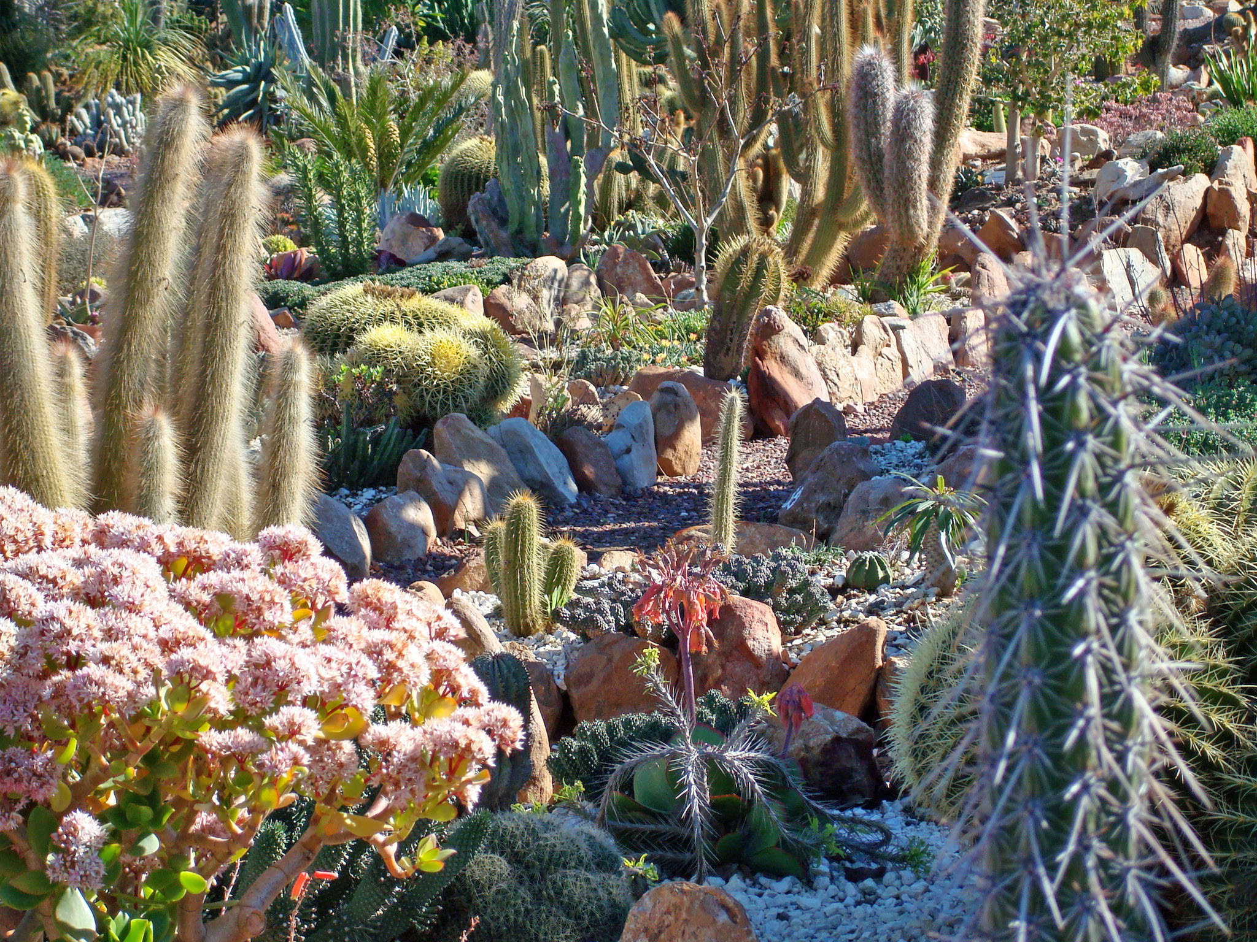

Slide 8
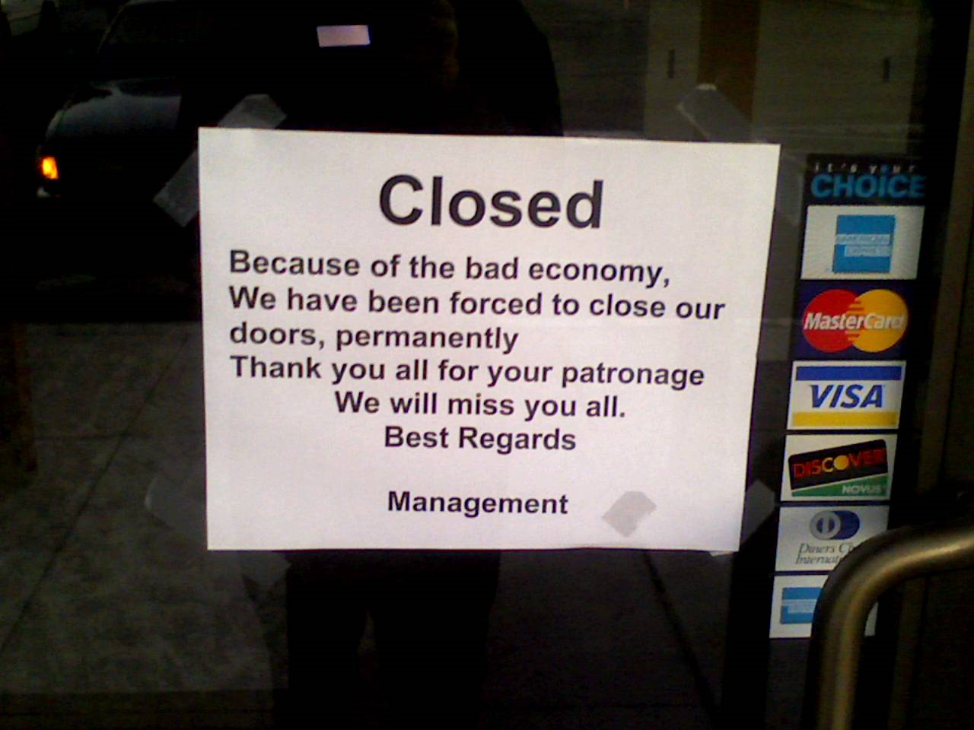

Slide 12
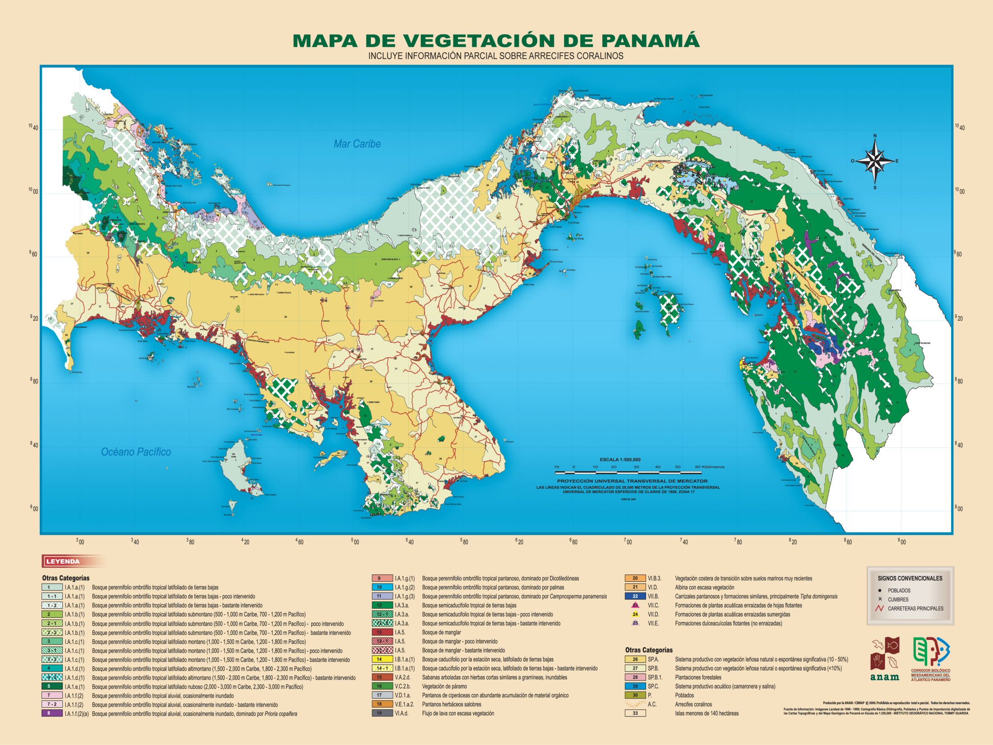

Slide 13
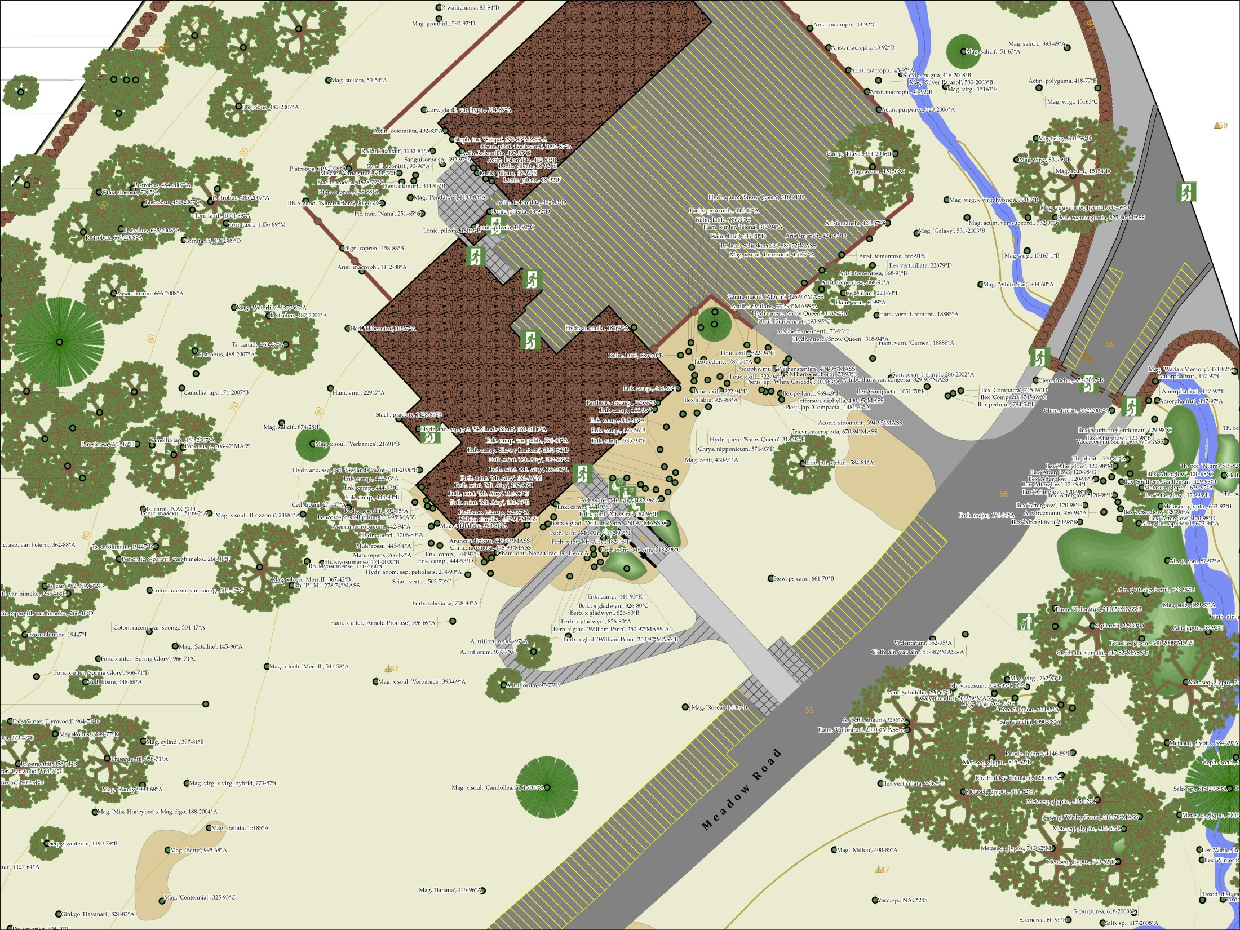

Slide 15
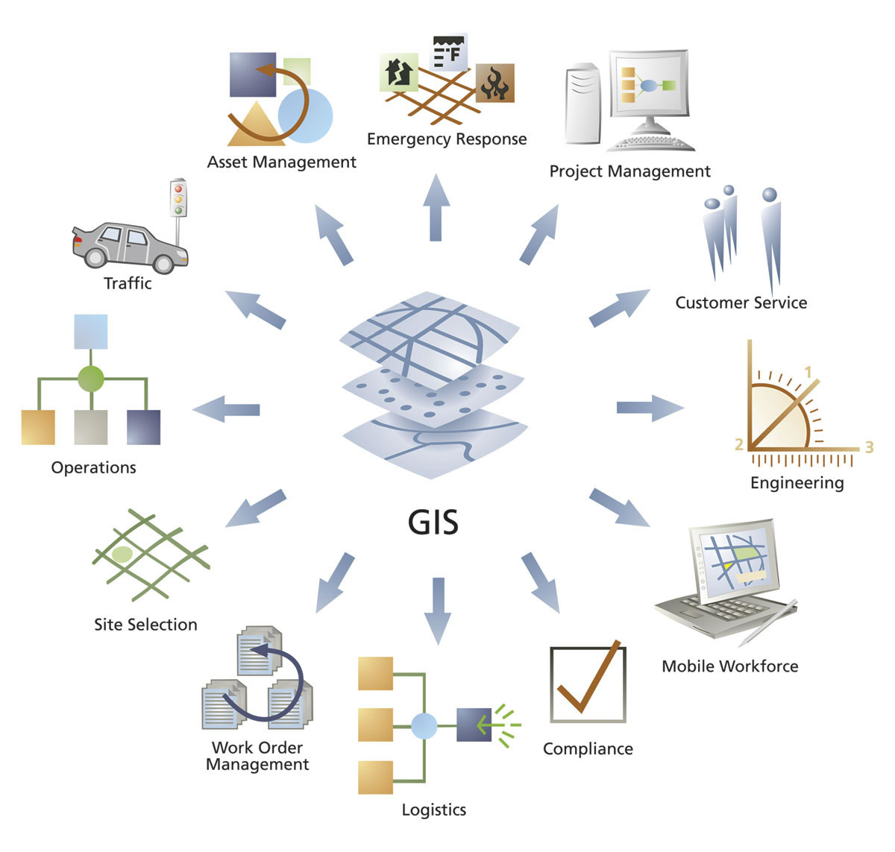
Enterprise GIS

Slide 16
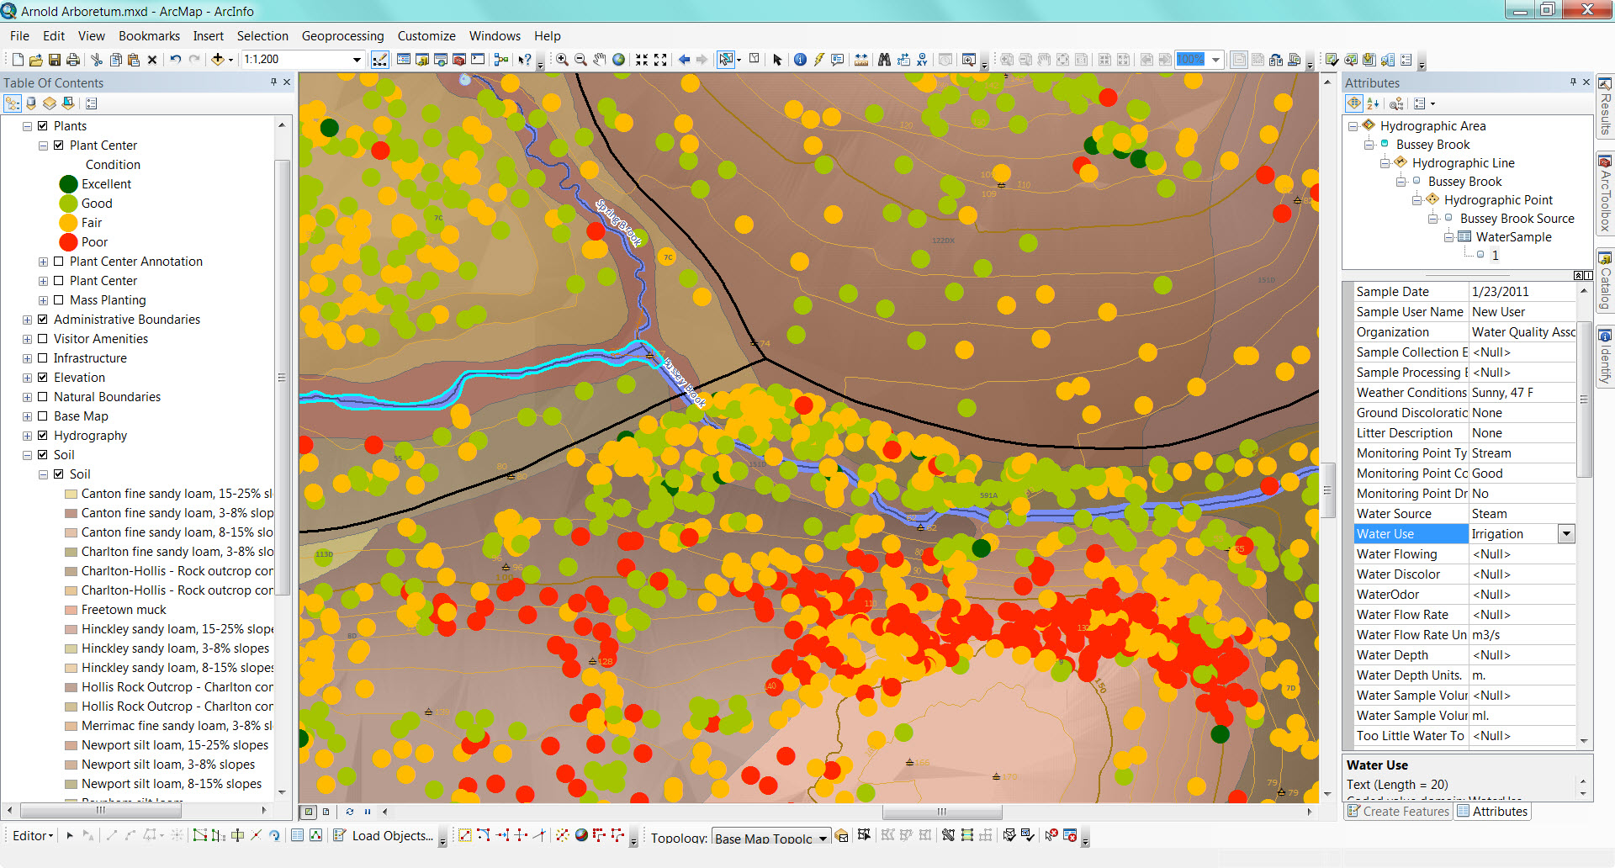

Slide 17
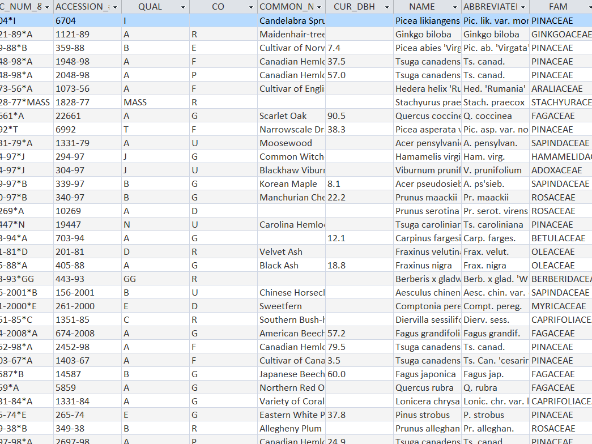

Slide 18
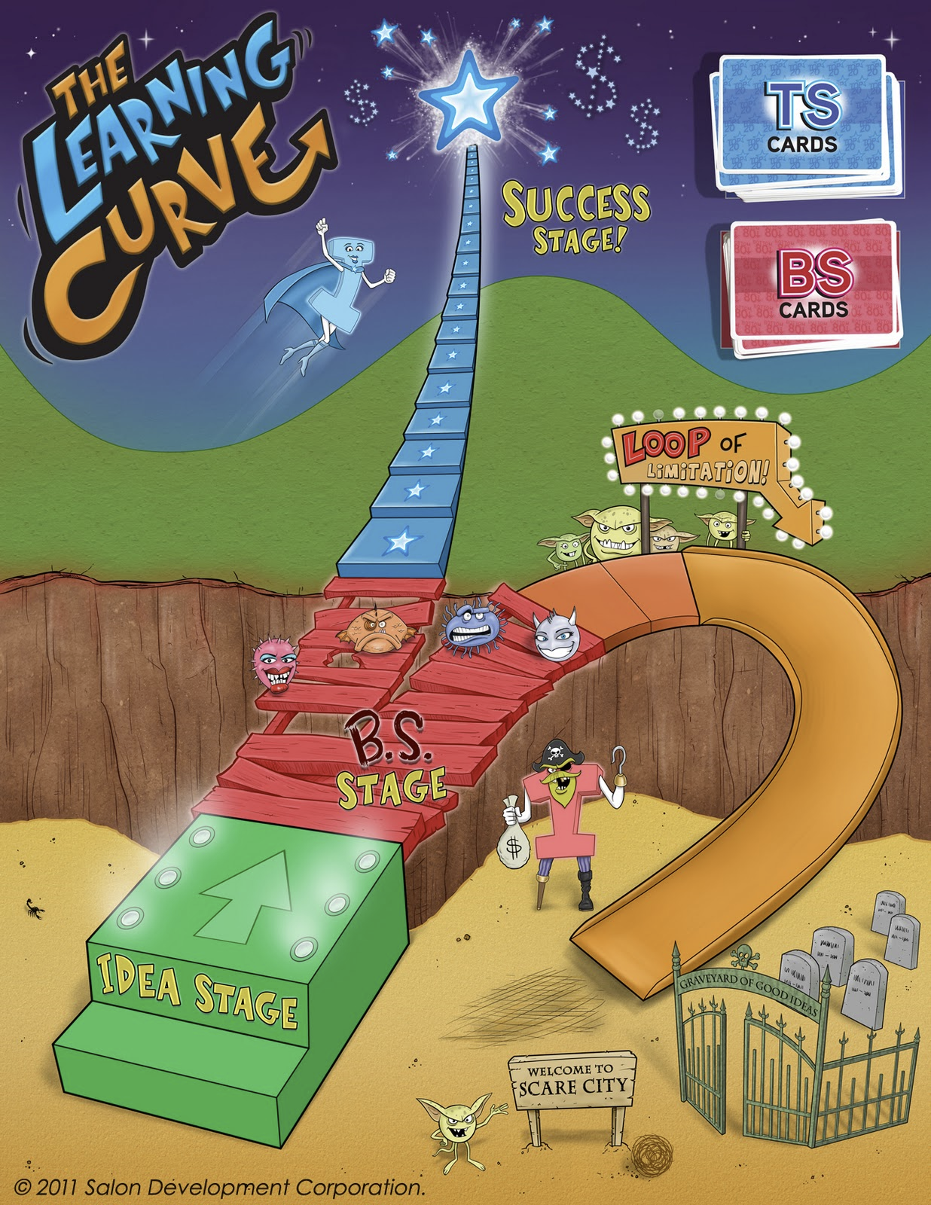

Slide 19
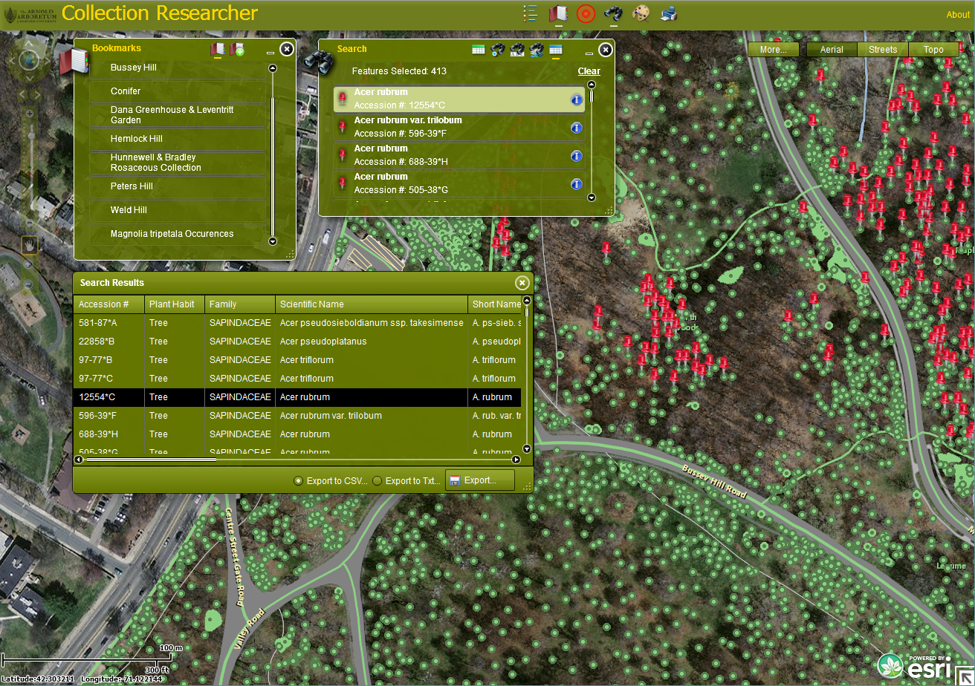

Slide 20
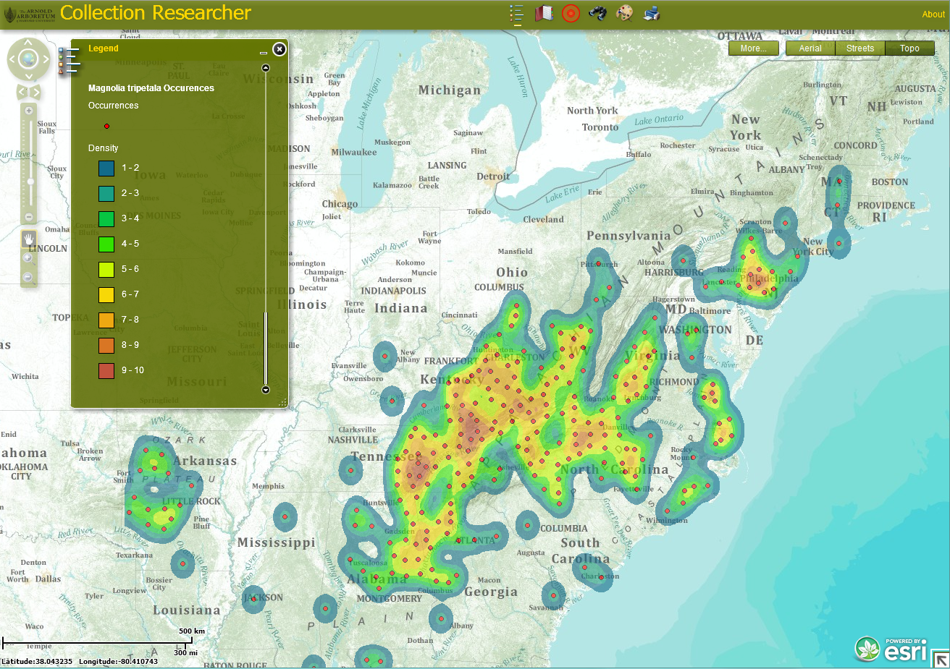

Slide 21
May 6, 2011
CGA Conference
Harvard University, Cambridge, MA
Collection Researcher:
A GIS Web Application for Living Plant Collection Research
10-11am & 2-3pm
CGIS Knafel Building Room K354
Brian Morgan
Putnam Research Fellow
Arnold Arboretum of Harvard University

