Slide 1
Web Services – Leveraging the MassGIS Platform to Build Web Mapping Applications Fast and Cheap
May 6 2011

Slide 2
MassGIS is….
State’s GIS program, now located in Information Technology Division in Administration and Finance
Central repository for state and other GIS data
Technical resource for state agencies
Hundreds of datasets, over a thousand “layers” of map data
Serving maps to the Web using ESRI and OGC formats since 2002 – over 20 million maps served!
Also provides data for download
GIS layers are frequently expensive to create and can be used in many different contexts, so serving, sharing and re-use are important strategies to maximize return on investment
Notes:
First a word about the MassGIS program – we are a technical resource for GIS users in the commonwealth.
We house hundreds of layers of map data and serve them to the web, which is what I want to talk about today, how web services make it possible to integrate OUR mapping content (or content from anybody else’s that has a similar infrastructure) into a web site that _YOU design and manage.
We serve up over a thousand “layers” of mapping data. I guess we’re kind of the macdonald’s of mapping in massachusetts – over 20 million maps served!
The take=home message here is that GIS data are frequently expensive to create and are by nature often multi-purpose, so making the data freely available in a variety of forms including via the web makes a lot of sense.

Slide 3
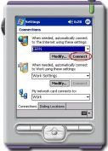
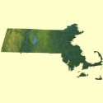
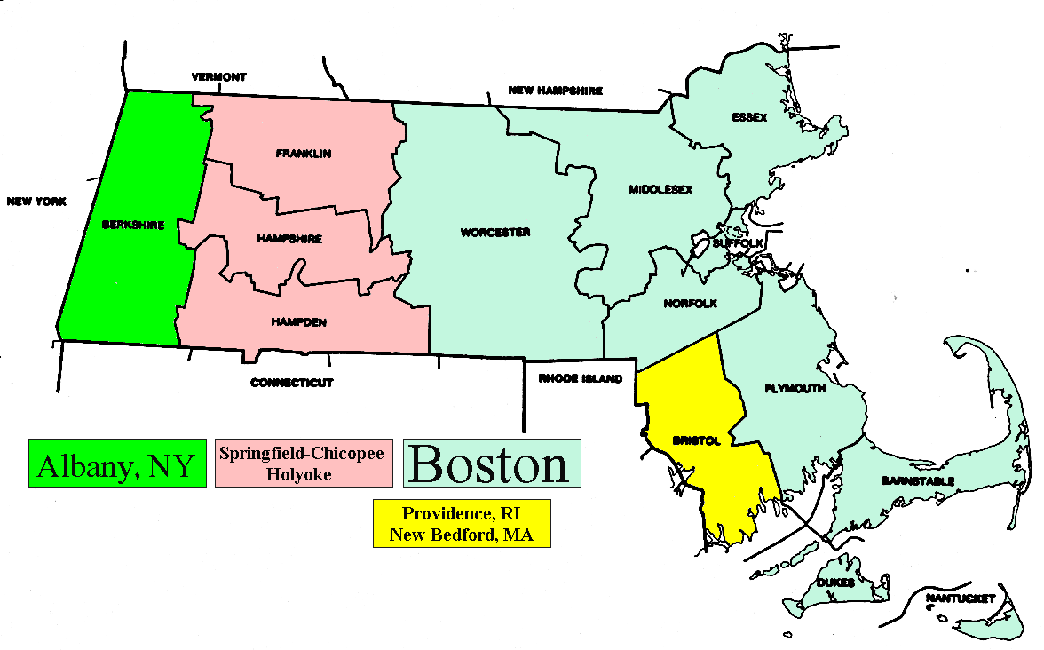
Our vision for GIS: access to mapping from everywhere
general public or state agency users
field data collection
cellphones
Access from inside or outside
Web mapping clients
Internet/Wireless access to Web Services mapping
Power users
Mass Information Technology Center / MassGIS
Transportation, environment and other agencies
Notes:
this is our vision for GIS – everybody is connected to a rich diversity of geospatial data whether by cell phone or desktop… we want all state agencies to have access to GIS, and all munis, and the private sector as well. in our vision every inspector in the field, every company doing business with the state, every citizen has access to mapping… This is how we see leveraging the full value of the enterprise investment in data – everybody gets to use all the resource

Slide 4
Web mapping services – DIY not necessary
Just think what you would have to do to draw a map in a browser from scratch –
Take coordinate values stored in a database:
491888.999999459,5458045.99963358 91904.999999458,5458044.99963358 491908.999999462,5458064.99963358 91924.999999461,5458064.99963358 491925.999999462,5458079.99963359 491977.999999466,5458120.9996336 491953.999999466,5458017.99963357 ……
transform them into your screen space
interpret them as shapes
symbolize them and draw them in the right order
manage the thematic listing of what you are drawing
refresh your map as you move, zoom and pan
draw things in the right order or re-order them
link the coordinates on your screen back to the database attributes
Don’t do it!
Web Mapping Services code libraries have been written for you...
Topology
Matrix Algebra
Normalization
Notes:
So about access - if you were trying to build a web site and integrate mapping into it, from scratch, starting with a bunch of GIS data in a database, it would be a pretty daunting task, in fact it might take you a person-year or two. these are conceptually all the things that you would need to do – get the geographic coordinates out of the database, transform the coordinates, etc. etc. It would be educational perhaps, but a big waste of time, because it’s already been done. a lot of the code you need to build a great map-enabled web site has already been written.

Slide 5
Web mapping and web feature services
Open GIS Consortium (open source) and ESRI
- two formats for requesting map data from server
OGC formats:
WMS – Web Map Service (GetMap)
Gets an image of a map (PNG, TIFF, etc)
Can get a legend graphic
WFS – Web Feature Service (GetFeature)
Gets attributes and/or coordinates
For WMS or WFS:
Request can be URL or XML
Can query on attributes or geometry
Notes:
We actually use a couple of different ways of getting at GIS data from the internet – one based on open standards and software and the other proprietary from ESRI. ESRI also supports the open standard, which comes from an organization called the open GIS consortium. These standards provide a way for you to request a map from any server that supports them, in fact there’s even a way to find out what maps that server could provide if you don’t already know.
For the OGC standard, there’s actually a few different kinds of requests – web map service or WMS asks for a map as an image (we sometimes call it a dumb image) and web feature service or WFS requests a set of coordinates or some attribute information (we call that an intelligent map because you can do more with it, like maybe edit it or attach additional descriptive information)

Slide 6
Here’s a WMS request:
http://giswebservices.massgis.state.ma.us/geoserver/wms?VERSION=1.1.1&REQUEST=GetMap&SERVICE=WMS&LAYERS=massgis:GISDATA.TOWNS_POLYM,massgis:GISDATA.SCHOOLS_PT&STYLES=Black_Lines,&BBOX=232325.38526025353,898705.3447384972,238934.49648710093,903749.1401484597&SRS=EPSG:26986&WIDTH=570&HEIGHT=435&FORMAT=image/png
Notes:
Here’s an OGC web request to get a map - if you had time to look at this closely you would see that it’s a WMS request, its referencing a couple of layers and an area of interest and specifying how the lines and symbols should be drawn. ... and finally that you want to get a png back, which is what you’ll put into your web page.

Slide 7
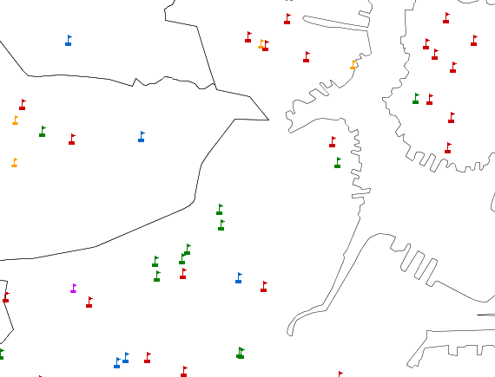
Here’s what you get back:
A map of schools
Notes:
and this is what you get back - a map of schools

Slide 8
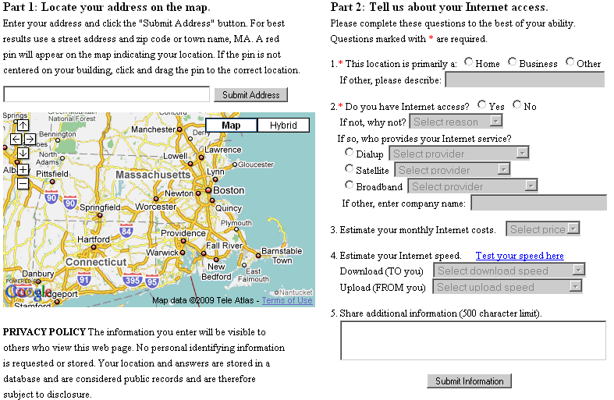
Tell us about your internet access – MBI survey http://www.massbroadband.org/mapping/survey.html
Notes:
So I want to show you what you can you do with web mapping services and the libraries of code that are out there – because you can do a lot. This is an on-line survey application that our web mapping lead Aleda Freeman put together for the mass broadband institute to collect point location data on where there was broadband service, so that they could plan for new infrastructure to extend the network.
This was a completely serviceable, crowd sourcing data collection application that was put together in a couple of days. They subsequently have expanded and changed it – so I don’t know if the URL still works. but they collected a lot of data with it.

Slide 9
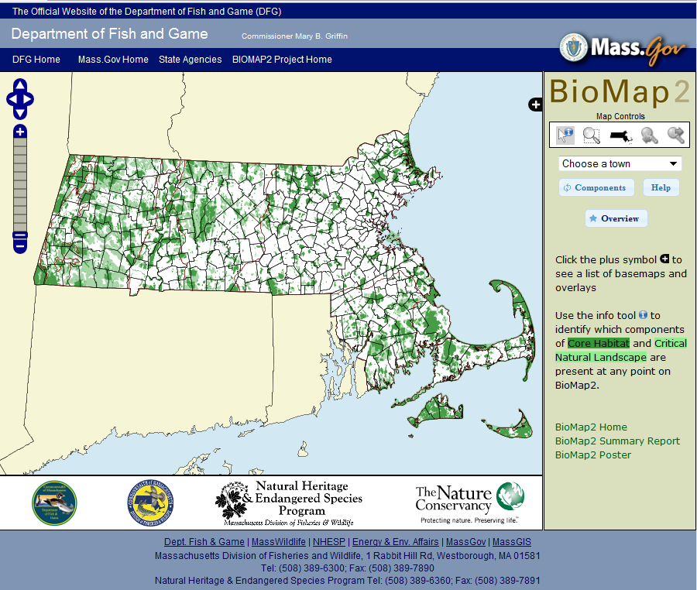
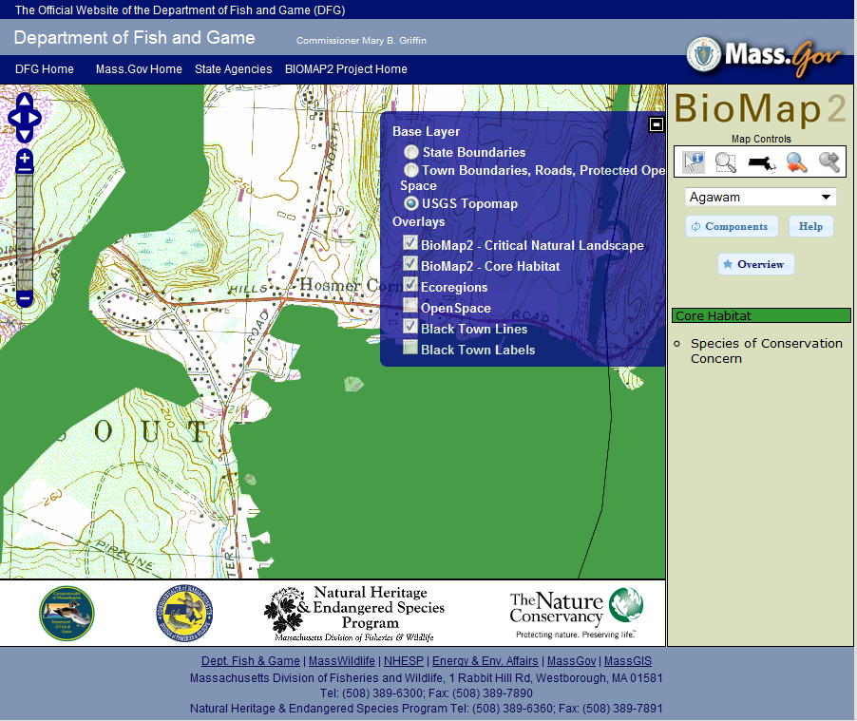
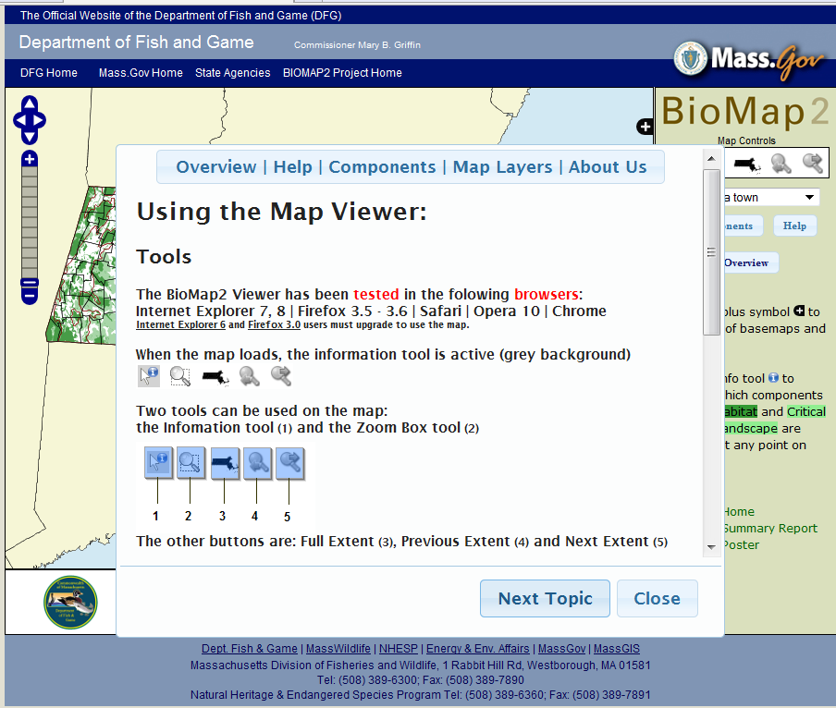
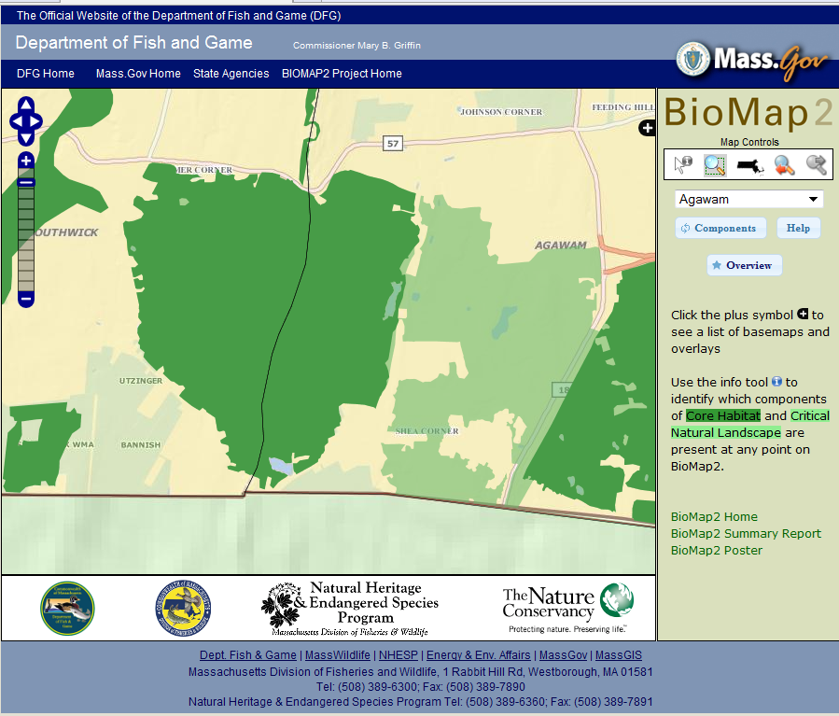
View rare species habitat – Biomap2 http://maps.massgis.state.ma.us/dfg/biomap2.htm
Notes:
Here’s another application built using web map services Its called Biomap2 from our state department of fish and game this one has gotten a lot of play, it was recently featured on the New york times green blog. it’s an interactive map displaying different kinds of habitat for rare species, so you can find your area of interest and determine that yet, its ok to build a golf course there, or no its not ok, or no its not ok but you’re going to hire some lawyers and try to do it anyway.

Slide 10
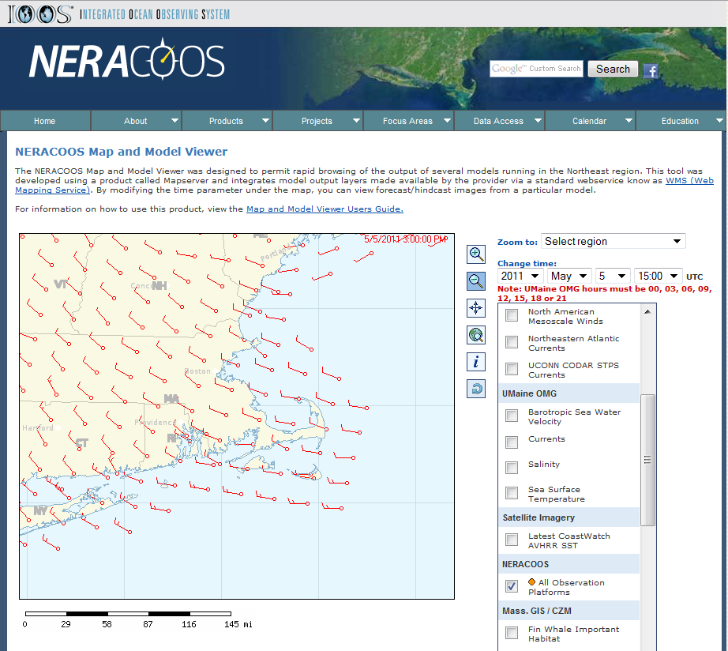
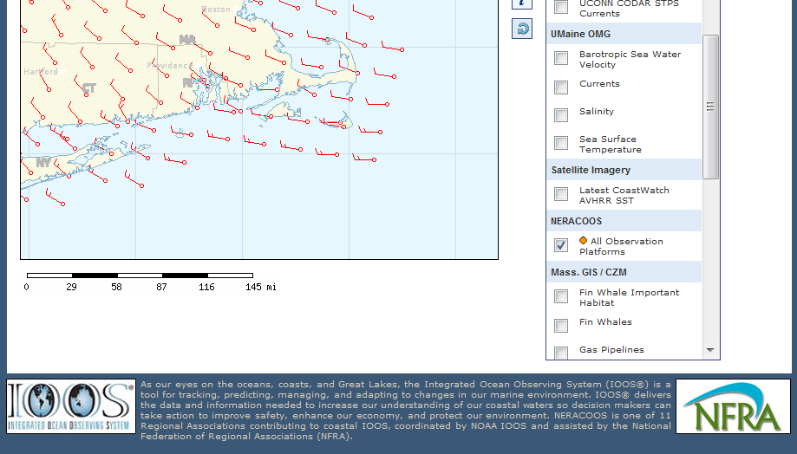
View real-time ocean monitoring data - NERACOOS
Notes:
This is one that’s a little unusual. It was built without any MassGIS involvment at all, some programmers working for NERACOOS which is a regional ocean monitoring consortium called us up to ask ‘are you running OGC web services?’ and we said yes and they said “ok, great, we’ll use them” and this was the application that they put together which pulls data from Federal, state and academic sources – what you see here is a wind field. this is really the huge payoff in my mind from using these standards that you can take a federated approach, you can integrate data for a region or from different institutions, different disciplines because remember our motto in GIS – everything is somewhere..

Slide 11
OLIVER 2
Notes:
next if I still have a few minutes I want to show you a few screenshots of a package called OLIVER, originally built in JAVA and now out in a version called OLIVER2 entirely re-written in javascript in a project funded by our wonderful partner mass ocean partnership. This application is entirely built on web services and has the additional distinction that the application itself is open source and can be cloned and customized. This is a pretty elaborate interface, with configurable drill down menus for data selection and lots of features that can be adapted and customized to your purposes, and we are currently enhancing it to support editing, but the concepts are all the same as what you’ve seen

Slide 12
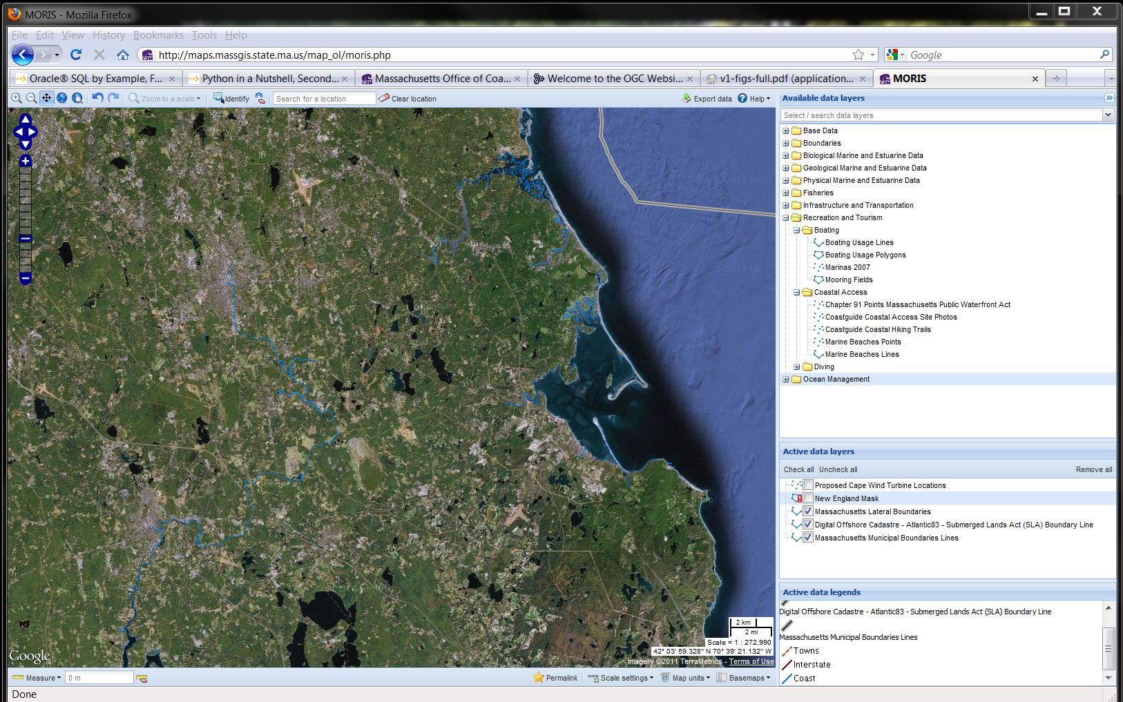
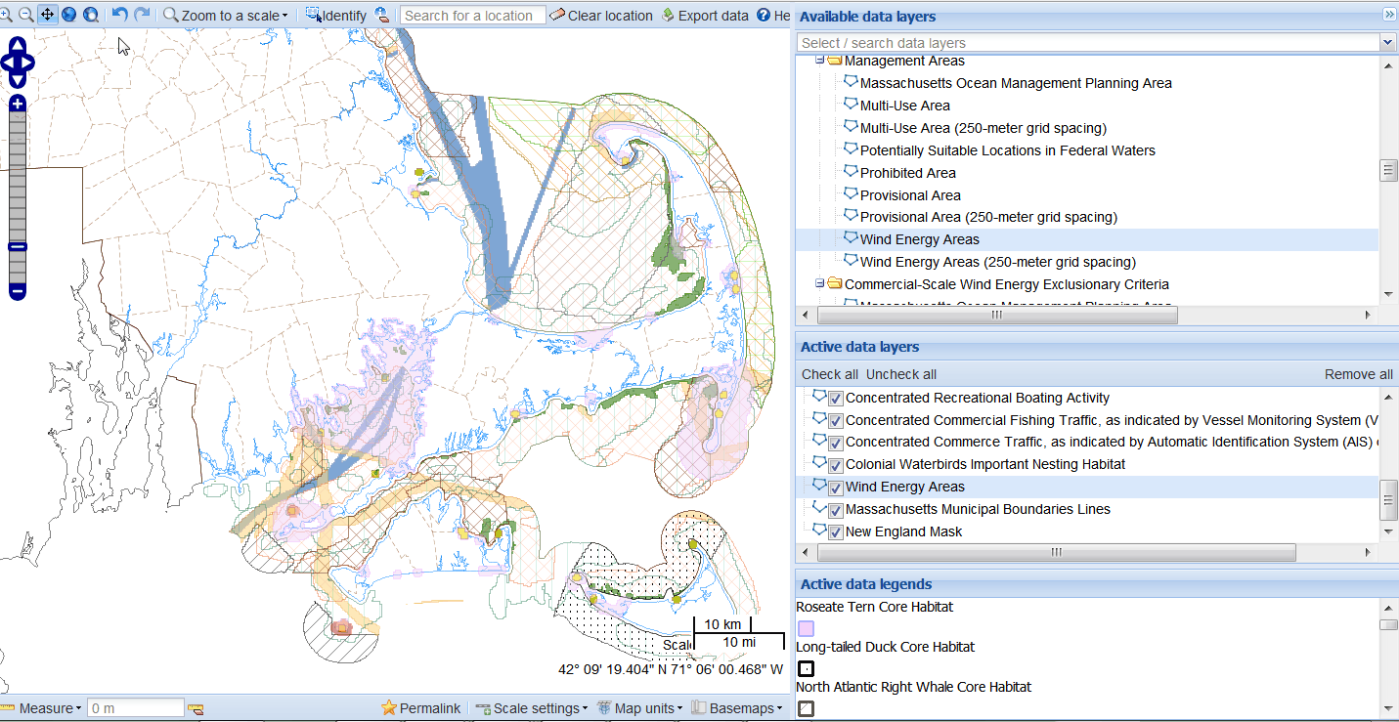
Understand ocean management policies – MORIS http://maps.massgis.state.ma.us/map_ol/moris.php
Notes:
This is a version of OLIVER called MORIS dedicated to ocean management planning..its displaying criteria for siting wind turbines offshore, which is or was a pretty hot topic. on the top right you see the menu tree for browsing data, which allows OLIVER applications to manage hundreds of data layers. and under that you see the current list of layers

Slide 13
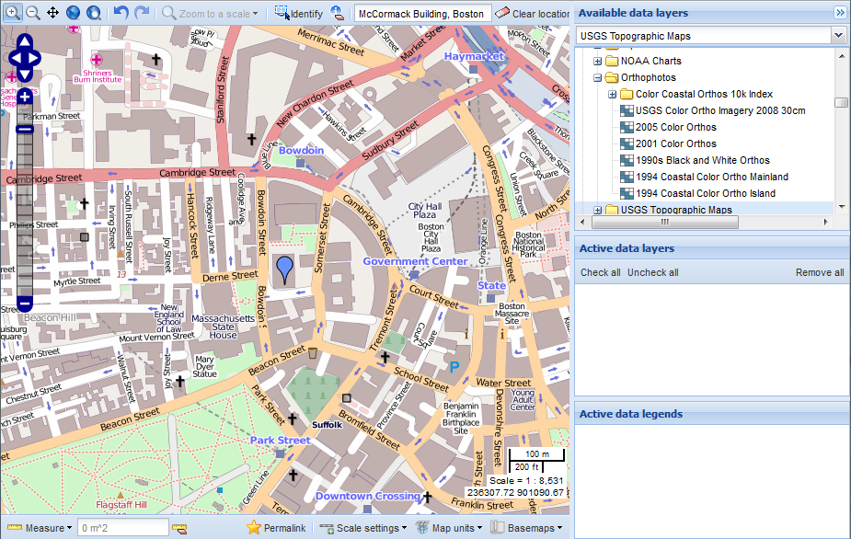
Geocode (find an address) anywhere – Bing in OLIVER2
Ignite Spatial Boston 3 March 24, 2011
Notes:
13
With the Bing geocoding service built into OLIVER the user can search for streets, buildings, towns or other geographies. Here at the red ellipse the user has entered the McCormack Building, Boston which is a state office builiding and that is enough to get there. Just “Fenway Park” also works.

Slide 14
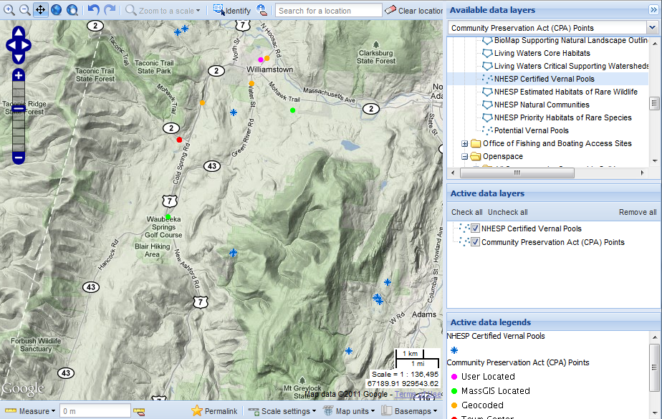
View any basemap – OLIVER2
Ignite Spatial Boston 3 March 24, 2011
Notes:
14
This is one of the basemaps that are built in .. down in the lower right at the red ellipse there you see the option to change basemap.
The use can drape MassGIS data on top of basemaps such Google Terrain, Google Satellite or OpenStreetMap. The GeoServer WMS automatically reprojects the MassGIS data to line up properly with the basemap.

Slide 15
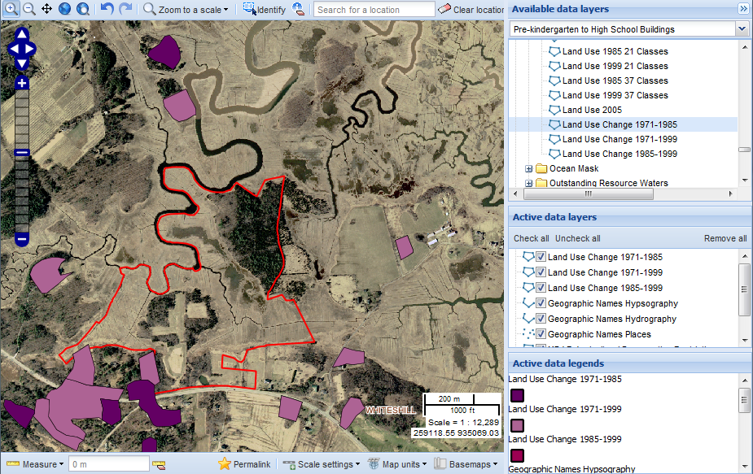
Bookmark and email a map
Ignite Spatial Boston 3 March 24, 2011
Notes:
15
Here’s another nice feature in the middle at the bottom of the map see the red ellipse there’s a tool to bookmark or email your special map with a Permalink URL. This URL will launch the viewer with that bounding box, datalayers, basemap and other customizations – remember the long URL at the beginning. All the receiving user needs is a browser.

Slide 16
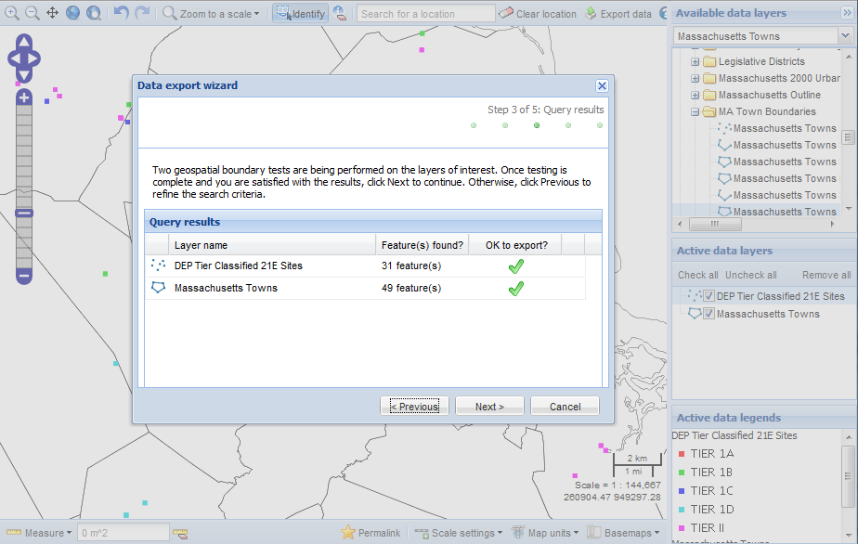
Download data after browsing it
Ignite Spatial Boston 3 March 24, 2011
Notes:
16
Vector and image data can be exported in several projections. This is also controlled via a web service. The user gets information about the number of features and can choose which layers to export.

Slide 17
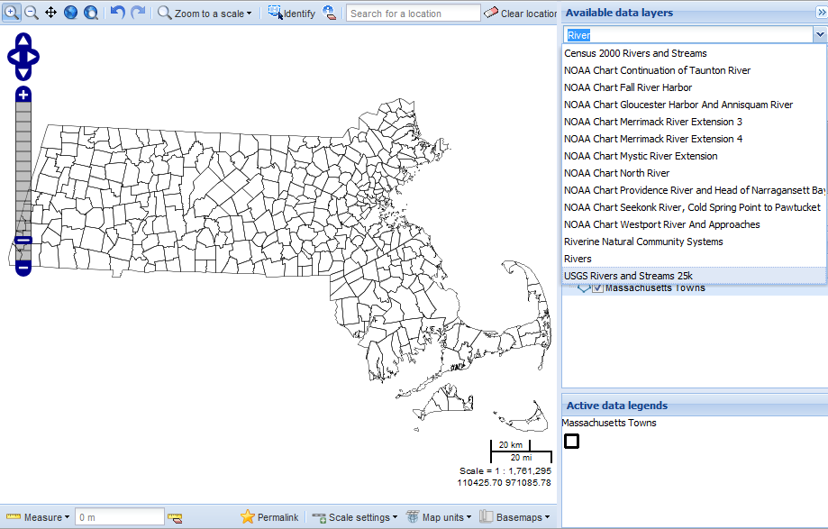
Free text search for layers
Ignite Spatial Boston 3 March 24, 2011
Notes:
17
Another nice feature is free text search for data layer content – that helps the user find the layers that they need out of the hundreds available. The string is matched anywhere in the datalayer title.

Slide 18
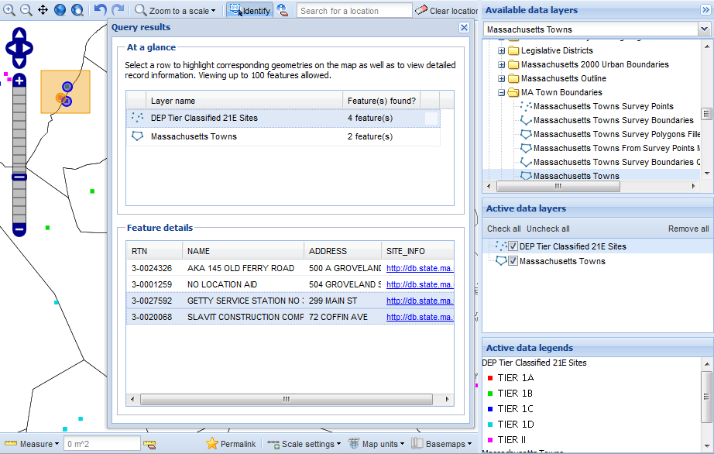
Query and identify layers and features
Ignite Spatial Boston 3 March 24, 2011
Notes:
18
There’s query capability as well, which is pretty sophisticated, providing a master-detail kind of interface to attributes.
The previous identify which was a point to one feature to get information method is now select multiple features in multiple layers. Results can be sorted and subselected with highlighting linked between the map and table.

Slide 19
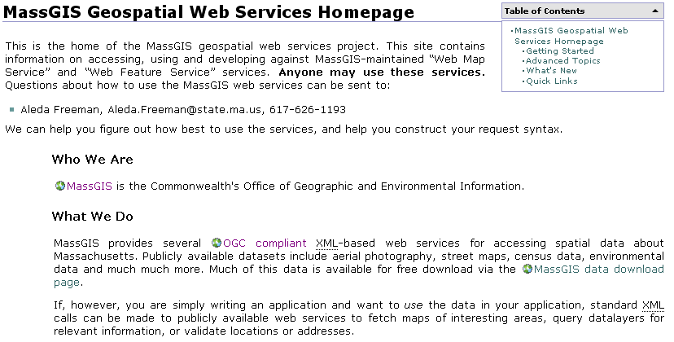
MassGIS Web Services Wiki http://lyceum.massgis.state.ma.us
Working examples of requests and responses with MassGIS data
Notes:
So if you want to find out more go to our web site, specifically the wiki at lyceum, its being moved so if you can’t find it call Aleda Freeman…

Slide 20
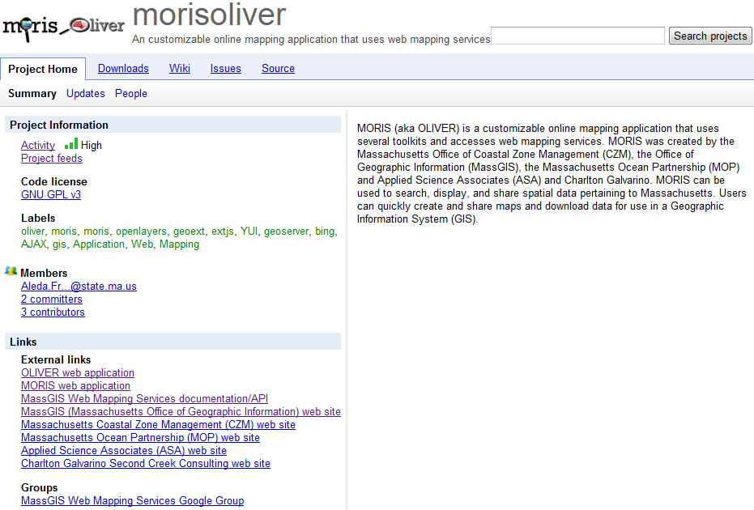
code.google.com/p/morisoliver
Ignite Spatial Boston 3 March 24, 2011
Notes:
20
And finally, here’s the code repository for moris and oliver code on the google code site, this code was paid for our wonderful collaborator the mass ocean partnership and is distributed under the GPL..
OpenLayers OLIVER is an open source project stored at Google code. Feel free to take it and use it. If you can fix a bug or add an enhancement we'd love to have it.

