Slide 1
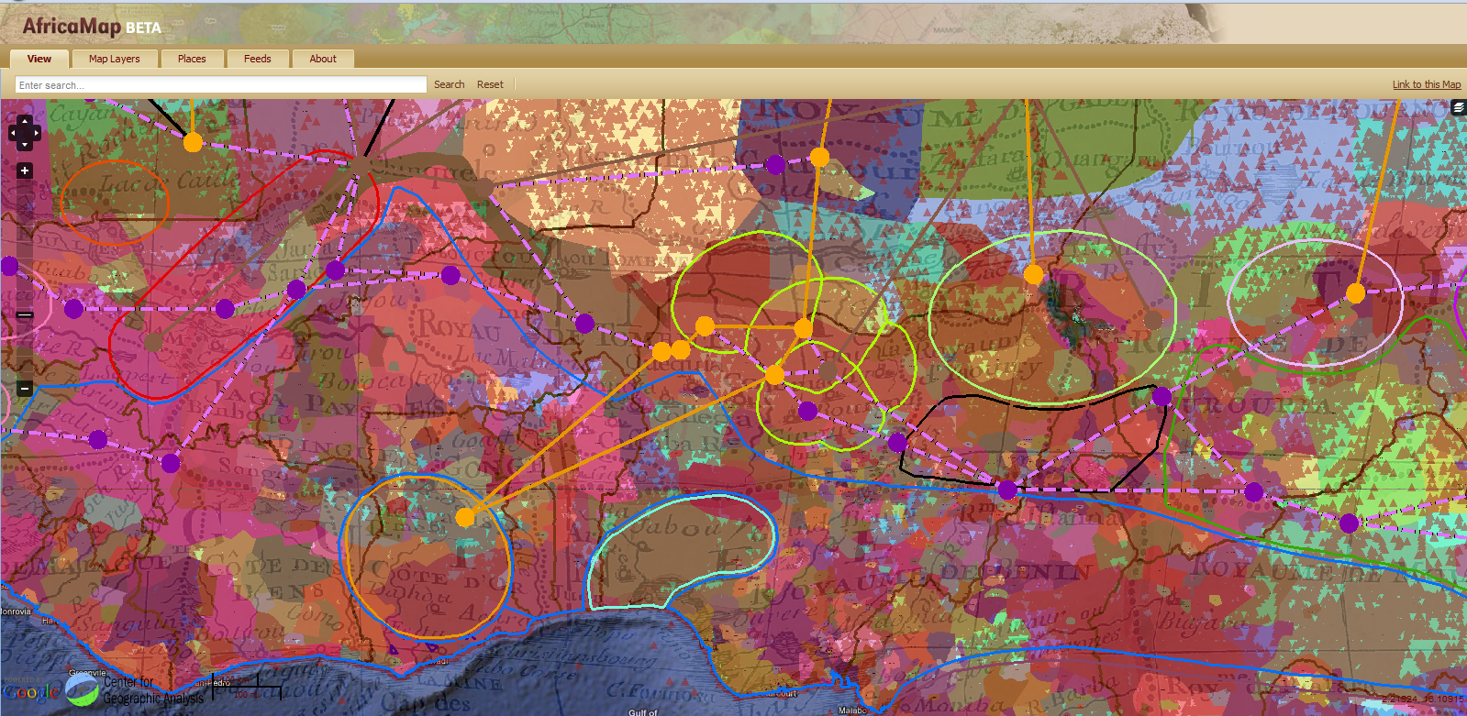
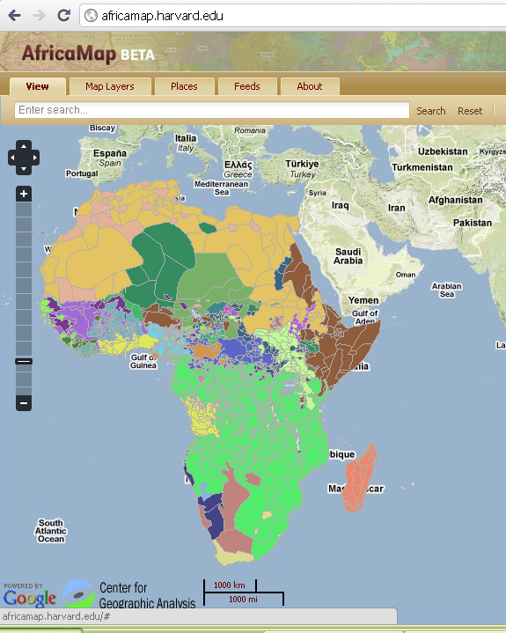
GIS Web Applications
in Africa
Suzanne Preston Blier, Harvard University
Allen Whitehill Clowes Professor of Fine Arts
and of African and African American Studies

Slide 2
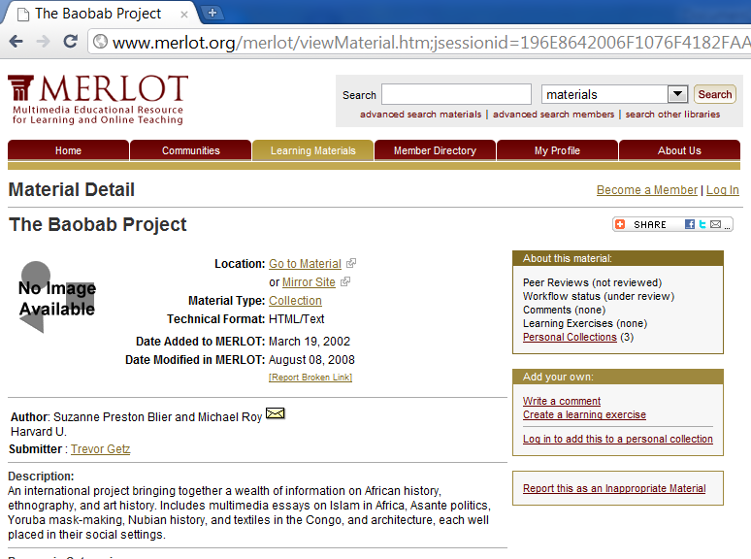
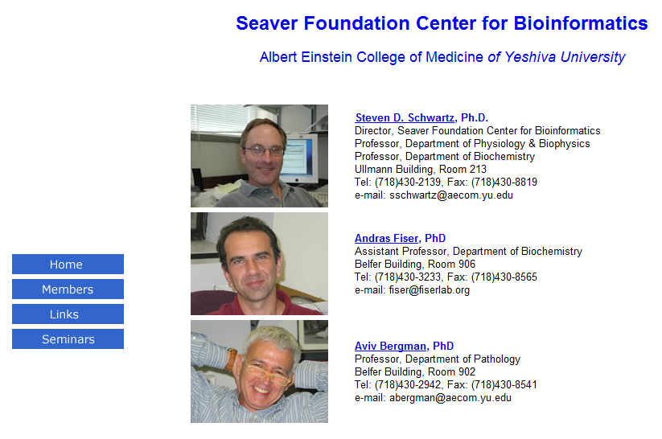
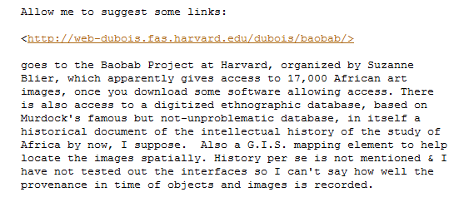
Africamap history:
Baobab Project
Begun 1994 –Blier w. Michael Roy

Slide 3
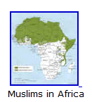
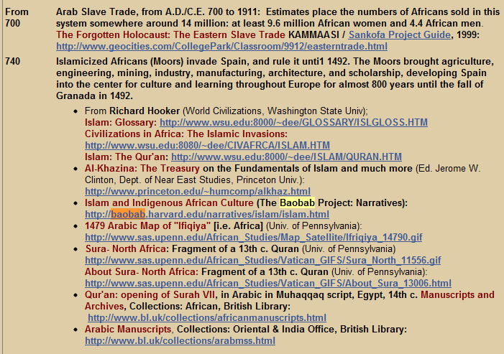

Slide 4
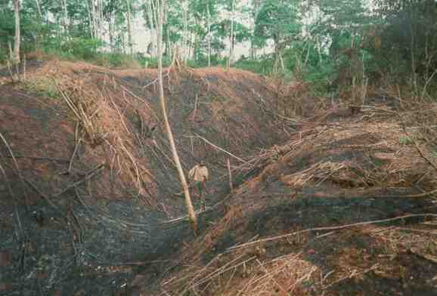
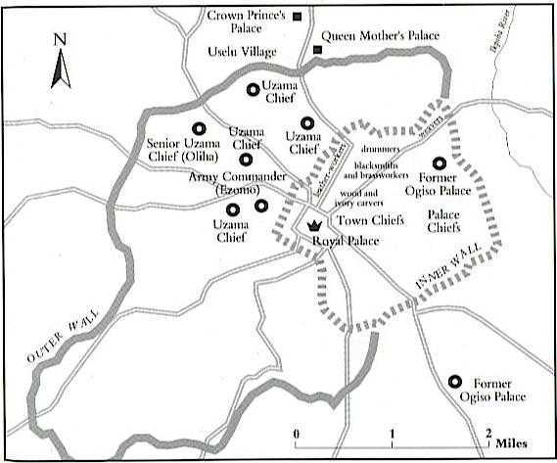
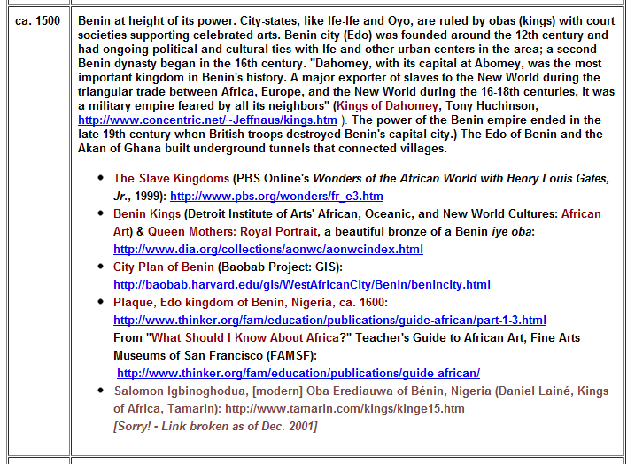

Slide 5
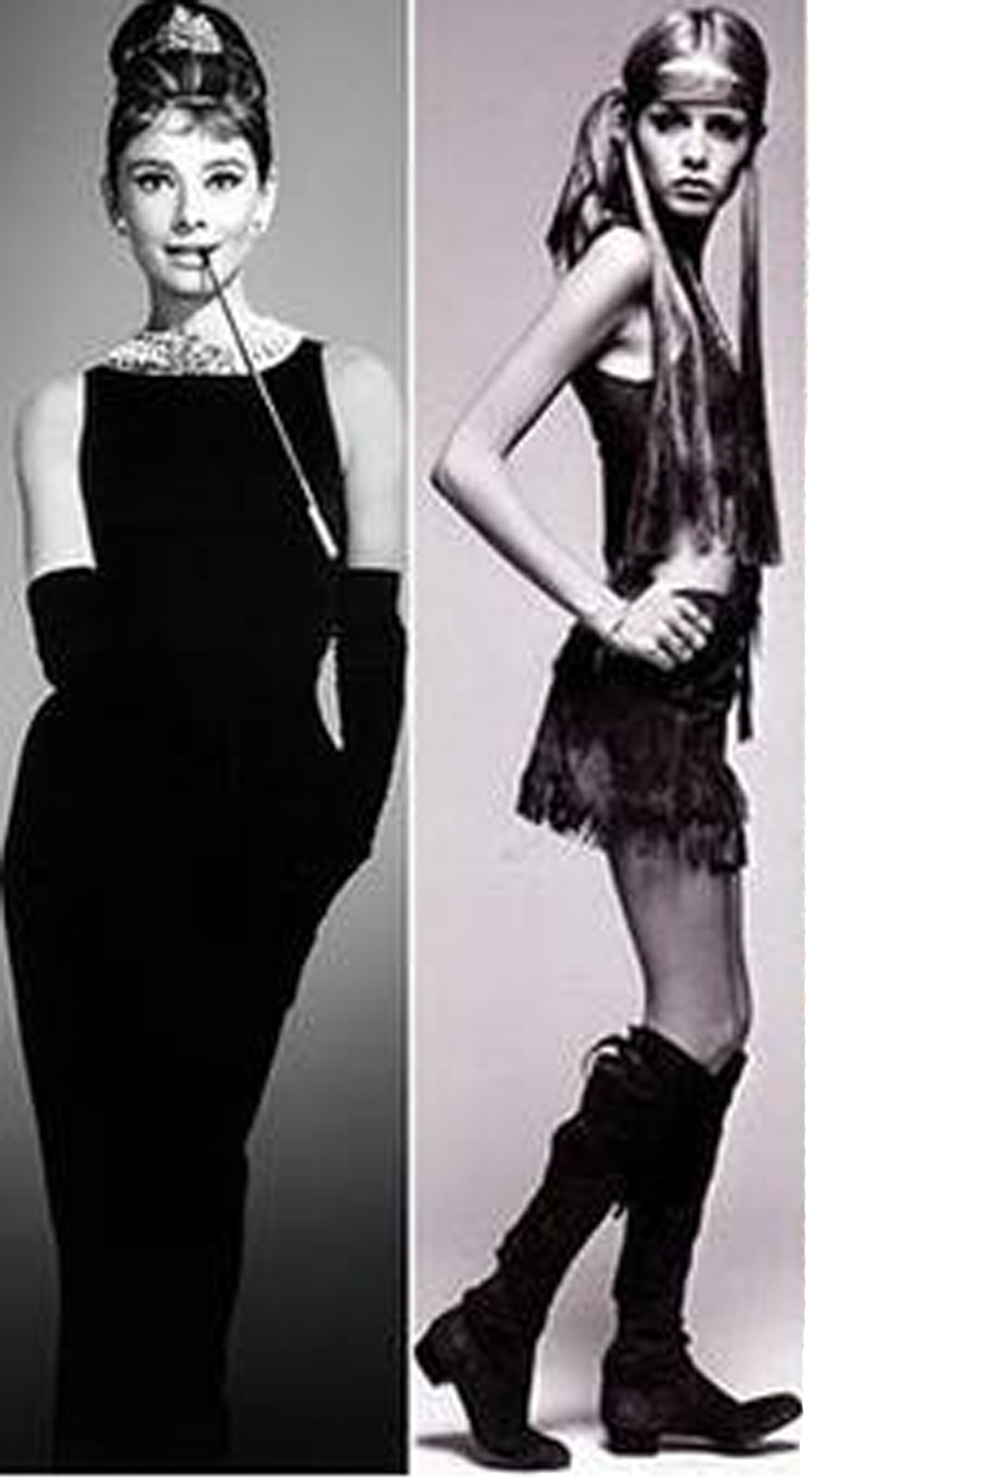
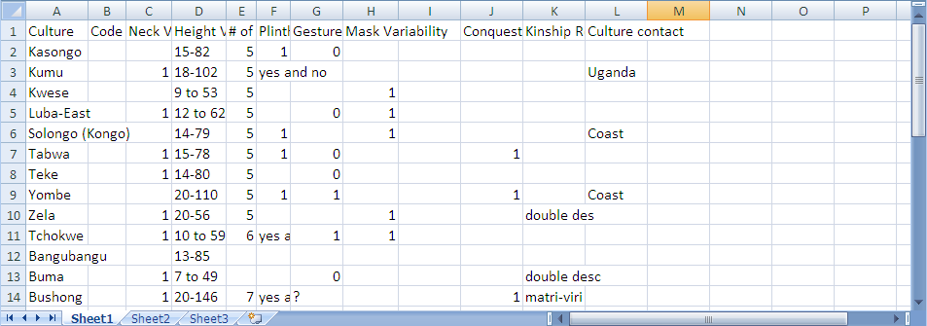
Art and Innovation
Gesture Variables
Neck Length Variables
Proportions
Arts of Congo

Slide 6
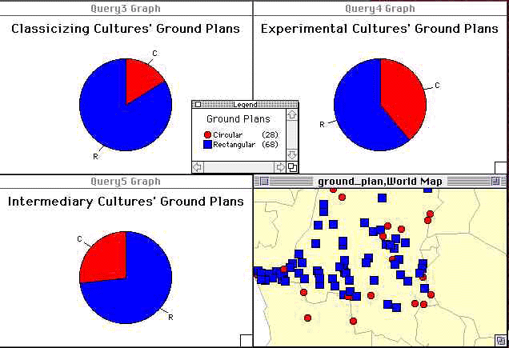
People who live in…
Experimental: Greater Proportion of circular houses

Slide 7
2003
Housed on Fine Arts Library and Arts Museums Servers
10 years faculty and graduate student research
Stephen Erwin “…libraries having to de-accession” (5/6/2011)

Slide 8
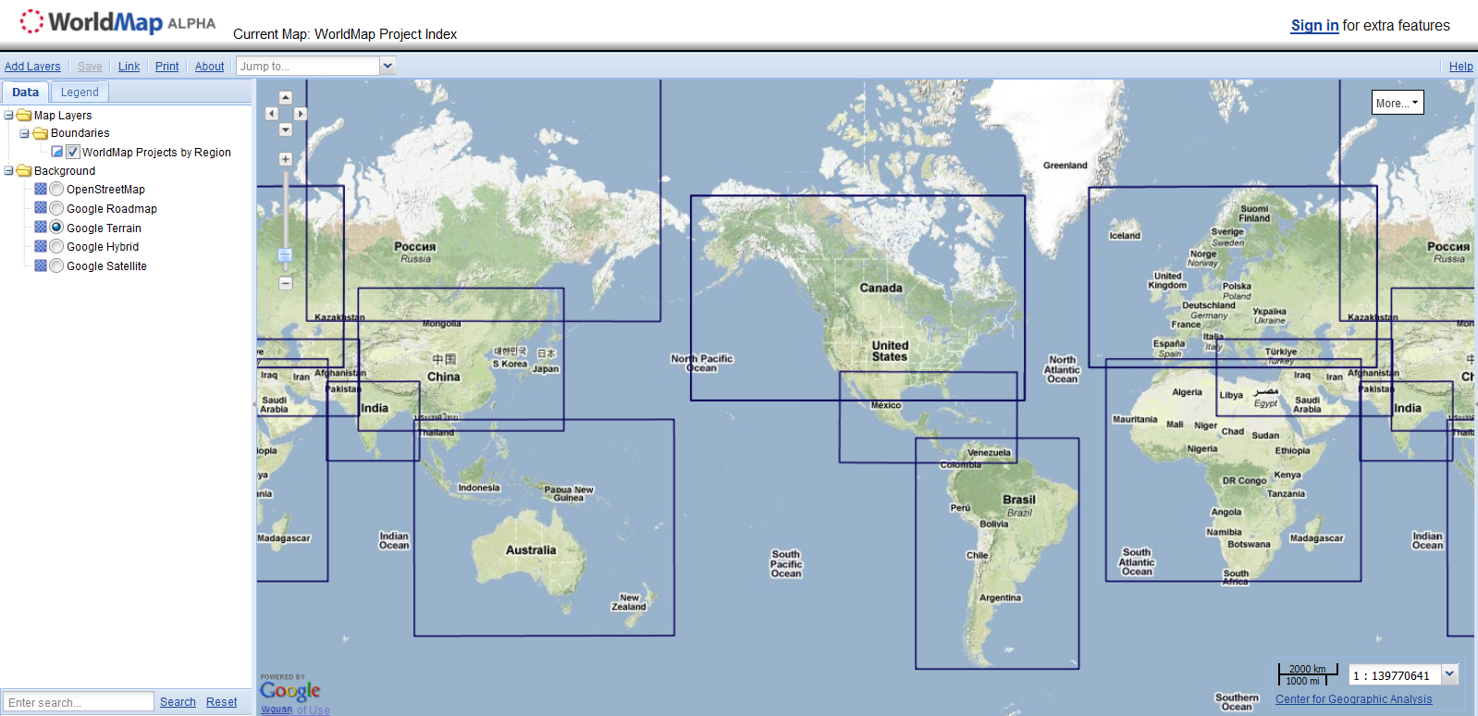
Africamap.harvard.edu
Worldmap.harvard.edu
Center for Geographic Analysis
Suzanne Blier & Peter Bol Ben Lewis
Connections c.14th-17th C.
Banda in Africamap

Slide 9
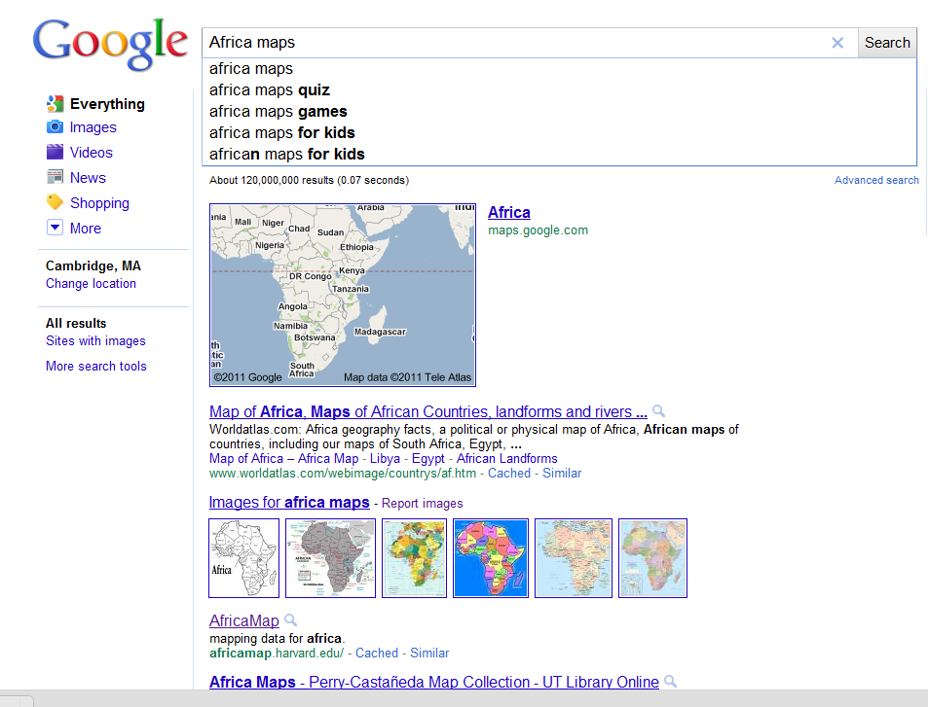
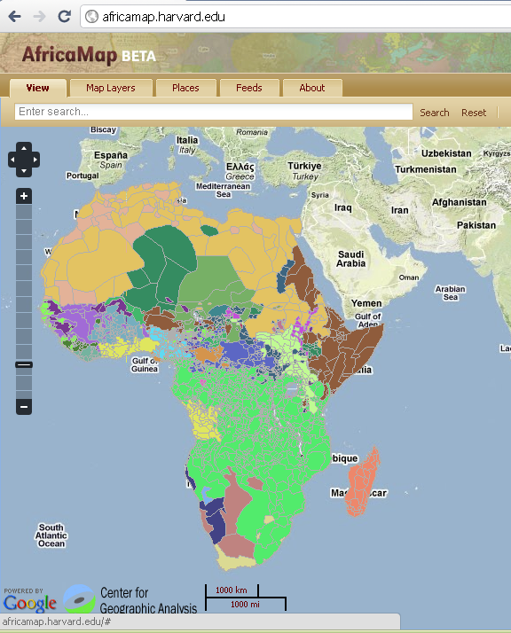
Africamap. Funded initially by grant I received from
Harvard Provost Funds for Innovation, Beta
version launched in November 2008.
Today (May 6, 2011) Africamap is
# 2 on Africa map searches, Google

Slide 10
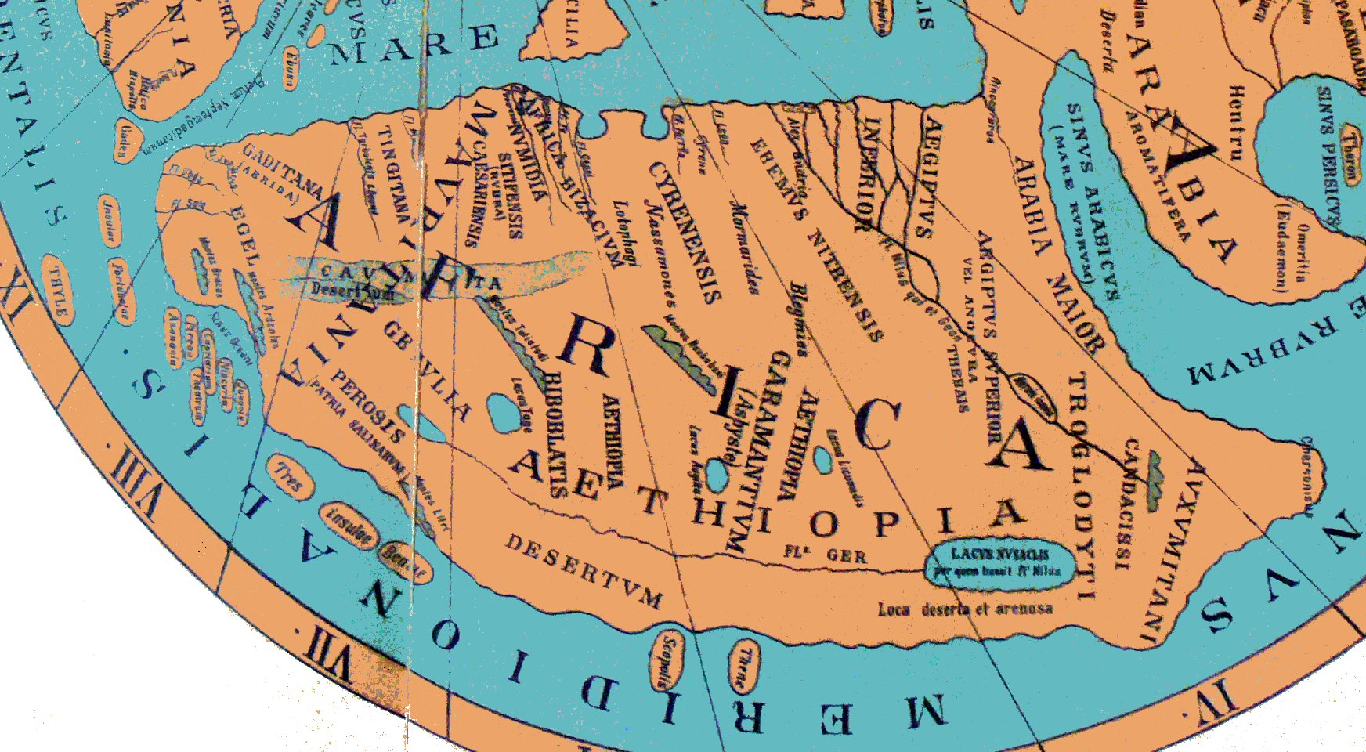
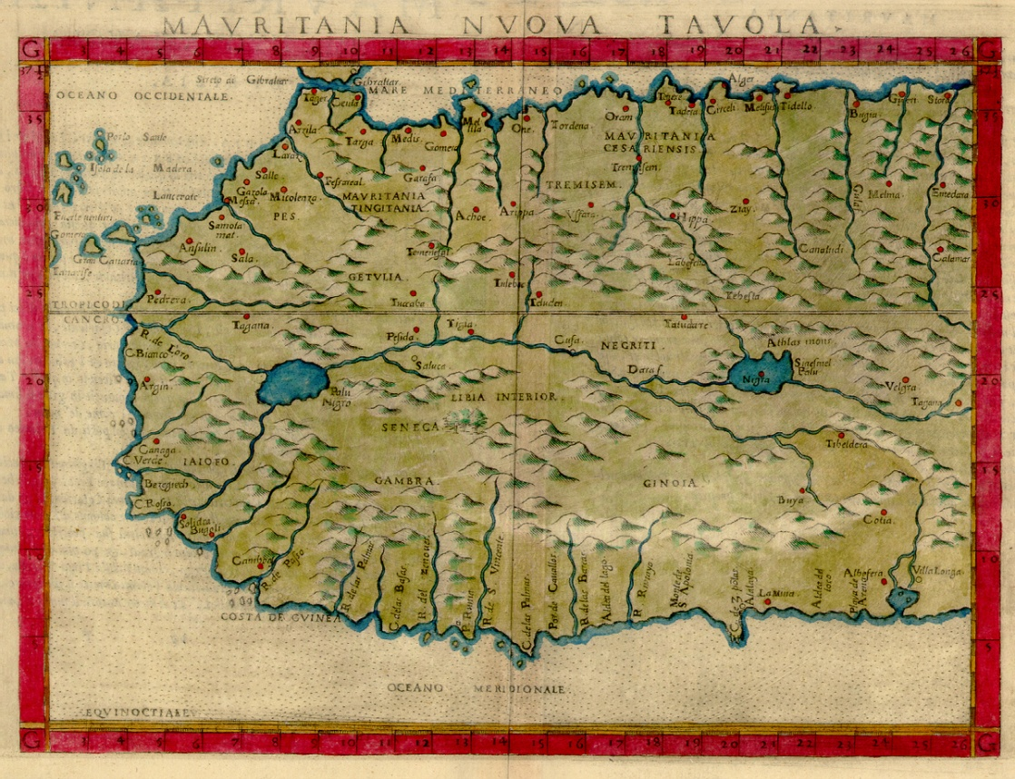
Ravenna_Cosmography after
Ptolemy
Ptolemy’s Africa
written in Italian and Latin
1561 Ruscelli

Slide 11
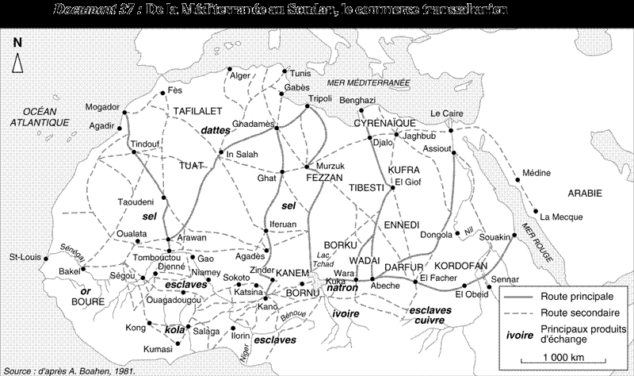
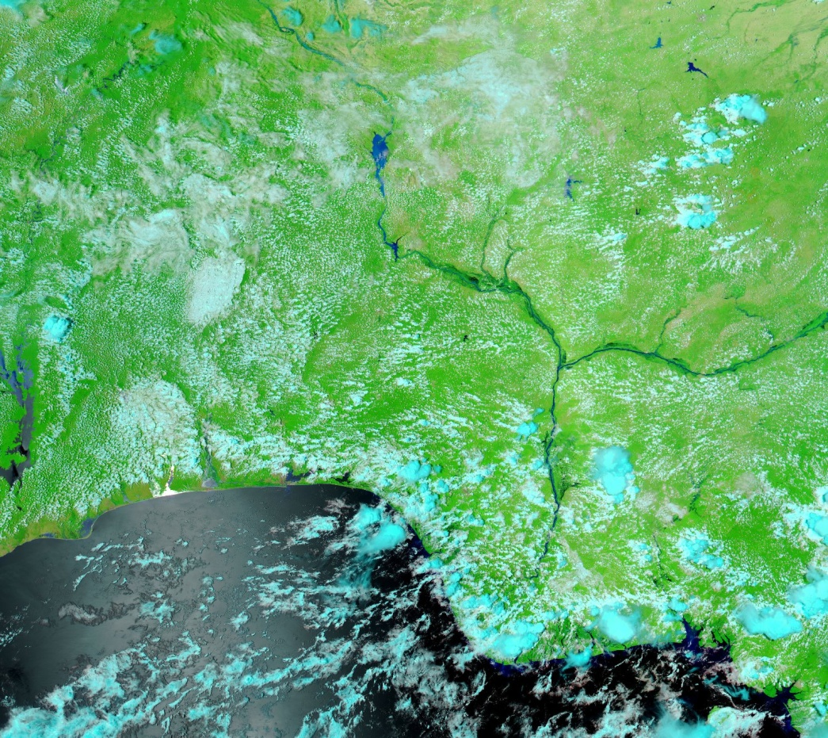
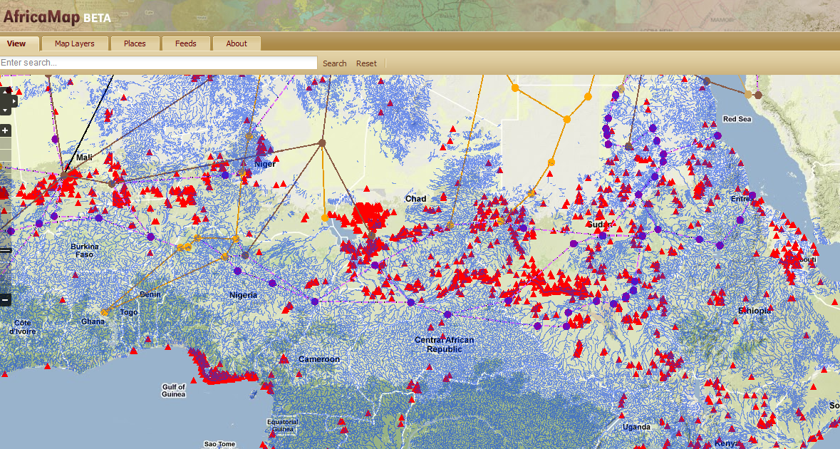
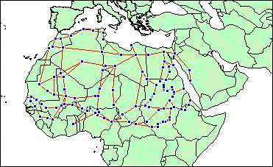
E. 14th Century Mamluk vessel
in Ghana
c.1300 Mamluk
Vessel in Ghana

Slide 12
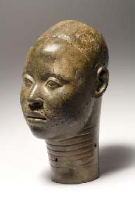
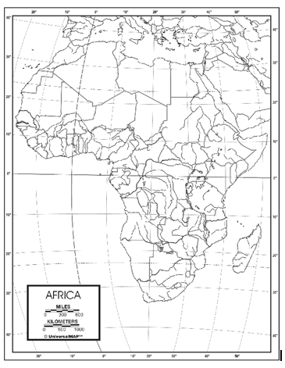
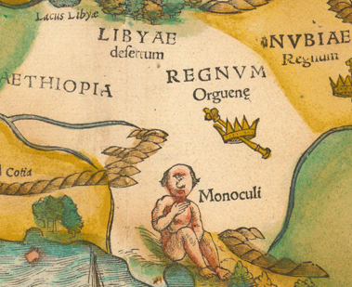
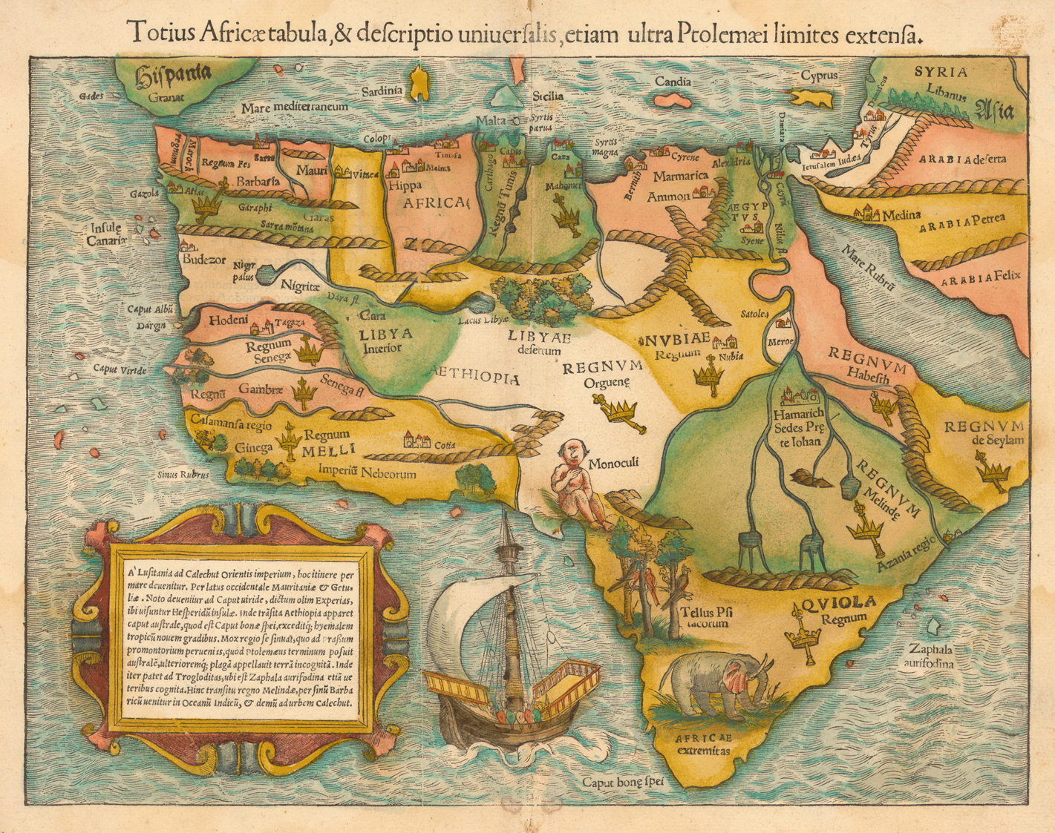
Regnum- Orguene (King of Ife –
Ogane: title of ruler)
1554 Munster Map

Slide 13
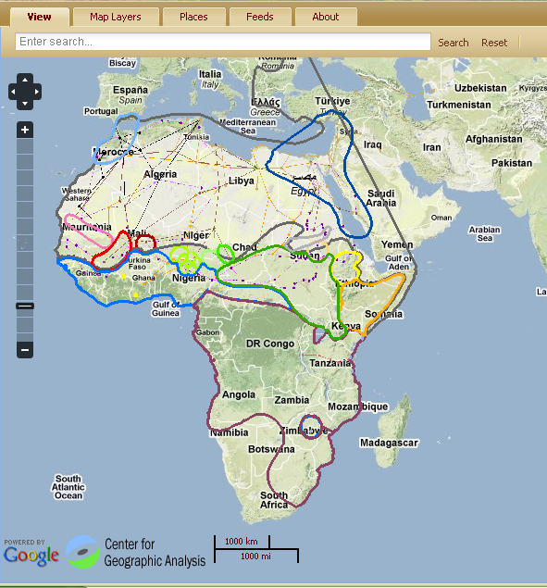
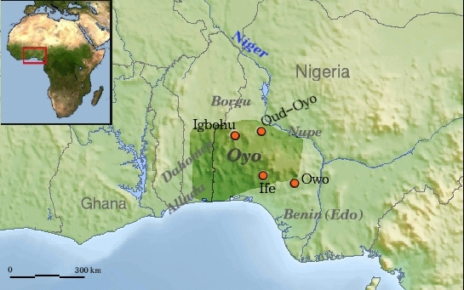

Slide 14
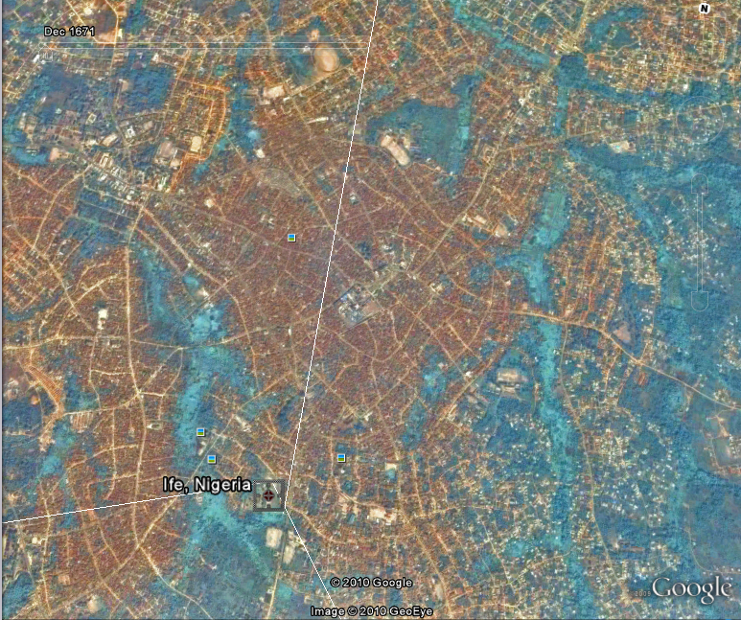
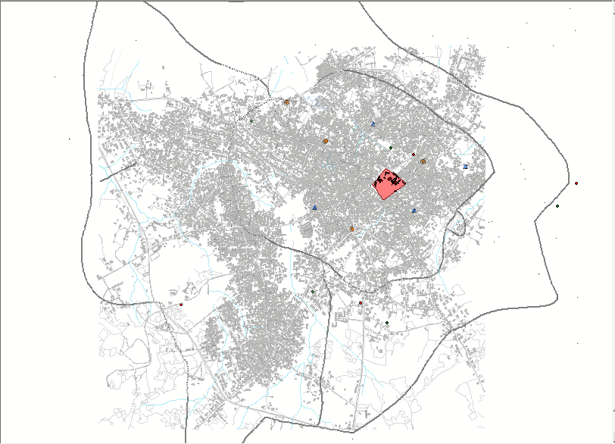
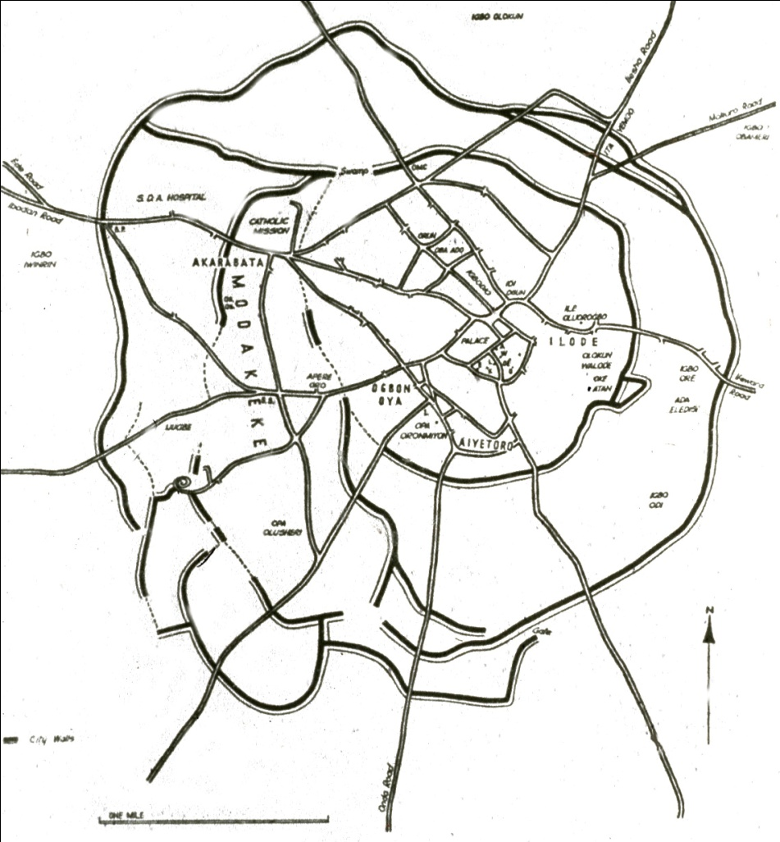
Julia Finkelstein, HSPH
City State of Ife (Nigeria)
founded c. 1300

Slide 15
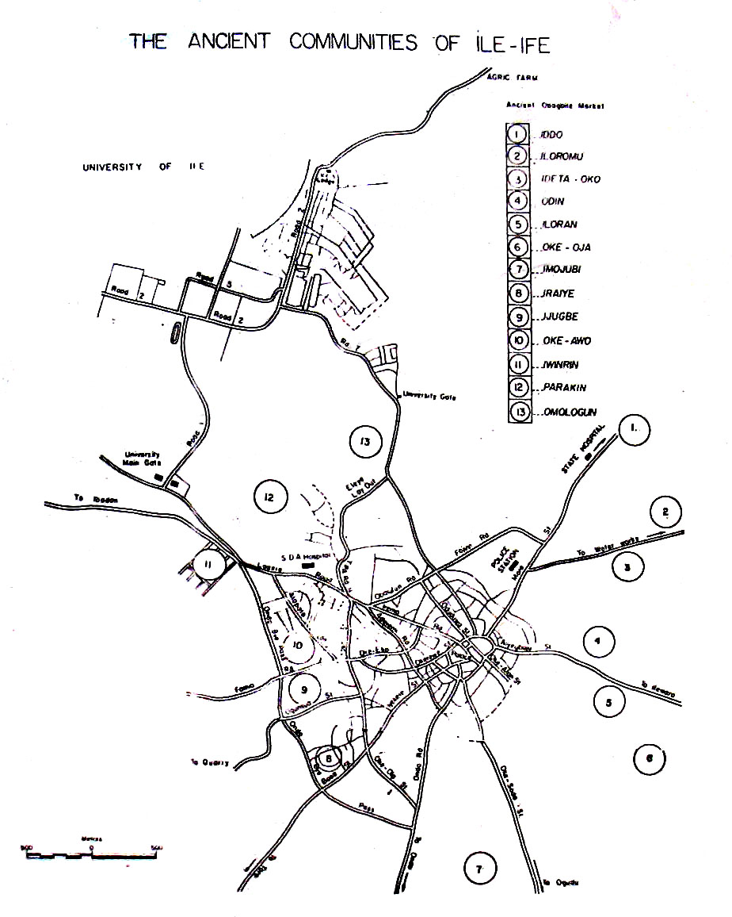
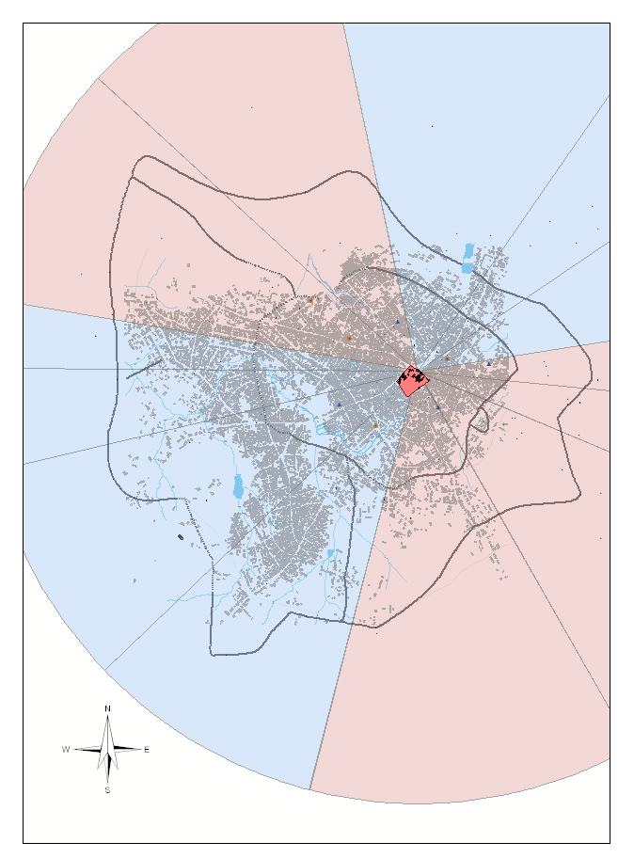
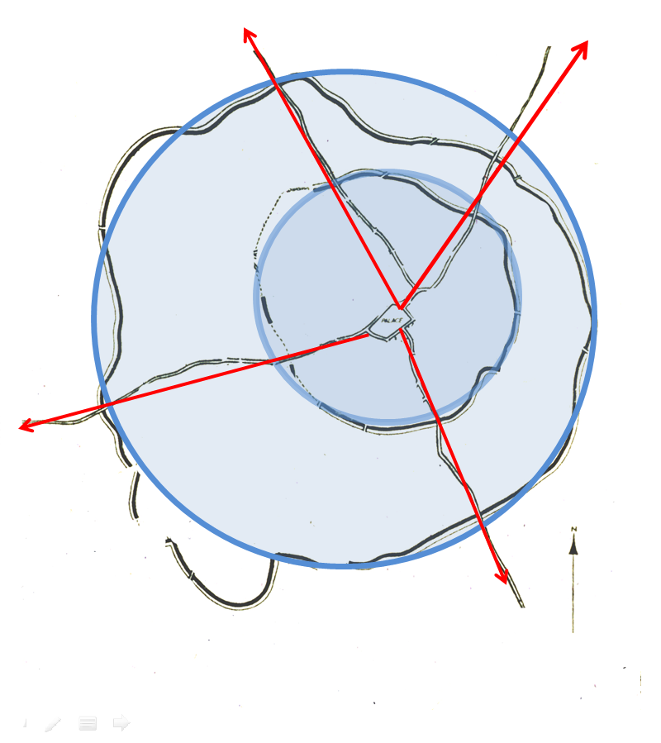

Slide 16
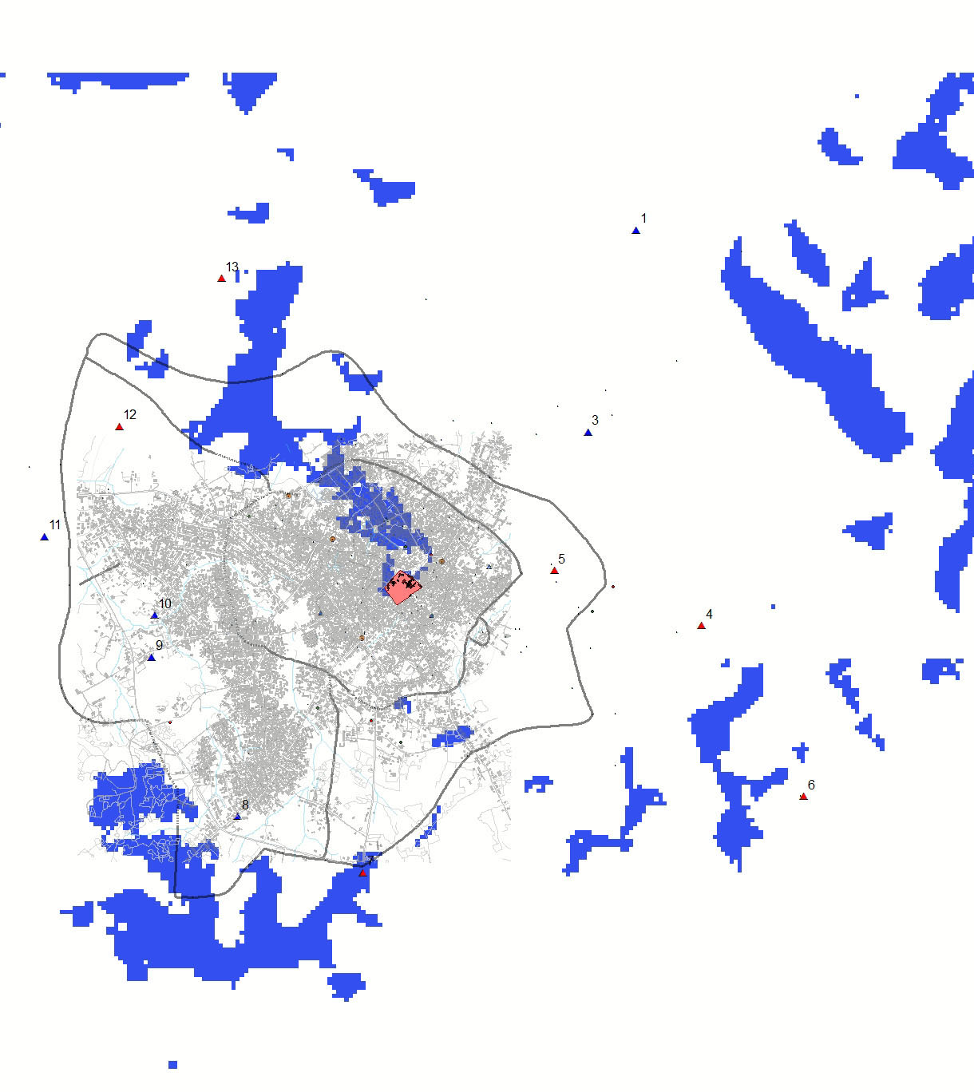
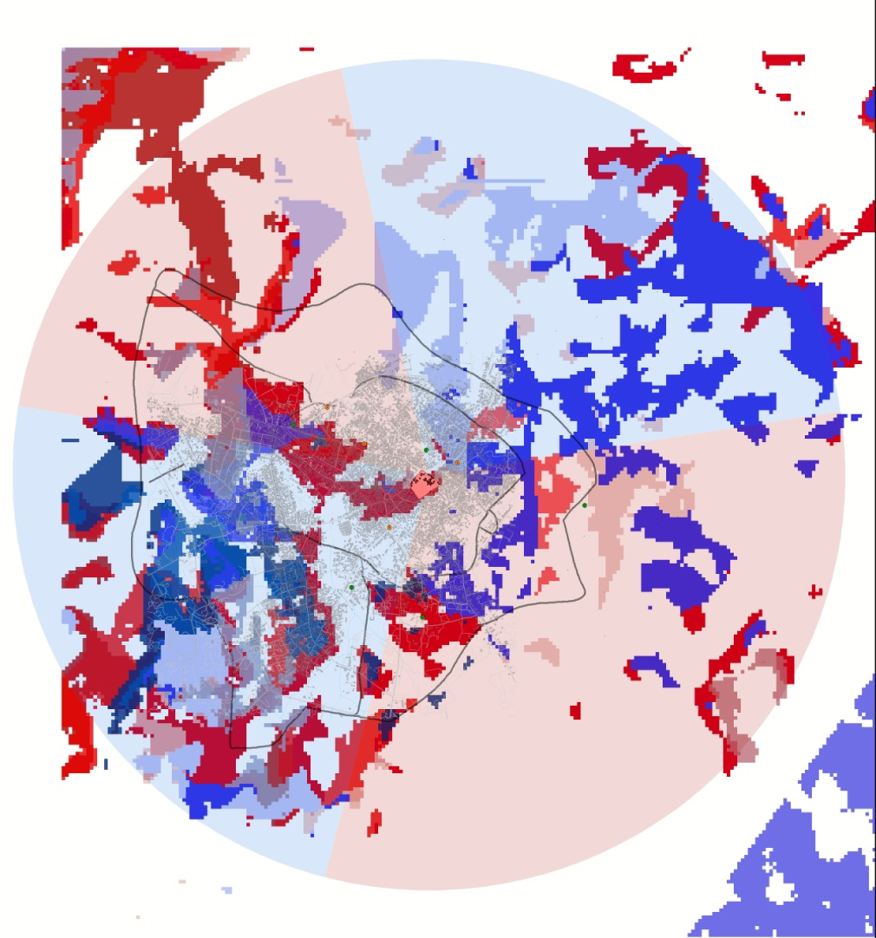
Ife politics and view sheds
w. J. Finklestein and J. Blossom

Slide 17
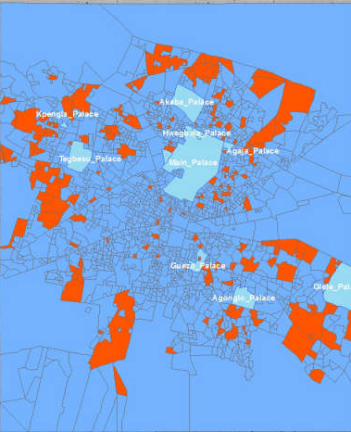
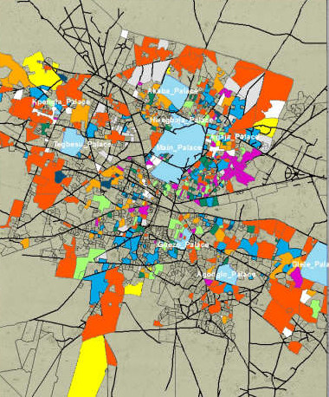
Fon (Abomey, Rep. of Benin)
Class
& Occupation
& Historical engagement

Slide 18
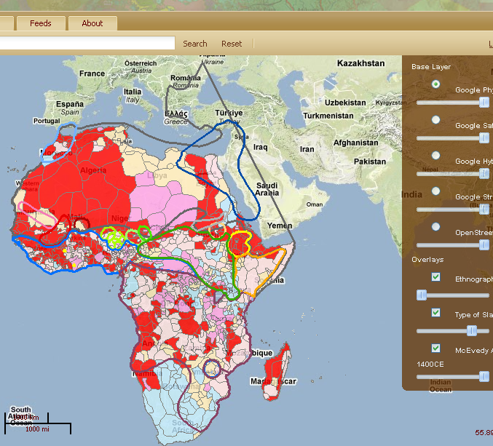
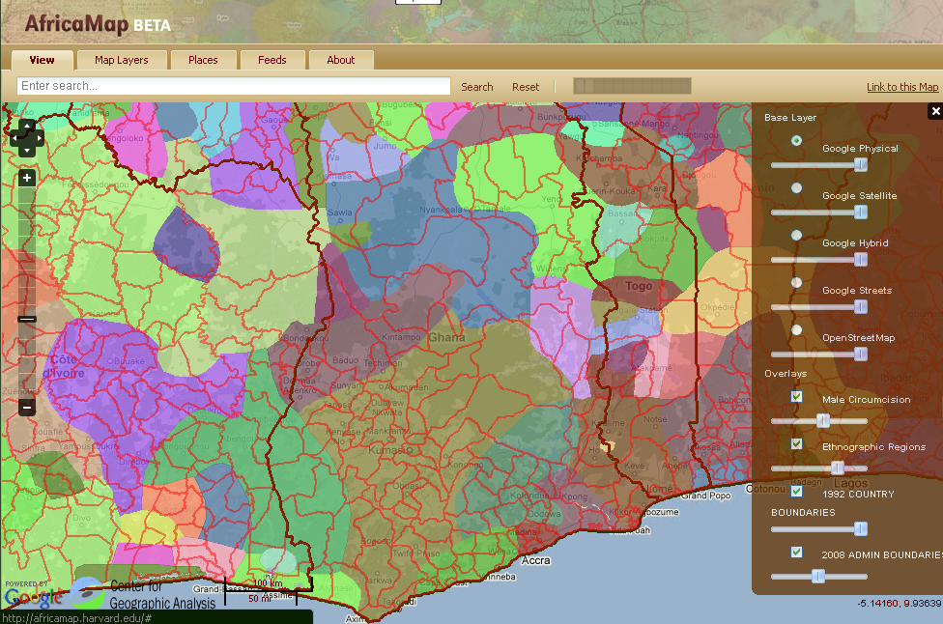
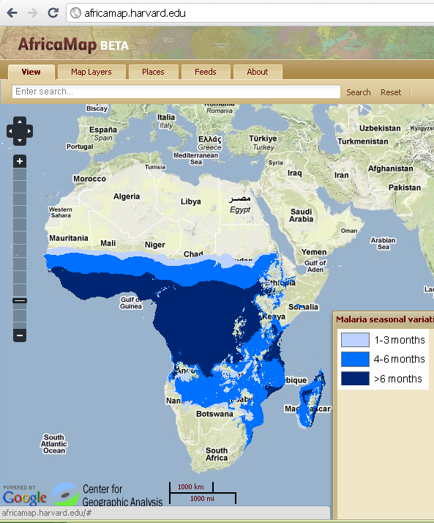
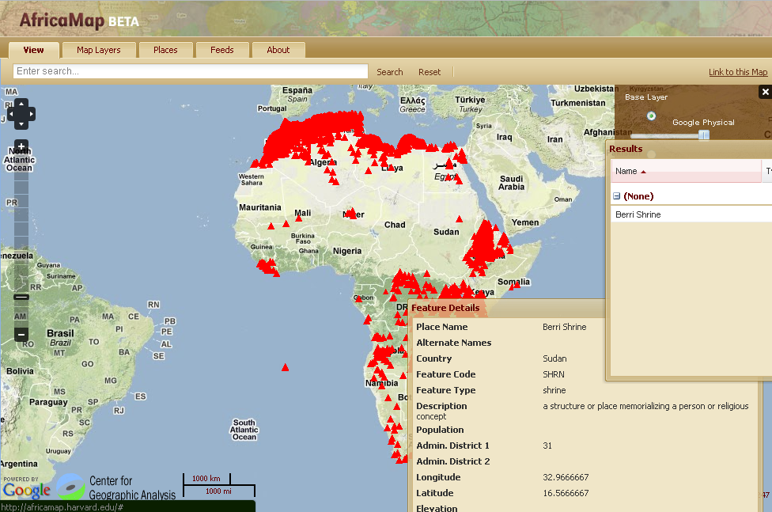

Slide 19
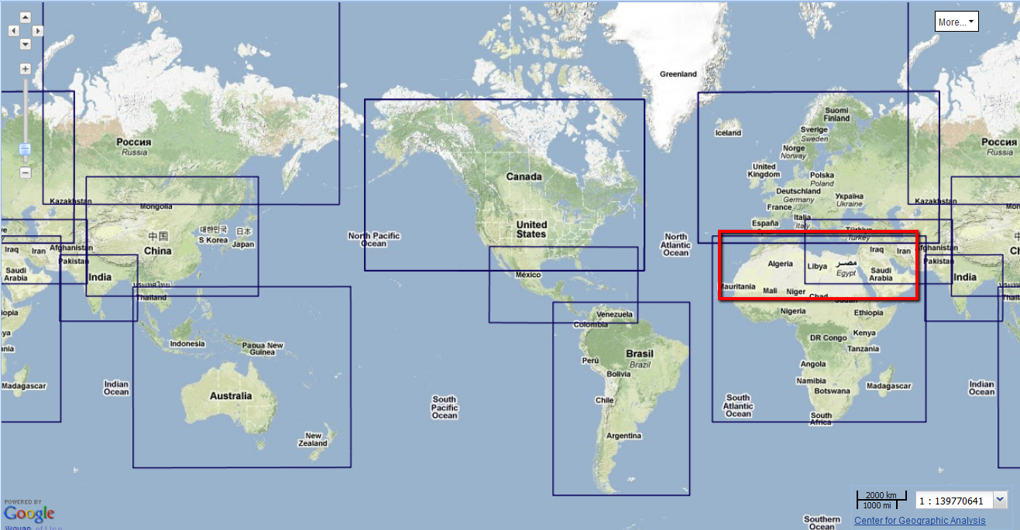
Worldmap

Slide 21
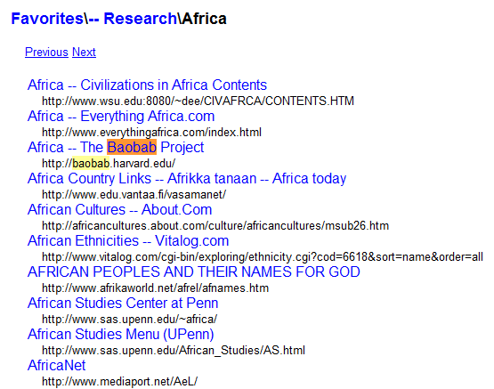
www-sul.stanfor.edu.depts.ssrg.africa

Slide 22
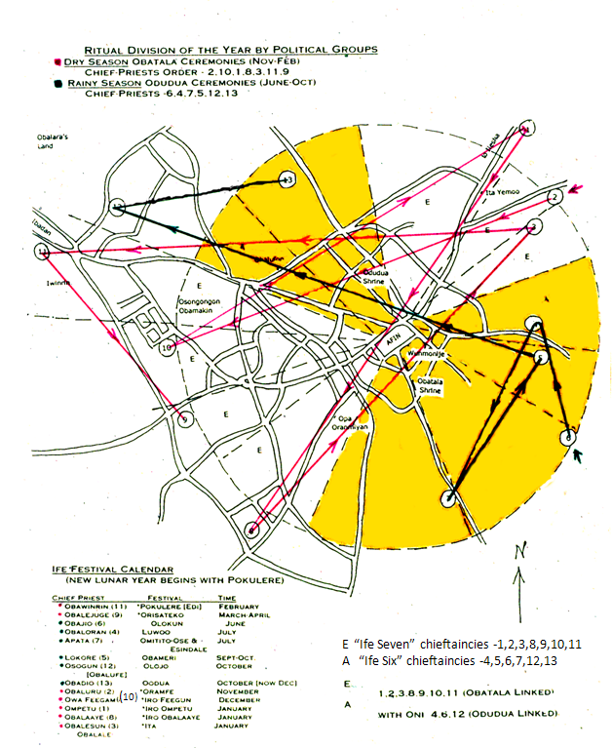
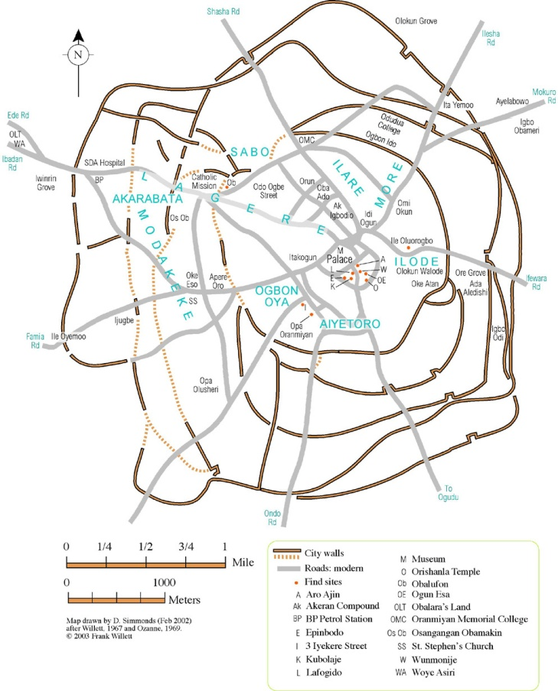
Political History, Urban Planning
Two dynasties divide the year

Slide 23
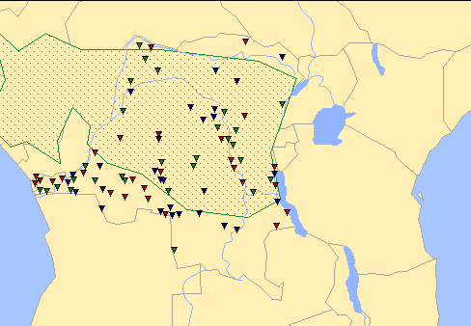
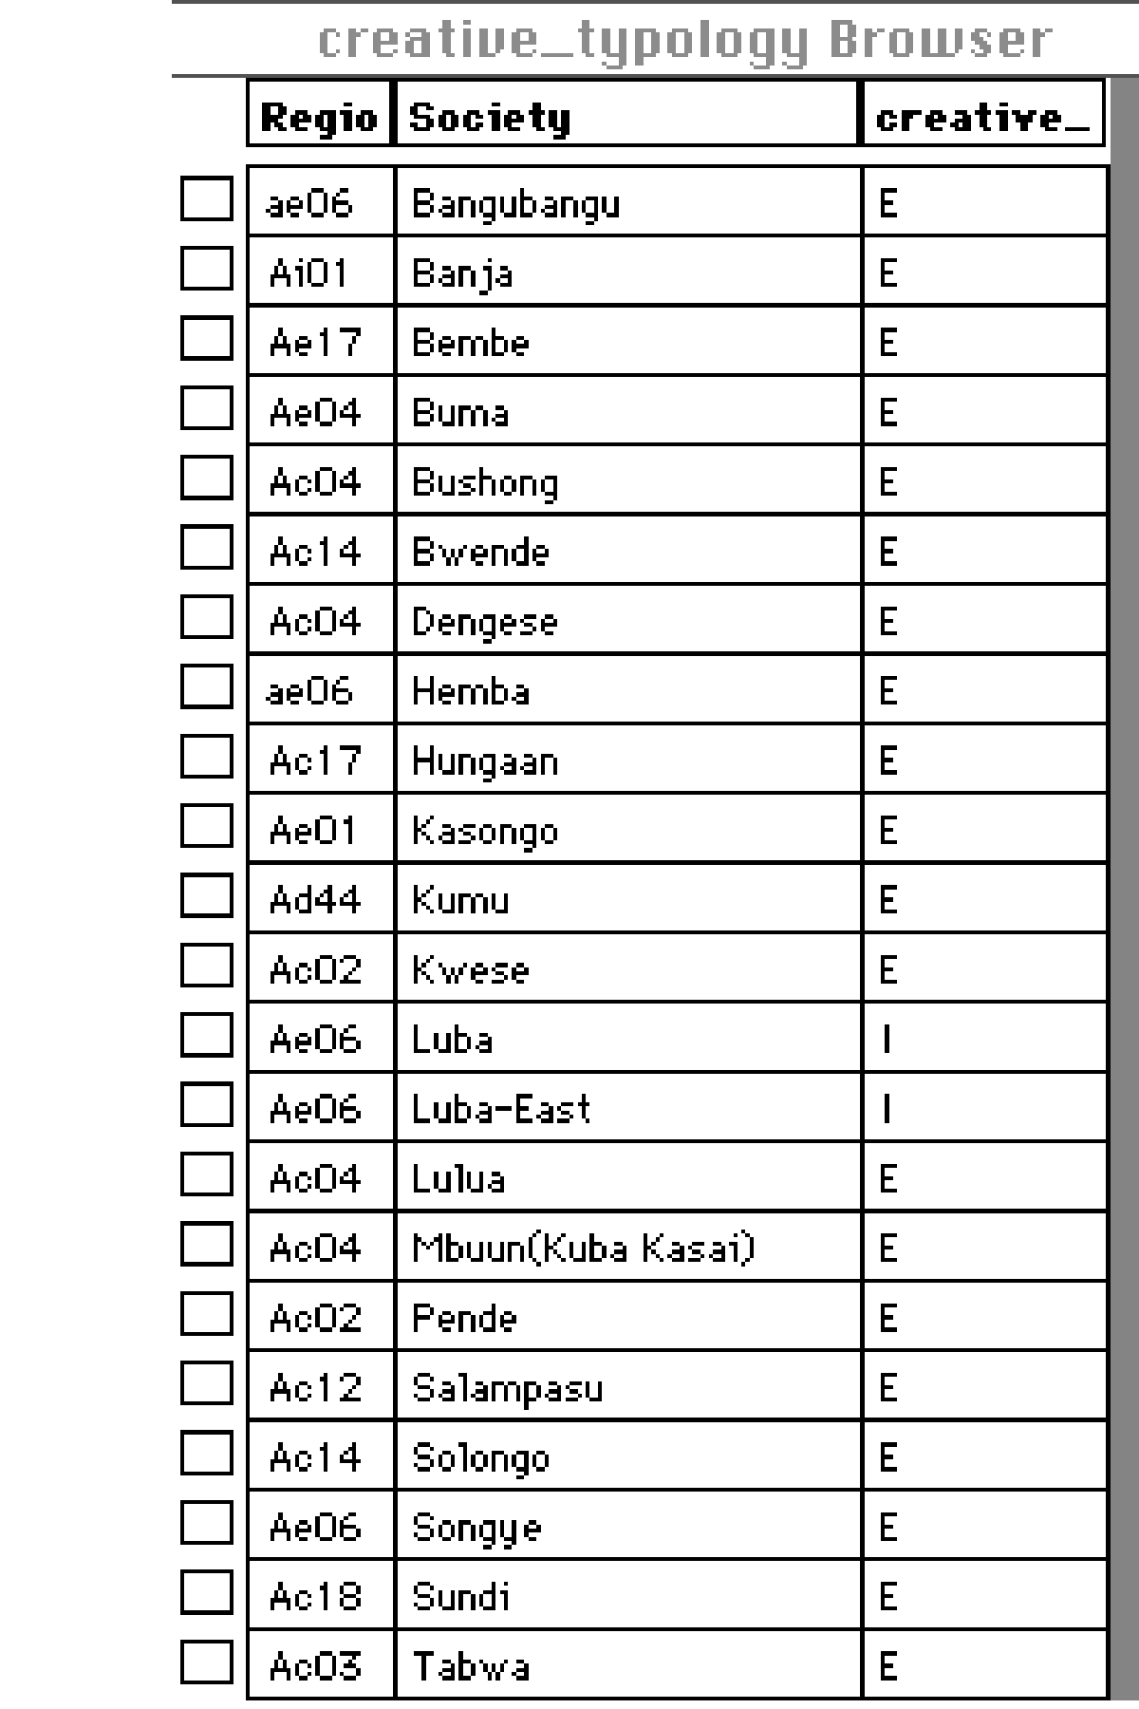
Social Roots of Creativity
Classicizing (traditional) Cultures (blue)
Experimental (innovative) Cultures (red)
Intermediary Cultures (green)

Slide 24
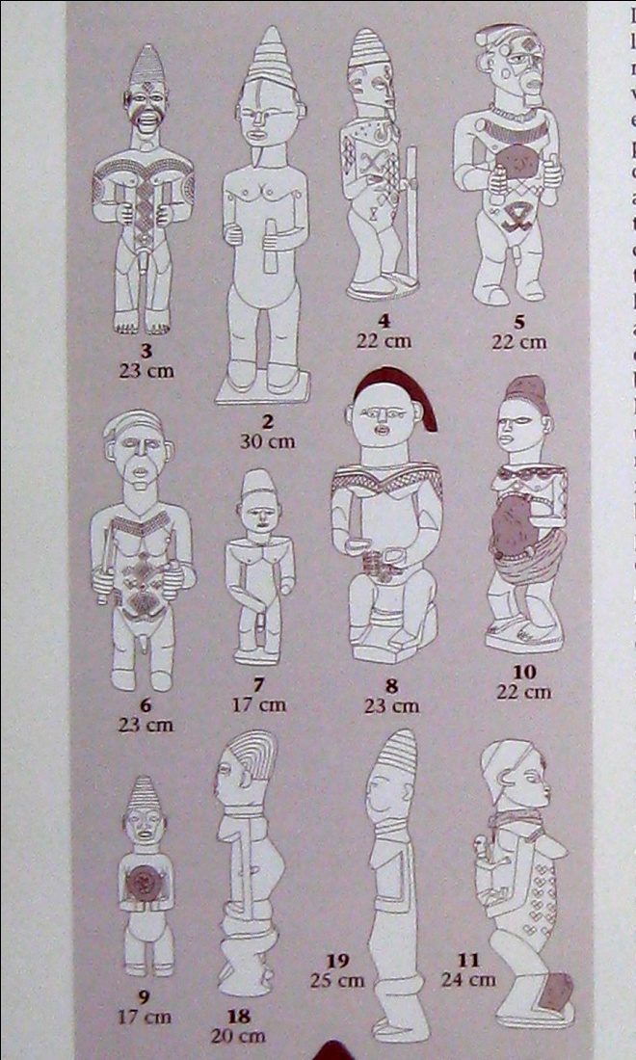
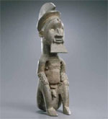

Slide 25
Niger and Benue River Confluence
Benue River at Mambila

Slide 28
Active Gods

Slide 29
Ife (Nigeria)
c.1300
Coptic Pope, Damietta Egypt)

Slide 30
Africamap layers

