Slide 1
Spatial Intelligence for Demographic and Economic Information of China
Shuming Bao
China Data Center
University of Michigan

Slide 2
The Census Data of China
Population Census:
1953, 1964, 1982, 1990, 2000, 2010
Economic Census:
Industrial Census (1995)
Basic Unit Census (2001)
Economic Census (2004, 2008)

Slide 3
China Data Online
- The primary data source for China studies
Statistical Database:
Monthly Statistics
National Statistics
Provincial Statistics
City Statistics
County Statistics
Monthly Industrial Data
Yearly Industrial Data
Statistics on Map
Statistical Yearbooks
Census Database:
Population Census 1982
Population Census 1990
Population Survey 1995, 2005
Province Census 2000
County Census 2000
Economic Census 2004

Slide 4
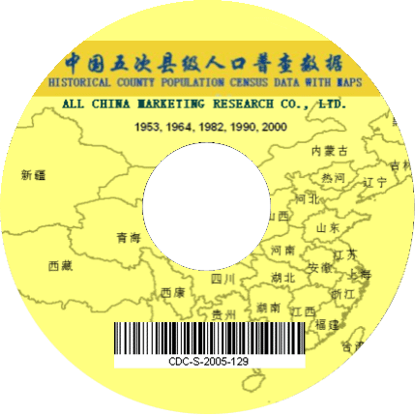
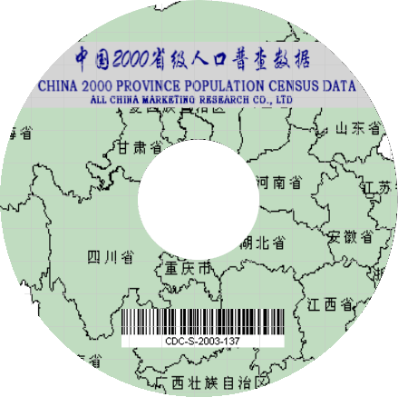
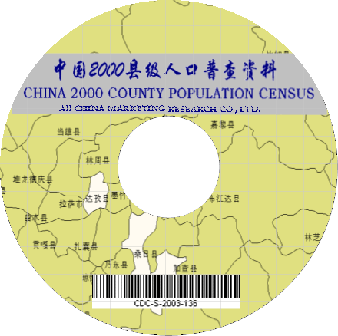
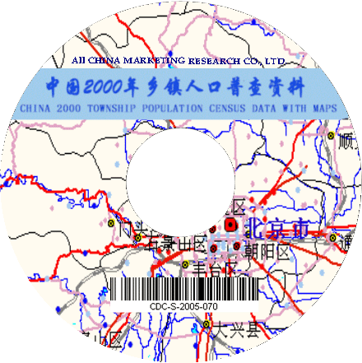
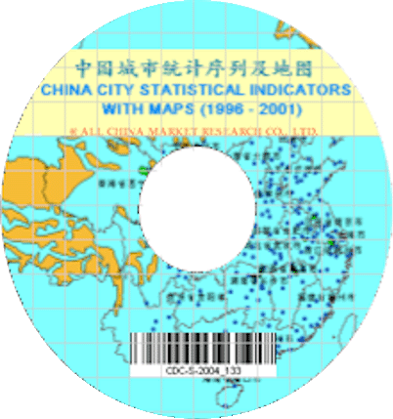
Spatial Data of China
2000 China Township Population Census Data with GIS Maps
2000 China County Population Census Data with GIS Maps (Version III)
2000 China Province Population Census Data with GIS Maps
2000 China Grid Population Census Data with Township Boundaries
China Historical Province Population Census Data with GIS Maps (1953, 1964, 1982, 1990, 2000)
China Historical County Population Census Data with GIS Maps (1953, 1964, 1982, 1990, 2000)
China 1995 Industrial Census Data with GIS Maps
China 2001 Basic Unit Census Data with GIS Maps
China 2004 Economic Census Data with GIS Maps
China City Statistical Indicators with Maps (1996-)
Geographic Layers (rivers, lakes, roads, highways, railways)

Slide 5
What is Spatial Intelligence?
+
+
Information
Methodology
knowledge
Technology

Slide 6
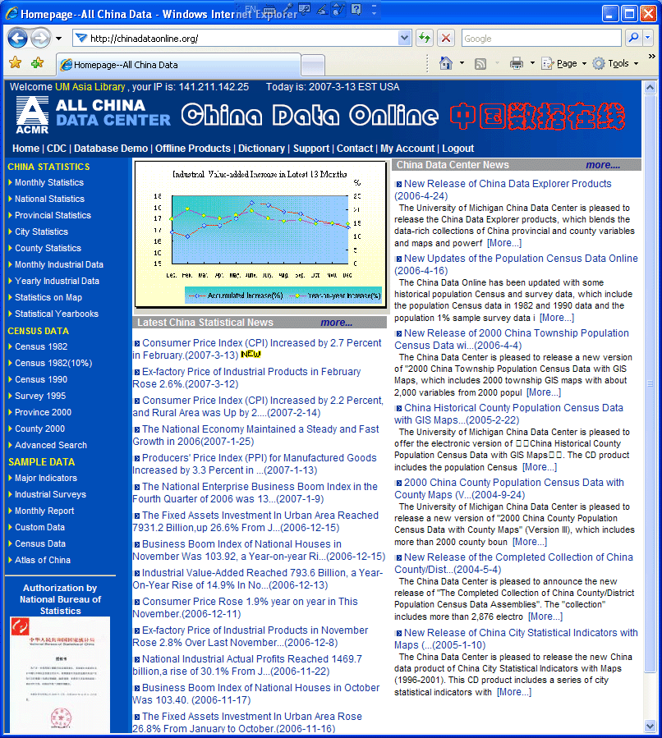
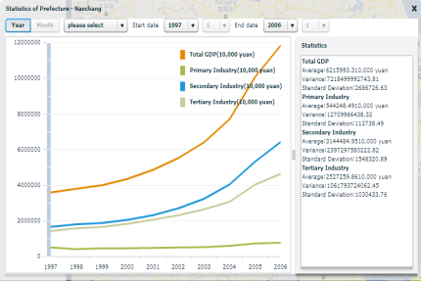
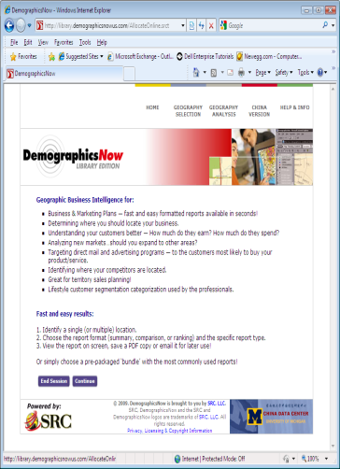
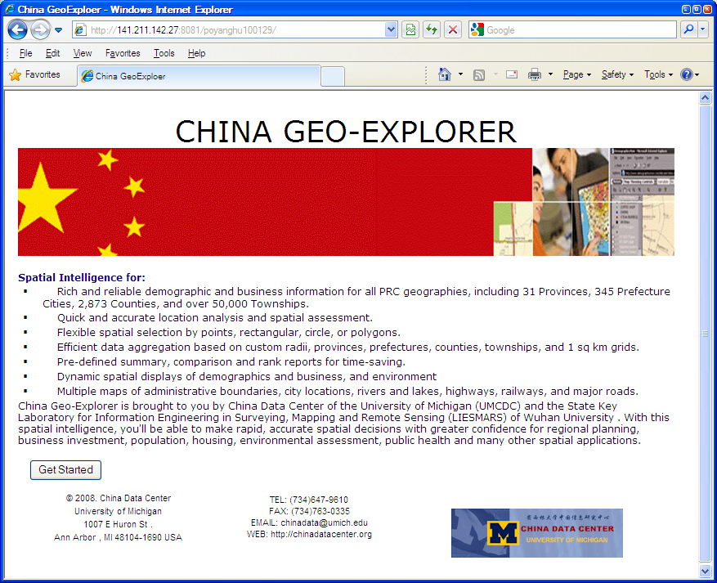
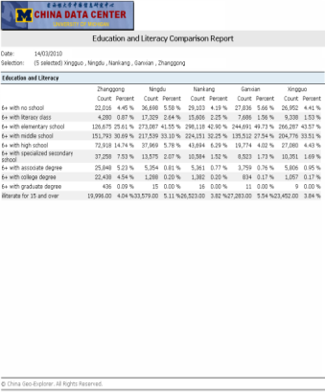
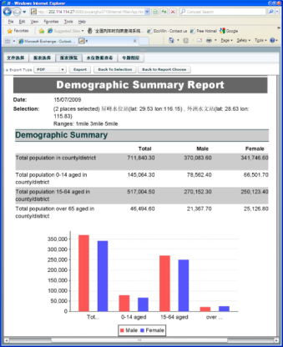
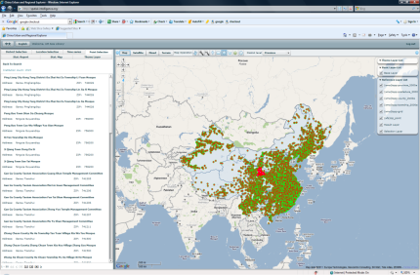
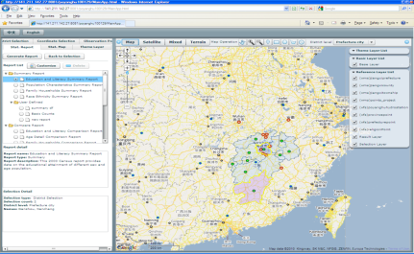
New Development: China Spatial Explorer Spatial Intelligence for Space-Time Data Integration and Analysis
Statistics
Charts
Tables
Reports
Census
GIS
Maps

Slide 7
China Spatial Explorer: System Structure
Data Selection
Report
Map
Chart
Data Integration & Analysis
Raster
Vector
Time-Series
GeoGlobe
Observation
Google Map
Statistics
WMS
WFS
Other

Slide 8
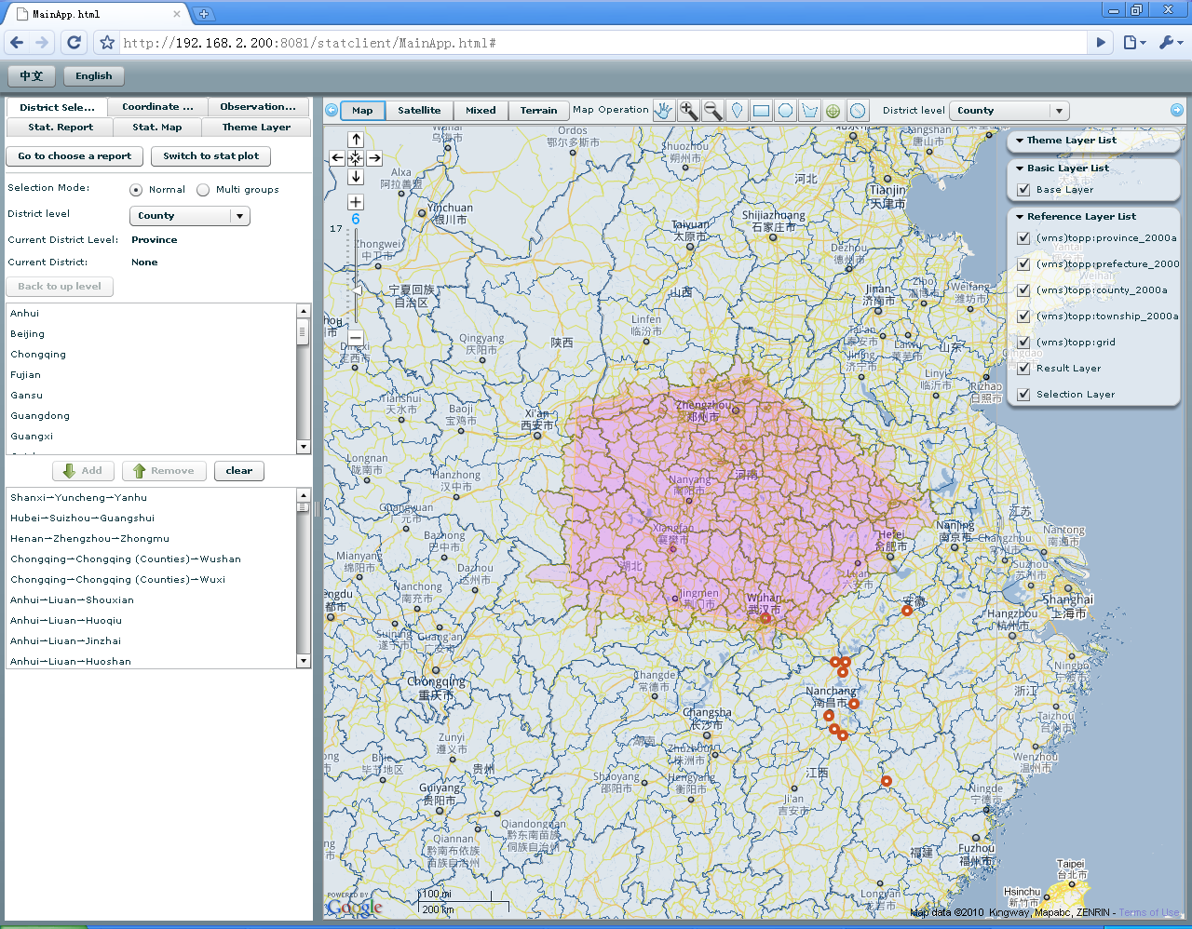
Selection by Administrative Units
Select by map
Select by administrative units
Notes:
8

Slide 9
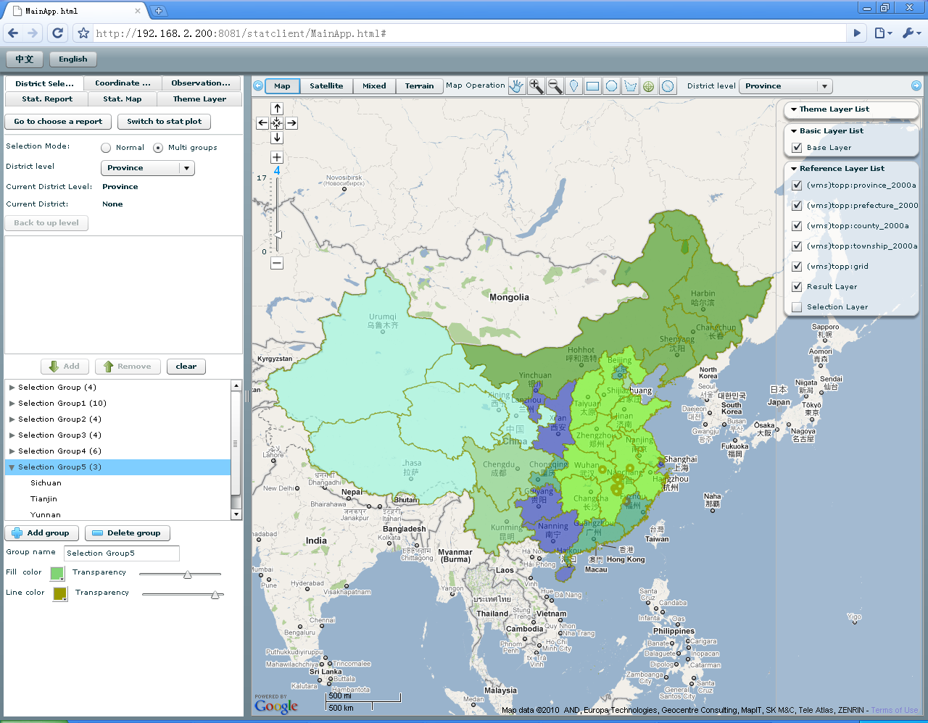
Selection by Groups
Notes:
9

Slide 10
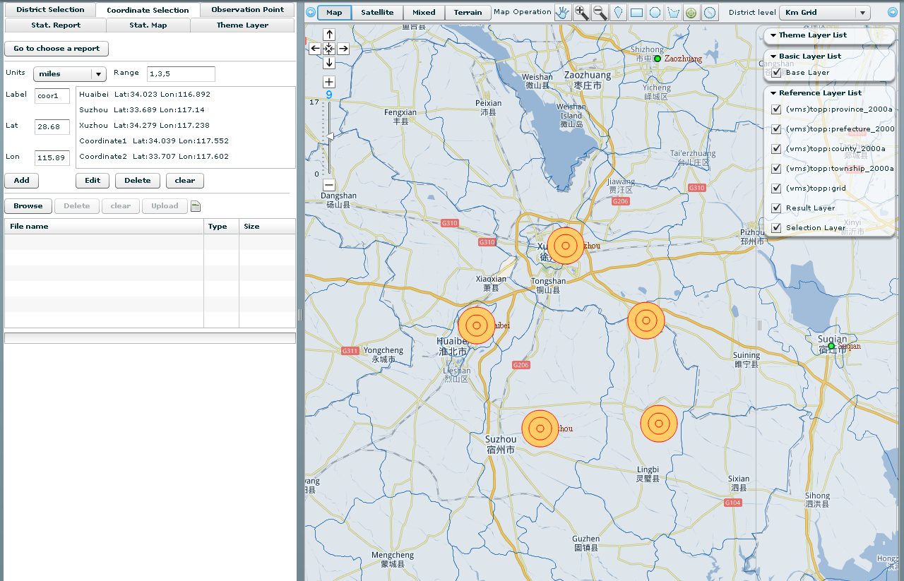
Selection by Locations
Select by X & Y coordinates
Select by locations on map
Notes:
10

Slide 11
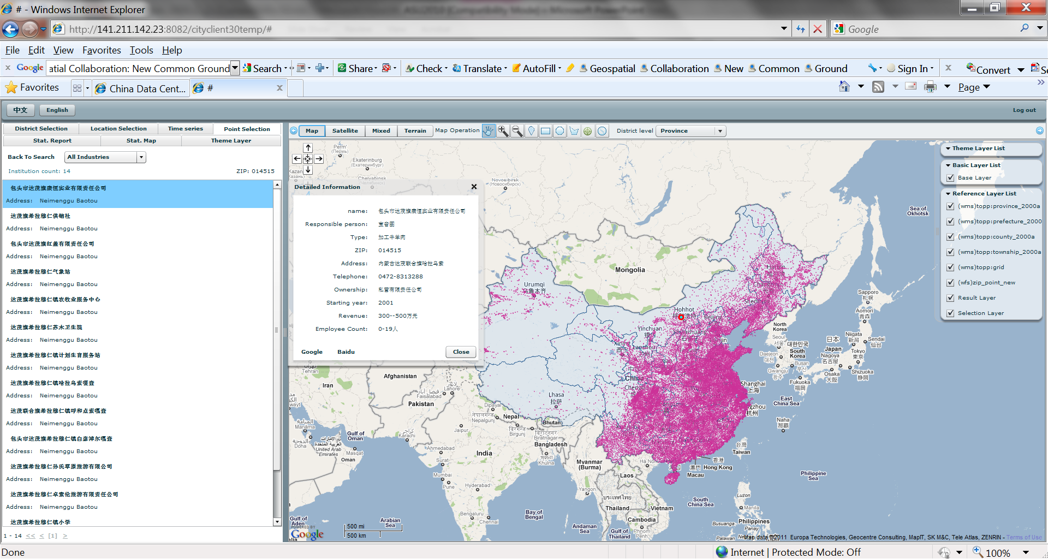
Selection by Establishments

Slide 12
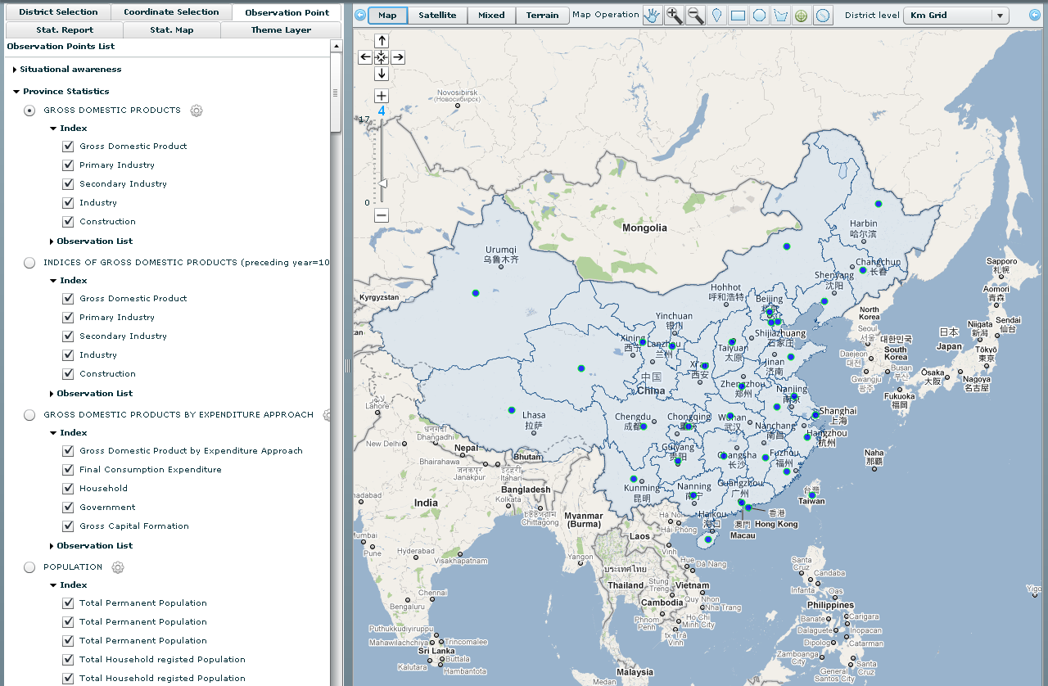
Space-Time Data Integration
Notes:
12

Slide 13
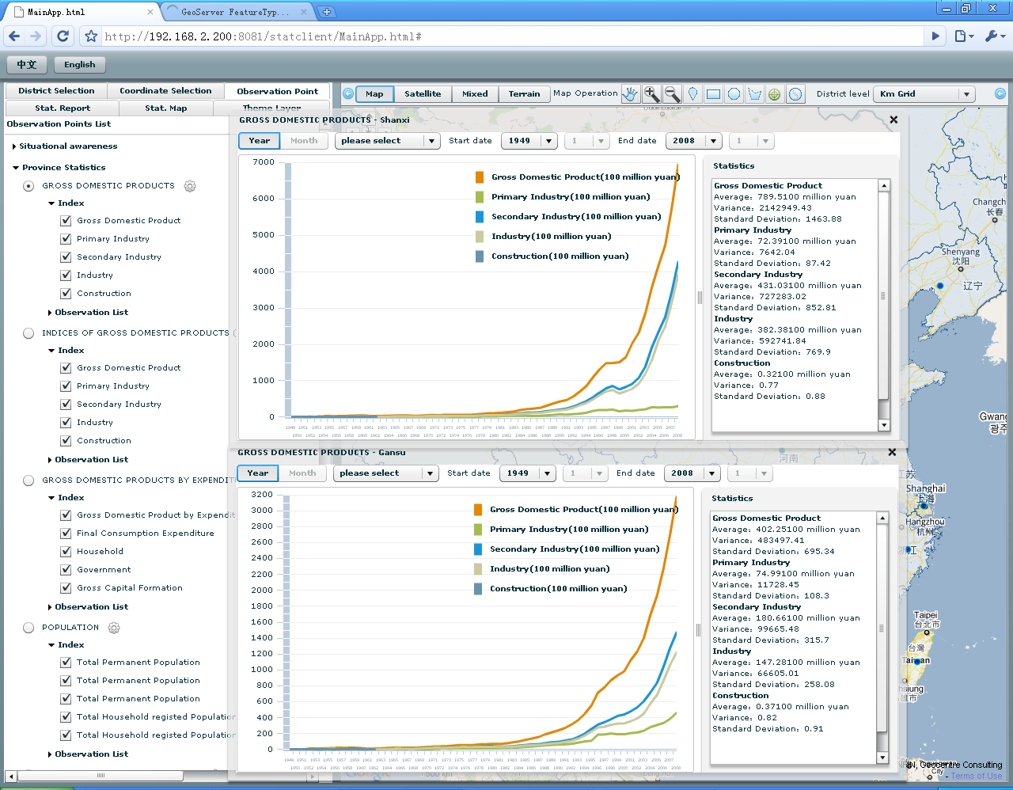
Province Statistics
Notes:
13

Slide 14
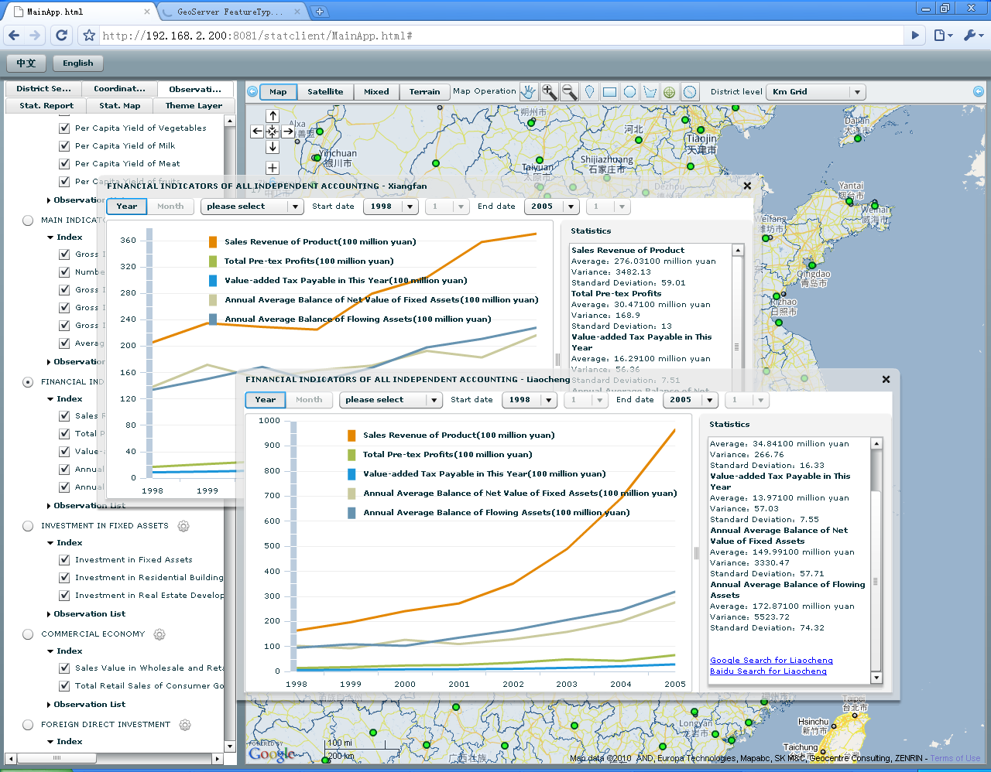
City Statistics
Notes:
14

Slide 15
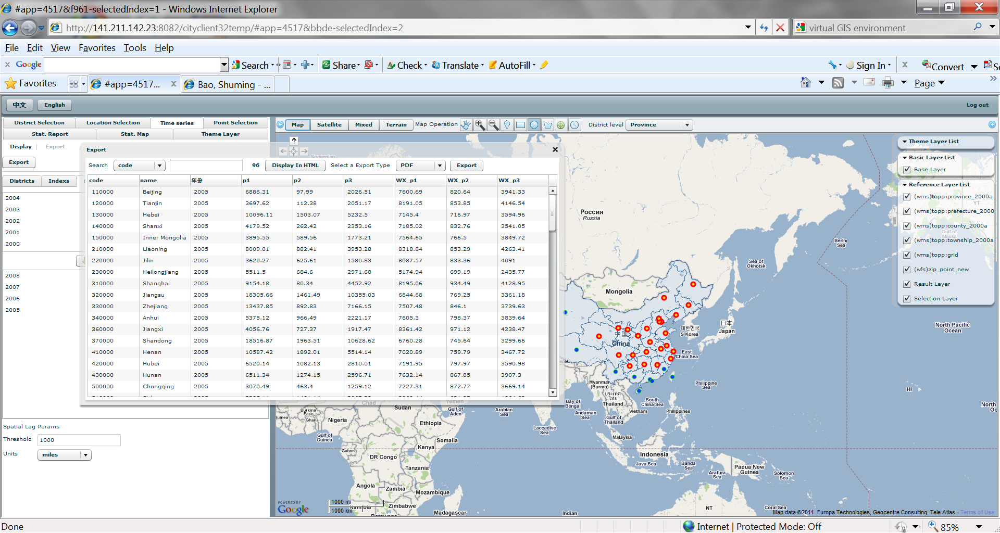
Export of Space-Time Series Data
Notes:
15

Slide 16
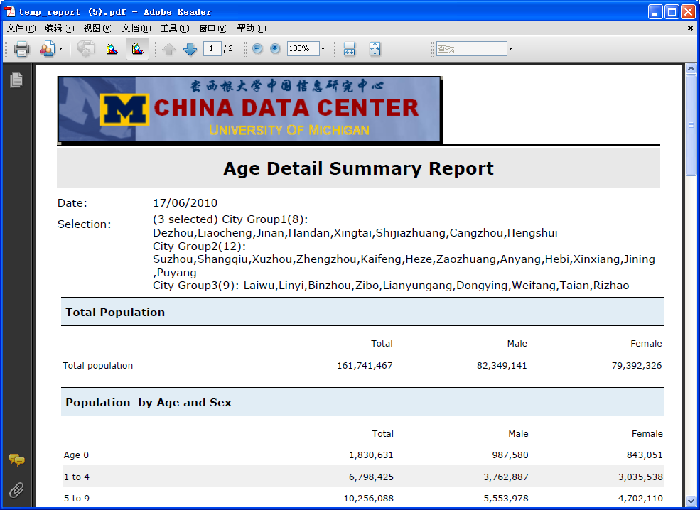
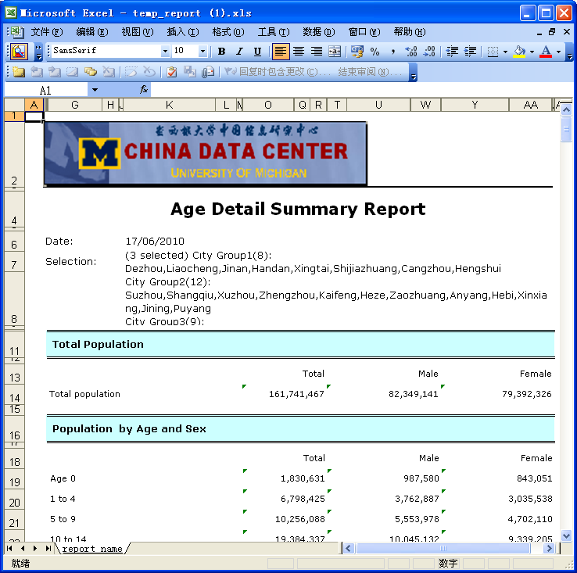
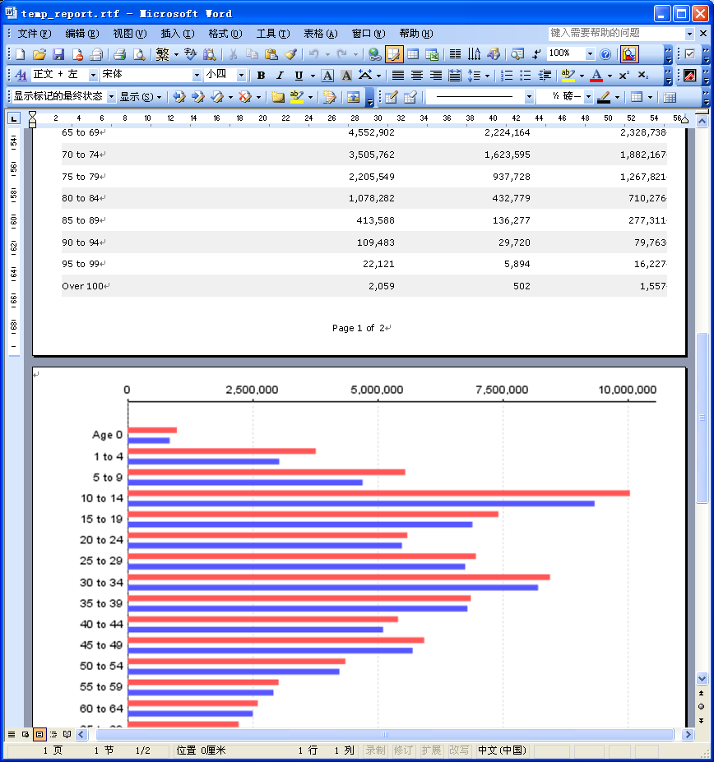
Multiple Outputs
Notes:
16

Slide 17
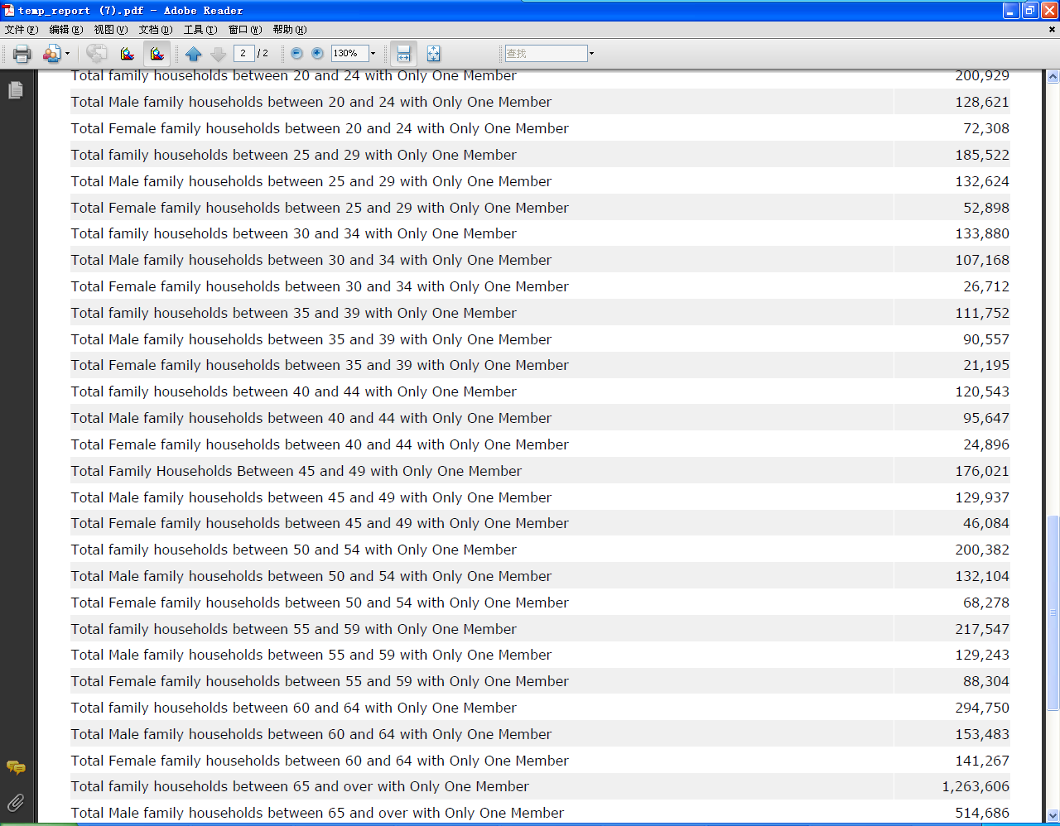
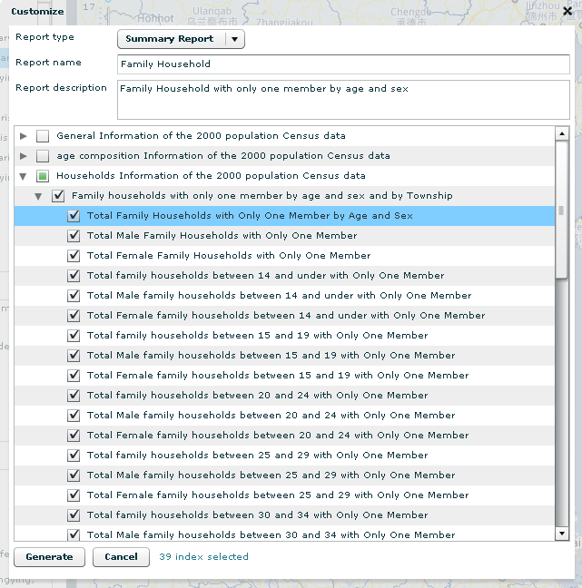
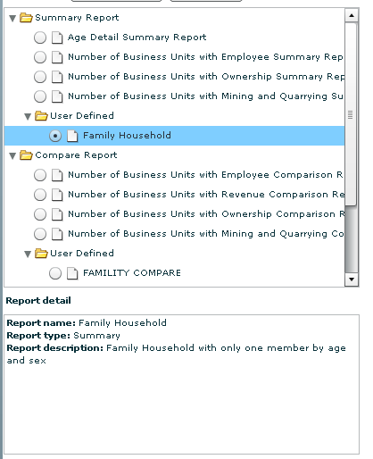
Customized Reports
Notes:
17

Slide 18
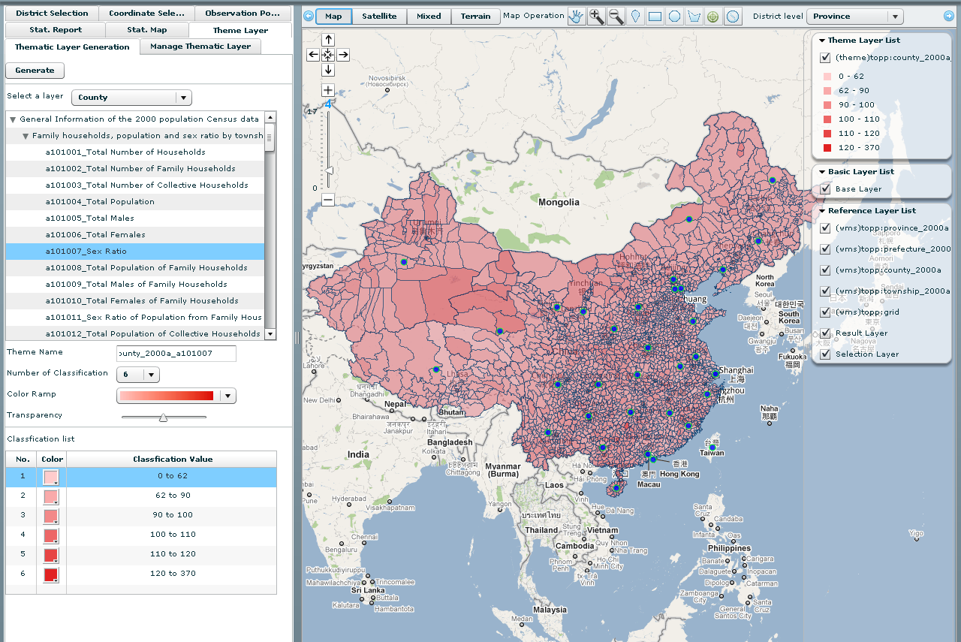
Spatial Visualization: Sex Ratio by County
Notes:
18

Slide 19
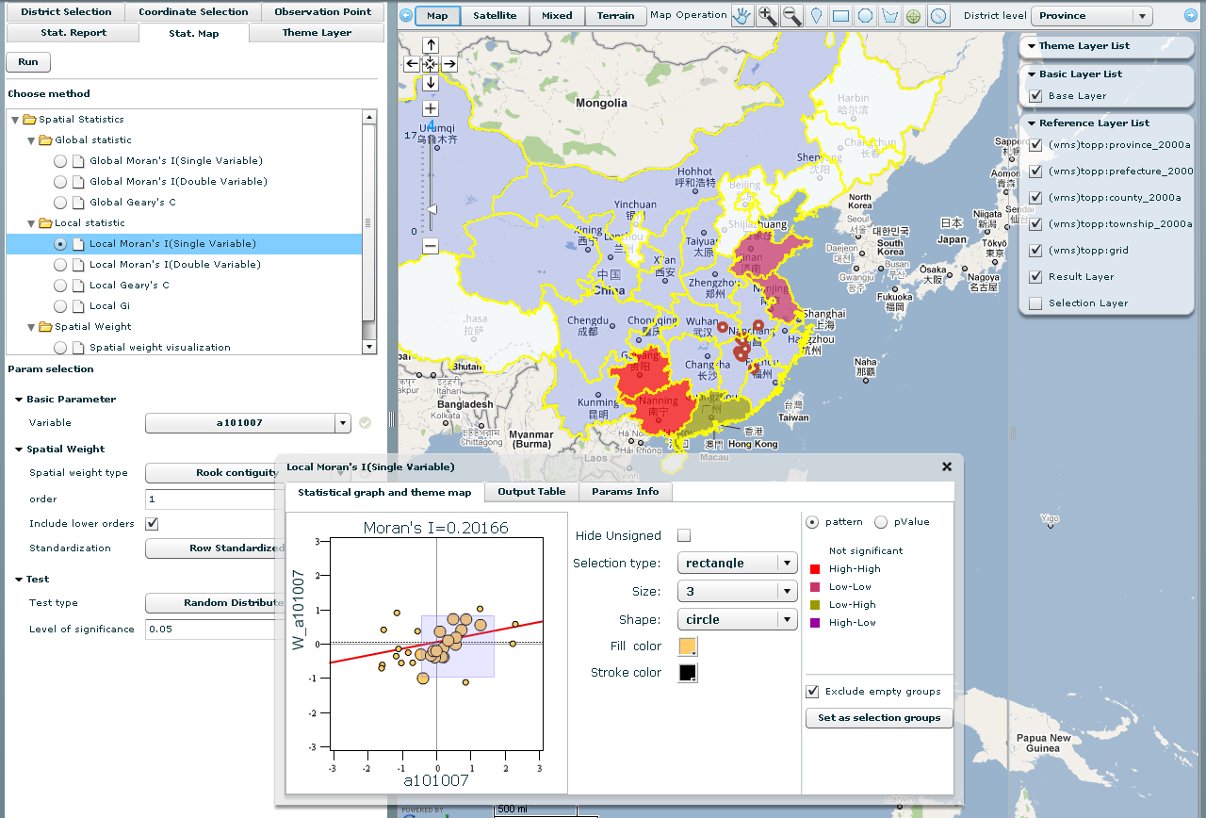
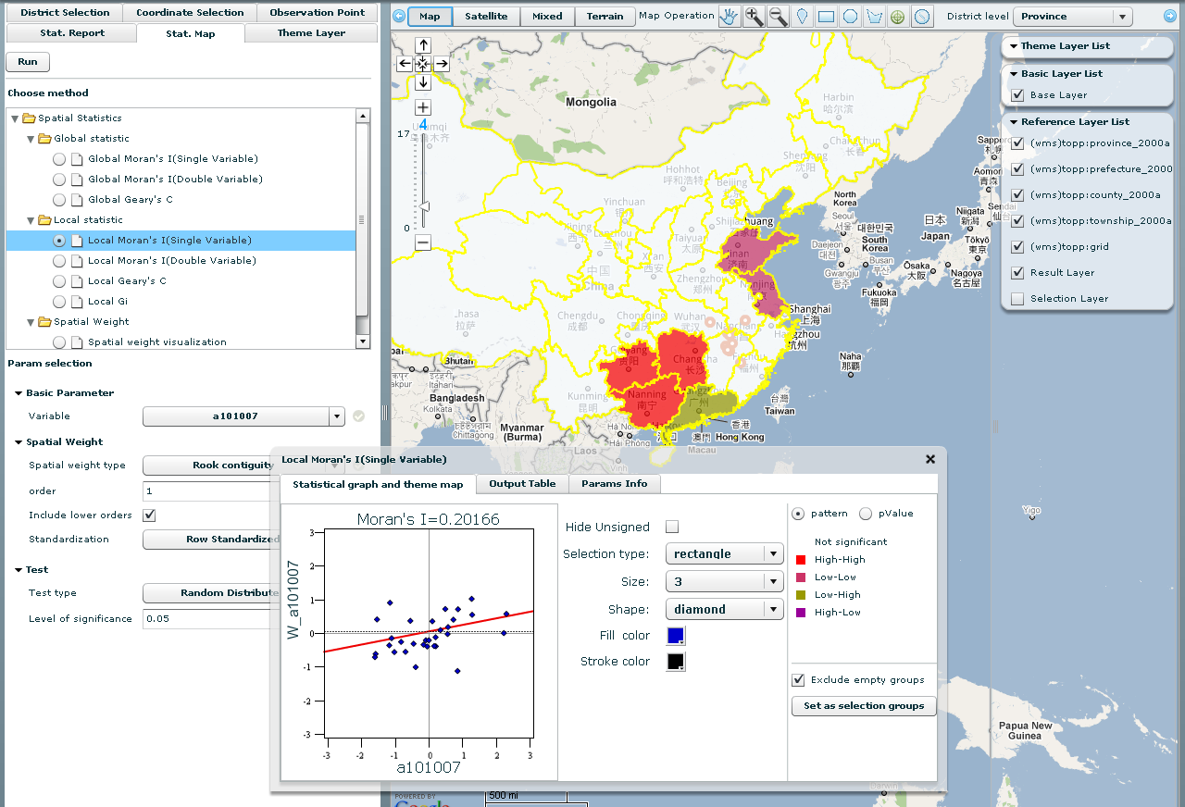
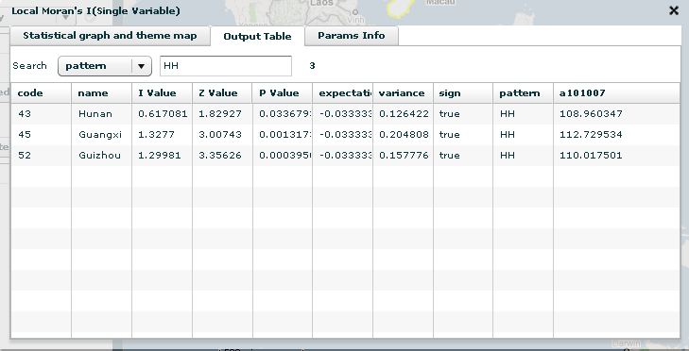
Exploratory Spatial Data Analysis
Notes:
19

Slide 20
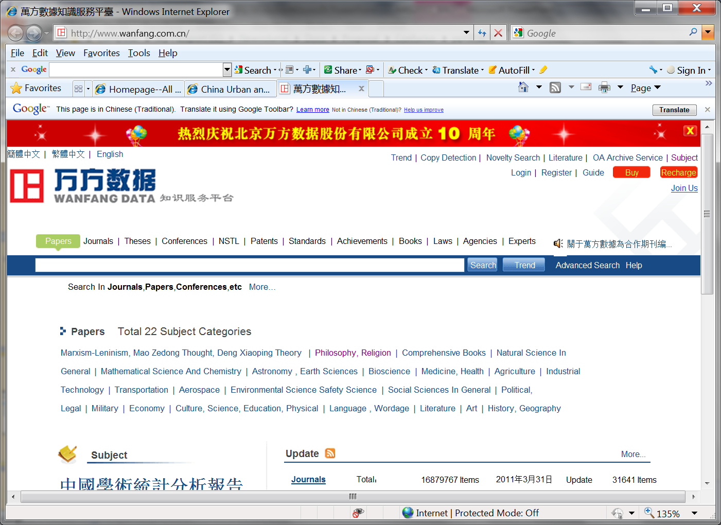
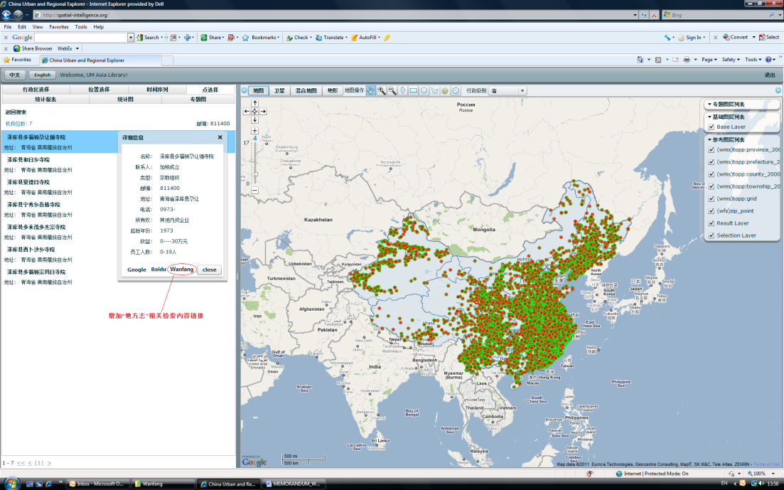
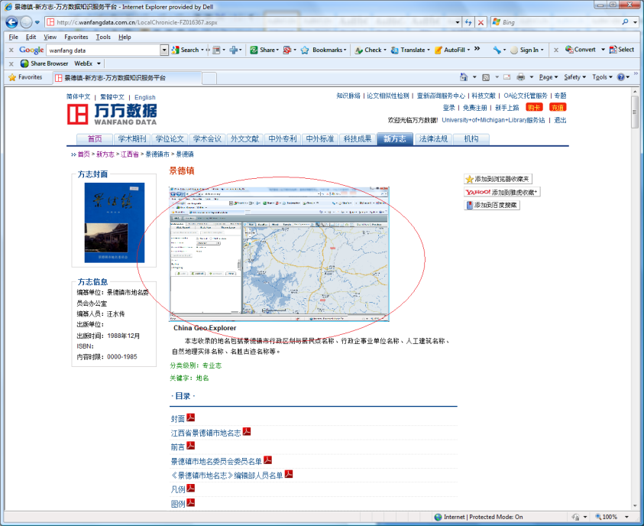
Integration with local Gazetteers

Slide 21
Applications
Disaster Assessment
Regional Planning
Environmental and Public Health
Religious Studies
Business Site Selections
Projections and Simulations
Household/Field Surveys

Slide 22
Future Plans
Data & Service:
Expanded data coverage to urban, environment, public health and other fields
Expanded data coverage to other countries and regions
Distributed Data Service
Research & Development:
Advanced Data Analysis with Spatial Statistics
Integration of Spatial Intelligence and Business Intelligence
Integration of Remote Sensing Data
Integration of Virtual Geographic Environment
Integration of Voluntary Geographic Information

Slide 23
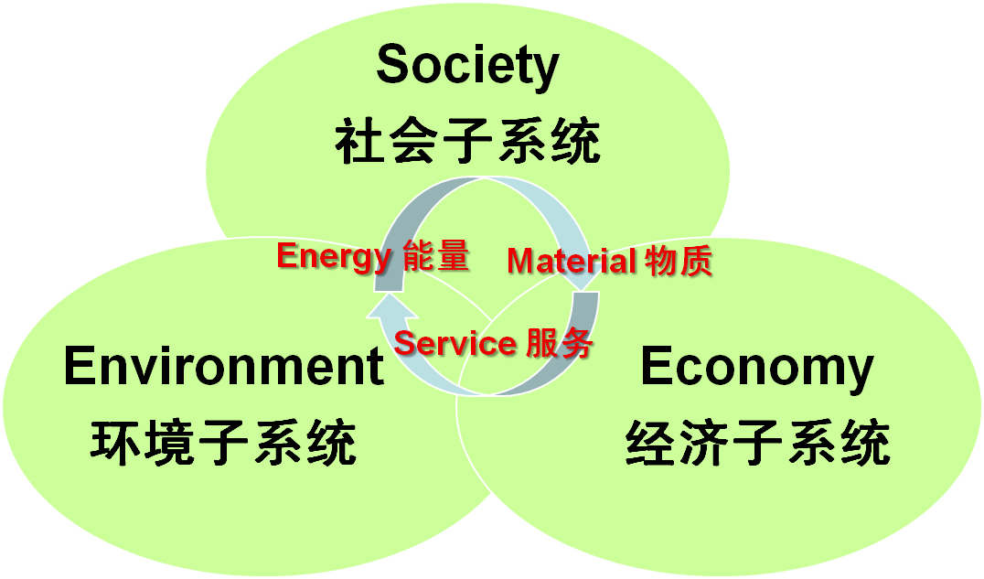
Building A Spatial Infrastructure for China and Global Studies
Spatial Religion
Spatial History
Spatial Economy
Spatial Demography…..
Spatial Culture and Education
Spatial Health
….

Slide 24
Chinadatacenter.org
Chinadataonline.org
Chinasurveycenter.org

