Slide 1
Notes:
This work. “The Public Mapping Project”, by Micah Altman (http://redistricting.info) is licensed under the Creative Commons Attribution-Share Alike 3.0 United States License. To view a copy of this license, visit http://creativecommons.org/licenses/by-sa/3.0/us/ or send a letter to Creative Commons, 171 Second Street, Suite 300, San Francisco, California, 94105, USA.

Slide 2
Now…Public Access Redistricting
Open Data
Open Access
Open Source

Slide 3
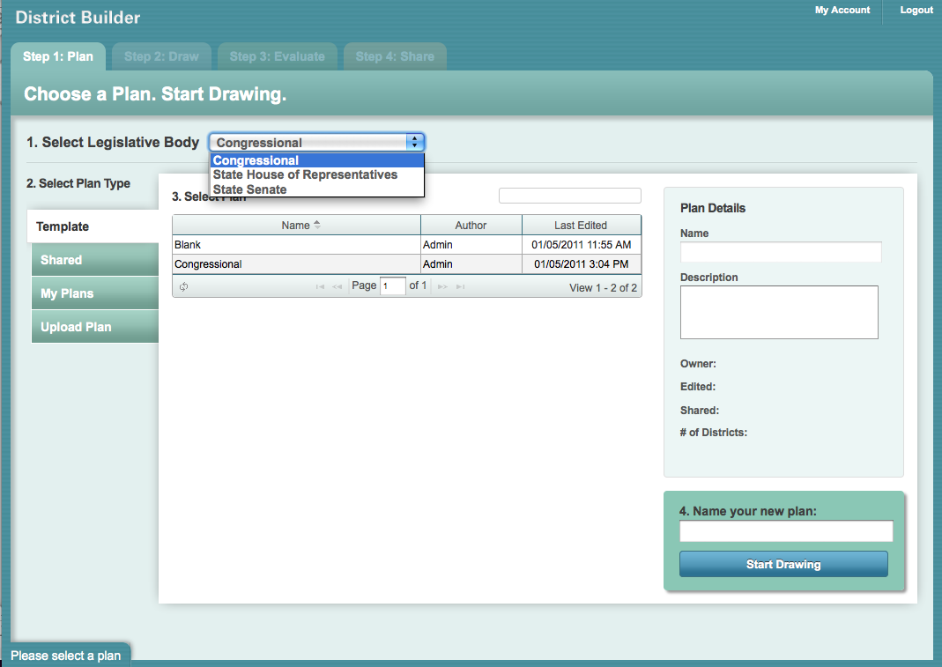
Choose Your Legislature

Slide 4
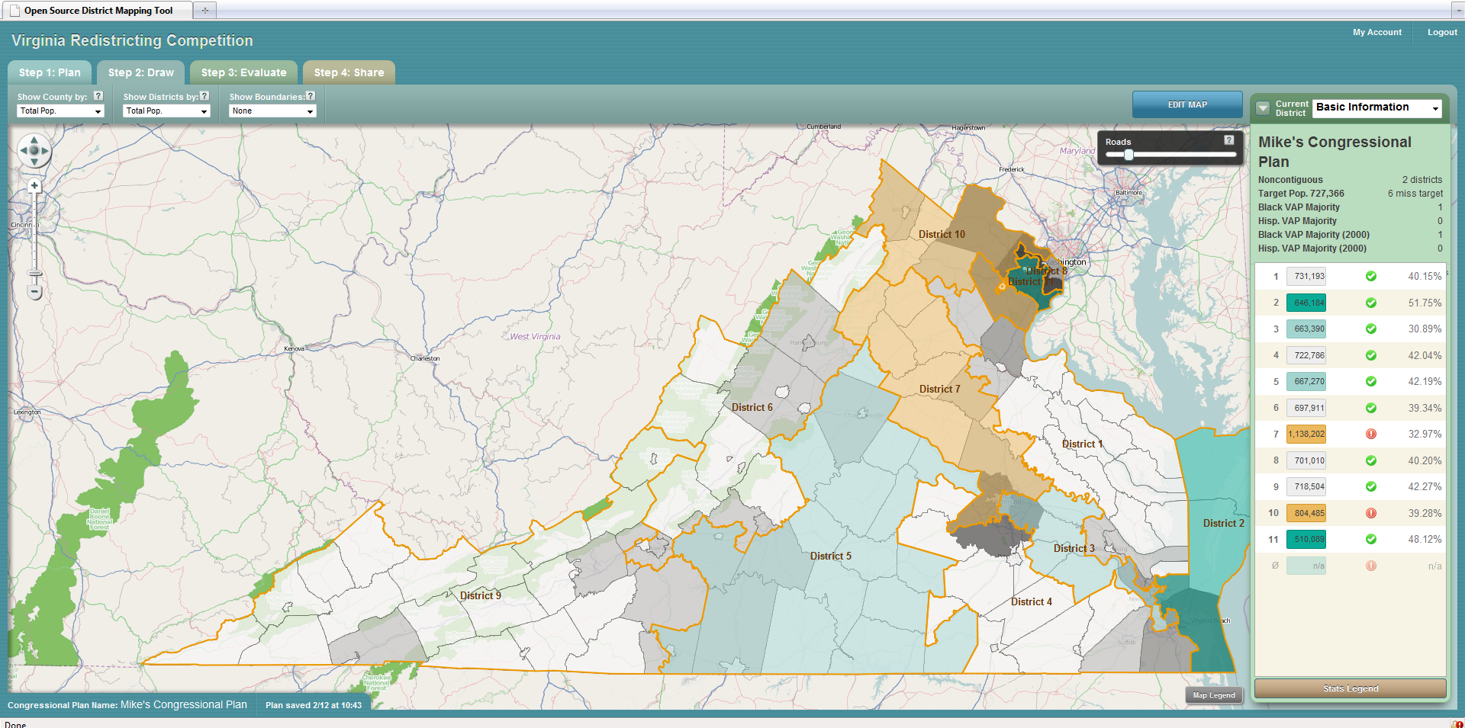
Look Around – Get the Picture

Slide 5
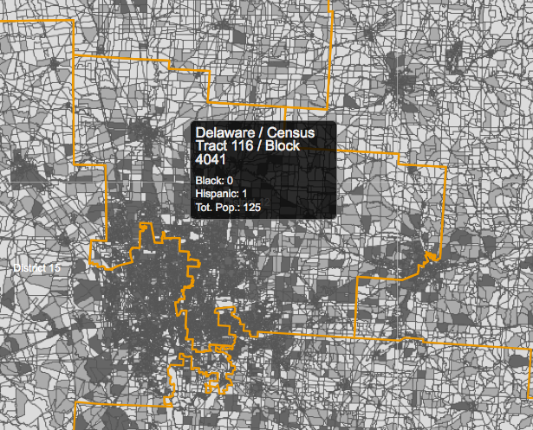
Drill Down – Get The Facts

Slide 6
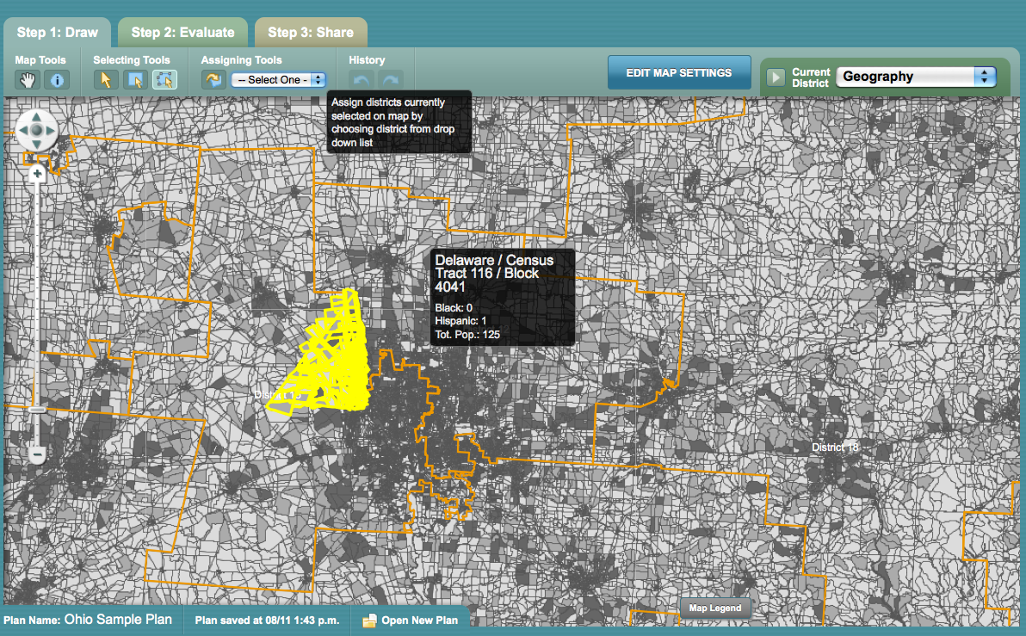
Make A Plan

Slide 7
Get the Details

Slide 8
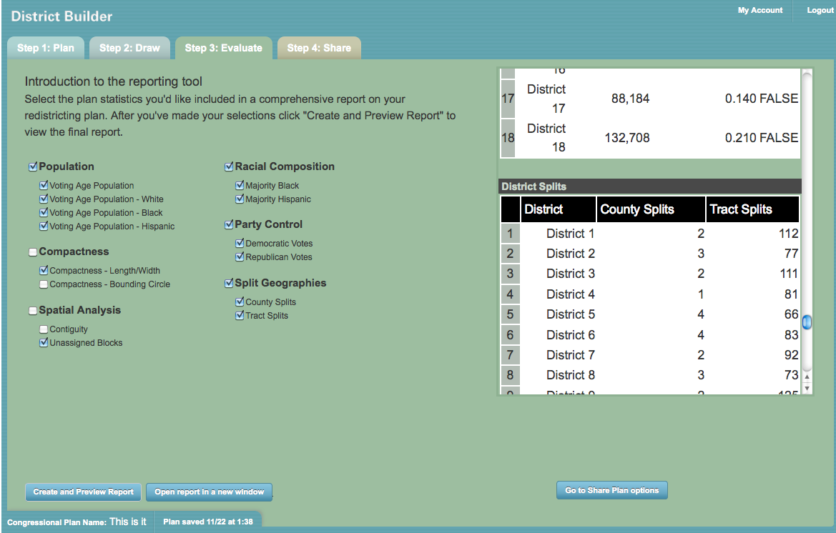
Run The Numbers

Slide 9
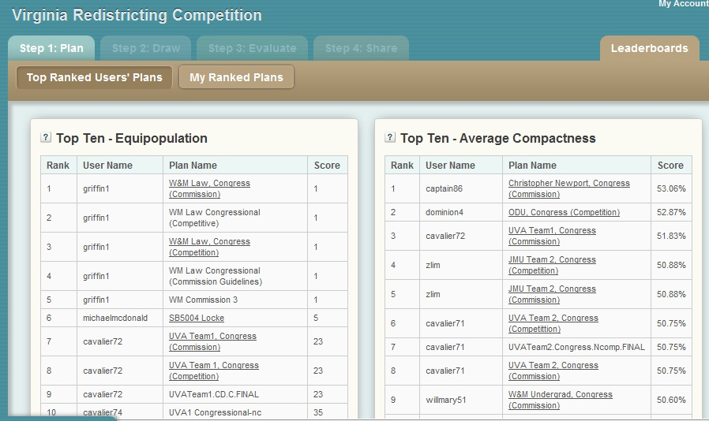
Is it legal? How Well Are You Doing?

Slide 10
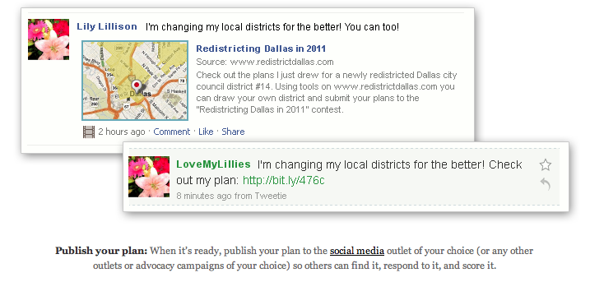
Spread the Word
Share your plans with others
Have a contest
Mash up and plug in

Slide 11
Virginia Redistricting Competition
Educating Students
150 students on 15 teams at 12 Universities and Colleges
Educating the Public
Over 30 news stories, including USA Today and Washington Post
Educating Policy Makers
Three student plans were introduced as bills
One student congressional plan demonstrated a way to increase minority representation, was adopted by the governor’s advisory commission and the approach was adopted by the Democrats.

Slide 12
Map a State -- Change the Nation
Identify communities
Explore the alternatives
Understand political consequences
Establish transparency
Catalyze participation
Create alternatives to politics-as-usual

Slide 13
Public Mapping Software – Features
Powered by Open Source
Create
Create districts and plans
Identify communities*
Evaluate
Visualize
Summarize
Population balance
Geographic compactness
Completeness and contiguity
Report in depth
Share
Import & export plans
Publish a plan
Run a contest
* Coming soon

Slide 14
The Public Mapping Project
Supported by
The Sloan Foundation
Joyce Foundation
Amazon Corporation
Judy Ford Wason Center at Christopher Newport Univ.
Michael McDonald
George Mason University
Brookings Institution
Micah Altman
Harvard University
Brookings Institution
Robert Cheetham
Azavea
Participating Organizations
Midwest Democracy Network
Arizona Competitive Districts Coalition
Virginia Redistricting Competition
Notes:
This work. “The Public Mapping Project”, by Micah Altman (http://redistricting.info) is licensed under the Creative Commons Attribution-Share Alike 3.0 United States License. To view a copy of this license, visit http://creativecommons.org/licenses/by-sa/3.0/us/ or send a letter to Creative Commons, 171 Second Street, Suite 300, San Francisco, California, 94105, USA.

Slide 15
Advisory Board
Mike Fortner | Illinois state Representative, 95th District
Carling Dinkler | John Tanner's office, Tennessee 8th Congressional District
Mary Wilson | Past President, League of Women Voters
Derek Cressman | Western Regional Director of State Operations, Common Cause
Anthony Fairfax | President, Census Channel
Kimball Brace | President, Election Data Services
Gerry Hebert | Executive Director, Campaign Legal Center and Americans for Redistricting Reform
Leah Rush | Executive Director, Midwest Democracy Network
Nancy Bekavac | Director, Scientists and Engineers for America
Karin Mac Donald | Director, Statewide Database, Institute for Government Studies, UC Berkeley
Thomas E. Mann | Senior Fellow, The Brookings Institution
Norman J. Ornstein | Senior Fellow, The American Enterprise Institute

Slide 16
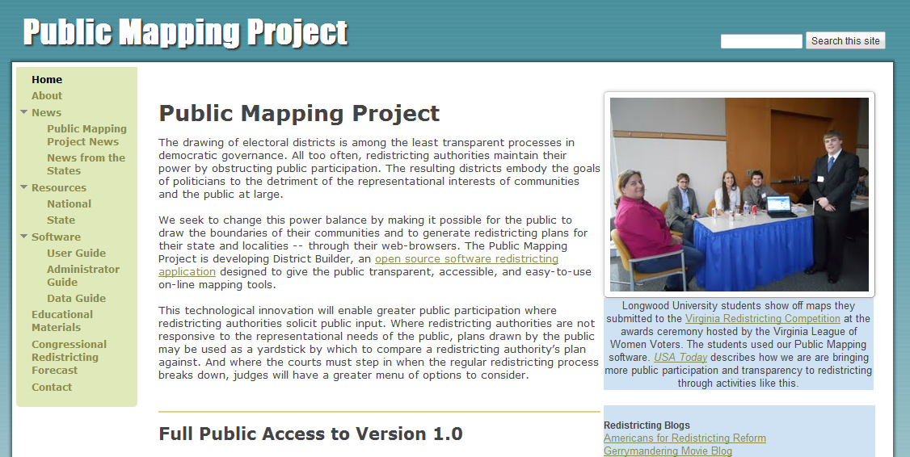
More Information at
www.publicmapping.org

