Slide 1
Establishing a Global Data Sharing Framework for Place Names Presentation to AAG, 25 February 2012
Raj Singh, PhD
Director, Interoperability Programs

Slide 2
POI “Core”
lowest common denominator for interoperable POI data
reviewed a huge number of popular POI formats:
USGS, NGA, AR, KML, NAVTEQ, Yelp, Yahoo!, Google, OS UK, etc.
universally useful: not very feature-rich, but easy to understand and implement
additional descriptiveness can come in community-specific profiles
focus is on links to related information, and categorization
today I’m showing XML, but JSON and RDF will likely “win”
Notes:
current POI spec is “Core” POI

Slide 3
Descriptive Properties
location: geography specifier
label: name
description: narrative text
category: tags, keywords, etc.
link: related items
time: when the POI exists in the world

Slide 4
Descriptive Property: category
category
term: the unique identifier – aka tag (mandatory)
scheme: URI identifier for the term’s definition. may be resolvable (optional)
value: human-readable description (optional)
href: URL to full definition. always resolvable (optional)
type: MIME type of the href (optional)
XML examples:
<category term="722110" scheme="http://www.census.gov/naics/2007/" type="text/html"
href="http://www.census.gov/econ/industry/def/d722110.htm">Full-service restaurants</category>
<category term="rating:food" scheme="http://www.example.com/category/ratings"
href="http://www.example.com/ratings/food#extraordinary_to_perfection">27</category>
<category term="cuisine" scheme="http://www.example.com/category/cuisines"
href="http://www.example.com/ratings/cuisines">Deli</category>

Slide 5
Descriptive Property: link
link
term: relationship of link to the POI (mandatory)
href: URL for linked content (mandatory)
type: MIME type of href (mandatory)
value: human-readable description (optional)
author: basic attribution (optional)
XML examples:
<link term="related" href="http://en.wikipedia.org/wiki/Faneuil_Hall" type="text/html"/>
<link term="related" href="http://www.cityofboston.gov/freedomtrail/faneuilhall.asp"
type="text/html"/>
<link term="related" href="http://www.thefreedomtrail.org/visitor/faneuil-hall.html"
type="text/html"/>
<link term="related" href="http://www.faneuilhallmarketplace.com/" type="text/html"/>
<link term="image”
href="http://www.cityofboston.gov/Images_Documents/Bright_Fan_Hall_tcm3-2661.gif"
type="image/gif"/>
<link term="related" href="http://hdl.loc.gov/loc.award/mhsalad.130006">
<value>Faneuil Hall, exterior: perspective view, Boston, MA</value>
<author term="LOC" href="http://www.loc.gov" type="text/plain">
<value>Library of Congress</value>
</author>
</link>

Slide 6
Location Properties
point, line, or polygon: GML 3.3 “compact encoding” -- simple!
coordinate reference system (with lat/lon default)
and/or address
and/or spatial relationship to another POI
<SimplePolygon>
<posList>42.358 -71.06 42.375 -71.093...</posList>
</SimplePolygon>
<Point>
<posList>42.358 -71.06</posList>
</Point>
<LineString>
<posList>42.358 -71.06 42.375 -71.093...</posList>
</LineString>

Slide 7
Data Management Properties (metadata)
id: unique identifier for the POI in the publisher’s system
created/updated/deleted: applies to the POI record (not the actual place in the world—time property covers that)
license: use restrictions, e.g. copyright

Slide 8
Basic Example: City of Boston, MA USA
<poi id="http://www.rajsingh.org/pois/45343489" created="2004-01-22T09:38:21-05:00”>
<author href="http://www.rajsingh.org/me.rdf" type="application/rdf+xml"/>
<license href="http://creativecommons.org/licenses/by/3.0/" type="text/html" term="CC BY 3.0"/>
<label term="Boston”>Boston</label>
<description updated="2011-10-21T22:10:00+12:00">
<value>Boston is the capital of and largest city in Massachusetts, and is one of the oldest
cities in the United States. Boston is regarded as the unofficial "Capital of New England" for its economic and cultural impact on the entire New England region.</value>
<author id="http://en.wikipedia.org" href="http://en.wikipedia.org/wiki/Boston" type="text/plain">
<value>Wikipedia</value>
</author>
</description>
<category term="city" scheme="http://www.usgs.gov/placetypes"type="text/html”>
<value>seat of a first-order administrative division</value>
</category>
<time term="start" type="text/datetime”>16300917</time>
<link term="canonical" href="http://www.rajsingh.org/pois/45343489.xml" scheme="http://www.iana.org/assignments/link-relations/link-relations.xml" type="text/xml"/>
<link term="related" href="http://en.wikipedia.org/wiki/Boston" type="text/html" scheme="http://www.iana.org/assignments/link-relations/link-relations.xml"/>
<link term=”map" href="http://www.geonames.org/maps/google_42.358_-71.06.html" type="text/html" scheme="http://www.iana.org/assignments/link-relations/link-relations.xml"/>
<location>
<point term="centroid">
<Point srsName="http://www.opengis.net/def/crs/EPSG/0/4326">
<posList>42.358 -71.06</posList>
</Point>
</point>
</location>
</poi>

Slide 9
different views of a place in time and space
discussed in AAG 2011
one of the more difficult problems in geodata management is easy with POI format
<poi id="a" base="http://www.rajsingh.org/pois/aag"> <label term=”primary”>Newtowne</label> <time term="end">1638</time> <link id="b" term="related" base="http://www.rajsingh.org/pois/aag" /> <location> <polygon term="centroid"> <SimplePolygon>… </polygon> <relationship term=”overlaps" targetPOI="http://www.rajsingh.org/pois/aag/b" /> </location> </poi>
<poi id="b" base="http://www.rajsingh.org/pois/aag"> <label term=”primary">Cambridge</label> <label term=”secondary">Newtowne</label> <time term="start">1846</time> <link id="a" term="related" base="http://www.rajsingh.org/pois/aag" /> <location> <polygon term="centroid"> <SimplePolygon>… </polygon> <relationship term=”overlaps" targetPOI="http://www.rajsingh.org/pois/aag/a" /> <relationship term=”contains" targetPOI="http://www.rajsingh.org/pois/aag/c" /> </location> </poi>
East Cambridge and Cambridgeport are two towns that were merged to create the City of Cambridge in 1846…
<relationship term=”within" targetPOI="http://www.rajsingh.org/pois/aag/b" />
Cambridge
East Cambridge
Cambridgeport
Newtowne

Slide 10
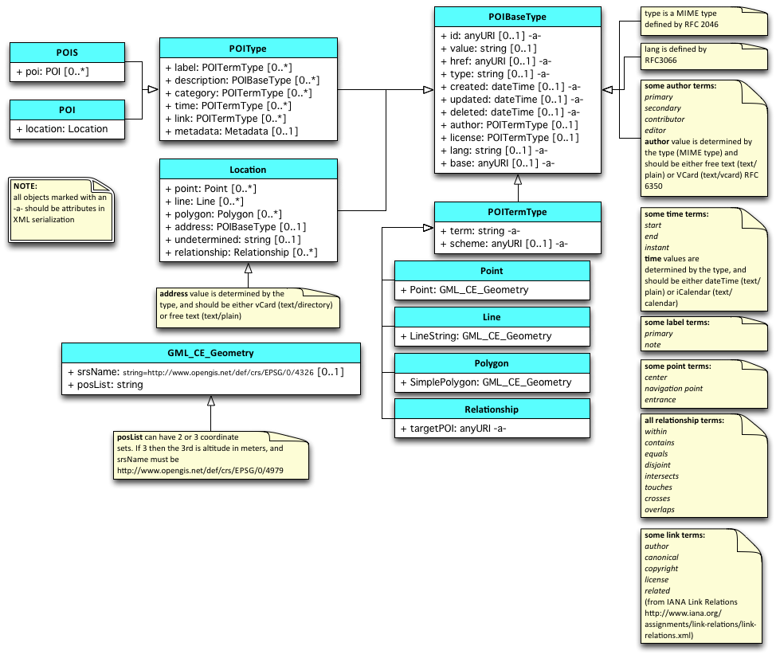
Data Model
http://www.w3.org/2010/POI/wiki/Data_Model

Slide 11
OpenPOI DB
http://openpoi.ogcnetwork.net
reference implementation of the POI format
free and open, always
provides a Rosetta Stone for all POIs, any time, anywhere
to include
OpenStreetMap
NGA, USGS, GeoNames
future work
China Historical GIS
foursquare, freebase
governments, historians
self-service synchronization

Slide 12
What should you do with the POI format?
have unique IDs for all your POIs
provide a public URL:
to get at every POI in W3C POI format
at least an ID and name please
adopt the link part of the data model
to maintain references to related POIs
add links to that public POI URL
be part of OpenPOI DB
work with me to link and sync to your POIs!

Slide 13
References
OpenPOI DB: http://openpoidb.ogcnetwork.net
OpenPOI DB mailing list signup: https://lists.opengeospatial.org/mailman/listinfo/openpoidb-announce
W3C POI Home: http://www.w3.org/2010/POI/
W3C POI Wiki: http://www.w3.org/2010/POI/wiki/Main_Page
GML 3.3: http://www.opengeospatial.org/standards/gml

