Slide 1
Modeling the History of the City using Library Resources
Michael Page
Coordinator of Geospatial Services, Emory University Libraries
Kim Durante
Metadata Librarian, Emory University Libraries
Randy Gue
Curator of Modern Political and Historical Collections, Manuscript, Archives, and Rare Book Library (MARBL)
Emory University
.

Slide 2
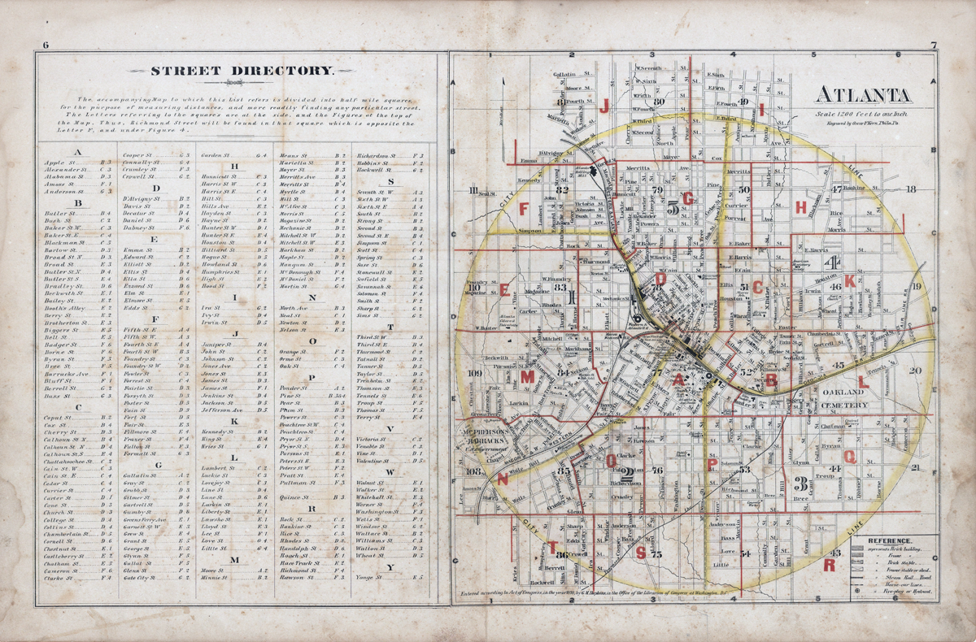
Notes:
Libraries collect maps both as current reference materials and as archival records. However, maps pose unique challenges for libraries in terms of storage, retention policies, and theft. Digitization is often seen as a solution to these challenges because it provides access but it also protects the original.
1878 Atlas from Atlanta.

Slide 3
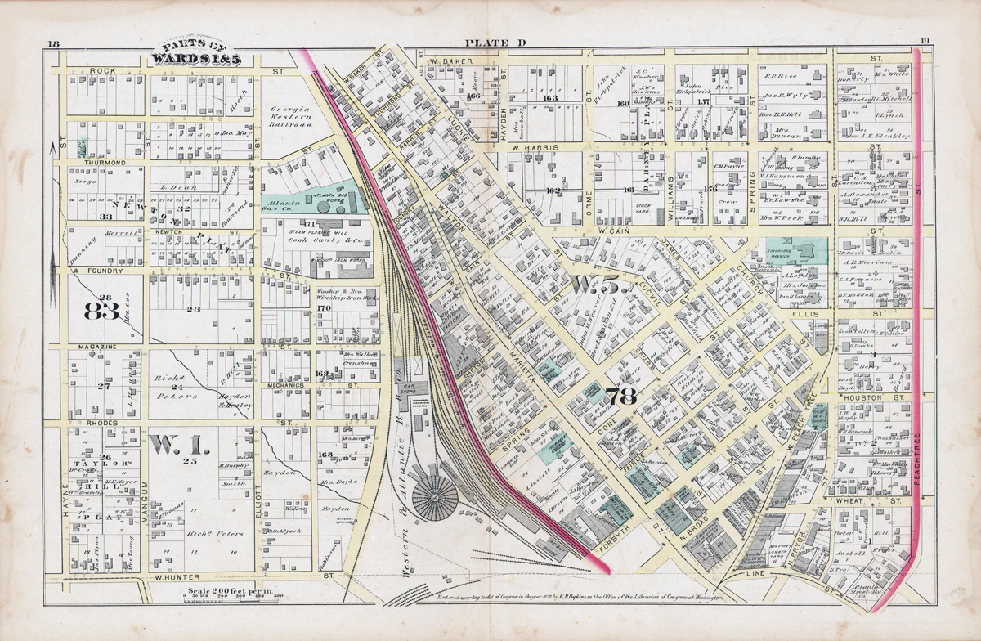
Notes:
Historic maps often contain rich information about the detail of a given area at a particular time. In the 1878 data is included beyond the lines of communication and the location of things to include the geometric shapes of object, for example, building footprints and descriptive information, for example the materials a building might be made of or perhaps the identity of a property owner.
Geographic Information Systems or GIS is directly related to how the cartographer’s printed map combined data with visual representation. In short, GIS is databases linked to maps.
GIS is therefore concerned with linking map features which in the system are geometric objects (points, lines, and areas) with data tables that describe each feature.

Slide 4
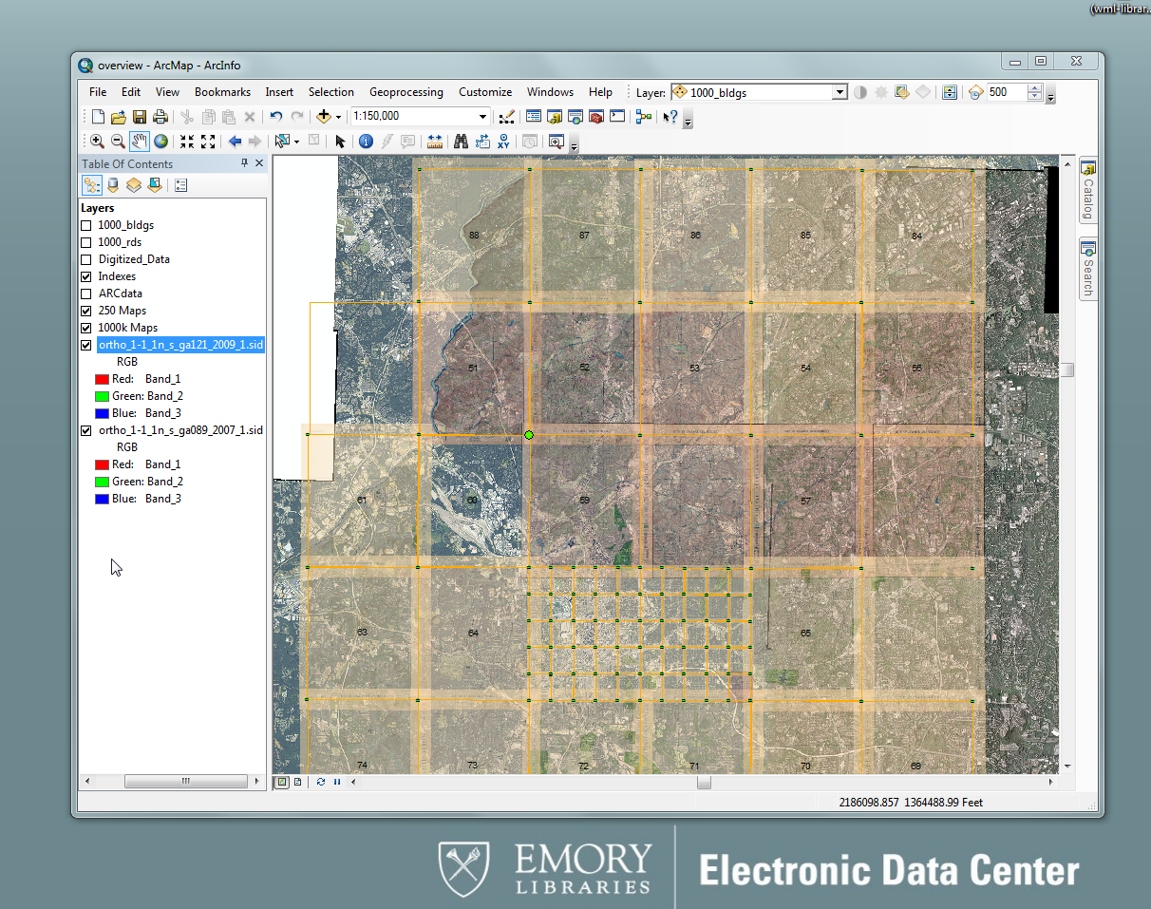
Notes:
Central to our mapping Atlanta project is a 1928 Atlas that we digitized, georeferenced, and began extracting features from.
Specific to mapping Atlanta our goals are to ….
Serve as an example of how to plan and construct a historical geodatabase
Provide to the community a geodatabase model and methodologies
Create a historic geocoder for Atlanta to serve as a research tool
Provide a basemap of historic Atlanta for future research projects

Slide 5
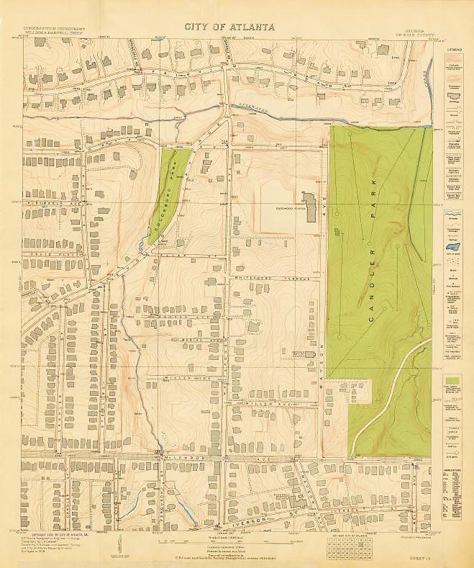
Notes:
Background of the Atlas
The map is intricately detailed: it includes everything from roads and railways to building footprints and manhole covers. Because construction all but ceased in the city shortly after this atlas was published due to, first, Great Depression, and then by World War Two, the map provides a relatively reliable image of the city as it was for the two decades leading up to the Civil Rights era.
Atlas as a foundation for the project
Processing and dissemination of digital object (scanned with sheetfed scanner into TIFF and JP2)

Slide 6
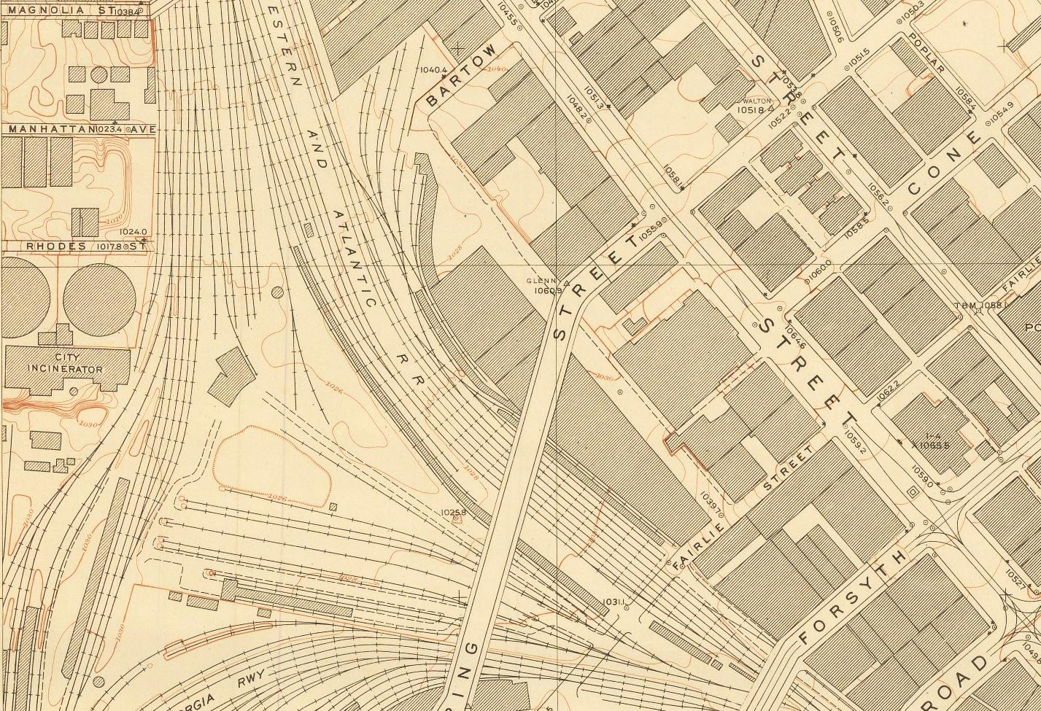
Notes:
As you can see the atlas symbology there is visual information about the lines of communication, the topography, building footprints, and other infrastructure.

Slide 7
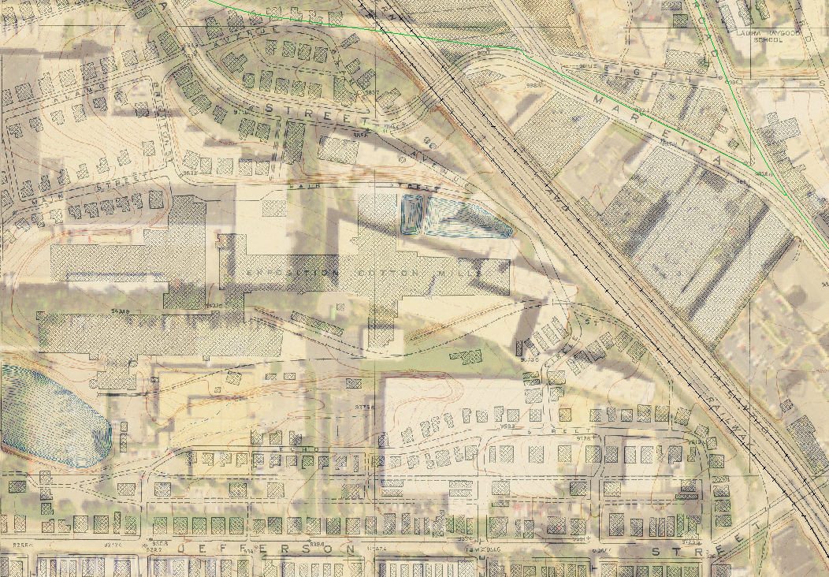
Notes:
With the map images georeferenced using 2009 aerial photography and transparency applied we then have evidence of urban landscape morphology.

Slide 8
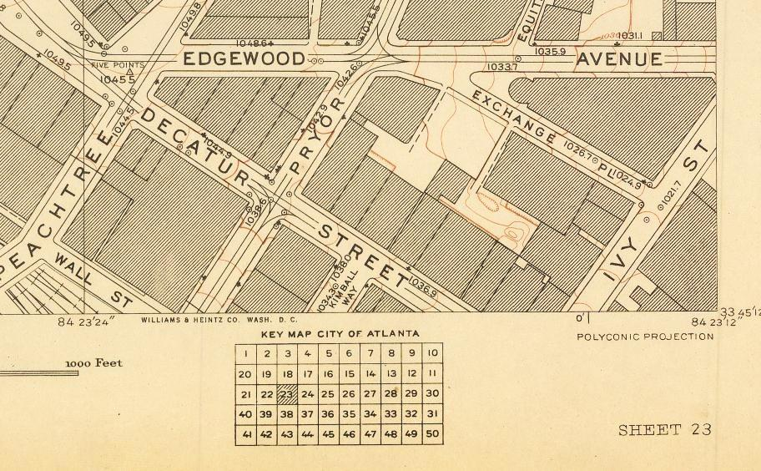
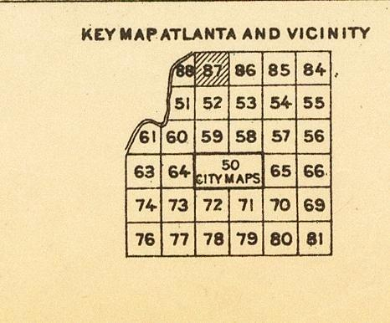
Notes:
The atlas contains to sets of maps at different scales, 1 to 250 feet and 1 to 1000 feet. The central business district (CB) has 50 maps and outer Atlanta 32.

Slide 9
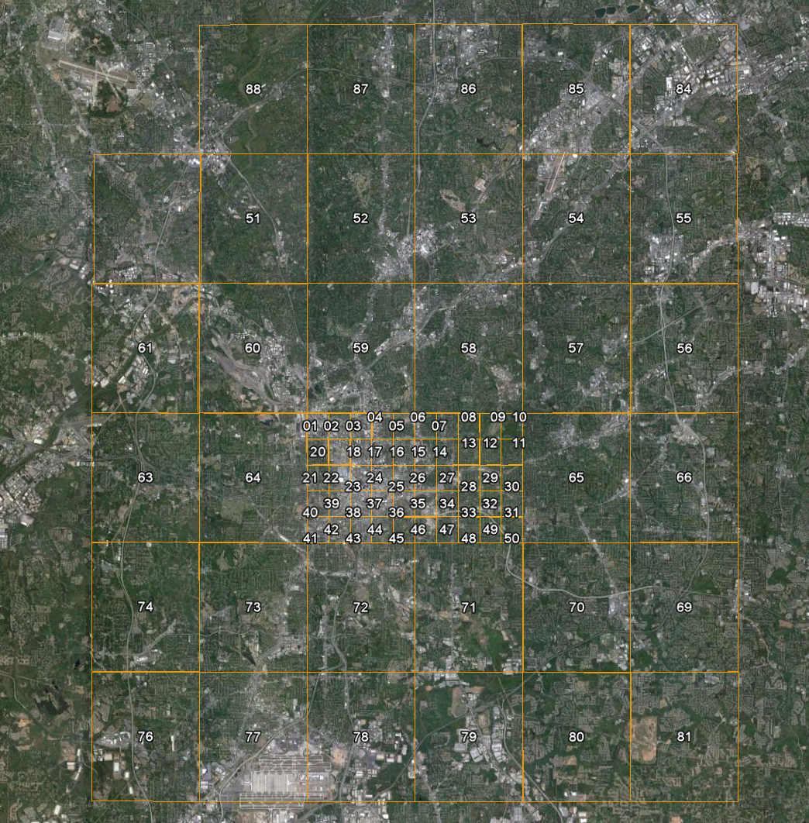
Notes:
Index grids were created for both sets of maps using ArcGIS. A version for browsing within Google Earth was also created.

Slide 10
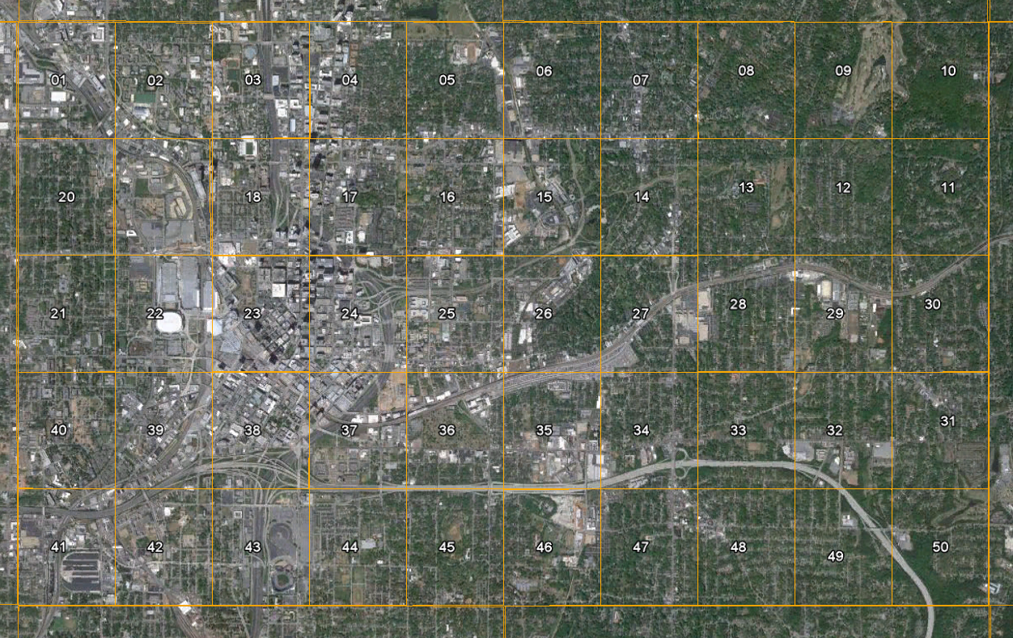
Notes:
50 maps of the Central Business District. An interesting side note is that Atlanta at the time was expanding towards the East. In the latter part of the 20th century the focus of expansion has shifted to the North.

Slide 11
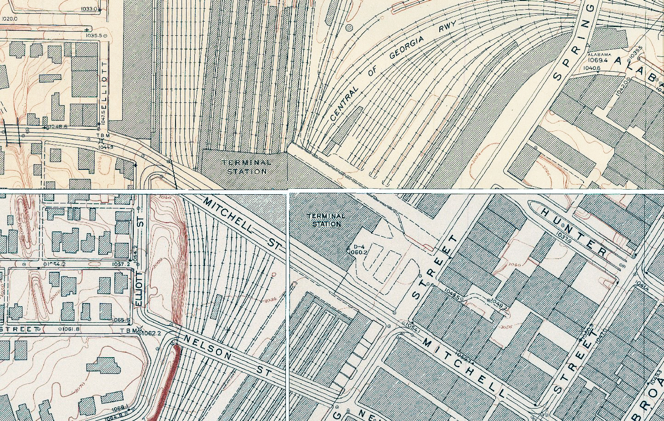
Notes:
Map collars were also removed in preparation for GIS digitization of vector features.

Slide 12
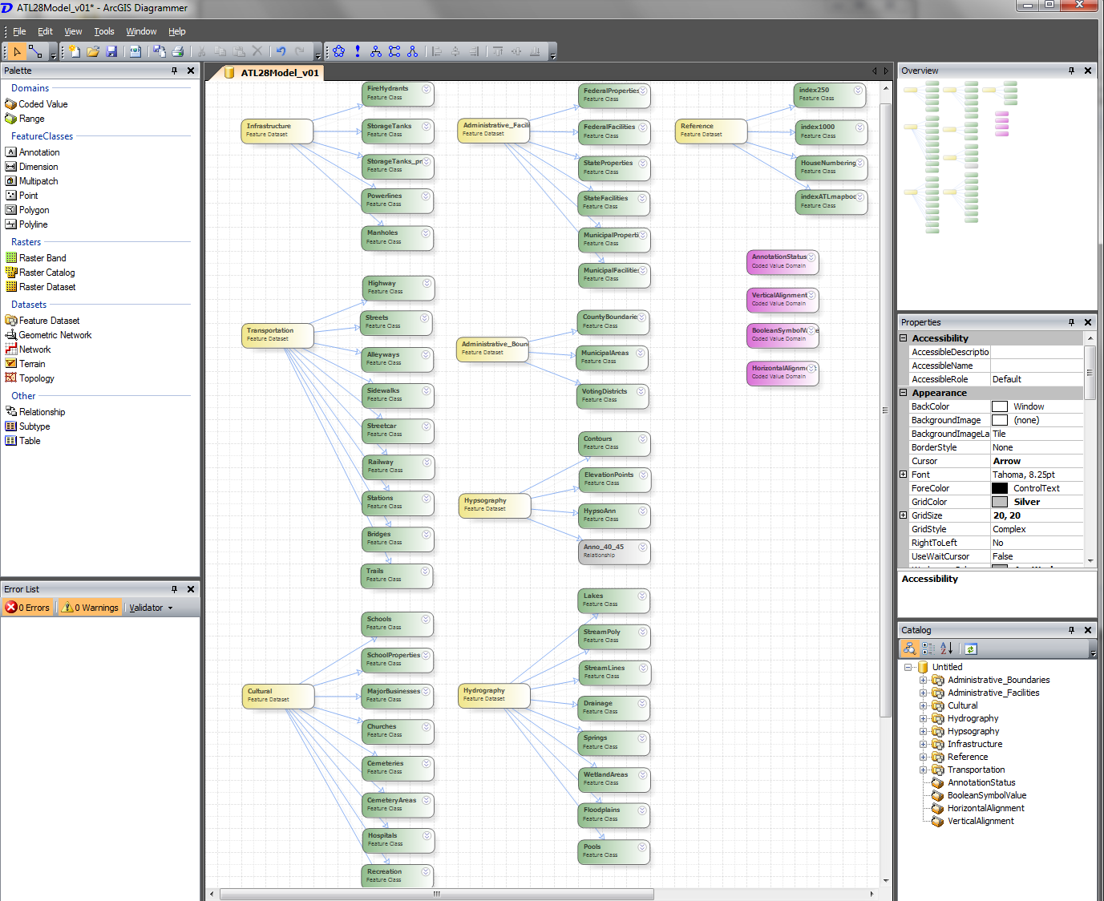
Notes:
A key resource will be the geodatabase. On level one of our library we have a very long whiteboard wall where several of us collaborated in designing the geodatabase schema which was later constructed in a third party application called ArcGIS Diagrammer.

Slide 13
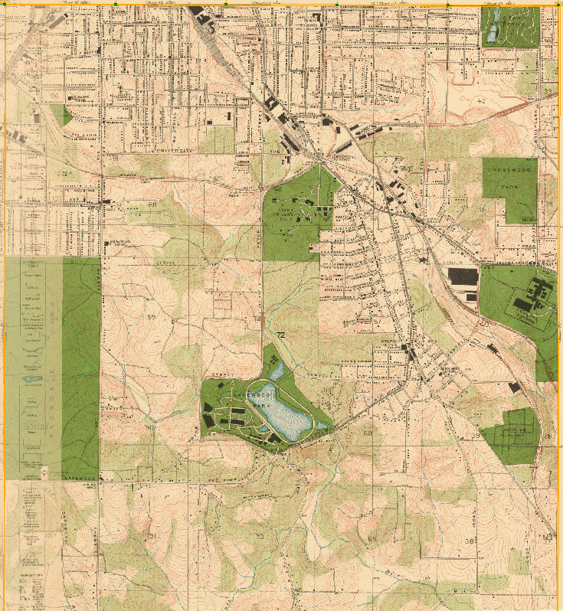
Notes:
This can then be converted via XML into a geodatabase for use in ESRI’s ArcCatalog.
Here you can see an example map, the map’s legend, and our geodatabase structure laid out as feature classes organized in feature datasets.

Slide 14
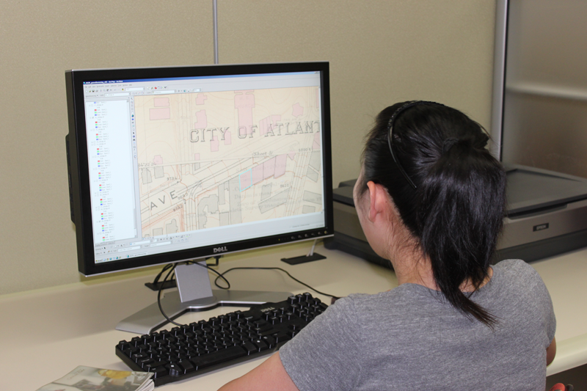
Notes:
Using ESRI’s ArcGIS application staff and volunteers in our library’s Electronic Data Center digitize features of the atlas to create new data sets that can be used in geodatabases or as Google Earth layers.

Slide 15
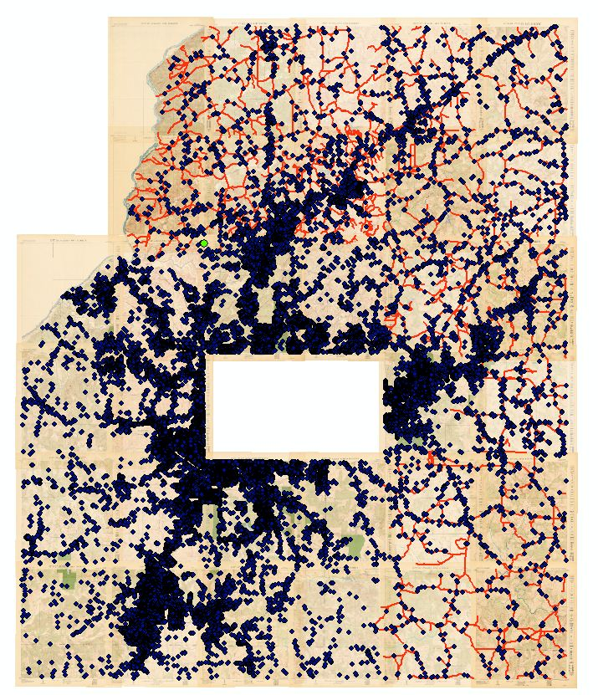
Data Extraction
Building Footprints
Streets & Alleys
Manholes
Fire Hydrants
Sidewalks
Railways (including electric)
Administrative Boundaries
Parks
Water Bodies & Streams
Survey Benchmarks
Notes:
Over the past few years we have been extracting features from the map.
All of these data layers will have an attribute table that will contain information about each feature.

Slide 16
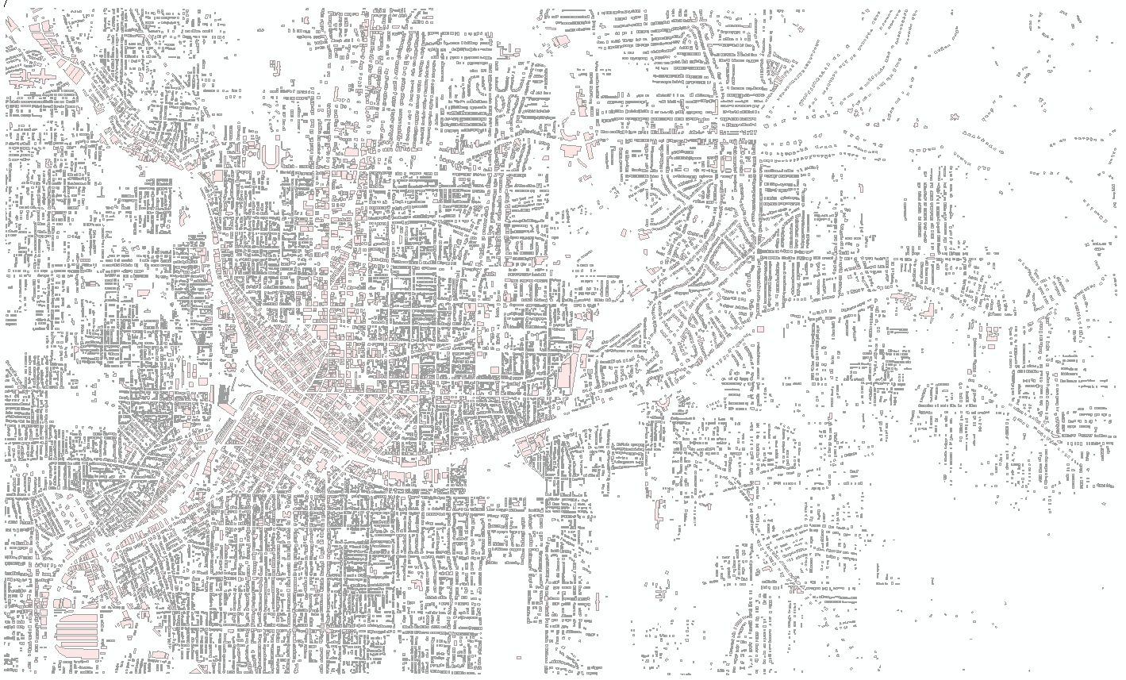
Notes:
Here is our result of the building footprint extraction at the 1 to 250 foot scale

Slide 17
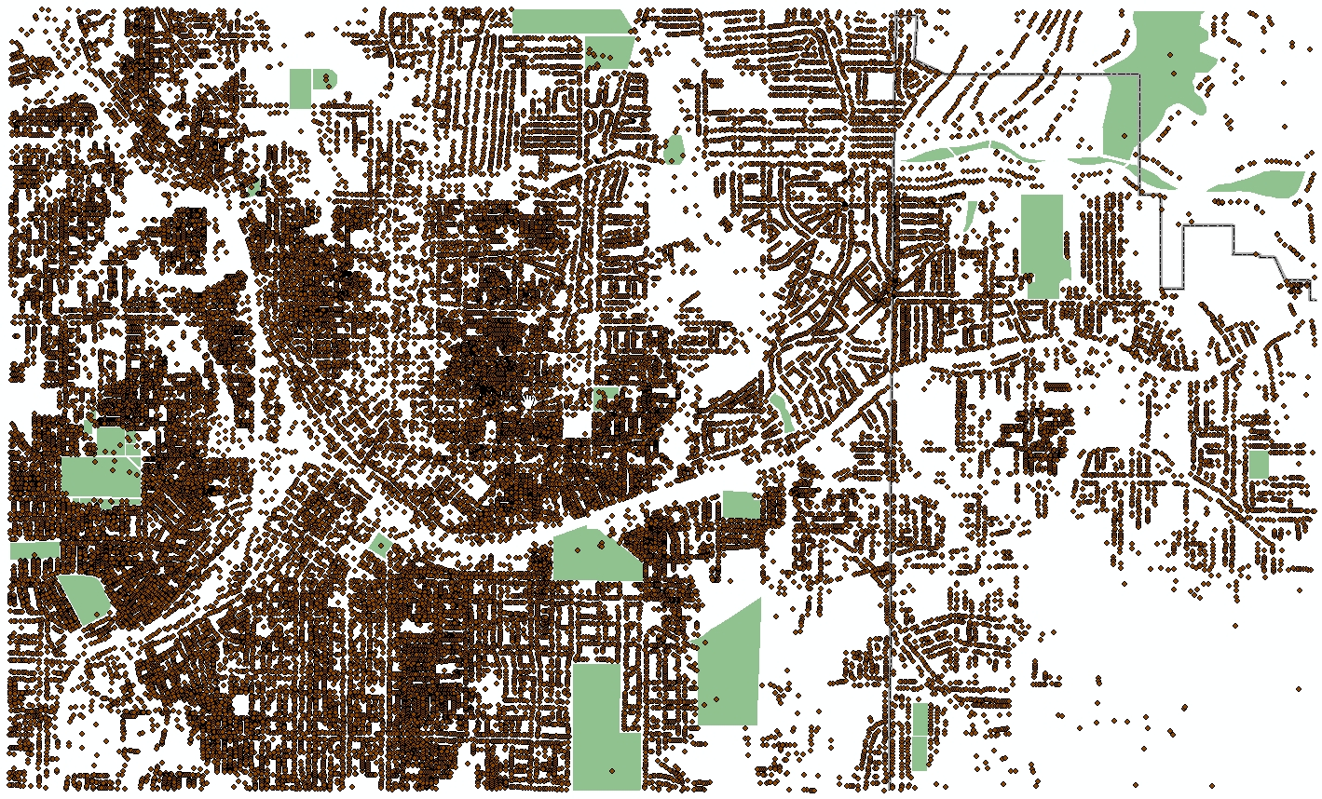
Notes:
The polygons were then converted to point data using the centroids of each polygon. This allows us to create a separate GIS layer which we can append to those points digitized for the building features at the 1 to 1000 foot scale thus giving us a complete point of interest dataset of well over 70,000 features for all of Atlanta during this time period.

Slide 18
Notes:
As you can imagine a large barrier to a GIS project of this scale is the availability of GIS trained staff to work on the digitization and editing process.
I teach several project based GIS undergraduate and graduate classes at Emory and in several cases students have elected to engage an aspect of the atlas as their final project.
This data represents Atlanta hydrology at the 1 to 250 scale. The undergraduate student not only digitized and edited the stream layer but also used the data to compare 1928 streams with current streams examining flow pattern changes and other phenomena.

Slide 19
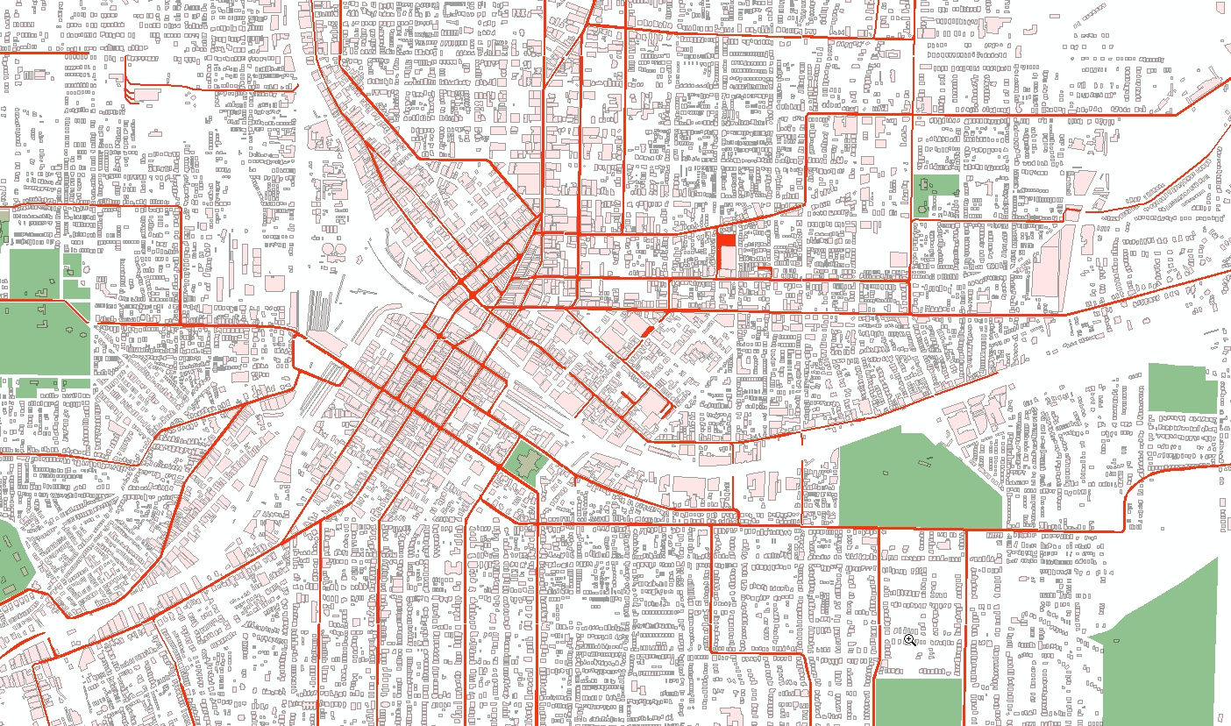
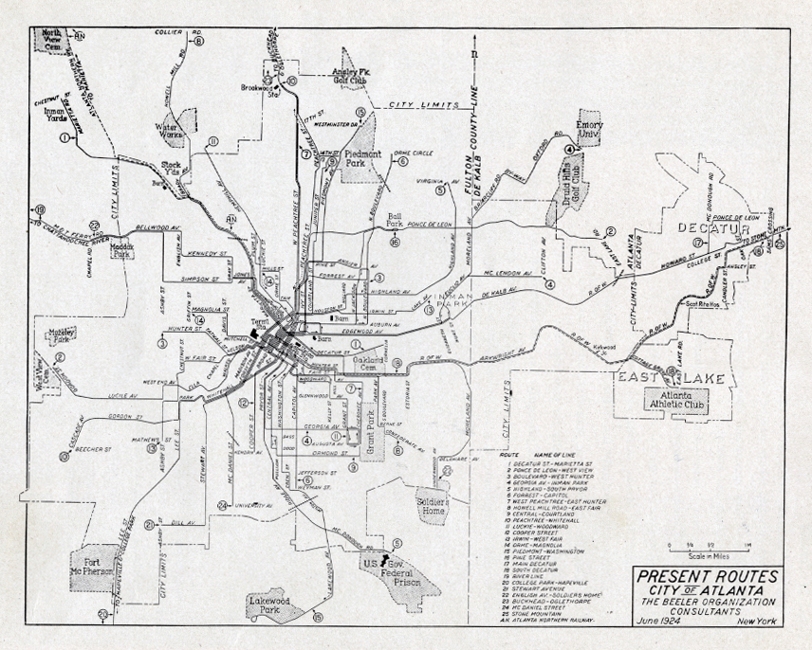
Notes:
In another example, red indicates the electric street car system in Atlanta during the period.
This layer was produced as part of a graduate students scholarly work on the history of Atlanta’s electric rail.
In order to populate the attribute table of the GIS layer archival reference material was consulted.
In this case, route, schedule, and type of equipment were added to the GIS layer.

Slide 20
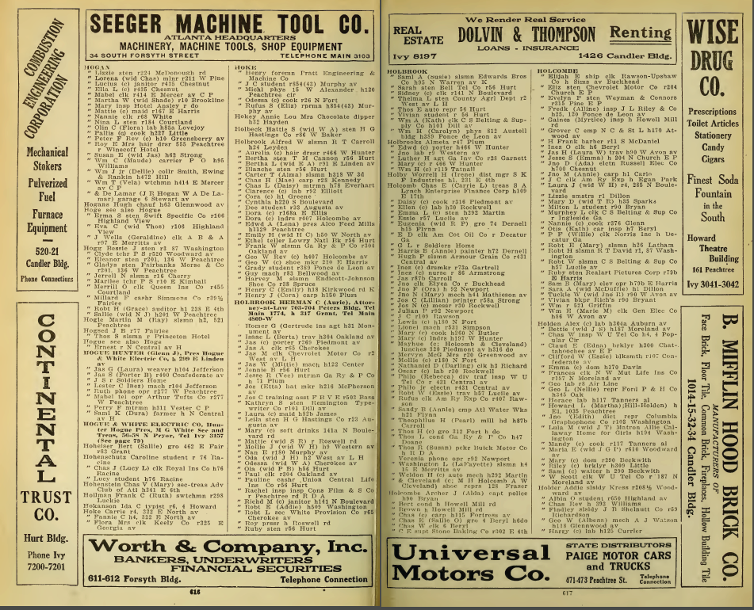
Notes:
While the construction of a geodatabase is core to our GIS users the development of a geocoding reference layer and a specific address locator is what enables to construct geocoding tools for Atlanta circa 1928.
The intent is to build two types of geocoders, both an address interpolator and a feature specific locator based on city director information.
Much like a user searches Google Maps they would be able to look up and individual or business in 1928 Atlanta and the location will display on the map.
Then they will be able to turn off or reduce the transparency of the 1928 data in order to see what exists in that location present day.
As I mentioned previously, GIS links geographic features represented as geometry with feature attributes so data from existing city directories and other sources will be used to provide details about each building footprint polygon in the database. ( type of business, resident, and race )
Further, we recognize that many users may not be using the geocoder within a professional GIS application therefore its our intent to create online search tools that return a Google Earth KML file. The user could search by address, person, or an institutional or business name. Within each Google Earth placemark could be linkages to the source material. For example, a georeferenced overlay of a page from the historic atlas.

Slide 21
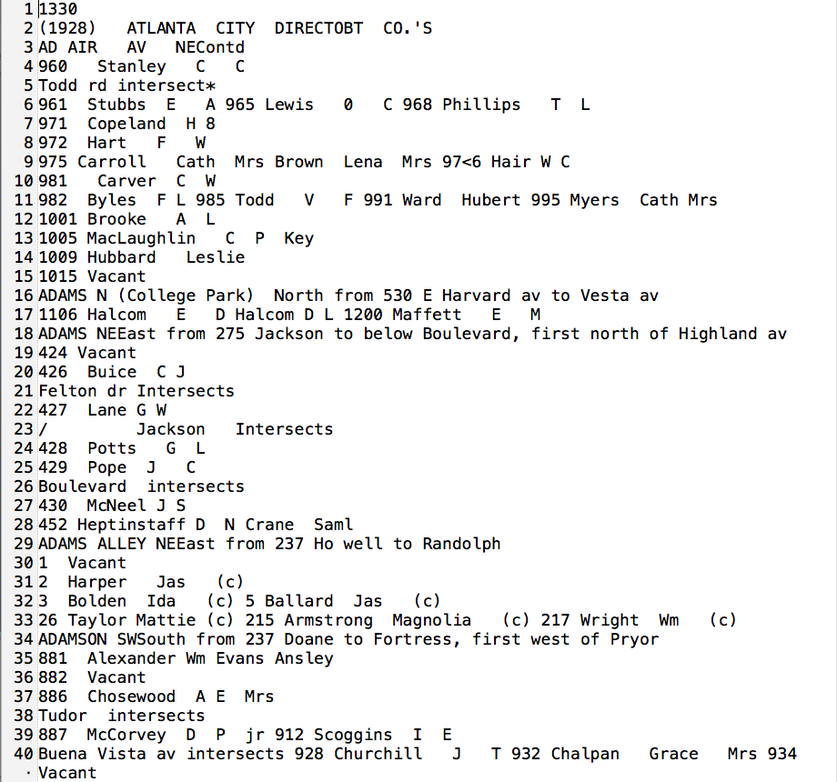
Notes:
Our initial thought was that we would only need to convert OCR’ed text to spreadsheet format to enable us to construct and address locator.
The idea was to automate the process as much as possible But as you can see here several hurdles were encountered in the extraction.
Of note, the C in brackets represents a person of color.

Slide 22
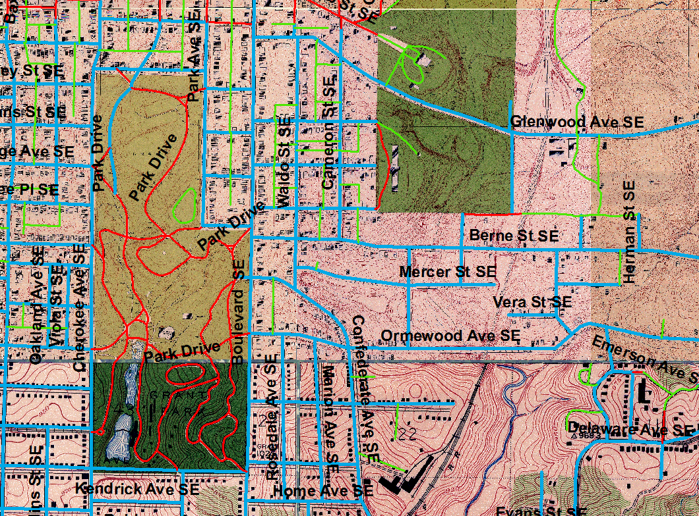
Notes:
We continued on with the geocoder despite not having a clean OCR’ed table to work from and used other maps produced at the time period to cross check our data. Of course we round many discrepancies in the data represented on the various maps which required a bit of research and in some cases a judgment call.
In production we applied a color symbology to represent the status of the lines of communication. Here ….
Red indicates streets that have been removed
Blue indicates streets that exist both now and in 1928
Green indicates unpaved roads, alleyways, paths

Slide 23
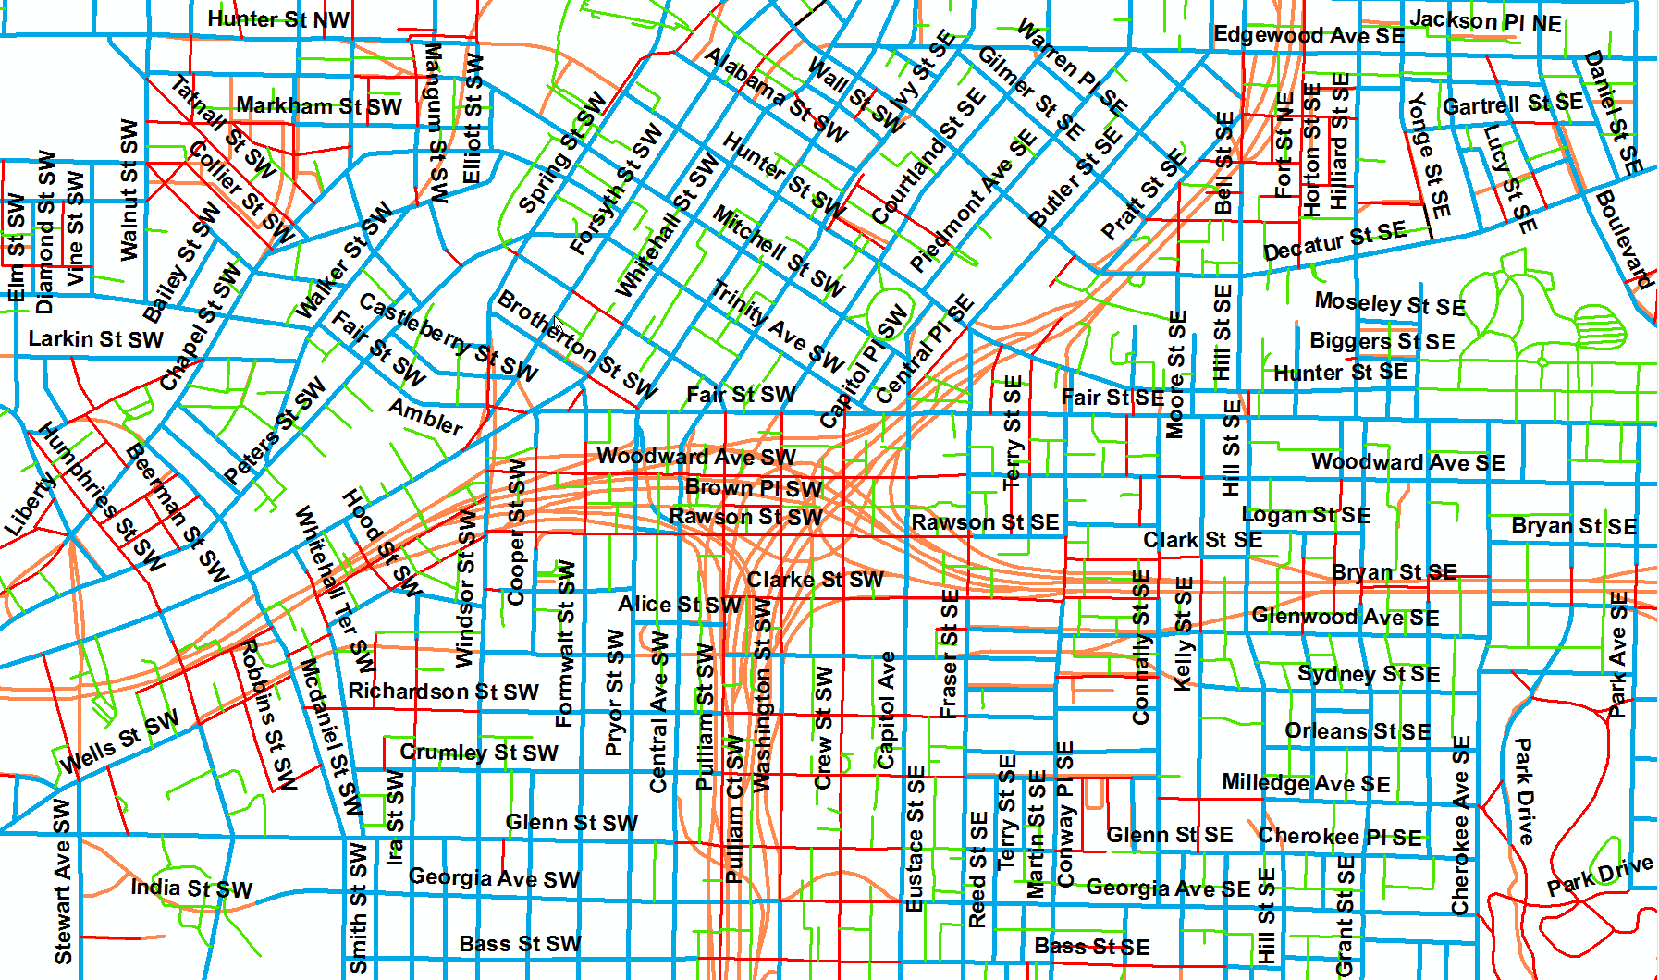
Notes:
Cluster in the center is where Interstates 75/85 converge with Interstate 20
Orange = streets based on Atlanta Regional Commission data, added since 1928
Again,
Red = streets that have been removed
Blue = streets that exist both now and in 1928
Green = unpaved roads, alleyways, paths

Slide 24
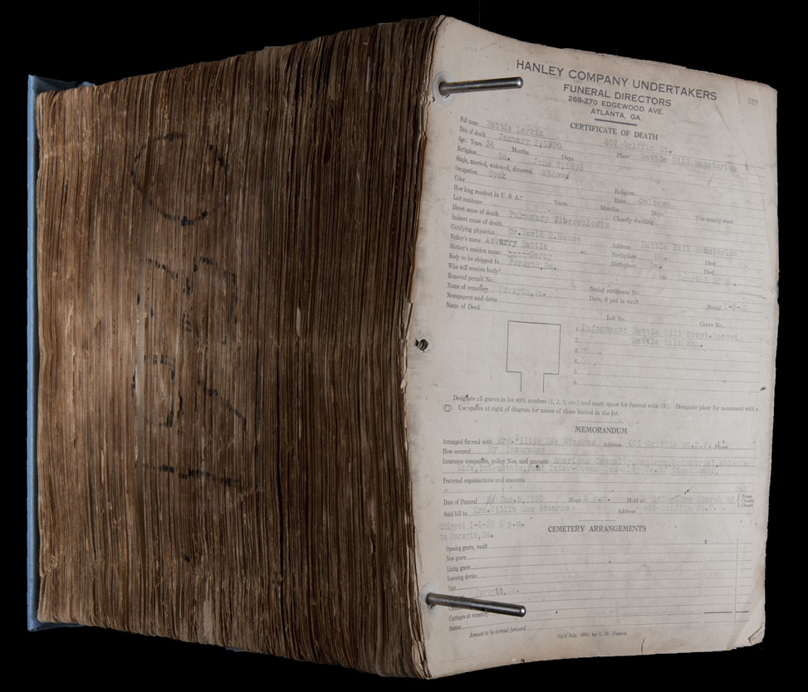
Notes:
Transforming additional library materials and archival collections
The library holds extensive historical records from a local African American funeral home. These records document the address, age and cause of death for thousands of individuals. By representing this information geographically on the digital map, scholars may be able to find new patterns that illuminate a relationship between utility infrastructure and public health or enhance our understanding of racial segregation. The map also offers exciting new ways to visualize this research.

Slide 25
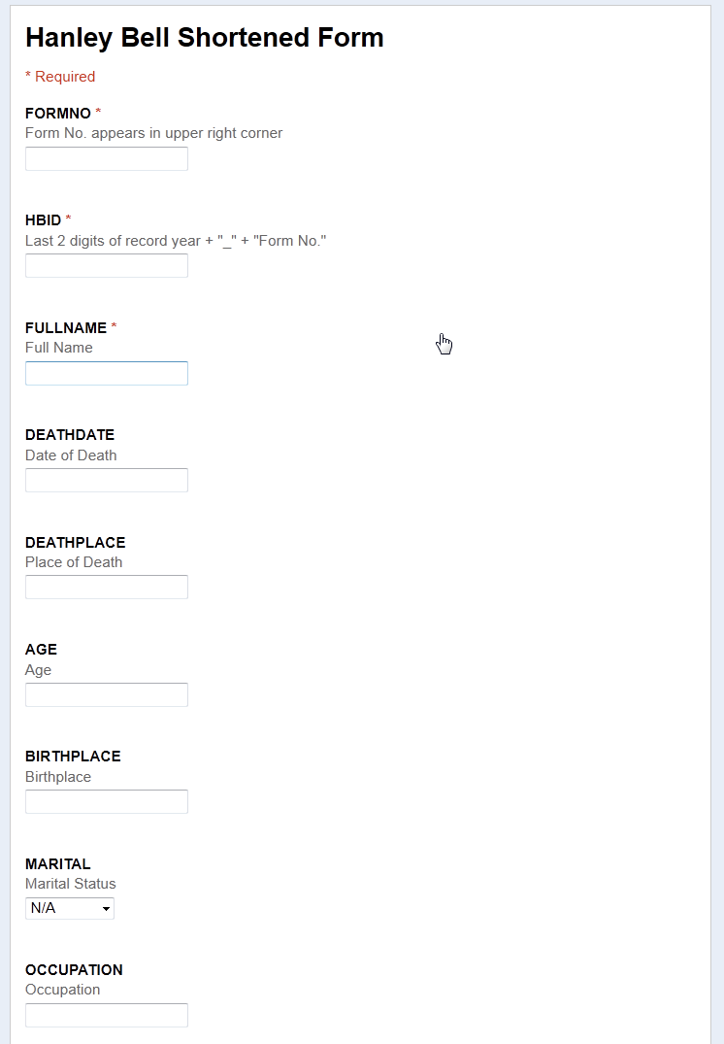
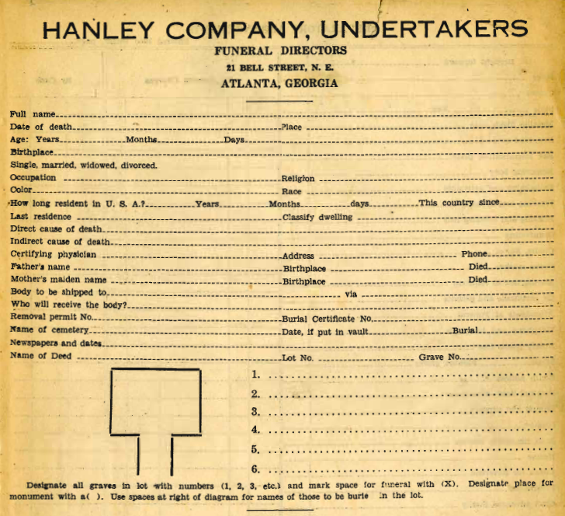
Notes:
Some other ideas on this project is to add other data sources like the census but perhaps also include material from special collections For example, the 1928 model could open up research opportunities to overlay unique demographic and public health data to examine the data spatially.

Slide 26
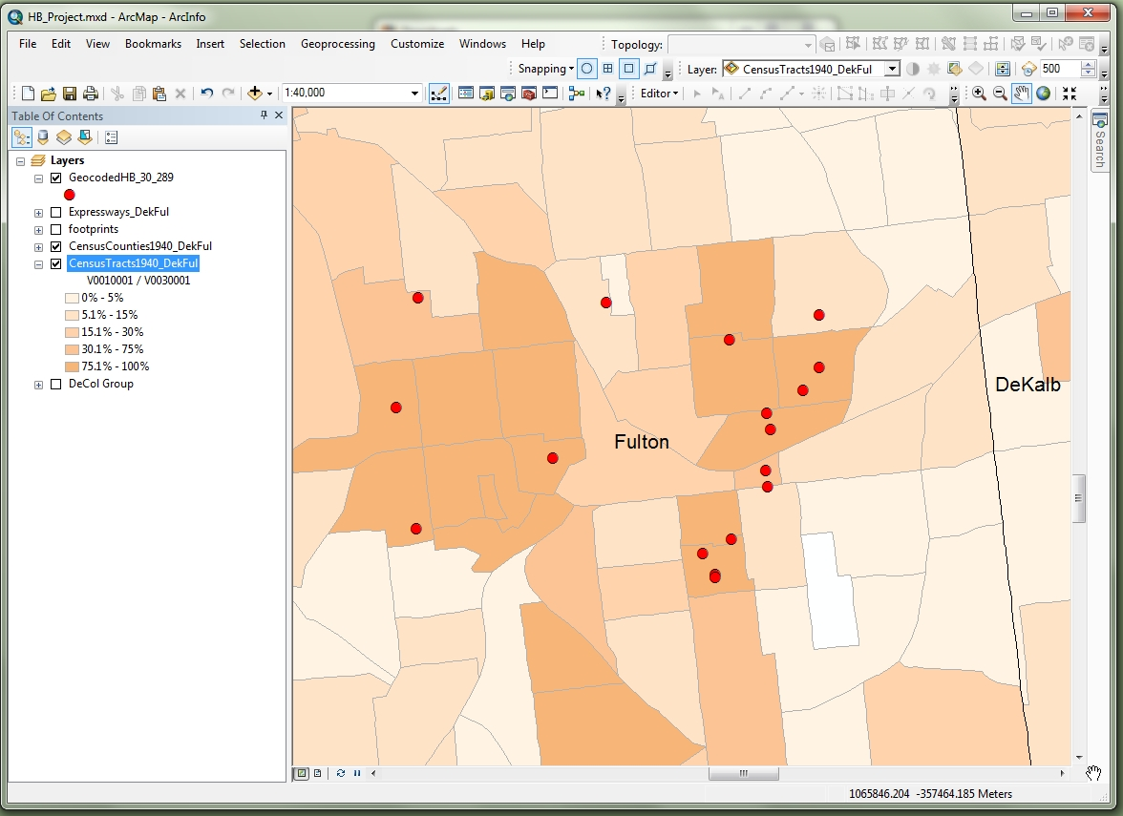

Slide 27
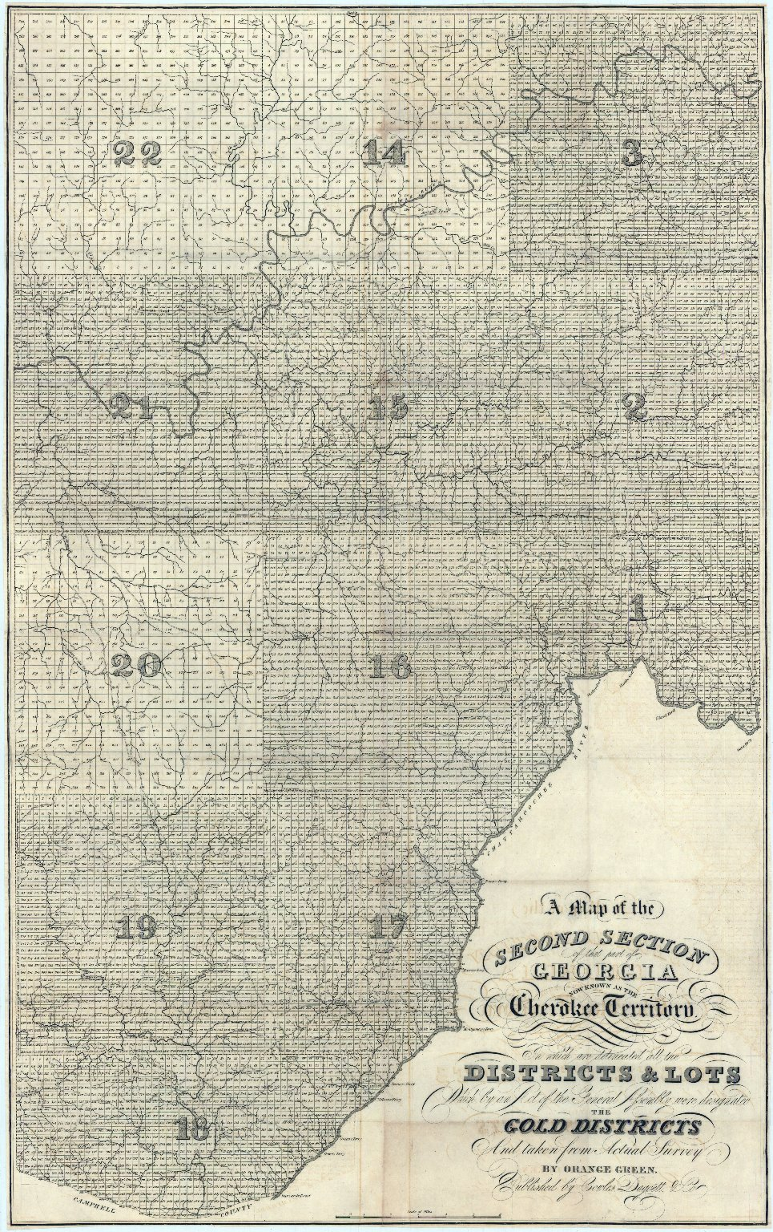
A Map of the Second Section of That Part of Georgia Now Known as the Cherokee Territory.
Date: 1833
Subject: Georgia -- Gold discoveries
Subject: Surveys -- Georgia
Spatial Coverage: Georgia
Temporal Coverage: 19th century
Notes:
27

Slide 28
Architecture and Dissemination
Digital Assets
Datasets
Literature
LUNA Insight
REPOSITORY
Geospatial Catalog
DATA
RDFa
Library Catalog
Notes:
Atlas Pages (images) Metadata for the individual map images from the atlas is created according the the Dublin Core Standard. This metadata, along with its source image, is ingested into our generic repository, which allows for the resource to be served out in any number of sizes and formats (pdf, jpeg2000, etc.) Using Dublin Core provides us with a basic model for information exchange using the OAI-PMH protocol and also allows for easy import into the LUNA Insight system. Datasets and Other Geospatial Resources The nature of most geospatial resources calls for a more detailed metadata standard due to the types of information necessary for retrieval and reuse of the item. And often the metadata librarian will have to work closely with the researcher to ensure the accuracy of the information provided in the record. For GIS datasets created by the Emory University community, FGDC metadata records are created for each set using ArcCatalog, and can be accessed through the ESRI software as well as our open-source catalog, GeoNetwork. Using an automated metadata transformation process, the repository converts the FGDC records into MARCXML for inclusion within our local ILS (Library Catalog), and ta second process converts the MARCXML into Dublin Core for more universal web interoperability.
Persistent Identifiers
As a policy, we assign persistent identifiers in the form of archival resource keys (arks) to ALL of these resources in order to guarantee their long term accessibility.

Slide 29
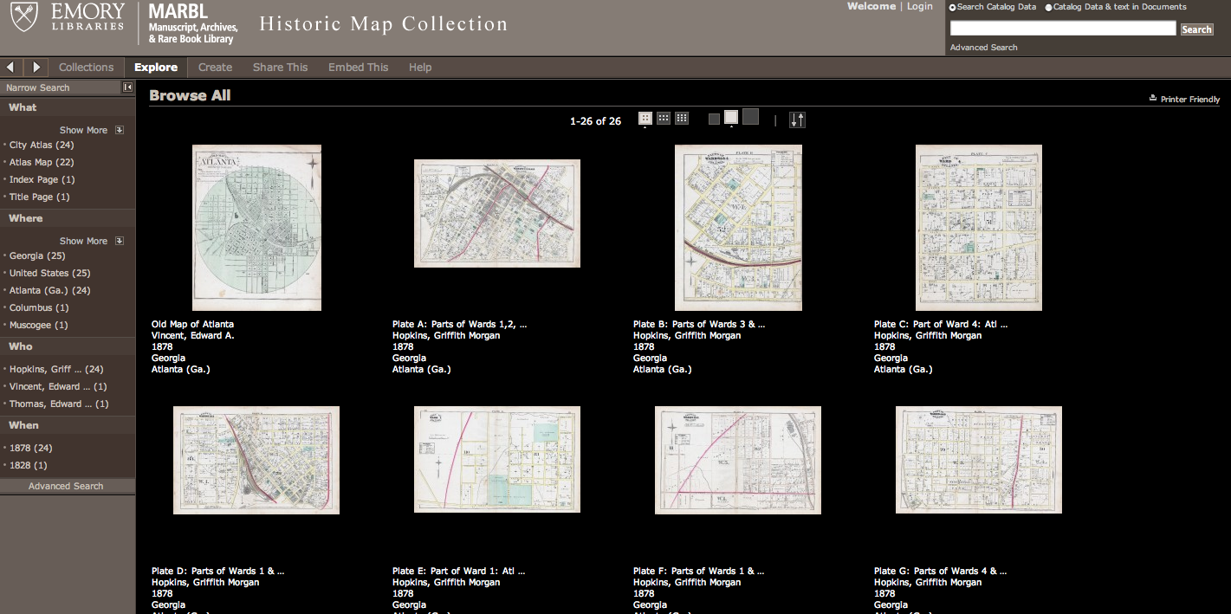

Slide 30
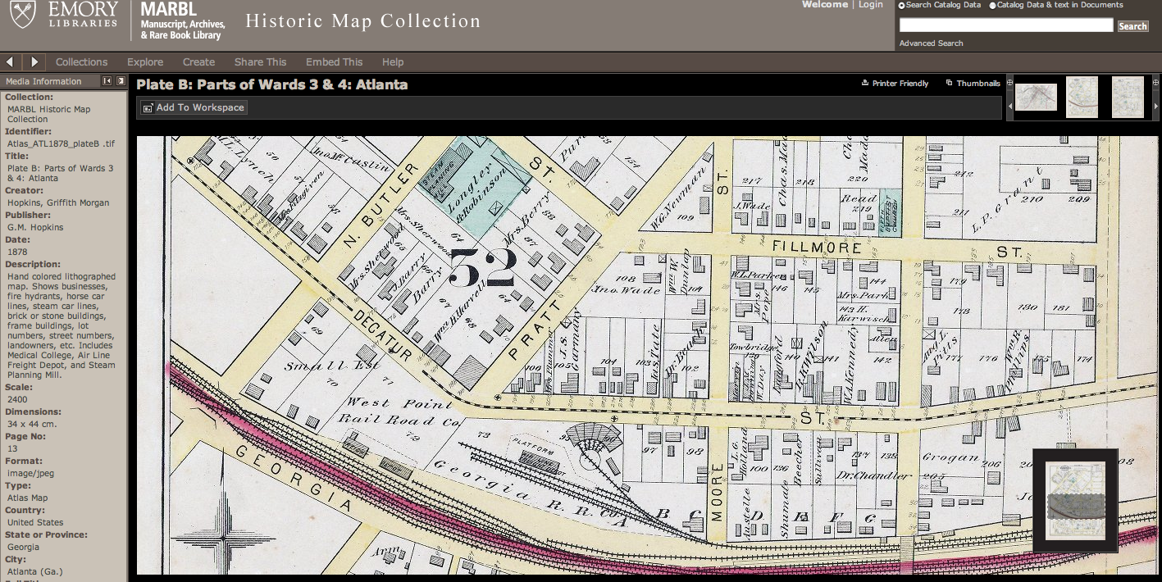

Slide 31
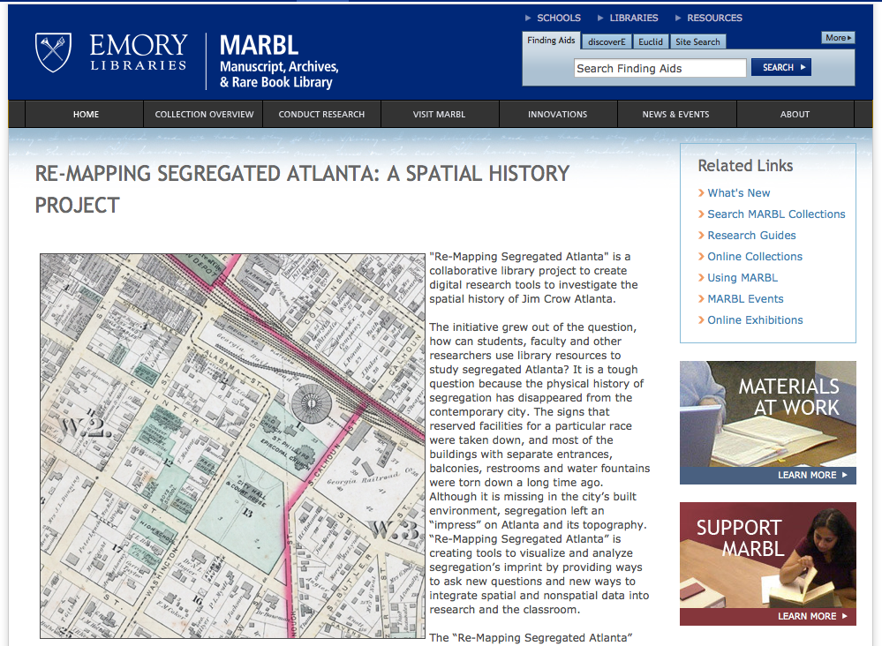

Slide 32
More Information:
Re-Mapping Segregated Atlanta
http://marbl.library.emory.edu/remapping
EUL-FEDORA on GITHUB
https://github.com/emory-libraries/eulfedora
MARBL Historic Map Collection
http://www.digitalgallery.emory.edu/luna/servlet/EMORYUL~3~3

