Slide 1
Efficient Georeferencing of Small-scale Scanned Map Images
James E. Burt¹, Gregory J. Allord² , Jeremy White^{1,3}
¹University of Wisconsin-Madison
²U.S. Geological Survey
³New York Times Company
Association of American Geographers
New York
25 Feb 2012
Notes:
Human efficiencies, not computational. Will describe new georeferencing software we think will be faster and easier to use for some kinds of problems. Have nearly all of the capabilities implemented, close to beta status.

Slide 2
Outline
  Problem/Background
  Addressing User Bottlenecks
    Data Entry
    Finding Control Mark Areas
    Pixel-level Digitizing
  Transform Diagnostics
  Identifying the Projection
  Summary

Slide 3
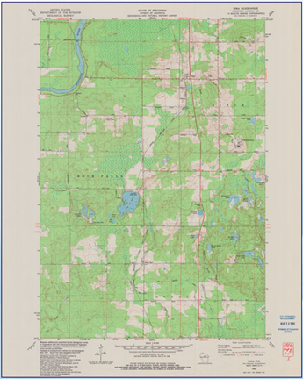
Problem/Background
Growing inventory of scanned maps worldwide:
    Acknowledged need for georeferencing
    Wide variety of theme, scale and projection
    Often at high resolution (~500 dpi)
Notes:
Proximate motivation is usgs thematic map scanning program, can situate more generally

Slide 4
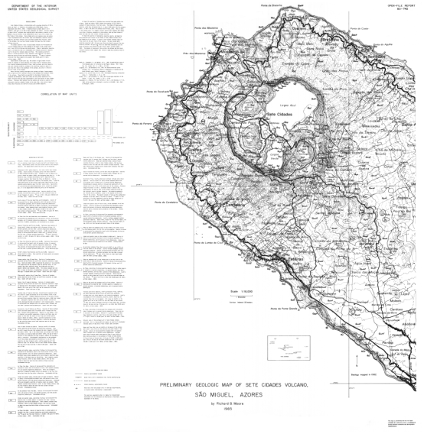
Problem/Background
Notes:
Give some examples of maps we are targeting

Slide 5
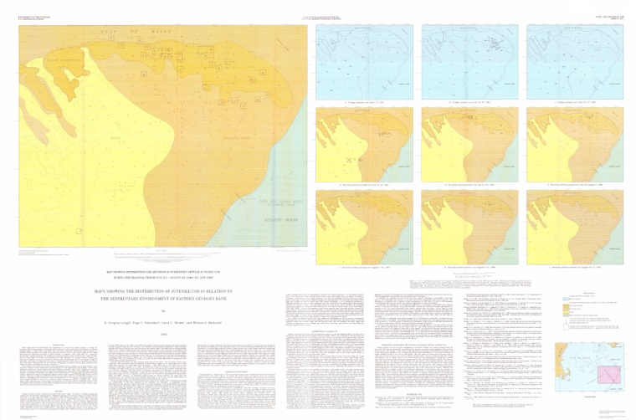
Problem/Background
Notes:
Map of juvenile cod in relation to sedimentary structures of georges banks

Slide 6
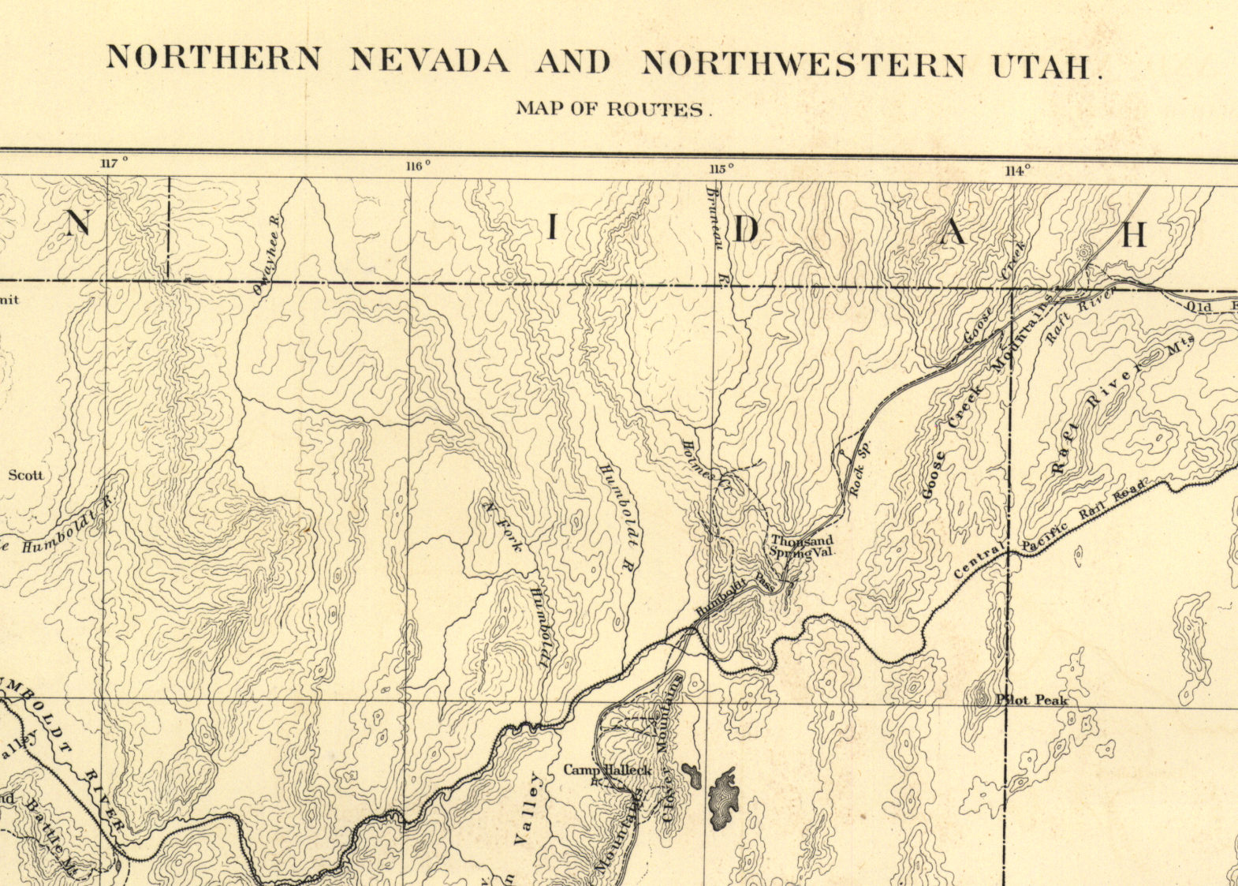
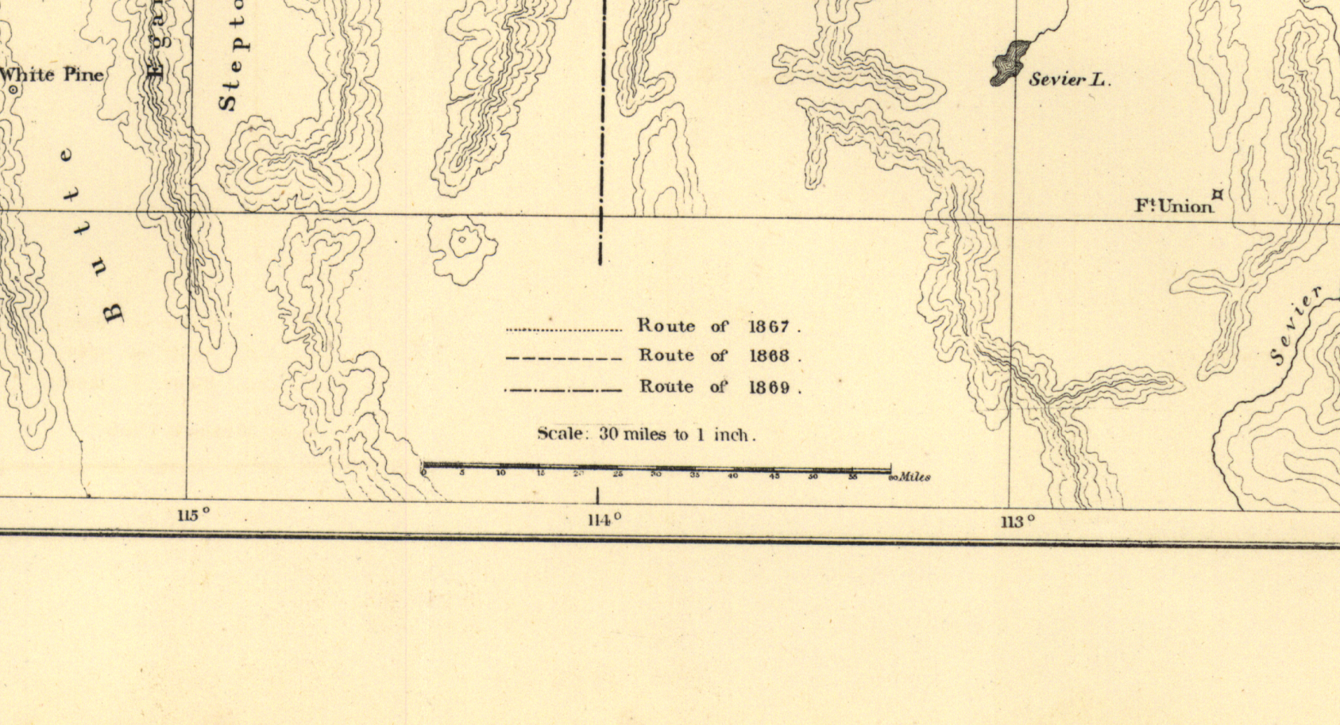
Problem/Background

Slide 7
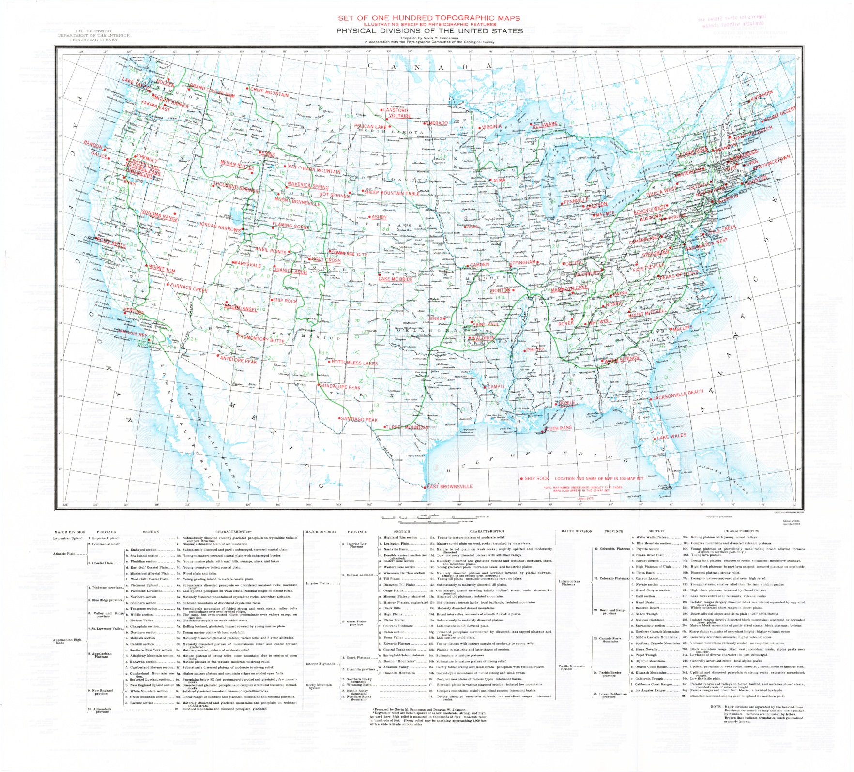
Notes:
1:7,000,000

Slide 8
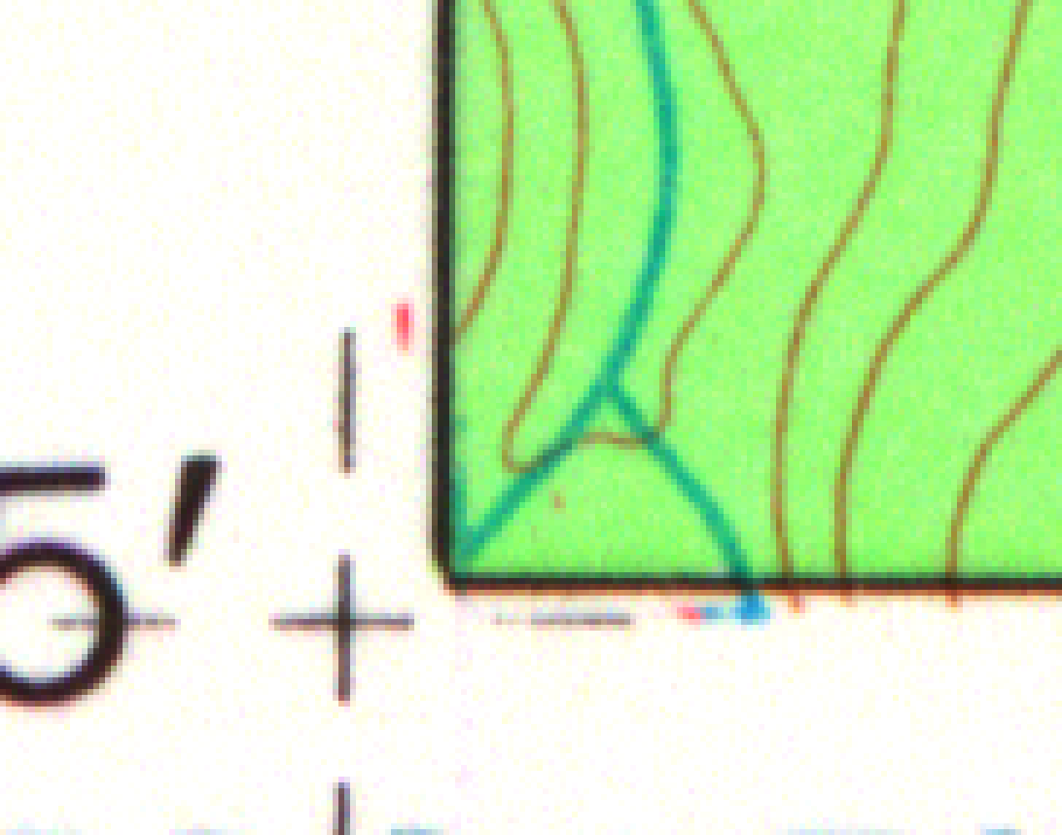
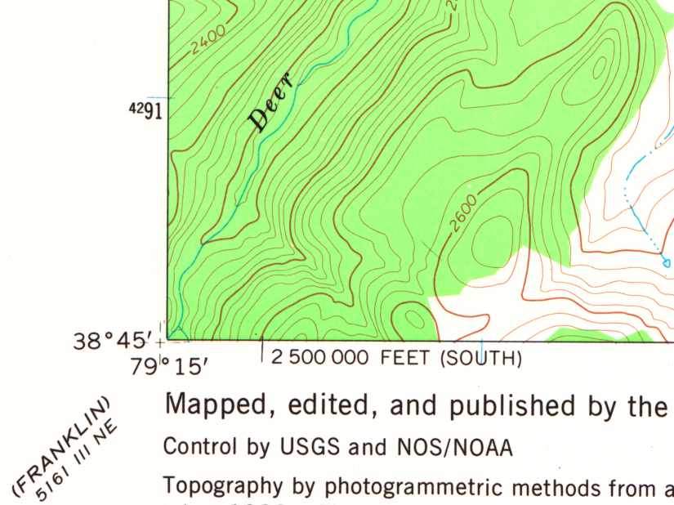
Notes:
Close facsimile to paper map

Slide 9
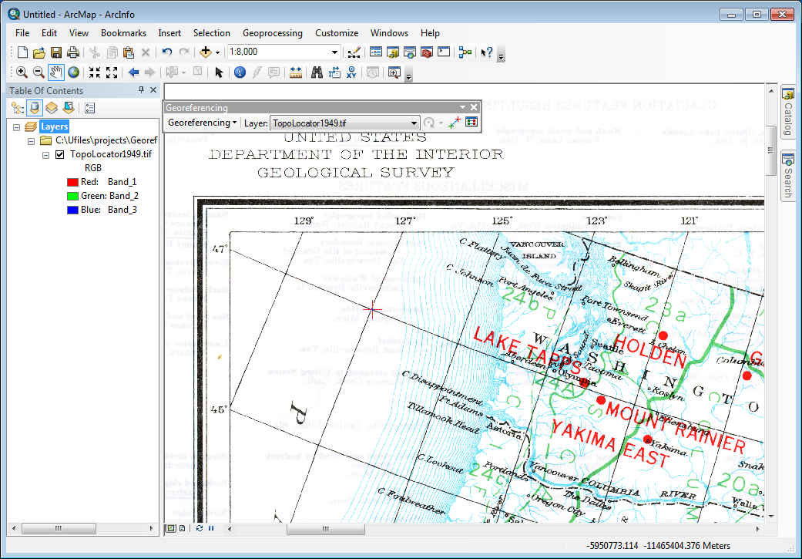
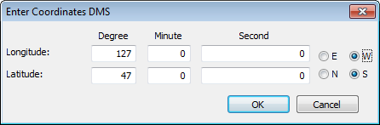
Problem/Background
Notes:
Many great tools, incl arcgis and mapwarper

Slide 10
Problem/Background
Challenges:
  Populating dialog boxes tedious, error-prone for more than a few control points
  Panning, zooming slow
  Fine-scale digitizing tiring
  Uncertain projection
  File sizes 0.5-1.5 GB
Notes:
Bullets 1-3 very different from cognitive and motor skill perspective, yet must switch serially among them to complete a suite of points

Slide 11
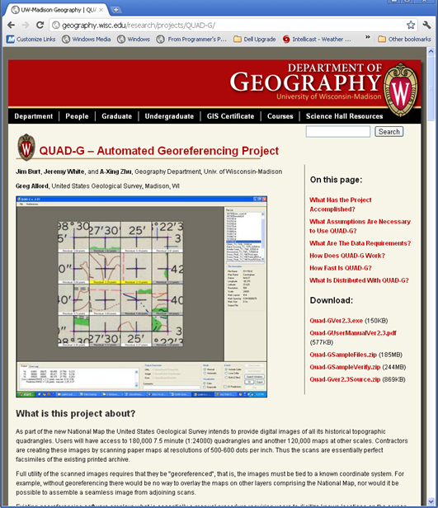
Problem/Background
Previously developed QUAD-G for automated georeferencing of large-scale USGS topo quads
  www.geography.wisc.edu\
  research\quad-g
Notes:
Building on experience with Quad-g

Slide 13
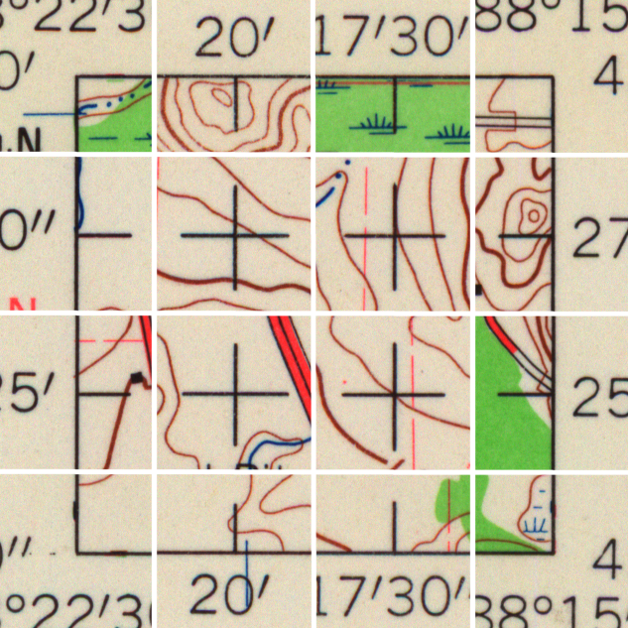
Notes:
16 to 45 control marks

Slide 14
Residuals 1:24K Quads
Neatline Width

Slide 15
Problem/Background
Quad-G not useful here:
  Might not have quad
  Possible small map scale, projection unknown
  Possible no rectangular grid of control marks

Slide 16
Problem/Background
  Georeferencing tool:
    Allow user to quickly identify control points known in both map (x,y) and image coordinates (u,v).
    Develop transformation from map to image space (u,v) = g(x,y)
    For any desired (x_{m},y_{m}) in map sheet area use g to find corresponding image pixel (u_{m},v_{m}), and write to a new (georeferenced) image file.
  Viewing Model:
  (φ ,λ) -> P(φ ,λ) -> (x,y) -> -> (u,v)
  (u,v) = g[P(φ ,λ)]
plotting, printing, deformation, scanning
g(x,y)
Notes:
Step 1 the hard part

Slide 17
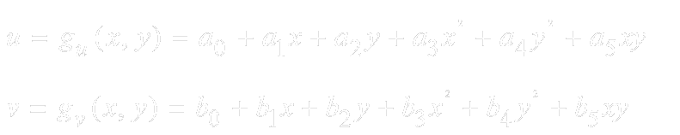
Problem/Background
  Note:
    In the absence of any scanning errors, plotting errors or deformation of the map sheet, components of g are linear in x and y.
    Assuming moderate errors and distortion, a low-degree polynomial will suffice for g:
    A user will nearly always provide control point locations as lat/lon (φ ,λ), thus we need the map projection to get (x,y) = P(φ ,λ) .
    Graticule intersections often used as control points

Slide 18
Outline
  Problem/Background
  Addressing User Bottlenecks
    Data Entry
    Finding Control Mark Areas
    Pixel-level Digitizing
  Transform Diagnostics
  Identifying the Projection
  Summary

Slide 19
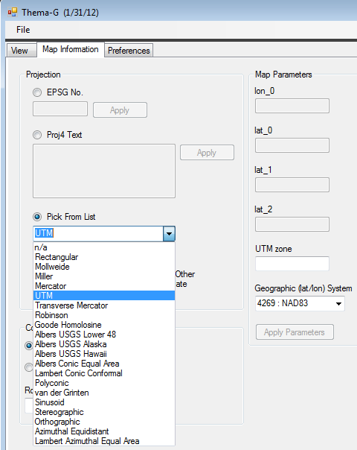
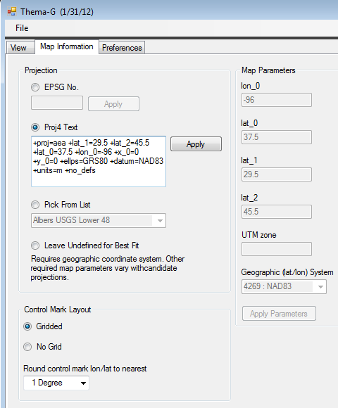
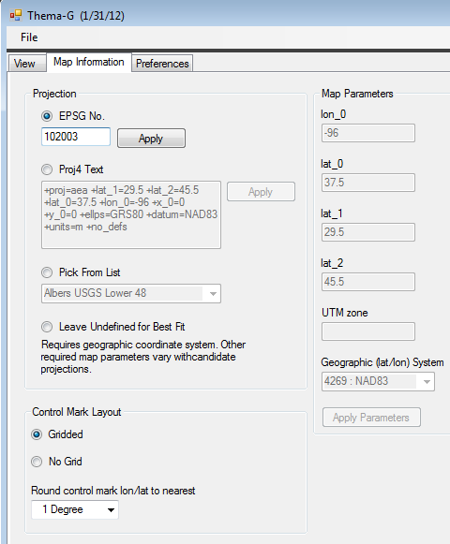
Addressing User Bottlenecks
  For the moment, assume user knows projection
  and can supply in one of the following ways:

Slide 20
Bottleneck 1: Data Entry
When user digitizes a point, lat/lon computed from previously digitized control points rather than entered manually.
I.e., find (φ_{new} ,λ_{new}) from (u_{new} ,v_{new}) given a few existing pairs (φ_{i} ,λ_{i}) , (u_{i},v_{i})
(u_{new} ,v_{new}) = g(x_{new} ,y_{new} ) = g[P (φ_{new} ,λ_{new}) ] (1)
(φ_{new} ,λ_{new}) = P⁻¹(x_{new} ,y_{new})]= P⁻¹[g⁻¹(u_{new} ,v_{new})] (2)
Do not know g⁻¹, but a rough approximation OK if new point is a graticule intersection

Slide 21
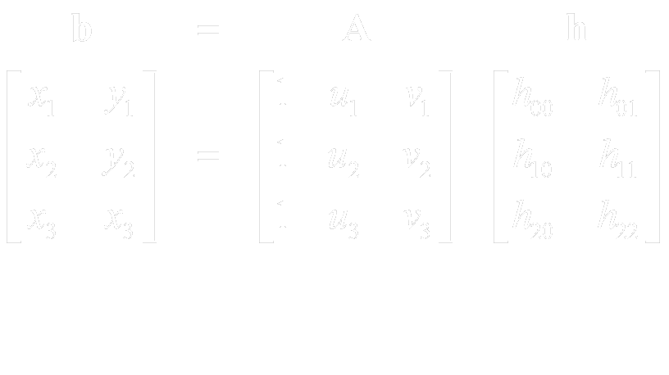
Bottleneck 1: Data Entry
Model g⁻¹ as a linear function h(u,v) built from 3 points closest to (u_{new} ,v_{new} ) :
(reduce accordingly if have only 2 points)
Solve for h and evaluate at u_{new} ,v_{new}
Obtain (φ_{new} ,λ_{new}) by rounding P⁻¹(x_{new} ,y_{new})

Slide 22
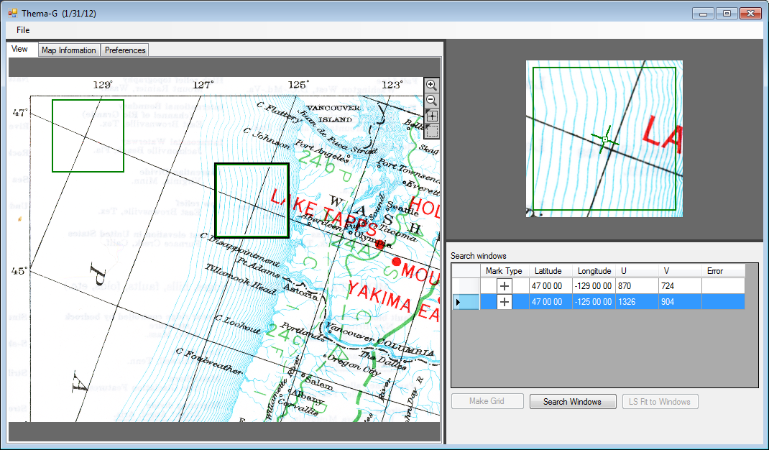
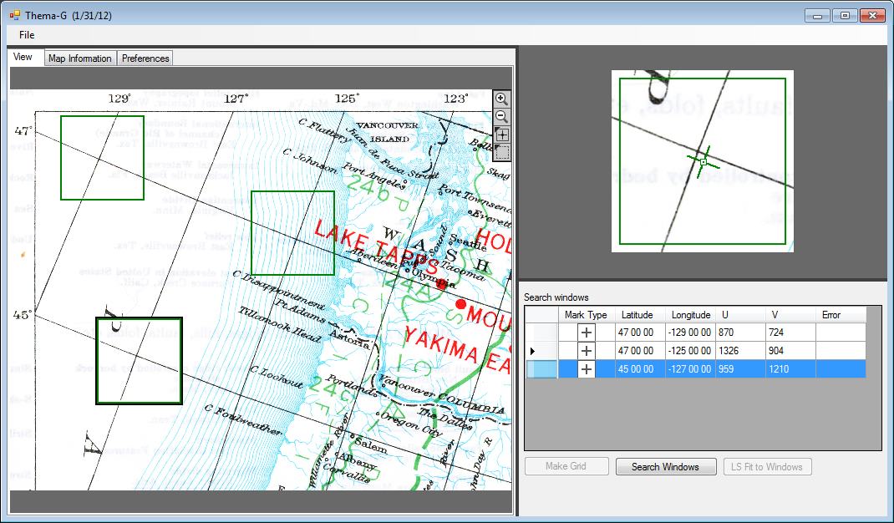
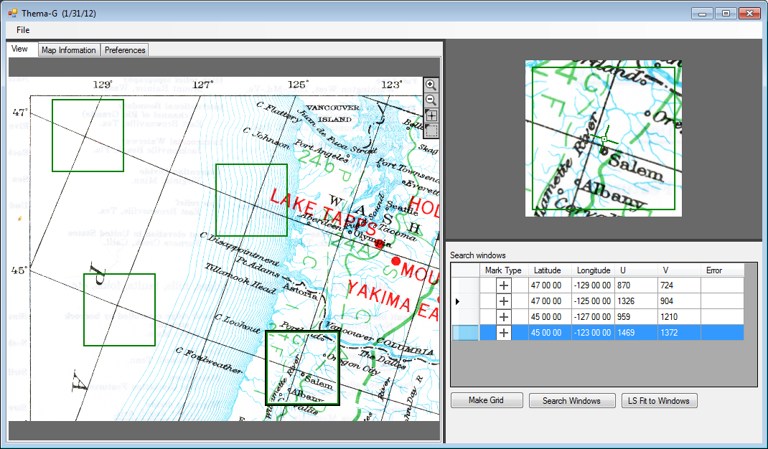
Lat/lon from new image point

Slide 23
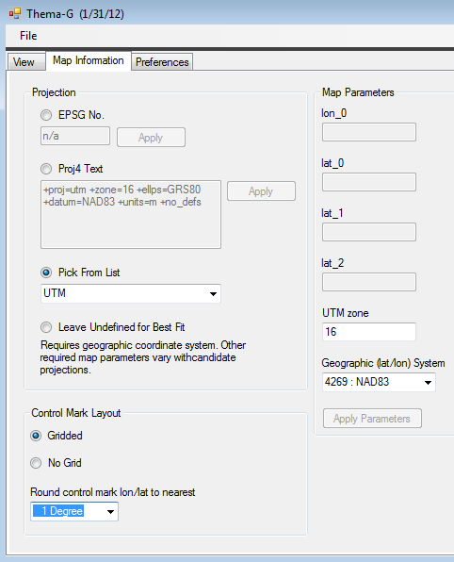
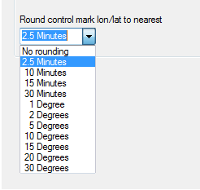
Bottleneck 1: Data Entry
Rounding needed depends on map scale…

Slide 24
Bottleneck 2: Finding
Control Mark Areas
Low resolution, multiple zoom levels
Full resolution

Slide 25
Bottleneck 2: Finding
Control Mark Areas
Graticule intersections often used as control marks, suggests building regular grid of control mark windows
Get grid dimensions and spacing from user
For every (φ_{g} ,λ_{g}) in grid, find (u_{g},v_{g}) = g*[P (φ_{g} ,λ_{g}) ]
Don’t have g , use provisional transform g* based on least-squares fit to all existing points (min of 3)
Notes:
Incomplete grid. Might be subarea, might be single row or column along parallel or meridian

Slide 26
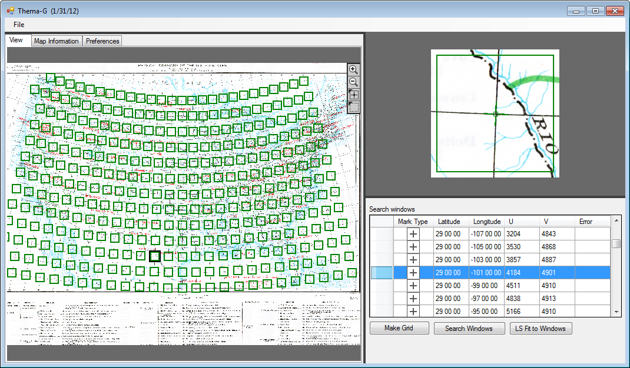
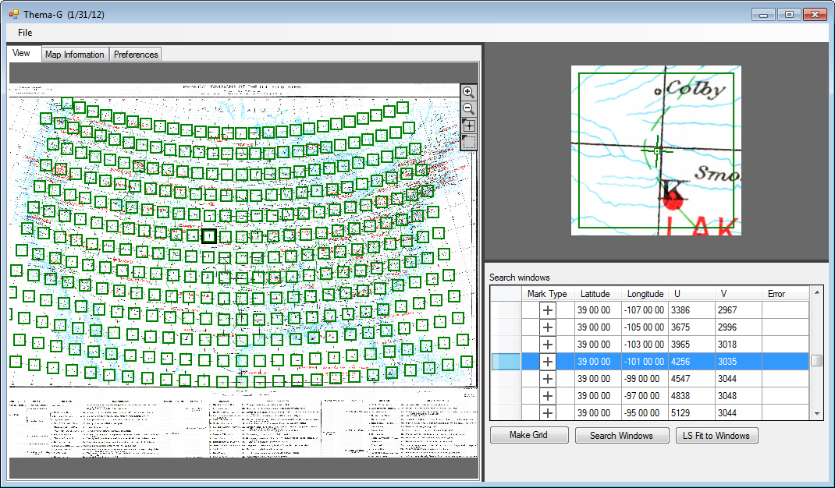
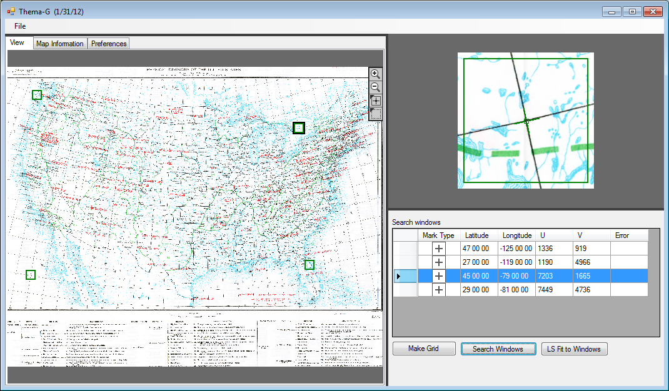
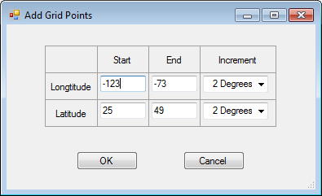
Bottleneck 2: Finding
Control Mark Areas
Could drag
Notes:
Some windows better-positioned than others

Slide 27
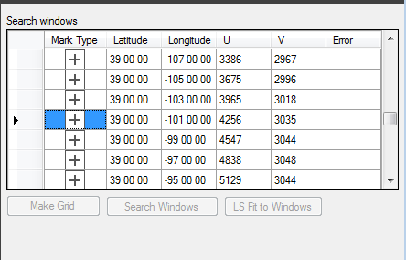
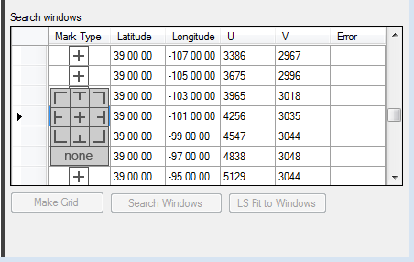


Bottleneck 3: Pixel-level Digitizing
Search each window for its control mark
Catalog of standard marks:
Marks defined in (φ ,λ)
Project to (x,y) before search
Notes:
In effect template is projected, though in fact only project 3 points. Use those to find angle of 2 lines comprising the mark and rotate each according to their angle.

Slide 28
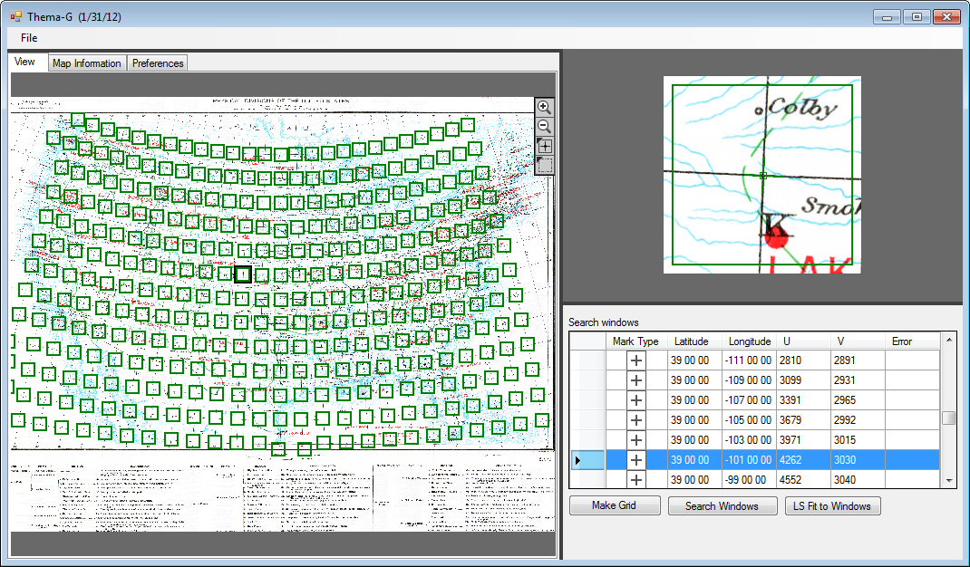
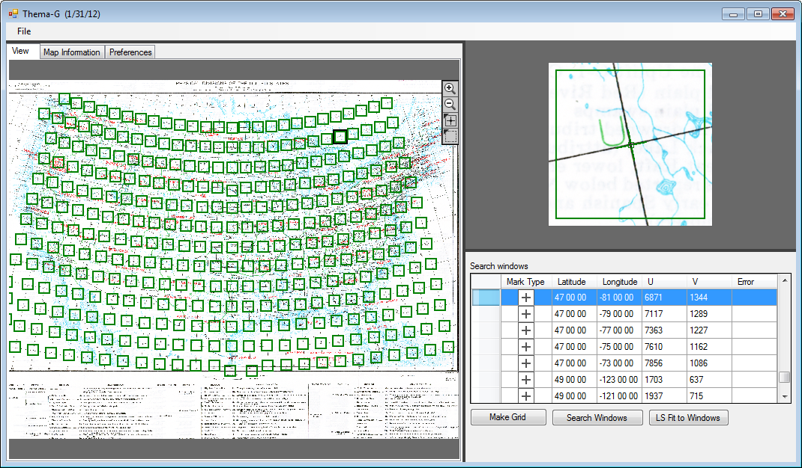
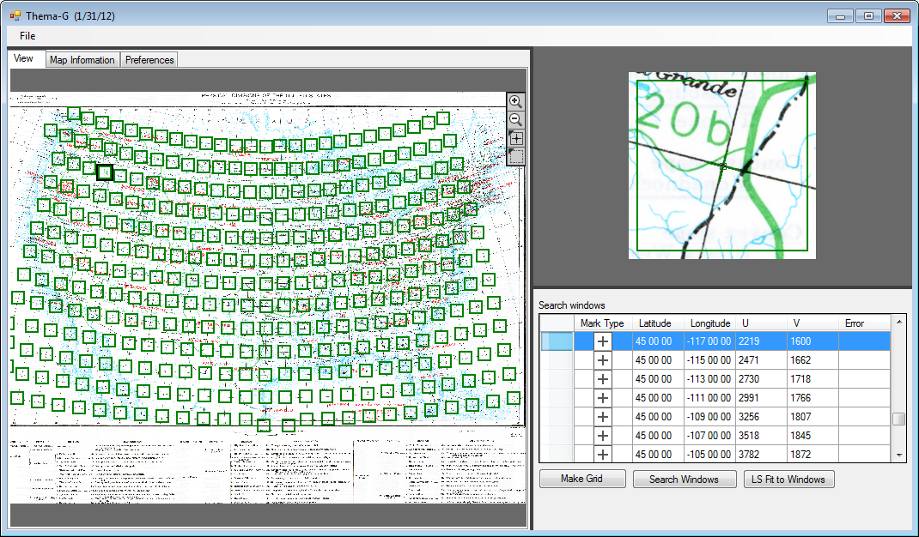
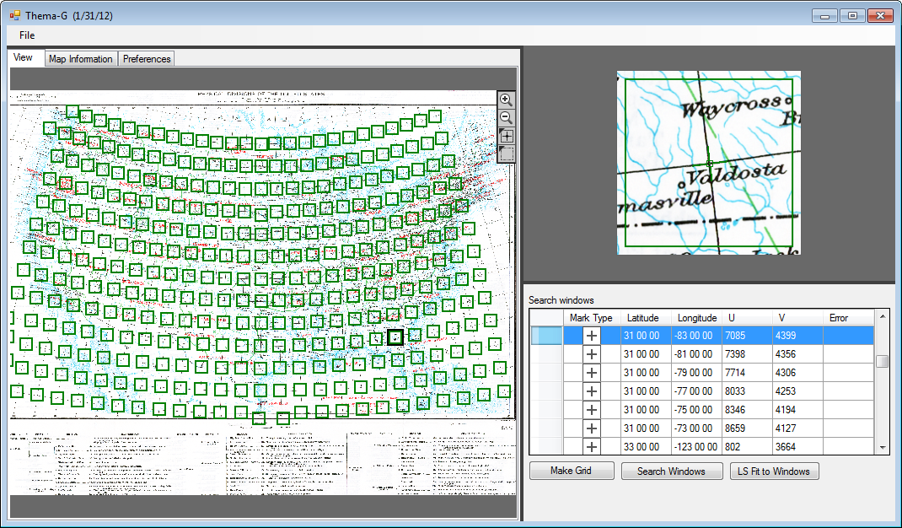
Bottleneck 3: Pixel-level Digitizing

Slide 29
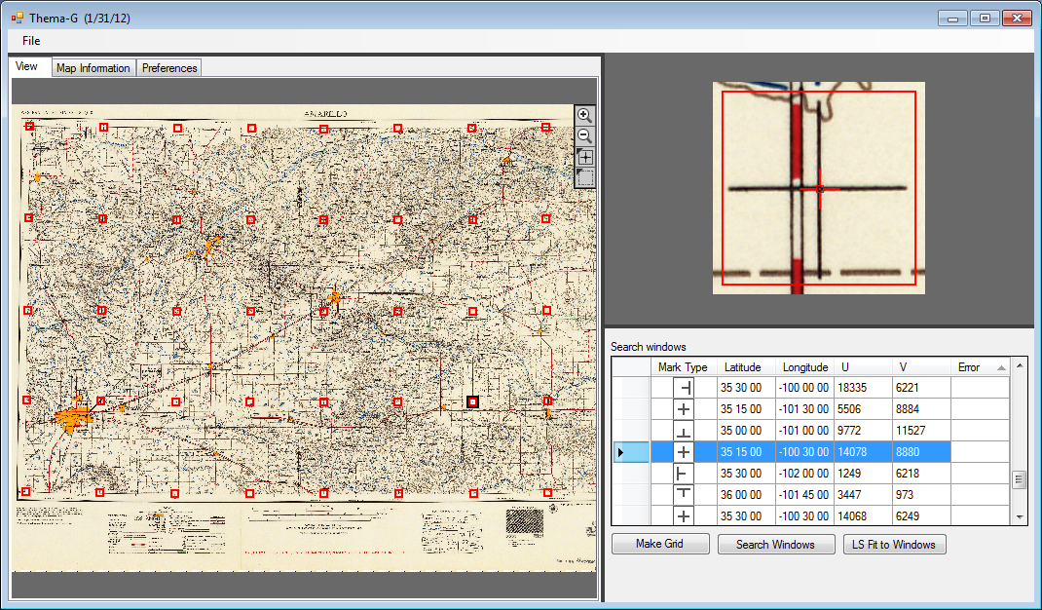
Bottleneck 3: Pixel-level Digitizing
Notes:
More realistic, 1958 Transverse M

Slide 30
Outline
  Problem/Background
  Addressing User Bottlenecks
    Data Entry
    Finding Control Mark Areas
    Pixel-level Digitizing
  Transform Diagnostics
  Identifying the Projection
  Summary

Slide 31
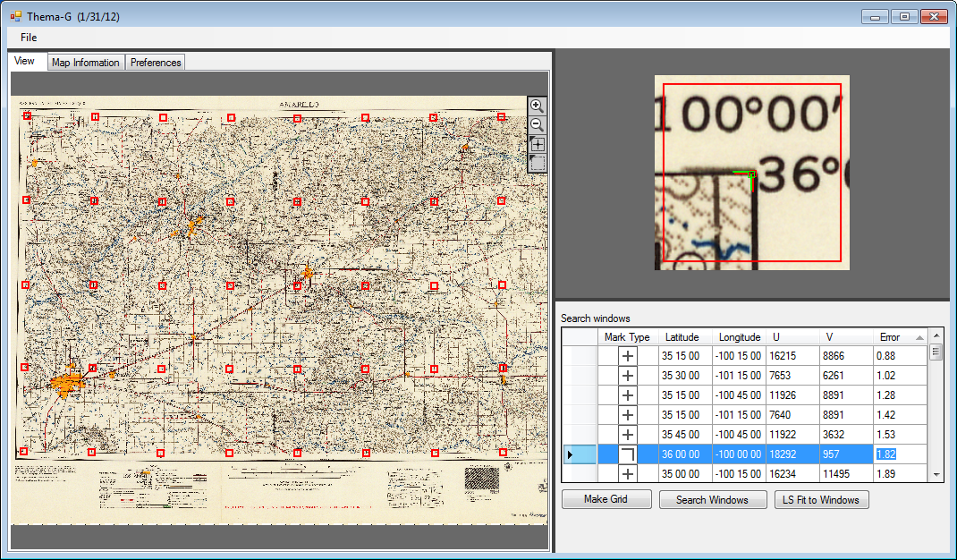
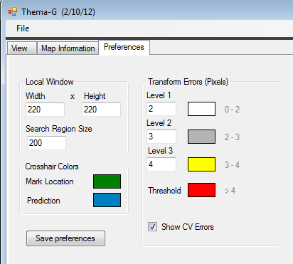
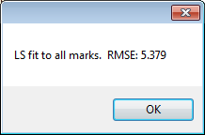
Transform Diagnostics
Notes:
More realistic, 1958 Transverse M

Slide 32
Outline
  Problem/Background
  Addressing User Bottlenecks
    Data Entry
    Finding Control Mark Areas
    Pixel-level Digitizing
  Transform Diagnostics
  Identifying the Projection
  Summary

Slide 33
Identifying the Projection
Projection important in above:
Needed to guess at (φ_{new} ,λ_{new})
Needed to position search windows
Needed for successful pattern search:
Search
Wrong Projection

Slide 34
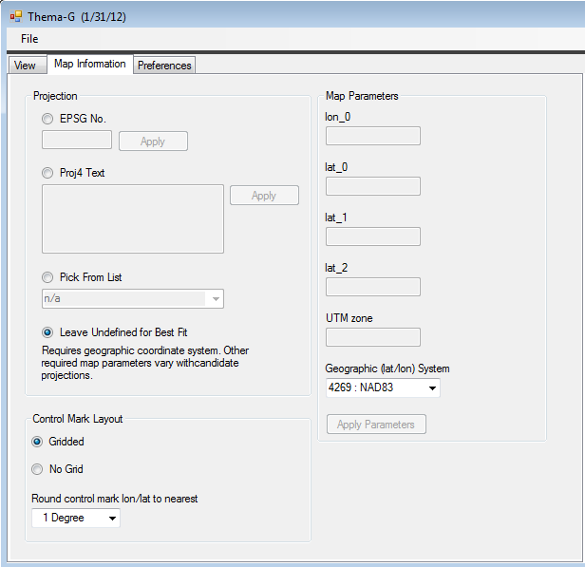
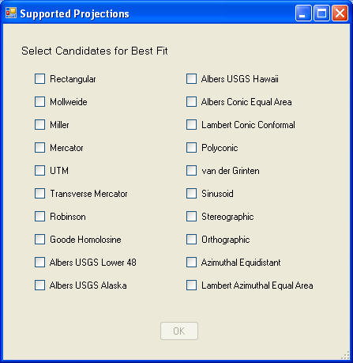
Identifying the Projection
If user doesn’t know projection,
cycle through candidates

Slide 35
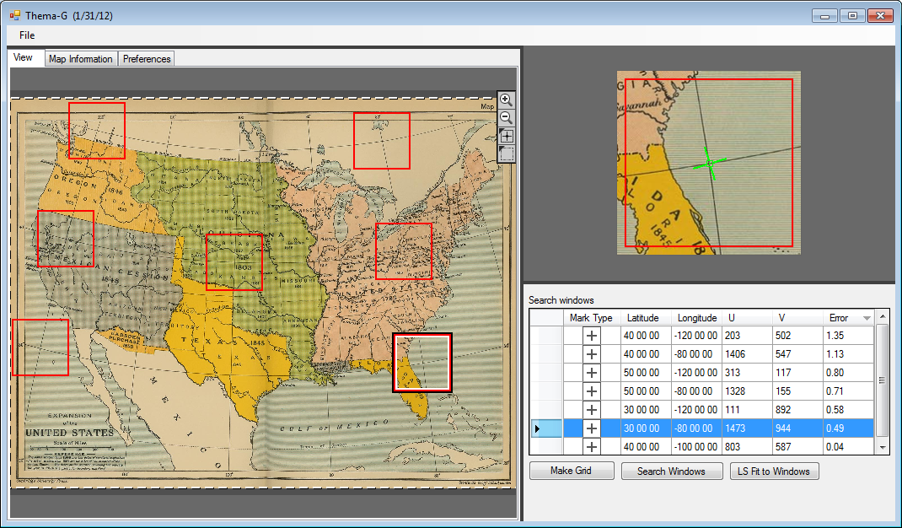
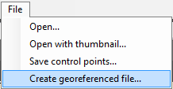
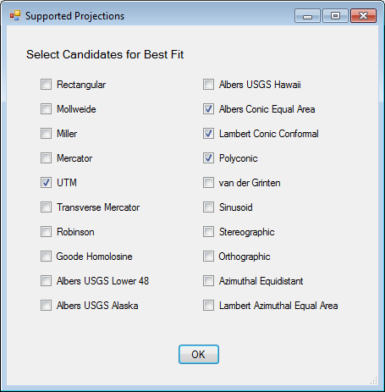
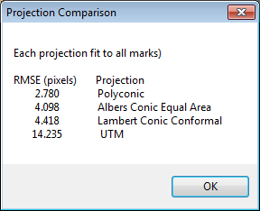
Identifying the Projection

Slide 36
Identifying the Projection
  What if imputed map projection is wrong?
    No issue if errors acceptably small
    Deplorable mistake

Slide 37
Summary
  New georeferencing tool:
    Suitable for large images scanned from large- or small-scale maps
    Achieves transform errors ~linewidth and preserves scan resolution
    Improved human efficiencies
    Aids identification of map projection
    Binaries and source code available summer 2012
Notes:
Described new georeferencing tool under development. B/c works at image resolution georeferencing errors ~linewidth

Slide 38
Thanks To:
Frank Warmerdam and gdal.org for OGR Spatial Reference classes
Tamas Szekeres and osgeo.org for C# bindings to above
U.S. Geological Survey for project funding and other support

Slide 39
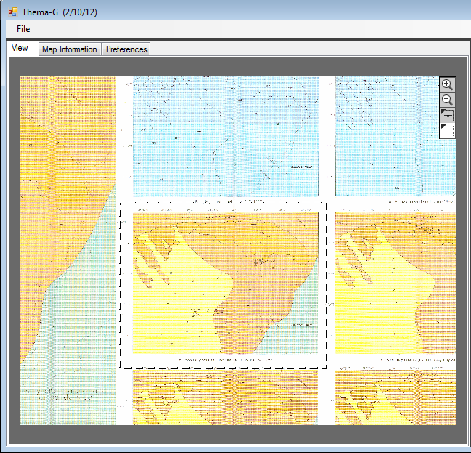

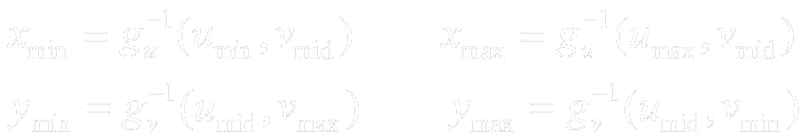
Transform: Application
  What map sheet coordinates covered by output file?
  Extent --- Full scan or sub-area
  Resolution --- match scan
v_{min}
v_{max}
u_{min}
u_{max}

Slide 40
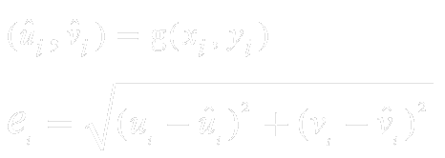
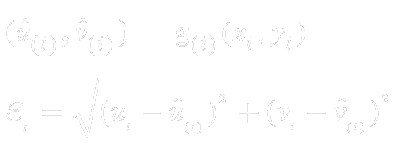
Transform Diagnostics
  Prediction Error:
  Cross-validation:

Slide 41
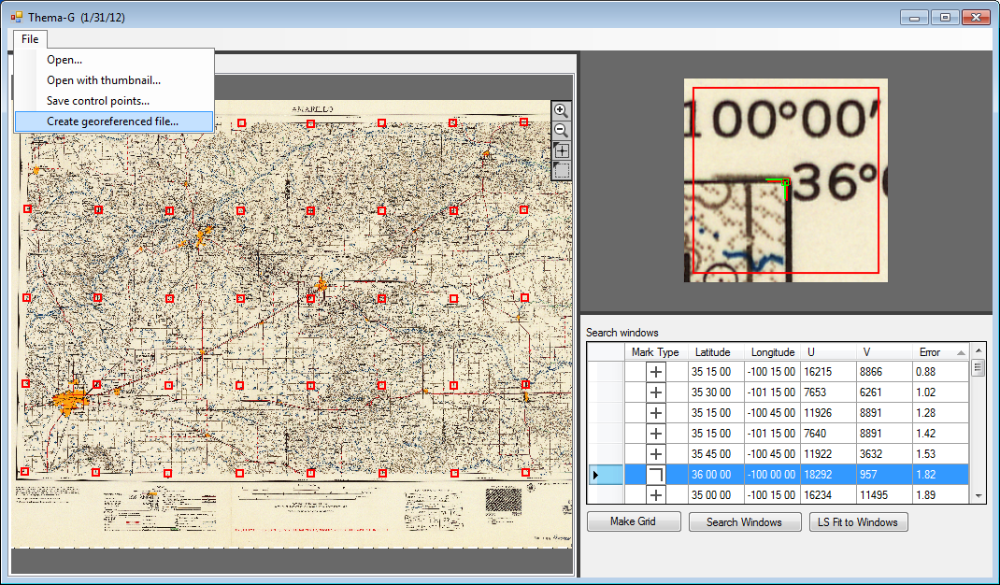
Transform: Application

Slide 42
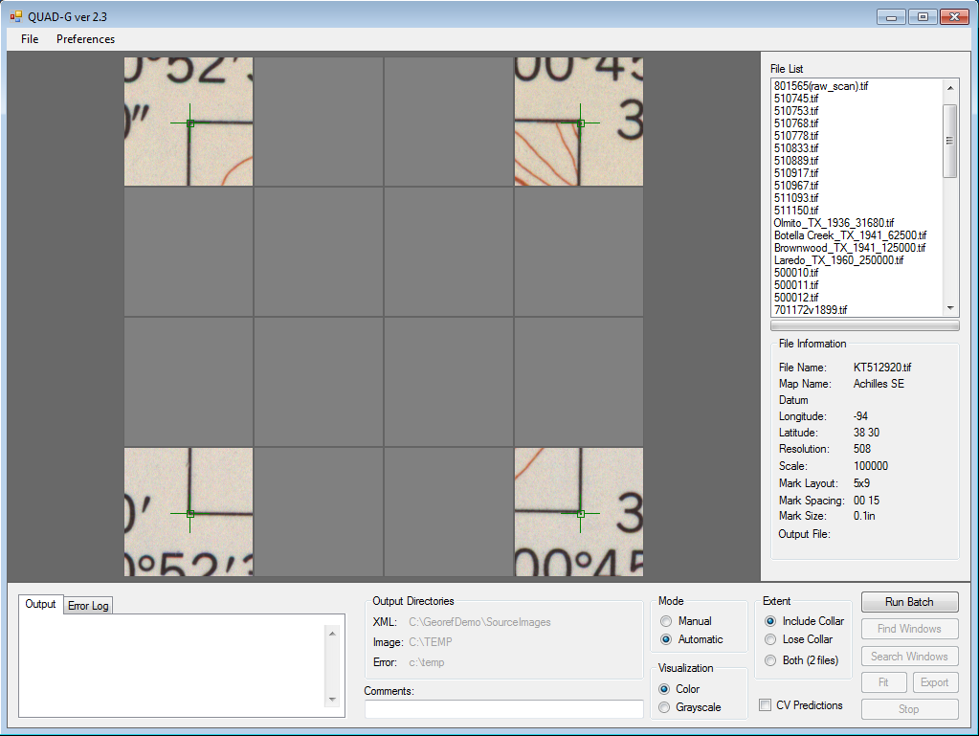
Problem/Background

