Slide 1
Modeling European administrative hierarchies and geographies
Humphrey Southall
(University of Portsmouth/
Great Britain Historical GIS)

Slide 2
What kinds of geographical entity?
Gazetteer Type | Landscape Features | Administrative Units | Places
Typed | Yes | Yes | No
Visible | Yes | No | No
Defined by | Existence in landscape | Legal establishment as corporate bodies | Shared perception; mention in texts and discourse – “social tagging”
Defined as | (mostly) points | legally defined polygons | (mostly) fuzzy polygons
Traditional GIS very focused on landscape features
But interpretation of historical texts is about units and places

Slide 3
Why administrative units matter?
Reporting units for most historical statistics
  Why I got involved with them
Units for recording births, marriages and deaths
  Why family historians are interested in them
  And main reason why there is money in them
Main creators of documents in archives
  Why archivists are interested in them
  And administrative units pay archivists salaries!
Provide a historical record for informal “places”
  Why historians not interested in AUs per se may still find them useful
  Examples yesterday of how two “places” named after pubs were recorded as AUs with defined polygons

Slide 4
QVIZ Project
Funded by EU Framework Programme 6
Two year project in 2006-8
Partners included:
  HumLab, University of Umea (Leaders)
  National Archives of Sweden (“Customers”)
  National Archives of Estonia (“Customers”)
  Regio (Estonian GIS company)
  Salzburg Research (developing Wikipedia replacement, I think)
  Telefonica (Spanish telephone company)
  GB Historical GIS, Portsmouth (AUO builders)
www.qviz.eu

Slide 5
The Archivist’s Perspective
At highest level, an archive is divided into Fonds, each consisting of all documents created by a single organisation, or Corporate Body
Then into (sub-fonds), series, (sub-series), files and items
Ideally every item in an archive is catalogued, but most basic task is the identification of the corporate bodies which defined fonds
Many (most?) archives are funded by government bodies, and mainly hold records of government bodies
Many (most?) government bodies defined by territories
Need to standardise author names – harder for Aus than people

Slide 6
Archival Documentation Standards
Encoded Archival Description (EAD)
  Widely used XML DTD
  Archivists equivalent of MARC
  Used in large scale metadata harvesting, such as A2A
Encoded Archival Context (EAC)
  Only just finalised XML Schema
  Implements ISAAR (CPF)
  Focus on record creators

Slide 7

Sample EAC Definition: Australian Biologist

Slide 8
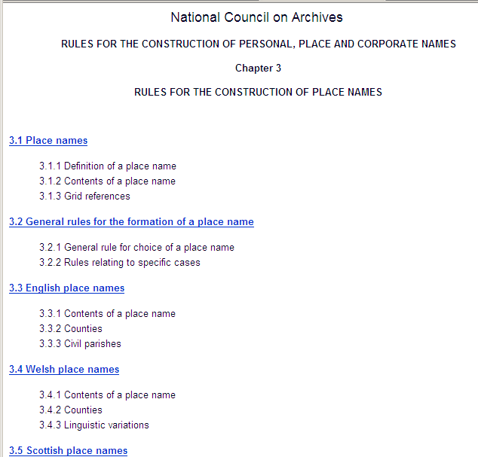
NCA Rules

Slide 9
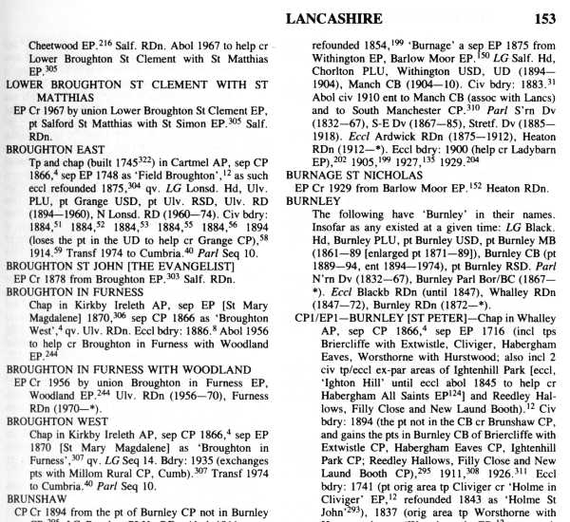
Key Source: F. Youngs’ Guide to the Local Administrative Units of England
Is this geographical information?
No maps, and no co-ordinates
Books like these let us populate very large ontologies quickly

Slide 10
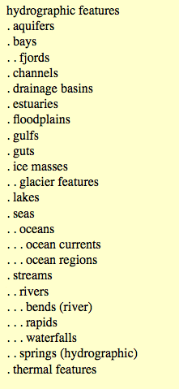
Defining Types
Landscape features have to be classified by the gazetteer builder or map maker
Hence ADL Gazetteer Feature Type Thesaurus

Slide 11
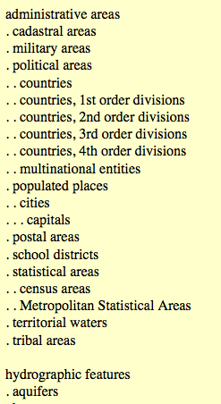
Defining AU Typologies
Should the same approach be taken for administrative units
This is what the ADL FTT says:
But Aus are completely defined in law
Our job is not to classify but to record what AUs actually are

Slide 12
Where? – The Administrative Unit Ontology
In the beginning was the unit …
Administrative areas, so corporate bodies with legally-defined boundaries, and dates of creation and abolition
  Districts and Unitary Authorities
  Hundreds and Wapentakes
  States of Europe since 1815
Basic unit record is minimal: ID number, type, dates of existence, and immediate and ultimate authorities
All units are assigned to a type, such as Ancient County or Sanitary District, and types are assigned to one of 13 geographical levels, e.g. County

Slide 13
Unit names and statuses
Every unit can have any number of names
Names have their own dates and authorities
Names have a status: preferred, alternate, official etc5
Name languages recorded via Ethnologue/Linguist codes
Units cannot change type, but can have multiple status values consecu-tively or concur-rently.
117 types, plus 93 status values associated with 20 of the types, so 190 kinds of unit – not 4!

Slide 14
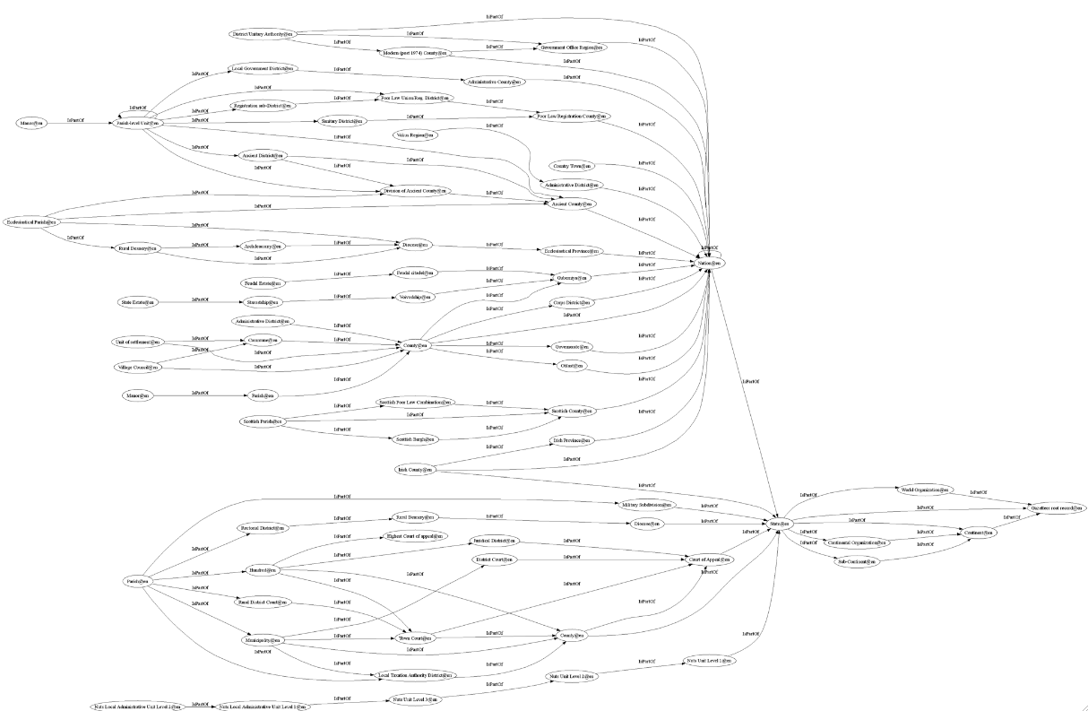
AUI Visualisation

Slide 15
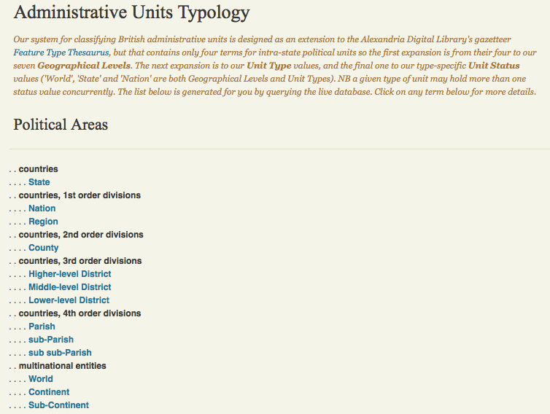
Typology Overview

Slide 16
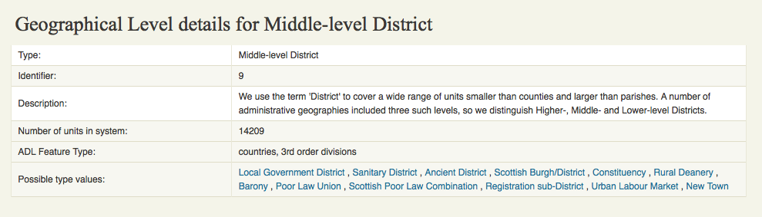
Geographical Level 9:

Slide 17
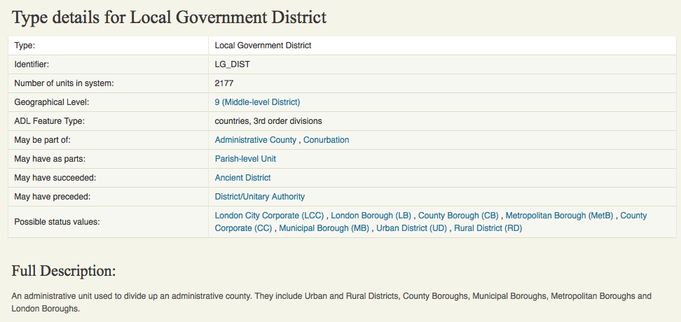
Type: Local Government District

Slide 18
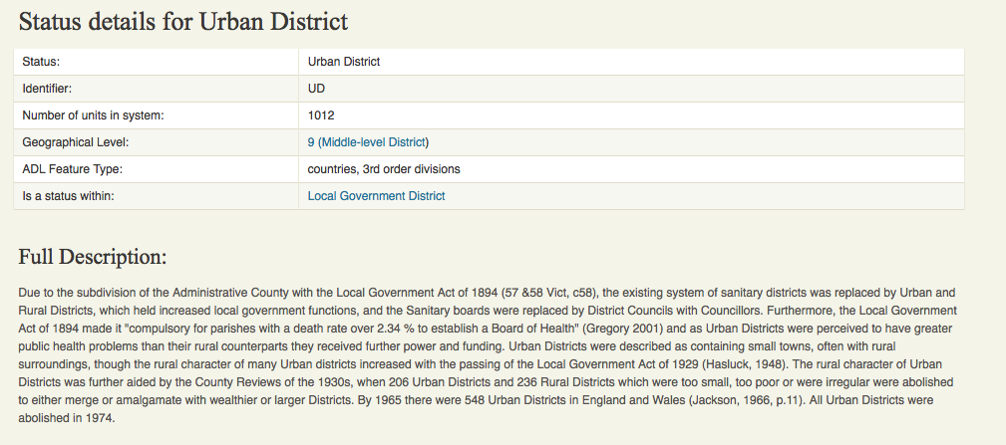
Status: Urban Districts

Slide 19
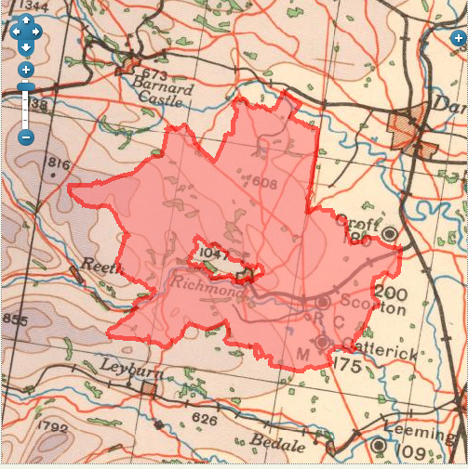
Status: Rural District Boundary

Slide 20
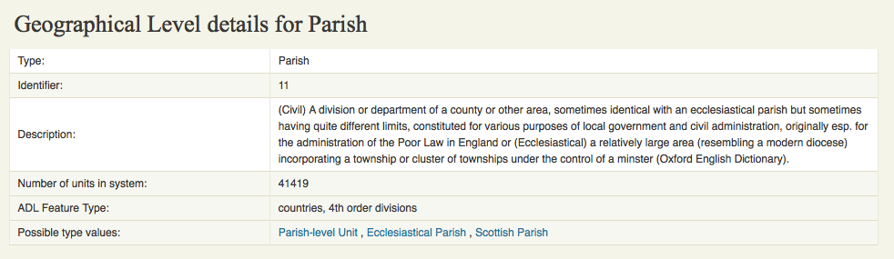
Geographical level 11

Slide 21
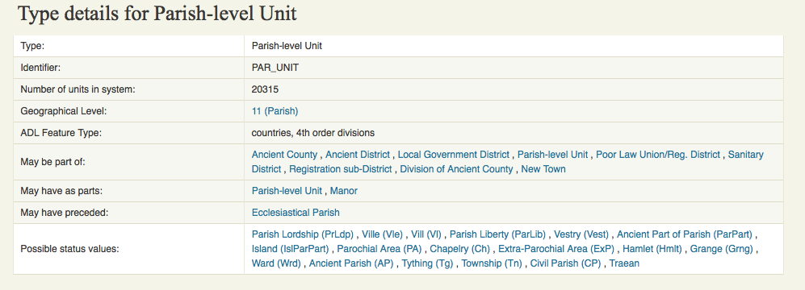
Type: Parish-level units

Slide 22
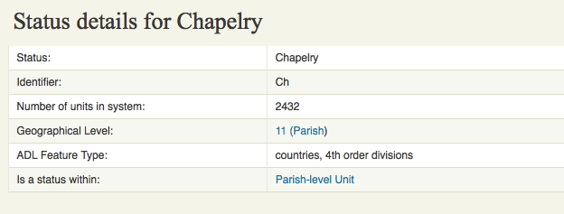
Status: Chapelry

Slide 23
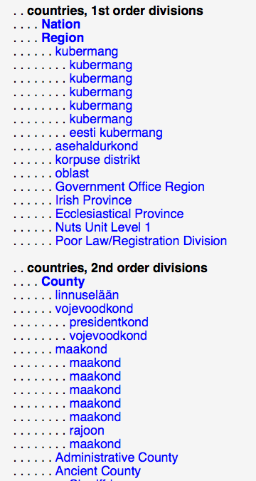
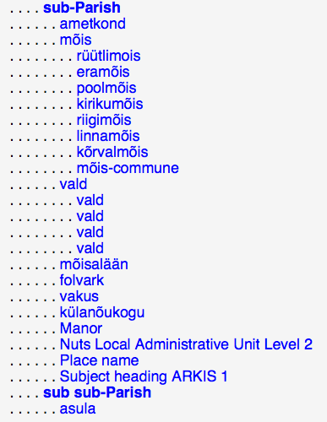
Estonian Typology

Slide 24
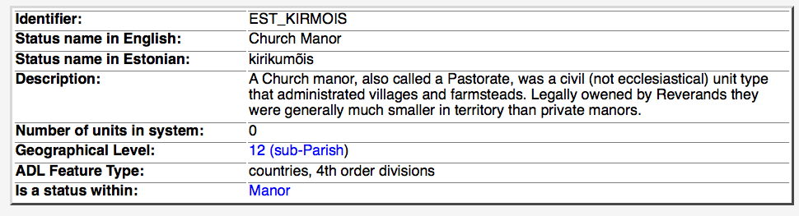
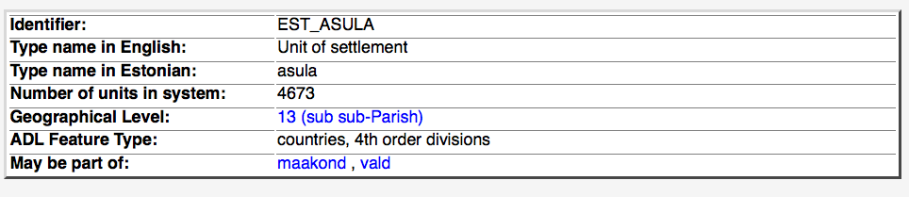
Estonian Units

Slide 25
Count of number of names per language
LANGUAGE | NUMBER OF NAMES
ENGLISH | 62603
SWEDISH | 7507
ESTONIAN | 11973
GERMAN | 5032
WELSH | 1069
FRENCH | 61
GREEK | 3
ITALIAN | 3
RUSSIAN | 2
TURKISH | 2
OTHER LANGUAGES WITH 1 NAME EACH | 26

Slide 26
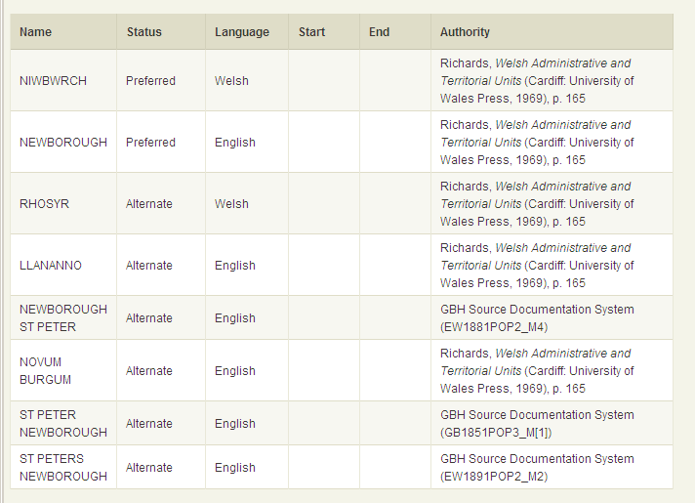
Example of unit with many names
Newborough, Anglesey parish

Slide 27
Unit relationships
IsPartOf
SucceededBy (‘see also’)
AdministeredBy
Boundary Changes
  ReducedToEnlarge
  ReducedToCreate
  AbolishedToEnlarge
  AbolishedToCreate
  BoundaryChange (other unit unknown)
All held in single table, allowing many-to-many relationships
Current system has 79,174 units but 250,029 relationships
Have dates,
authorities, etc

Slide 28
AUO – E-R Diagram

Slide 29
AUO – E-R Diagram
This structure now holds:
  79,174 admin units5
  250,029 relationships between them
  82,864 boundary polygons (for 40,006 units)
  18,230 “places” (groupings of AUs)
  38,524 descriptions from C19 gazetteers linked to “places” (plus another 57,569 un-linked entries)
  150,529 geographical names, for units and places

Slide 30
Carisbrooke, Isle of Wight

Slide 31
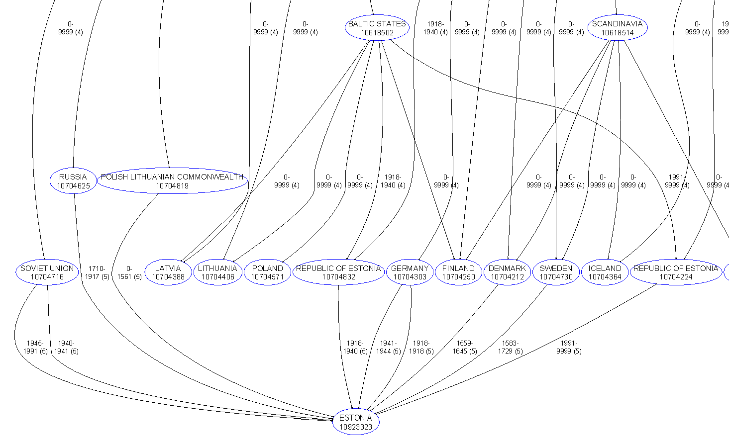
Estonia

Slide 32
European international boundary changes since 1815, by decade

Slide 33
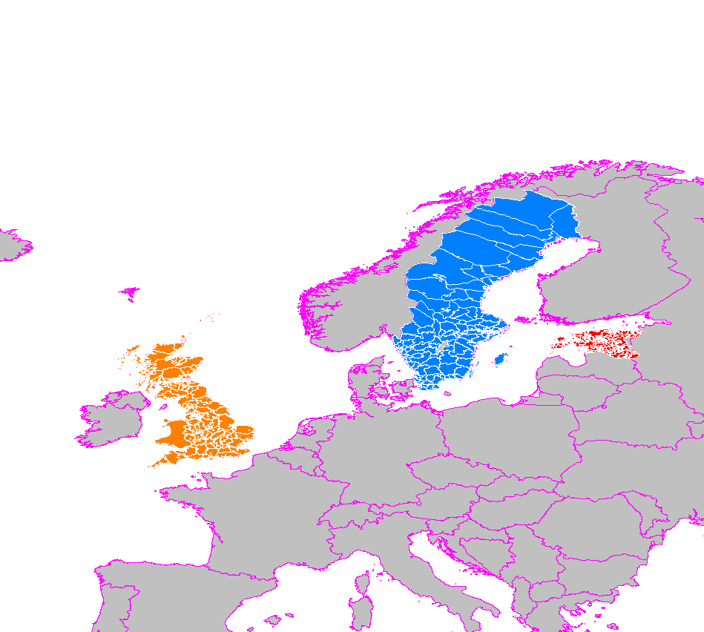
Boundary Mapping: Britain, Estonia, Sweden
Example shows boundaries down only to county-level
Current system goes
down to or below
parishes for all
3 countries
Largest multi-
national
historical GIS?
  NB few other
  candidates

Slide 34
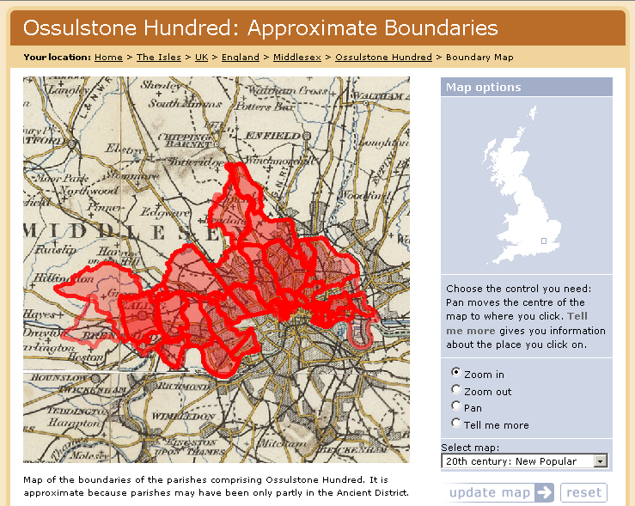
Mapping a unit lacking boundaries

Slide 35
Web sites, etc
Vision of Britain:
  www.VisionOfBritain.org.uk
Data Documentation System:
  www.VisionOfBritain.org.uk/data
Great Britain Historical GIS:
  www.gbhgis.org
  www.port.ac.uk/research/gbhgis
Mailing lists:
  www.jiscmail.ac.uk/lists/gbhgis
  www.jiscmail.ac.uk/lists/history-gis

