Slide 1
Towards standards in capturing the changing characteristics of a place for disparate interests Presentation to AAG, 14 April 2011
Raj Singh, PhD
Director, Interoperability Programs

Slide 2
agenda
a little bit about OGC
overview of OGC’s current gazetteer spec (WFS-G)
moving towards a web-centric view of place information
the global gazetteer

Slide 3
Address Critical Interoperability Issues
OGC Standards and Programs are Addressing Common Concerns:
“We can‘t share location data on the Web.”
“We can‘t deliver data to different systems.”
“We don‘t have a common language to exchange our geospatial data and services.”

Slide 4
What is the OGC?
Open Geospatial Consortium, Inc. (OGC)
Not-for-profit, international voluntary consensus standards organization
Founded in 1994, Incorporated in US, UK, Australia
415 industry, government, research and university members
OGC Mission
To lead in the development, promotion and harmonization of open geospatial standards …

Slide 5
OGC Standards (30+)
Data Services
Sensor Observation Service
Web Coverage Service
Web Feature Service
Web Map Service ..
Catalogue Services
Catalogue Service
Processing Services
Coordinate Transformation Service
Web Processing Service
Portrayal Services …
Encodings
GML
SLD
SensorML
CityGML
WMC
O&M
Filter Encoding
KML
Symbology Encoding
GML in JPEG 2000
NetCDF

Slide 6
OGC’s Interoperability Approach
Interoperability Program (IP) - a global, innovative, hands-on prototyping and testing program designed to accelerate interface development and validation, and bring interoperability to the market
Rapid Interface
Development
Specification Development Program – Consensus processes similar to other Industry consortia (World Wide Web Consortium, OMA, OMG, etc.).
Standards
Setting
Outreach and Community Adoption Program – education and training, encourage take up of OGC specifications, business development, communications, etc.
Market
Adoption
Notes:
As a response, the OpenGIS® concept and dream began due to:
1. The user’s need to integrate geographic information contained in heterogeneous data stores whose incompatible formats and data structures have prevented interoperability. This incompatibility has limited use of the technology in enterprise and Internet computing environments, and the time, cost, and expertise required for data conversion have slowed adoption of geoprocessing across all market segments.
2. The larger community’s need for improved access to public and private geodata sources, with preservation of the data’s semantics.
3. Agency and vendor needs to develop standardized approaches for specification of geoprocessing requirements for information system procurements.
4. The industry’s need to incorporate geodata and geoprocessing resources into national and enterprise information infrastructures, in order that these resources may be found and used as easily as any other network-resident data and processing resources.
5. Users’ need to preserve the value of their legacy geoprocessing systems and legacy geodata while incorporating new geoprocessing capabilities and geodata sources.

Slide 7
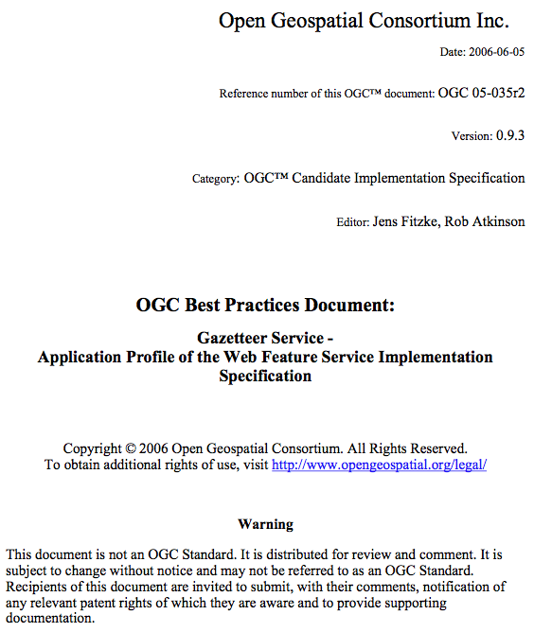
the specification…

Slide 8
the specification…
There is growing interest in the development of a common feature-based model for access to named features, often referred to as a gazetteer. Two major activities form the basis of this specification, an OGC Discussion paper on gazetteers, and an ISO draft standard for geographic identifiers.
As a result of the OGC Geospatial Fusion Services Testbed Phase I and the Web Mapping Testbed Phase II, an Open GIS Gazetteer Interface was defined and published as an OGC Discussion Paper [OGC 2001].
The standardization process in the ISO TC 211 led to a separate mature draft standard defining "Spatial referencing by geographic identifiers" [ISO19112] that defines an abstract model to be implemented by a gazetteer service.
The outcomes of these activities have been taken into account and a consolidated Gazetteer Service implementation specification has been developed and published as a discussion paper [OGC 02-076r3]. As the underlying specifications have been further developed the present document makes the necessary adjustments.

Slide 9
the specification…
The Gazetteer Service is a specialized Application Profile (hereafter referred to as “profile”) of a Web Feature Service that specifies a minimum set of Feature Types and operations required to support an instance of a gazetteer service. Instances within a collection of gazetteer features may be – as the terms in a thesaurus – related to each other and constitute a hierarchical vocabulary of geographic places. The overall information model is here implemented as a GML application schema that defines a general feature type to be served by a Gazetteer Service.
By using the capabilities of a Web Feature Server, the Gazetteer Service as proposed here exposes the following interfaces to query location instances in a gazetteer database:
Get or Query features based on thesaurus-specific properties (broader term (BT), narrower term (NT), related term (RT)
Retrieve properties of the gazetteer database, such as the location type class definitions and the spatial reference system definitions
Notes:
thesaurus-specific properties means that the required navigational properties of a gazetteer are left unstandardized

Slide 10
gazetteer specification’s data model

Slide 11
XML text example of NGA GNS

Slide 12
XML graphic example of NGA GNS

Slide 13
WFS Gazetteer bottom line
works well and easy to implement if…
you want to use WFS
your places are “features” -- mapping emphasis
you can do data modeling in GML
your information schema is structured and fixed

Slide 14
does WFS-G promote OGC’s goals?
OGC’s mission: make location information and its use pervasive throughout society
are we achieving this goal?

Slide 15
pervasiveness before apps
favor geospatial information creation, sharing, and collaboration over application use cases
tension between structured information (which promotes interesting queries, i.e. application development) and unstructured information (which promotes easy publishing and annotation)
how do we get the best of both worlds?
Notes:
we talked about VGI and the many different forms “volunteers” could take, from history buffs, local historical societies, museums, and even other research institutions
how can we consider any strategy that doesn’t allow participation from at least most of these audiences?
[show bullet 1]
so therefore pervasive information has priority over what types of structure, performance, or queries required by a particular app
[show bullet 2]
but this creates a tension, because of course we still need to build apps unless all we get is a crappy version of Google
[show bullet 3]
so the question for me is, how does the standards world facilitate all these goals

Slide 16
traditional views of gazetteer design
id-x
id-x
id-x
id-x
name
placetype
startdate
enddate
location
name
placetype
startdate
enddate
location
id-x
id-x
name
placetype
startdate
enddate
location
name
placetype
startdate
enddate
location
id-x
id-x
name
placetype
startdate
enddate
location
name
placetype
startdate
enddate
location
name
placetype
startdate
enddate
location
name
placetype
startdate
enddate
location
Notes:
I want to support queries like, “give me all pubs in London from 1600 to 1650”
[click]
first of all, we think of structuring a database with place type (pub), date and location
even before we talk about those attributes however, we’ve already lost the battle, because we’re thinking of a database and structured queries right off – whose database? who owns it? Will an Iranian university contribute to a US database? Or to take touchy international issues out of the equation, will MIT contribute to a Harvard database? Why should they have to?
[click]
so step 2 is to say, well let’s get everyone to implement the same data model in their own database, then do distributed query through a single search interface
this is largely the model suggested by OGC’s “catalog service for the web” (CSW) standard
this is better, but you’re still making everyone use a single data model, which discourages participation and innovation
I’ve been in A LOT of data model discussions, and getting everyone to agree on one is impossible, and not that productive (much of what the W3C POI discussion has been about so far)

Slide 17
the dream of a global gazetteer
not one database but different degrees of interoperability between gazetteers in the face of differing ontologies, languages, etc. – Peter Bol
At one point we thought they would all be in WFSes, now there’s a focus on linked data (an anarchic approach) – Humphrey Southall
give us raw data now! – Tim Berners-Lee

Slide 18
conceptual foundations of the solution
think of POIs as a loosely coupled network of information, not a database
optimize for publication (sharing) first
collaboration second
applications third
traditional benefits of a database can be added later (as apps): transactional data consistency, query optimization, QA/QC, mapping/visualization
note: this is all from a standards perspective
Notes:
so let’s take a step back and talk about an information architecture as a decentralized, layered federation of place name data

Slide 19
standards tenets
throw all place information onto the web
standards: use WFS-G (sometimes)
standards: shared data models and formats
standards: at this point, the only query mechanism is HTTP GET
link related places with URLs
standards: small vocab of types of links, e.g. identity, sort of identity, within, next to, related
standards: still only querying with URLs
layer higher level gazetteers on top
standards: shared data models

Slide 20
a walkthrough
even more structured search
more apps
more structured search
more apps
unstructured search
id-x
id-x
id-x
id-x
id-x
id-x
id-x
id-x
id-x
name
placetype
startdate
enddate
location
name
placetype
startdate
enddate
location
name
placetype
startdate
enddate
location
name
placetype
startdate
enddate
location
id-x
id-x
id-x
id-x
id-x
name
placetype
startdate
enddate
location
name
placetype
startdate
enddate
location
name
placetype
startdate
enddate
location
name
placetype
startdate
enddate
location
name
placetype
startdate
enddate
location
id-x
linked data
semantic query
name
placetype
startdate
enddate
location
name
placetype
startdate
enddate
location
name
placetype
startdate
enddate
location
id-x
name
placetype
startdate
enddate
location
name
placetype
startdate
enddate
location
name
placetype
startdate
enddate
location
name
placetype
startdate
enddate
location
WFS-G
text editors!
microformats
Python, Oracle,
ArcGIS
Fusion Tables
structured search
apps

Slide 21
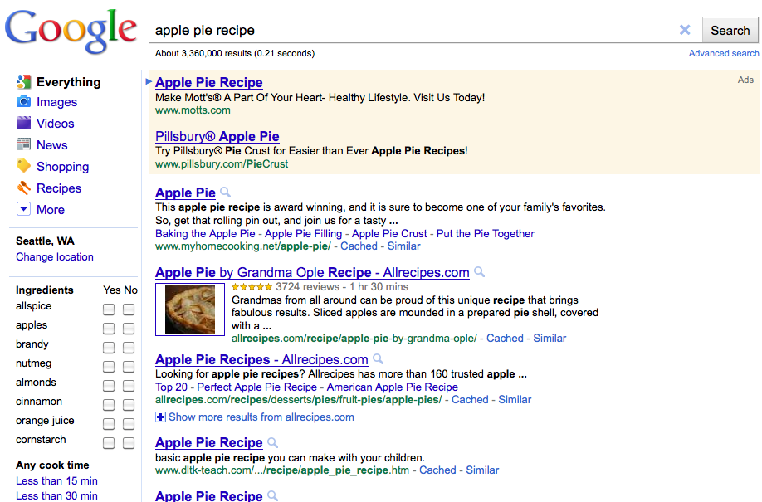
it’s already happening…

Slide 22
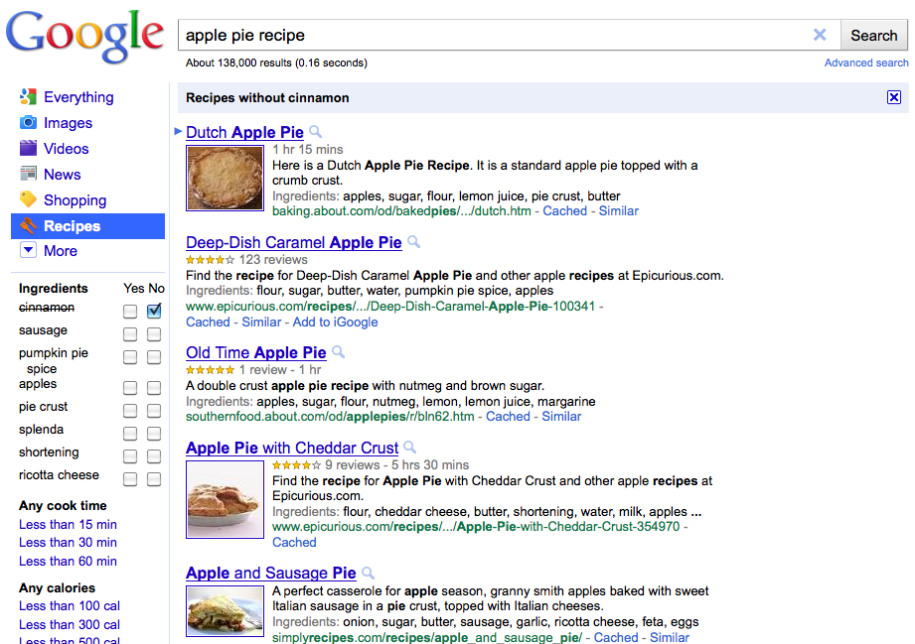
it’s already happening…

Slide 23
what kind of info do we put in gazetteers
what makes a place a place
what are the use cases? infinite
characteristics of a place
experiential places
relationships with other places
etymology
agency
why not make it encyclopedic?

Slide 24
your users will be your best editors
Prof. Songdi: wiser to think of a place name dictionary than a gazetteer
Prof. Bol: we may have to rely on volunteer data (but we have not until now)
Gillies: work of other academic researchers is largely VGI

Slide 25
USGS world of official places for government use
Personal geography—Yi-Fu Tuan world of people creating an experiential description of their own world of places
and everything in between…
history as a means of organizing bike routes

