Slide 1
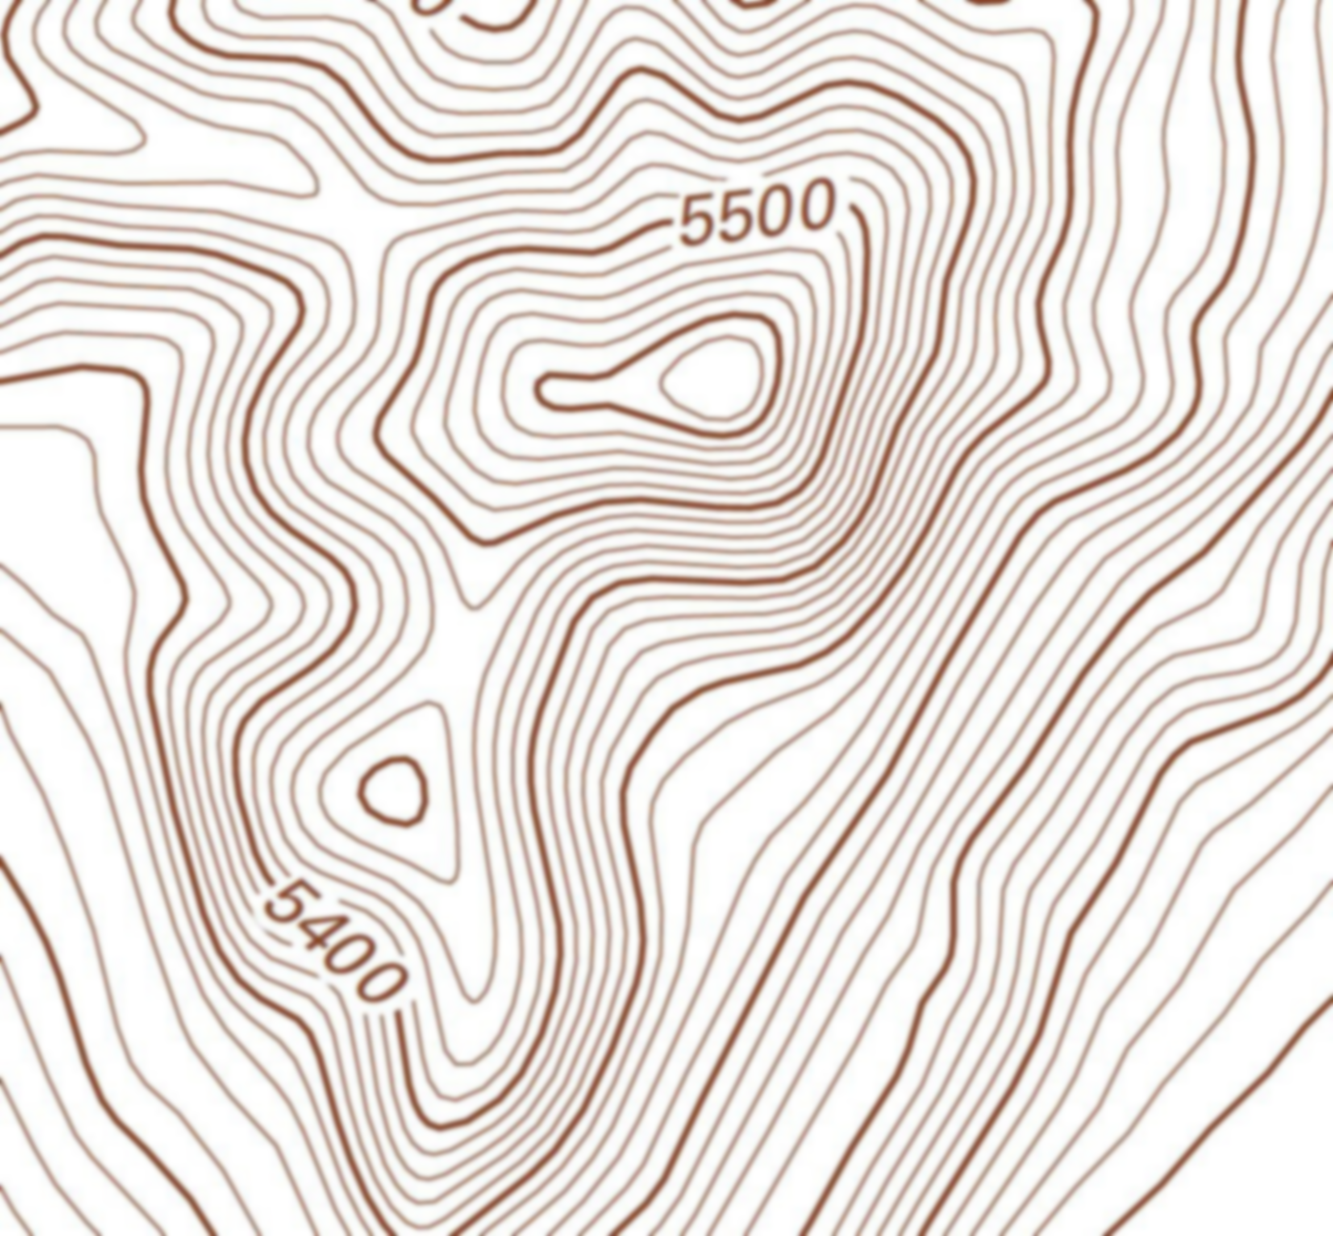
On the topology of topography
Keith C. Clarke
Department of Geography
UC Santa Barbara
kclarke@geog.ucsb.edu

Slide 2
Context

Slide 3
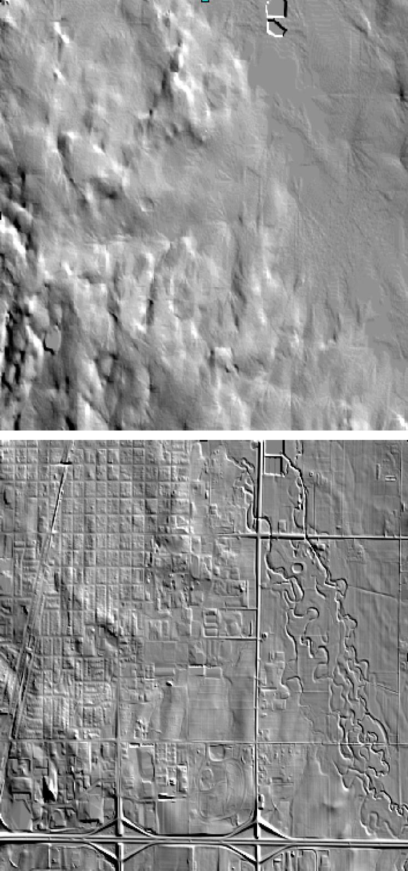
Context
Contours and slope lines
DEM, DTM, DSM, DFM, TIN, Point Cloud
Change in accuracy, resolution--physical to human
DEM algorithms: Surface network as features
Trends in recent research
Some unresolved issues
10m NED
1m LiDAR

Slide 4
Topology
“study of geometric properties and spatial relations unaffected by the continuous change of shape or size of figures”

Slide 5
The history

Slide 6
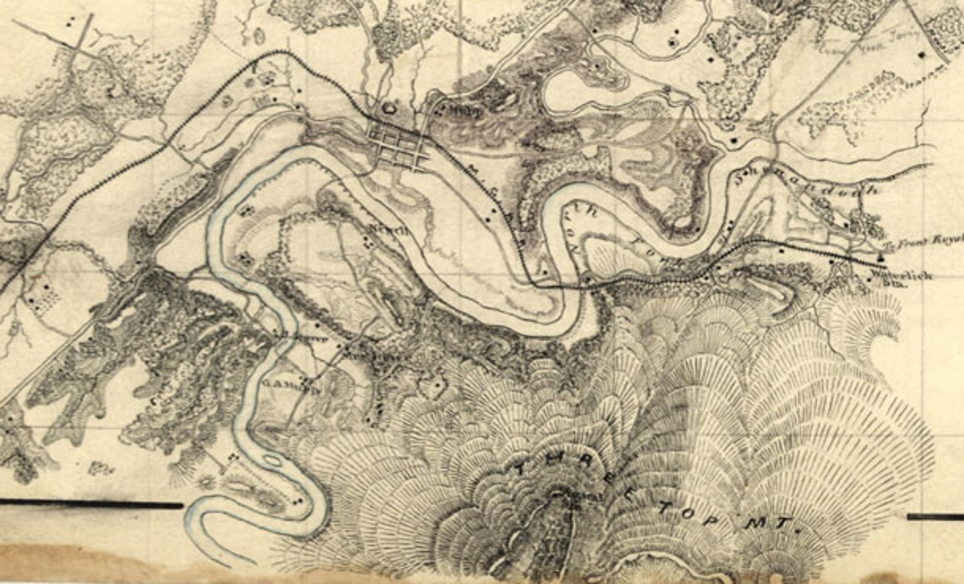
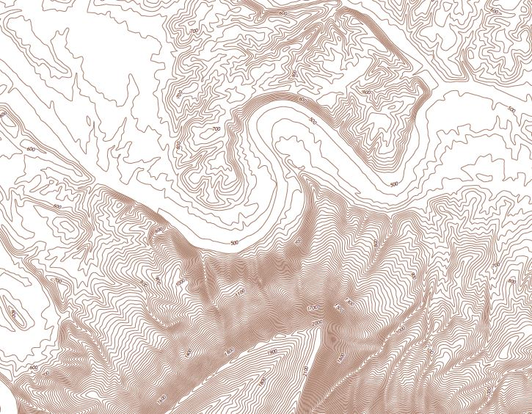
Topographic mapping in the 1850s
Slope lines
Contour lines

Slide 7
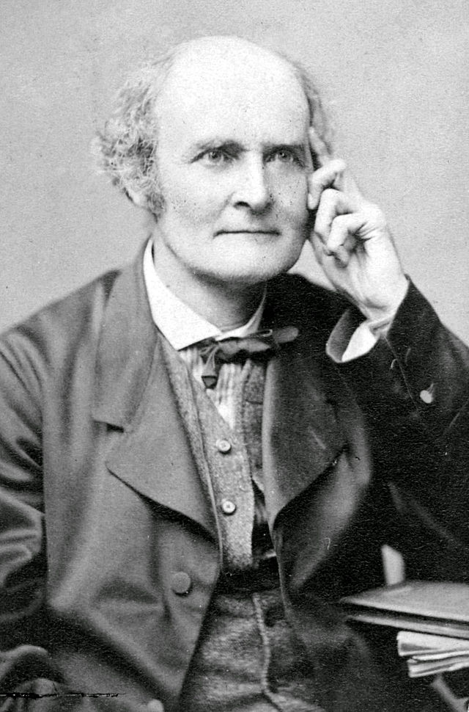
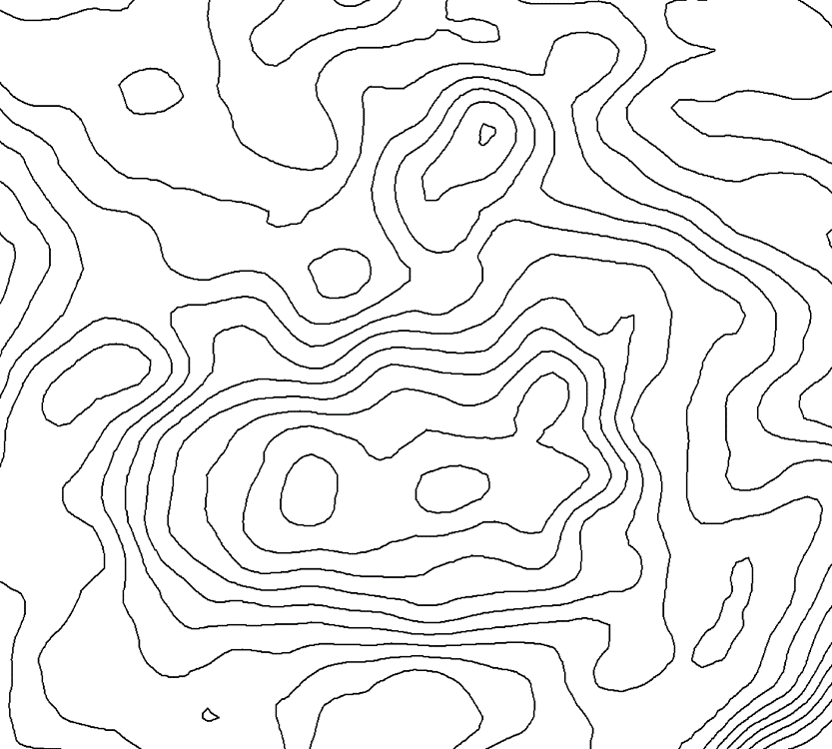
Arthur Crayley (1821-1895) Cambridge mathematician and “pure” math advocate
"Arthur Cayley" by http://www-groups.dcs.st-and.ac.uk/~history/PictDisplay/Cayley.html.
Licensed under Public Domain via Wikimedia Commons –
http://commons.wikimedia.org/wiki/File:Arthur_Cayley.jpg#/media/File:Arthur_Cayley.jpg

Slide 8
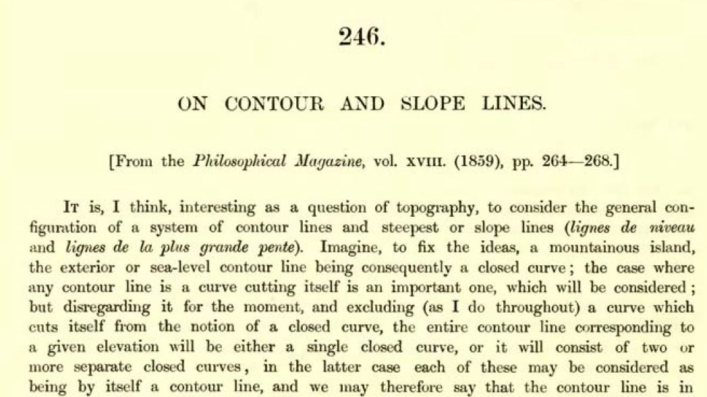
Cayley A. (1859) On Contour Lines and Slope Lines. London, Edinburgh, and Dublin Philosophical Magazine and Journal of Science, 18, 264-268.

Slide 9
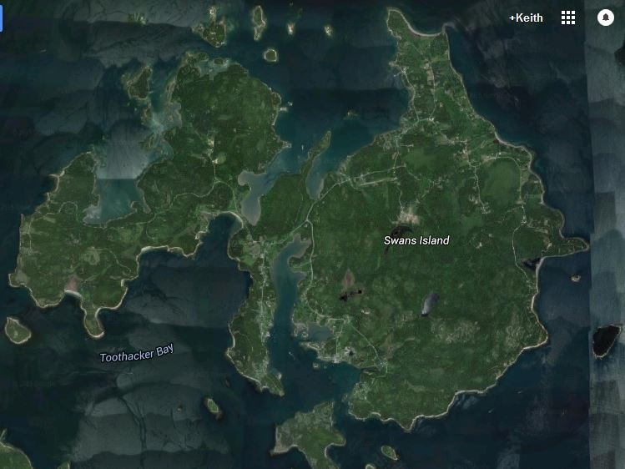
Swan’s Island Maine

Slide 10
Flooding the island

Slide 11
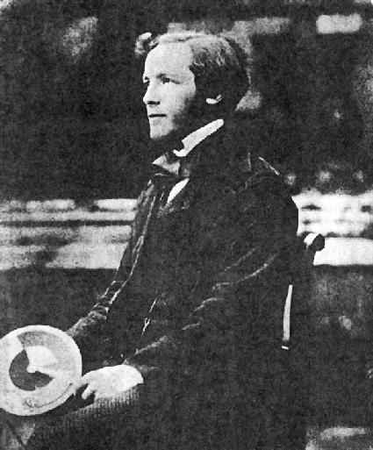
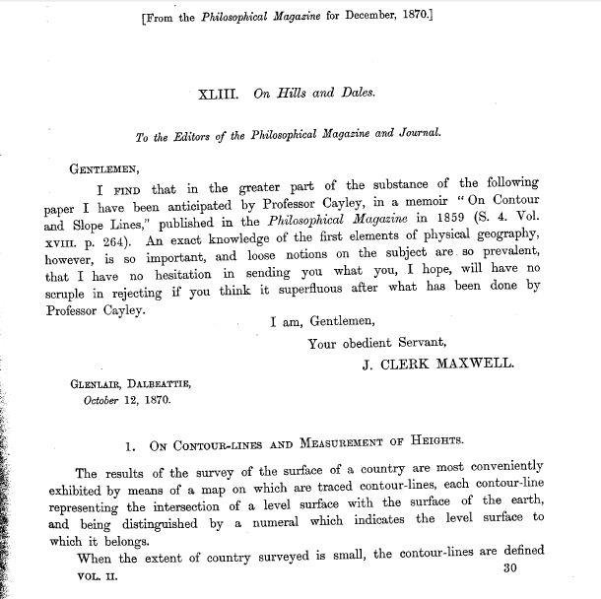
James Clerk Maxwell (1831–1879) Scottish physicist On hills and dales (1870)

Slide 12
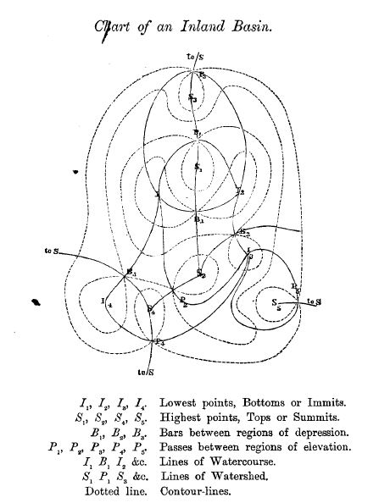
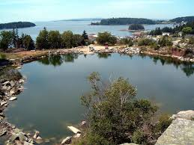
A figure! Adds regions: watersheds, hills, dales

Slide 13
Surface network theory
Points are peaks, pits, saddles
Lines are ridges, streams
Areas are watersheds, slopes, districts
Also often included are break of slope lines (plan curvature, slope curvature etc.)
Numerical relations given by Maxwell
Assumption of homomorphic surface
Saddles are key—upward to a peak, down to a pit
Reviews and syntheses by Rana and Morley (2002) and Rana (2004).

Slide 14
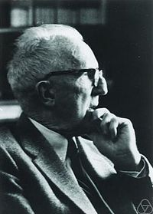
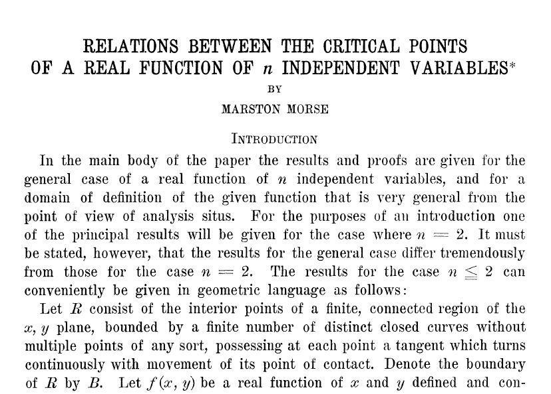
Marston Morse (1925) Extrema elliptics and saddles hyperbolic functions Nine theorems

Slide 15
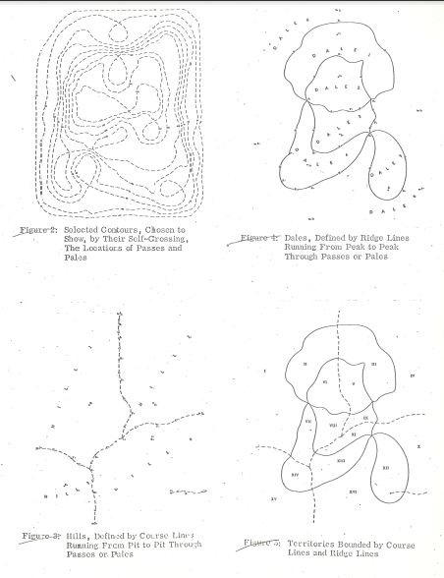
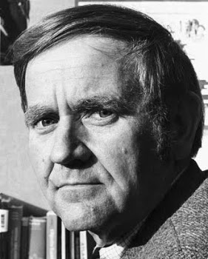
A return to cartography William Warntz (1967)

Slide 16
Warntz’s contributions
Reviewed and summarized prior work
Returned to topographic surface
Added to set of regions, intersected surface network, hills and dales
Added vergency: convergent, divergent
Extended to all fields, especially potential surfaces from demography and economic geography
Provided first links to computer cartography and GIS
Warntz network later formalized as surface network by Pfaltz in 1974

Slide 17
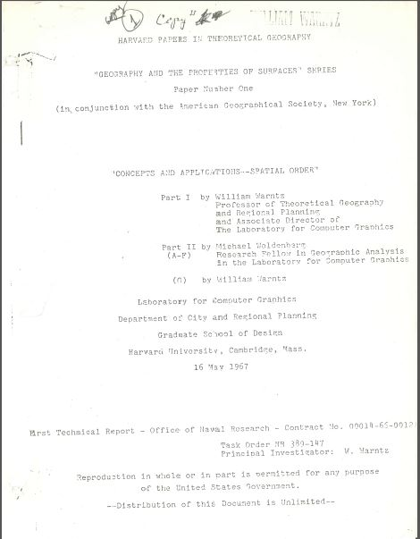
Harvard Papers in Theoretical Geography
Paper One: Geography and the Properties of
Surfaces Series
Report on an ONR contract
William Warntz’s personal copy
Courtesy of Don Janelle

Slide 18
Enter the computer

Slide 19
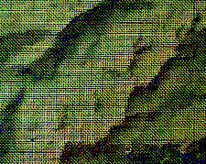
Digital terrain mapping
Source: Geoff Dutton, Spatial Effects

Slide 20
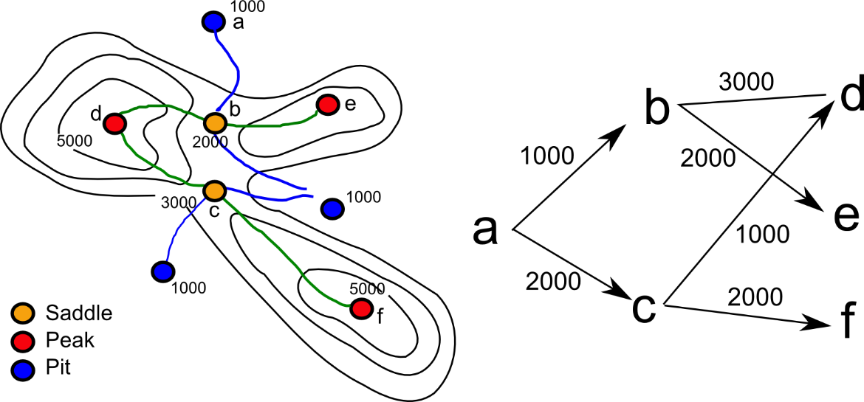
Stephen Morse (1969): Contour maps as Freeman codes Saddles as branch points

Slide 21
Pfaltz (1976) About surface networks
“They are of practical use as one means of condensed surface description; particularly since they may be used as a directory in conjunction with a computer representation, and also they support an automatic abstraction process.”
SN is a data structure
SN is an abstract representation
But…how to extract them?

Slide 22
Emergence of methods and the link to GIS
Peucker and Douglas (1975)—Critical point detection
Fowler and Little (1979)—Point labeling methods
Haralick (1983)—Zero crossings counts
O’Callaghan and Mark (1984), Jenson and Domingue (1988), Band (1984; 1988), (Moore et al. 1991)—Focus on issues of stream network extraction
TAPES-G (Gallant and Wilson 1996) and Landserf (Wood 2009)--Incorporation into broader software packages
Standardization of algorithms around surface flow

Slide 23
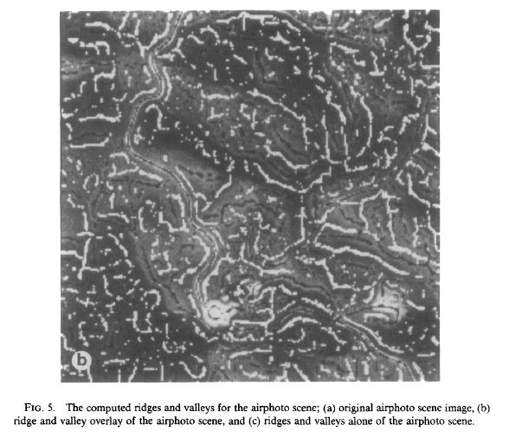
Haralick (1983) image processing

Slide 24
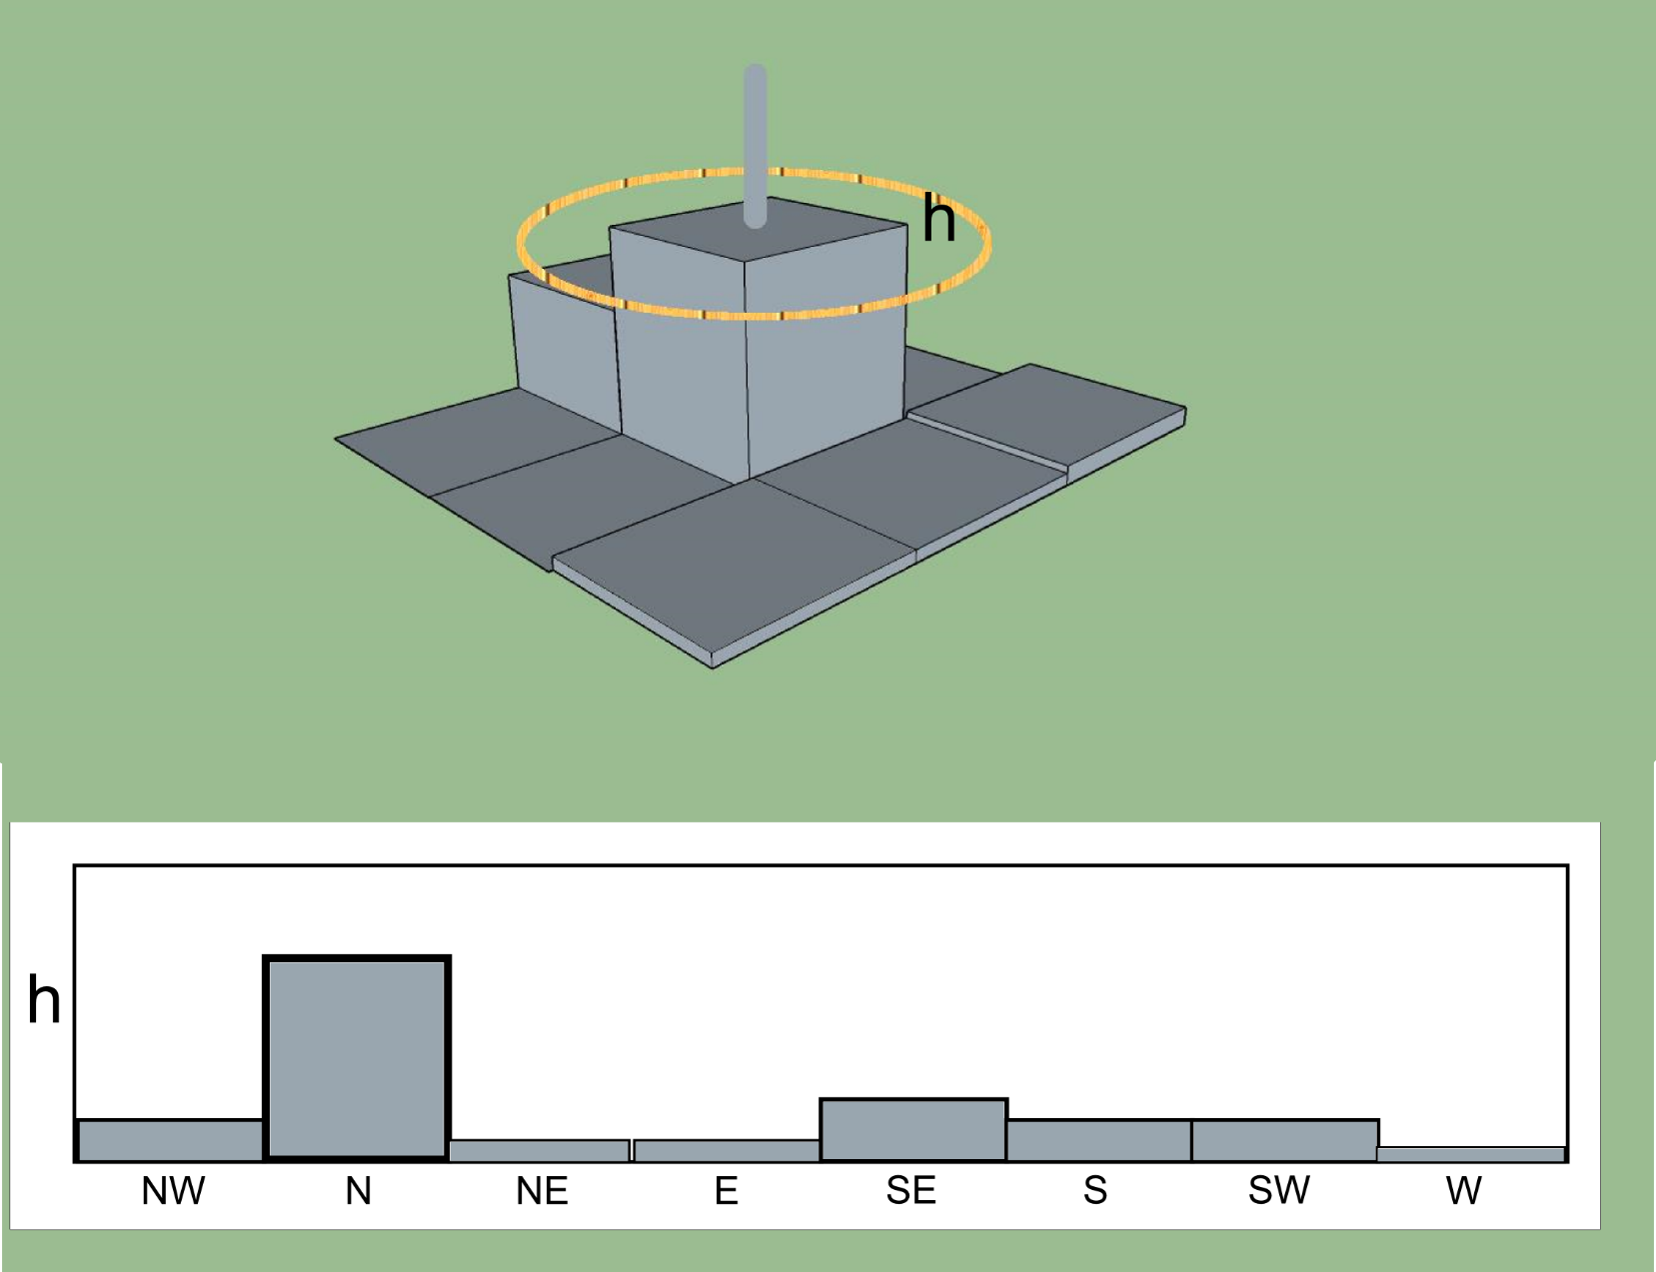
Zero crossings

Slide 25
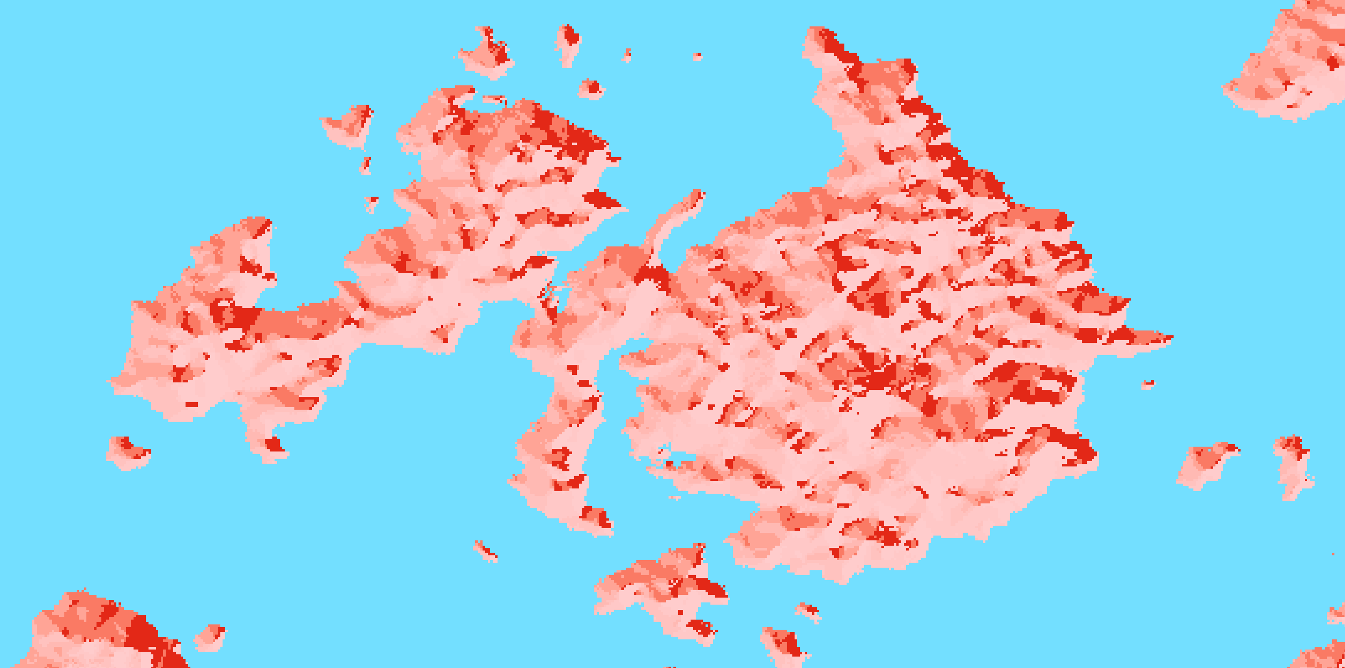
Flow accumulation methods
Start with raw DEM
Fill pits to overflow points
Calculate flow direction
D4 Von Neumann
D8 Moore
Variants
Calculate downslope flow accumulation
Threshold
Thin, prune and connect

Slide 26
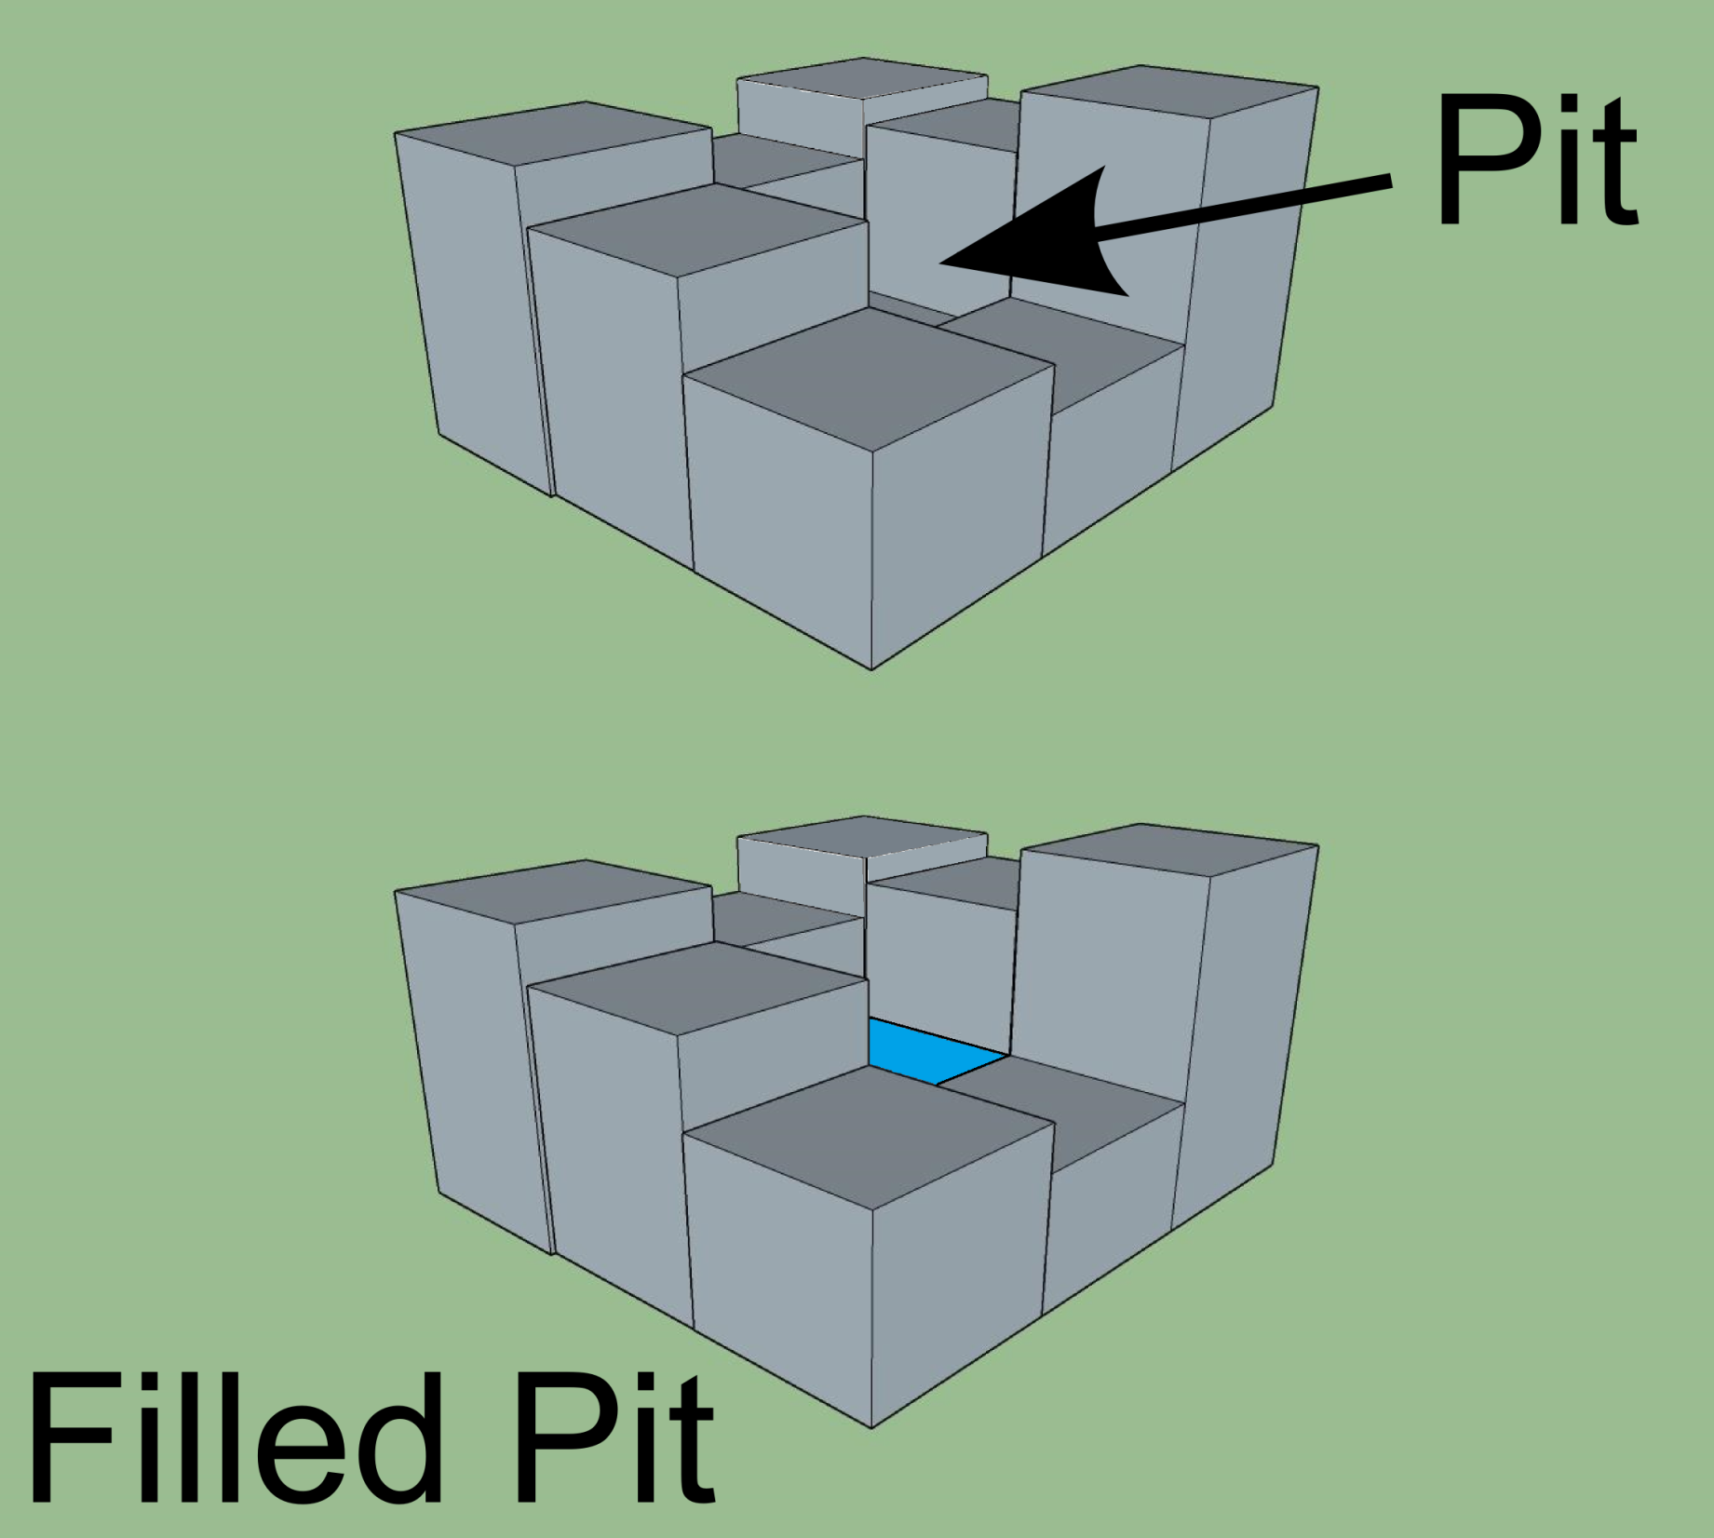
Filling pits

Slide 27
Issues
Neighborhood
Edges
Pit filling
Flat zones
Discontinuity
Ends of features vs. surface network
Scale/Resolution/Granularity

Slide 28
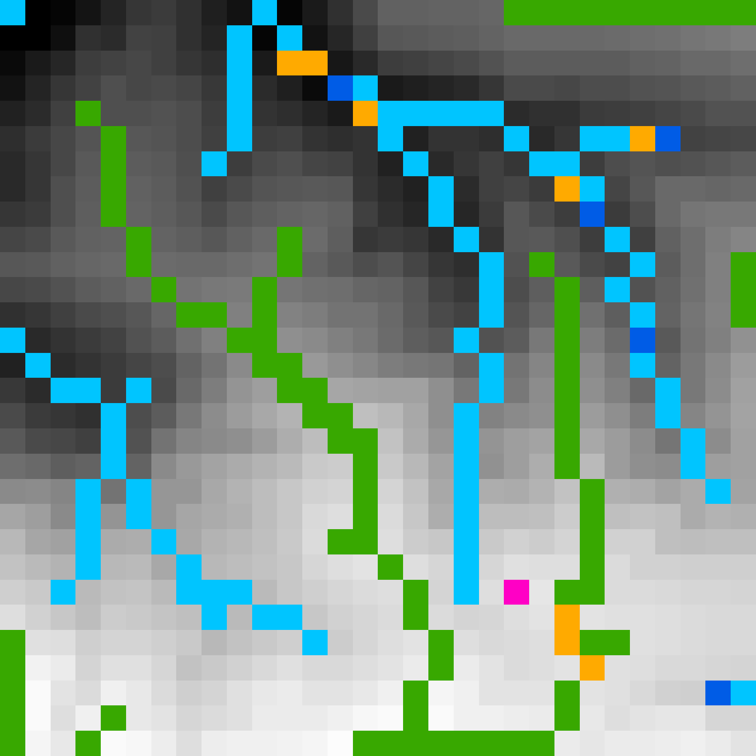
Example: Santa Cruz Island, CA at 30m NED
Peak Purple
Pit Dk Blue
Saddle Orange
Ridge Green
Stream Lt Blue

Slide 29
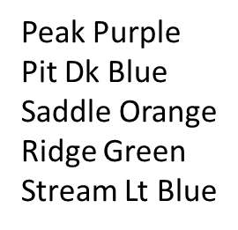
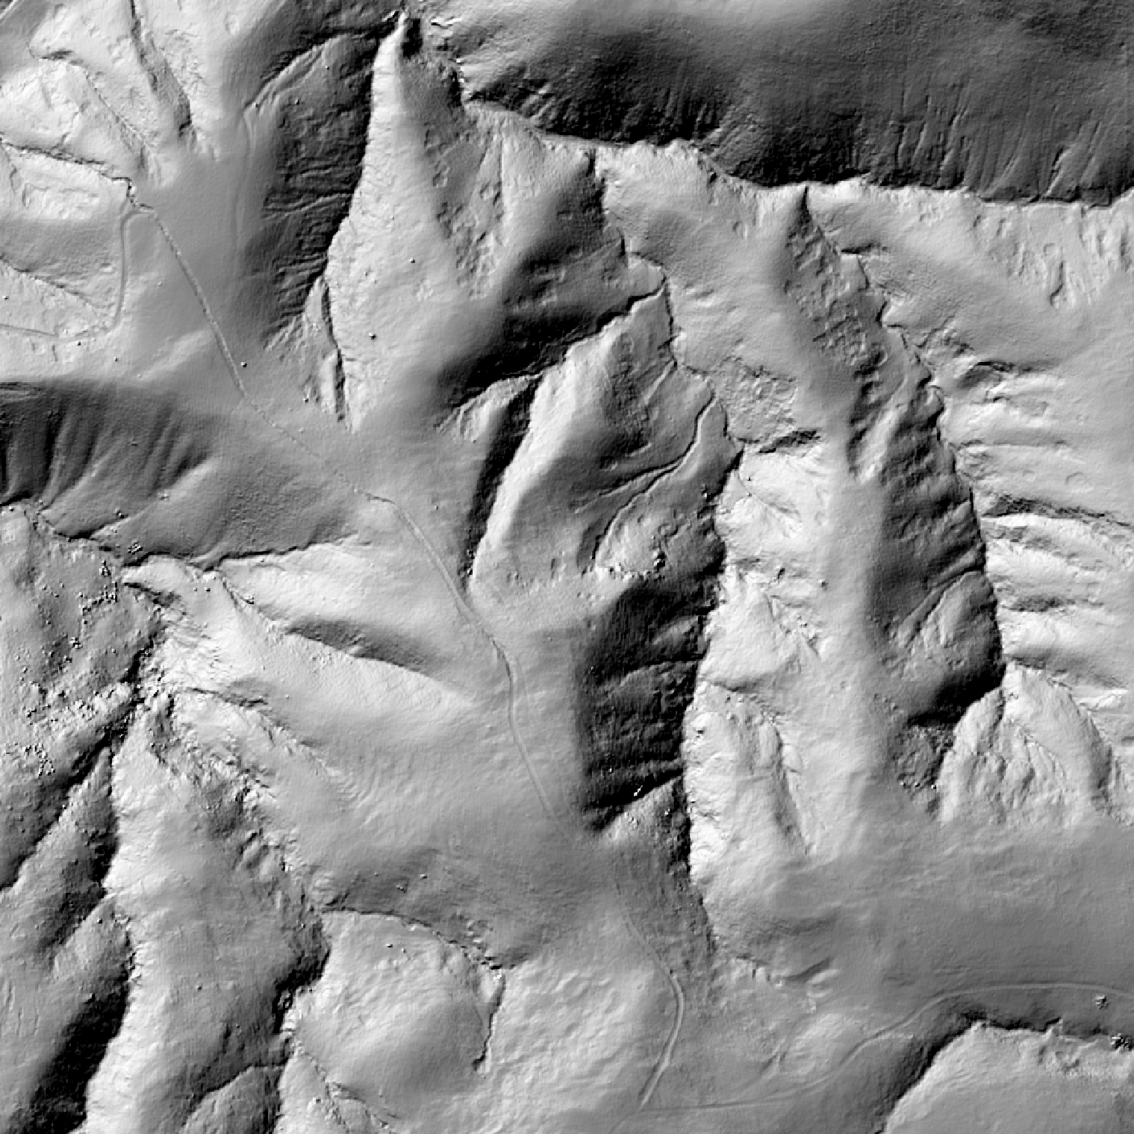
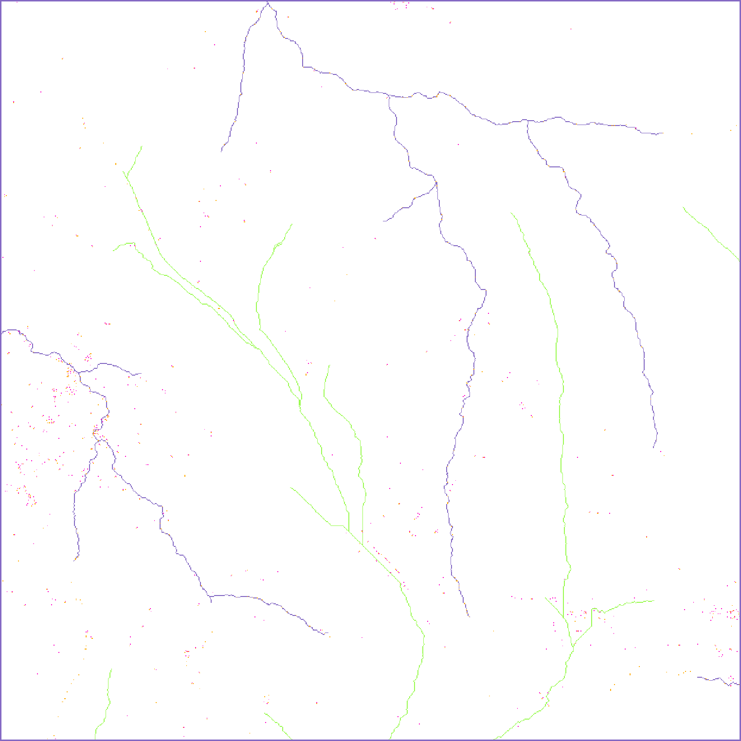
Example: Santa Cruz Island, CA at 30m NED

Slide 30
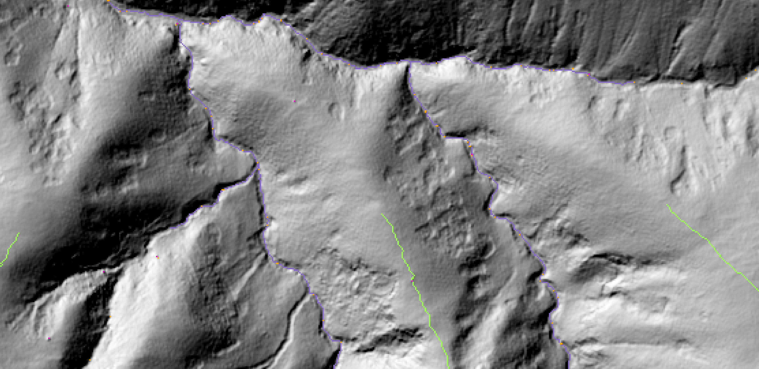
Detail at 1m

Slide 31
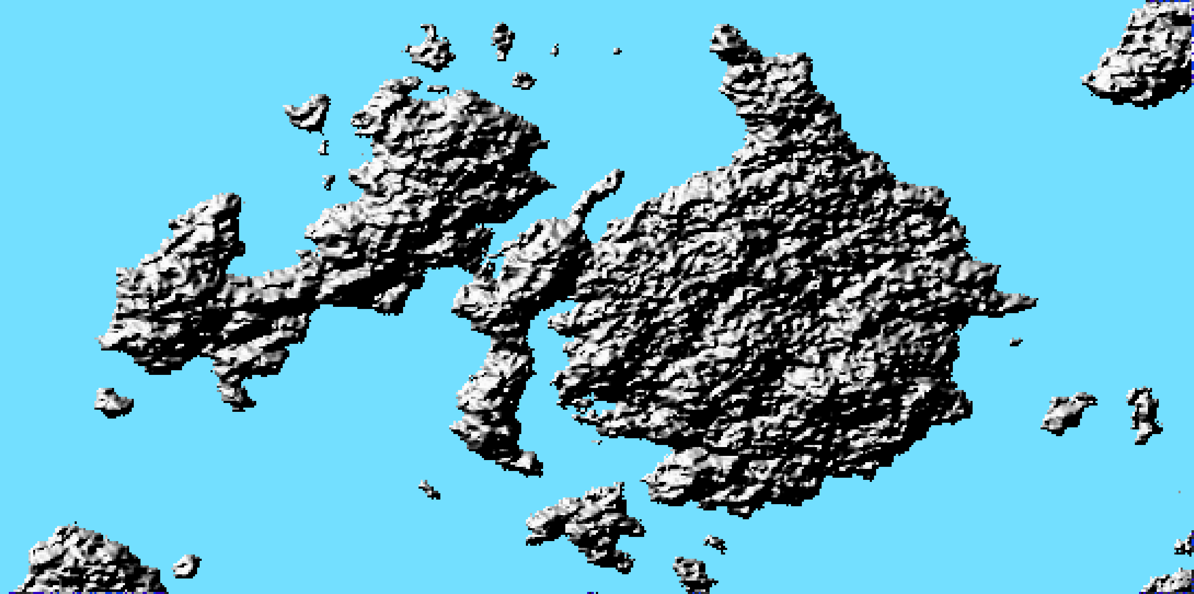
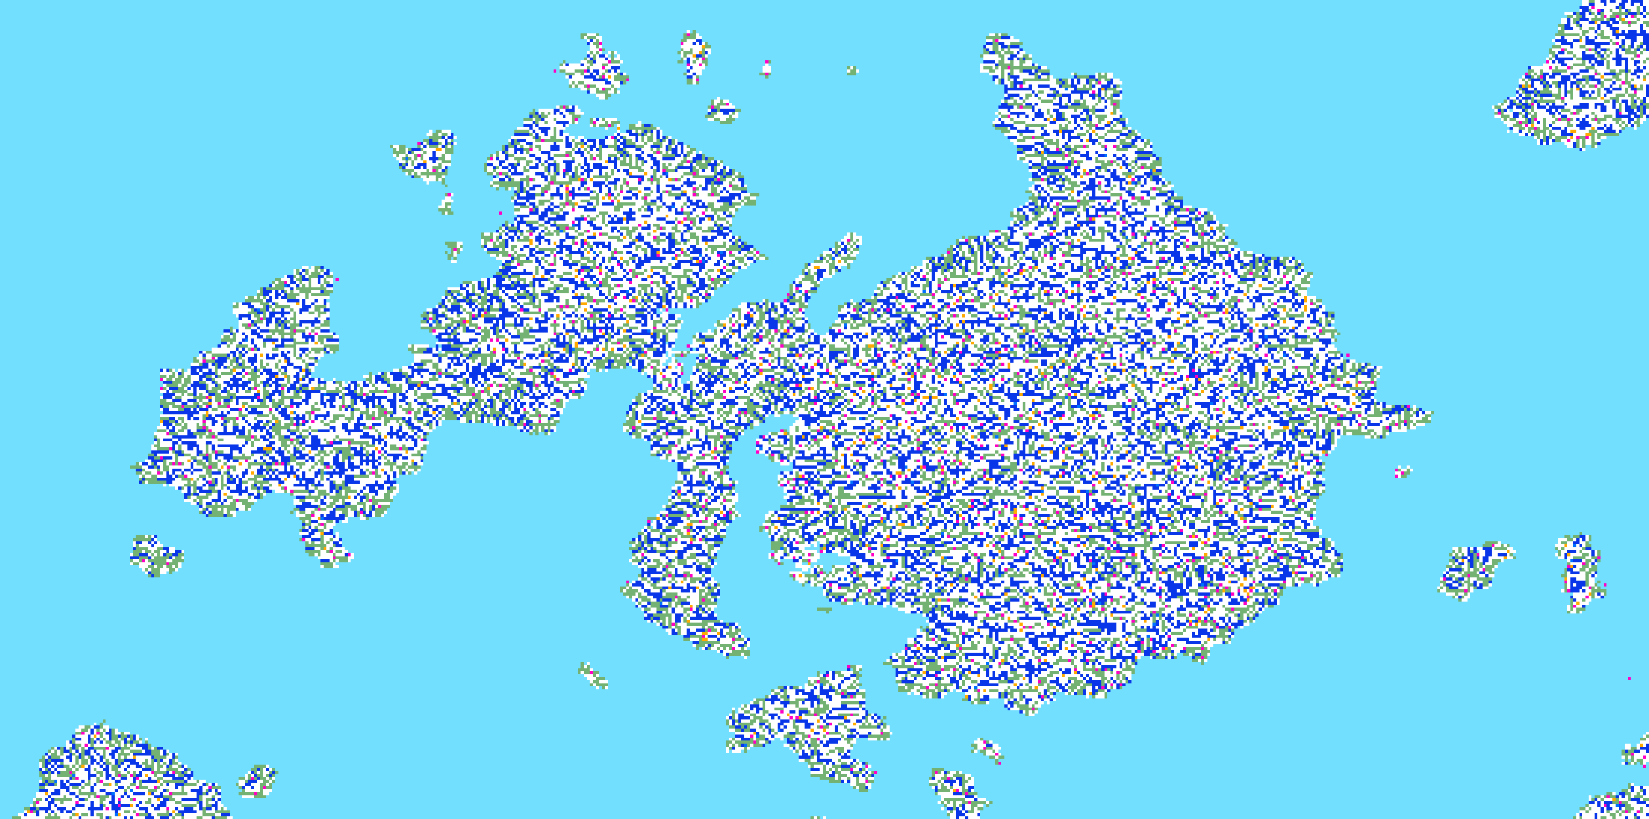
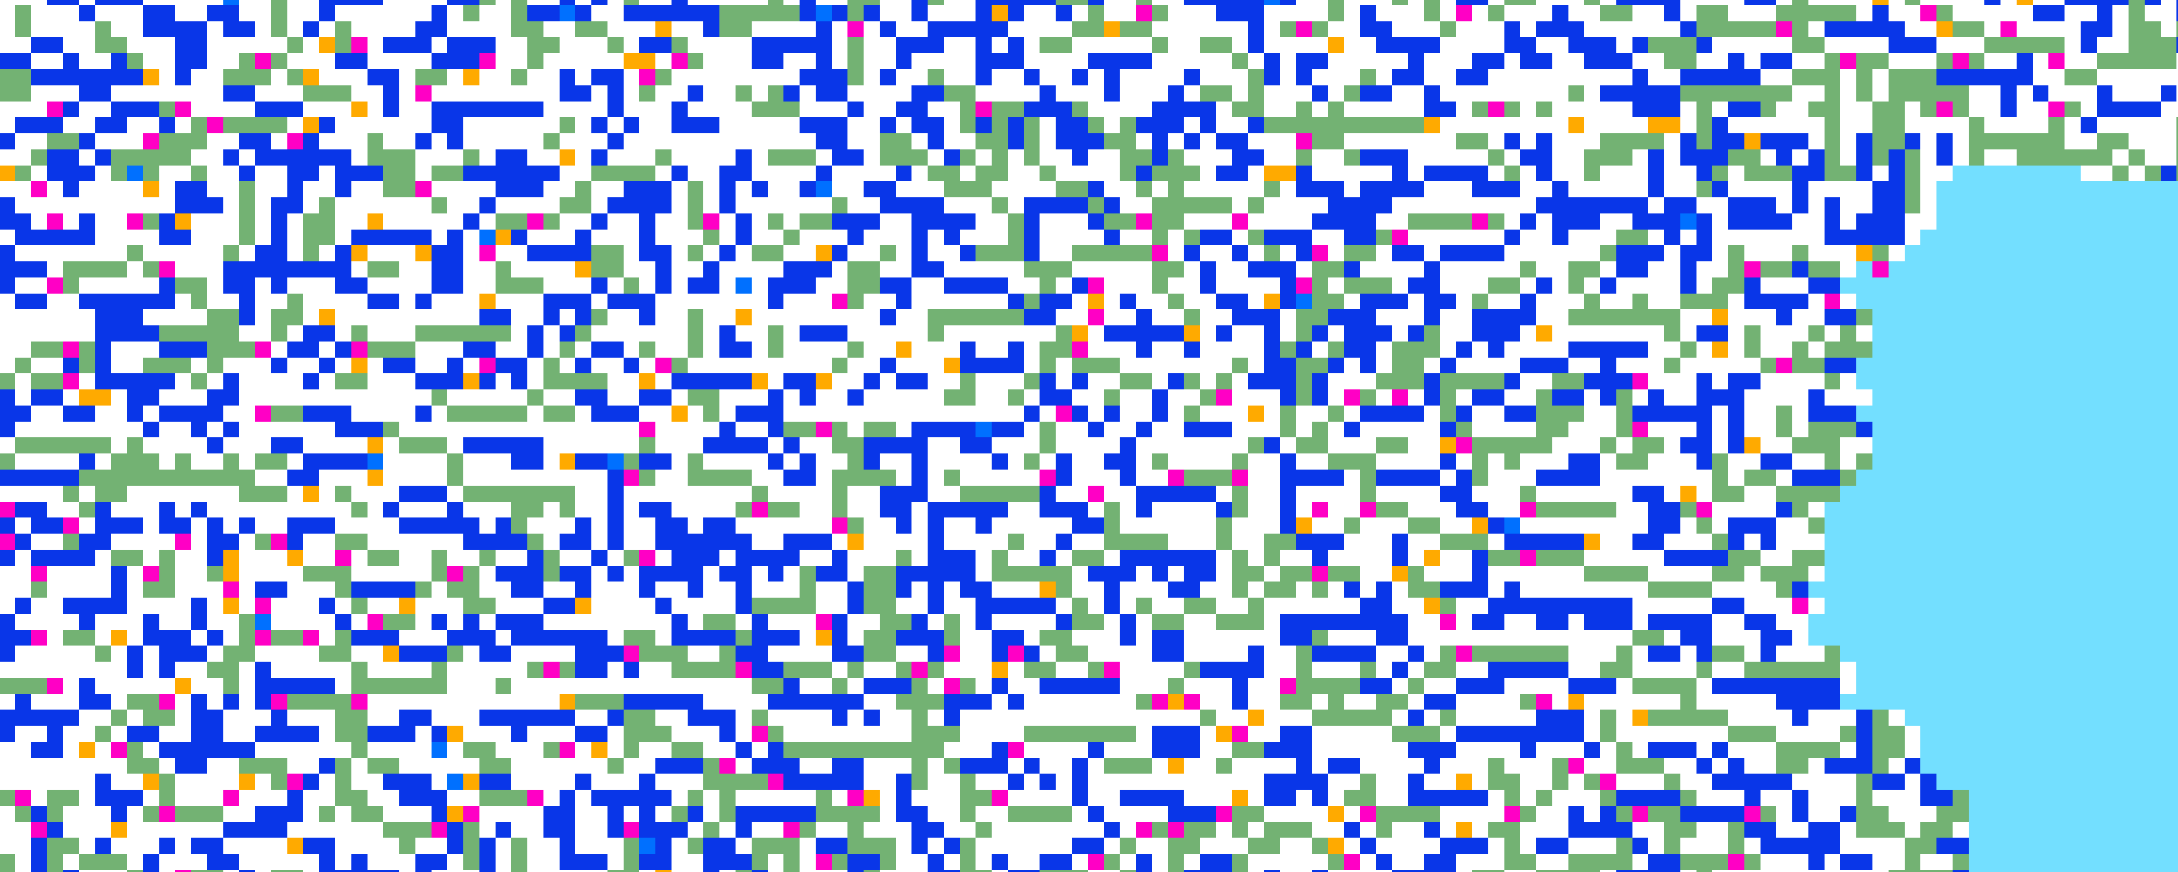
Back to Swan Island

Slide 32
The last 15 years

Slide 33
Since 2000
More algorithms, good literature reviews
Better visualizations (e.g. Mitasova)
Scale sensitivity explored
Better hydrologic models
Links to Morse theory
3D extensions
Use of uncertainty: metric and semantic
Link to feature identification and context

Slide 34
Example: Peter Fisher, Jo Wood, Tao Cheng (2004) Where is Helvellyn? Fuzziness of multi‐scale landscape morphometry Transactions of the Institute of British Geographers 29, 1,106-128
Used toponymy of features
Computed fuzzy membership of pixels by six VIP feature types
Aligned fuzzy surface terrain networks with labels to gauge location and extent
Computed likelihood of extent of named features
Sensitive to labeled features and scale
Used 6 model classes

Slide 35
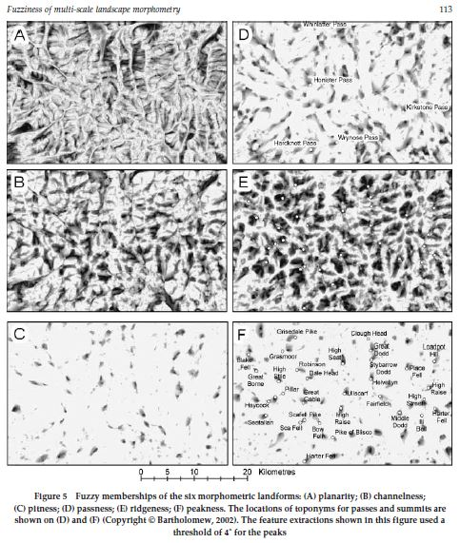
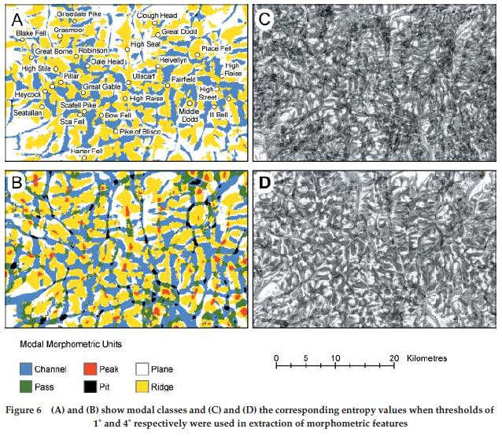

Slide 36
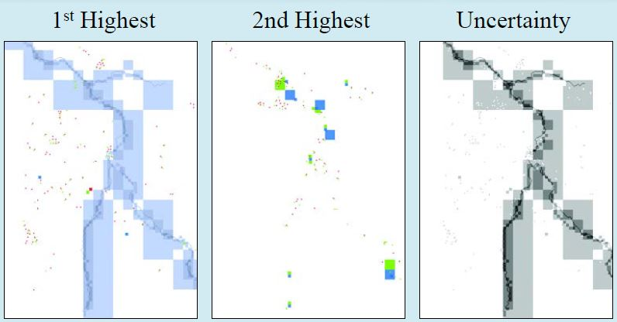
Feature type uncertainty due to scale and method

Slide 37
On the topology of topography

Slide 38
The good news
Surface network research remains vigorous
We have more surface elevation data than you can shake a stick at
Its is highly accurate and at high levels of resolution, in grid and point cloud formats
Broad choice of methods to compute and extract the surface network
The methods are available in many GIS packages (ArcGIS, GRASS, MapWindow GIS, SAGA GIS, QGIS, Landserf)
This has promoted the use of the surface network as a tool for data modeling, analysis and for applications that now extend far beyond the realm of contour maps and digital terrain models
Links to features types, toponyms, ontologies and uncertainty show promise

Slide 39
The bad news
A single “solution” approach that produces a complete and unambiguous network automatically for any terrain remains elusive
Networks are discontinuous and vague in places, clear in others
There are major scale sensitivities
Using the software is still both an art and a science
Flat areas work worst, but are of most interest in flooding and sea level rise modeling
No discontinuities, holes or interior spaces, e.g. caves or building interiors—poor link to 3D models

Slide 40
Where next?
Now possible to bulk data mine entire countries terrain at high resolution
What are the spatially convergent patterns?
What features change type across scale and method?
What kinds of features get labels and can be solved as parts of the terrain?
How do toponyms relate to ontology and surfaces?
Does terrain surface theory generalize to all surfaces?

Slide 41
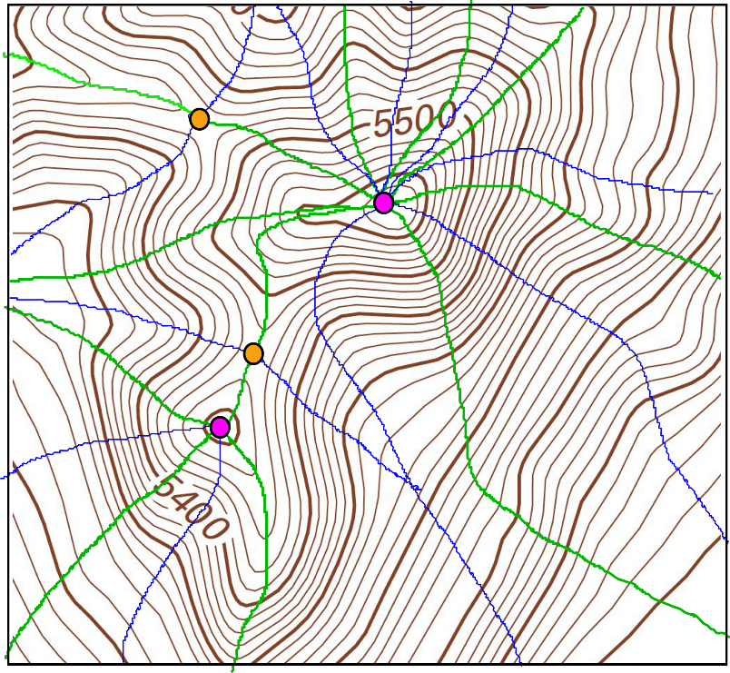
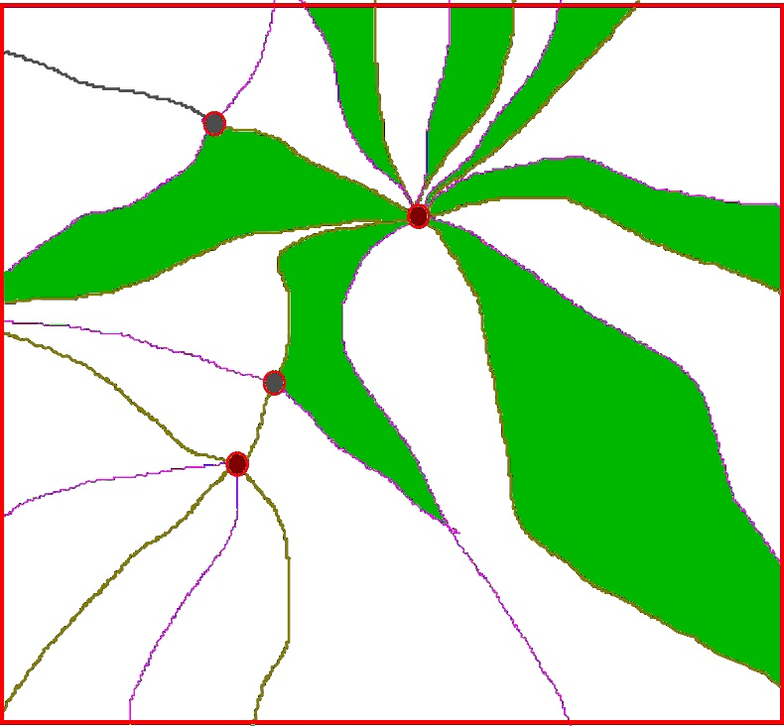
Network patterns around summits

Slide 42
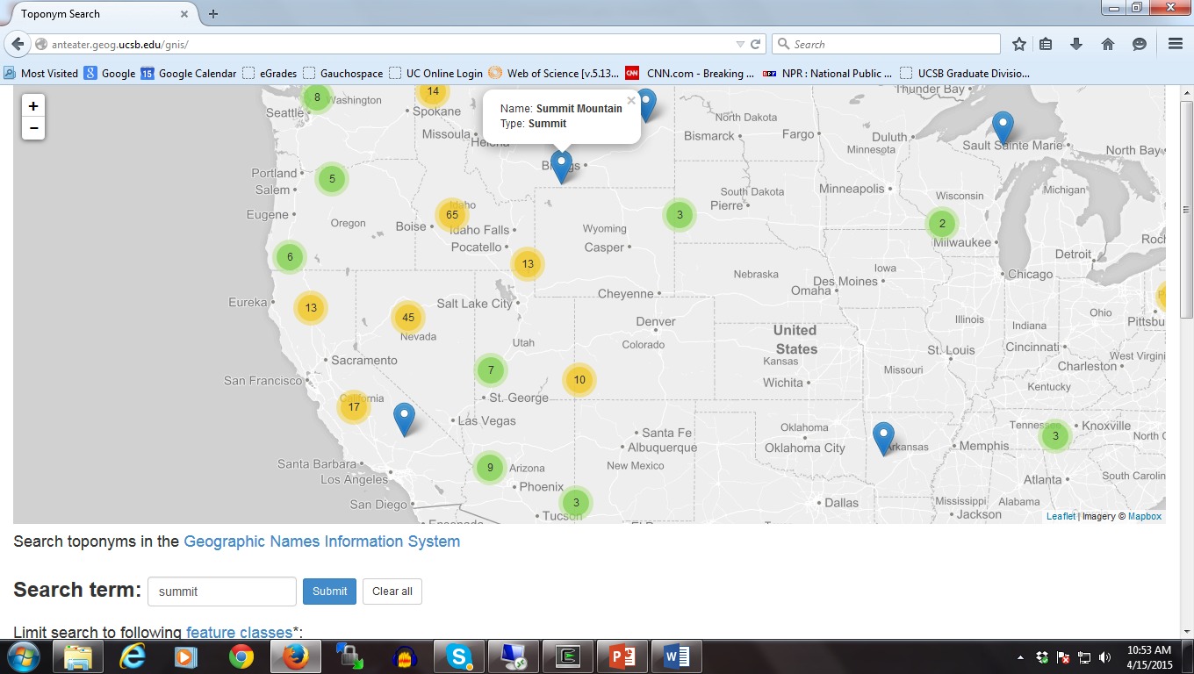
Topographic features called “summit” in GNIS

Slide 43
Acknowledgement We gratefully acknowledge funding and support from Lynn Usery and the USGS Center of Excellence for Geospatial Information Science (CEGIS) through the CESU program. My co-author on this work is Boleslo Romero, who did much of the research and created the empirical results.

